Slide 1
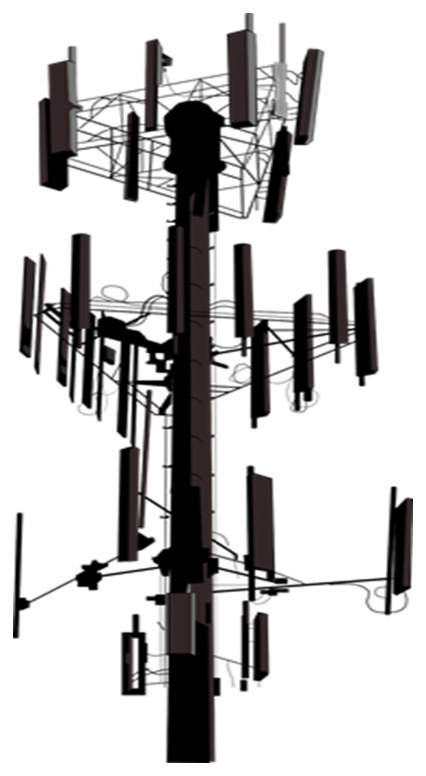
5G “Internet of Things”
BIG TECH CAUGHT CENSORING 5G LINKS TO COVID
BIG TECH COLLECTING DNA WHAT YOU NEED TO KNOW ABOUT CONDUCTIVE HYDROGELS
DARPA HYDROGEL COVID VACCINE
OPERATION WARP SPEED EXPOSED
BIG TECH GOT THE DEFENSE CONTRACT FOR COVID VACCINE DATA EARLY “COVID” SYMPTOMS PROBABLY CAUSED BY 5G CHINA USING MICROWAVE TECH TO TORTURE CITIZENS SOCIAL DISTANCING AND FACE MASKS: THE TECHNOLOGICAL REASONS SOLUTIONS : EMF PROTECTION : HELP SUPPORT SGT REPORT

Slide 2
STATEMENT OF ENCOURAGEMENT
AWARENESS is part of the WAR STRATEGY. We are told not to be ignorant of what the enemy is doing. “Lest Satan should get an advantage of us: for we are not ignorant of his devices.” 2 Corinthians 2:11
We are instructed to STUDY THINGS and DO THE RESEARCH. “Now the Bereans were more noble-minded than the Thessalonians, for they received the message with great eagerness and examined the Scriptures every day to see if these teachings were true.” Acts 17:11
The MARK OF THE BEAST is MUCH MORE than just a Microchip made by Bill Gates. It is based on what people believe and what they act on. “Taking the Mark” today could resemble those who are going along with the agenda of the system, as evidenced by their thoughts and deeds. Revelation 13, Deut 11:18, Hebrews 8:10

Slide 3
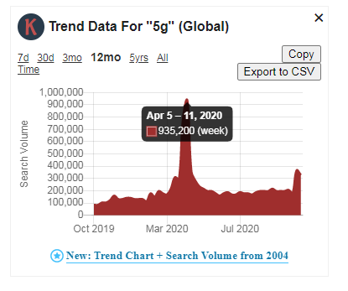
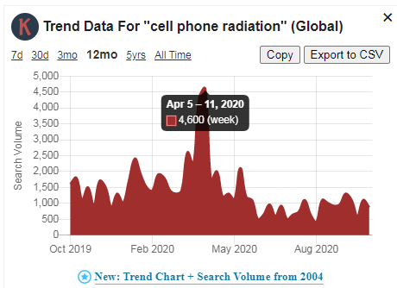
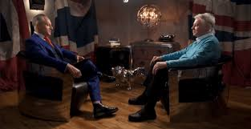
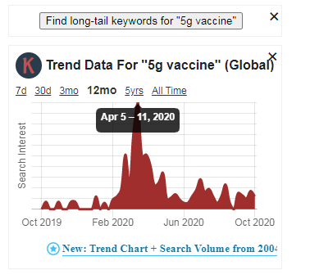
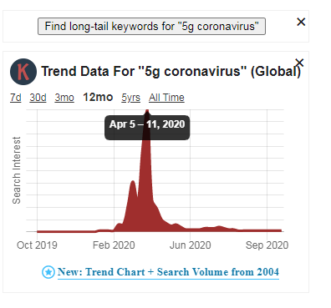
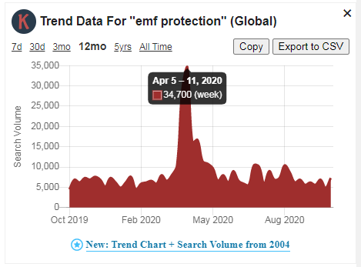
BIG TECH CAUGHT CENSORING 5G
APRIL 6TH 5G INTERVIEW WITH DAVID ICKE AND BRYAN ROSE

Slide 4
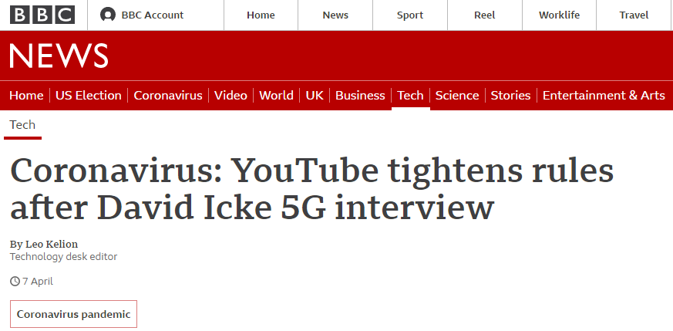
WHAT WAS SAID TO TRIGGER CENSORSHIP?
During the interview, Mr. Icke falsely claimed there "is a link between 5G and this health crisis". "If 5G continues and reaches where they want to take it, human life as we know it is over... so people have to make a decision." Mr. Icke also claimed that a coronavirus vaccine, when one is developed, would include "nanotechnology microchips" that would allow humans to be controlled. He added that Bill Gates - who is helping fund Covid-19 vaccine research - should be jailed.

Slide 5
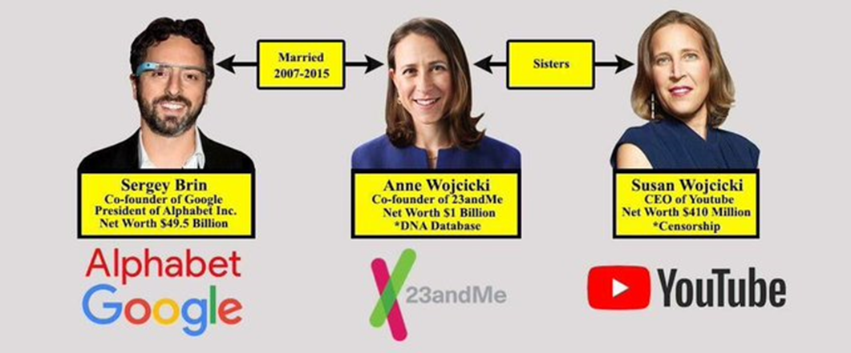
BIG TECH and BIO RELATIONS
DNA DATABASE?!?!

Slide 6
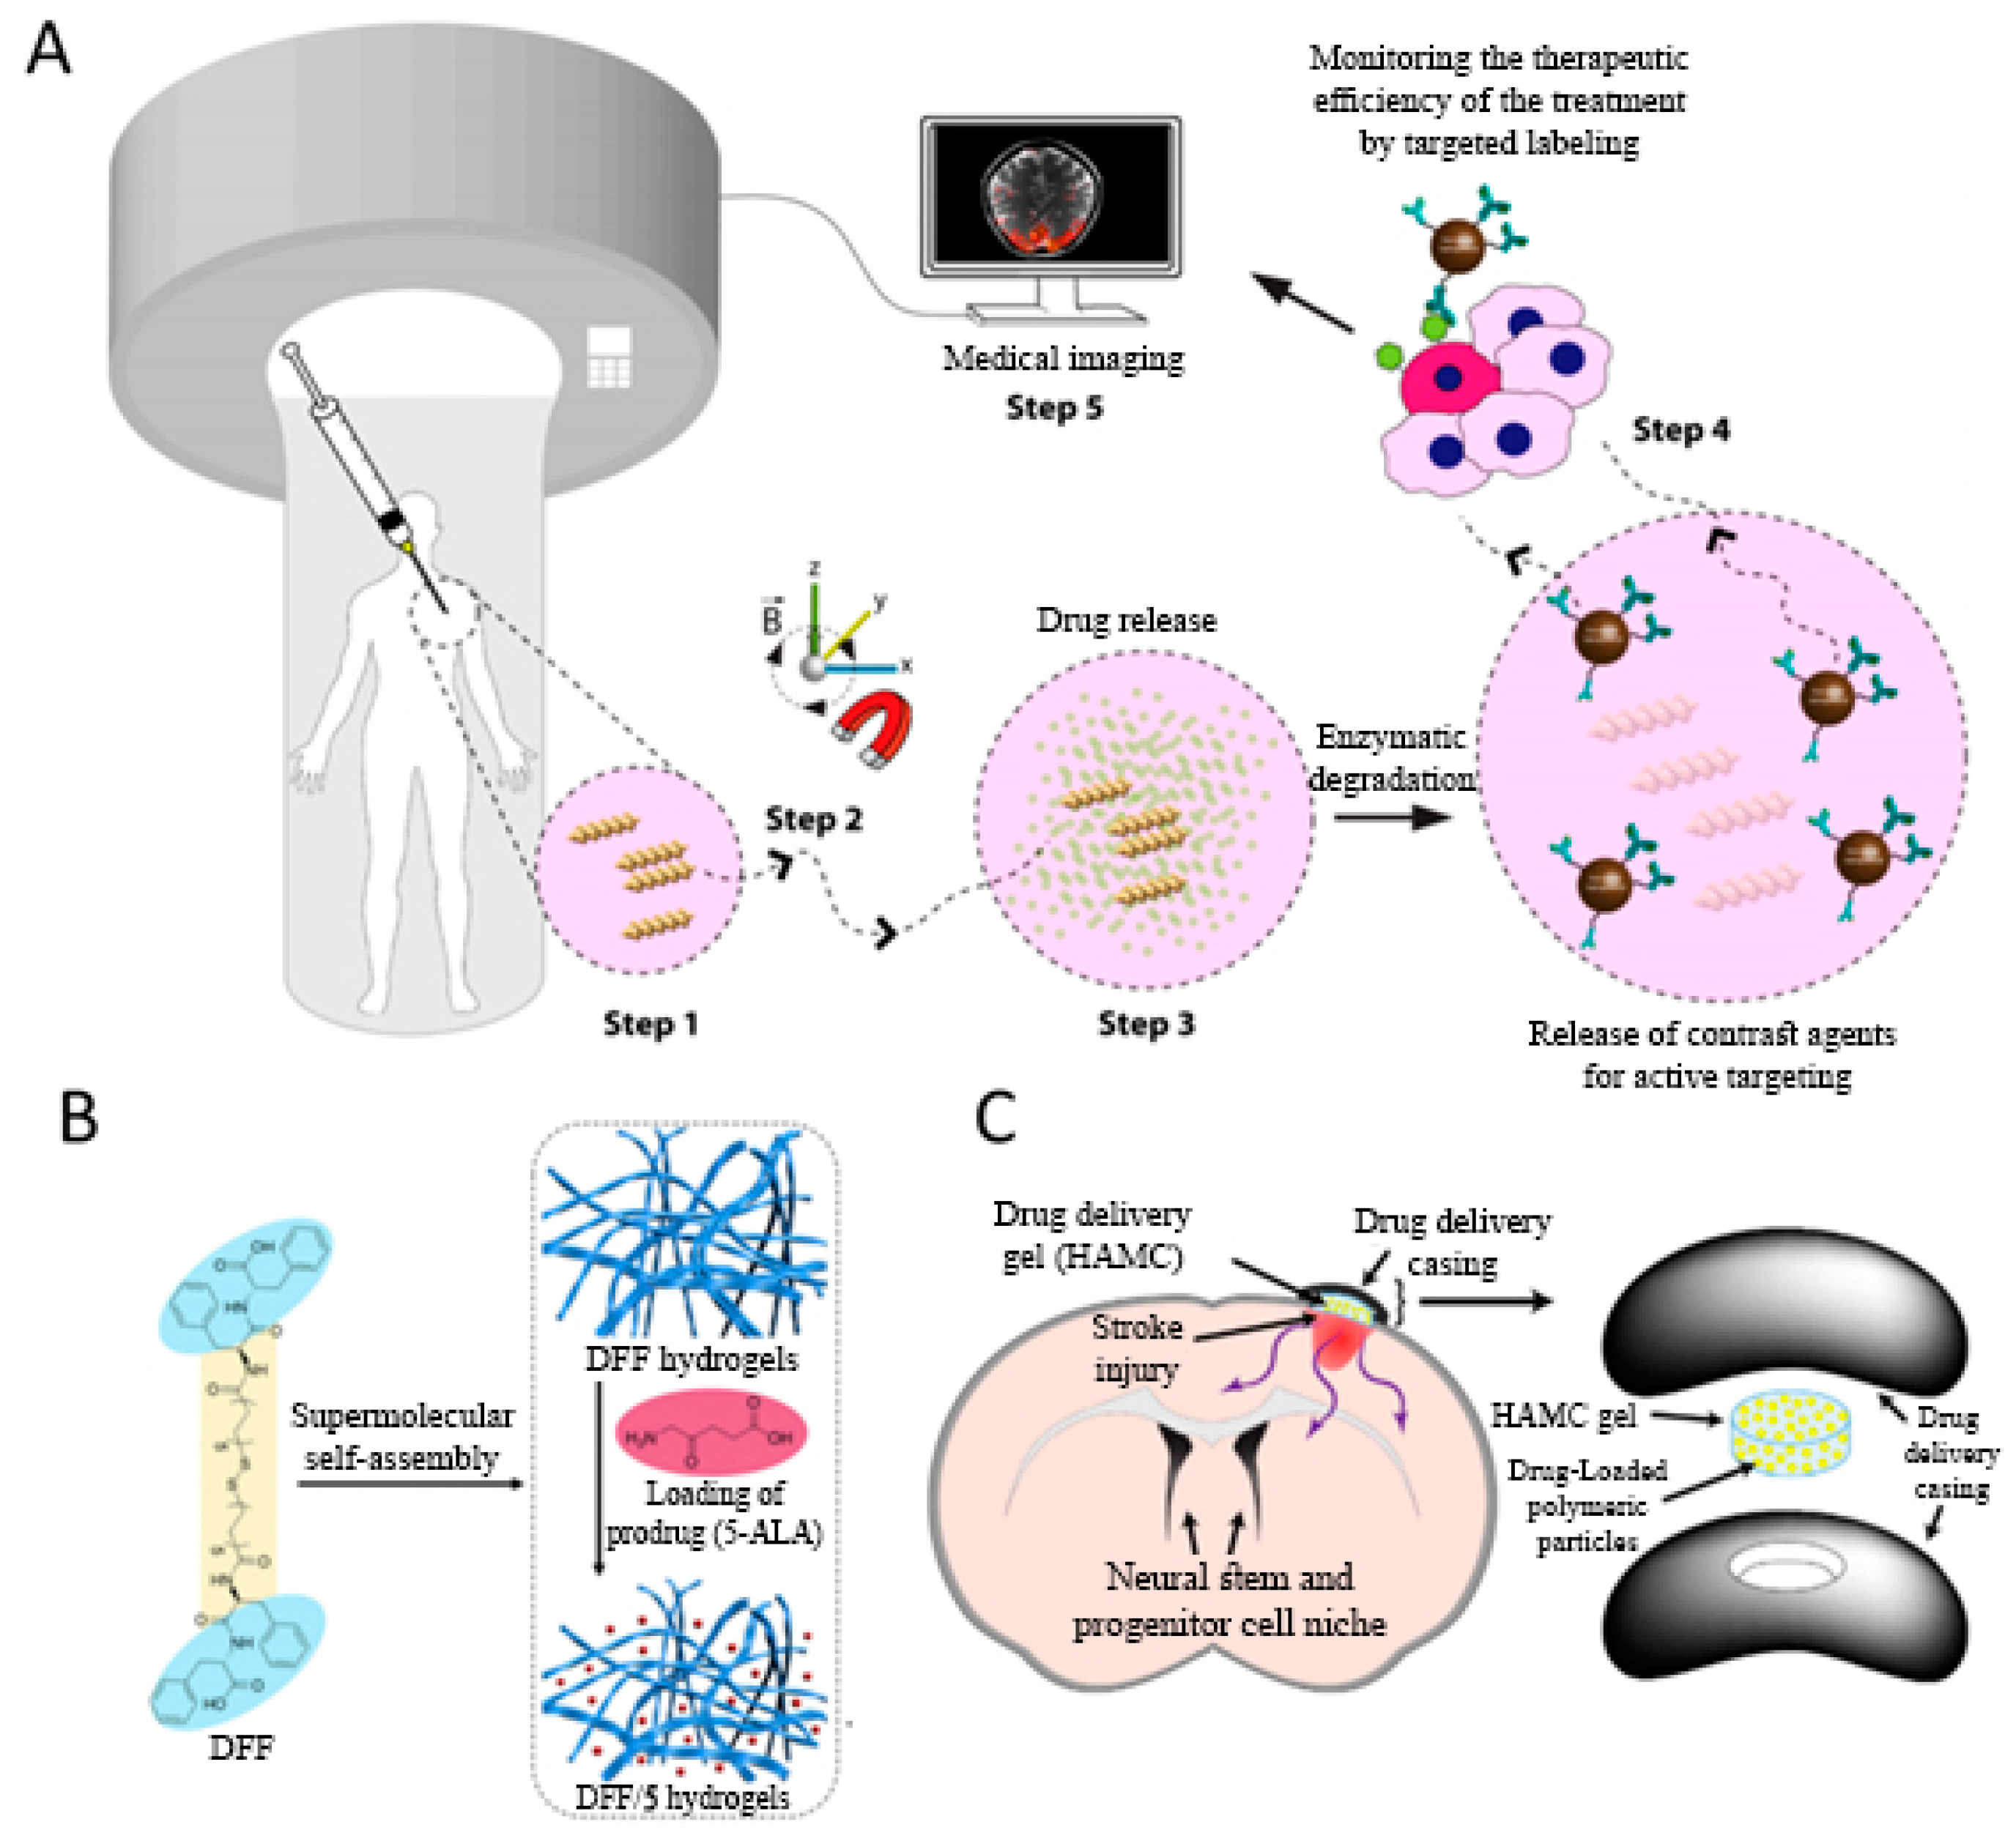
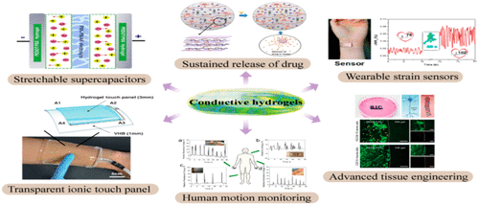
CONDUCTIVE HYDROGELS

Slide 7
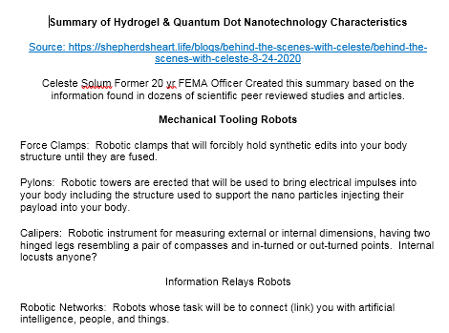
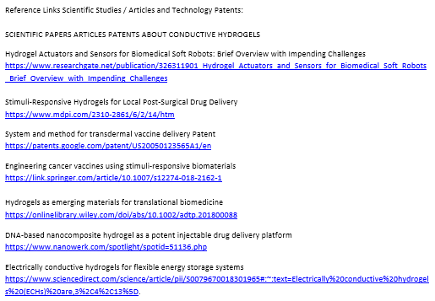
HYDROGEL NANOTECH CHARACTERISTICS STUDIES AND PATENTS
Nanotech used in hydrogels is designed to lock into our DNA to manipulate it, track and trace our bodies by collecting and transmitting our information to a data collection point, monitor our vitals, fuse into our system to allow a means of physical, biological control by an outside source. They are putting hydrogels in the Food Supply (Journal of Agriculture and Food Chemistry)

Slide 8
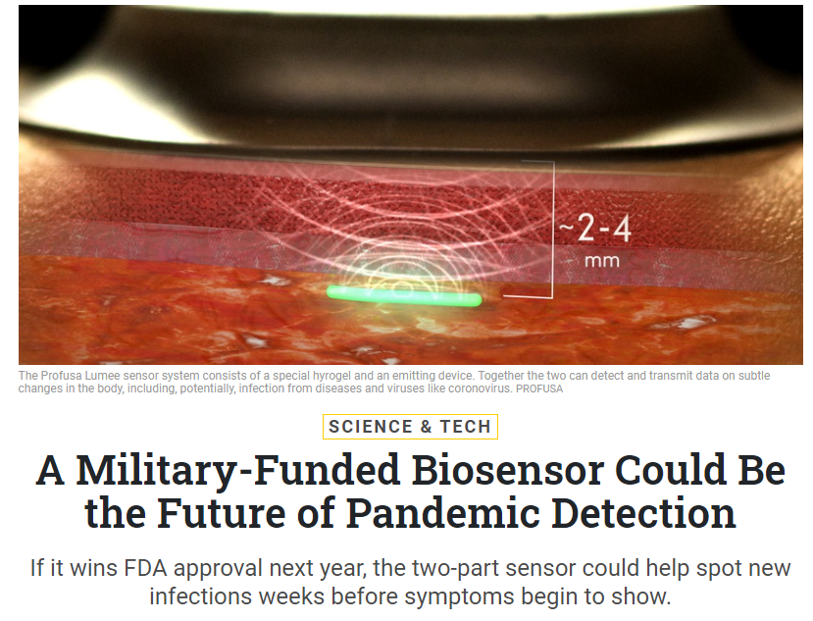
DARPA HYDROGEL COVID VACCINE
The Profusa Lumee sensor system consists of a special hydrogel and an emitting device. Together the two can detect and transmit data on subtle changes in the body including, potentially, infection from diseases and viruses like coronavirus. -ProfUSA

Slide 9
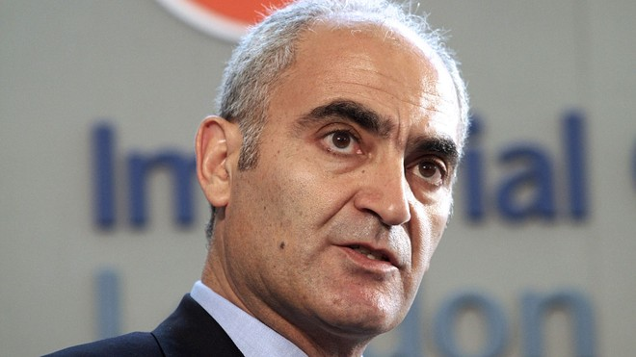
OPERATION WARP SPEED EXPOSED
“VACCINE CZAR” Moncef Slaoui
During these interviews he disclosed two VERY DISTURBING bits of information. 1) Millions of Americans who receive the vaccine will be tracked via an “incredibly precise pharmacovigilance surveillance system” that will track the vitals and whereabouts of Americans who receive the Warp Speed Vaccine. 2) Google and Oracle have been awarded the Defense Contract to track and trace Americans who receive the vaccine.

Slide 10
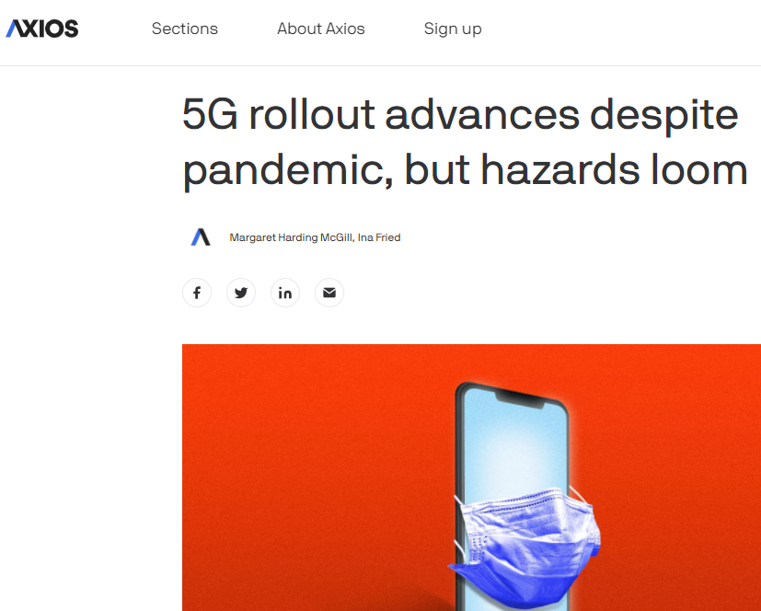
BIG TECH GOT THE DEFENSE CONTRACT TO COLLECT DNA AND TRACK AND TRACE EVERY AMERICAN WHO GETS THE COVID VACCINE
5G ROLLED OUT AT “WARP SPEED” DURING ENTIRE COVID PANDEMIC WHILE EVERYONE WAS LOCKED IN THEIR HOMES AND FORBIDDEN TO PROTEST.

Slide 11
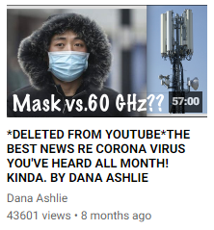
EARLY COVID SYMPTOMS PROBABLY CAUSE BY 5G AND MASKED AS COVID
-Wuhan China PILOT CITY FOR 5G -Lombardy Italy 5G tech hub set up by China -Princess Cruise Ship boasted 5G onboard -5G in the Ambulances -5G in hospitals on each hospital bed -5G tech running robots in Chinese Hospitals

Slide 12
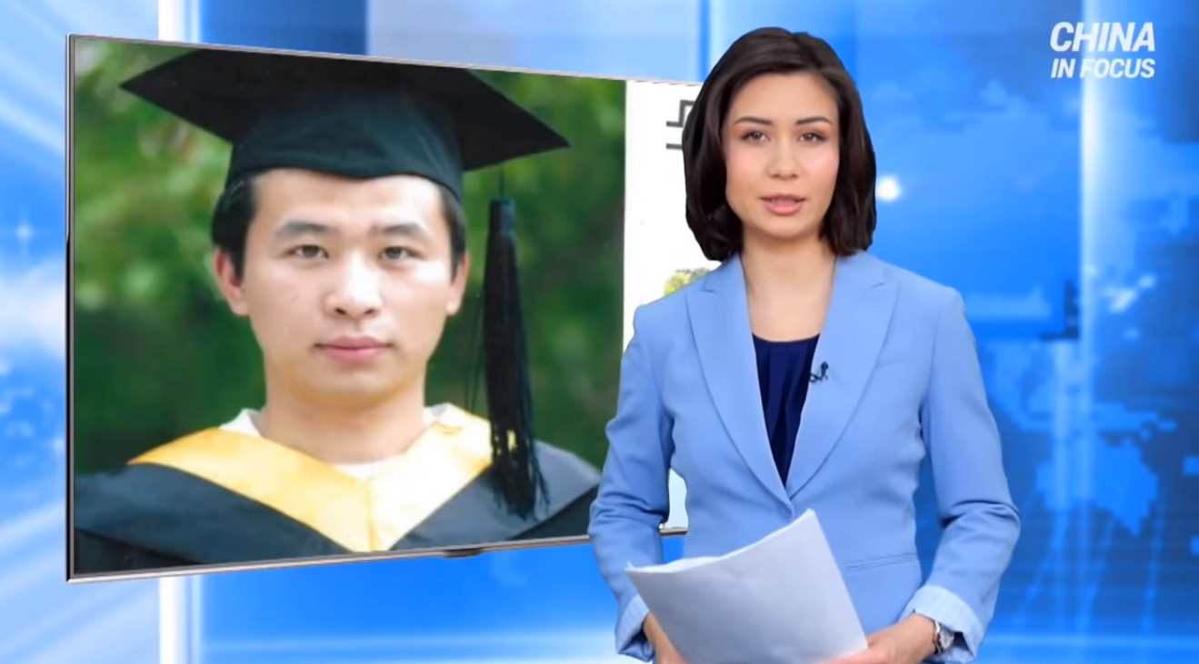
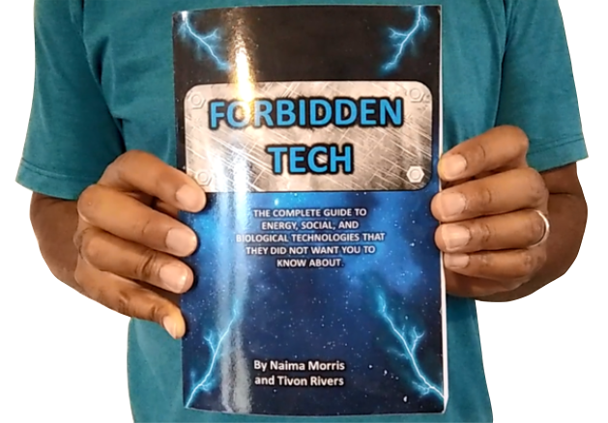
5G Controls All Kinds of Microwave Tech Including “Voice To Skull” and Electronic Harassment Technology
COMMUNIST CHINA TESTING MICROWAVE TECHNOLOGY ON CITIZENS
PATENTS FOR V2K TECH DESRIBED IN OUR BOOK “FORBIDDEN TECH”
https://www.youtube.com/watch?v=aVj7_0A5-Ew
Notes:
If time permits we’d like to play this 4 minute clip https://www.youtube.com/watch?v=aVj7_0A5-Ew

Slide 13
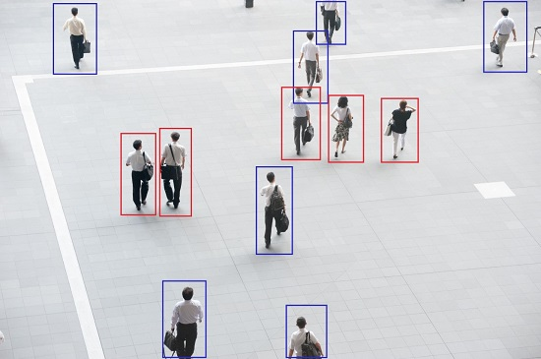
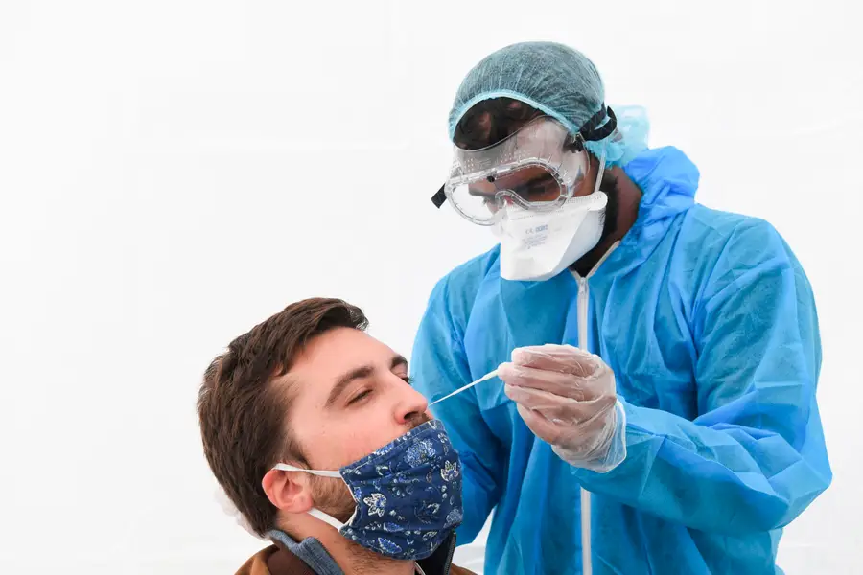
MORE TO CONSIDER: TECHNOLOGICAL REASONS BEHIND
SOCIAL DISTANCING Easier to be tracked
FACE MASKS Increase Viral Load

Slide 14
SOLUTIONS:
There are several things you can do to protect yourself and your family. DON’T GET THE VACCINE DON’T WEAR FACE MASKS ALL DAY LONG This increases your viral load DETOX YOUR BODY from heavy metals CHANGE YOUR DIET to boost your immune system
MOVE TO A MORE NATURAL AREA get out of the city TURN OFF YOUR WIFI AT NIGHT EQUIP YOUR HOME WITH EMF PROTECTION PRODUCTS

Slide 15
EMF PROTECTION PRODUCTS
MADE WITH SHUNGITE
HELP SUPPORT SGT REPORT BY SHOPPING FROM THIS LINK: https://www.ftwproject.com/ref/6/
Notes:
While we are describing the products we’d like to play this three minute video showing how we make the products: https://www.youtube.com/watch?v=k0ti-R0dEfQ

