Slide 1
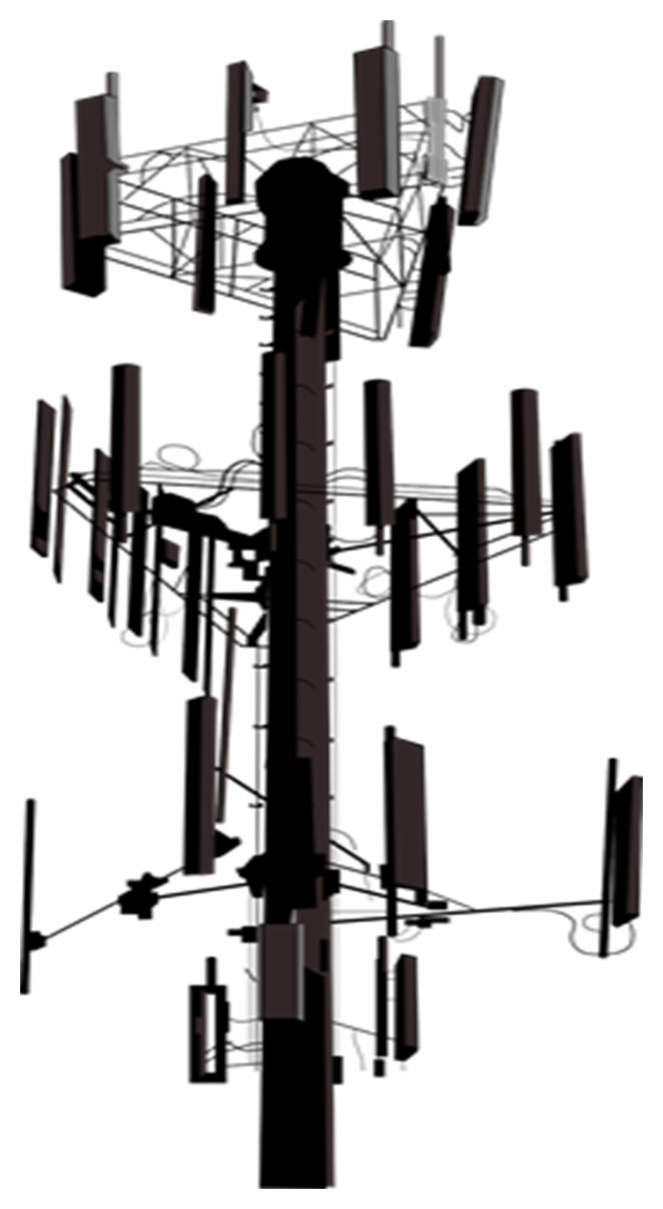
5G and Covid Vaccines on SGT Report
SUMMARY -Brief Introduction -Recent alarming articles about Covid Vaccines -Collection of adverse reactions to Covid Vaccines -Collection of public refusals to take the Vaccine -Recent Important 5G Headlines 5G Auction / Nashville Bombing -5G Rollout is not slowing down its accelerating! -Ookla 5G Map- How to find out where the 5G has been turned on -Solutions: EMF Protection Products, Shungite and Bee Colony Collapse, Support SGT Report!

Slide 2
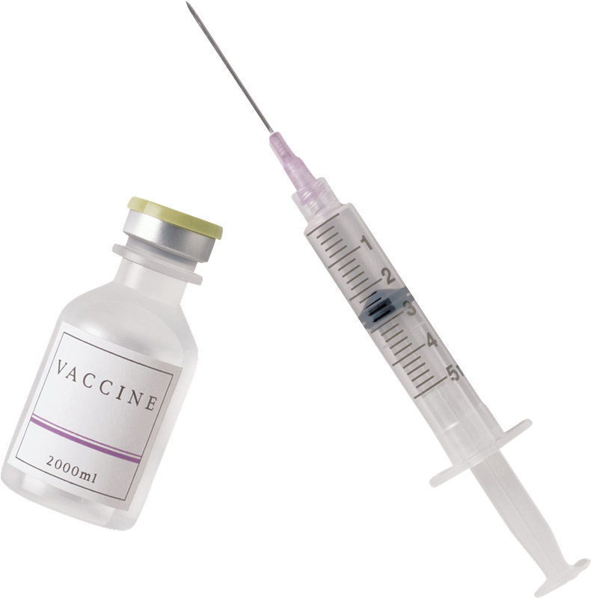
The 5G COVID Connection
Covid Vaccines Contain Nanotechnology that can be controlled by 5G signals. 5G and Covid Vaccines change RNA/DNA 5G (hazardous RF exposure) and Covid have the same health symptoms 5G and the Covid-19 Pandemic and its Vaccine are being used to socially engineer a police state surveillance grid of the entire population

Slide 3
BE SURE TO WATCH OUR LAST SHOW ON SGT REPORT AS WE ARE BUILDING ON THIS FOUNDATION
COVERED IN LAST SHOW: BIG TECH CAUGHT CENSORING 5G LINKS TO COVID BIG TECH COLLECTING DNA WHAT YOU NEED TO KNOW ABOUT CONDUCTIVE HYDROGELS
DARPA HYDROGEL COVID VACCINE
OPERATION WARP SPEED EXPOSED
BIG TECH GOT THE DEFENSE CONTRACT FOR COVID VACCINE DATA EARLY “COVID” SYMPTOMS PROBABLY CAUSED BY 5G CHINA USING MICROWAVE TECH TO TORTURE CITIZENS SOCIAL DISTANCING AND FACE MASKS: THE TECHNOLOGICAL REASONS SOLUTIONS : EMF PROTECTION : HELP SUPPORT SGT REPORT

Slide 4
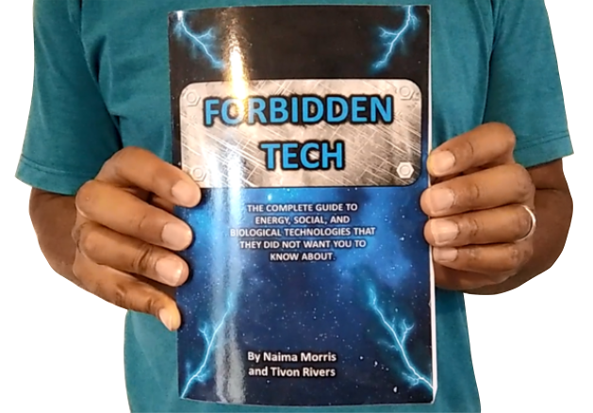
WHY WE DO WHAT WE DO
FORBIDDEN TECH: The complete guide to energy, social, and biological technologies that they did not want you to know about. (2017)
We are Christians, Engineers and Scientists. We feel it is our calling to help inform people about the technology that is being used against Gods creation.
We have been monitoring the news on 5G, Covid Vaccine related issues so that we can present them in a condensed summary to inform the public.
www.Forbiddentech.website
Notes:
If time permits we’d like to play this 4 minute clip https://www.youtube.com/watch?v=aVj7_0A5-Ew

Slide 5
RECENT ALARMING ARTICLES RELATED TO COVID VACCINES

Slide 6
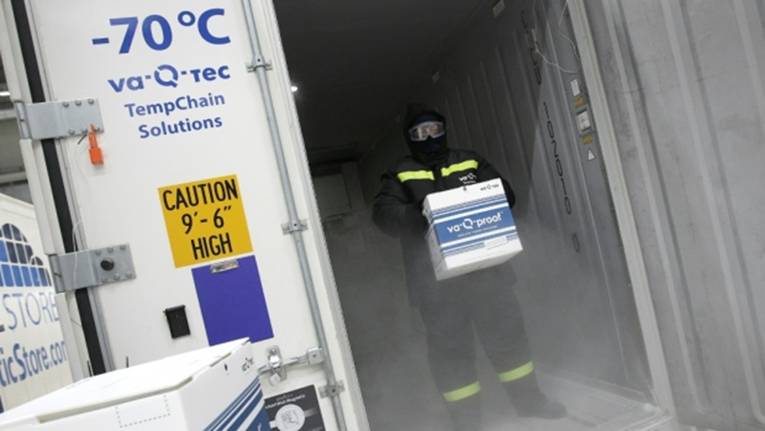
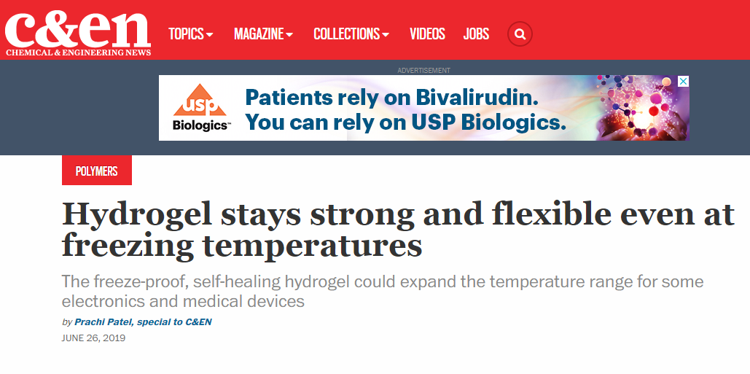
Reason why vaccines stored at -70 degrees: NANOTECH

Slide 7
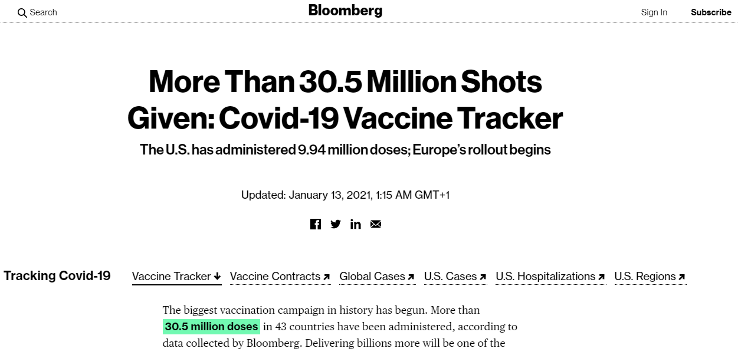
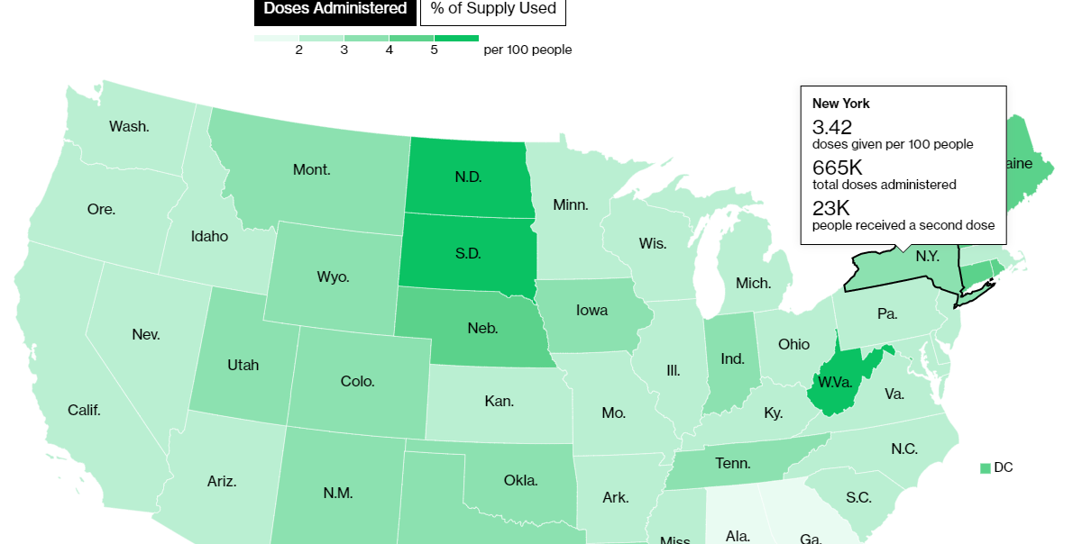
HOW MANY VACCINES HAVE BEEN ADMINISTERED?

Slide 8
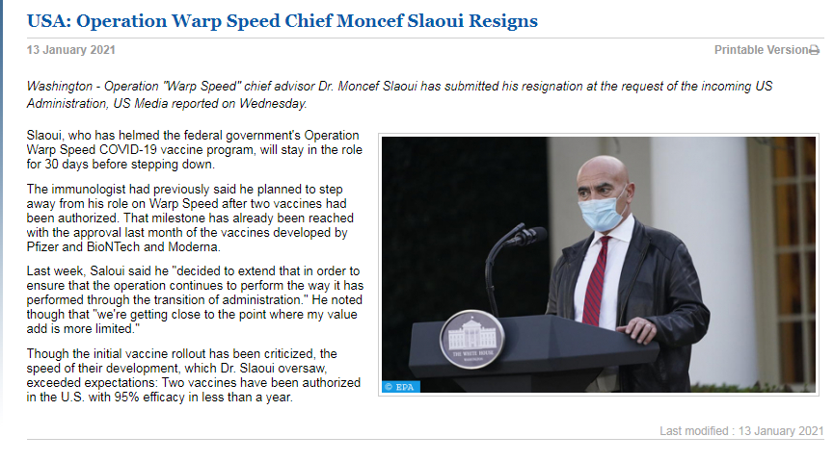
BREAKING: OPERATION WARP SPEED VACCINE CZAR RESIGNS

Slide 9
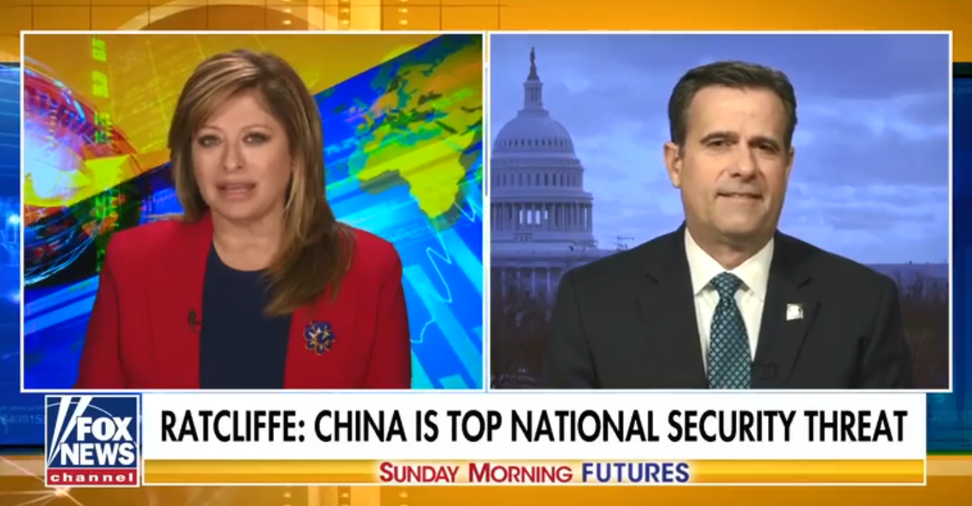
CHINA IS DOING GENE EDITING HUMAN EXPERIMENTS SAYS DIRECTOR OF NATIONAL INTELLIGENCE JOHN RATCLIFFE
“Us Intelligence shows that China has conducted human testing on members of the Peoples Liberation Army in hopes of developing soldiers with biologically enhanced capabilities. They want to create new humans that can handle extreme weather or handle chemical attacks.
Its called gene editing and its altering DNA Its one of the things that our intelligence shows that China is doing. The Peoples Republic of China has 2 million people in its military and it is trying to make them stronger through gene editing.”

Slide 10
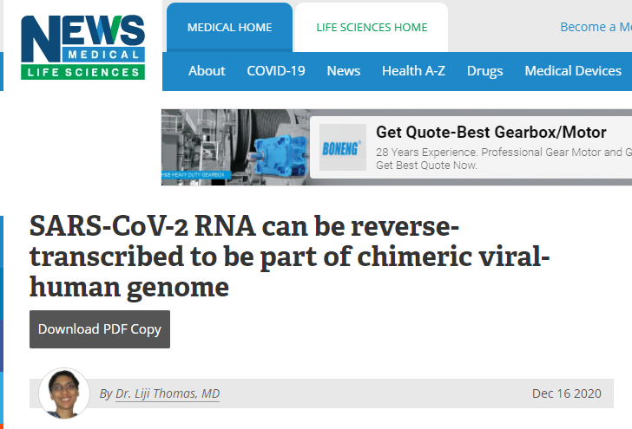
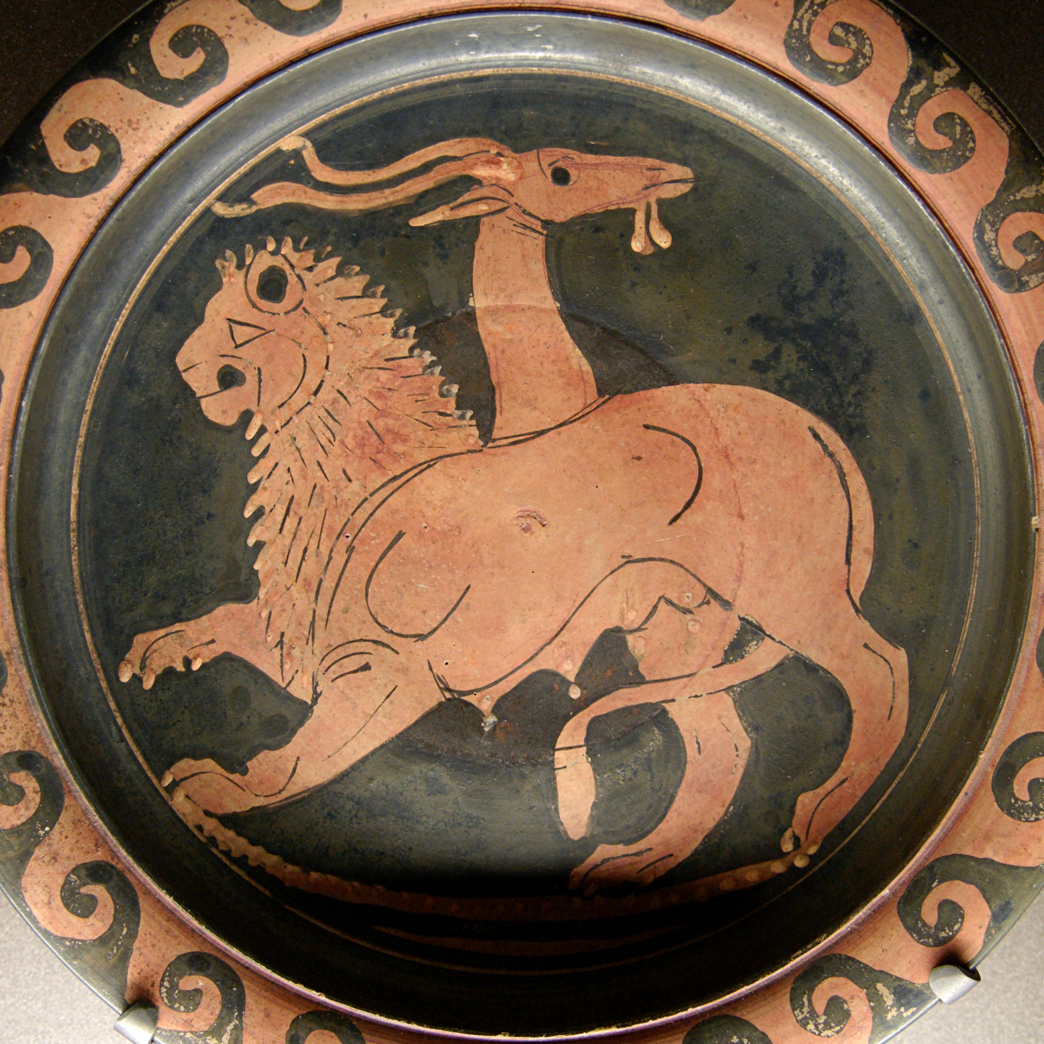
ALARMING ARTICLES RELATED TO COVID VACCINE
A chimera is essentially a single organism that's made up of cells from two or more "individuals"—that is, it contains two sets of DNA, with the code to make two separate organisms.

Slide 11
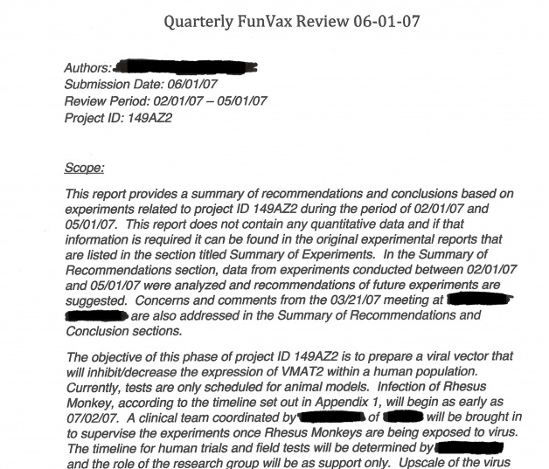
“FunVax” and the “God Gene”
“FunVax” is a Government created viral vaccine that “cures” religious fundamentalism. The way it works is that viral vaccine injects a gene that cause the VMAT2 (the so-called “God Gene”) to become inactivated. The inactivity of this gene causes people to become less likely to believe in Religion.
Leaked Report and Pentagon Briefing: Removing the God Gene

Slide 12
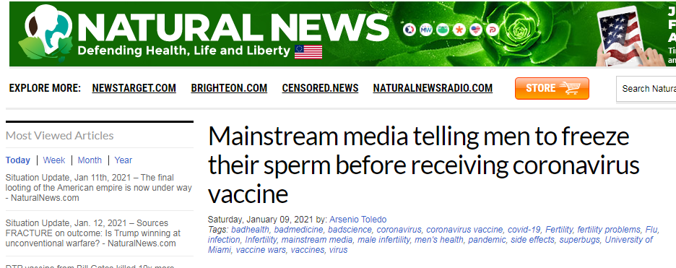
ALARMING ARTICLES RELATED TO COVID VACCINE

Slide 13
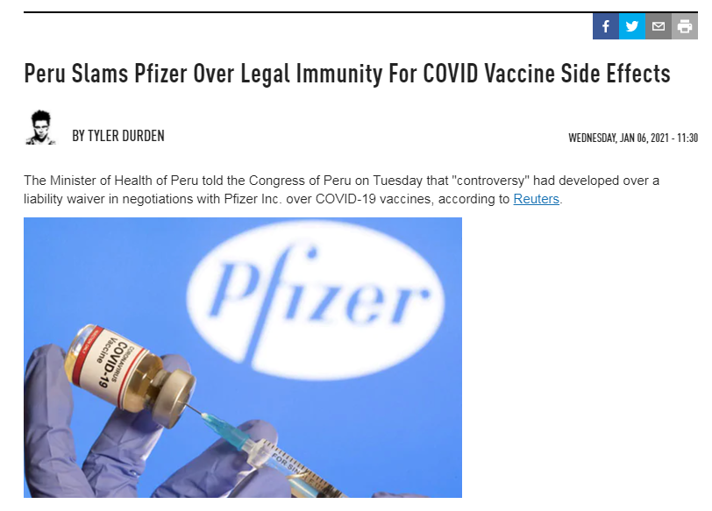
ALARMING ARTICLES RELATED TO COVID VACCINE

Slide 14
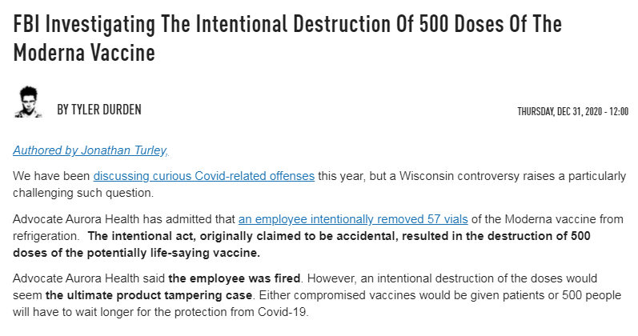
ALARMING ARTICLES RELATED TO COVID VACCINE

Slide 15
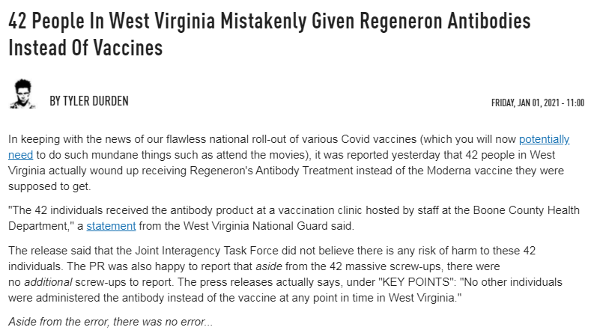
ALARMING ARTICLES RELATED TO COVID VACCINE

Slide 16
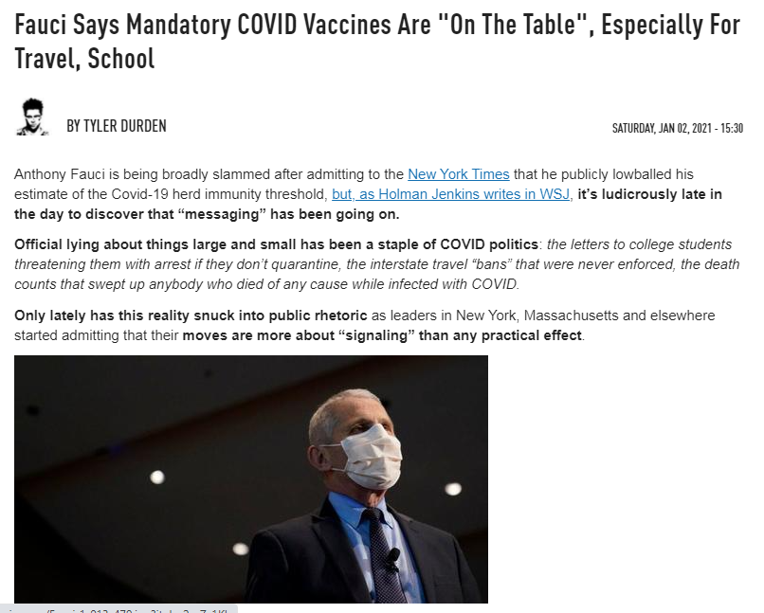
ALARMING ARTICLES RELATED TO COVID VACCINE

Slide 17
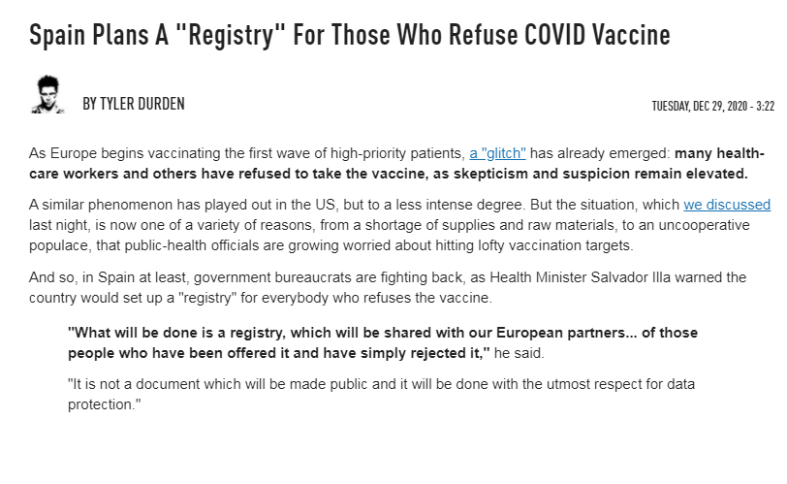
ALARMING ARTICLES RELATED TO COVID VACCINE

Slide 18
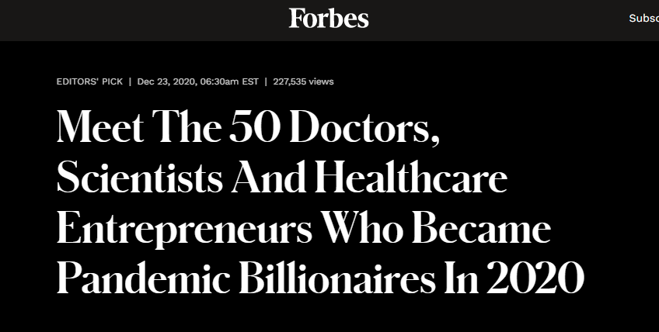
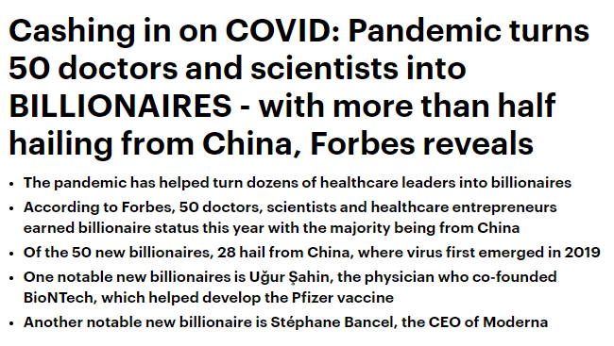
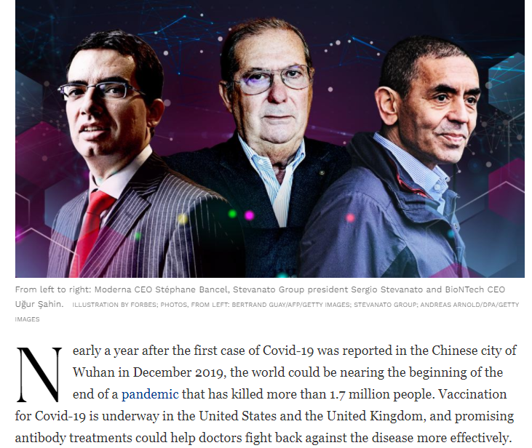
ALARMING ARTICLES RELATED TO COVID VACCINE

Slide 19
ALARMING ARTICLES RELATED TO COVID VACCINE

Slide 20
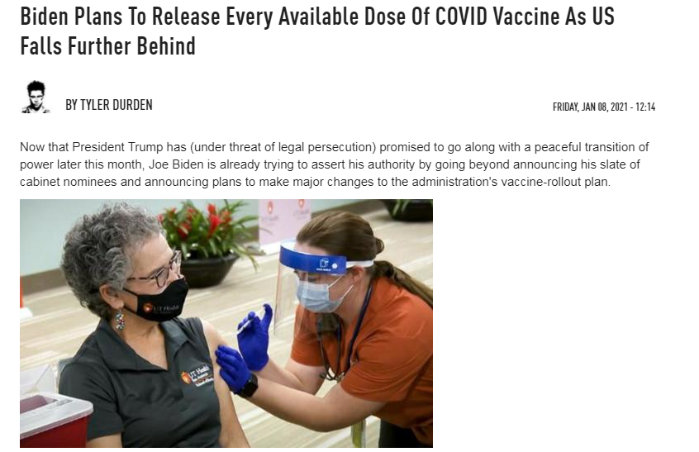
ALARMING ARTICLES RELATED TO COVID VACCINE

Slide 21
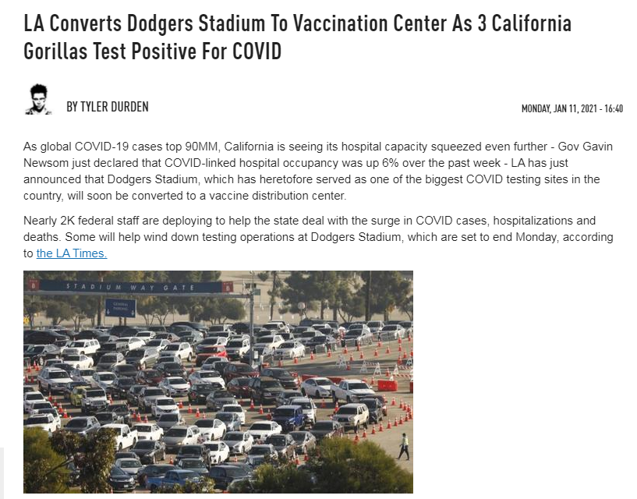
ALARMING ARTICLES RELATED TO COVID VACCINE

Slide 22
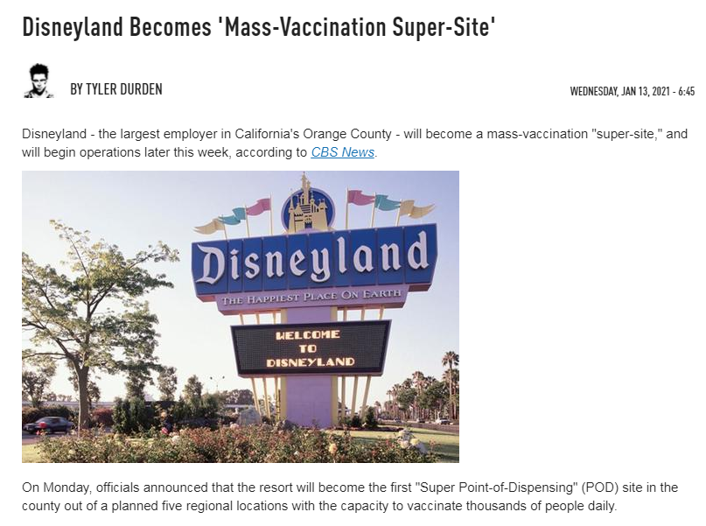
ALARMING ARTICLES RELATED TO COVID VACCINE

Slide 23
ADVERSE REACTIONS TO COVID VACCINES

Slide 24
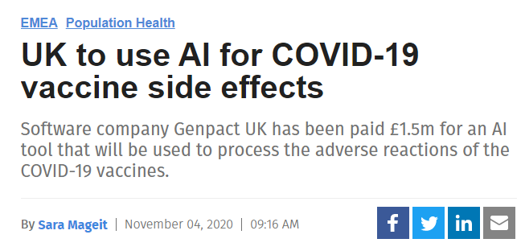
ADVERSE REACTIONS TO COVID VACCINES

Slide 25
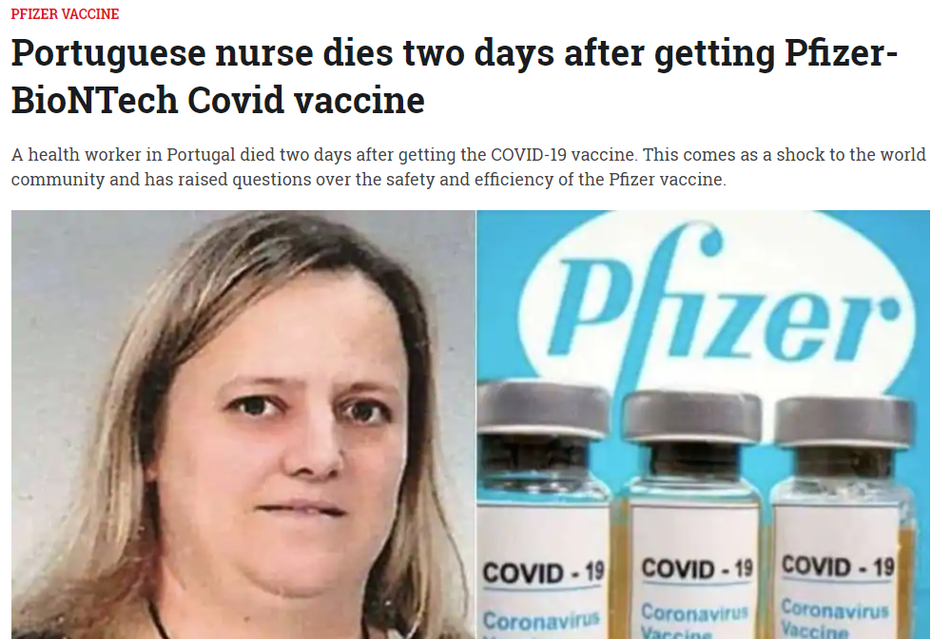
ADVERSE REACTIONS TO COVID VACCINES

Slide 26
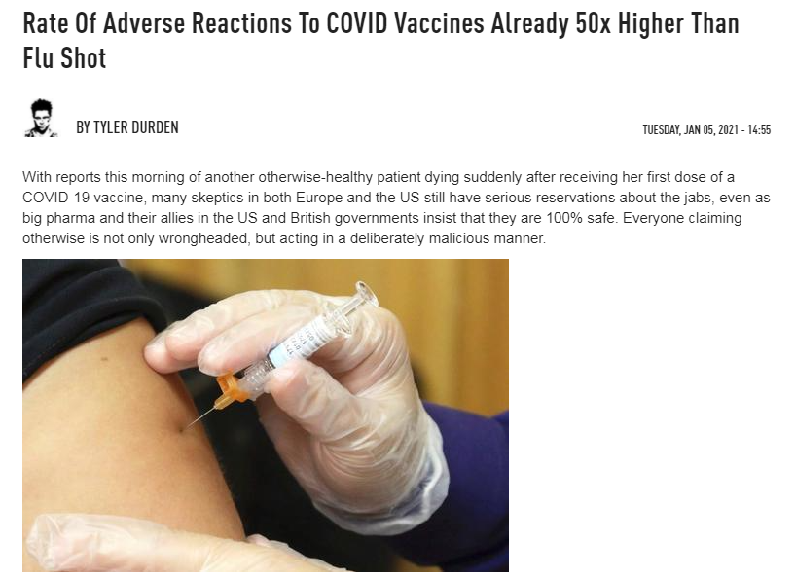
ADVERSE REACTIONS TO COVID VACCINES

Slide 27
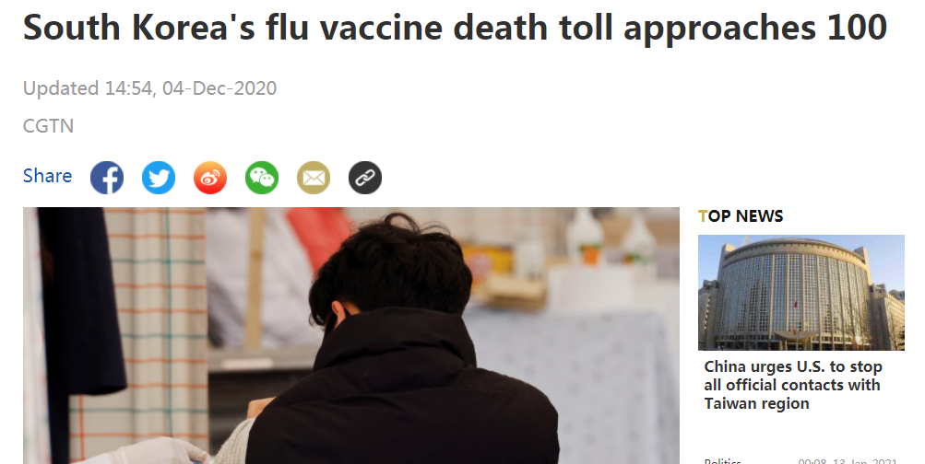
ADVERSE REACTIONS TO COVID VACCINES

Slide 28
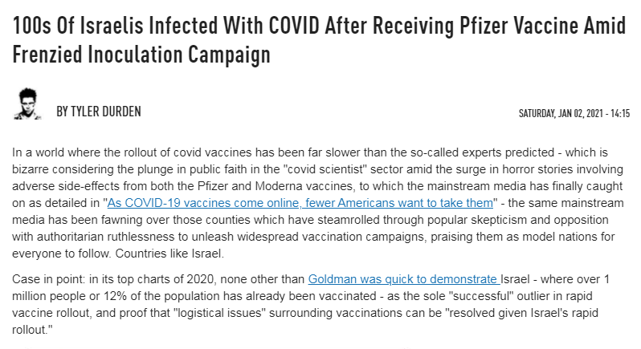
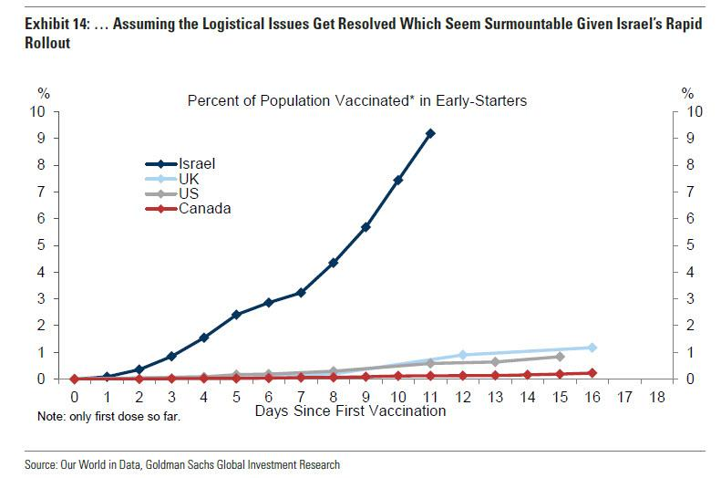
ADVERSE REACTIONS TO COVID VACCINES

Slide 29
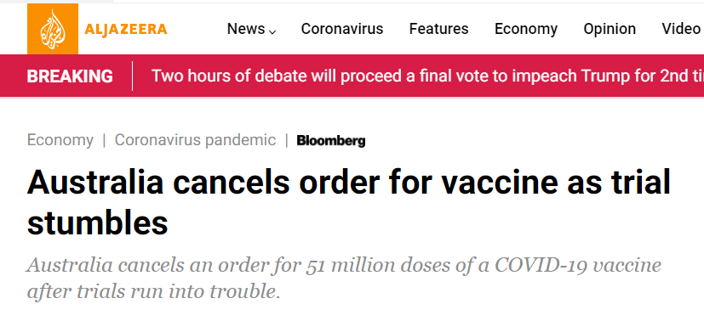
ADVERSE REACTIONS TO COVID VACCINES
VACCINE MAKES YOU TEST POSITIVE FOR HIV!!!!

Slide 30
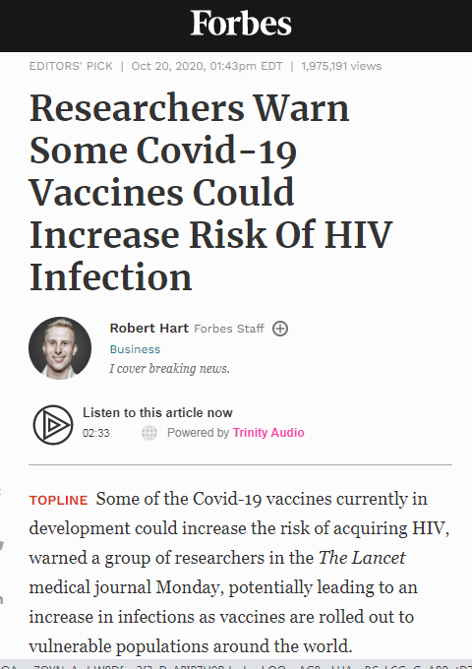
ADVERSE REACTIONS TO COVID VACCINES

Slide 31
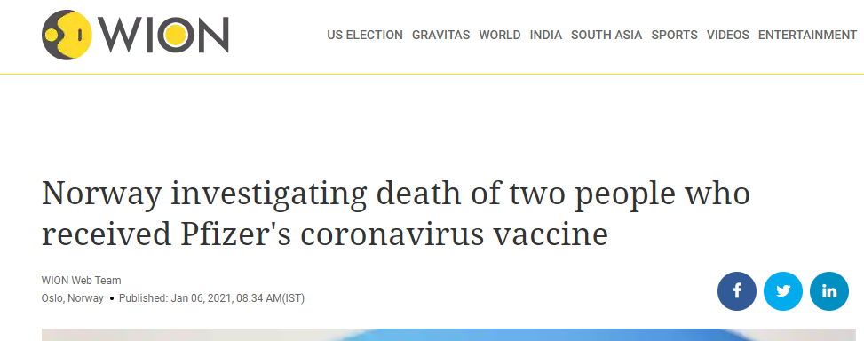
ADVERSE REACTIONS TO COVID VACCINES

Slide 32
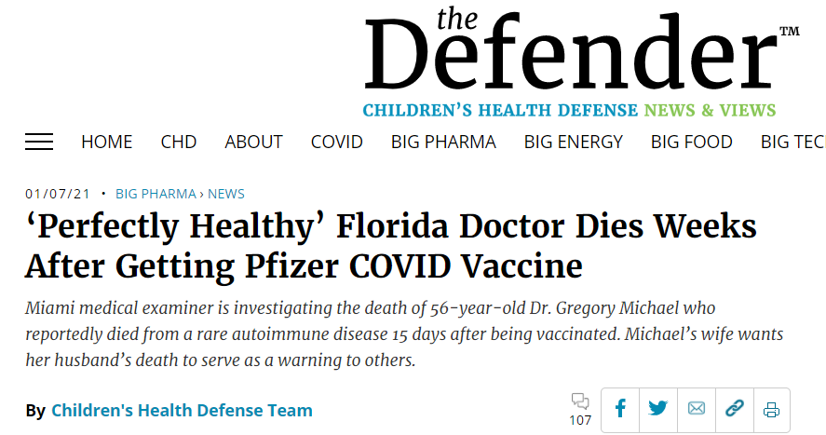
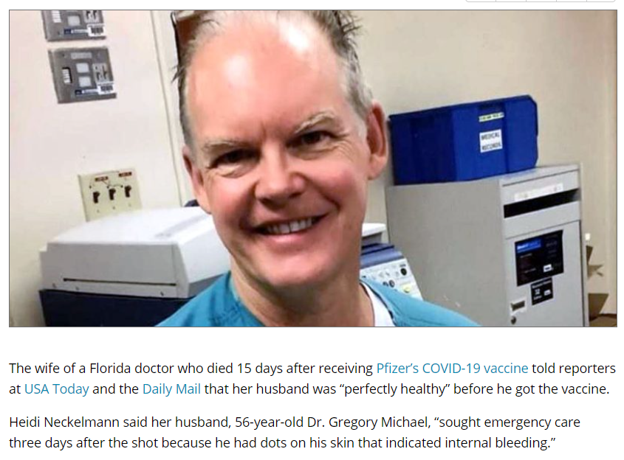
ADVERSE REACTIONS TO COVID VACCINES

Slide 33
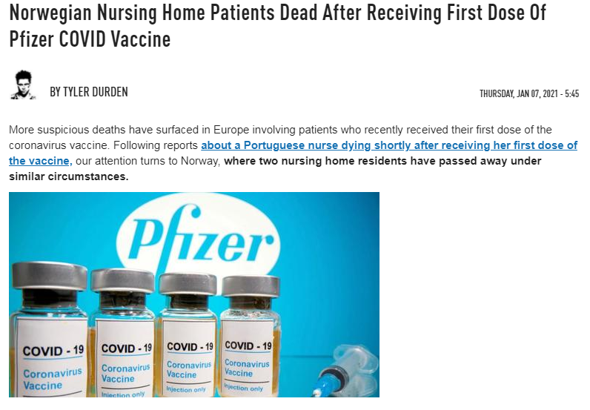
ADVERSE REACTIONS TO COVID VACCINES

Slide 34
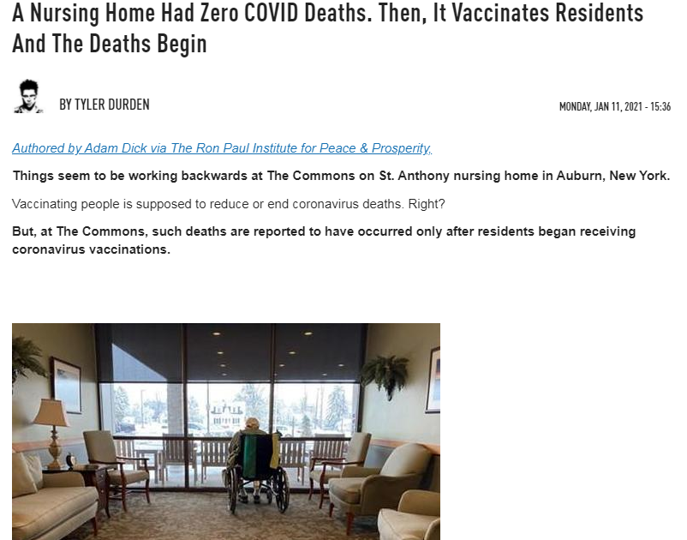
ADVERSE REACTIONS TO COVID VACCINES

Slide 35
ADVERSE REACTIONS TO COVID VACCINES

Slide 36
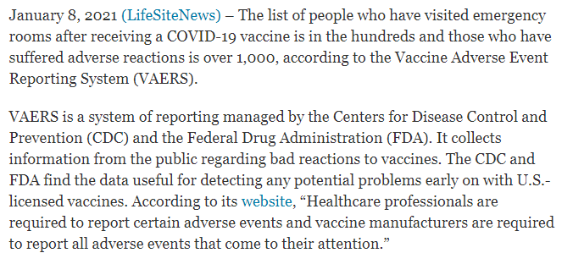
ADVERSE REACTIONS TO COVID VACCINES

Slide 37
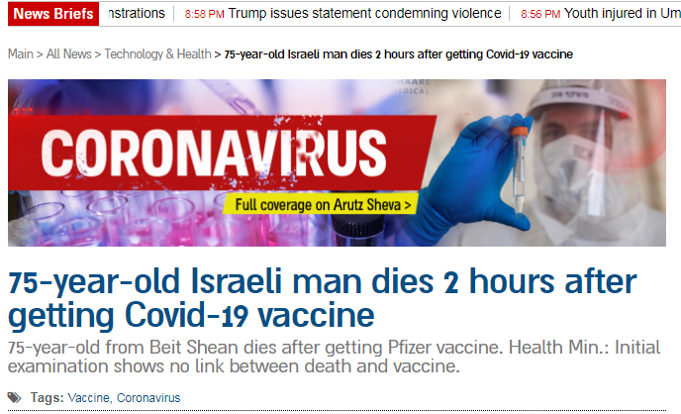
ADVERSE REACTIONS TO COVID VACCINES

Slide 38
ADVERSE REACTIONS TO COVID VACCINES

Slide 39
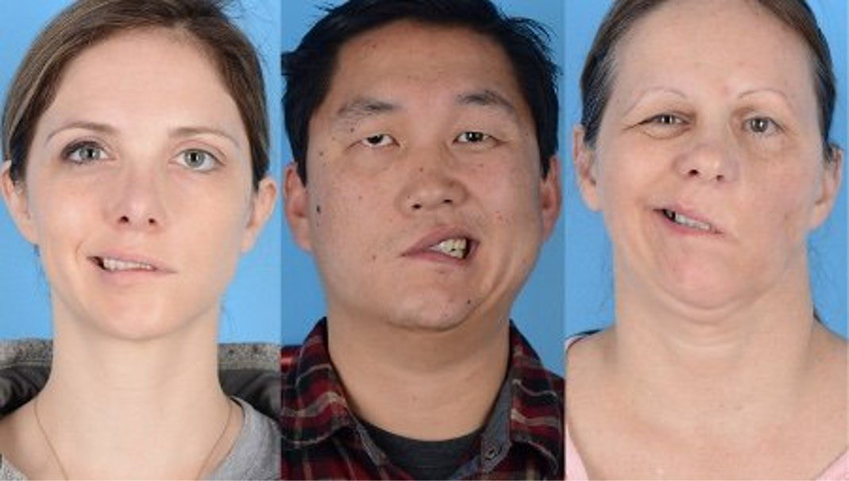
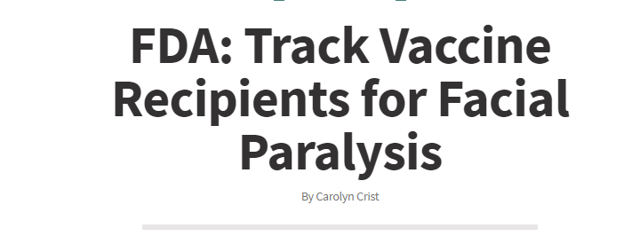
ADVERSE REACTIONS TO COVID VACCINES
There are a lot of “Debunking” Articles out there that are not true. The Report set out by the FDA is in the reference links. Picture above are examples of Bells Palsy.

Slide 40
COLLECTION OF PUBLIC REFUSALS TO TAKE THE VACCINE

Slide 41
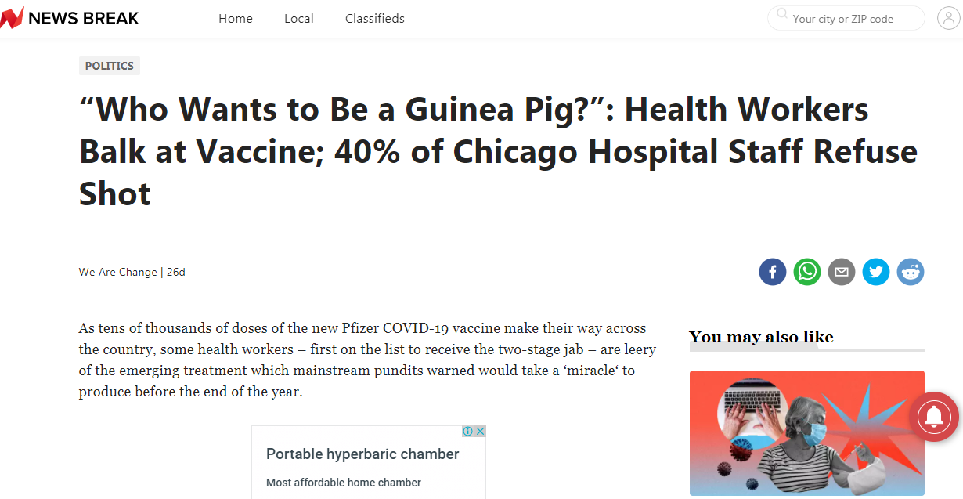
COLLECTION OF PUBLIC REFUSALS TO TAKE THE VACCINE

Slide 42
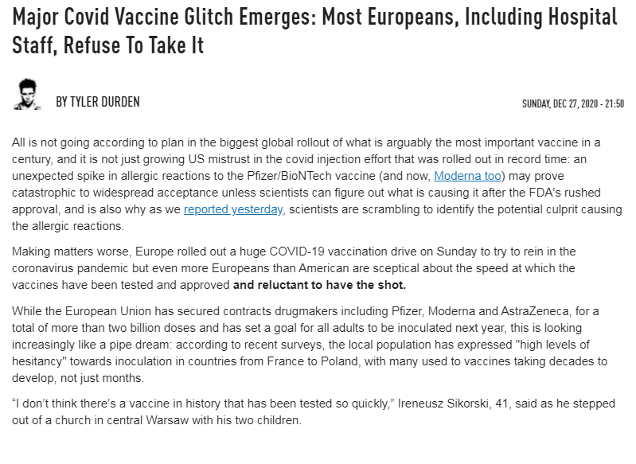
COLLECTION OF PUBLIC REFUSALS TO TAKE THE VACCINE

Slide 43
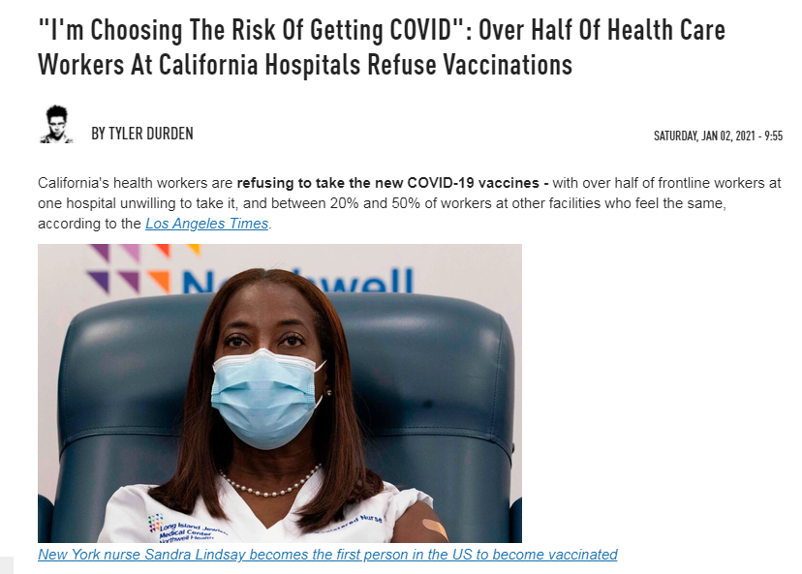
COLLECTION OF PUBLIC REFUSALS TO TAKE THE VACCINE

Slide 44
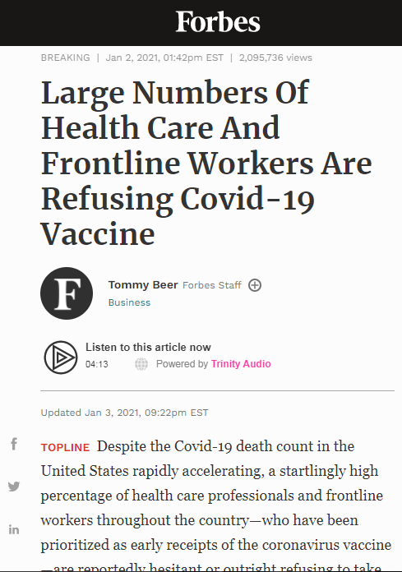
COLLECTION OF PUBLIC REFUSALS TO TAKE THE VACCINE

Slide 45
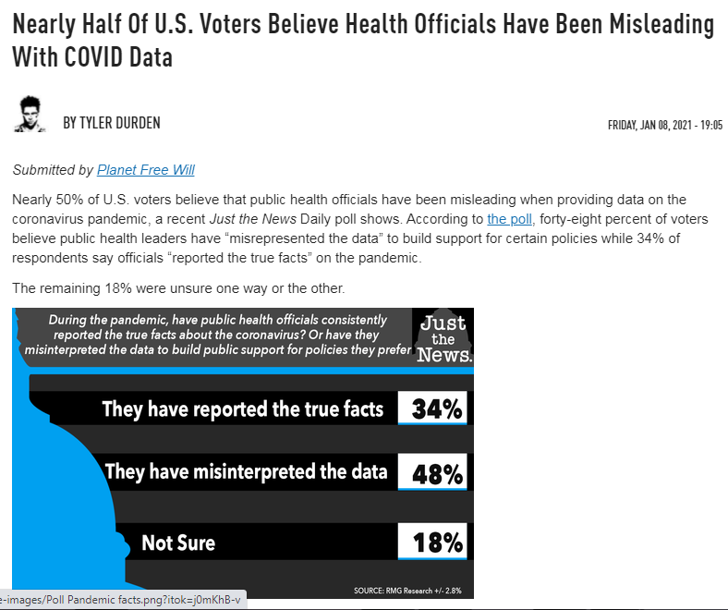
COLLECTION OF PUBLIC REFUSALS TO TAKE THE VACCINE

Slide 46
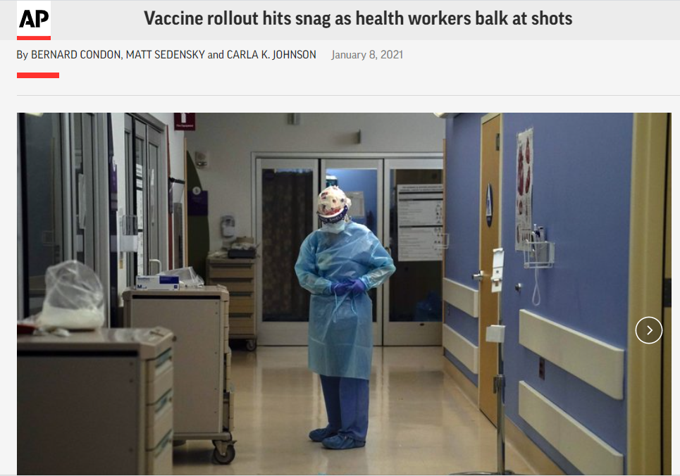
COLLECTION OF PUBLIC REFUSALS TO TAKE THE VACCINE

Slide 47
5G Recent Headlines

Slide 48
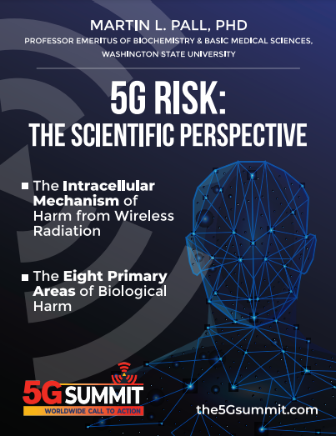
5G Risk: The Scientific Perspective
Compelling Evidence for Eight Distinct Types of Great Harm Caused by Electromagnetic Field (EMF) Exposures and the Mechanism that Causes Them This 127-page eBook is a powerful summary of the science that telecoms don't want us to know, because it scientifically demonstrates, beyond any reasonable doubt, the biologically harmful effect of 5G deployments and wireless radiation in general. Includes citations to 139 scientific research papers.

Slide 49
THE 5G AUCTION
FCC sells licenses to companies who bid for 5G territory. While a “pandemic” was going on, the 5G Auction broke all records an ended up being almost $100 Billion
This article talks about the tremendous amount of money and resources that are being put into 5G and the 5G auction. Stating “there’s Gold in those 5G airwaves”

Slide 50
5G Auction Biden Pledges $300 Billion to 5G and AI

Slide 51
“AT&T NASHVILLE BOMBING BLAMED ON 5G CONSPIRACY THEORIST”
In this video Polly does an excellent job disclosing links showing that the AT&T building was a network hub with data storage. The same building run by SolarWinds parent company Silver Lake. (connection to the Dominion voting machines) The bombing that took place at this building was targeted perhaps to take out the data stored here. The Network was most likely part of the “StormBrew” Spying operation disclosed by Snowden. The identity of the bomber is questionable to say the least. FBI blames it on Anti-5G Conspiracy Theorists. Targeting anyone who has concerns about 5G as a “terrorist” and threat to National Security.

Slide 52
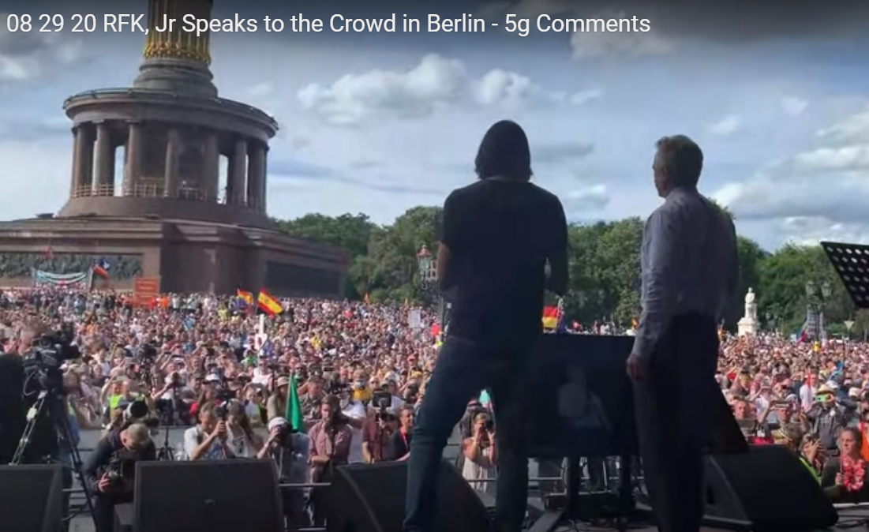
RFK Jr. SPEAKS IN BERLIN 5G SPYING NETWORK
“They haven’t done a very good job at protecting public health. But they’ve done a very good job at using the quarantine to bring 5G in to all our communities. And the shift us all to a digital currency, which is the beginning of slavery. If they control your bank account, they control your behavior.
Why are they spending 5 Trillion dollars on 5G? The reason is for surveillance and data harvesting. Its not for you and me, its for Bill Gates, for Jeff Zuckerberg… Bill Gates’ satellite will be able to look at every square inch of the planet 24 hours a day. That’s only the beginning. He also will be able to follow you on smart devices through biometric facial recognition through GPS. You think that Alexa is working for you. She isn’t working for you, she’s working for Bill Gates spying on you. “

Slide 53
5G R OLLOUT NOT SLOWING DOWN
ITS ACCELERATING!

Slide 54
RECENT 5G ROLLOUT NEWS

Slide 55
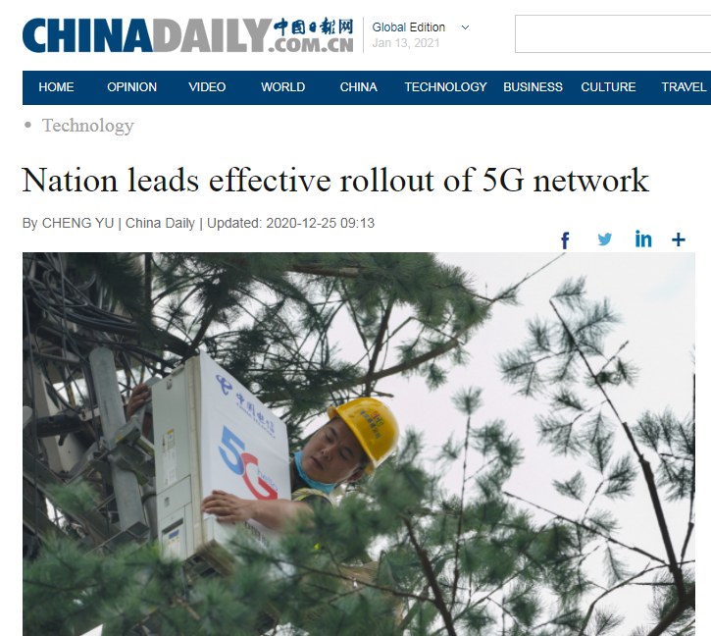
RECENT 5G ROLLOUT NEWS

Slide 56
RECENT 5G ROLLOUT NEWS

Slide 57
RECENT 5G ROLLOUT NEWS

Slide 58
RECENT 5G ROLLOUT NEWS

Slide 59
RECENT 5G ROLLOUT NEWS

Slide 60
RECENT 5G ROLLOUT NEWS

Slide 61
RECENT 5G ROLLOUT NEWS

Slide 62
RECENT 5G ROLLOUT NEWS

Slide 63
RECENT 5G ROLLOUT NEWS
Major Exposé on 5G Wireless and How Industry Influence Suppresses the Science

Slide 64
RECENT 5G ROLLOUT NEWS
Now we know why New York City experienced such a large explosion of Coronavirus clusters
President of T-Mobile Technology

Slide 65
OOKLA 5G MAP SPEEDTEST.NET

Slide 66
OOKLA 5G MAP

Slide 67
SOLUTIONS:
There are several things you can do to protect yourself and your family. DON’T GET THE VACCINE DON’T WEAR FACE MASKS ALL DAY LONG This increases your viral load DETOX YOUR BODY from heavy metals CHANGE YOUR DIET to boost your immune system
MOVE TO A MORE NATURAL AREA get out of the city TURN OFF YOUR WIFI AT NIGHT EQUIP YOUR HOME WITH EMF PROTECTION PRODUCTS

Slide 68
EMF PROTECTION PRODUCTS
MADE WITH SHUNGITE
HELP SUPPORT SGT REPORT BY SHOPPING FROM THIS LINK: https://www.ftwproject.com/ref/6/
Notes:
While we are describing the products we’d like to play this three minute video showing how we make the products: https://www.youtube.com/watch?v=k0ti-R0dEfQ

Slide 69
BENEFITS OF OUR EMF PROTECTION PRODUCTS
-Better sleep -Stress relief -Pain relief -Healthy home environment -Better seed germination and plant growth -Preserves fresh food and extends shelf life -Maintain Healthy Blood

Slide 70
Testimonials From Last Show
Read more testimonials on our website

Slide 71
Shungite Cures Bee Colony Collapse & 5G
What is Shungite and why are we talking about Bees?
Read more testimonials on our website

Slide 72
Shungite Cures Bee Colony Collapse & 5G
More information on shungitehoney.com/about
Further Shungite Scientific Research Links:
1) Derek Condit Beekeeper/Researcher
2) Shungite Benefits 3) Shungite Research Studies
- Shungite (entry #13 on database) - creates protective shields against electromagnetic radiation in the frequency range 100kHz - 100 GHz
- Radio Shielding Properties of Concrete based on Shungite Nanomaterials -
- Effect of magnetic impurities in based on shungite electromagnetic absorbers on its shielding properties -
- The use of Shungite in the diets of high productive cattle
- Medicinal applications of Fullerenes
- Possible Mechanism of Fullerene C60 Antioxidant Action
4) Video - Miracle of Shungite (Derek Condit interview
5) Video - Shungite Beehives bees gathering around Shungite Furtnuggets:
6) Video - Save the Bees with Shungite (Fernando Martinez)

Slide 73
Science Behind our Products
Full length explanatory videos on our Website! FTWProject.com

Slide 74
How we make our EMF protection products

Slide 75
EMF PROTECTION PRODUCTS
MADE WITH SHUNGITE
HELP SUPPORT SGT REPORT BY SHOPPING FROM THIS LINK: https://www.ftwproject.com/ref/6/
Notes:
While we are describing the products we’d like to play this three minute video showing how we make the products: https://www.youtube.com/watch?v=k0ti-R0dEfQ

