Slide 1
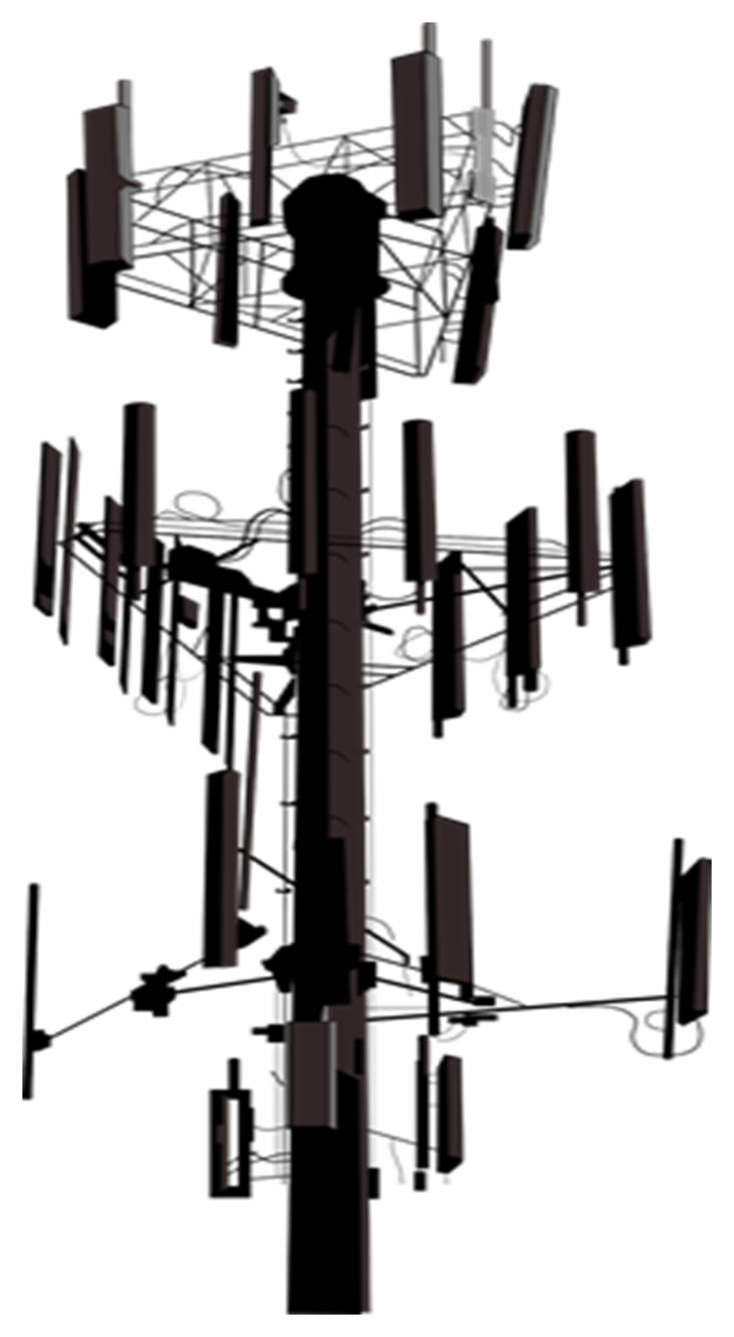
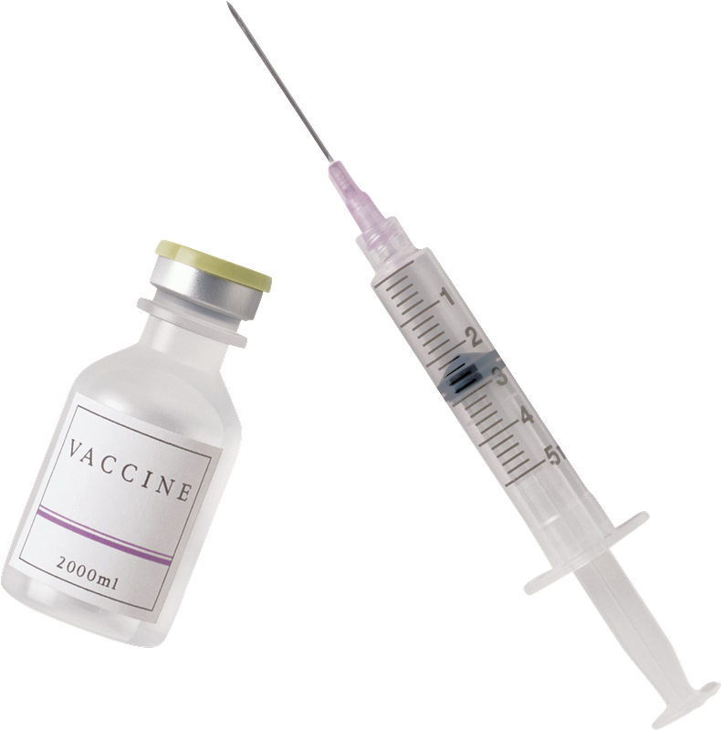
COVID VACCINE SHEDDING. UNDERSTANDING WHAT IS HAPPENING IN THE UNSEEN REALM.
SUMMARY --Reports coming in about non vaccinated people getting sick after being around those who got the shot. -What is Happening? Spike Proteins, Shedding vs. Transmission, EMF properties of Hydrogel in Covid Injections. -For Non-Vaxxed: Contaminants in the environment may affect you, chemtrails, hydrogel in GMO foods, 5G and EMF radiation, strange fibers found in Covid masks and PCR test swabs. -Understanding the Unseen Realm, Morphic Field, Biophotons, Doctrine of Signatures, Orgone Energy and Shungite -“Gene Therapies” and genetic manipulation of humans has happened before. The Days of Noah. -The role of prayer and spirituality in these times. Fight back in the unseen realm! -Solutions

Slide 2
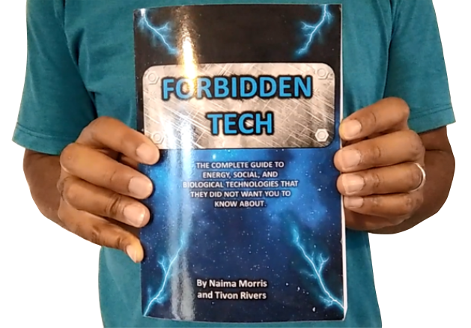
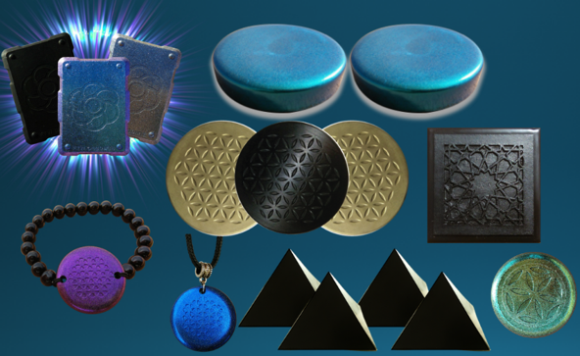
WHY WE DO WHAT WE DO
We are Christians, Engineers and Scientists. We feel it is our calling to help inform people about the technology that is being used against Gods creation. We have been monitoring the news on 5G, Covid Vaccine related issues so that we can present them in a condensed summary to inform the public.
“I will give thee the treasures of darkness, the hidden riches of the secret places…” Isaiah 45:3
FORBIDDEN TECH: The complete guide to energy, social, and biological technologies that they did not want you to know about. (2017) www.FORBIDDENTECH.WEBSITE
Handmade products orgone and shungite for EMF protection. Made by us in our workshop in Morocco. WWW.FTWPROJECT.COM
Online engineering academy for the co-development of researching and building DIY off grid energy devices. WWW.CLEANENERGYACADEMY.COM
Notes:
If time permits we’d like to play this 4 minute clip https://www.youtube.com/watch?v=aVj7_0A5-Ew

Slide 3
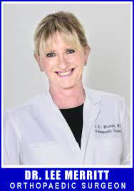
Reports Begin to come in about Non Vaccinated People getting sick
after being around those who got the shot.
“I’m getting Reports of a hairdresser who did not get the shot, but everyone in her salon did and she has been getting sick, COVID symptoms for weeks now. And, reports of a man who got the Johnson and Johnson shot, his mother who lived with him who was 88 years old she did not get the shot but she got COVID and died right after her vaccinated son came home “
-Dr. Lee Merritt
“The reports began with an unvaccinated Instagram user sharing with her followers that after years of regular cycles she missed her menstrual cycle two months in a row. Shortly after she shared her experience, the woman began noticing mainstream news articles drawing a connection between menstrual issues and the COVID vaccine. After hypothesizing that women’s negative reaction to the experimental mRNA vaccines- even if they’re unvaccinated- may be due to shedding, many other women started sharing their testimonies. The account went from 9,000 followers to 30,000 in less than 24 hours as she started sharing the testimonies.

Slide 4
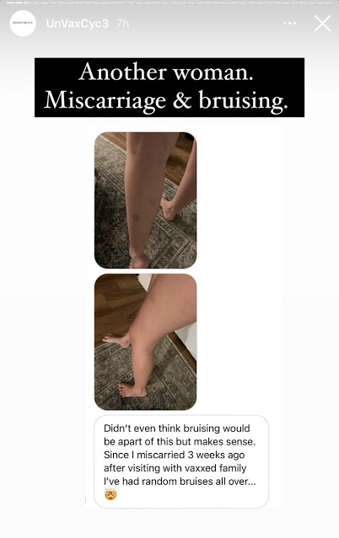
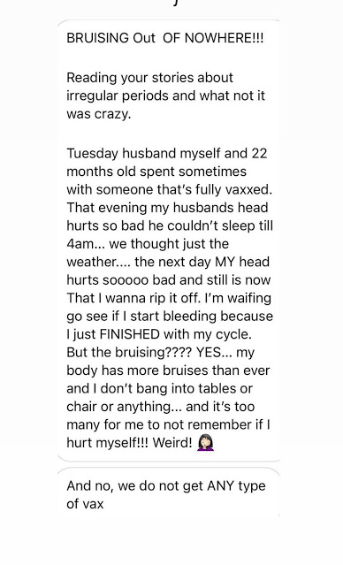
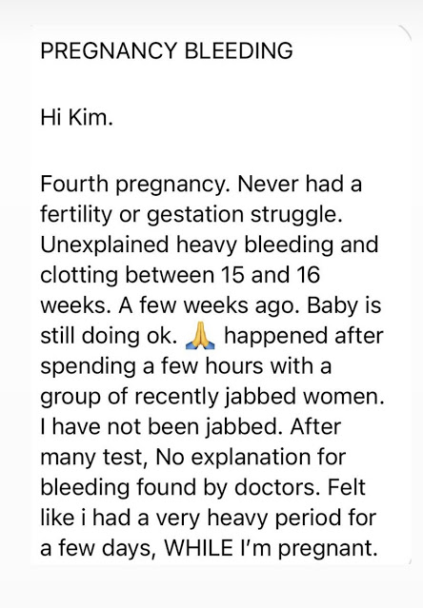
“Stay Away” Post shows testimonies / reports of side effects NON VACCINATED people are experiencing after being around people who got the shot. https://www.truthunmasked.org/p/stay-away.html

Slide 5
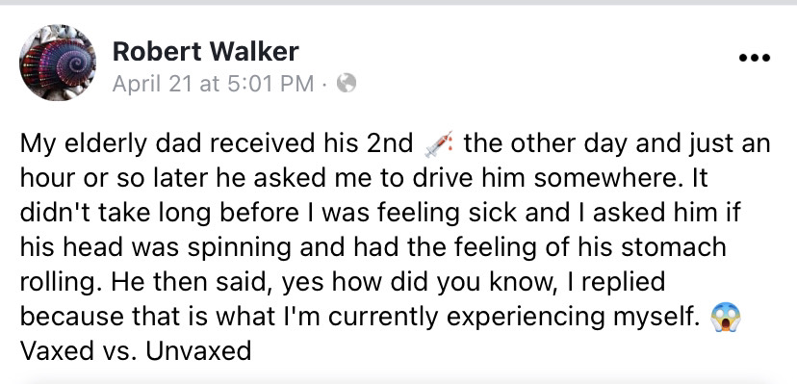
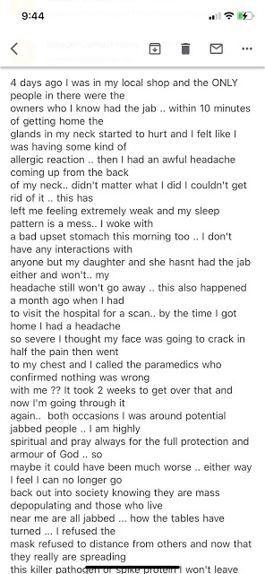
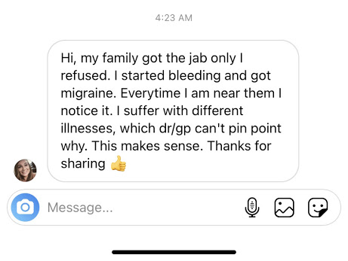
“Stay Away” Post shows testimonies / reports of side effects NON VACCINATED people are experiencing after being around people who got the shot. https://www.truthunmasked.org/p/stay-away.html
Note: The timing in which sickness occurs, its almost instantaneous. Similar to radiation EMF sickness.

Slide 6
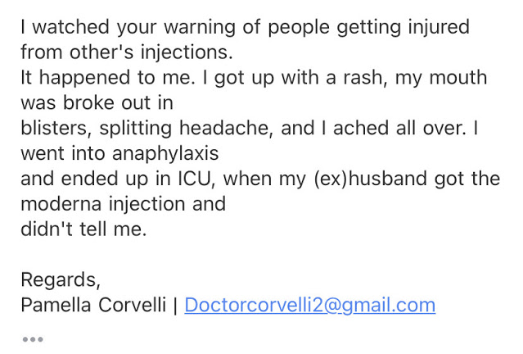
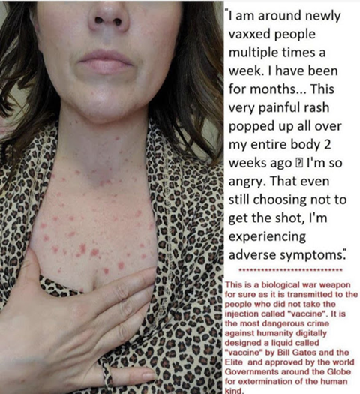
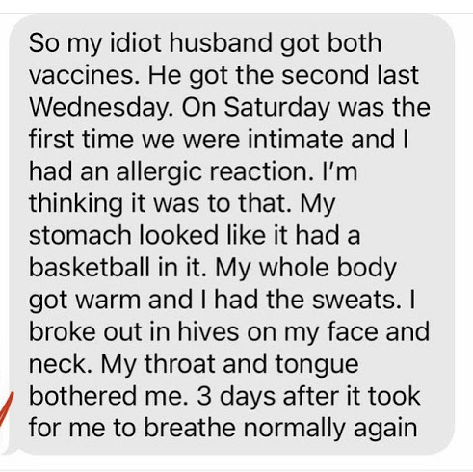
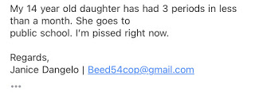
“Stay Away” Post shows testimonies / reports of side effects NON VACCINATED people are experiencing after being around people who got the shot. https://www.truthunmasked.org/p/stay-away.html

Slide 7
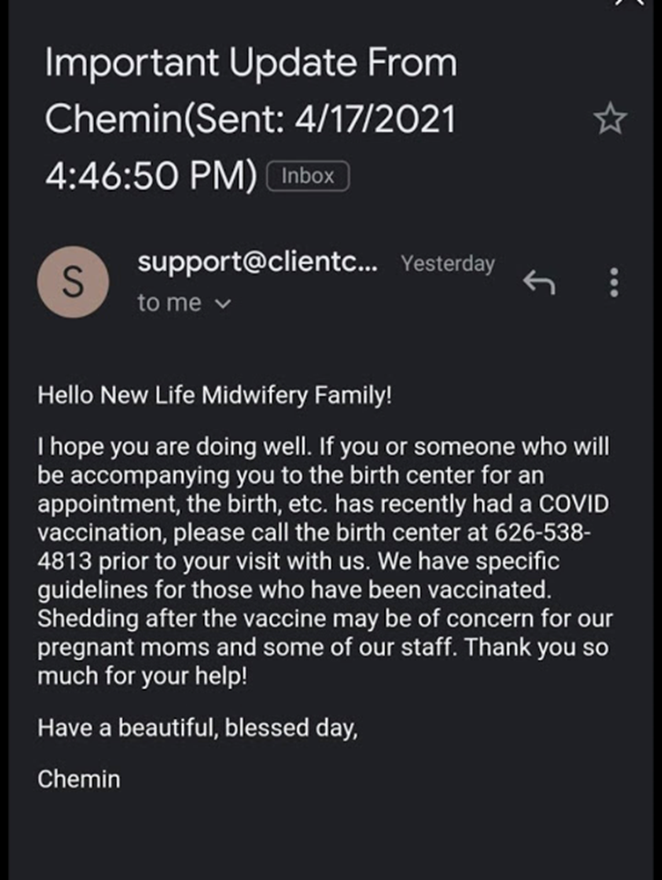
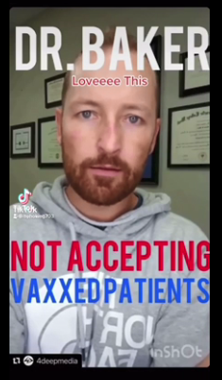
People are waking up to this bioweapon, telling the VAXXED to stay away.
“To protect the people in my office, I am not willing to watch somebody who made a poor decision and got the shot, stand next to a young female in my office and risk the chance of her becoming infertile. Its not happening on my watch! We don’t know why this is happening but I hear stories of hundreds of thousands of women talking about their cycle being irregular, clotting, bleeding, cysts in their ovaries after being around a vaccinated person.” https://rumble.com/vge2uv-doctor-refuses-to-have-vaxed-patients-around-others.html

Slide 8
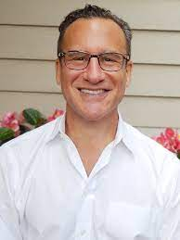
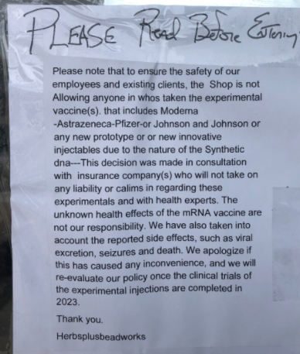
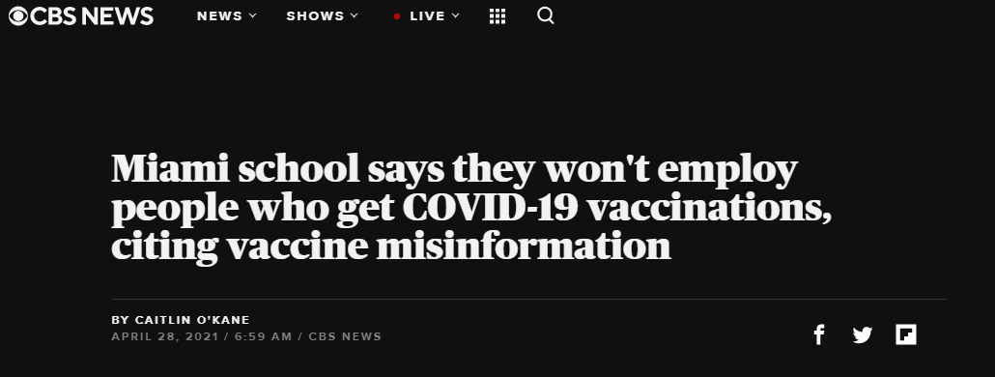
People are waking up to this bioweapon, telling the VAXXED to stay away.
“I think that we should start quarantining people who have had the shot. And they should be the ones to wear a badge on their arm saying “I’ve been vaccinated” so that we know to avoid being around them.” Dr. Larry Palevsky Former Fellow of the American Academy of Pediatrics

Slide 9
What is Happening?
-Spike Proteins
-Shedding vs. transmission -EMF properties of Hydrogel in COVID Injections.

Slide 10
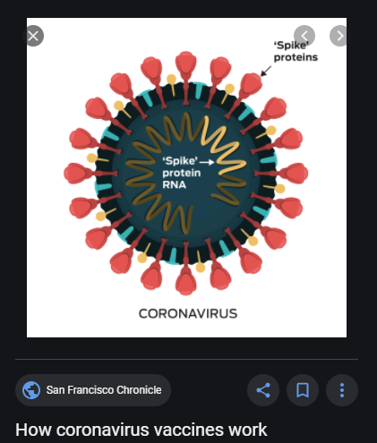
Spike Proteins
This is not a normal immunization. These injections have something that cause the body to make a synthetic spike protein against SARS-CV2. This is a synthetic protein that has never been seen before in human bodies. It causes the body to become a synthetic spike protein creating factory that just keeps creating these spike proteins and it NEVER SHUTS OFF.
We have no idea what these spike proteins will do over time. Dr. Sherry Tenpenny explains it will take 3-6 for us to see the real effects of the COVID injections. https://www.bitchute.com/video/nCJgZLroYJiK/

Slide 11
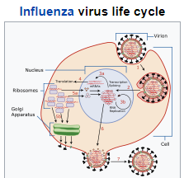
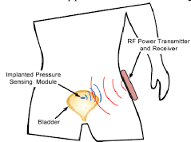
Shedding Vs. Transmission
Shedding
Transmission
When you're sick with a virus, the cells in your body hosting the infection release infectious virus particles, which you then shed into the environment. This process is called viral shedding. The term shedding has always been connected with live viruses like the flu, or the polio vaccines, or chicken pox etc.
A passage or transfer, as of a disease from one individual to another or of neutral impulses from one neuron to another. The passage of a nerve impulse across synapses.
The act of transmitting data or electrical power The passage of radio waves in the space between transmitting and receiving stations
What is happening with the COVID injections isn’t shedding, its something different so we are calling it “transmission”. Something is being transmitted from a vaccinated person to an unvaccinated person that we haven’t clearly identified yet. -Dr. Sherri Tenpenny

Slide 12
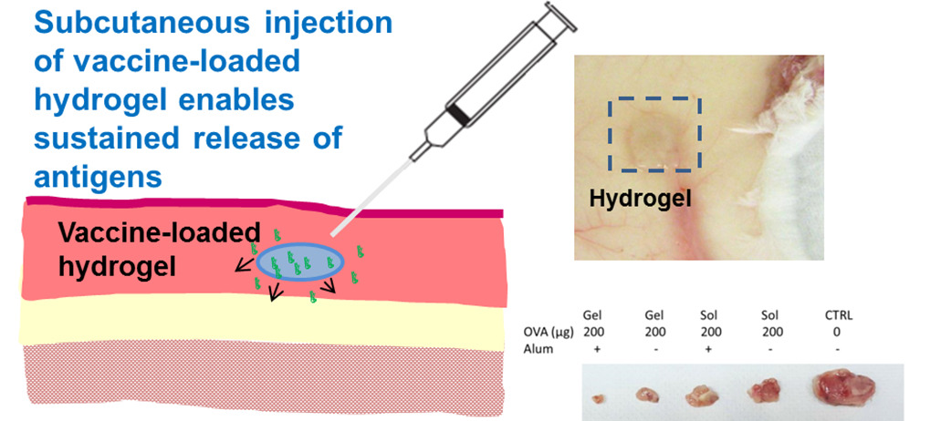
EMF PROPERTIES OF HYDROGELS IN COVID INJECTIONS
Hydrogel – also called by many other names to describe the very same structure. (nano-lipid particles, nanobots, nanotechnology, sci-fi substance)
Drug Companies claim: The human body would reject the synthetic protein that is being injected into it in the vaccine, so they coat the synthetic protein with a hydrogel substance in order to trick the body into accepting the synthetic protein. Their reasoning is that the hydrogel is a drug delivery system.
We are not told what happens to this hydrogel after the drug is delivered. We know that hydrogels can remain in the body for many years after they have been injected. We can only deduce from what we know about the properties of hydrogels. (next slide and video)
Reference Dr. Carrie Madej

Slide 13
EMF PROPERTIES OF HYDROGELS IN COVID INJECTIONS
Properties of Hydrogels: Hydrogels are “ON DEMAND” which means they can be triggered at any moment to deliver a payload. Hydrogels can be used as “BIOCENSORS” in the body, meaning they have the ability to accumulate data from your body such as your breathing, respiration, thoughts emotions, etc. Hydrogels have the ability to act through WIFI. They can both TRANSMIT AND RECEIVE Energy, messages, frequencies or impulses.
See it with your own eyes! Video of what hydrogels can do while beamed with electrical fields.

Slide 14
WHAT IS HAPPENING?
We believe that one of the ways people who have taken COVID Injections are transmitting illness to people who have not had the injection is through the vehicle of hydrogels that are both emitting and receiving frequencies to the people around them. Hydrogels Emit voltage and can send signals. Hydrogels can receive signals and be triggered and used as actuators (turning energy into motion) through wi-fi. Some of the symptoms happen immediately which is similar to EMF sickness. In addition, we still don’t know what these spike proteins are going to do to humans in the long term. Is the information in the spike protein being transmitted by the hydrogels through EMF interaction?

Slide 15
FOR NON-VAXXED How are the contaminants in the environment effecting you?
Chemtrails- heavy metals and chemicals that lower your immune system and turn you into a walking antenna (covered in previous shows) Food- GMO foods. Processed Foods. Synthetic meats. They are putting hydrogels in vegetables now. (covered in previous shows) Water- fluoride, pharmaceuticals and heavy metals in the water supply (we recommend using a water distiller and mineral supplements) 5G and EMF radiation
Masks and Test Swabs

Slide 16
5G and EMF Radiation
“…the course of this world, according to the prince of the power of the air, the spirit that now worketh in the children of disobedience” Ephesians 2:2
Professore Emeritus of Biochemistry and Basic Medical Sciences at Washingon State University
“EMFs act by activating channels in the membrane that surrounds each of our cells, called voltage-gated calcium channels (VGCCs). The EMFs put forces on the voltage sensor that controls the VGCCs of about 7.2 million times greater than the forces on other charged groups in our cells [4,6,7]. This is why weak EMFs have such large biological effects on the cells of our bodies! EMFs works this way not only on human and diverse animal cells [1-7] but also in plant cells [7] so that this is a universal or near universal mechanism of action. “
Listed in this 90 page paper on 5G EMF Hazards is a summary of the top 12 adverse health effects.
Hydrogels used in vaccines emit their own voltage, emit their own EMF

Slide 17
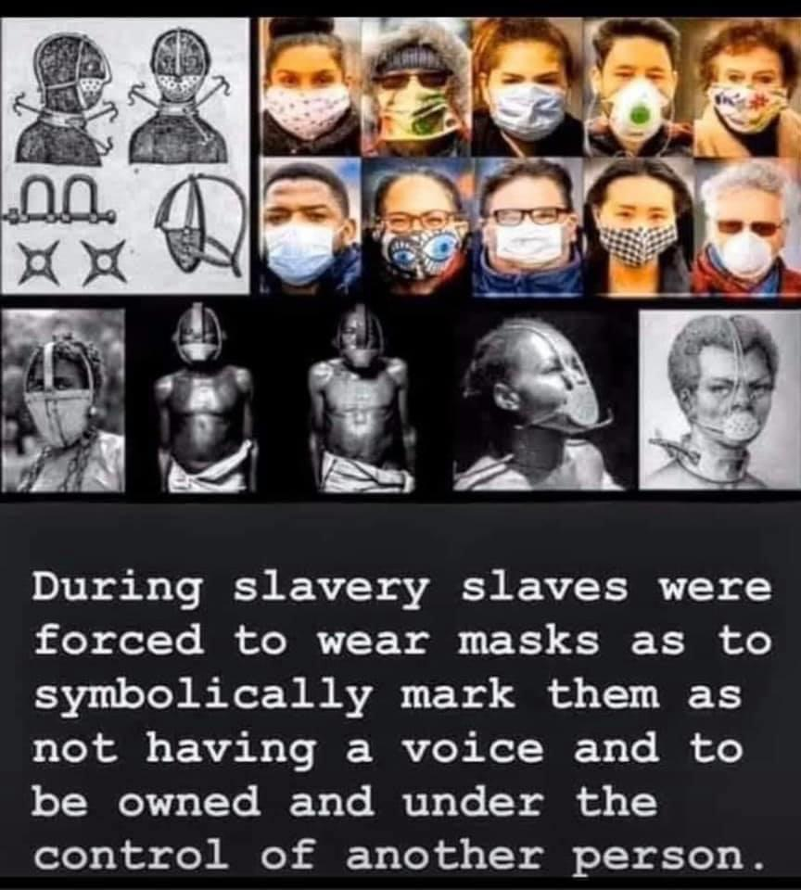
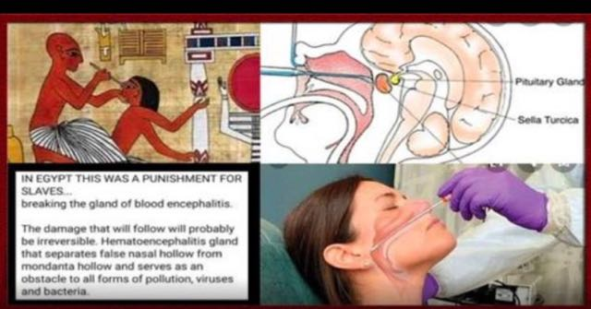
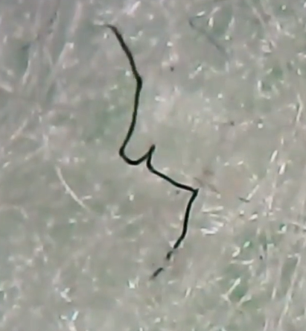
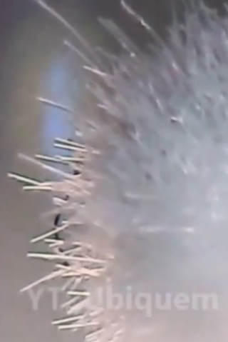
Strange Fibers Found in Masks and COVID Test Swabs
People are finding strange fibers inside their masks and inside the COVID 19 test swabs. These fibers are similar to the strange fibers found in Morgellons disease. The fibers “appear come to life” when in contact with warm human breath. They look and behave similar to how theragrippers work. Inspired by parasitic worms, theragrippers were created at Johns Hopkins University. They are as small as a speck of dust and designed to deliver time released medication into the host body. They operate like small triggered springs with a temperature controlled coating that releases the stored energy autonomously at body temperature.
The masks are a delivery system for hidden theragrippers loaded with drugs. The same spring like fibers are found in the swabs. The swabs have glass like fibers that deeply penetrate themselves and break off into the flesh of your nasal cavity. Directly next to your brain, and specifically the pineal gland.
Big Pharma’s Rape of Mankind https://banned.video/watch?id=6088376b1875f60f7fd18dce

Slide 18
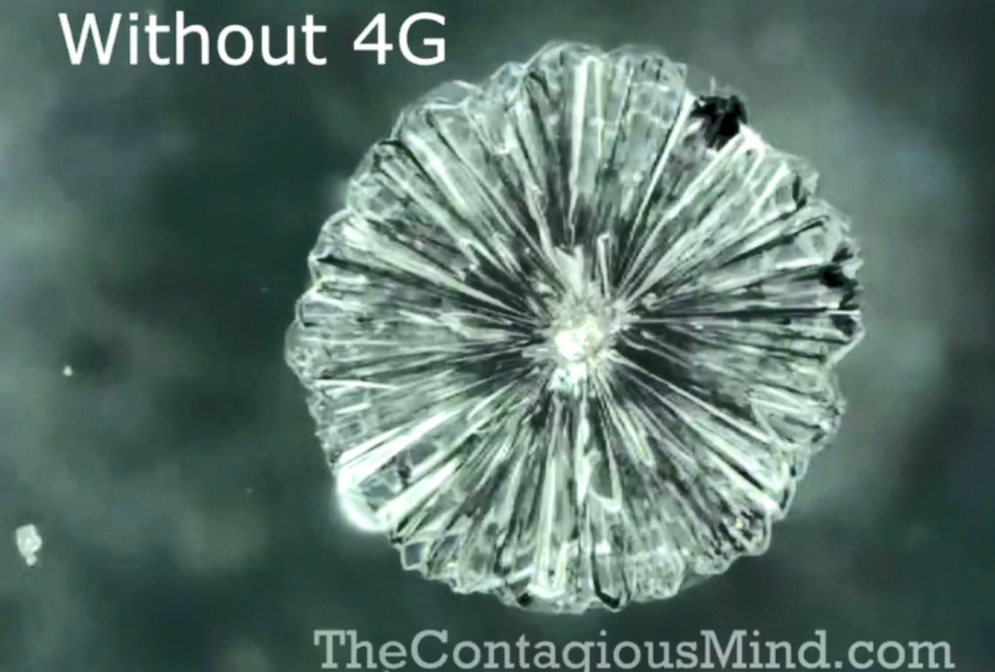
UNDERSTANDING THE UNSEEN REALM
“In the beginning God created the heavens and the earth. Now the earth was formless and empty, darkness was over the surface of the deep, and the Spirit of God was hovering over the waters. And God said, "Let there be light," and there was light.” “By faith we understand that the universe was formed at God’s command, so that what is seen was not made out of what was visible.” Hebrews 11:3
4 minute video: Mike Adams showing Crystallography via morphic resonance
The unseen realm, has been studied in many ways and has many different names. Some have called this domain the virtual space, morphic field, holographic field, quantum resonant field, zeropoint, heavenly realm, etc. It is a extra-dimensional realm of coherent information, containing the perfect template for all living things. The mind of God. The space where God creates from . There is information there that manifests in the world we can see. Understanding this realm can help us to understand what is going on Covid Injections transmission and EMF.

Slide 19
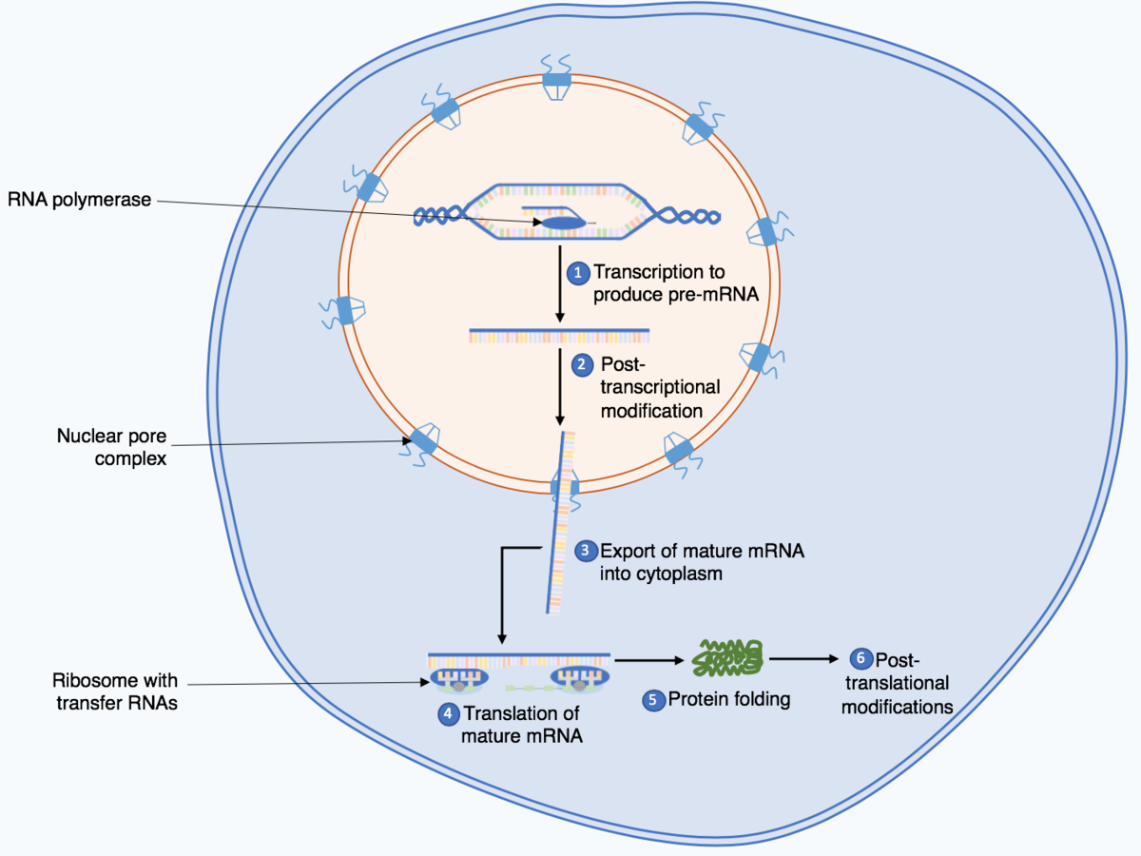
UNDERSTANDING THE UNSEEN REALM DNA AND QUANTUM COMMUNICATION
What Is DNA and the Function of RNA?
It transmits information This is the part they are messing with!

Slide 20
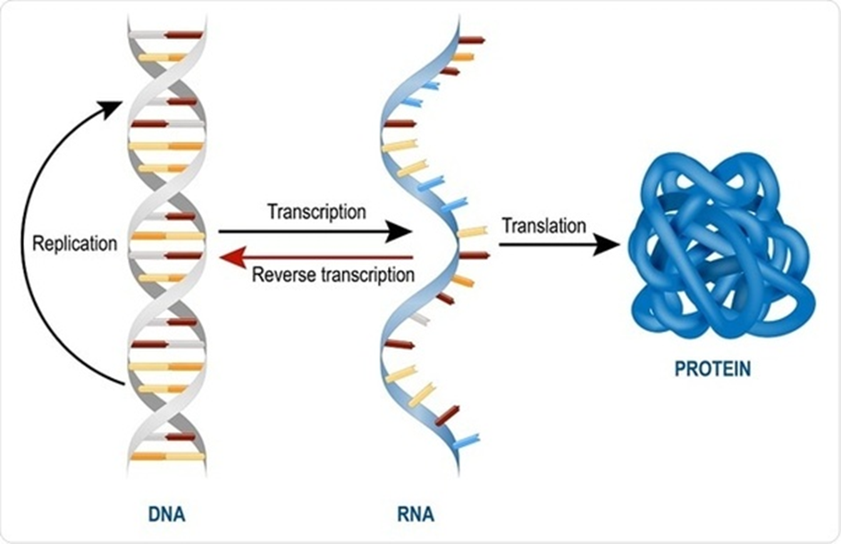
UNDERSTANDING THE UNSEEN REALM DNA AND QUANTUM COMMUNICATION
This is Transmission Not Shedding!

Slide 21
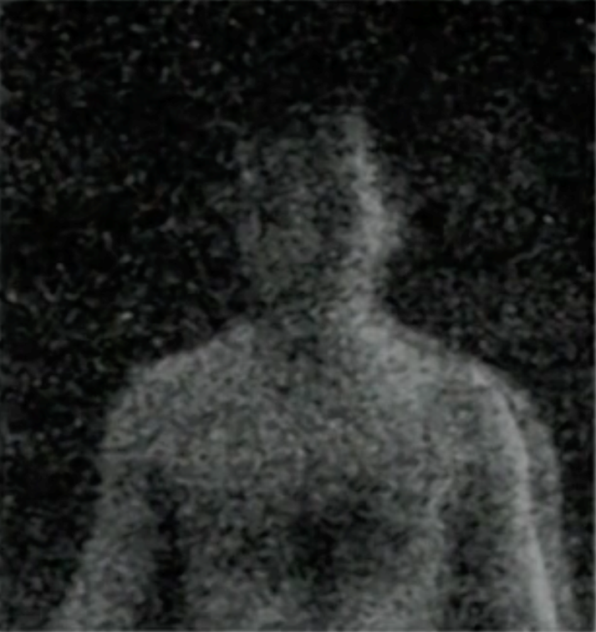
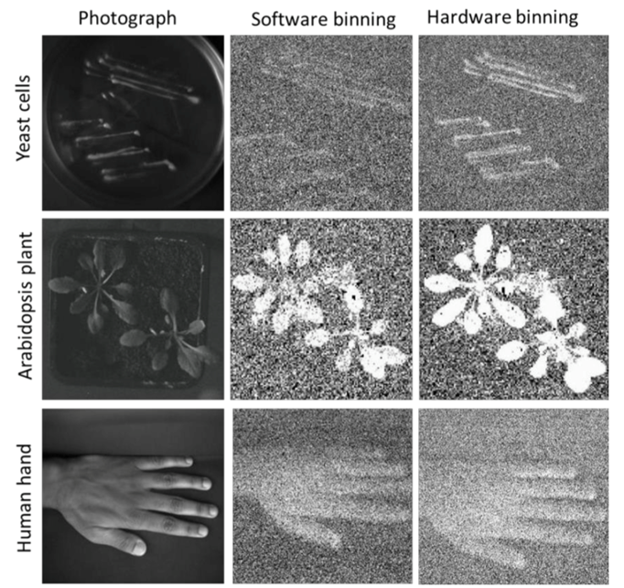
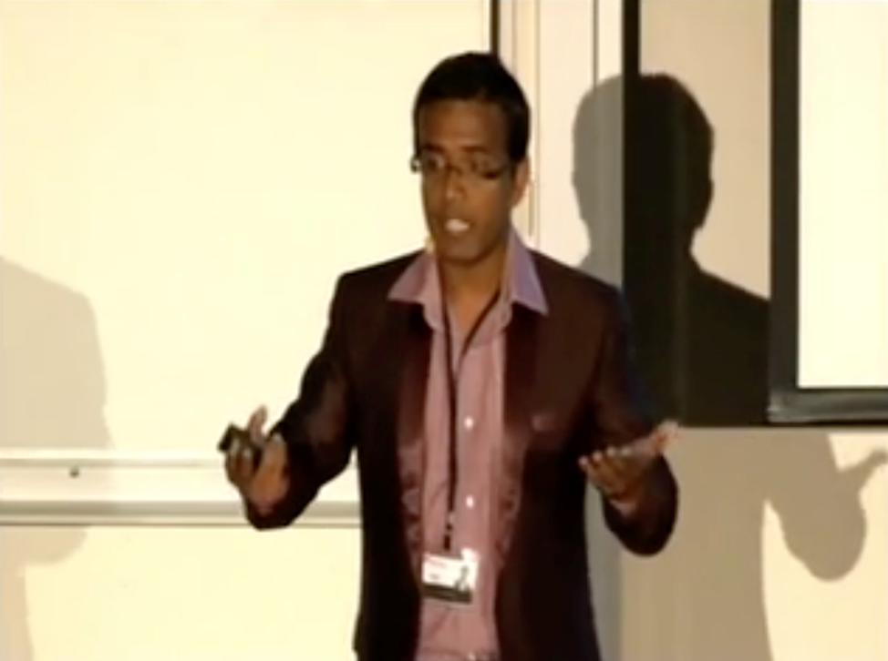
UNDERSTANDING THE UNSEEN REALM ”The light of the body is the eye: if therefore thine eye be single; thy whole body shall be full of light.” Matthew 6:22
-Biophotons Our Bodies Emit Light!
Debate Among Academia dead cells vs. living cells
Biophysicist Dr. Ankush Prasad

Slide 22
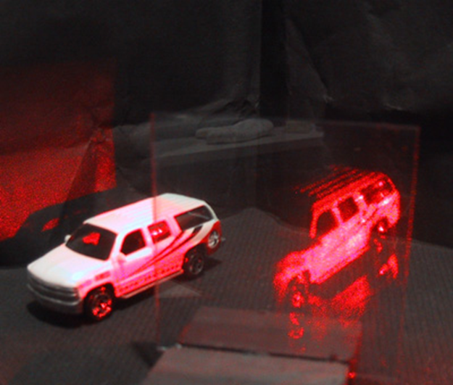
UNDERSTANDING THE UNSEEN REALM Beam Interference Technology and Holography?
Holography is a photographic technique that records the light scattered from an object, and then presents it in a way that appears three-dimensional. Holography functions on the physical principle of using constructive and destructive interference patterns created by combining the wavefronts of two (or more) coherent beams (i.e. lasers or masers) in order to receive, store, and transmit spacial information.

Slide 23
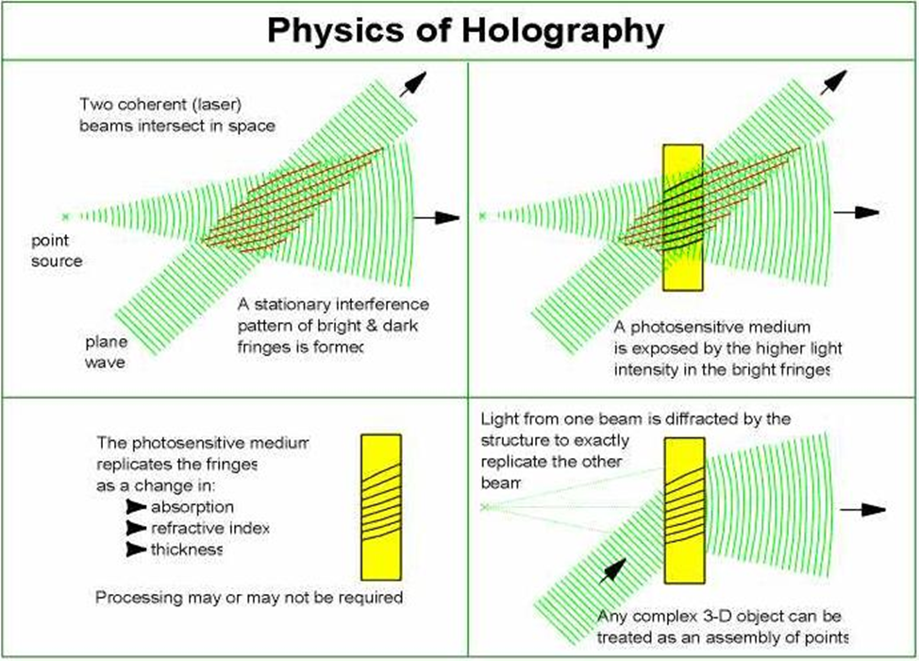
UNDERSTANDING THE UNSEEN REALM Beam Interference Technology and Holography?

Slide 24
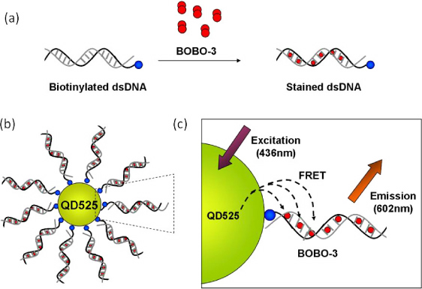
UNDERSTANDING THE UNSEEN REALM Beam Interference Technology and Holography?

Slide 25
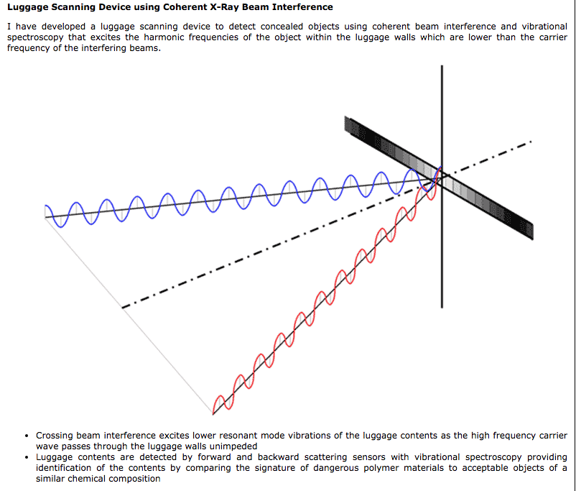
UNDERSTANDING THE UNSEEN REALM Interference and Diffraction

Slide 26
UNDERSTANDING THE UNSEEN REALM Interference and Diffraction

Slide 27
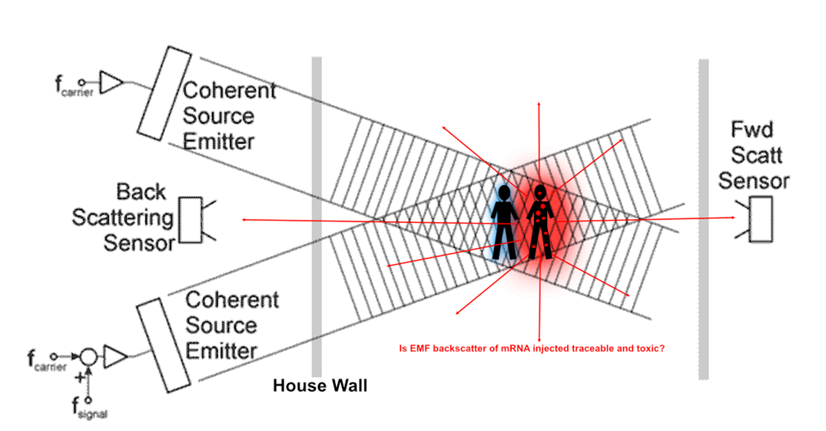
UNDERSTANDING THE UNSEEN REALM Interference and Diffraction

Slide 28
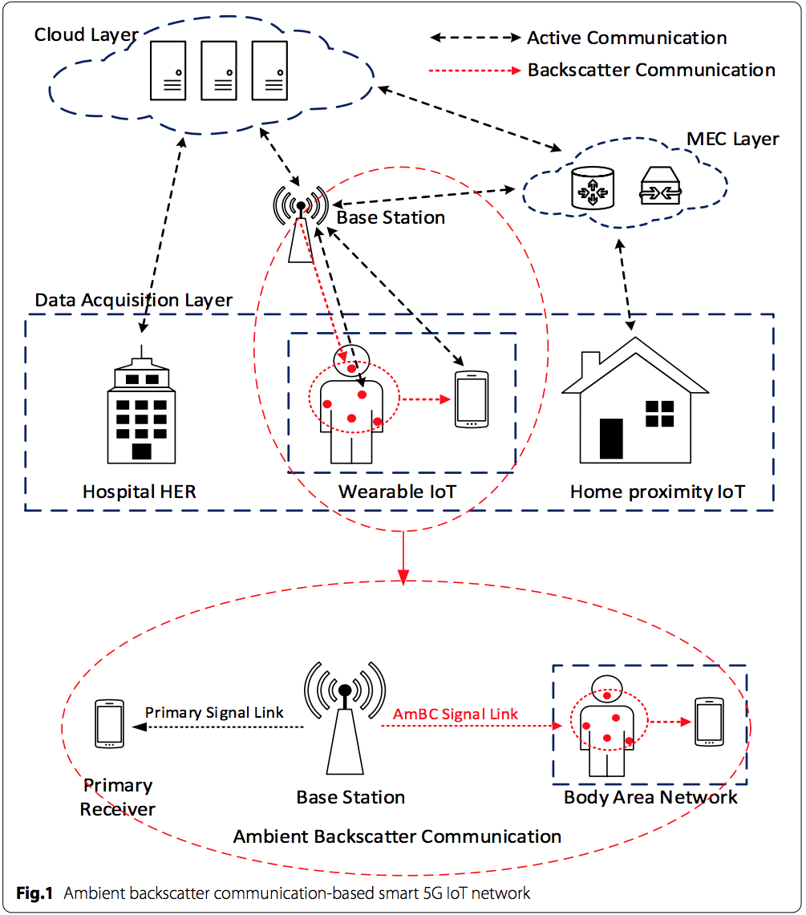
UNDERSTANDING THE UNSEEN REALM
Hydrogel Wearables

Slide 29
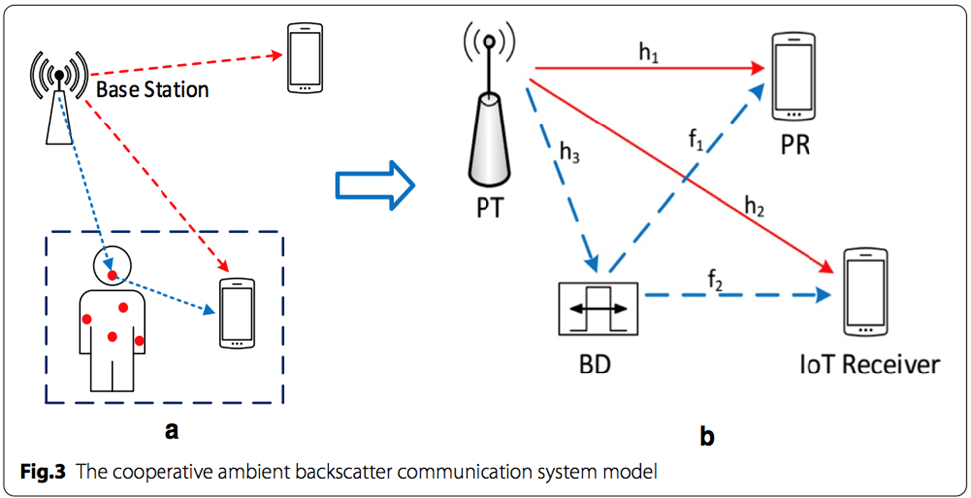
UNDERSTANDING THE UNSEEN REALM DNA AND QUANTUM COMMUNICATION

Slide 30
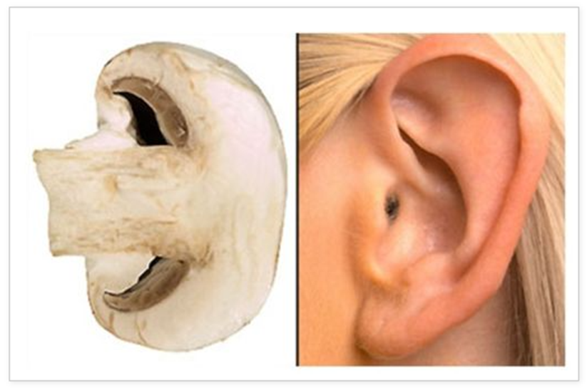
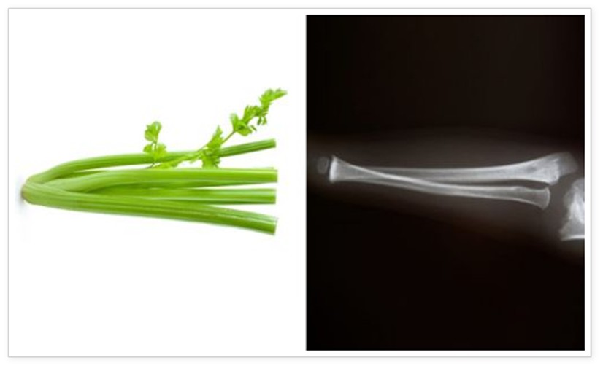
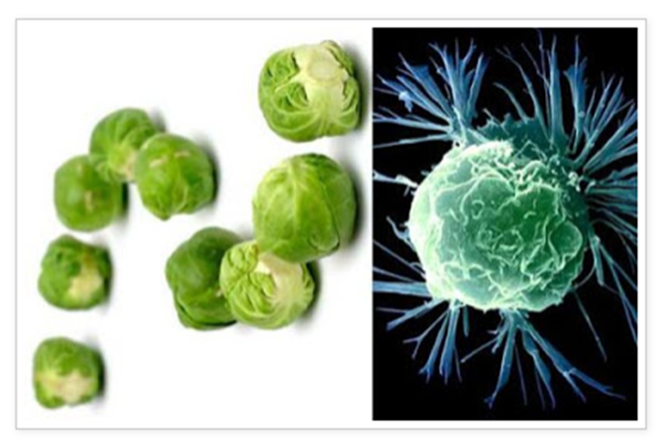
UNDERSTANDING THE UNSEEN REALM -Doctrine of Signatures
Foods That Resemble the Body Parts They Heal Referred to in the classical period of Rome as the "Law of Similarities", The Doctrine of Signatures is now called by scientists, "Teleological Nutritional Targeting." It now contends that every whole food has a pattern that resembles a body organ or physiological function and that this pattern acts as a signal or sign, as to the benefit the food provides the eater.
Mushrooms Good for Ears
This science goes much deeper. It holds true down to the cellular level. In the book Healing Plants by Wilhelm Pelikan there are microscopic images of the cell of a chamomile plant next to an intestinal cell (the organ chamomile heals) THEY LOOK IDENTICAL!
We believe this is an example of how both the organ and its cure were formed from the same set of information in the morphic field.
Celery good for bones
Brussel sprouts heal cancer

Slide 31
Heavy Metals Herbal Detox Protocol
Due to high demand we are now offering a full heavy metal herbal detox protocol for both men and women. Protocol has been put together by Valerie Robitaille, PHD in Community Health, Clinical Nutritionist and Herbalist. Also Hope’s Mom ☺
Find Out More and Purchase on our website www.FTWProject.com

Slide 32
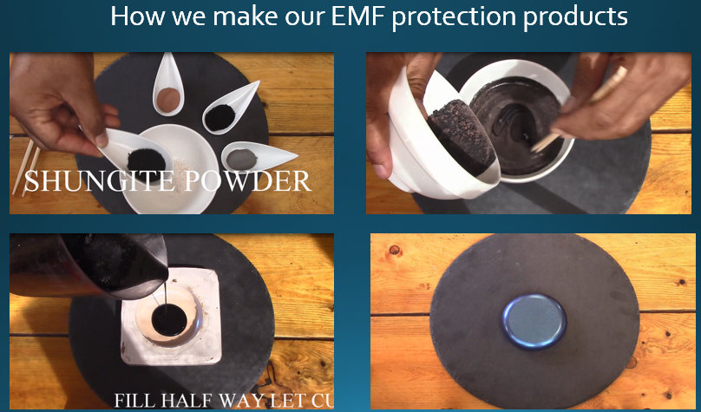
UNDERSTANDING THE UNSEEN REALM : Orgone Energy
In the 1930’s, the late Dr. Wilhelm Reich discovered that living samples placed within containers made from alternating layers of steel and non-conductive organic material were able to harness healthy ‘cosmic energy’ from the environment. He called this energy ‘orgone’. These orgone accumulators and had the ability to: – Preserve blood samples for longer periods of time – Sprout healthier plant seedlings – Provided pain relief for his patients who sat inside them.
Instead of a box, composites made from a blend of; iron oxide, steel, brass, shungite and crystal powders encased in epoxy resin produce the same effects and are able to transform the harmful wireless fields from; cell towers, smart meters, smartphones, internet router and your television, into more beneficial energy for you and your plants and pets.
Full length explanatory videos on our Website! FTWProject.com

Slide 33
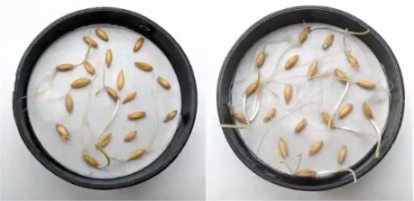
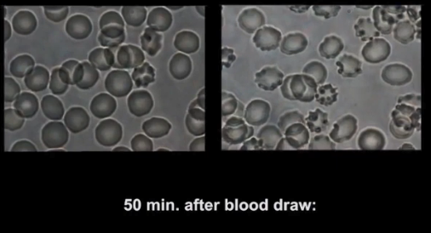
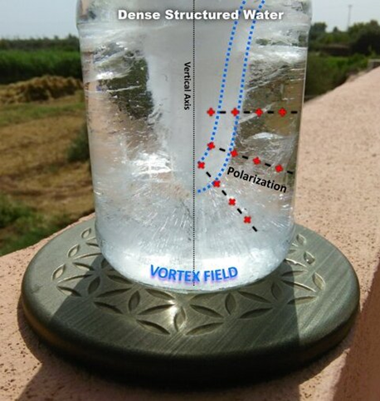
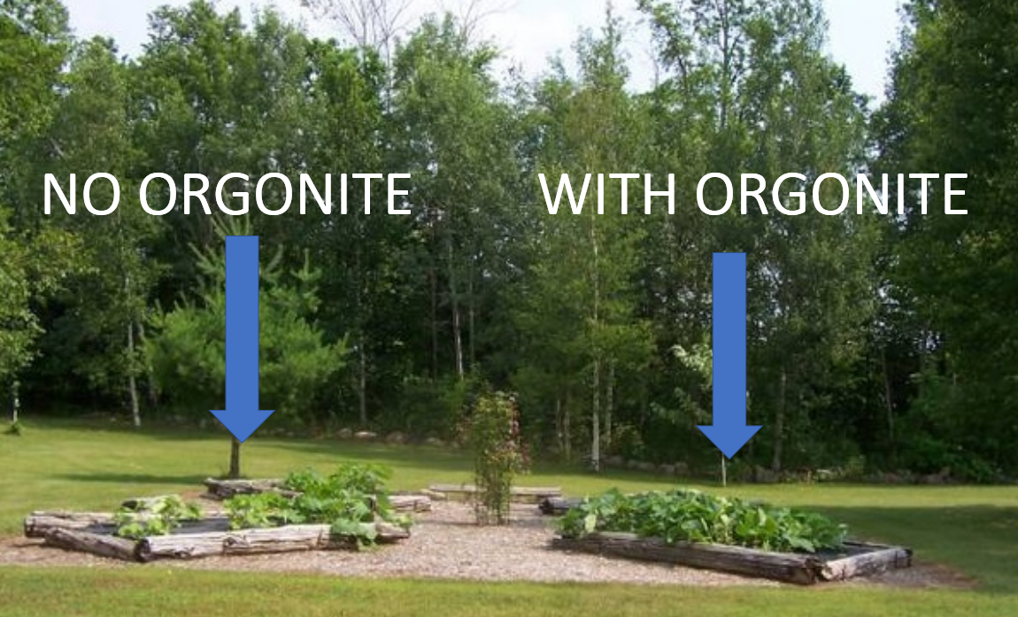
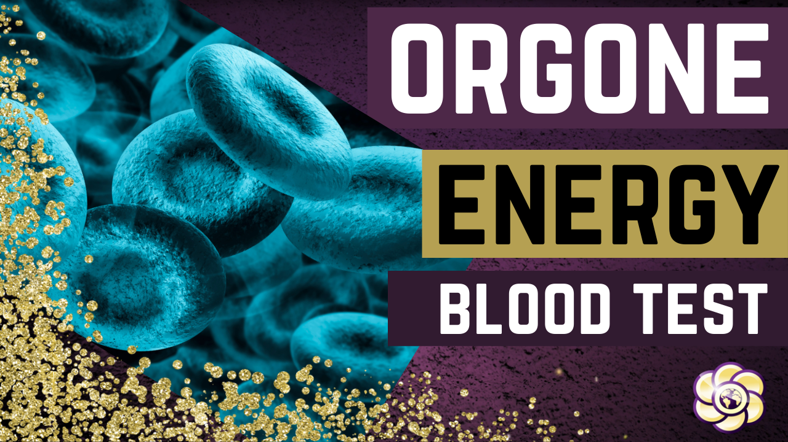
UNDERSTANDING THE UNSEEN REALM : Orgone Energy
The effects of this scientific phenomenon were replicated and well documented in studies done by the University of Pennsylvania and the Heraclitus Microscopic research laboratory. Also, the field can be seen in an “ice test”
Full length explanatory videos on our Website! www.FTWProject.com

Slide 34
UNDERSTANDING THE UNSEEN REALM : Shungite
Shungite is a rare mineral, believed to come from an asteroid that can only be found in one place in the world: Karelia Russia. It is the only mineral of its kind that contains fullerenes, which have been proven effective in protection from EMF’s and also used for cleaning nuclear waste, such as Fukushima.
Full length explanatory videos on our Website! FTWProject.com

Slide 35
UNDERSTANDING THE UNSEEN REALM : The Pyramid Shape
“See that you make them after the pattern for them, which was shown to you on the mountain.” Exodus 25:40
Alexander Golod, a Ukrainian former defense contractor and scientist performed pyramid research experiments that involved using expensive military helicopters and equipment that could measure ion columns in the atmosphere that were generated from pyramids. The shape of the pyramid has a function, it directs energy out through the tip to effect the environment around it. This is why we make Orgone Energy Shungite Pyramids. They can be used to place around your property to create a grid of protection against EMF’s, cell phone towers, and chemtrails.
Full length explanatory videos on our Website! FTWProject.com

Slide 36
“GENE THERAPIES” AND GENETIC MANIPULATION OF HUMANS HAS HAPPENED BEFORE
“As it was in the Days of Noah, so will it be at the coming of the son of Man” -Jesus (Matthew 24:37) What do we know about the days of Noah? “The Nephilim were on the earth in those days—and afterward as well—when the sons of God had relations with the daughters of men. And they bore them children who became the mighty men of old, men of renown. Then the LORD saw that the wickedness of man was great upon the earth, and that every inclination of the thoughts of his heart was altogether evil all the time” Genesis 6:4
The “sons of God” were the fallen angels, who left their first estate, meaning they left their spiritual bodies and devolved into human like form to mate with human women. The offspring they produced, “the mighty men of old, the men of renown” were the Nephilim also referred to as giants.
“Noah, however, found favor in the eyes of the LORD. This is the account of Noah. Noah was a righteous man, who was perfect in his generation; Noah walked with God” Genesis 6:9 Noah was 'perfect in his generation' because his genetic profile had not been contaminated by the fallen angelic beings, who left their first estate, engaged in sexual acts with women and produce a genetically modified man that was an abomination in the eyes of God. We learn more detail about what it was like in the days of Noah from “The Book of Giants”

Slide 37
“GENE THERAPIES” AND GENETIC MANIPULATION OF HUMANS HAS HAPPENED BEFORE
The “Book of Giants” was one of the many manuscripts found in the caves of Qumran in 1947 now known as the “Dead Sea Scrolls” The Book of Giants composed in Aramaic, and dated with certainty to at least the second century BC if not much earlier. The content of the manuscript, though severely fragmented expounds of the narrative of the book of Enoch concerning the fall of the angelic watchers, their malevolent hybrid offspring, and the great flood that ensued as a result. The book of giants describes in detail how the fallen angels insidiously corrupted the genetics of all flesh on the earth.

Slide 38
“GENE THERAPIES” AND GENETIC MANIPULATION OF HUMANS HAS HAPPENED BEFORE
Miscegenation refers to the mixing of races or species.
This was extreme cross species genetics involving the seed of the fallen angels themselves.

Slide 39
“Days of Noah” Archaeological evidence has been found and covered up
Giants: giant skeletons have been found all over the world the evidence was confiscated by places like the Smithsonian and the Vatican. Holocaust of Giants and The Unholy See by Gensix True Legends Fims: https://www.gensix.com/true-legends-films/
The Nephilim: Elongated skulls found all over the world they are usually covered up or explained away as tribal head binding. These skulls are completely different from a human skull. Watch “On the Trail of the Nephilim” Series by LA Marzulli https://lamarzulli.net/store/
The Ark of Noah was found. It is on Mount Tendurek in eastern Turkey near Mount Ararat. Discovered by Ron Wyatt. See the fascinating documentary done on this. The REAL Noah's Ark FOUND by Archaeologist Ron Wyatt! - Short Documentary https://www.youtube.com/watch?v=oQwfU7DvUyE
Remnants of fallen angel technology are still around today. Sacsayhuaman in Peru. Watch Technology of the Fallen by Gensix True Legends Films. https://www.gensix.com/true-legends-films/

Slide 40
THE ROLE OF PRAYER AND SPIRITUALITY IN THESE TIMES Fight Back in the Unseen Realm!
We were created by our creator as electro-magnetic beings. Our bodies, our brain signals, our nerves, our synapses is a complex network of wiring. We have electric circuits in our bodies. We emit frequencies and energy.
When we pray , when we worship corporately, we create a frequency, an energy. In Biblical terms this is called the power of God, the fire of God, the anointing, the Holy Spirit, a move of God.
“For where two or three are gathered together in my name, there am I in the midst of them.” Matthew 18:20 Midst-in the middle of, the middle part or point. The space in between, the unseen realm.
THIS IS WHY THEY HAVE STOPPED US FROM GATHERING.
“Not forsaking the assembling of ourselves together, as the manner of some is; but exhorting one another: and so much the more, as ye see the day approaching” Hebrews 10:25

Slide 41
SOLUTIONS:
If you are around Vaccinated people, here are some of the things you can do to protect yourself. -Ivermectin, Hydroxychloroquine, Quercetin, zinc, Vitamin D. (doses recommended by Dr. Sheri Tenpenny are in the show notes blog post) -Detox your body from heavy metals -Change your diet to boost your immune system (sugar, white flour, etc)
-Prayer and a Spiritual Life -Minimize your exposure to EMF’s -Equip your home with EMF protection products

Slide 42
EMF PROTECTION PRODUCTS
MADE WITH SHUNGITE
HELP SUPPORT SGT REPORT BY SHOPPING FROM THIS LINK: https://www.ftwproject.com/ref/6/
Notes:
While we are describing the products we’d like to play this three minute video showing how we make the products: https://www.youtube.com/watch?v=k0ti-R0dEfQ

Slide 43
BENEFITS OF OUR EMF PROTECTION PRODUCTS
-Better sleep -Stress relief -Pain relief -Healthy home environment -Better seed germination and plant growth -Preserves fresh food and extends shelf life -Maintain Healthy Blood

Slide 44
Testimonials From Customers
Read more testimonials on our website

Slide 45
EMF PROTECTION PRODUCTS
MADE WITH SHUNGITE
HELP SUPPORT SGT REPORT BY SHOPPING FROM THIS LINK: https://www.ftwproject.com/ref/6/
Notes:
While we are describing the products we’d like to play this three minute video showing how we make the products: https://www.youtube.com/watch?v=k0ti-R0dEfQ

