Slide 1
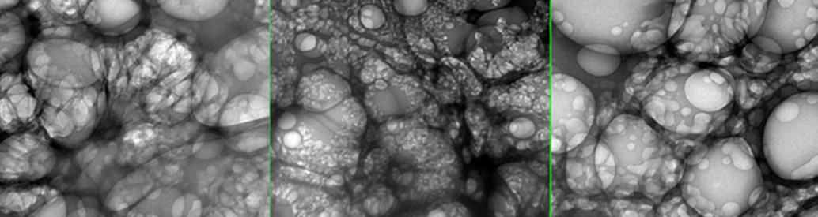
GRAPHENE OXIDE, 5G AND COVID
A PRESENTATION BY FTWPROJECT.COM

Slide 2

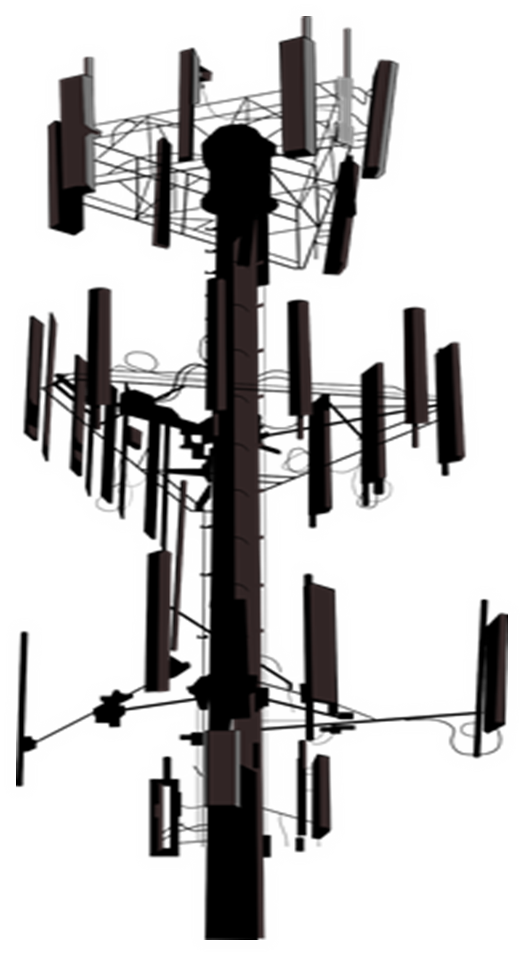
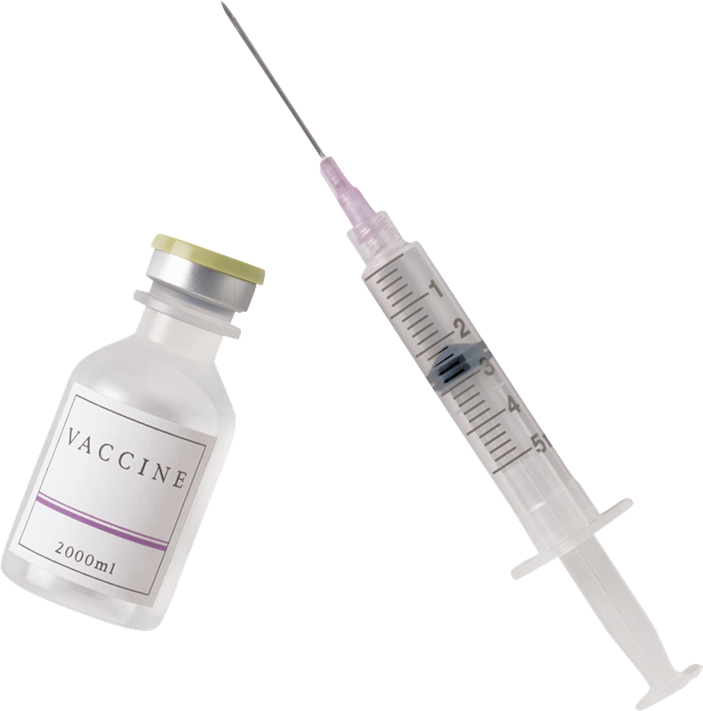
GRAPHENE OXIDE, 5G AND COVID
SUMMARY
PART 1
-Graphene Oxide Explained. They are trying to kill you with a 160 year old poison.
Graphene vs. Graphene Oxide- why its important to know the difference
How is Graphene Oxide made?
What can Graphene Oxide Do? Its unique properties is why they put it in everything.
-Graphene Oxide is the main ingredient in DARPA Hydrogels
-What’s in the Covid shots? GO, Steel, Parasites and more: New Photos
-Graphene Flagship. The money and power behind the agenda.
-Before Covid, a study was done: How much GO can they put in a human before fatal?
-Graphene Oxide in the PCR tests, in the masks, in the water supply and in chemtrails.
-How Graphene Oxide works with 5G
WWW.FTWPROJECT.COM

Slide 3
GRAPHENE OXIDE, 5G AND COVID
SUMMARY
PART 2
-Spike Proteins, Graphene Oxide, Covid Shots Explained
-Health concerns of Graphene Oxide
-Its the same symptoms! GO poisoning, EMF Radiation Sickness, Covid
-Magnetism in those who got the shots explained. It’s the graphene oxide and other nanotech.
-Connection between 5G rollouts and the Covid Variants
-How to get graphene oxide out of your body
-Orgone Energy, EMF protection and Graphene Oxide
WE CAN BACK UP EVERYTHING WE SAY WITH SCIENTIFIC EVIDENCE
EXTENSIVE NOTES, ARTICLES, REFERENCE LINKS, STUDIES, VIDEOS AS WELL AS FREE TO USE GRAPHICS AND COPIES OF THIS SLIDESHOW ARE AVAILABLE AT OUR WEBSITE WWW.FTWPROJECT.COM
WWW.FTWPROJECT.COM

Slide 4
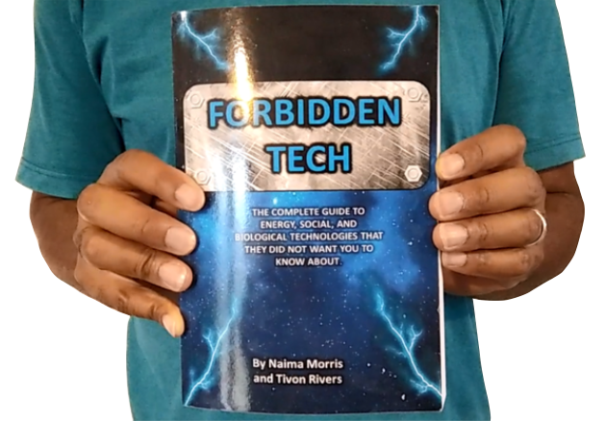
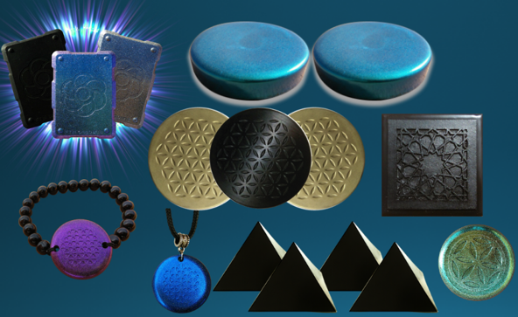

WHY WE DO WHAT WE DO
We are Christians, Engineers and Scientists. We feel it is our calling to help inform people about the technology that is being used against Gods creation. We have been monitoring the news on 5G, Covid Vaccine related issues so that we can present them in a condensed summary to inform the public.
“I will give thee the treasures of darkness, the hidden riches of the secret places…” Isaiah 45:3
FORBIDDEN TECH: The complete guide to energy, social, and biological technologies that they did not want you to know about. (2017)
www.FORBIDDENTECH.WEBSITE
Handmade products orgone and shungite for EMF protection. Made by us in our workshop in Morocco. WWW.FTWPROJECT.COM
Online engineering academy for the co-development of researching and building DIY off grid energy devices. WWW.CLEANENERGYACADEMY.COM
WWW.FTWPROJECT.COM
Notes:
If time permits we’d like to play this 4 minute clip https://www.youtube.com/watch?v=aVj7_0A5-Ew

Slide 5
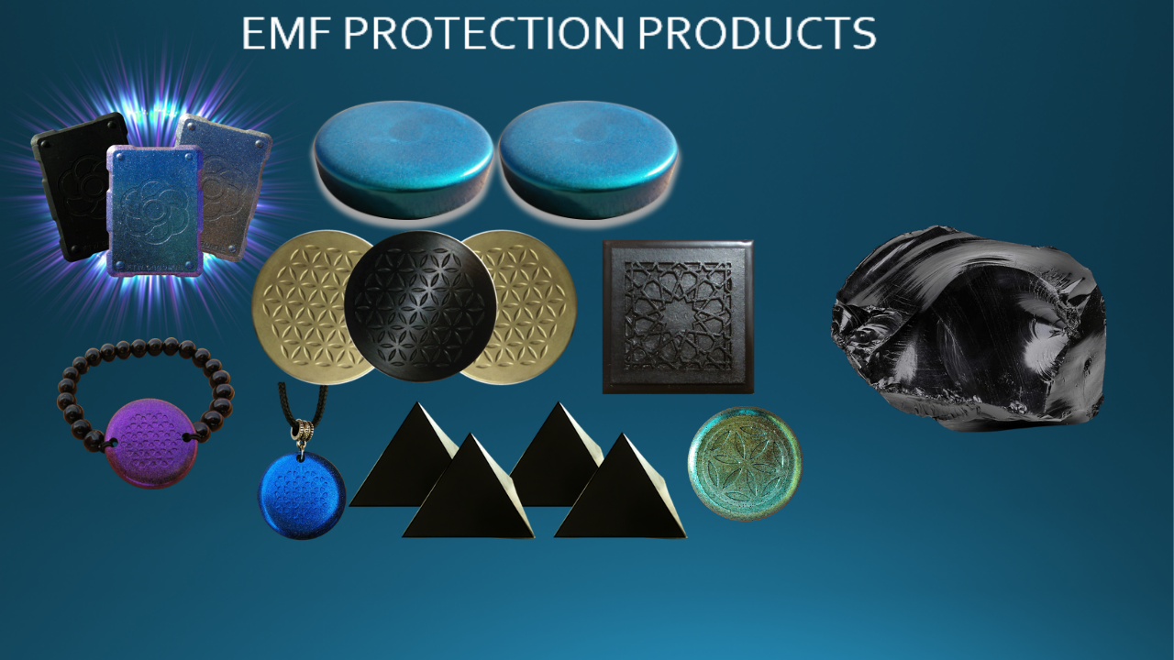
EMF PROTECTION PRODUCTS
MADE WITH SHUNGITE
HELP SUPPORT SGT REPORT BY SHOPPING FROM THIS LINK: https://www.ftwproject.com/ref/6/
WWW.FTWPROJECT.COM
Notes:
While we are describing the products we’d like to play this three minute video showing how we make the products: https://www.youtube.com/watch?v=k0ti-R0dEfQ

Slide 6
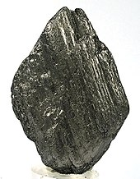
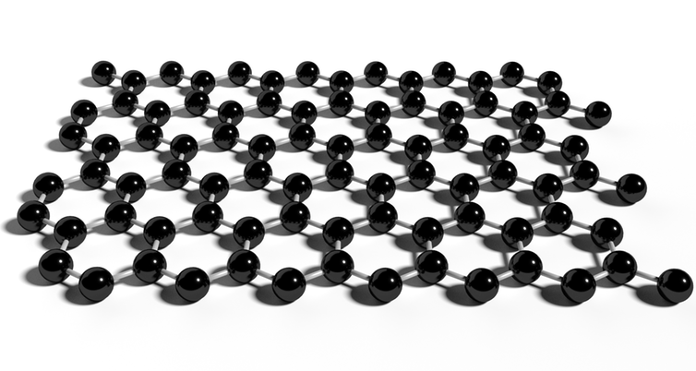
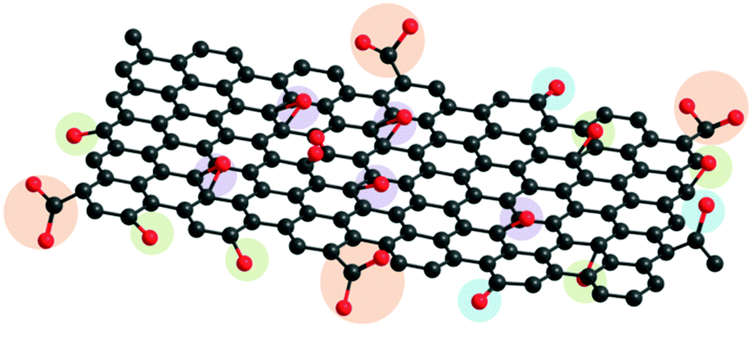
Graphite
STEP 1
STEP 2
Graphene Oxide
Exfoliate to get
Graphene
Oxidize
to get
A natural form of carbon
“DISCOVERED”
IN 2004?!?!
DISCOVERED IN 1859
( a known poison according to its Wikipedia page)
THE GRAPHENE INDUSTRY TROJAN HORSE
FOR A 160 YEAR OLD KNOWN POISON?
WWW.FTWPROJECT.COM

Slide 7
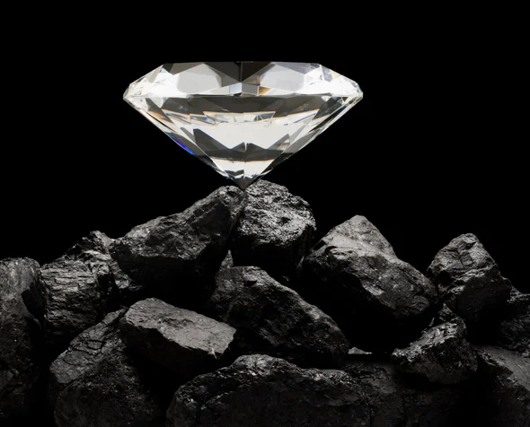
GRAPHITE BASICS: UNDERSTANDING CARBON
-Has the elemental symbol of 3 and an atomic number of 6
-Carbon-12 (one of two stable isotopes) is composed of 6 protons, 6 neutrons and 6 electrons in all diverse organic compounds and has the unusual ability to form polymers at commonly encountered temperatures on earth
-4th most abundant element in the observable universe & 15th most abundant in the Earth’s crust
-It is the second most abundant element in the human body by mass (about 18.5%) after oxygen.
-It is readily able to bond with other carbon atoms to form allotropes with unique properties, a form of the element that has a distinctly different molecular structure to another form of the same element. Physical and electrical properties are determined by different structural modifications of the same element alone! (example diamond vs. graphite)
-Carbon forms vast amount of compounds, more than any other element ( about 10 million compounds to date, both organic; limestones, dolomites & CO₂ and inorganic; coal, peat, oil, etc.) Thus, carbon has been referred to as the “King of Elements”
Note: Carbon nanotubes may or may not contain graphene
WWW.FTWPROJECT.COM

Slide 8
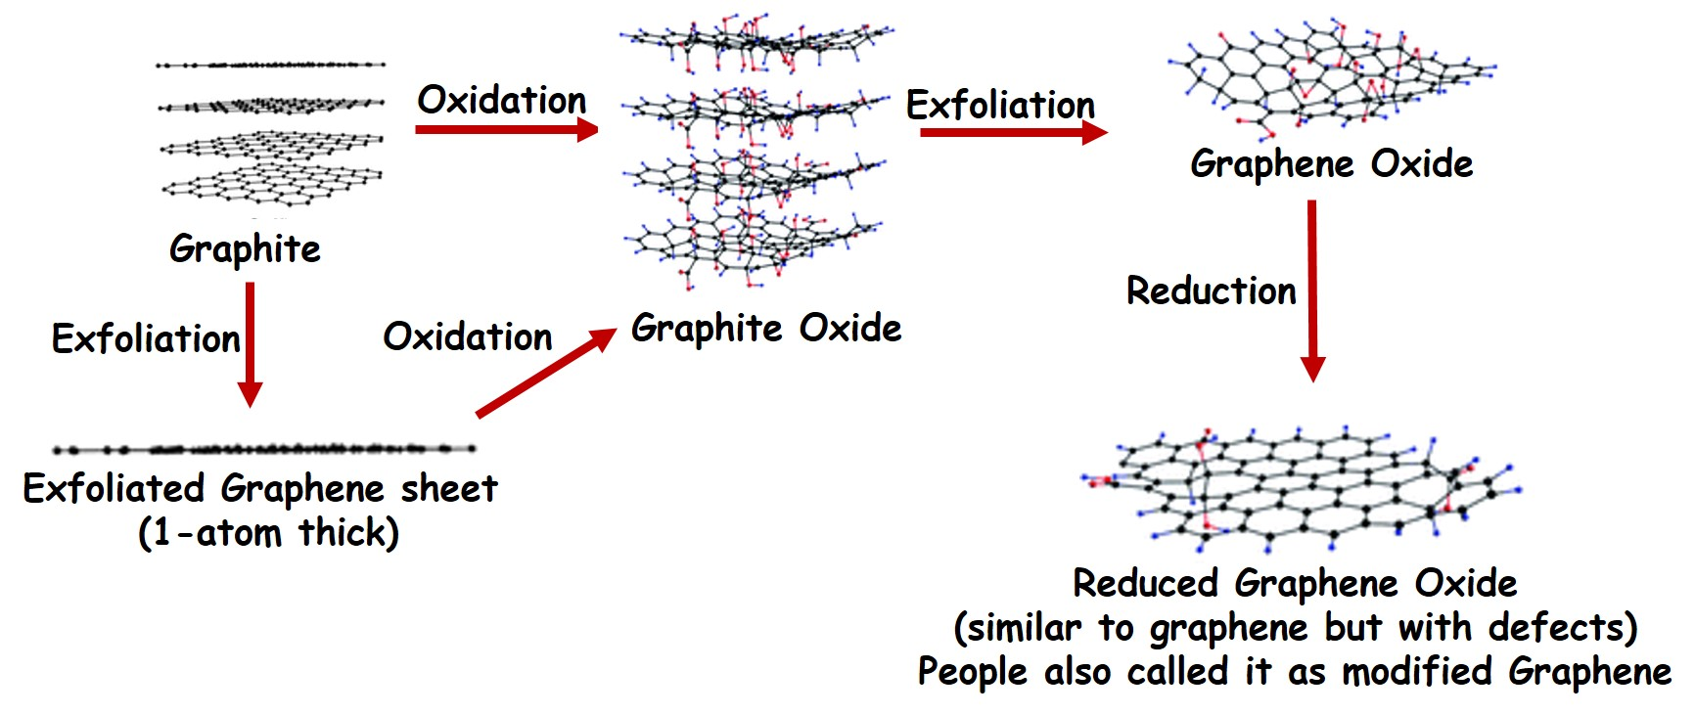
How is Graphene and Graphene Oxide Made?
WWW.FTWPROJECT.COM

Slide 9
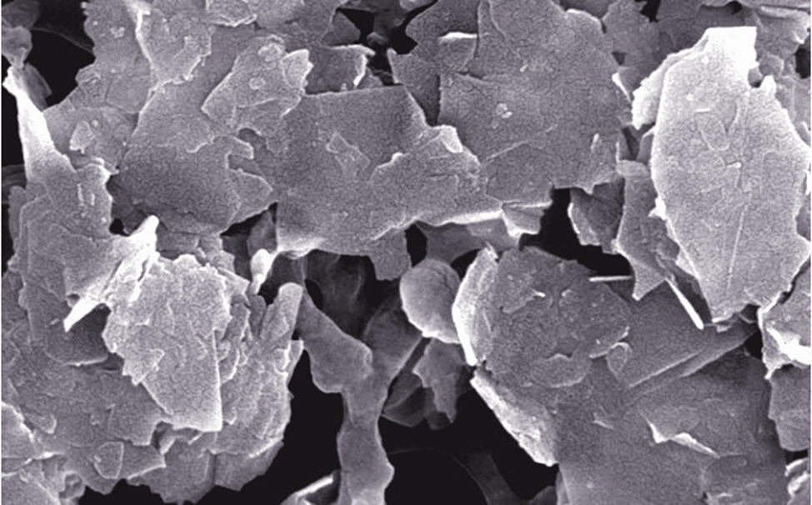
What is Graphene?
Graphene is a single layer of carbon atoms, tightly bound in a honeycomb lattice. It is an allotrope of carbon.
According to the official narrative:
“Discovered” in 2004 when researchers at University of Manchester isolated a single plane of graphite (graphene) using a kind of scotch tape.
This 2D material revealed properties that lend to a number of applications in electronics, remote sensing, medicine (in graphene oxide form), quantum computing:
It is stronger than diamond yet flexible and transparent
Graphene conducts heat and electricity and superconductor efficiencies!
Its electronic properties make it highly sensitive to the absorption of molecules such as CO, NO, NO2, and NH3. Research has indicated that this sensitivity can be increased by 100 fold with addition of Boron.
Graphene has made possible the development of electron-spin based quantum computing. Many types of graphene components are in development to test various quantum computing qubit models.
Water filtration and purification (highly absorbent used in oil spill cleanups at only a fraction of the weight)
WWW.FTWPROJECT.COM

Slide 10
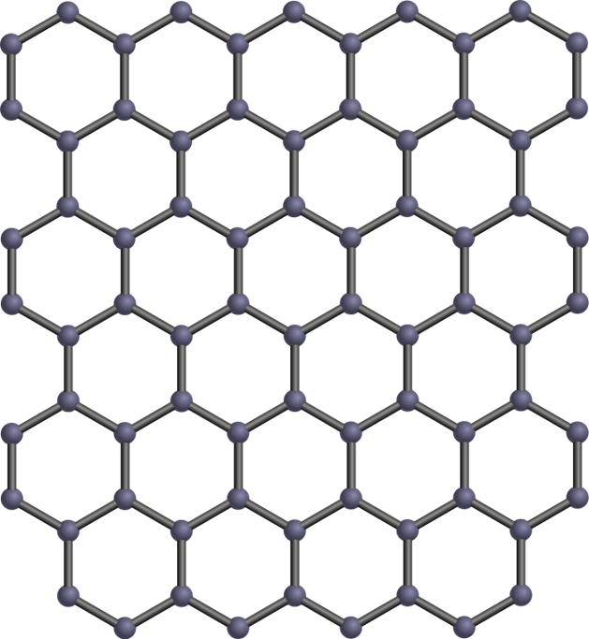
Properties and Uses for Graphene
Revolutionary supercapacitor technology and antimicrobial devices using laser etching fabrication
Strengthen different composites including human bone implants
Magnetically-driven nano-scale human bio-sensor and graphene micro-motor drug delivery research – “Graphene micromotors spin forward” –(video in blog post)
Strongly electrically and mechanically reactive to external electrostatic and RF radiation (Teslaphoresis) - “Nanotubes assemble rice introduces Teslaphoresis” (video in blog post)
Graphene synthesis in bulk is still challenging even though it can be made by the garage researcher using Laser-Induced Method or Flash method. Quality of Graphene fabrication is proportional to the cost, but is an unregulated market and open to lack of quality control and fraud
WWW.FTWPROJECT.COM

Slide 11
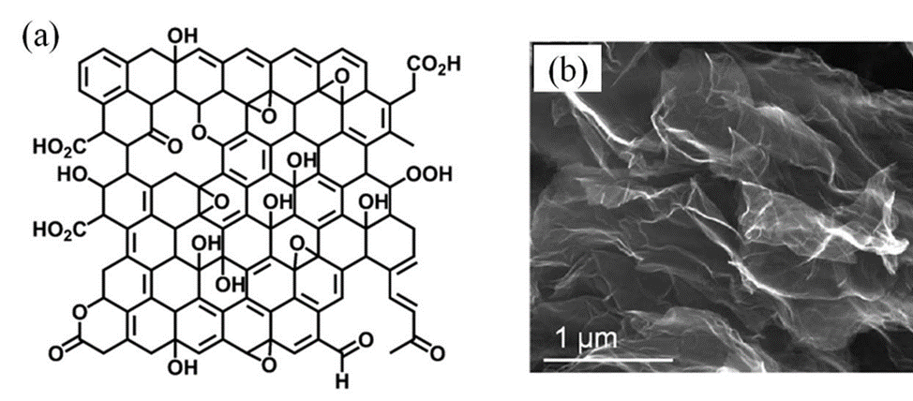
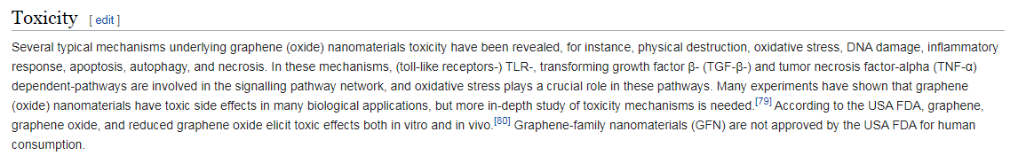
What is Graphene Oxide?
Graphene oxide (GO) is and oxidized form of graphene with oxygen molecules (ie. OH, CO, COOH, HO, etc.) attached on the surface (called functional groups).
Discovered in 1859
GRAPHENE OXIDE 160 YEAR KNOWN POISON !!!
“Oops” they forgot to scrub the Wikipedia page
This is why they don’t want to disclose what’s in the shots.
WWW.FTWPROJECT.COM

Slide 12
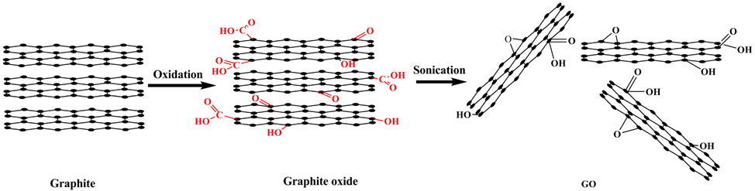
Why Graphene Oxide is Used in the Bio-Medical Industry
(even though it shouldn’t be):
The type of oxygen-based molecules attached to graphene oxide determines its unique properties and function to the graphene lattice, and why it has been researched in the biotech industry.
Graphene oxide production is relatively easier to produce on large scales compared to graphene. It contains semi-conducting properties proportional to the level of oxidation of the graphene oxide. It’s hydrophilic (attracted to water) and has good dispersibility in an aqueous environment.
Applications for Graphene and Graphene Oxide include:
Water filtration
Covalent functionalization (drugs, polymers, fluorescent tags)
Bio-devices, biosensors, human tissue scaffolds, drug delivery and gene therapy vectors
Energy Storage for ultracapacitors and batteries cathode/dielectric interface
Enhanced fluid separation for passive porous membrane filters
Claimed GO shows excellent DNA absorption properties and ‘biocompatiblity’. DNA binding to GO is found to be very stable and reversible. 6 - (conflicting studies)
WWW.FTWPROJECT.COM

Slide 13


Properties of Graphene Oxide
(or why they are REALLY using it in Bio-Medical Industry)
-Stimulated / controlled by EMF frequencies, specifically those found in 5G
-multiplies when electronically stimulated
-transparent
-LUCIFEROUS-bioluminescence
-magnetism
-passes through the blood brain barrier
- extremely strong
-can be used to manipulate neural pathways in the brain.
THIS IS WHAT THEY ARE PUTTING IN YOUR BODY!!
(VIEW IN SLIDESHOW MODE FOR ANIMATION)
WWW.FTWPROJECT.COM

Slide 14

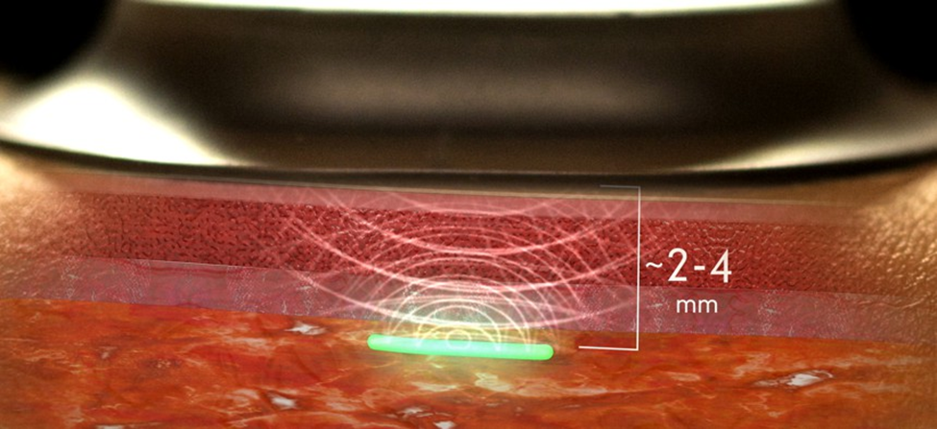
From: A Military-Funded Biosensor Could Be the Future of Pandemic Detection
There are THOUSANDS of peer reviewed scientific studies and articles discussing conductive hydrogels. We’ve put together a short list of some relative studies as backup documentation.
Summary of Hydrogel & Quantum Dot Nanotechnology Characteristics-Click to Download
WWW.FTWPROJECT.COM

Slide 15

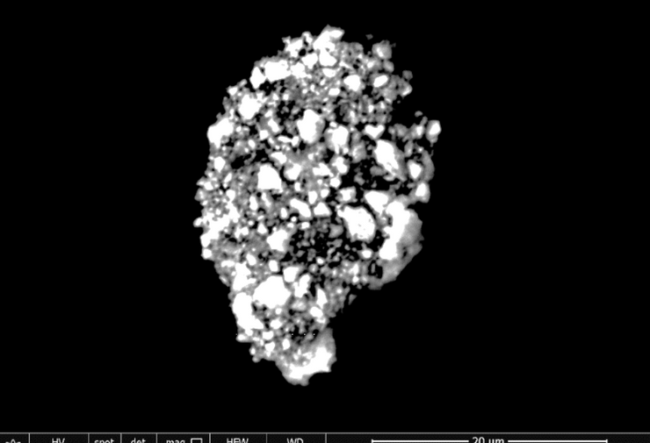
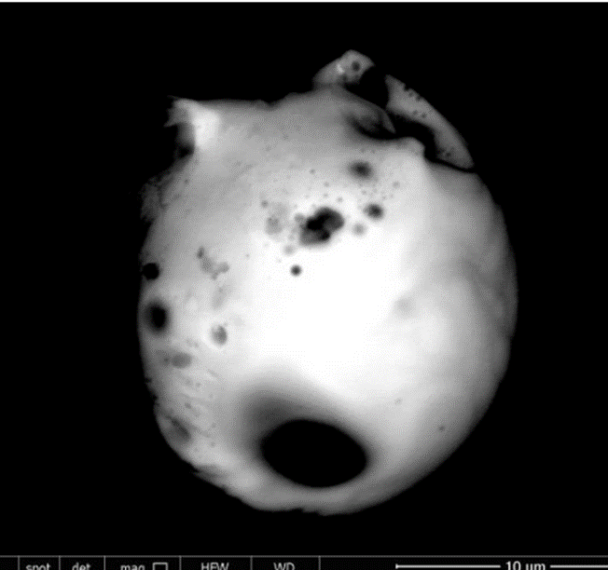
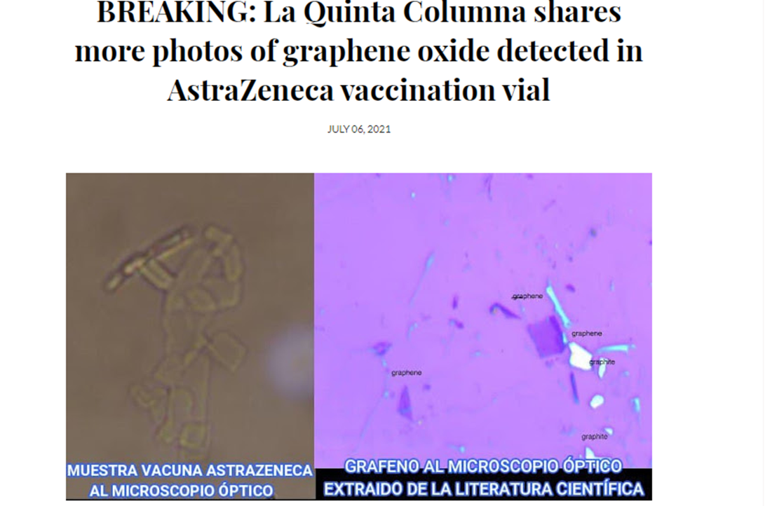
WHATS IN THE COVID SHOTS? GRAPHENE OXIDE, STEEL, PARASITES AND MORE
GRAPHENE OXIDE FOUND IN ALL THE COVID SHOTS
J&J
MODERNA
ASTRA ZENECA
PFIZER
Photo’s from lab work done on Covid Vaccine Vials from Dr. Robert Young and La Quinta Columna
Many other independent lab teams are replicating this work, in the true scientific method.
WWW.FTWPROJECT.COM

Slide 16
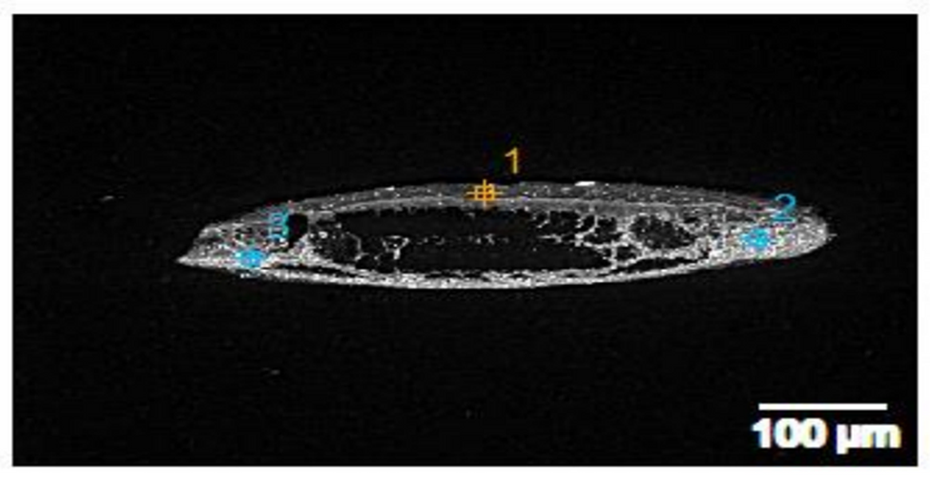
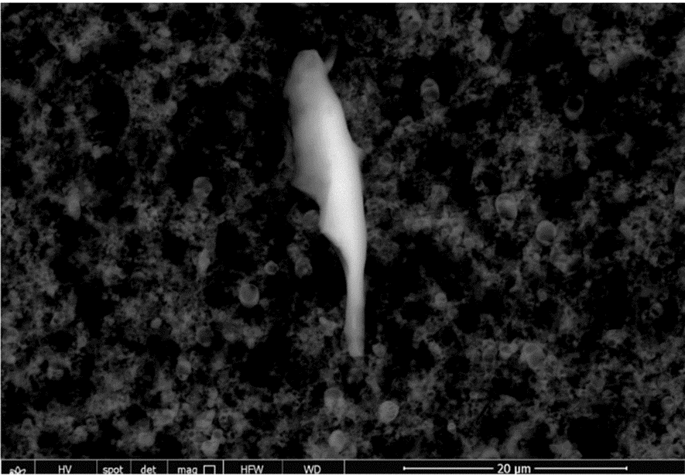

WHATS IN THE COVID SHOTS? GRAPHENE OXIDE, STEEL, PARASITES AND MORE
Stainless Steel found in Astra Zeneca
WWW.FTWPROJECT.COM

Slide 17
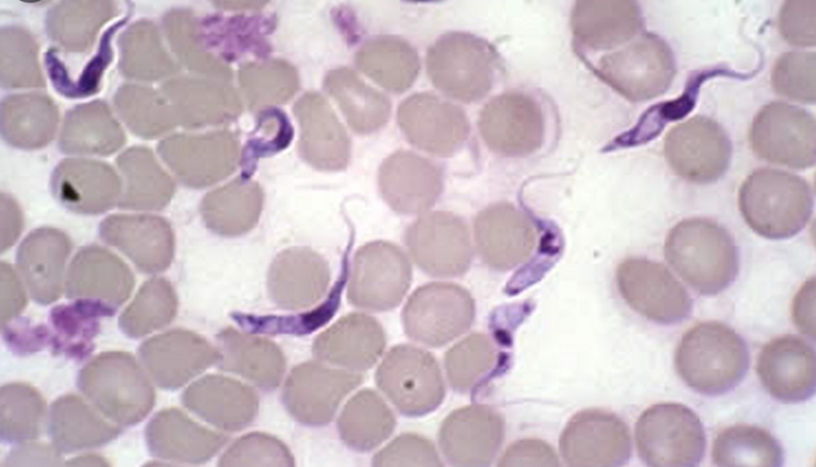
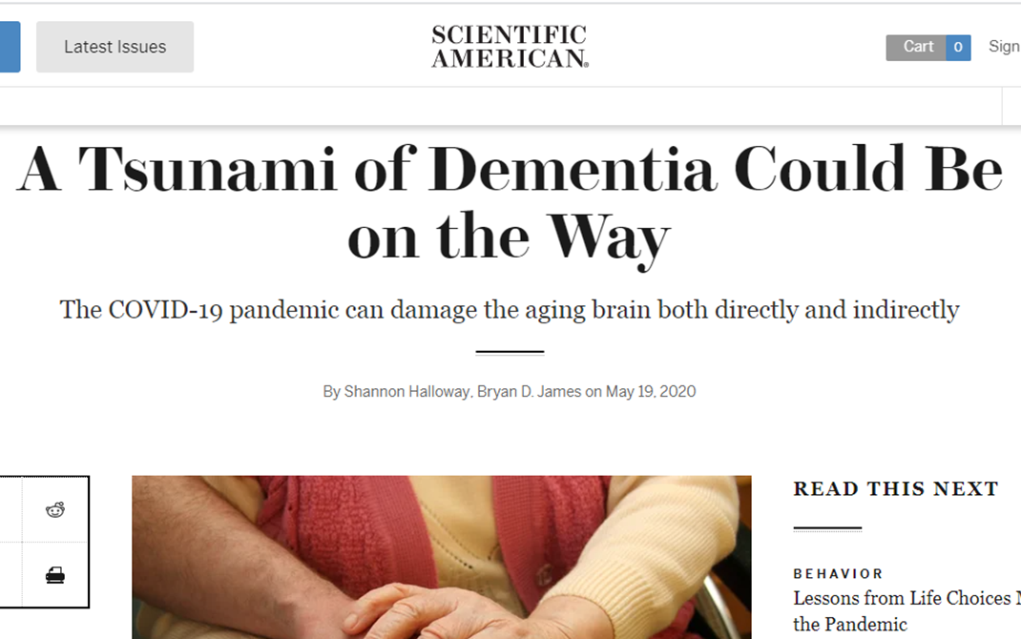
WHATS IN THE COVID SHOTS? GRAPHENE OXIDE, STEEL, PARASITES AND MORE
Trypanosoma Parasite in human blood.
This parasite is known as
“Sleeping Sickness”
According to the CDC website, symptoms are: Fever, severe headaches, irritability, extreme fatigue, swollen lymph nodes, and aching muscles and joints are common symptoms of sleeping sickness. Some people develop a skin rash. Progressive confusion, personality changes, and other neurologic problems occur after infection has invaded the central nervous system.
THEY WERE EXPECTING THIS
BECAUSE THEY PUT IT IN THE SHOTS!
WWW.FTWPROJECT.COM

Slide 18
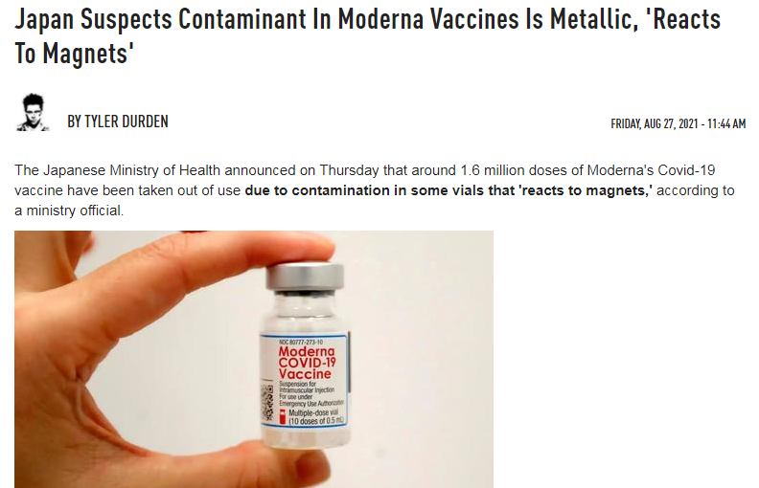
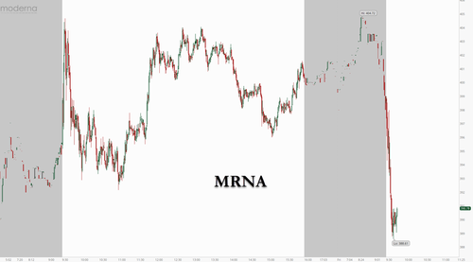
What’s in the Covid Shots?
Japanese government recalls Moderna vaccines because of a “metallic substance” that is magnetic and is killing people.
This is what happened to Moderna Stock afterwards:
WWW.FTWPROJECT.COM

Slide 19
Re-branded with a
different name
TROJAN HORSE
Poison Injected into billions of people without their informed consent
Funded by Globalists
Multi-Billion
$$
160+ Years of experimentation
with invisible known poison
2013
Graphene Flagship Founded
1859
2004
Graphene
“Discovered”
(patentable
Trade secret)
2021
Covid “Vaccine” Rollout
Graphene Oxide Discovered
(unpatentable)
2010
Nobel Prize Awarded
WWW.FTWPROJECT.COM

Slide 20

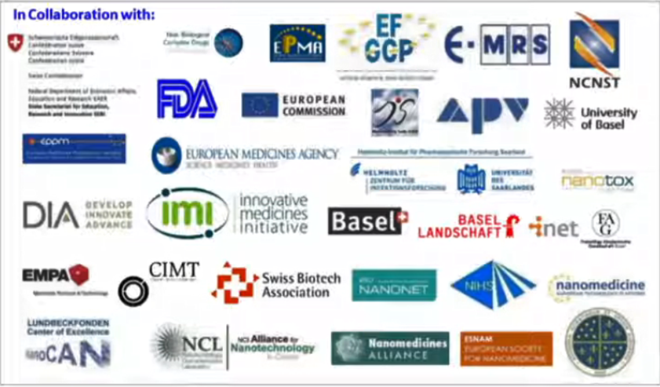
SUMMARY
-text
These are only some of the many organizations and governments that are a part of the “Graphene Flagship” Multibillion $ Project.
“GRAPHENE WILL CHANGE THE WORLD!
GRAPHENE WILL BE IN EVERYTHING!!”
WWW.FTWPROJECT.COM

Slide 21
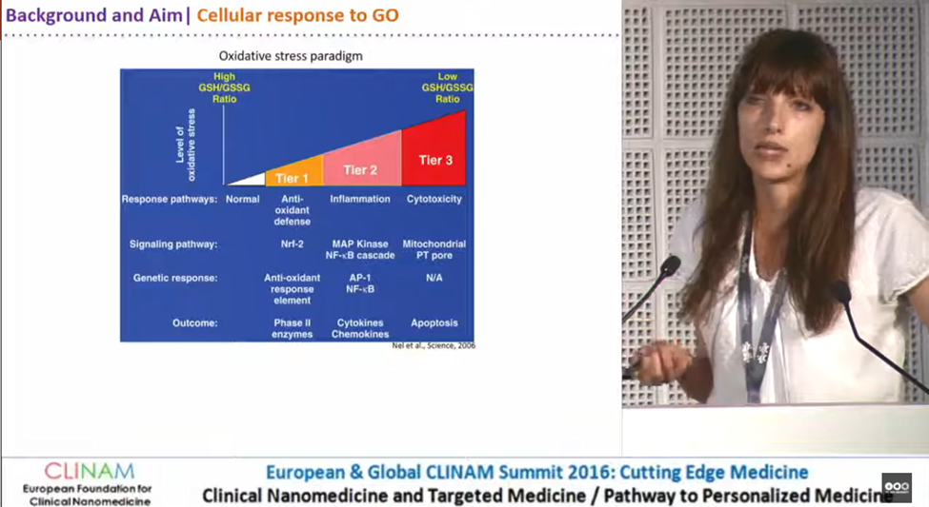
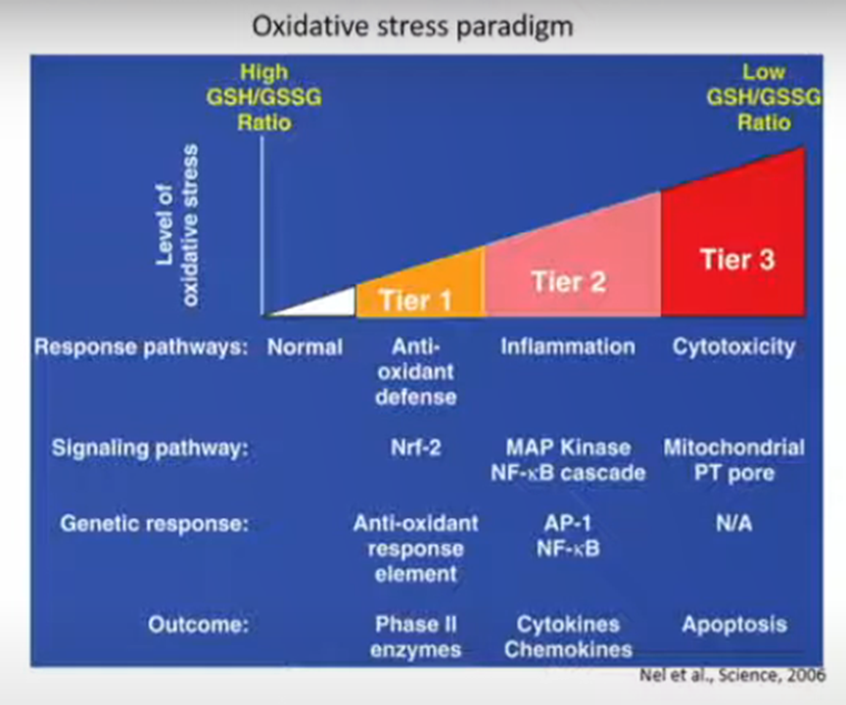
2016 “Cellular Responses to Graphene Oxide Sheets” Dr. Sandra Vranic
PROOF THEY KNEW THIS WOULD KILL PEOPLE BEFORE THEY INJECTED BILLIONS WITH THIS TOXIC SUBSTANCE IN COVID SHOTS.
Special thanks given to the “Graphene Flagship” in the presentation
AFTER GO was discovered in the Covid Vaccines, people found this presentation and the comments section exploded. It will probably be removed from Youtube soon, we saved the video file and screen shots of the comments.
WWW.FTWPROJECT.COM

Slide 22
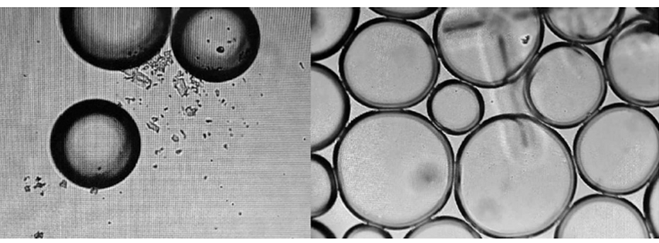
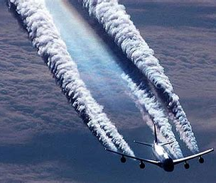
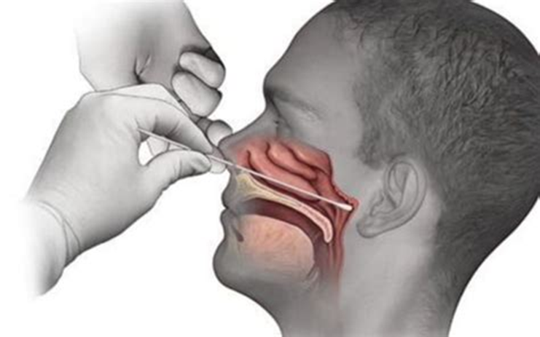
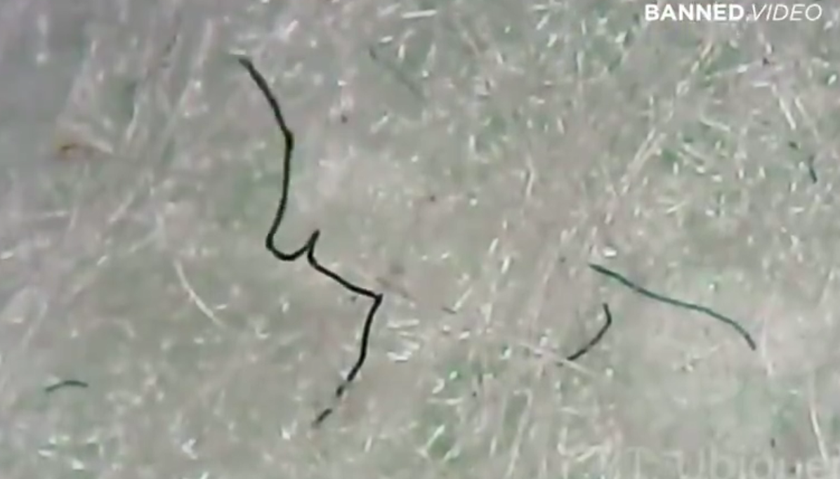
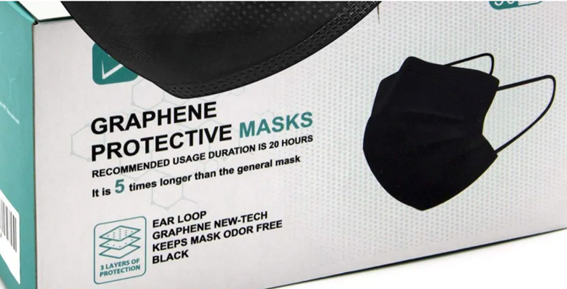
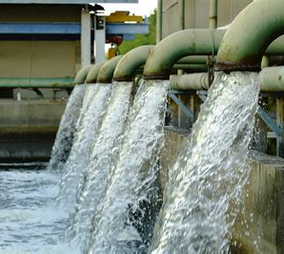

Graphene Oxide used in chemtrails (studies and patents)
Graphene Oxide found in PCR Tests
(lab studies)
Graphene Oxide used in water supply
(major contract in UK)
Graphene Oxide found in masks
(Canada and Spain Gov recall and independent findings)
WWW.FTWPROJECT.COM

Slide 23
How Graphene Oxide Works with 5G
Graphene oxide is activated by electromagnetic frequencies (EMF), specifically the frequencies that are part of the 5G spectrum.
All materials have what is known as an electronic absorption band. An absorption band is a range of wavelengths, frequencies or energies in the electromagnetic spectrum which are characteristic of a particular transition from initial to final state in a substance. This is a specific frequency above which a substance is excited and oxidizes very quickly.
Frequencies beamed at human beings that have a build up of graphene oxide in their body can cause the graphene oxide to multiply very rapidly, breaking the balance of glutathione and causing a cytokine storm in a matter of hours.
THIS IS WHAT THEY ARE PUTTING IN YOUR BODY!!
(VIEW IN SLIDESHOW MODE FOR ANIMATION)
This is why EMF protection and graphene oxide removal are an essential way for you and your family to fight back.
MUCH MORE ABOUT THIS IN PART TWO!
WWW.FTWPROJECT.COM

Slide 24
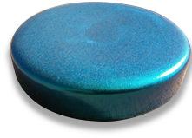
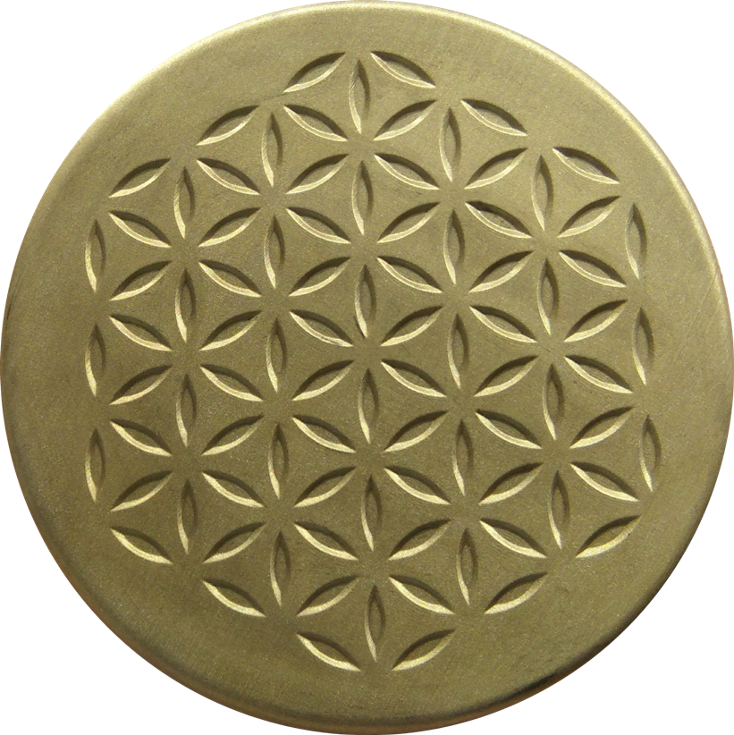
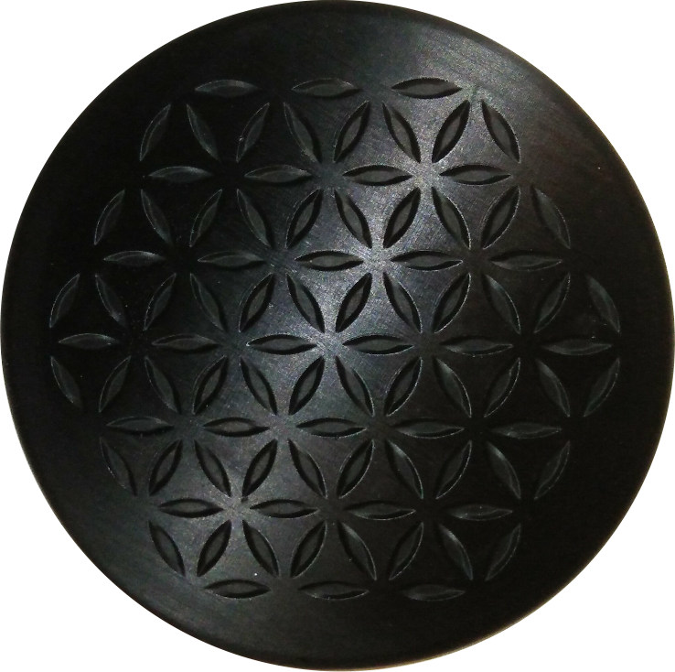

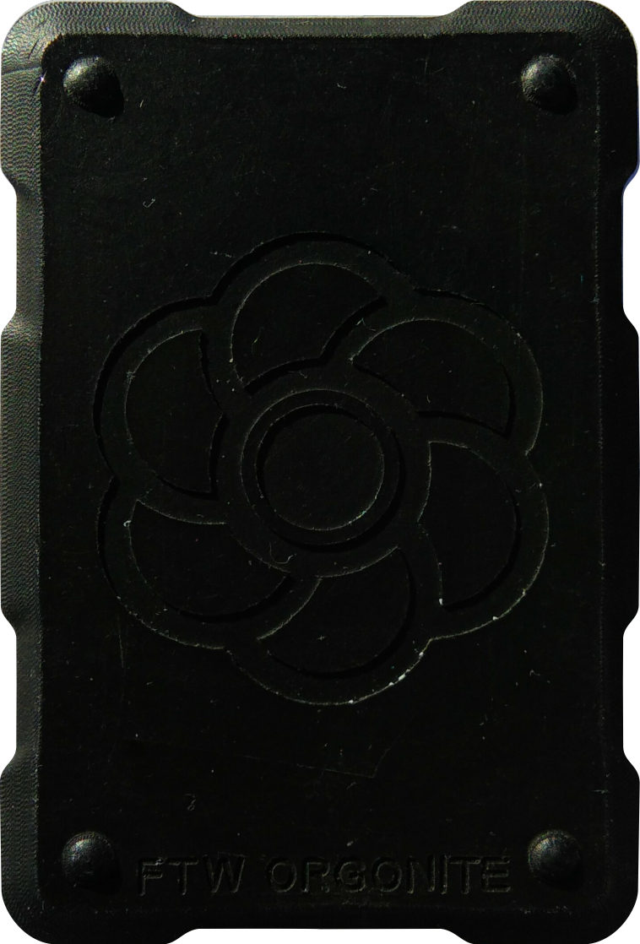
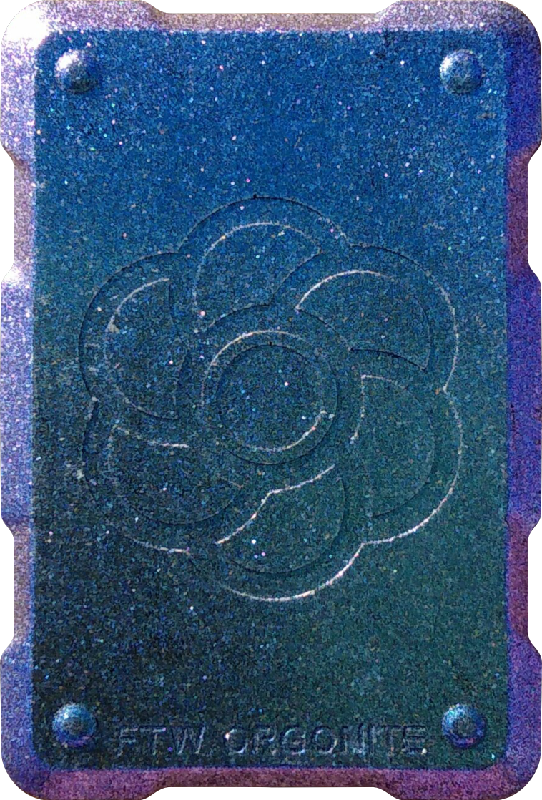
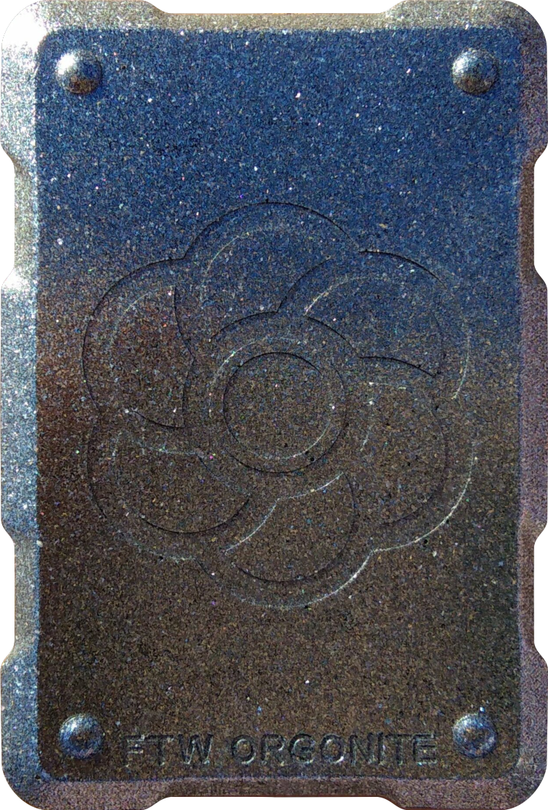
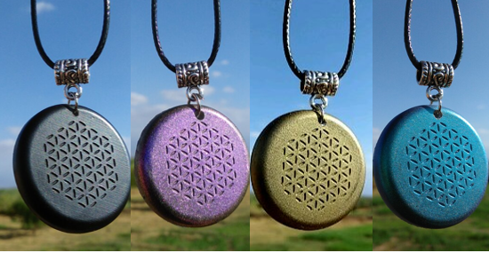
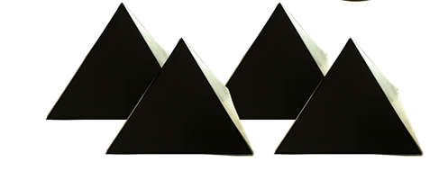
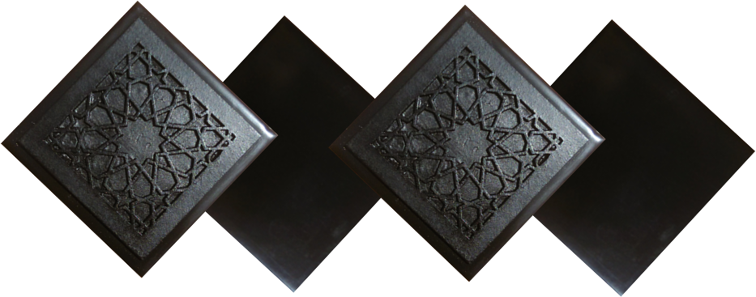
ABOUT OUR EMF PROTECTION PRODUCTS
HELP SUPPORT SGT REPORT BY SHOPPING FROM THIS LINK: https://www.ftwproject.com/ref/6/
SLEEPING PODS For a good nights sleep
CHARGE PLATES for use around the home, to preserve food and more
PHONE SHIELDS to put on your cell phone, laptop and routers
PENDANTS for personal emf protection on your body
PYRAMIDS for gridding your home / property / garden for emf protection on a large scale
TILES for incorporating emf protection into construction projects
WWW.FTWPROJECT.COM

Slide 25
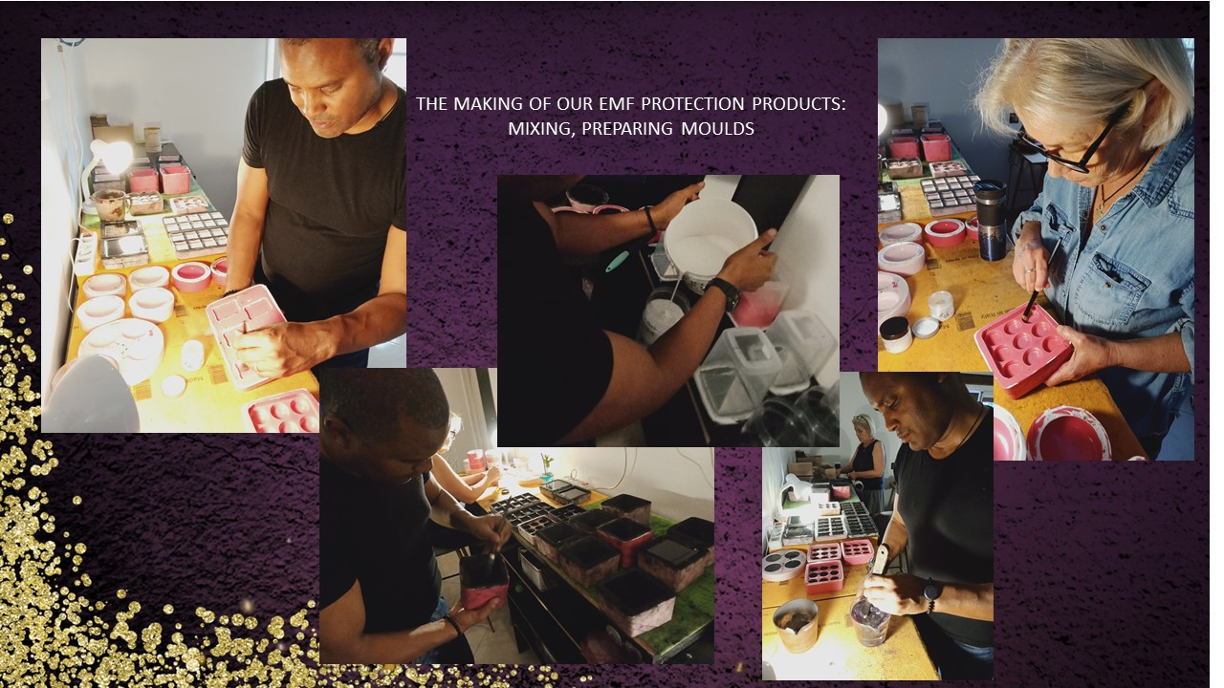
WWW.FTWPROJECT.COM

Slide 26
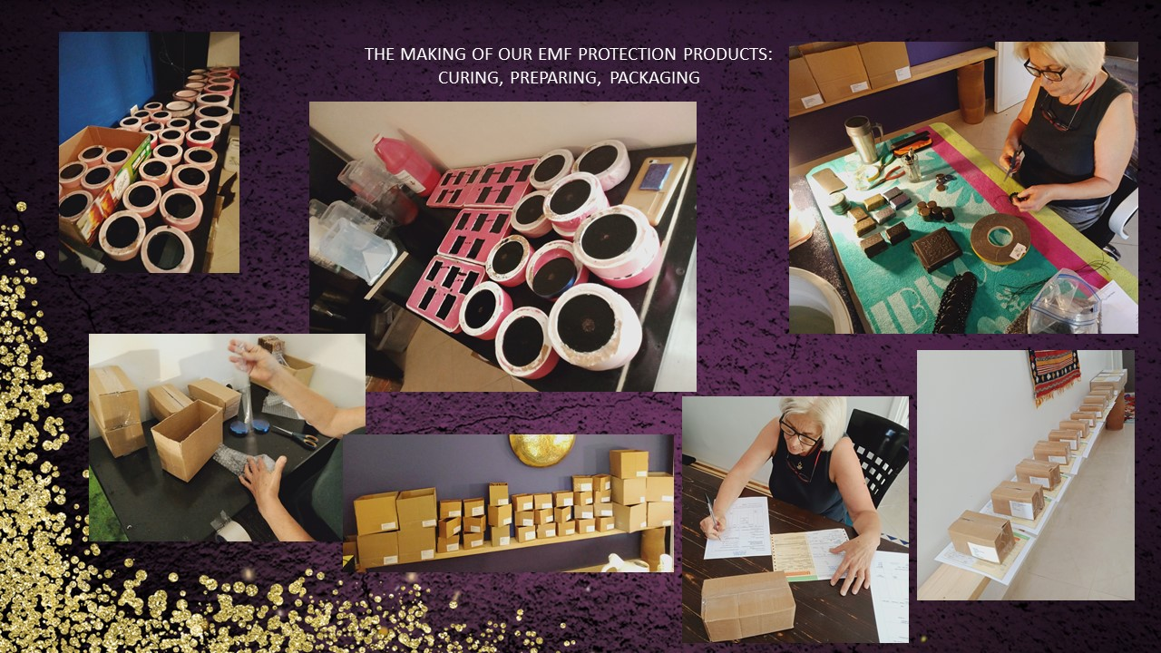
WWW.FTWPROJECT.COM

Slide 27
COMING UP IN PART 2!
SUMMARY
PART 2
-Spike Proteins, Graphene Oxide, Covid Shots Explained
-Health concerns of Graphene Oxide
-Its the same symptoms! GO poisoning, EMF Radiation Sickness, Covid
-Magnetism in those who got the shots explained. It’s the graphene oxide and other nanotech.
-Connection between 5G rollouts and the Covid Variants
-How to get graphene oxide out of your body
-Orgone Energy, EMF protection and Graphene Oxide
WWW.FTWPROJECT.COM

Slide 28
GRAPHENE OXIDE, 5G AND COVID
SUMMARY
PART 2
-Spike Proteins, Graphene Oxide, Covid Shots Explained
-Health concerns of Graphene Oxide
-Its the same symptoms! GO poisoning, EMF Radiation Sickness, Covid
-Magnetism in those who got the shots explained. It’s the graphene oxide and other nanotech.
-Connection between 5G rollouts and the Covid Variants
-How to get graphene oxide out of your body
-Orgone Energy, EMF protection and Graphene Oxide
WE CAN BACK UP EVERYTHING WE SAY WITH SCIENTIFIC EVIDENCE
EXTENSIVE NOTES, ARTICLES, REFERENCE LINKS, STUDIES, VIDEOS AS WELL AS FREE TO USE GRAPHICS AND COPIES OF THIS SLIDESHOW ARE AVAILABLE AT OUR WEBSITE WWW.FTWPROJECT.COM
WWW.FTWPROJECT.COM

Slide 29
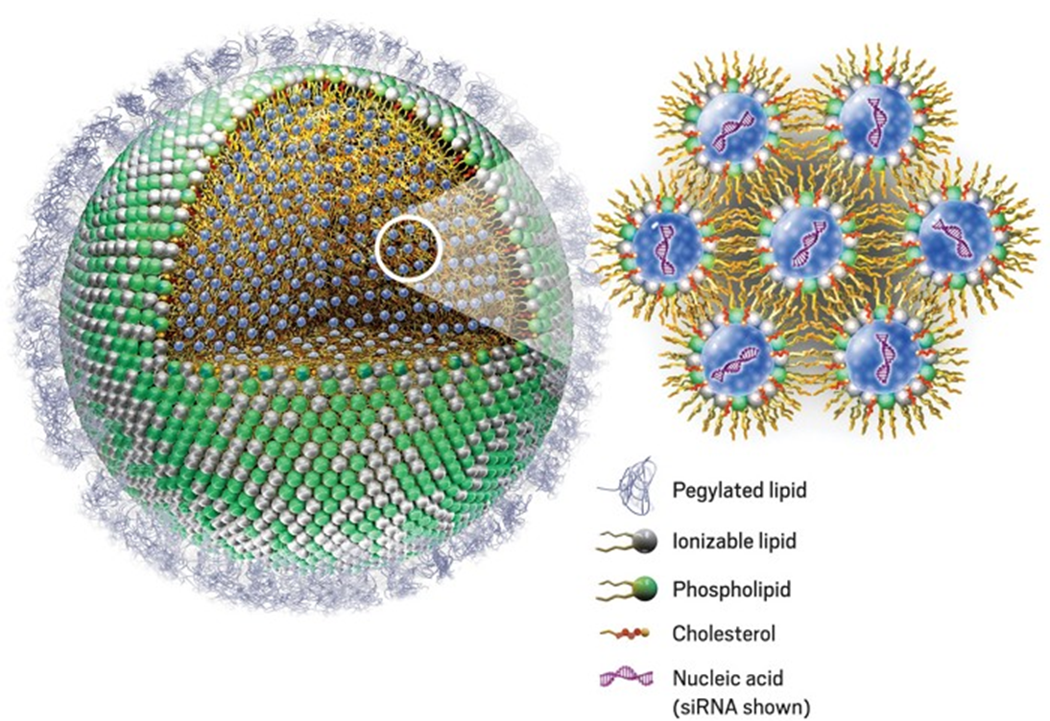
Spike Proteins, Graphene Oxide, Covid Shots Explained
Covid Shots – contain mRNA which causes your body to become a spike protein production factory.
Graphene Oxide- used in the shots to surround the mRNA in a protective biosphere in order to get it into the cells. After it delivers this, the graphene oxide stays in the body and causes many diseases and sickness. It also multiplies when stimulated by EMF.
Spike Proteins- are being continuously generated in your body due to the shot, and they cause many problems and disease, including prion disease in the old and infertility in the young. They also cause “shedding” of the vaxxed to the non-vaxxed. New information is coming to light everyday about what these spike proteins are doing.
WWW.FTWPROJECT.COM

Slide 30

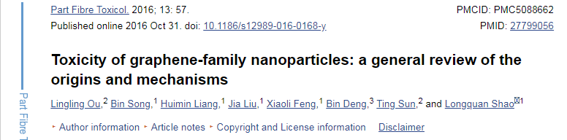
Health Concerns of Graphene Oxide
Graphene is poisonous to humans. Toxicity of Graphene Family Nanoparticles a general review of origins and mechanisms.
“This is a mass, uniformed, without consent global experiment. They have never been able to get this into humans on an experimental basis. No human subject review board would ever approve of protocols with this stuff in it.”
-Dr. Jane Ruby
Some of the symptoms
GO creates thromboses.
GO causes blood clots.
GO disrupts the immune system.
GO can trigger a cytokine storm.
GO toxicity can instigate pneumonia.
GO creates a metallic taste in the mouth.
GO causes inflammation of the mucous membranes.
GO produces a loss in the sense of taste and smell.
GO is magnetic (especially at the injection site.)
GO blocks detoxification in the body by blocking glutathione.
GO may be activated by 5G frequencies.
GO passes thru the blood-brain barrier.
WWW.FTWPROJECT.COM

Slide 31

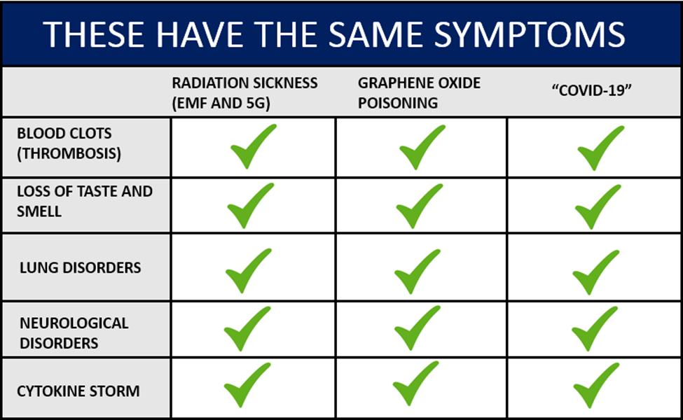
-Based on studies linked in blog post for each sickness
-Creation of MASS CONFUSION AND MISDIAGNOSIS ON PURPOSE!
-Everything gets diagnosed as COVID
-Covid Virus has never been isolated
WWW.FTWPROJECT.COM

Slide 32

Magnetism From the Shots Explained
Magnetism after the shots usually begins at the injection site, but then it moves through the body, usually towards the head.
Magnetism can be caused by a number of things:
(none of which should be legal as it is experimenting on humans)
-Graphene Oxide in the shots – becomes magnet with contact of hydrogen in the body
-Manipulative magnetic nanoparticles in the shots (link to study in blog)
-SPIONS – Superparamegnetic Iron Oxide Nanoparticles in the shots
(link to study in blog)
-EMFs stimulating inside of the body whatever is in the shot
Brittany Galvin
Magnetism and Vaccine Injury
from the Moderna Shot
See her story in blog post
Sharing of a personal story about this. People are sticking metal objects to themselves all over the world!
WWW.FTWPROJECT.COM

Slide 33
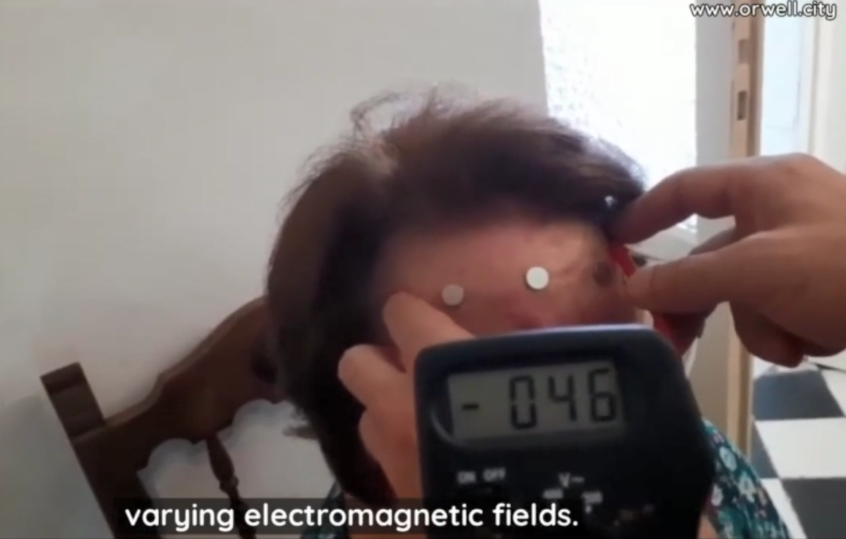

EMF’S AND MAGNETISM
Video: Ricardo Delgado from La Quinta Columna in Spain
shows result of magnetism and EMF on a person who had 2 Pfizer shots.
First is shown that 5 neodymium magnets are sticking to the forehead.
A multimeter measures fluctuating voltage coming from the subjects head. the difference in voltage coming from the subjects head. This shows that something outside of the body is inducing these voltage fluctuations. EMF is generating varying electromagnetic fields. Which is why there is repulsion and sometimes extraction of magnets.
An electromagnetic radiation detector pencil placed directly on the head of the twice jabbed Pfizer subject and it starts going off in specific areas of the head, showing that the Pfizer Jabs make you EMIT EMF!
This is precisely what we covered in our last presentation in regards to “shedding” one theory being that the shots were turning humans body into EMF emitters and that’s how they were transmitting illness to non vaxxed people.
WWW.FTWPROJECT.COM

Slide 34


Treatments to get rid of magnetism
Drug name: Suramin, but the natural name is Shikimic Acid or Shikimate. You can make your own tea with Star Anise / Pine Needles / Fennel. Link to recipe and explanation in blog post.
Zinc in combination with NAC
Dr. Ricardo from La Quinta Columna has been treating people with double Pfizer shots who are effected with magnetism. After these supplements they no longer have this symptom. Link for these supplements and dose recommendations in blog post.
WWW.FTWPROJECT.COM

Slide 35

The Rollout of 5G infrastructure has gone full steam ahead despite the “pandemic”
First Links to 5G and Covid:
Wuhan 5G Pilot City
Lombardy Italy 5G Pilot City
Princess Cruise Ships using 5G
NYC First to turn on 5G
Princess Cruise Ship with Covid Breakout
WWW.FTWPROJECT.COM

Slide 36


Dr. Magda Havas Ph.D did a study that compared the average number of cases, deaths and tests for Covid-19 per million population in states with and without 5G.
Dr. Havas found that the standardized testing for states with and without 5G was similar.
“Covid-19 cases per million are 95% higher and covid-19 deaths per million are 126% higher in states with 5G.”
A Spanish study proved that countries with 5G had 220% more COVID-19 infections than countries that had not deployed 5G.
“THE RESULTS OBTAINED DEMONSTRATE A CLEAR AND CLOSE RELATIONSHIP BETWEEN THE RATE OF CORONAVIRUS INFECTIONS AND 5G ANTENNA LOCATION.”
“THE CASE OF SAN MARINO IS PARTICULARLY SIGNIFICANT. IT WAS THE FIRST STATE IN THE WORLD TO INSTALL 5G AND THEREFORE, THE STATE WHOSE CITIZENS HAVE BEEN EXPOSED TO 5G RADIATION THE LONGEST, AND SUSPICIOUSLY, THE FIRST STATE IN THE WORLD WITH INFECTIONS. THE PROBABILITY OF THIS HAPPENING IS 1 IN 37,636.”
WWW.FTWPROJECT.COM

Slide 37


IS 5G BEING USED TO CREATE THE “VARIANTS”?
JUNE 4 – UK switches on 5G network in 9 coastal towns where all the people are going to be on holiday
JUNE 20– “Delta Variant” hits and shuts down all travel.
1-2 weeks later
BLAME INDIA!!
IS THIS HOW THEY ARE CAUSING SICKNESS TO CONTROL AND SHUT DOWN OUR SOCIETY?
WWW.FTWPROJECT.COM

Slide 38


IS 5G BEING USED TO CREATE THE “VARIANTS”?
JUNE 30 – 5G experimental network turned on in France
JULY 7– “Delta Variant” wave peaks in France
1-2 weeks later
BLAME The UK!!
You can do this research yourself, compare 5G latest news and rollout dates and “variant” narratives according to geographic locations.
WWW.FTWPROJECT.COM

Slide 39

This is a holistic approach of using several different methods simultaneously for the best effect. Including, specific supplements to degrade the graphene oxide in the body, and controlling EMF’s in the environment to minimize graphene oxide activation. This information comes from several sources and is based on scientific studies. Links are reference in the blog post.
High Glutathione levels in the body= good immune system
When Graphene Oxide levels exceed glutathione levels our immune system collapses and triggers a cytokine storm.
Graphene Oxide levels can rapidly increase when it is activated by EMF’s. This can rapidly trigger the disease.
NAC- “N-acetylcysteine” is a supplement that causes the body to product glutathione. It is the precursor. The FDA is trying to ban NAC after it has been discovered that people are using it to recover from Covid symptoms.
Zinc and NAC degrade graphene oxide in the body.
Other supplements that can be taken in the removal of graphene oxide are:
Astaxanthin, Melatonin , Milk Thistle, Quercetin, Vitamin C , Vitamin D3
More information on these protocols / doses can be found at our link in the blog post.
WWW.FTWPROJECT.COM

Slide 40

ELECTOMAGNETIC FREQUENCY (EMF) PROTECTION
Since graphene oxide is activated by EMF, you want to create a protective barrier in your immediate environment that mitigates the EMF so that it does not activate the graphene oxide.
-Don’t live near towers crowded cities
-Turn off Wifi at night
-Don’t use smart meters or smart appliances
-Use orgone energy devices to clean up the EMF in your environment
WWW.FTWPROJECT.COM

Slide 41



Orgone Energy, EMF Protection and Graphene Oxide
In the 1930’s a discovery was made that can be applied today to help with EMF protection. During a series of experiments, the late Dr. Wilhelm Reich discovered that living samples placed within containers made from alternating layers of steel and non-conductive organic material were able to harness healthy ‘cosmic energy’ from the environment. He called this energy ‘orgone’.
These orgone accumulators and had the ability to:
– Preserve blood samples for longer periods of time
– Sprout healthier plant seedlings
– Provided pain relief for his patients who sat inside them.
Today, instead of using sheets of steel and plastic we use a composite made from a blend of; iron oxide, steel, brass, shungite and crystal powders encased in epoxy resin. The end result is a harmonizer that is able to transform the harmful wireless fields from; cell towers, smart meters, smartphones, internet router and your television, into more beneficial energy for you and your plants and pets.
WWW.FTWPROJECT.COM

Slide 42



Reich Blood Test- Shows dying red blood cells and life force or orgone energy (blue light)
When a red blood cell has defects and starts to die, they can develop something called Acanthocyte formation, where multiple spiky like projections of varying lengths protrude from the cell. These slides above are showing the bionic disintegration of living and non-living matter. The healthier cell has a more solid membrane with a blue light around it. This blue light is actually the lifeforce or “Aura” of the cell. It is what Reich called “orgone” energy. As the cell dies and disintegrates, the membrane wall forms spikey protrusions coming out of it.
WWW.FTWPROJECT.COM

Slide 43



Recent Blood work samples from Dr. Robert Young showing graphene oxide damage of red blood cells
Dr. Robert Young’s conclusion is that what we are seeing in these blood cells is from the effect of EMF radiation poisoning and graphene oxide poisoning. He calls the formation of the blood cell membranes “The corona effect” and the “Spike protein effect”. The graphene oxide based nanoparticles used in the Covid shots is designed to penetrate the membrane of the cells in order to get the mRNA into them. This constant penetration of the cell membrane wall could be what is causing these membrane deformities. This looks identical to the behavior of the dying blood cells in the Reich Blood Test experiment. What we are seeing here are cells that have been poisoned and are dying. We also see the formation of the spike protein in the last slide.
WWW.FTWPROJECT.COM

Slide 44

“For the life of the flesh is in the blood” – Leviticus 17:11
A striking discovery is found in the Reich Blood Test that shows how the orgone energy devices slows down, and stops this decay of blood cells. This is showing, at a cellular level, how the orgone energy devices protect the human body from harmful EMF.
Orgone Energy
Control
5% Rate of decay
50% Rate of decay
WWW.FTWPROJECT.COM

Slide 45
ABOUT OUR EMF PROTECTION PRODUCTS
HELP SUPPORT SGT REPORT BY SHOPPING FROM THIS LINK: https://www.ftwproject.com/ref/6/
SLEEPING PODS For a good nights sleep
CHARGE PLATES for use around the home, to preserve food and more
PHONE SHIELDS to put on your cell phone, laptop and routers
PENDANTS for personal emf protection on your body
PYRAMIDS for gridding your home / property / garden for emf protection on a large scale
TILES for incorporating emf protection into construction projects
WWW.FTWPROJECT.COM

Slide 46
WWW.FTWPROJECT.COM

Slide 47
WWW.FTWPROJECT.COM

