Slide 1
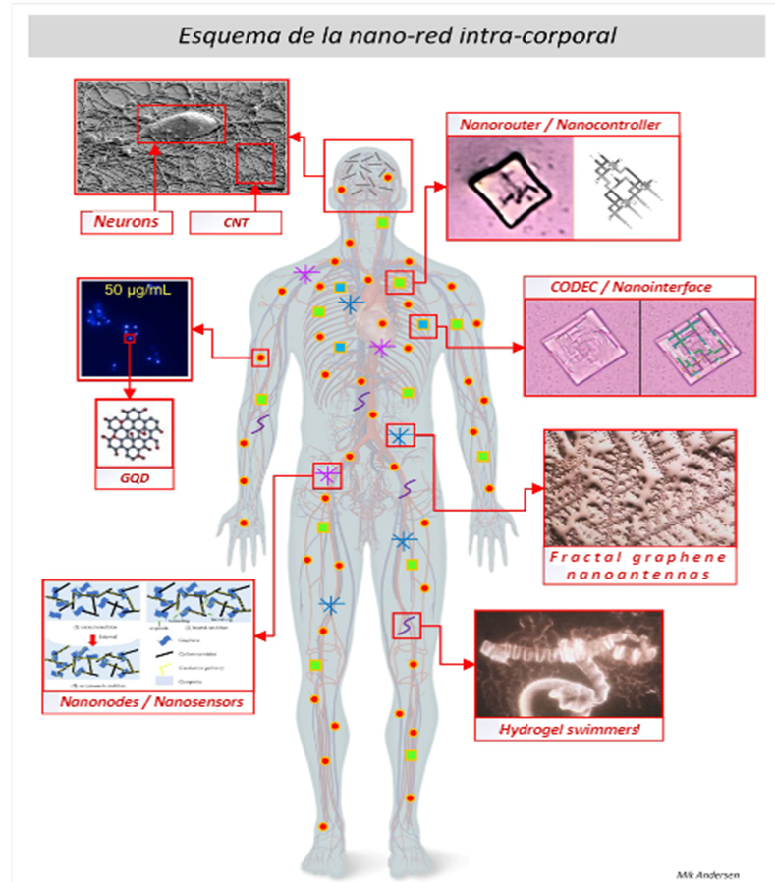
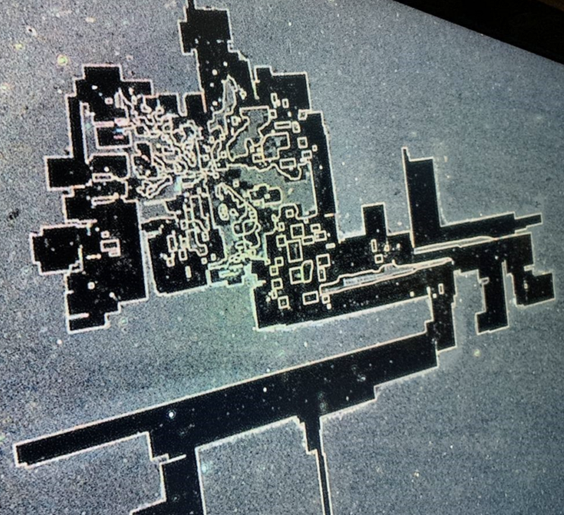
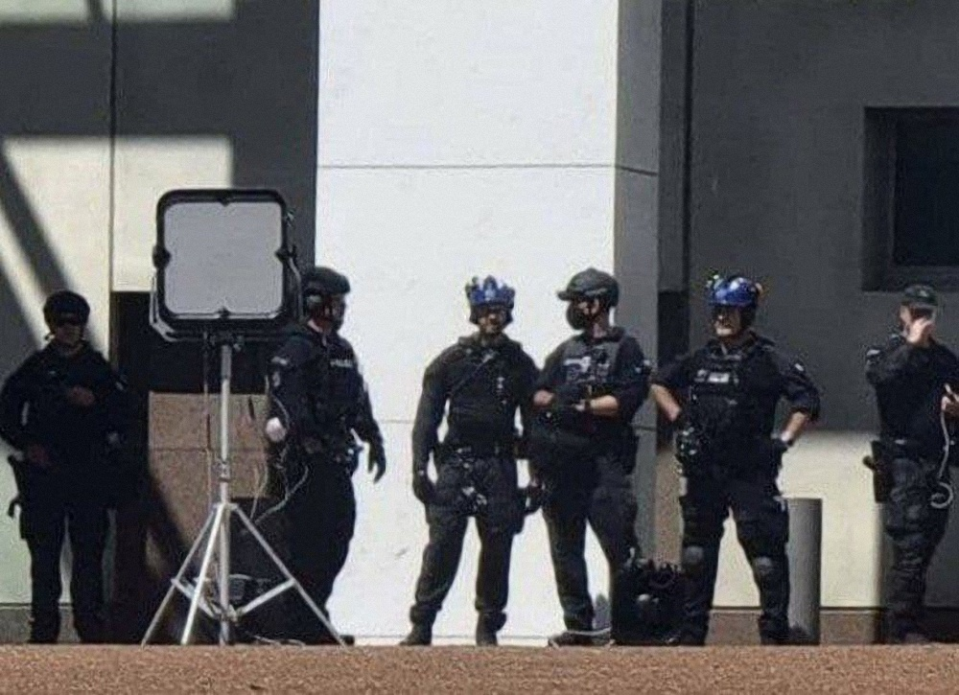
5G, NANOTECH AND THE COVID AGENDA
A PRESENTATION BY FTWPROJECT.COM

Slide 2
5G, NANOTECH AND THE COVID AGENDA
A PRESENTATION BY FTWPROJECT.COM

Slide 3
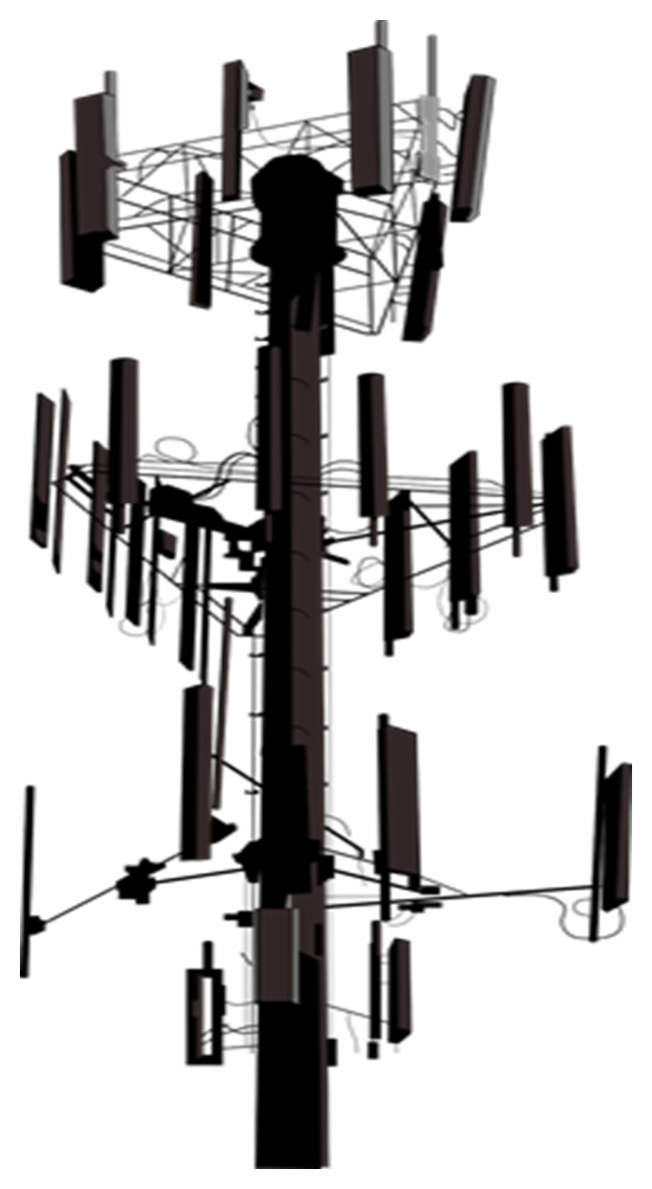
5G, Nanotech, and COVID Summary
This presentation will explain how electromagnetic frequencies like 5G work to activate nanotechnology in our environment and our bodies and how it is part of the COVID agenda. This is a distillation of the research we have done over the past two years of closely monitoring the censored disclosures of the latest developments of the COVID agenda.
-Hydrogels Nanotech -Graphene Oxide (the main ingredient in Hydrogels) -Hydrogels Graphene oxide are in everything: COVID Injections, water supply, food, chemtrails -EMF radiation activates the nanotech -EMF radiation effects on health, it’s the same symptoms labeled “COVID” -EMF Electrical Pollution and the FLU- A history -Energy Weapons Used on the Population -What’s in the Shots- a collection of nanotech findings -Big Tech tracking and tracing vaxxed individuals and collecting DNA
-Why am I sick? Shedding Transmission and Protecting yourself
All of our references in this presentation have been documented with links to scientific articles and backup documentation on our blog section of our website www.FTWproject.com
WWW.FTWPROJECT.COM

Slide 4
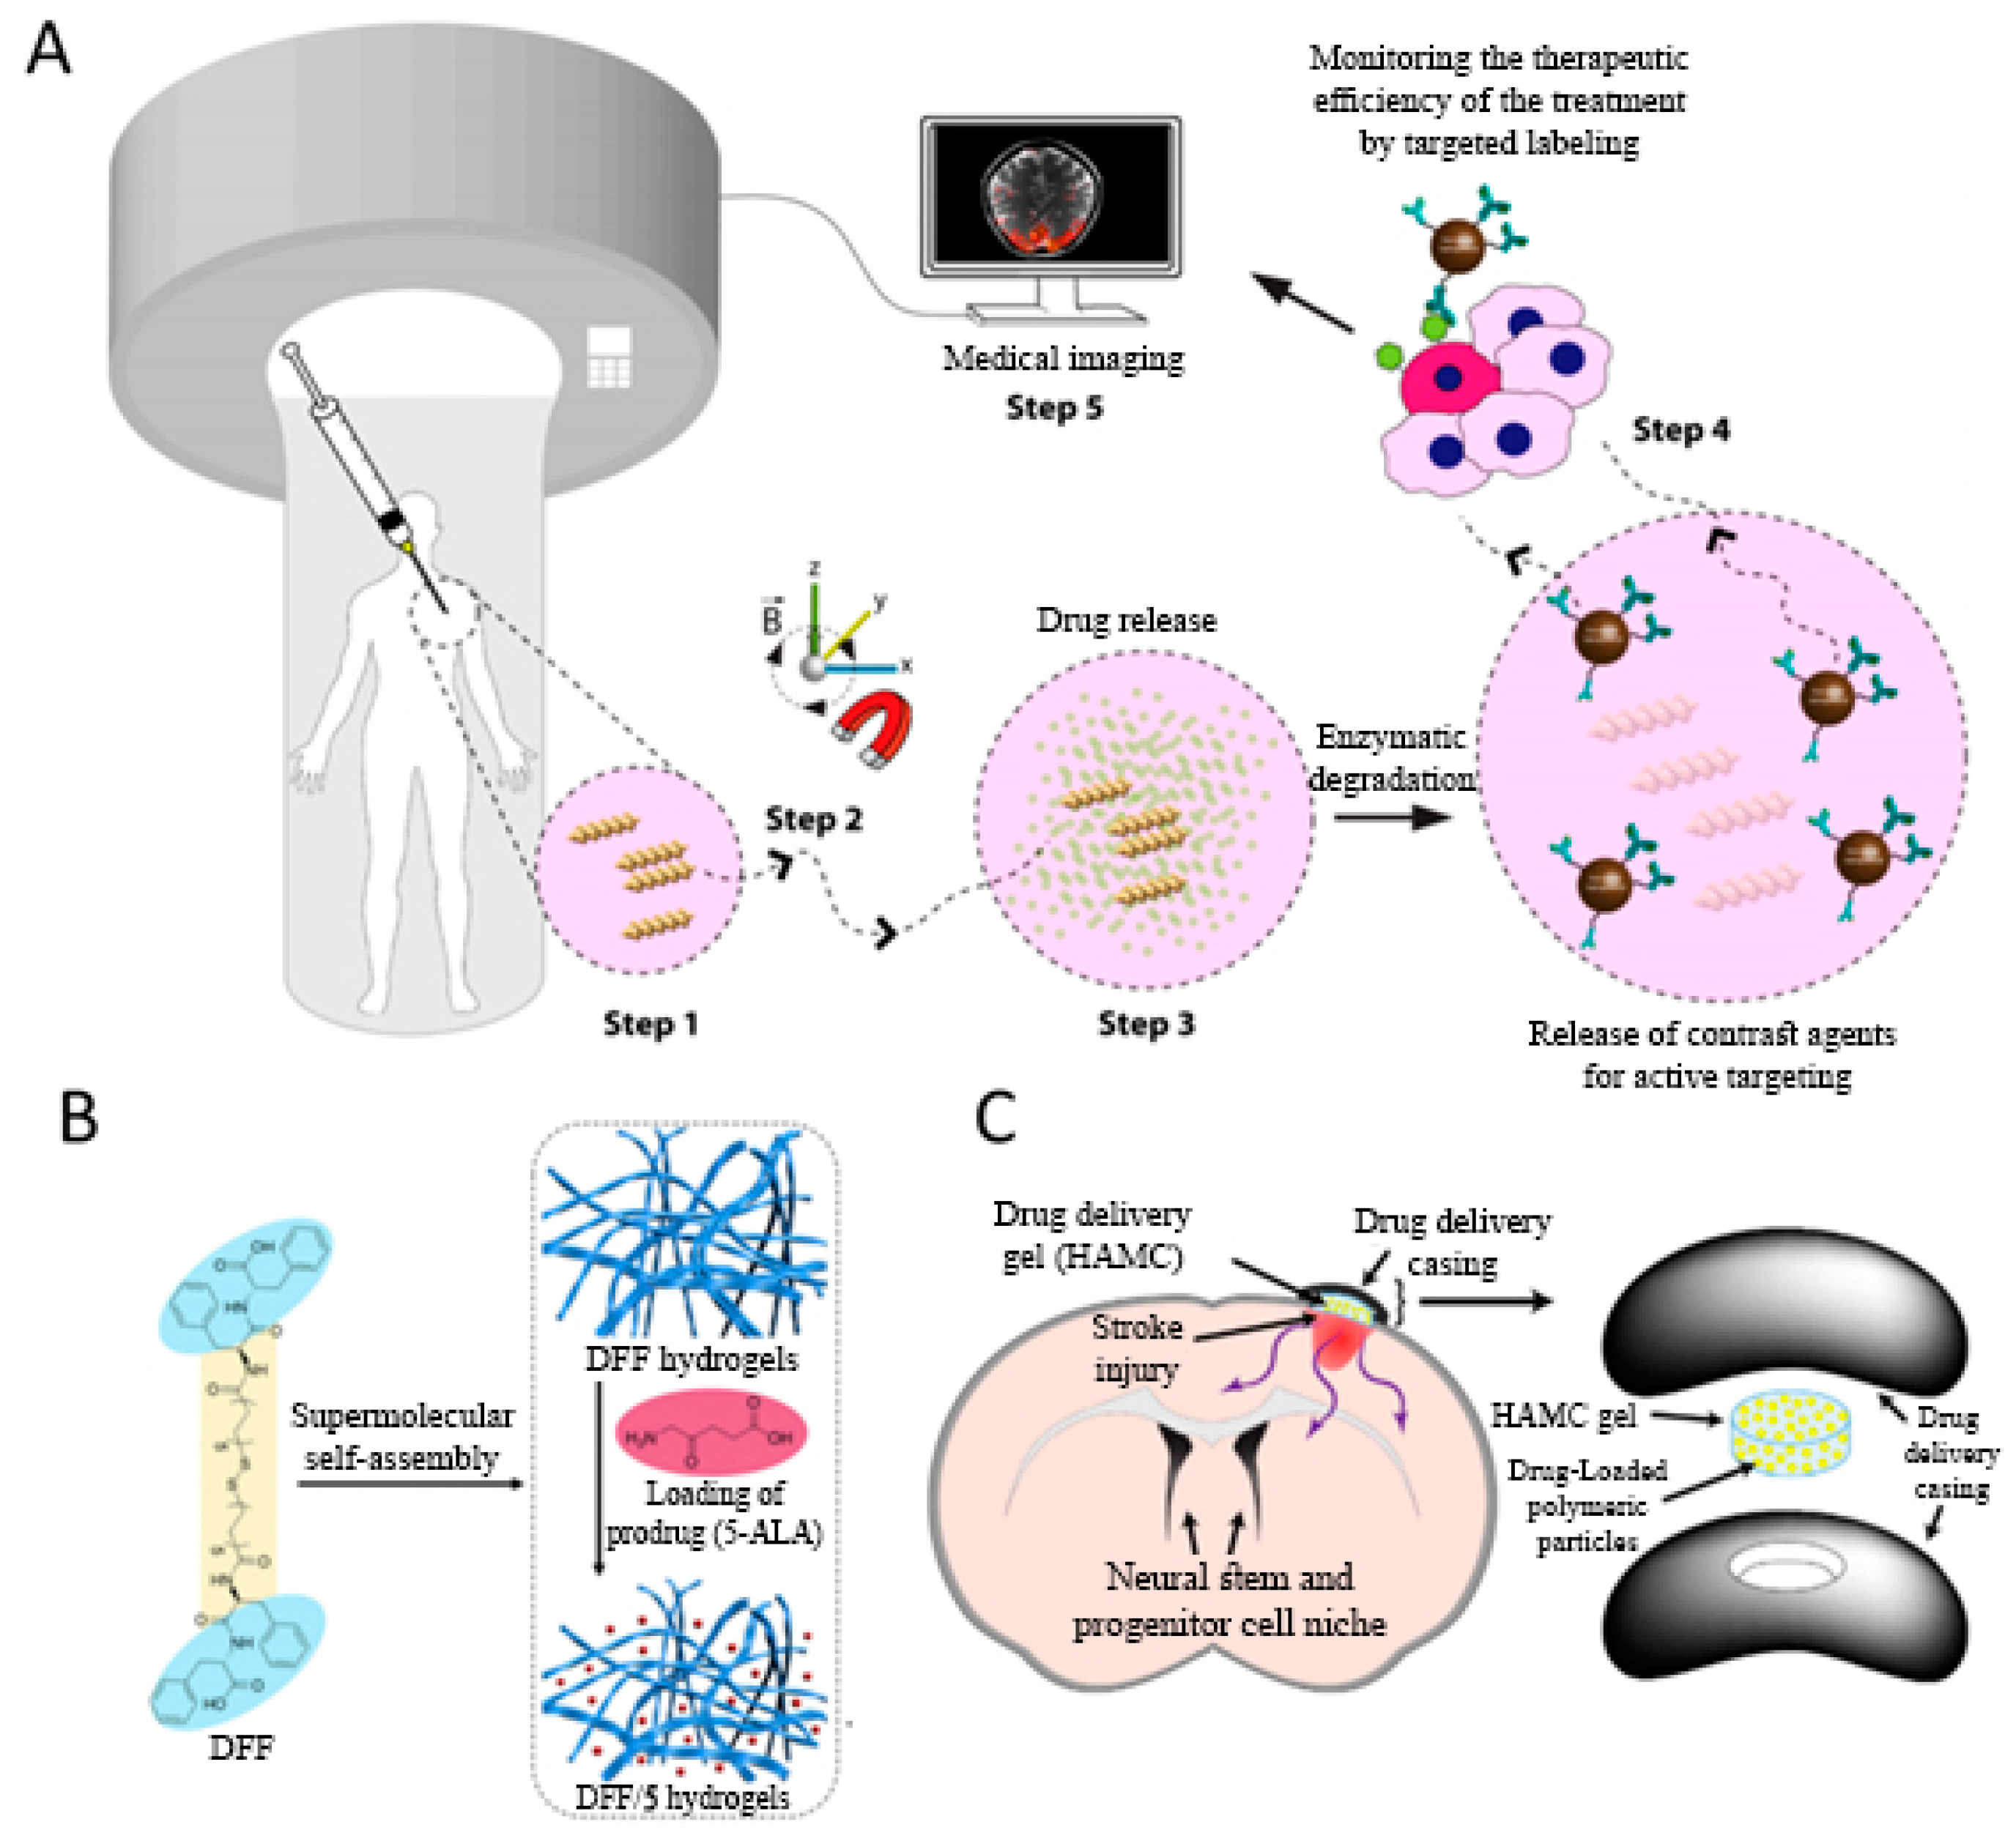
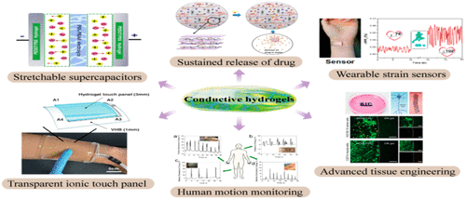
CONDUCTIVE HYDROGELS

Slide 5
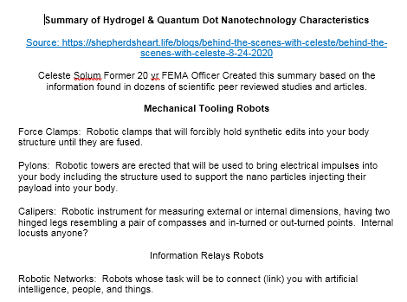
HYDROGEL NANOTECH CHARACTERISTICS STUDIES AND PATENTS
Nanotech used in hydrogels is designed to lock into our DNA to manipulate it, track and trace our bodies by collecting and transmitting our information to a data collection point, monitor our vitals, fuse into our system to allow a means of physical, biological control by an outside source. They are putting hydrogels in the Food Supply (Journal of Agriculture and Food Chemistry)

Slide 6
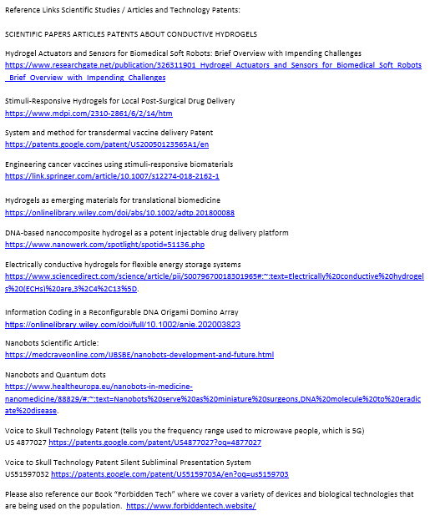
HYDROGEL NANOTECH CHARACTERISTICS STUDIES AND PATENTS

Slide 7
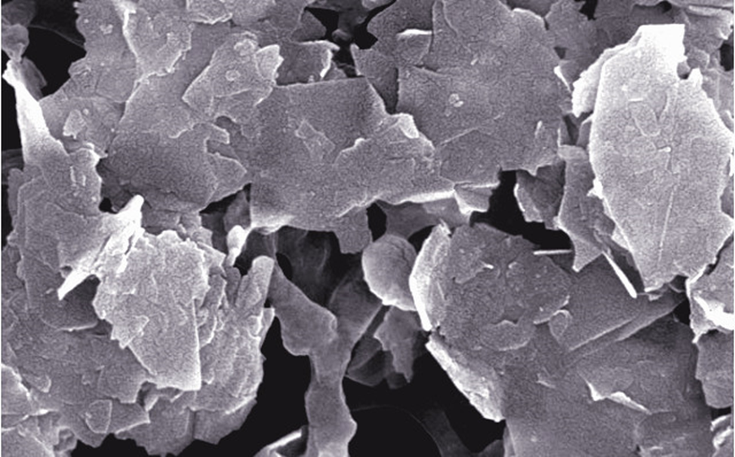
What is Graphene?
Graphene is a single layer of carbon atoms, tightly bound in a honeycomb lattice. It is an allotrope of carbon.
According to the official narrative: “Discovered” in 2004 when researchers at University of Manchester isolated a single plane of graphite (graphene) using a kind of scotch tape. This 2D material revealed properties that lend to a number of applications in electronics, remote sensing, medicine (in graphene oxide form), quantum computing:
It is stronger than diamond yet flexible and transparent
Graphene conducts heat and electricity and superconductor efficiencies!
Its electronic properties make it highly sensitive to the absorption of molecules such as CO, NO, NO2, and NH3. Research has indicated that this sensitivity can be increased by 100 fold with addition of Boron.
Graphene has made possible the development of electron-spin based quantum computing. Many types of graphene components are in development to test various quantum computing qubit models.
Water filtration and purification (highly absorbent used in oil spill cleanups at only a fraction of the weight)
WWW.FTWPROJECT.COM

Slide 8
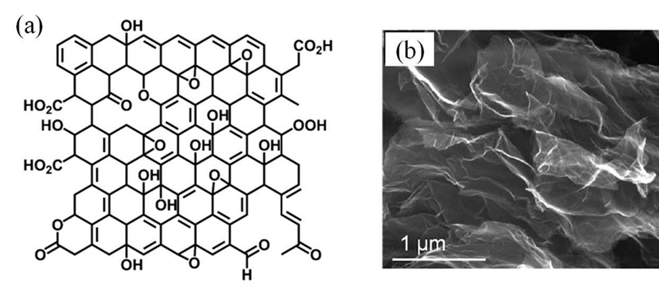
What is Graphene Oxide?
Graphene oxide (GO) is and oxidized form of graphene with oxygen molecules (ie. OH, CO, COOH, HO, etc.) attached on the surface (called functional groups).
Discovered in 1859
GRAPHENE OXIDE 160 YEAR KNOWN POISON !!! “Oops” they forgot to scrub the Wikipedia page
This is why they don’t want to disclose what’s in the shots.
WWW.FTWPROJECT.COM

Slide 9
Why Graphene Oxide is Used in the Bio-Medical Industry (even though it shouldn’t be):
The type of oxygen-based molecules attached to graphene oxide determines its unique properties and function to the graphene lattice, and why it has been researched in the biotech industry.
Graphene oxide production is relatively easier to produce on large scales compared to graphene. It contains semi-conducting properties proportional to the level of oxidation of the graphene oxide. It’s hydrophilic (attracted to water) and has good dispersibility in an aqueous environment.
Applications for Graphene and Graphene Oxide include:
Water filtration
Covalent functionalization (drugs, polymers, fluorescent tags)
Bio-devices, biosensors, human tissue scaffolds, drug delivery and gene therapy vectors
Energy Storage for ultracapacitors and batteries cathode/dielectric interface
Enhanced fluid separation for passive porous membrane filters
Claimed GO shows excellent DNA absorption properties and ‘biocompatiblity’. DNA binding to GO is found to be very stable and reversible. 6 - (conflicting studies)
WWW.FTWPROJECT.COM

Slide 10
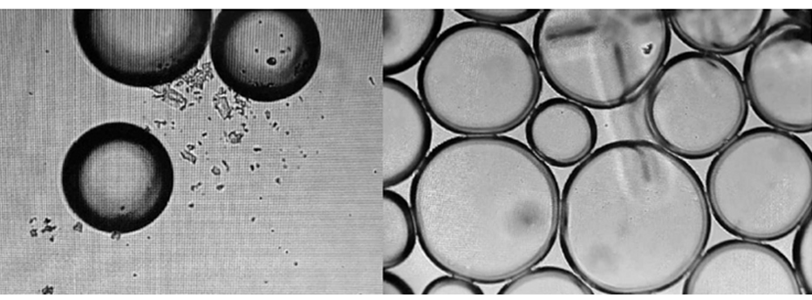
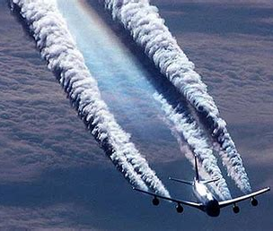
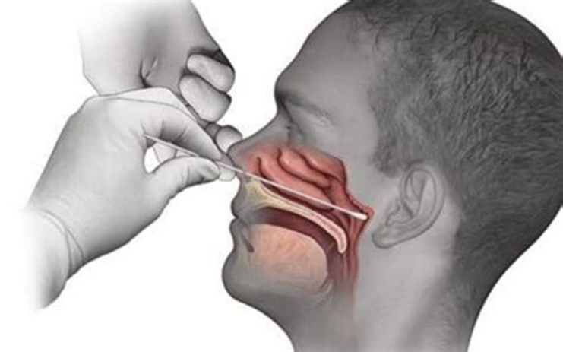
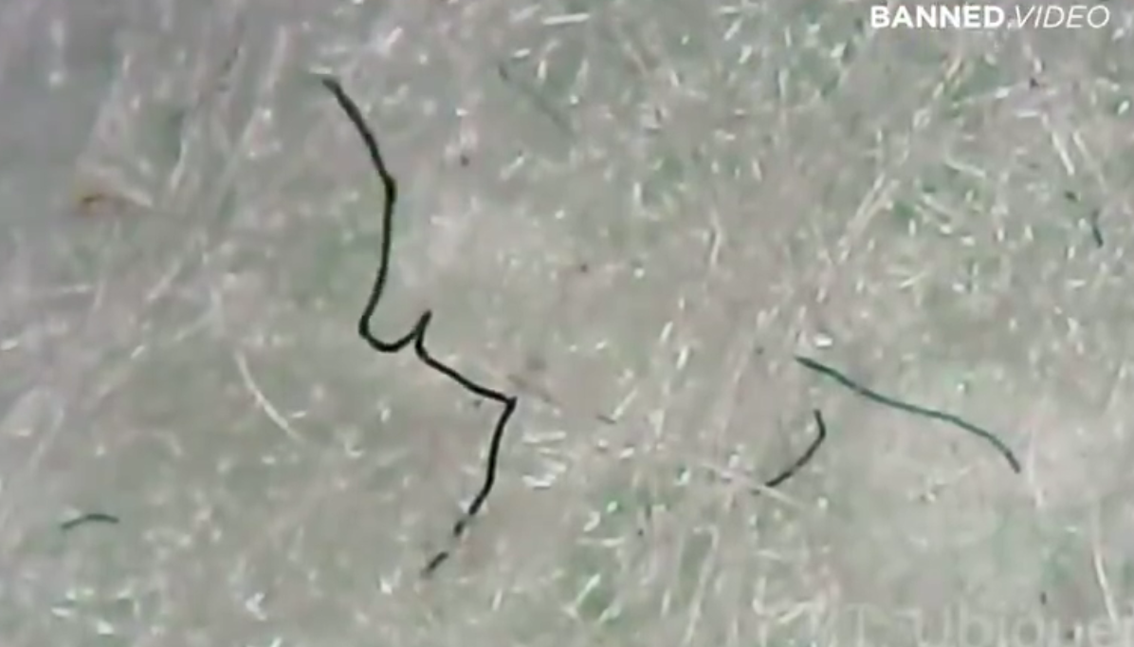
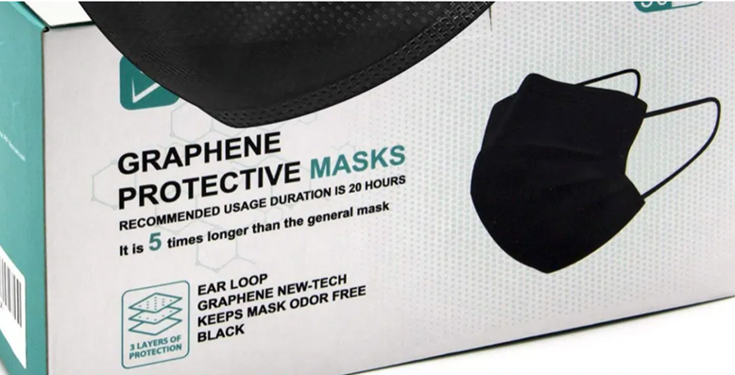
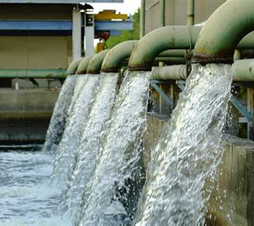
Graphene Oxide used in chemtrails (studies and patents)
Graphene Oxide found in PCR Tests (lab studies)
Graphene Oxide used in water supply (major contract in UK)
Graphene Oxide found in masks (Canada and Spain Gov recall and independent findings)
WWW.FTWPROJECT.COM

Slide 11
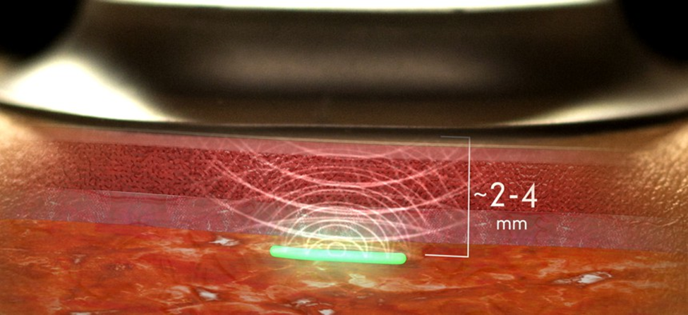
From: A Military-Funded Biosensor Could Be the Future of Pandemic Detection
WWW.FTWPROJECT.COM

Slide 12
Properties of Graphene Oxide (or why they are REALLY using it in Bio-Medical Industry)
-Stimulated / controlled by EMF frequencies, specifically those found in 5G -multiplies when electronically stimulated -transparent -LUCIFEROUS-bioluminescence -magnetism - extremely strong -can be used to manipulate neural pathways in the brain.
THIS IS WHAT THEY ARE PUTTING IN YOUR BODY!! (VIEW IN SLIDESHOW MODE FOR ANIMATION)
WWW.FTWPROJECT.COM

Slide 13
EMF PROPERTIES OF HYDROGELS IN COVID INJECTIONS
Properties of Hydrogels: Hydrogels are “ON DEMAND” which means they can be triggered at any moment to deliver a payload. Hydrogels can be used as “BIOCENSORS” in the body, meaning they have the ability to accumulate data from your body such as your breathing, respiration, thoughts emotions, etc. Hydrogels have the ability to act through WIFI. They can both TRANSMIT AND RECEIVE Energy, messages, frequencies or impulses.
See it with your own eyes! Video of what hydrogels can do while beamed with electrical fields.

Slide 14
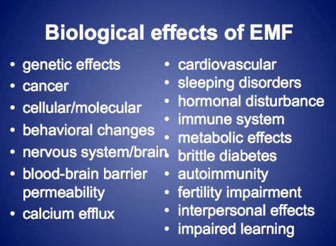
ELECTOMAGNETIC FREQUENCY (EMF) PROTECTION
Since graphene oxide is activated by EMF, you want to create a protective barrier in your immediate environment that mitigates the EMF so that it does not activate the graphene oxide.
-Don’t live near towers crowded cities -Turn off Wifi at night -Don’t use smart meters or smart appliances -Use orgone energy EMF protection devices to clean up the EMF in your environment
WWW.FTWPROJECT.COM

Slide 15
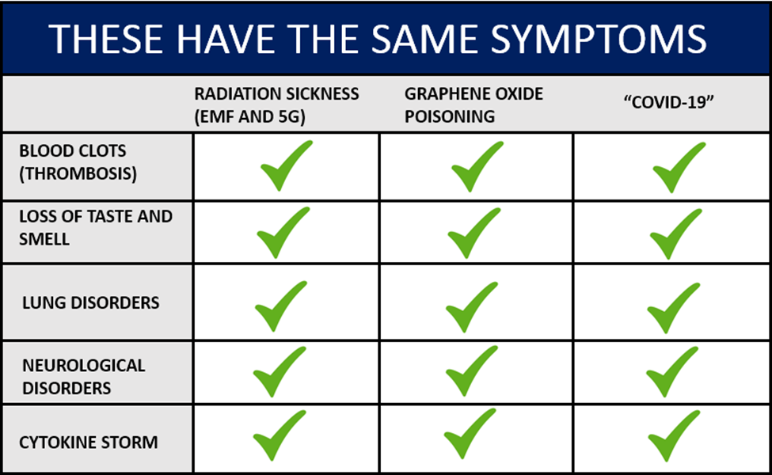
-Based on studies linked in blog post for each sickness -Creation of MASS CONFUSION AND MISDIAGNOSIS ON PURPOSE!
-Everything gets diagnosed as COVID
-Covid Virus has never been isolated
WWW.FTWPROJECT.COM

Slide 16
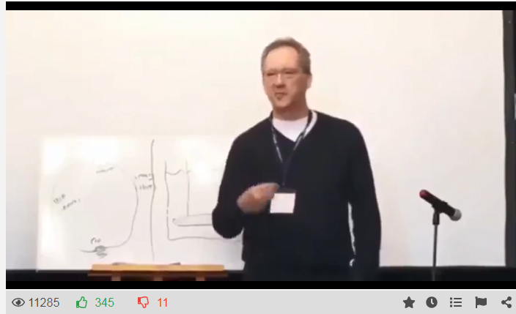
EMF ELECTRICAL POLLUTION AND THE FLU – A HISTORY
Flu-viruses, pandemic and electromagnetic radio and microwave radiation connections:
In The Invisible Rainbow, Firstenberg traces the history of electricity from the early eighteenth century to the present, making a compelling case that many environmental problems, as well as the major diseases of industrialized civilization—heart disease, diabetes, and cancer—are related to electrical pollution.
1918 Radio Era – towers installed all over the planet –SPANISH FLU 1957 Radar Era- radar stations all over the plant- Asian Flu Virus 1968 Satellites- satellites all over the planet- Hong Kong Flu Pandemic 1976 First 1G cell tower in New Jersey – Swine Flu outbreak in New Jersey 1989 upgrade from 2G to 3G tower all over the planet Swine Flu outbreak worldwide 2013 upgrade 3G to 4G – Avian bird Flu 2019 upgrade of 4G to 5G, first town to activate on full scale=Wuhan, China.
Concepts Mentioned in a presentation given by Dr. Tom Cowan
WWW.FTWPROJECT.COM

Slide 17
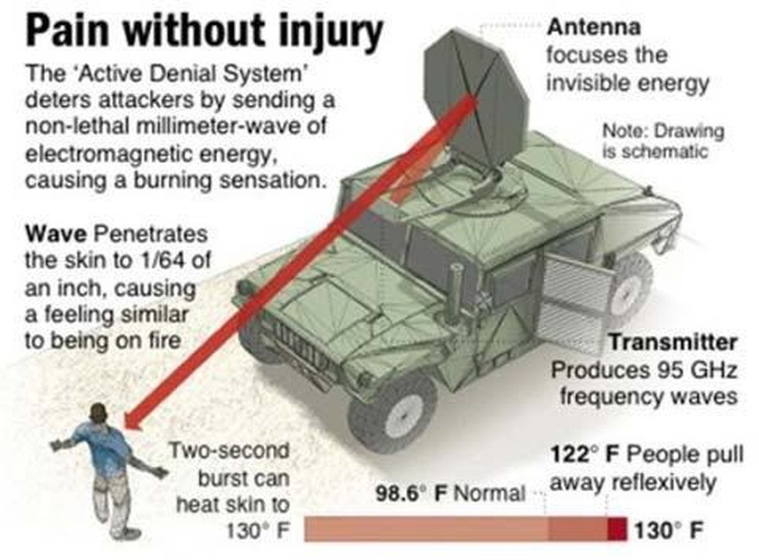
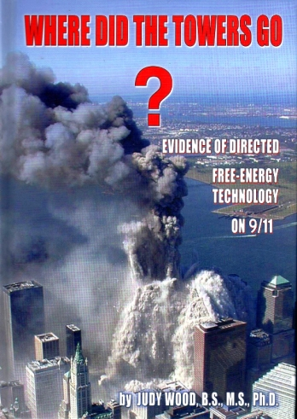
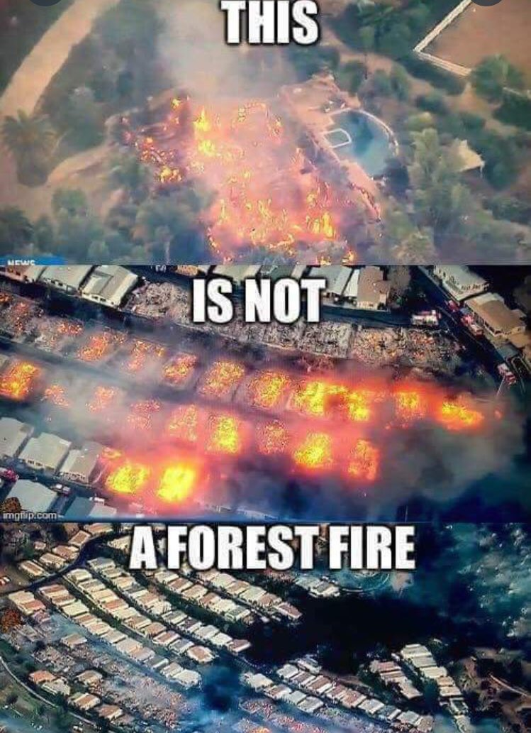
ELECTROMAGNETIC FREQUENCIES ARE A FORM OF ENERGY WEAPON
INSTANCES WHERE ENERGY WEAPONS HAVE BEEN USED ON THE POPULATION
Iraq War
911
California Fires / Australia Fires
And most recently in Australia at the Canberra protests
WWW.FTWPROJECT.COM

Slide 18
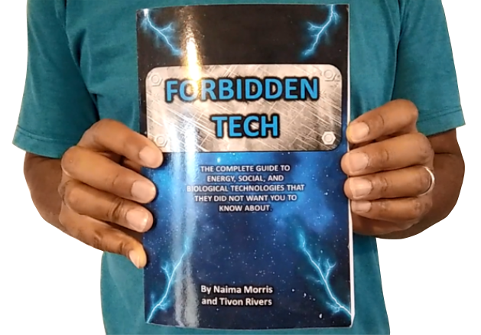
5G Controls All Kinds of Microwave Tech Including “Voice To Skull” and Electronic Harassment Technology
COMMUNIST CHINA TESTING MICROWAVE TECHNOLOGY ON CITIZENS
PATENTS FOR V2K TECH DESRIBED IN OUR BOOK “FORBIDDEN TECH”
https://www.youtube.com/watch?v=aVj7_0A5-Ew
Notes:
If time permits we’d like to play this 4 minute clip https://www.youtube.com/watch?v=aVj7_0A5-Ew

Slide 19
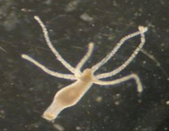
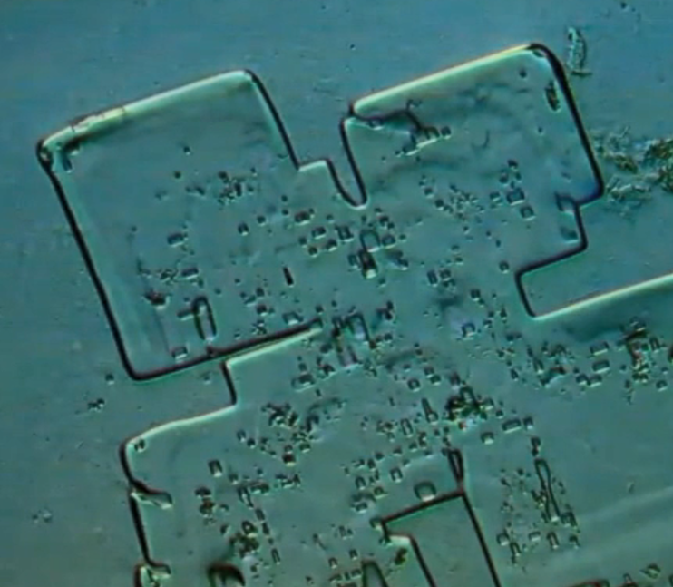
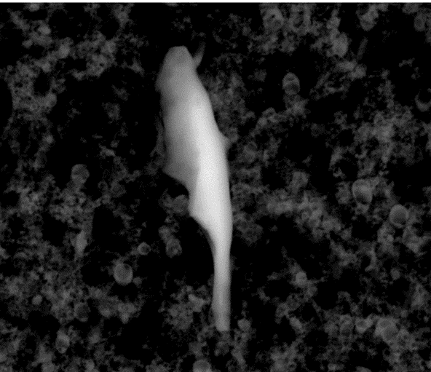
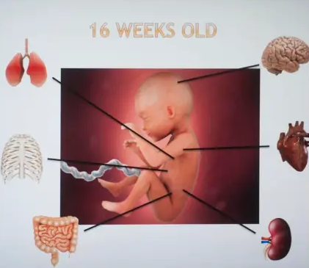
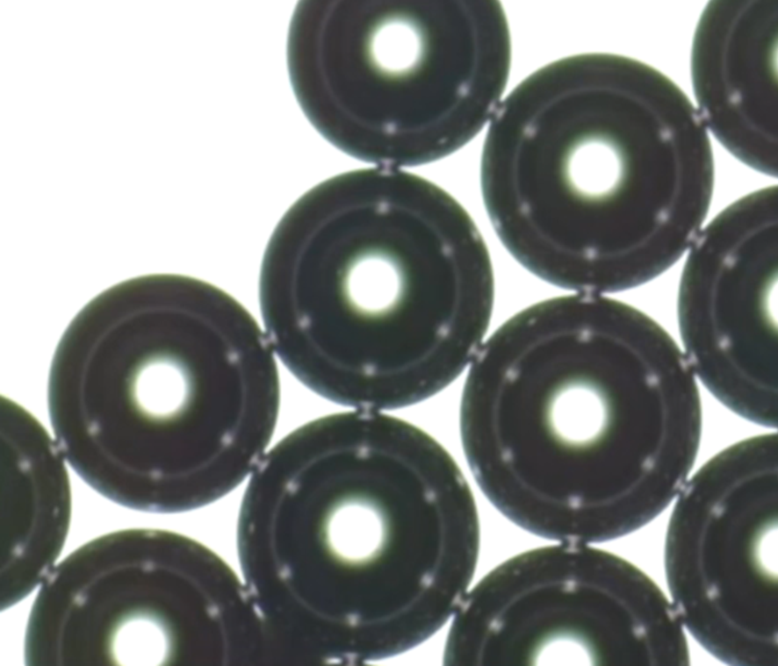
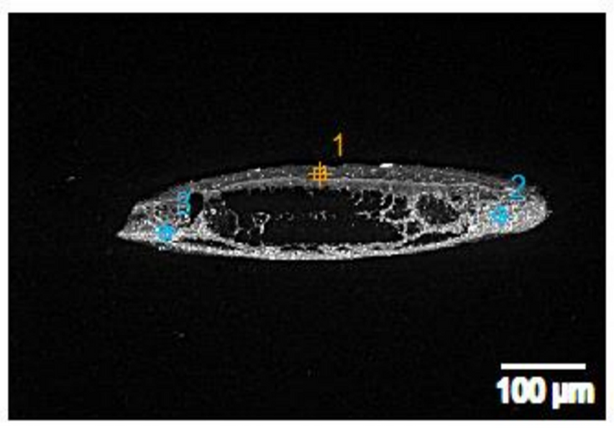
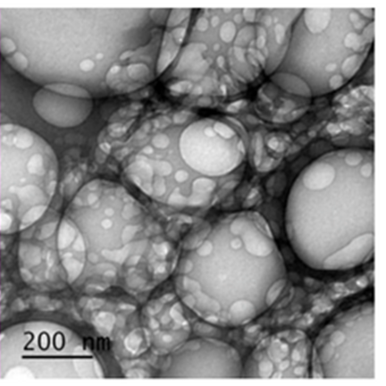
THIS IS WHAT WE KNOW IS IN THE COVID INJECTIONS (SO FAR):
HYDRA VULGARIS ORGANISMS (GMO)
PARASITES
ABORTED HUMAN FETAL TISSUE
MICROCHIPS
MICROBUBBLE TECHNOLOGY
STEEL AND ALUMINUM METALS
GRAPHENE OXIDE
AND THEY WANT TO REQUIRE YOU TO INJECT THIS INTO YOURSELF IF YOU WISH TO TRAVEL, EAT OUT, SHOP, WORK, OR GO TO SCHOOL.
WWW.FTWPROJECT.COM

Slide 20
Found in Covid Injections: (compared to scientific papers) Nano Routers that emit MAC addresses via Bluetooth Nano antennas and plasmonic antennas to amplify signal Nano rectennas as rectifier bridge of alternating and direct current Codecs- devices that perform transformations on a data stream or signal Logic gates- small digital electronic devices that compute binary functions like “and”, “or” ,“not” ,“true”, “false” ,“less than” ,“greater than” , etc. Used for the encryption of these network communications from vaccinated individuals to a remote network server.
PATENTS THAT DESCRIBE HOW THEY WILL HOOK UP HUMAN BEINGS TO THE “INTERNET OF THINGS” VIA 5G. (Now we know that they need the nanotech in the Covid shots in order to accomplish this) Routing policies for biological hosts (AT&T) US10163055B2 Devices and Methods for Transferring Data through a Human Body (AT&T) No. 20130142363 Cryptocurrency system Using Body Activity Data (Microsoft) W02020060606
Text
EXCELLENT REPORT! MUST READ! LINK IN BLOG POST TO REPORT IN ENGLISH “INTRABODY NANO NETWORK BRIEF SUMMARY” –MIK ANDERSON THROUGH LA QUINTA COLUMNA
WWW.FTWPROJECT.COM

Slide 21
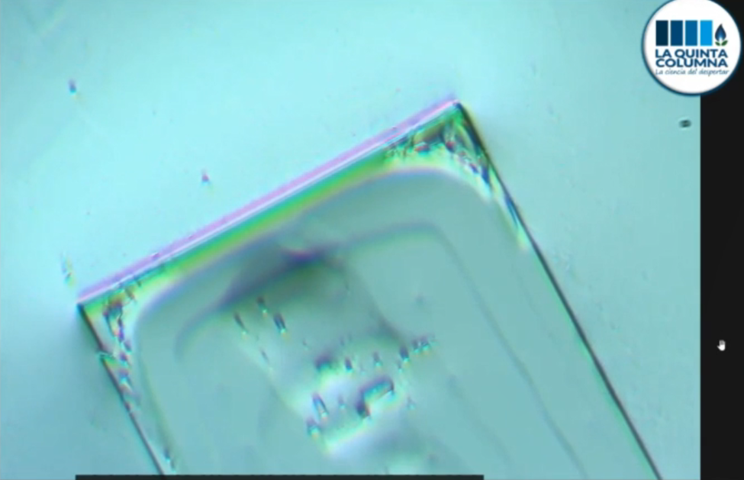
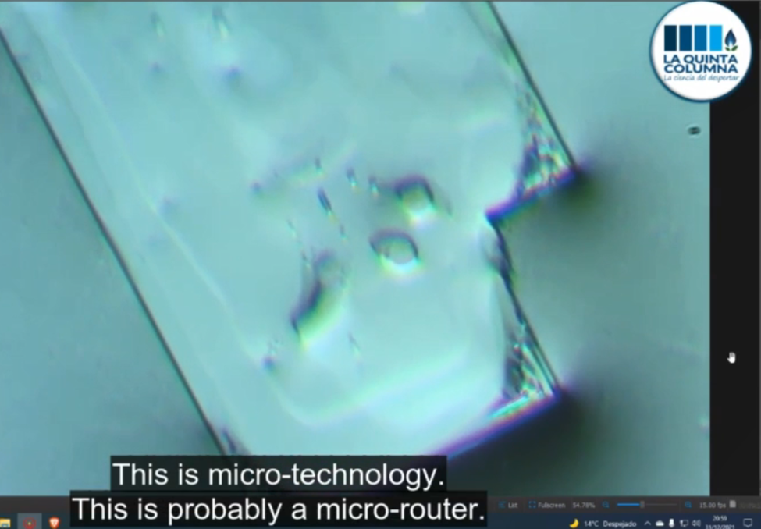
CIRCUITRY AND MICROTECHNOLOGY THAT SELF ASSEMBLES WITH EMF FOUND IN THE PFIZER VACCINES
Ricardo Delgado from La Quinta Columna discusses what they found in the Pfizer Vaccines, its CIRCUITRY AND MICROTECHNOLOGY. When the hydrogel in the vaccine dries it forms these images under the microscope. The edges form perfect squares, and it appears to have circuitry much like a circuit board. In several of the formations they have the same central square chip that looks like a CPU (central processing Unit). In these reports and videos the formations are shown to self assemble when stimulated with EMF.
WWW.FTWPROJECT.COM

Slide 22
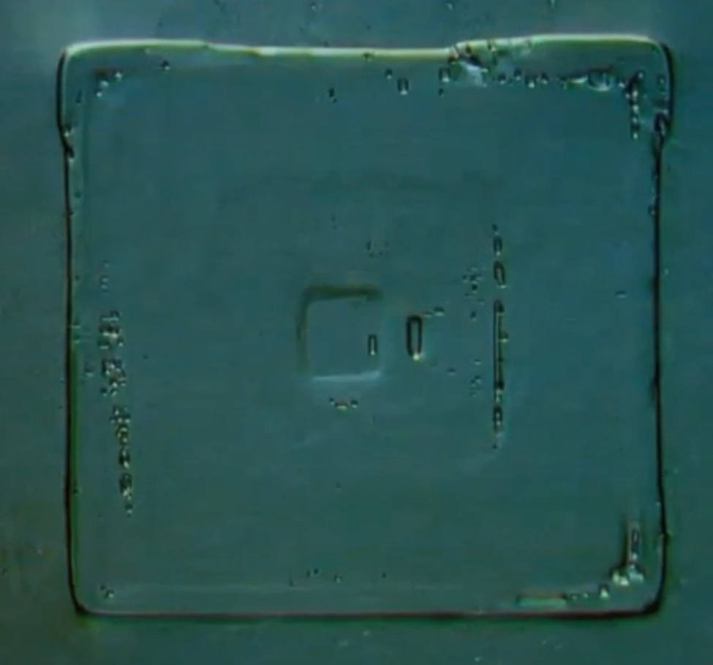
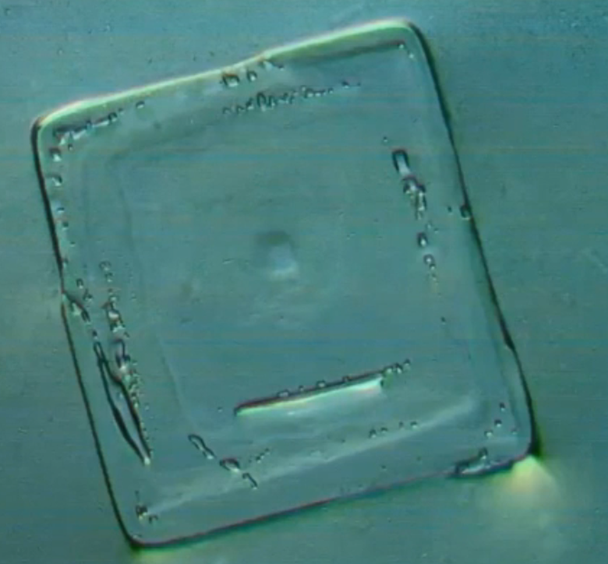
CIRCUITRY AND MICROTECHNOLOGY THAT SELF ASSEMBLES WITH EMF FOUND IN THE PFIZER VACCINES
CPU
WWW.FTWPROJECT.COM

Slide 23
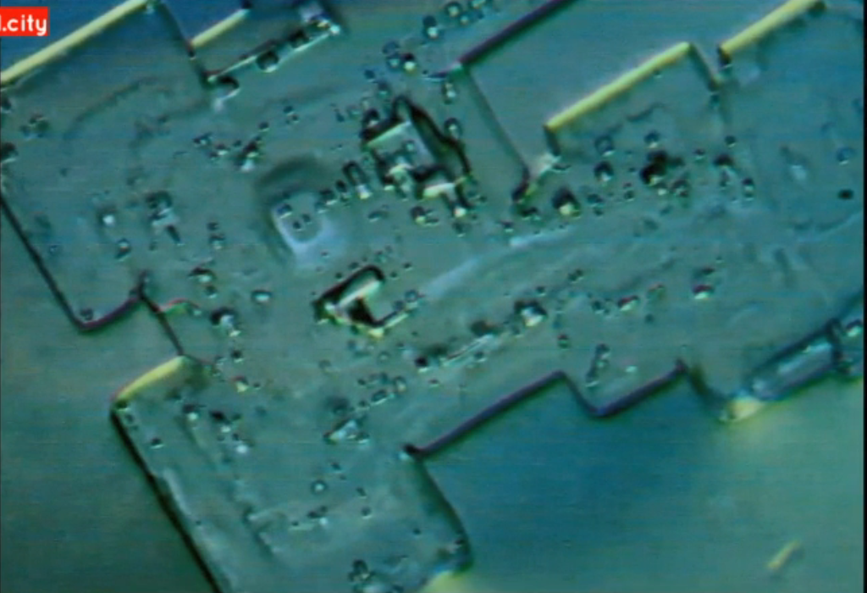
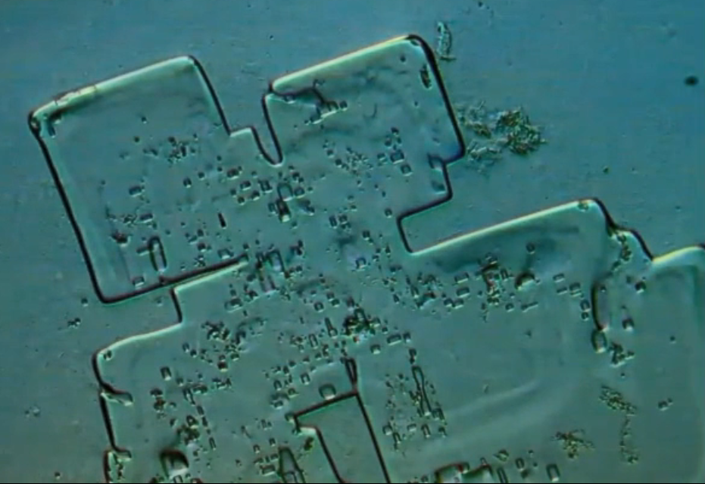
CIRCUITRY AND MICROTECHNOLOGY THAT SELF ASSEMBLES WITH EMF FOUND IN THE PFIZER VACCINES
CIRCUITRY
You can download the NEW REPORT from La Quinta Columna "Identification of possible microtechnology and artificial patterns in Pfizer vaccine with optical microscopy“ WWW.LAQUINTACOLUMNA.NET
WWW.FTWPROJECT.COM

Slide 24
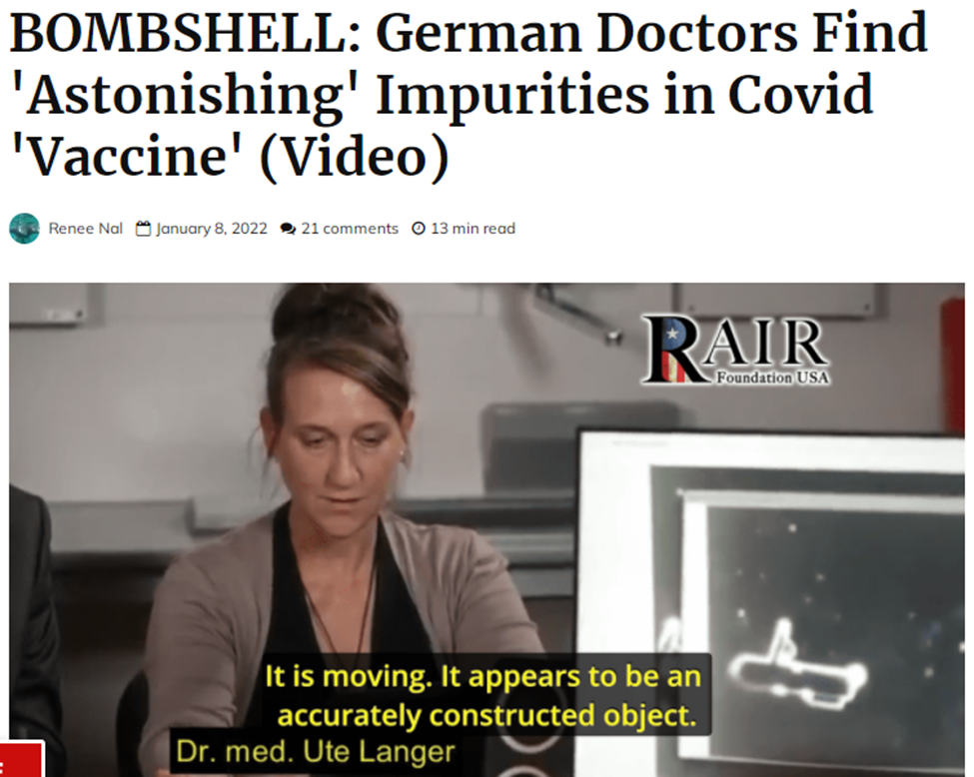
GERMAN PATHOLOGISTS FIND SAME MICROCHIP SUBSANCES IN COVID SHOTS
Since the initial discovery by La Quinta Columna, other teams of scientists from around the world have been replicating the work and finding the same things in the shots. This presentation shows a mechanically constructed object in the Pfizer vaccine. The machine is moving itself in the fluid.
The same types of object were also found in the J&J shots.
WWW.FTWPROJECT.COM

Slide 25
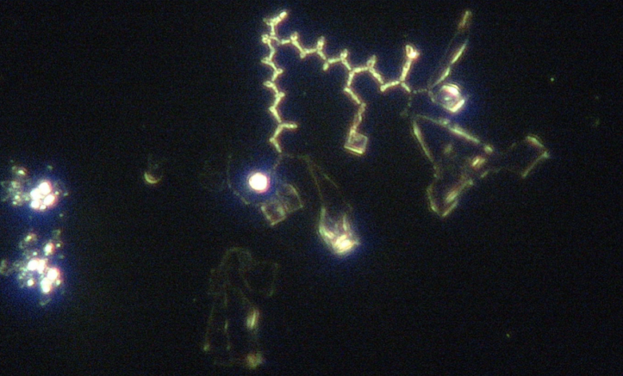
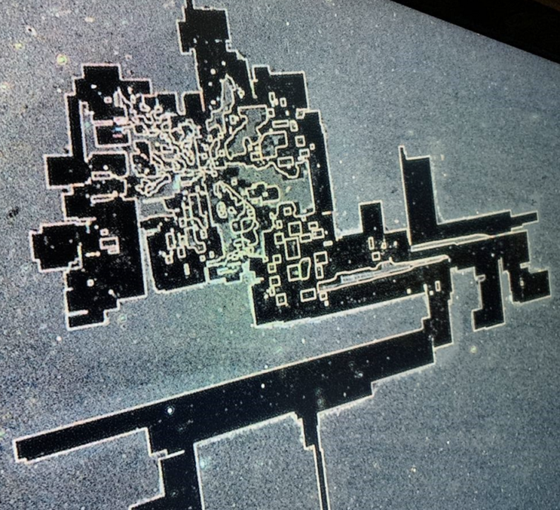
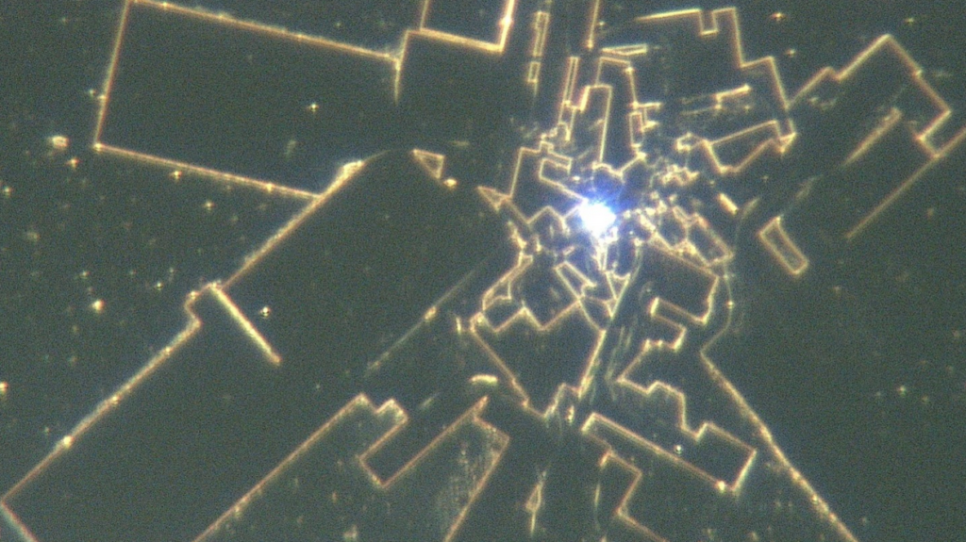
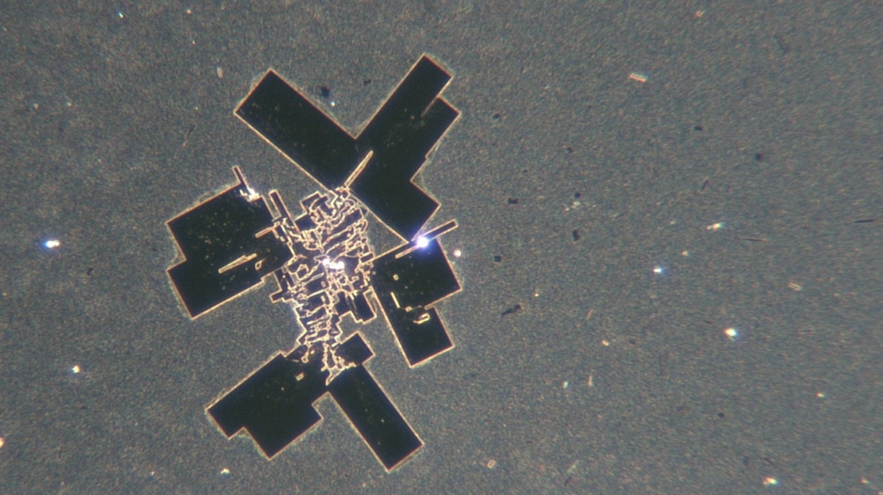
UNDECLARED NANO TECH FOUND IN PFIZER SHOTS BY NEW ZEALAND SCIENTISTS
Shapes and objects were found in the Pfizer shots, after exposure to heat and time and EMF, these shapes SELF ASSEMBLED into microchip circuit boards.
WWW.FTWPROJECT.COM

Slide 26
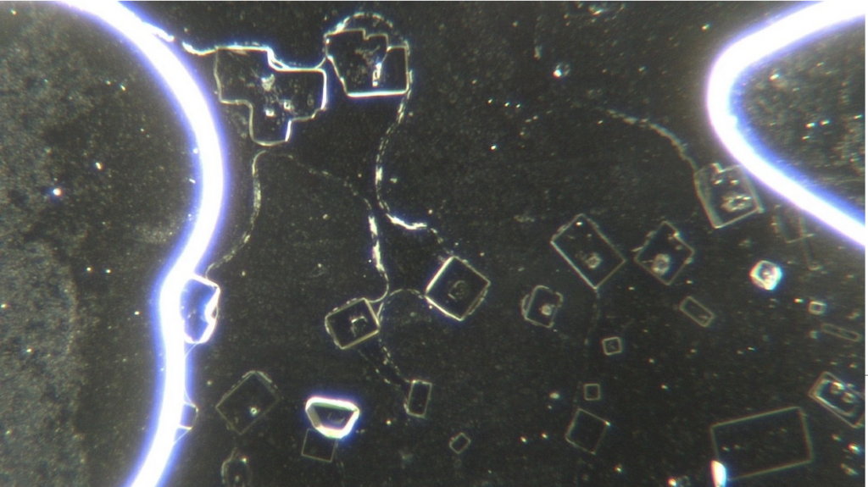
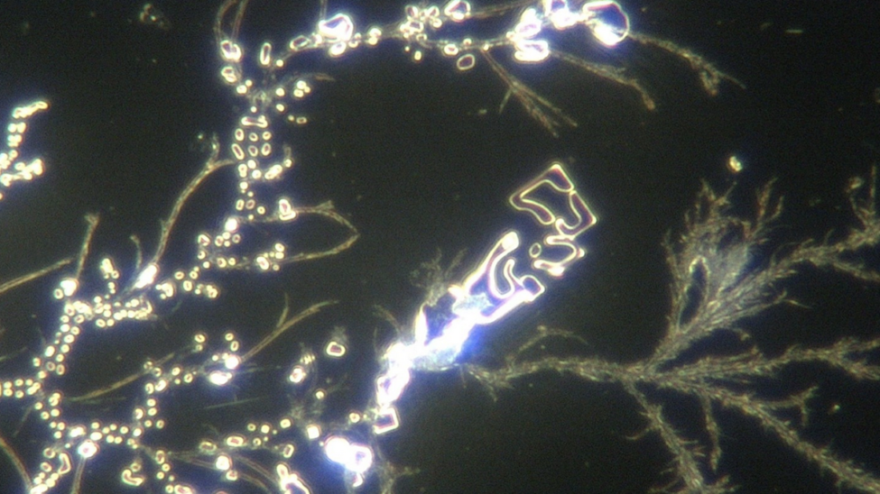
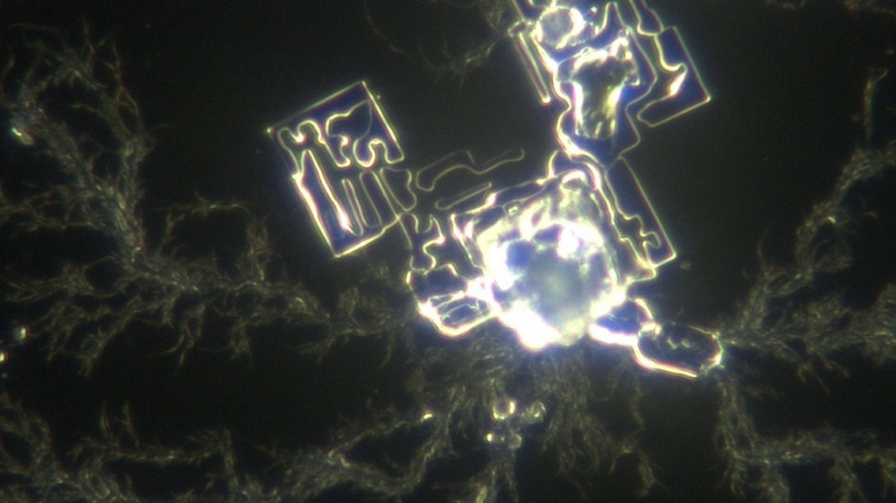
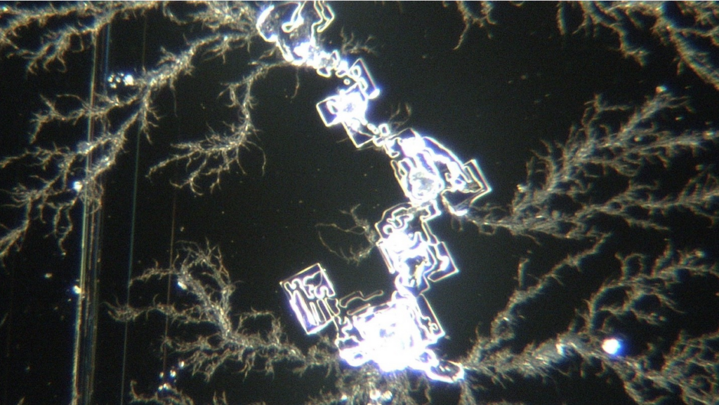
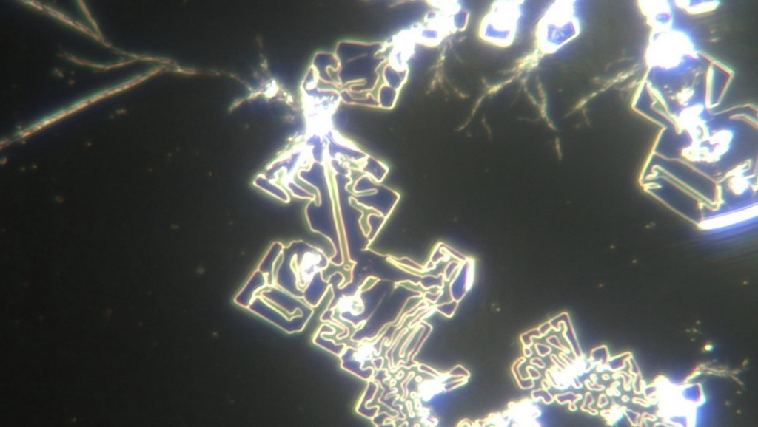
UNDECLARED NANO TECH FOUND IN PFIZER SHOTS BY NEW ZEALAND SCIENTISTS
These images show the vaccine mixed with human blood. When the vaccine meets up with human blood the white blood cells were annihilated and the red blood cells are heavily damaged.
WWW.FTWPROJECT.COM

Slide 27
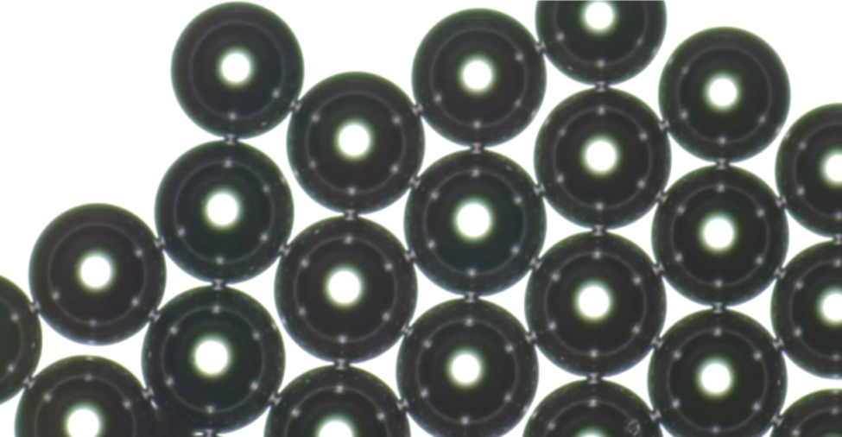
SELF ASSEMBLING MICROBUBBLES OF GRAPHENE FOUND IN COVID VACCINES
“Microbeads”, “Microspheres”, “Microbubbles” listed as active ingredients in the Pfizer patent and the Moderna patent.
Made from Graphene Oxide. They are coated with gold nanoparticles and are used for “scaffolding” new DNA based tissues inside the human body.
They interlink by electrodes and can self replicate via electrical pulses. They are used to deliver drugs or a payload over a period of time, which can be over days, weeks, months or years as the Moderna patent specifies.
Found by Dr. Zandre Botha from South Africa while viewing one drop of covid vaccine through a microscope.
WWW.FTWPROJECT.COM

Slide 28
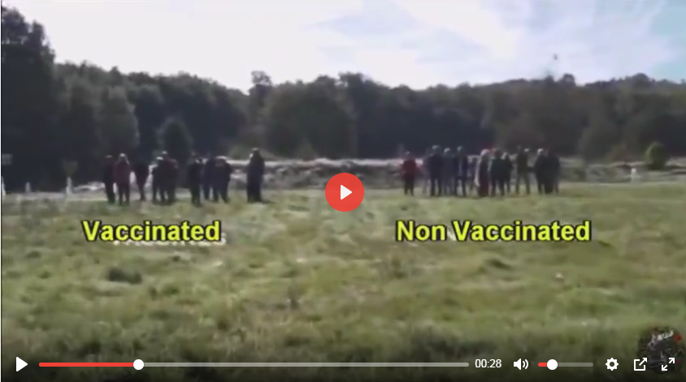
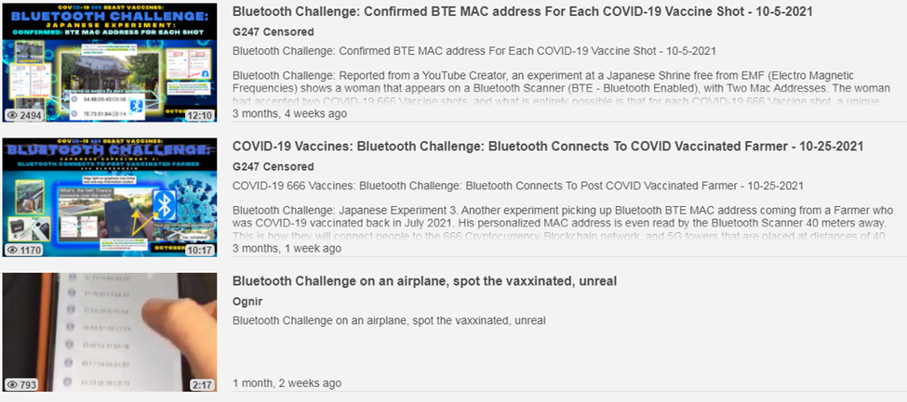
VACCINATED HUMANS ARE NOW EMITTING BLUETOOTH CODES
BLUETOOTH CHALLENGE VIDEOS Normally Bluetooth devices have a name on them. But now when you go into a crowded room full of vaccinated people all of these anonymous Bluetooth addresses show up on your phone. Bluetooth challenge videos are popping up everywhere.
A French research team stopped random volunteers in a park. Separated them into groups of vaccinated and non vaccinated. They were then tested with their laptops Bluetooth and the vaccinated were registering an unnamed mac address as each were called near from the field.
HUMAN BEINGS SHOULD NOT EMIT A CODE!!!
WWW.FTWPROJECT.COM

Slide 29
REVIEW: FROM OPERATION WARP SPEED EXPOSED
“VACCINE CZAR” Moncef Slaoui
During these interviews he disclosed two VERY DISTURBING bits of information. 1) Millions of Americans who receive the vaccine will be tracked via an “incredibly precise pharmacovigilance surveillance system” that will track the vitals and whereabouts of Americans who receive the Warp Speed Vaccine. 2) Google and Oracle have been awarded the Defense Contract to track and trace Americans who receive the vaccine.

Slide 30
BIG TECH GOT THE DEFENSE CONTRACT TO COLLECT DNA AND TRACK AND TRACE EVERY AMERICAN WHO GETS THE COVID VACCINE
5G ROLLED OUT AT “WARP SPEED” DURING ENTIRE COVID PANDEMIC WHILE EVERYONE WAS LOCKED IN THEIR HOMES AND FORBIDDEN TO PROTEST.

Slide 31
PURPOSE OF FRAUDULENT PCR TESTS IS TO COLLECT AND SELL YOUR DNA
WWW.FTWPROJECT.COM

Slide 32
WHY AM I SICK? SHEDDING TRANSMISSSION AND PROTECTION
Expect Flu Like Symptoms from EMF Pollution and “shedding” from vaccinated individuals.
Set of symptoms branded as “Covid”: fever, headache, loss of taste and smell, achy joints, extremely fatigued.
EMF Pollution / Radiation Sickness
“shedding” or “transmission” from the vaxxed
-studies and reports show that something is indeed being spread from vaxxed to unvaxxed.
-billions of people vaccinated with nanotech that emit a signal are adding to the radiation in the atmosphere. People are the new cell towers.
-more 5G radiating the public
-more satellites launched during the pandemic
WWW.FTWPROJECT.COM

Slide 33
VACCINATED PEOPLE MAKING THE UNVACCINATED SICK
We covered shedding and transmission from the vaccinated in depth in our presentation in May 2021. We believe that the sickness that is being transmitted from the vaccinated to the unvaccinated is being transmitted on an energetic level via the morphogenic field. We showed examples of how this works in our May presentation.
Documentation that shows knowledge and intent of the vaccine manufacturers to promote the shedding of vaccination symptoms to the unvaccinated.
John Hopkins- Self Spreading Vaccines
Pfizer documents admit that the experimental mRNA trial subjects are Super Spreaders who transmit disease to the unvaxxed. During Pfizer’s clinical trials it’s cleverly termed “occupational exposure”.
WWW.FTWPROJECT.COM

Slide 34
How to protect yourself
Boost your immune system
Detox your body from heavy metals and graphene oxide (protocols are available, suggestions on our website)
Use EMF protection products to clean your environment
Do not take Covid injections or boosters, do not take PCR tests. If you have it may still be possible to follow a detox protocol to restore your health
Turn off wifi at night
If you live near towers and it is possible, you can move to a more rural area

Slide 35
Study Done on Nanotech found in covid test swabs:
“Analysis of test sticks from surface testing in the Slovak Republic – confirmation of genocide”
Fractal Graphene nanoantenna’s from La Quinta Columna Report Same thing found by the Slovak Republic team
Figure 17 3D. Darpa Hydrogel Crystals. To this was added human saliva with antibodies on the left and then on the right ivermectin. see Figures 18 and 19.
WWW.FTWPROJECT.COM

Slide 36
IMMUNE SYSTEM TREATMENTS ERADICATE NANOTECHNOLOGY FOUND IN COVID SHOTS
Human saliva with strong immune system antibodies (“recovered from Covid”) broke down the fractal antennae structures when applied to the left side of the slide:
Ivermectin applied to the RIGHT side of the slide completely eradicated the antennae structures and made them disappear all together:
Figure 18
Figure 19
WWW.FTWPROJECT.COM

Slide 37
WHY WE DO WHAT WE DO
We are Christians, Engineers and Scientists. We feel it is our calling to help inform people about the technology that is being used against Gods creation. We have been monitoring the news on 5G, Covid Vaccine related issues so that we can present them in a condensed summary to inform the public.
“I will give thee the treasures of darkness, the hidden riches of the secret places…” Isaiah 45:3
FORBIDDEN TECH: The complete guide to energy, social, and biological technologies that they did not want you to know about. (2017) www.FORBIDDENTECH.WEBSITE
Handmade products orgone and shungite for EMF protection. Made by us in our workshop in Morocco. WWW.FTWPROJECT.COM
Online engineering academy for the co-development of researching and building DIY off grid energy devices. WWW.CLEANENERGYACADEMY.COM
WWW.FTWPROJECT.COM
Notes:
If time permits we’d like to play this 4 minute clip https://www.youtube.com/watch?v=aVj7_0A5-Ew

