Slide 1
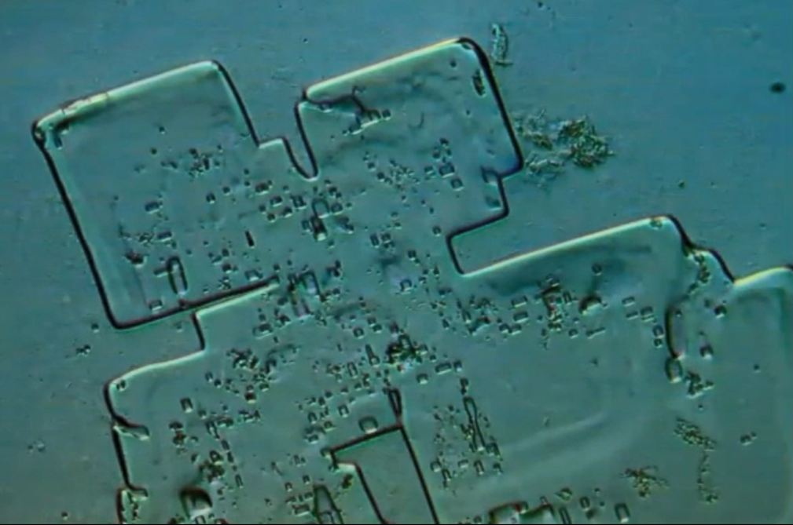
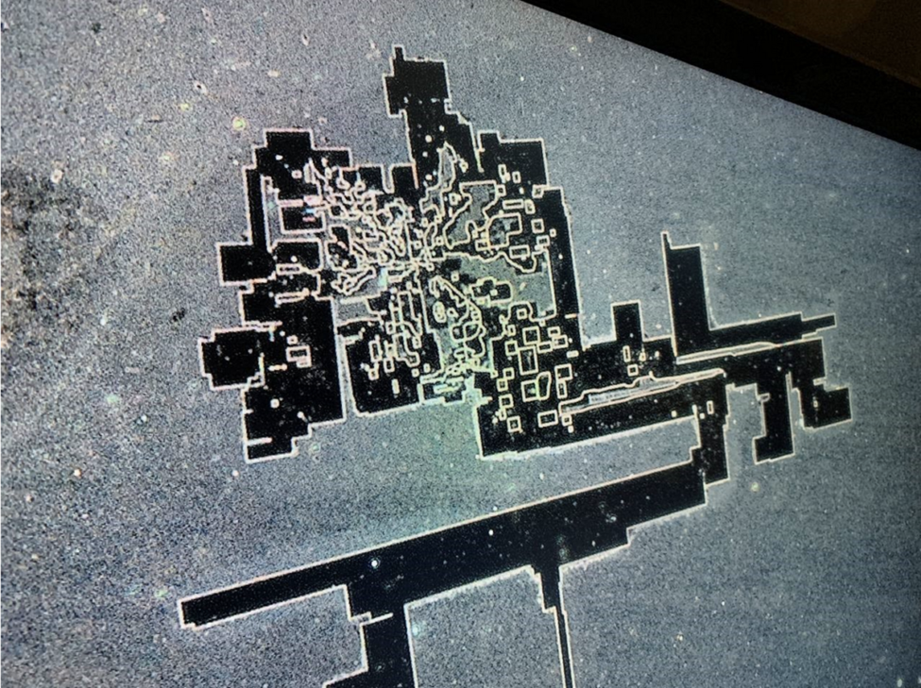
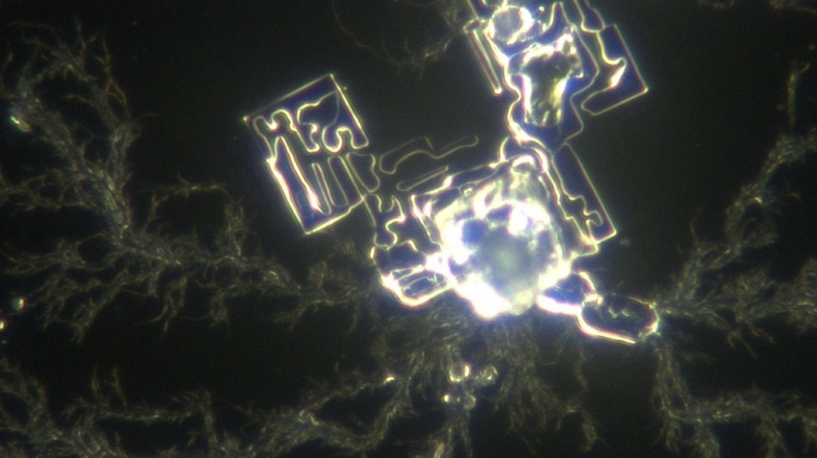
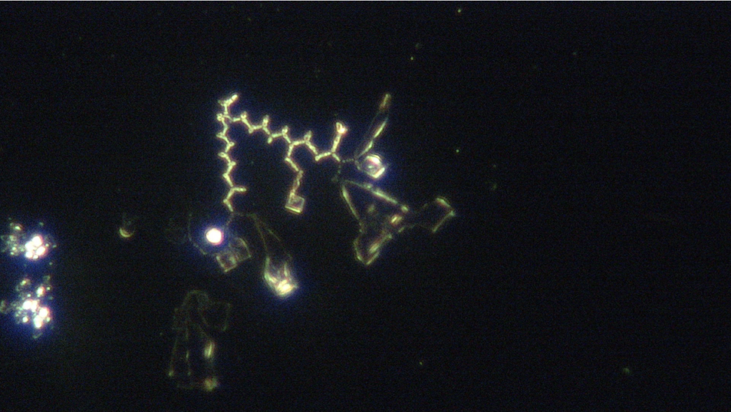
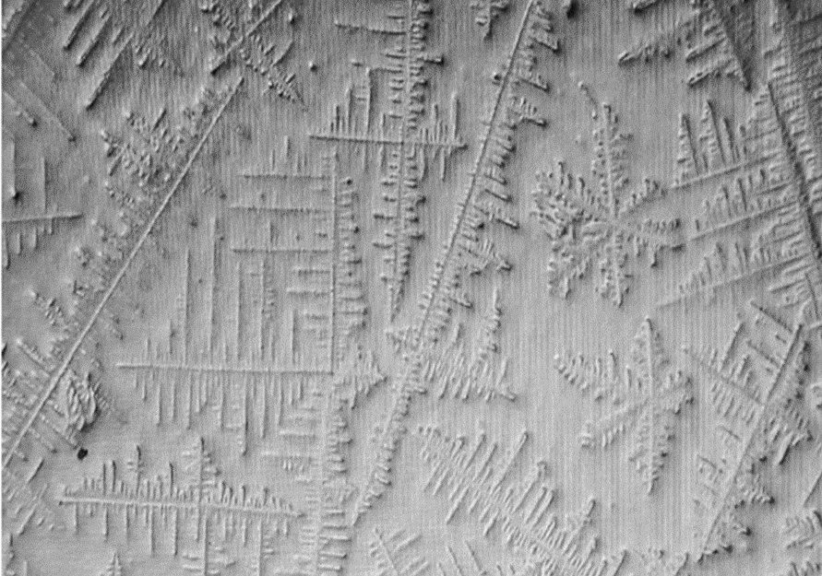
5G AND NANOTECH IN COVID JABS
A PRESENTATION BY FTWPROJECT.COM

Slide 2
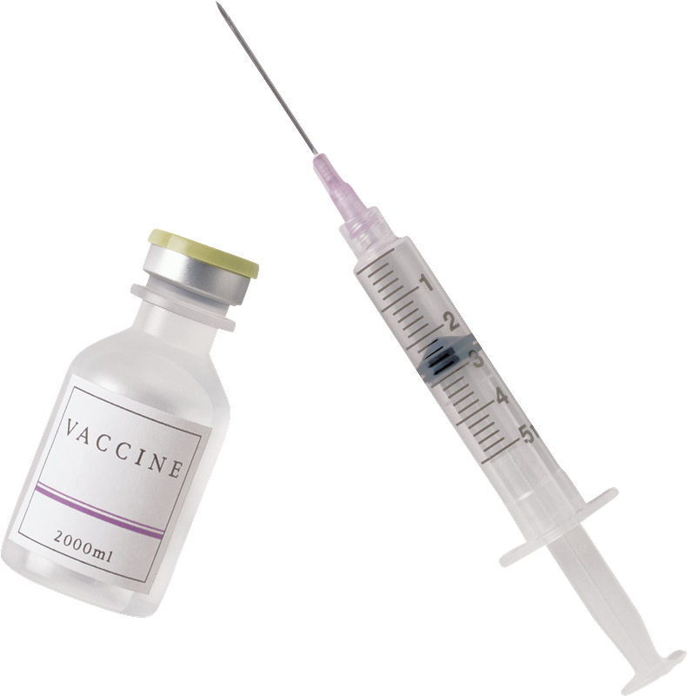
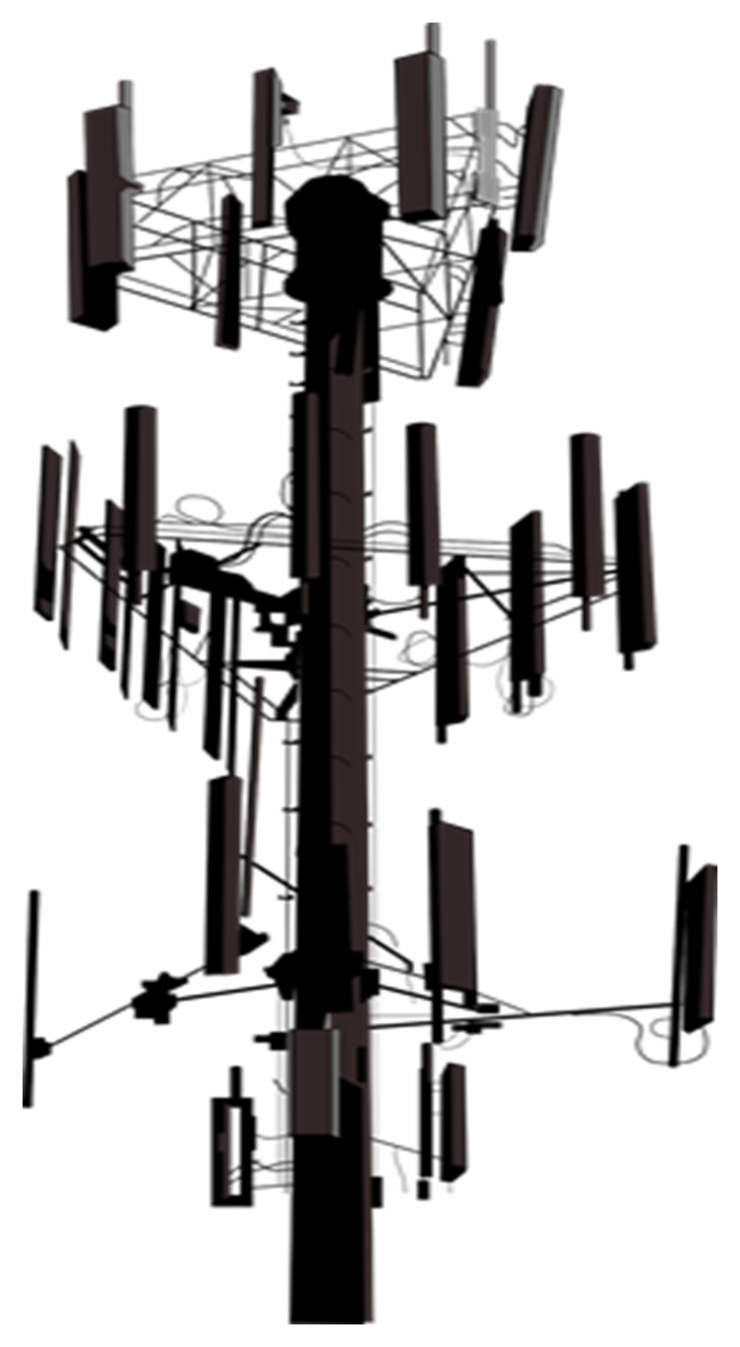
5G AND NANOTECH IN COVID JABS SUMMARY -5G What is C-Band
-EMF Electrical Pollution and the FLU = A History -Tri Field Meters -Lethal Dose Experiment Vaccines and 5G Rollout
-Energy weapons
-Is there a Virus? Virology Fraud Debate -Rockefeller Medical System and the Flexnor Report
-The Nanotechnology Network injected into the Human Body -Humans Emitting Blue Tooth Codes
-Gene Editing and DNA collection -Why am I sick? “Shedding” or transmission -How to protect yourself: EMFs in environment and Strengthening your immune system
EXTENSIVE notes, and reference links provided in blog post article on our website
WWW.FTWPROJECT.COM

Slide 3
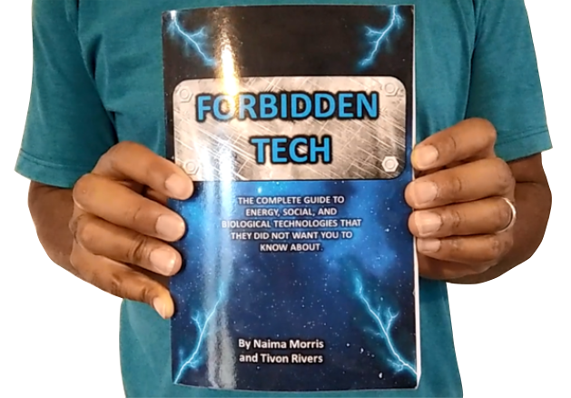
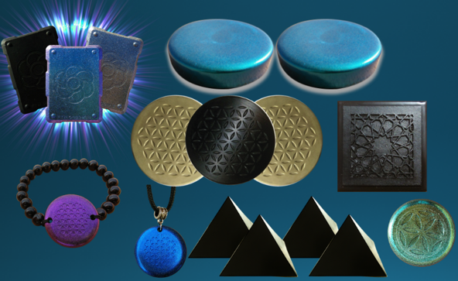
WHY WE DO WHAT WE DO
We are Christians, Engineers and Scientists. We feel it is our calling to help inform people about the technology that is being used against Gods creation. We have been monitoring the news on 5G, Covid Vaccine related issues so that we can present them in a condensed summary to inform the public.
“I will give thee the treasures of darkness, the hidden riches of the secret places…” Isaiah 45:3
FORBIDDEN TECH: The complete guide to energy, social, and biological technologies that they did not want you to know about. (2017) www.FORBIDDENTECH.WEBSITE
Handmade products orgone and shungite for EMF protection. Made by us in our workshop in Morocco. WWW.FTWPROJECT.COM
Online engineering academy for the co-development of researching and building DIY off grid energy devices. WWW.CLEANENERGYACADEMY.COM
WWW.FTWPROJECT.COM
Notes:
If time permits we’d like to play this 4 minute clip https://www.youtube.com/watch?v=aVj7_0A5-Ew

Slide 4
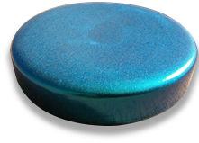
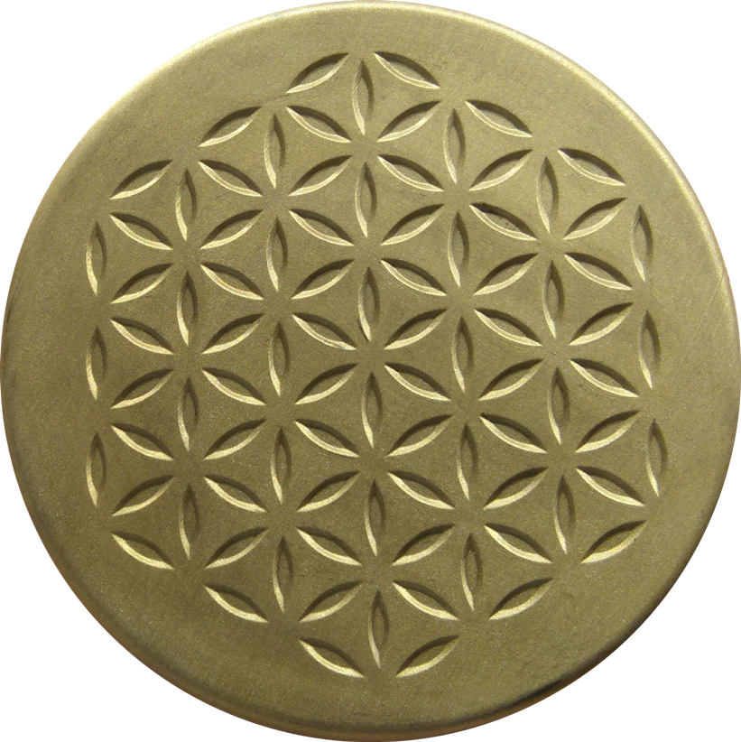
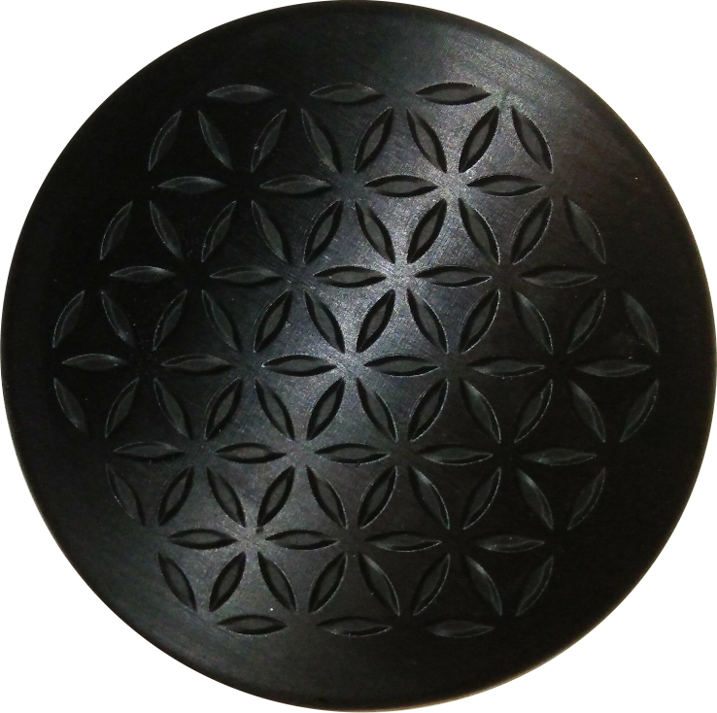
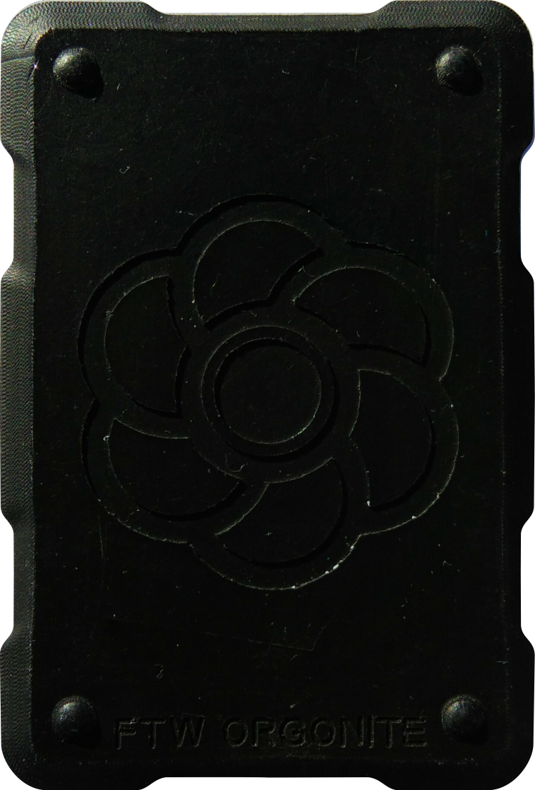
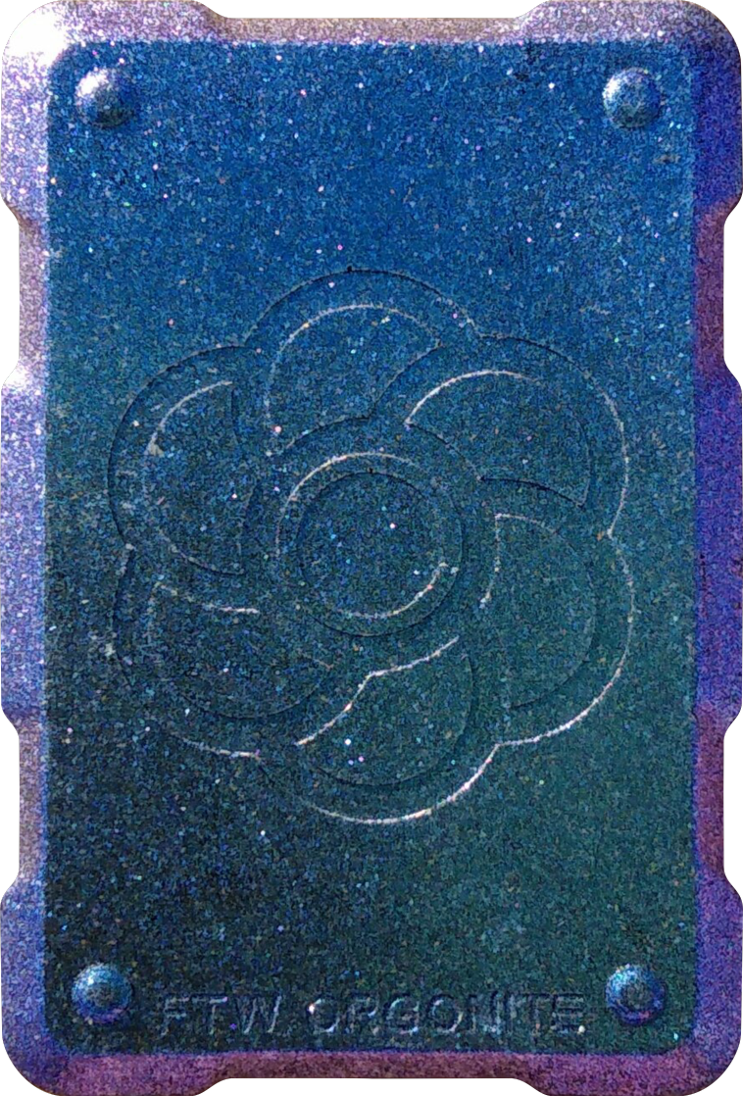
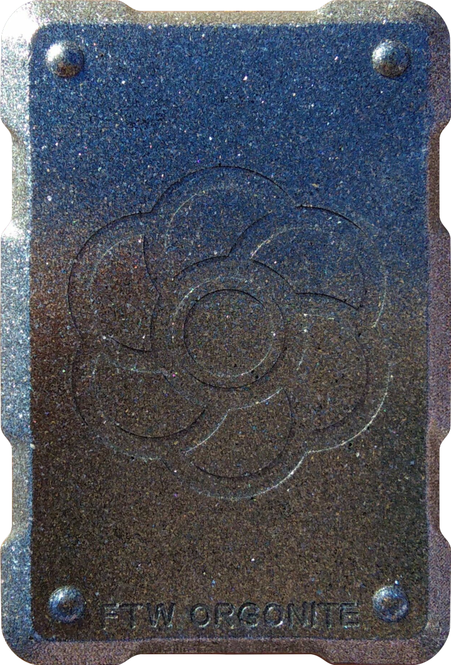
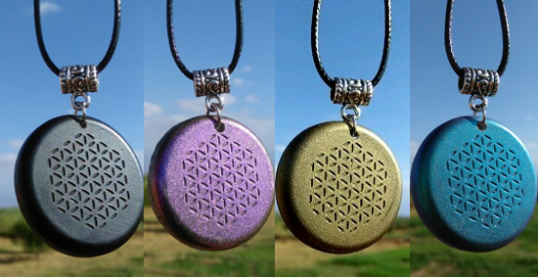
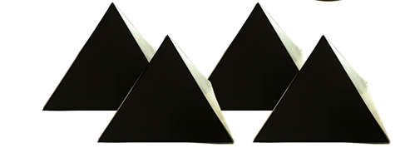
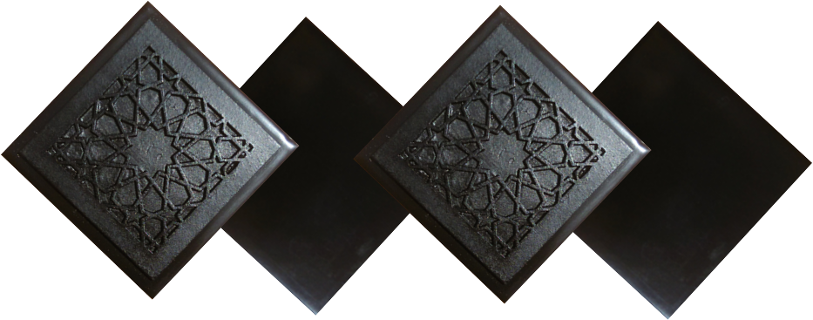
ABOUT OUR EMF PROTECTION PRODUCTS
SLEEPING PODS For a good nights sleep
HELP SUPPORT THE CRAZZ FILES BY SHOPPING FROM THIS LINK: https://www.ftwproject.com/ref/451
CHARGE PLATES for use around the home, to preserve food and more
PHONE SHIELDS to put on your cell phone, laptop and routers
PENDANTS for personal emf protection on your body
SCIENTIFIC STUDIES AND DOCUMENTATION DESCRIBING HOW OUR PRODUCTS WORK AVAILABLE ON OUR WEBSITE.
PYRAMIDS for gridding your home / property / garden for emf protection on a large scale
TILES for incorporating emf protection into construction projects
WWW.FTWPROJECT.COM

Slide 5
WWW.FTWPROJECT.COM

Slide 6
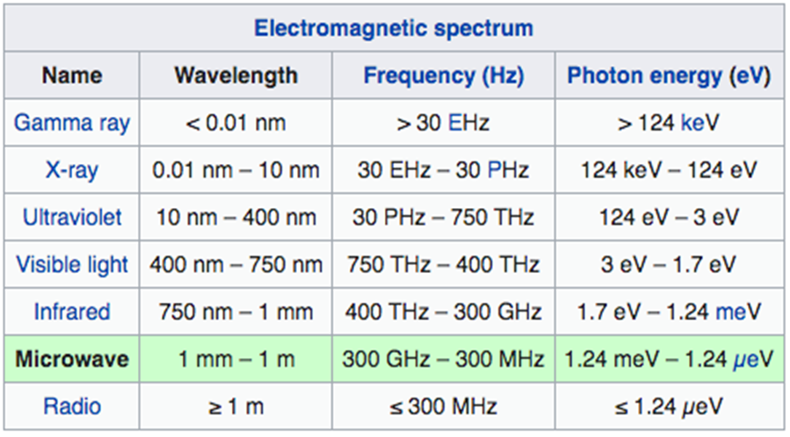
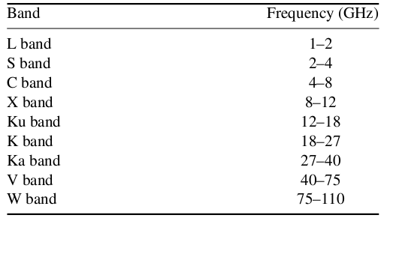
5G: What is C-Band?
Facts about C-Band:
C-band is a designated by IEEE (Institute of Electrical and Electronic Engineers) range of satellite frequencies that TV, government and radio channels use to transmit to ground-based larger satellite dishes, ranging from 4-8 GHz. In the United States, C-band is within 3.7-4.2 GHz (as determined by US FCC).
·Nuclear Fusion facilities and Particle Accelerators use high-power C-band RF sources to power their experiments (3.7, 4.6, 5.996 and 5.713 GHz)
·4.2-4.4 GHz is allocated to the Aeronautical Radio navigation Service (ARNS) worldwide to be use exclusively for radar altimeters installed on-board aircraft and ground-based transponders.
·In February 2020, The FCC adopted rules for C-Band at 3.7-4.2 GHz that allocated the lower 280 megahertz of the band, at 3.7-3.98 GHz, for terrestrial wireless use. Existing satellite operators will have to shift operations to the upper 200 megahertz of the band from 4-4.2 GHz
·In December 2021, Boeing and Airbus called on the US Government to delay the rollout of C-Band due to possible interference with aircraft instruments. January 18th, 2022, Verizon and AT&T announced that they would delay the 5G C-Band rollout near airports in response.
WWW.FTWPROJECT.COM

Slide 7
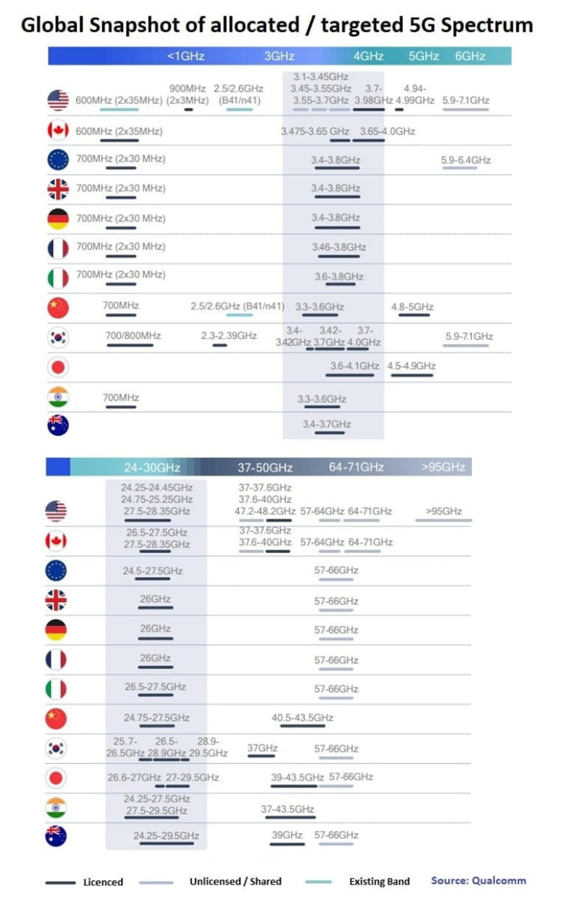
5G / C-Band Situation (source: Qualcomm)
WWW.FTWPROJECT.COM

Slide 8
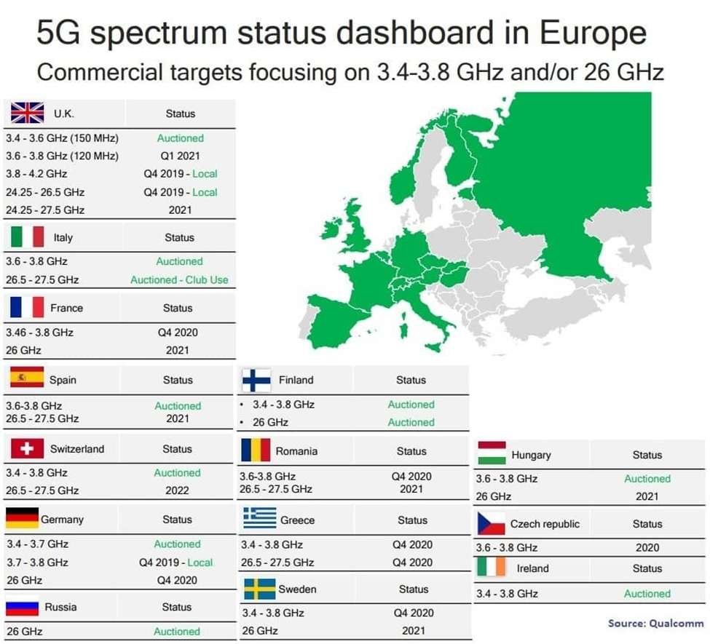
WWW.FTWPROJECT.COM

Slide 9
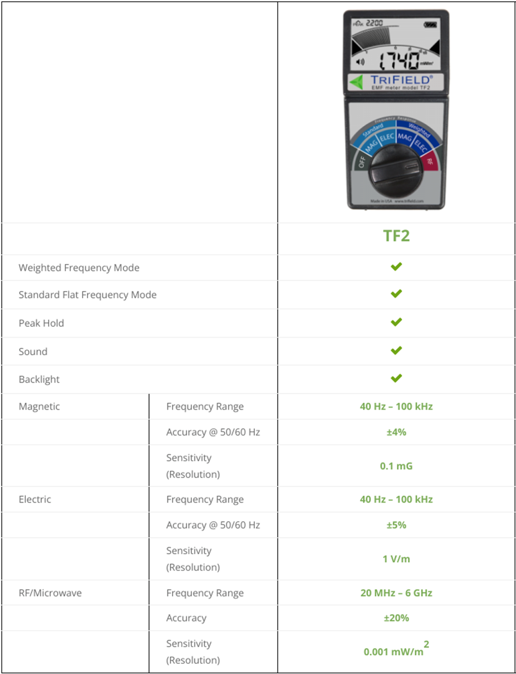
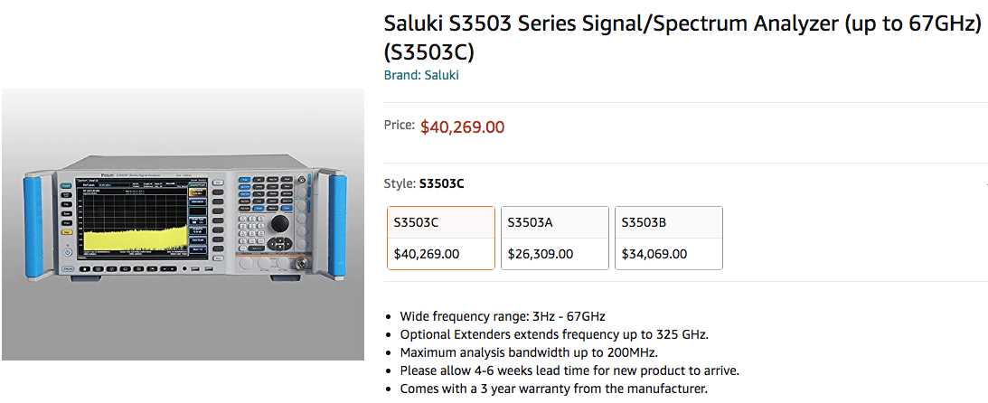
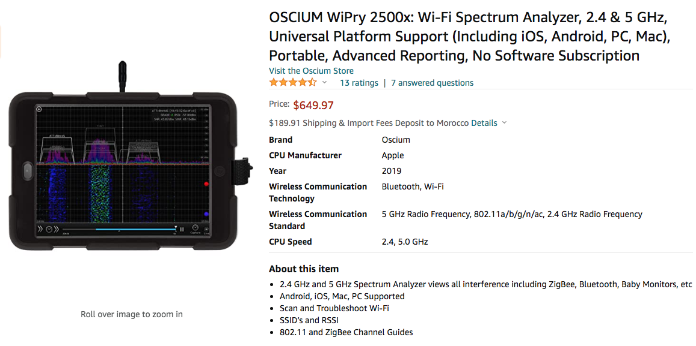
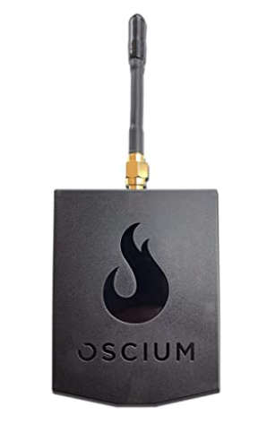
TRIFIELD METERS
WWW.FTWPROJECT.COM

Slide 10
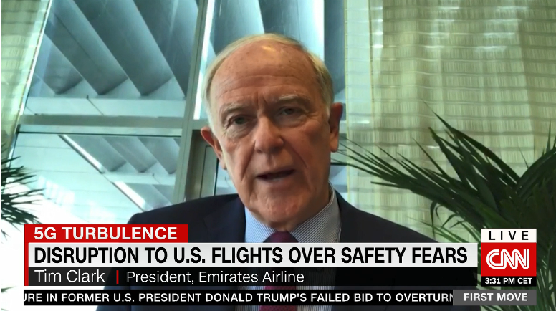
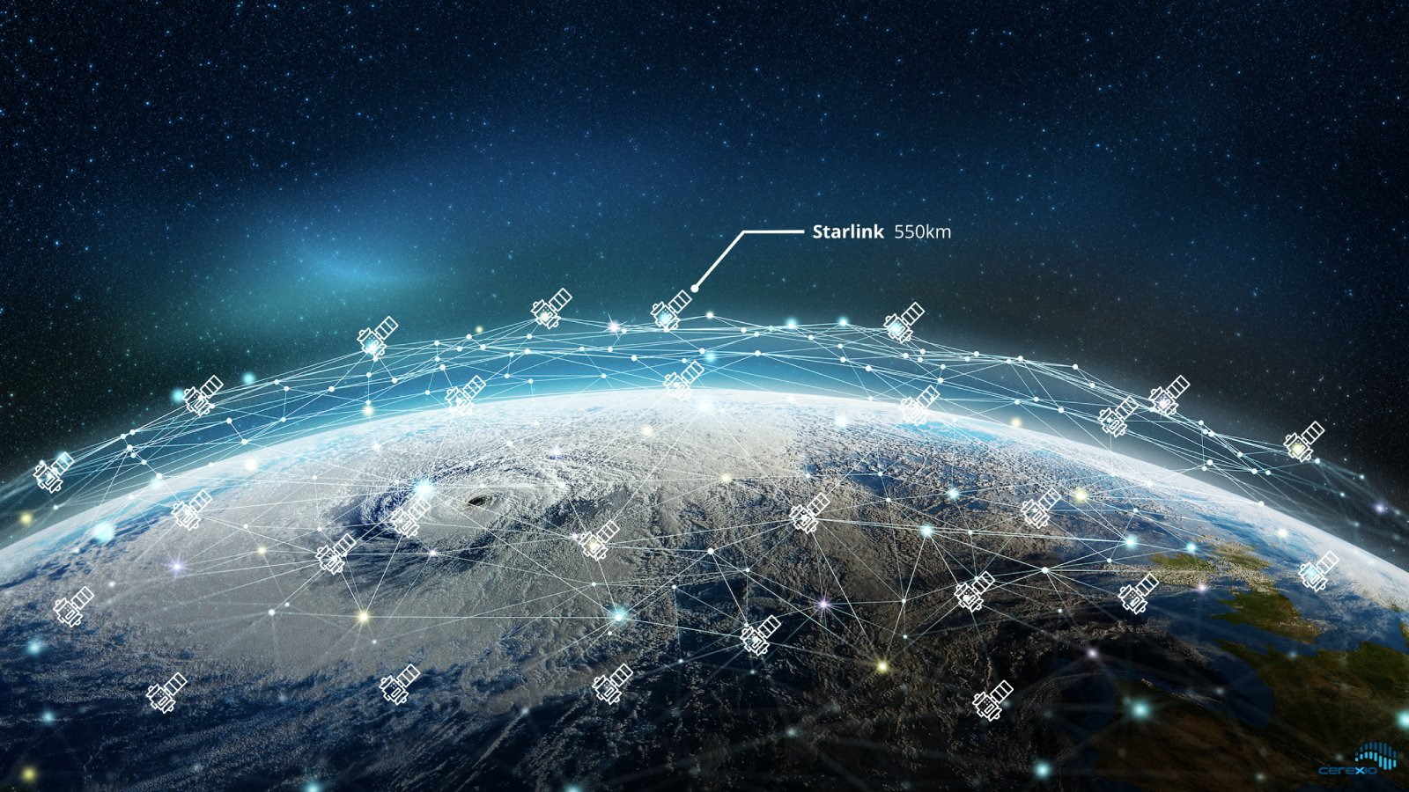
International Airlines cancel flights to the US due to Dangerous US 5G rollout.
Tim Clark, president of Emirates Airlines canceled flights because of US 5G rollout issues:
“We were not aware that the power of the antennae’s in the United States have been doubled compared to what is going on elsewhere, and the antennae’s themselves have been put into a vertical position rather than a sideways position.”
WWW.FTWPROJECT.COM

Slide 11
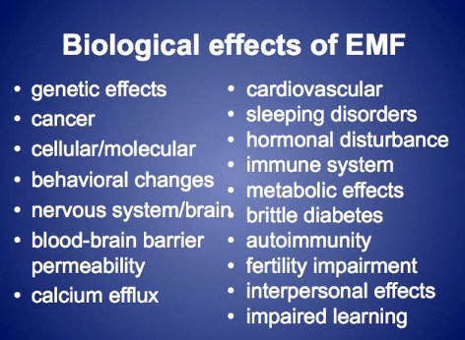
ELECTOMAGNETIC FREQUENCY (EMF) PROTECTION
Since graphene oxide is activated by EMF, you want to create a protective barrier in your immediate environment that mitigates the EMF so that it does not activate the graphene oxide.
-Don’t live near towers crowded cities -Turn off Wifi at night -Don’t use smart meters or smart appliances -Use orgone energy devices to clean up the EMF in your environment
WWW.FTWPROJECT.COM

Slide 12
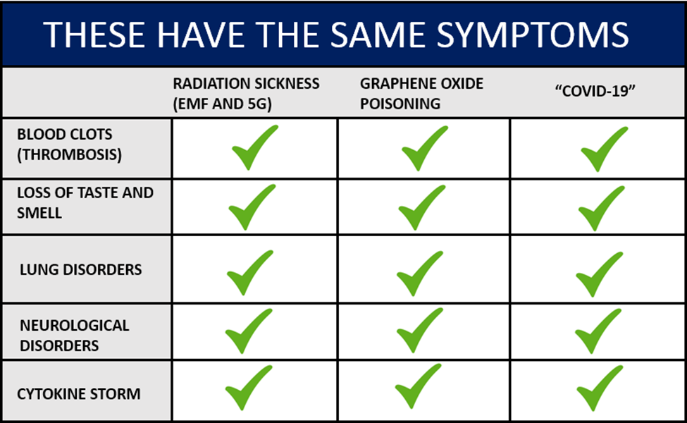
-Based on studies linked in blog post for each sickness -Creation of MASS CONFUSION AND MISDIAGNOSIS ON PURPOSE!
-Everything gets diagnosed as COVID
-Covid Virus has never been isolated
WWW.FTWPROJECT.COM

Slide 13
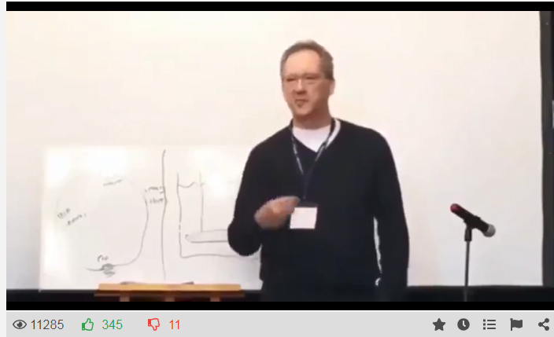
EMF ELECTRICAL POLLUTION AND THE FLU – A HISTORY
Flu-viruses, pandemic and electromagnetic radio and microwave radiation connections:
In The Invisible Rainbow, Firstenberg traces the history of electricity from the early eighteenth century to the present, making a compelling case that many environmental problems, as well as the major diseases of industrialized civilization—heart disease, diabetes, and cancer—are related to electrical pollution.
1918 Radio Era – towers installed all over the planet –SPANISH FLU 1957 Radar Era- radar stations all over the plant- Asian Flu Virus 1968 Satellites- satellites all over the planet- Hong Kong Flu Pandemic 1976 First 1G cell tower in New Jersey – Swine Flu outbreak in New Jersey 1989 upgrade from 2G to 3G tower all over the planet Swine Flu outbreak worldwide 2013 upgrade 3G to 4G – Avian bird Flu 2019 upgrade of 4G to 5G, first town to activate on full scale=Wuhan, China.
Concepts Mentioned in a presentation given by Dr. Tom Cowan
WWW.FTWPROJECT.COM

Slide 14
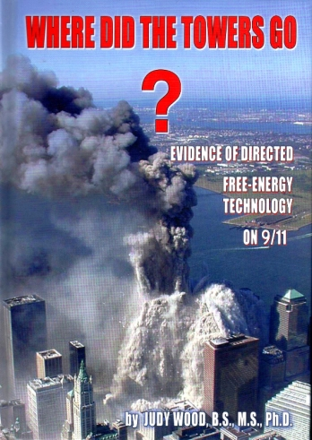
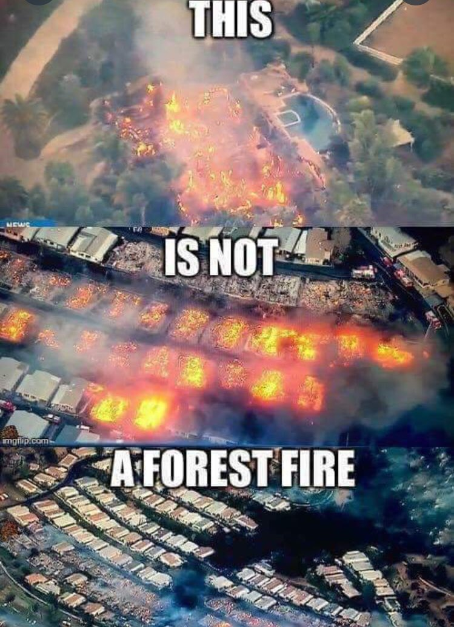
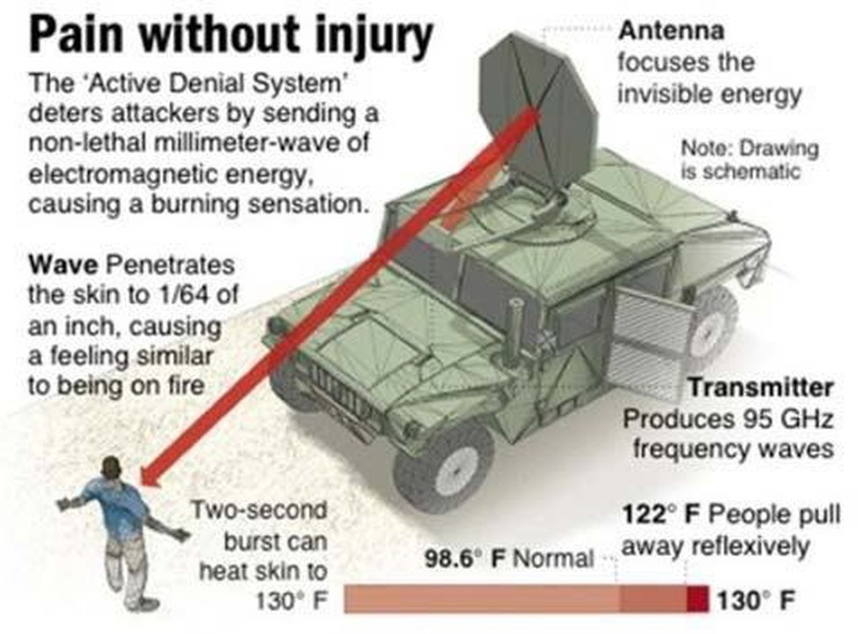
INSTANCES WHERE ENERGY WEAPONS HAVE BEEN USED ON THE POPULATION
Iraq War
911
California Fires
WWW.FTWPROJECT.COM

Slide 15
LETHAL DOSE EXPERIMENT VACCINES AND 5G ROLLOUT
The following analysis is a comparison of research done by Team Enigma on Covid Vaccine batches, a presentation by former Pfizer Chief Scientist Dr. Mike Yeadon in front of the Corona Committee, an explanation by Dr. Lee Merritt former President of the Association of American Physicians and Surgeons, and a presentation done by Dr. Sandra Vranic from the Nanomedicine Lab Faculty of Medical and Human Sciences & National Graphene Institute University of Manchester.
Using VAERS data, Team Enigma matched up vaccine batch or lot numbers to the number of adverse reactions.
WWW.FTWPROJECT.COM

Slide 16
LETHAL DOSE EXPERIMENT VACCINES AND 5G ROLLOUT
ALARMING FINDINGS: -Not all vials (per brand) have the same stuff in them. Some have very lethal dosages, others have saline or placebo, some are in between. They have the quality control to manufacture billions of consistent doses (per Dr. Yeadon’s expert testimony) which they did not adhere to. This was done intentionally by the companies who then lied to the public about it, gaslighting billions of people into taking the injections. “I took it and I’m fine, so you should take it too because it’s the same thing, you’ll be fine too”.
- The batch data shows a coordinated release of each vaccine company, meaning that they were working together and collaborating on this and were not working independently. (per Dr. Merritt’s expert testimony)
-The Pfizer batch release on the chart shows a “dose response curve”, meaning they would release a very toxic batch see what it does, then release a placebo, then release a less toxic batch, then a placebo, then a less toxic batch… (per Dr. Merritt’s expert testimony) The intention is to find out how much poison they can inject into people before it kills them. This dose response curve in the data shows premeditated mass murder by the pharma companies.
This pattern mirrors an experiment that was done in 2016 where they were trying to find out how much graphene oxide they can put into a person before it kills them. (covered this in our last show)
WWW.FTWPROJECT.COM

Slide 17
2016 “Cellular Responses to Graphene Oxide Sheets” Dr. Sandra Vranic
PROOF THEY KNEW THIS WOULD KILL PEOPLE BEFORE THEY INJECTED BILLIONS WITH THIS TOXIC SUBSTANCE IN COVID SHOTS.
Special thanks given to the “Graphene Flagship” in the presentation
AFTER GO was discovered in the Covid Vaccines, people found this presentation and the comments section exploded. It will probably be removed from Youtube soon, we saved the video file and screen shots of the comments.
WWW.FTWPROJECT.COM

Slide 18
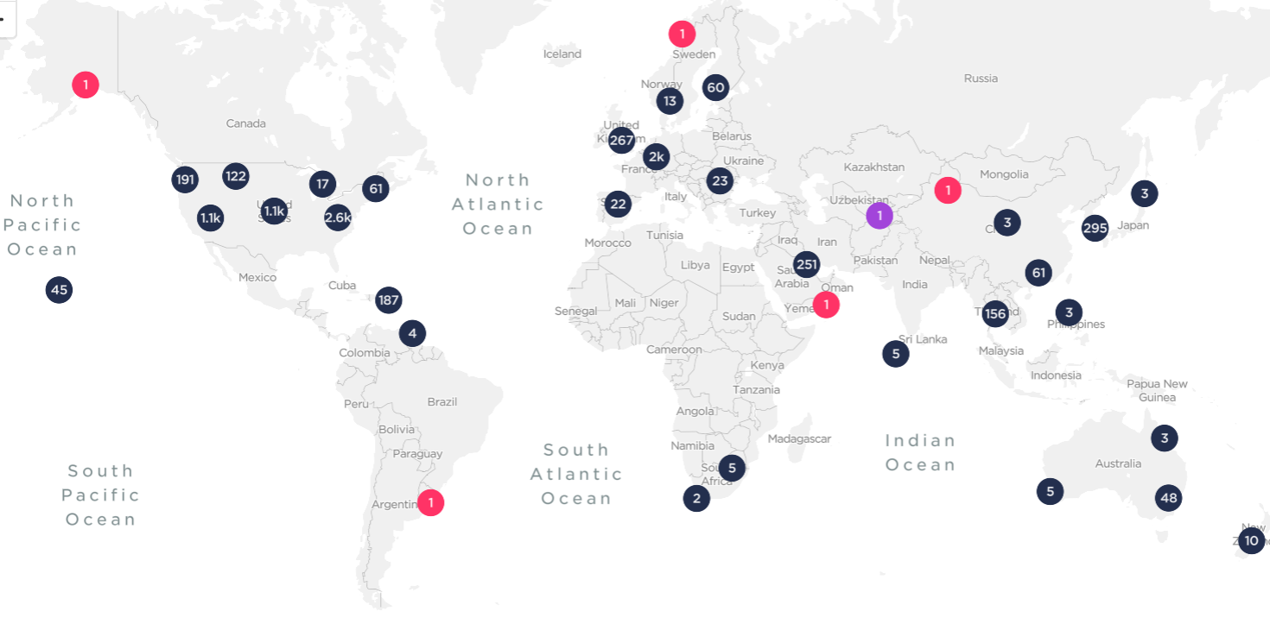
5G LETHAL DOSE EXPERIMENT HYPOTHESIS
Our 5G rollout hypothesis is that they will be experimenting on the population in the same pattern that they have been shown to do with Graphene Oxide experiments and the Covid injections.
They WILL NOT turn on all frequency bands at the same time. They will fluctuate the amount of frequencies emitted in a controlled experiment in various locations based on criteria that we do not have access to.
OOKLA 5G Networks Coverage Map
Testimony sent in by a listener: (name and location redacted) This mans son is a dispatcher in a small Midwest town population 4,000. Normally he gets about one call a night between 6pm-7am which is usually just a drunk doing something stupid or something small like this. On the evening when they turned on the 5G in his town, he got 5 calls. 5 People in different locations all collapsed at the same time. They had to be medevac’d out and luckily they survived. This is what happened when they turned on the 5G in this town.
WWW.FTWPROJECT.COM

Slide 19
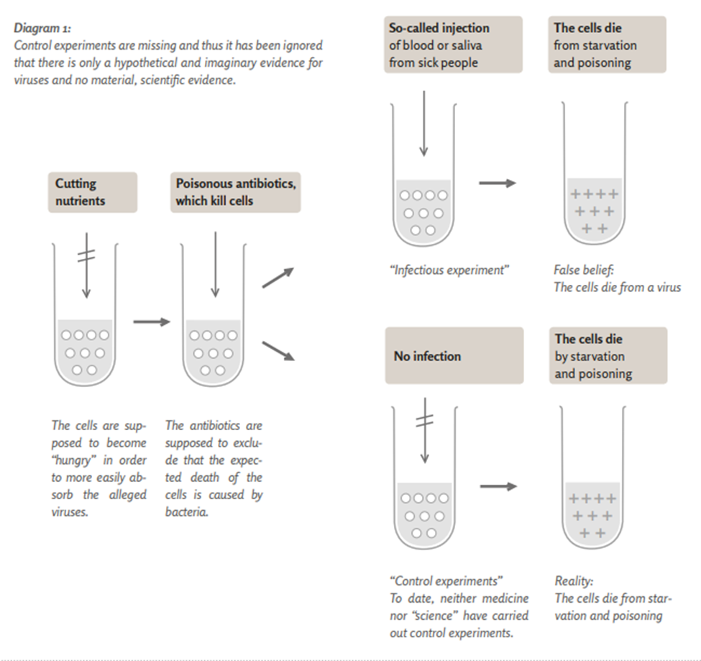
IS THERE A VIRUS? VIROLOGY FRAUD DEBATE.
For the first time in history, a world renown virologist Dr. Stefan Lanka ran a three phased controlled experiment that proved that the way the establishment is claiming to “find viruses” in people is a fraud. THE FINAL REFUTAL OF VIROLOGY: "The first sensational news has arrived. The control tests, which Dr. Stefan Lanka commissioned in a laboratory, confirm that the claimed cytopatic effect, which is regarded by all virologists as evidence for SARS-CoV-2, is refuted.
The laboratory confirmed that this effect is not VIRUS-SPECIFIC and therefore cannot and must not be claimed as evidence of a disease-causing virus.
The central effect, the death of tissue cells in the test tube, is achieved in the same way without any infected material."
WWW.FTWPROJECT.COM

Slide 20
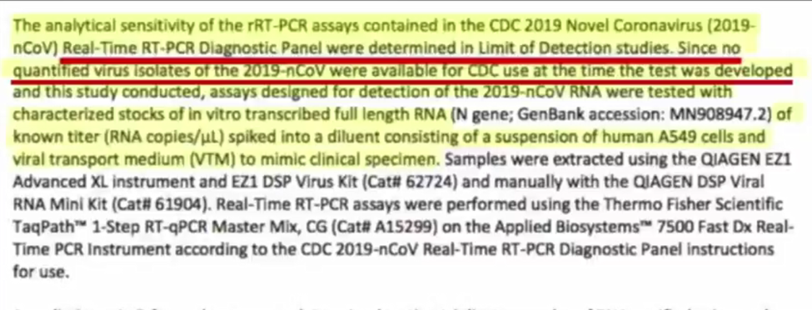
IS THERE A VIRUS? VIROLOGY FRAUD DEBATE.
The “Sars-Cov-2 Virus” that is the official reason for this pandemic, only exists in the form of an “Insilco computer model” or computer sequence simulation. The real “virus” (meaning it was taken from a sick person and isolated to show that it indeed does exist and this virus is what is causing people to get sick) does not exist outside of a computer sequence.
Freedom of information act requests where sent to 159 of the worlds top health officials, health authorities and agencies, virology labs and universities asking them to provide proof that the virus exists. None of them were able to provide proof. Even the CDC openly admits that their PCR test does not look for and cannot detect Sars Cov 2 because they have possession of no such thing outside of a theoretical computer model.
From the CDC WEBSITE
IS THE COVID VIRUS NOTHING MORE THAN A THEORETICAL COMPUTER SIMULATION?
WWW.FTWPROJECT.COM

Slide 21
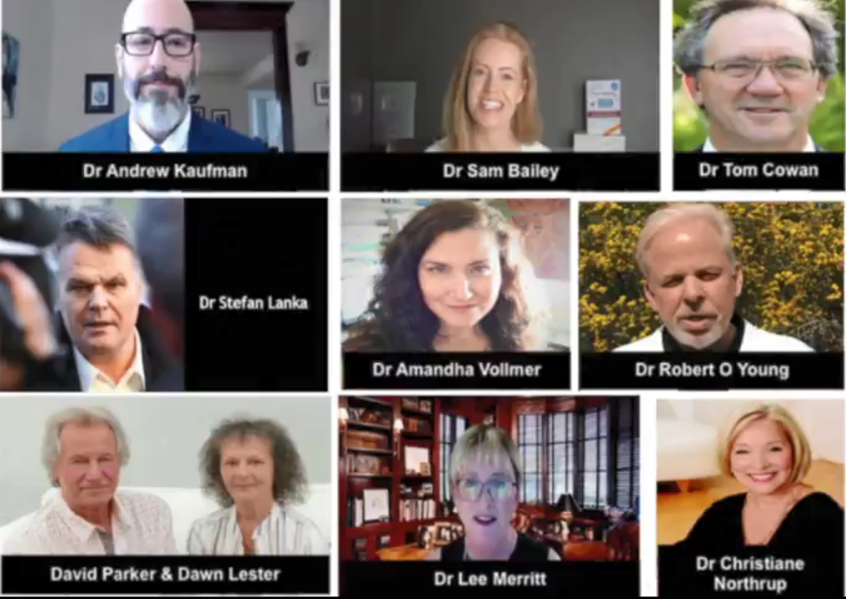
IS THERE A VIRUS? VIROLOGY FRAUD DEBATE.
THESE DOCTORS (AND OTHERS) HAVE BEEN “GOING VIRAL” DEBUNKING THE EXISTENCE OF A REAL VIRUS.
“What’s most important here is that we are all being held hostage, we are having our rights taken away, and all of it is being done with the intent of pushing this experimental technology they call a vaccine upon us. We can see reports already of “mutating viruses”, and second and third waves. As long as we embrace this false virus paradigm that viruses are particles that cause disease from the outside, we are going to be vulnerable to the “next pandemic” and the next one after that, and the next one after that, just like all the ones that came before it that were all fake in just the same way. We have to destroy this paradigm of “viruses that cause disease” because this is the bogyman and this is what is causing the fear and panic that is allowing us to be manipulated.
Dr. Kaufman
While other Doctors hold to their medical establishment beliefs that the virus does exist. More information and references in show notes.
WWW.FTWPROJECT.COM

Slide 22
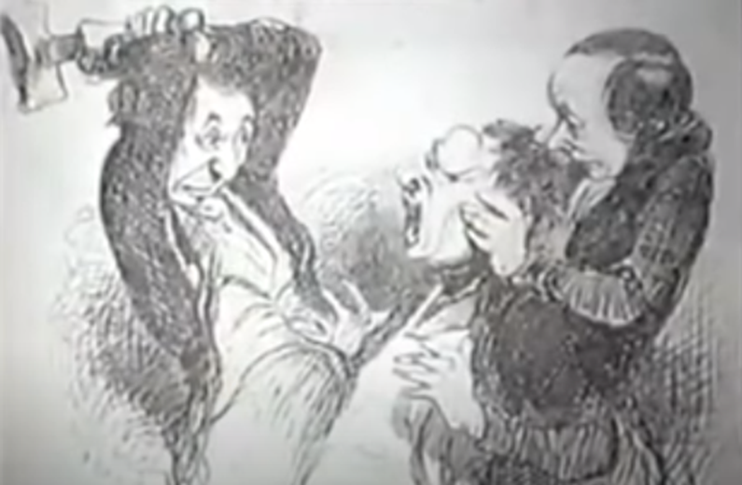
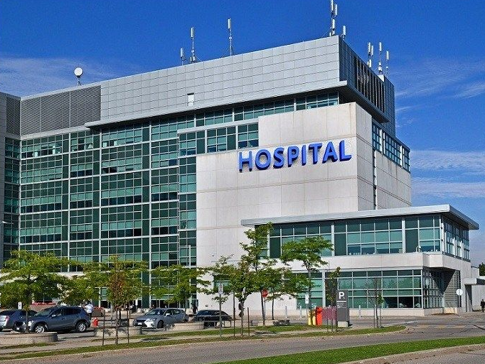
THE ROCKEFELLER MEDICAL ESTABLISHMENT AND THE FLEXNOR REPORT (understanding the medical training and why hospitals are the new “death ovens” of the plandemic holocaust)
In the 1800’s society sanctioned two approaches to healing: Allopathic and Homeopathic.
Allopathic= barbaric aggressive practices like blood letting to “drain out bad humors”, huge doses of toxic minerals like mercury and lead to “displace the disease” , and surgery BEFORE THERE WAS ANESTESIA AND INFECTION CONTROL.
Homeopathic= used herbs and natural ingredients to assist the body in healing itself.
Since most people were afraid of being murdered by allopathic doctors, the homeopathic doctors made all the money. The allopathic doctors formed the American Medical Association (AMA) in order to try to take out their competition of homeopathic doctors.
At the turn of the century new HIGHLY PROFITABLE medical treatments were discovered: anesthesia for surgery, radiation therapy, and patented pharmaceuticals. This caused the fortunes of the Elite families: CARNEGIE, MORGAN, AND ROCKEFELLER to invest in the AMA and transform medicine into a profitable industry, creating the first hospital system. It was all based on profit. Ironically, Rockefeller himself only used a homeopathic doctor while he was investing in allopathic medicine.
WWW.FTWPROJECT.COM

Slide 23
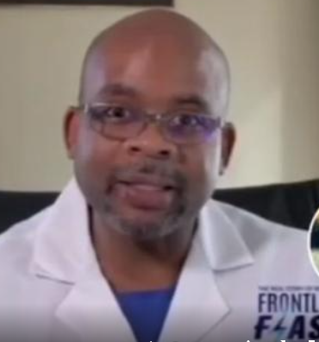
THE ROCKEFELLER MEDICAL ESTABLISHMENT AND THE FLEXNOR REPORT (understanding the medical training and why hospitals are the new “death ovens” of the plandemic holocaust)
FLEXNOR REPORT
In 1910 the Flexnor report was published. Backed by tremendous fortune and profit, the Flexnor Report changed the educational standards and licensing requirements to exclude naturopathic knowledge. Soon, only AMA licensed doctors could legally practice medicine. All naturopathic doctors were put out of business. All the knowledge of natural healing was banned from being taught in medical schools. Within only 20 years, the AMA began to dominate medical practice. They started making a list of homeopathic doctors to slander and smear, which quickly grew to 300,000 names. The Fitzgerald report to congress named at least a dozen other treatments to heal cancer put forward by naturopath doctors They were all blocked by organized medicine, panels of surgeons and radiation therapists.
Dr. Peterson Pierre from the American Frontline doctors
Cares Act provides bonus payments to Hospitals when you have Covid diagnosis. Center for Medicare and Medicaid service is waiving patient rights
Hospitals get a bonus payment: 1) When they give you a free Covid test 2) Another when you have positive Covid test result. 3) Another when they admit you with a Covid diagnosis 4) Another when they put you on remdesivir 5) Another when they put you on a ventilator 6) Another if your death certificate states you died of Covid 7) Another bonus payment to Coroners Up to a $100,000 Per Patient!!
WWW.FTWPROJECT.COM

Slide 24
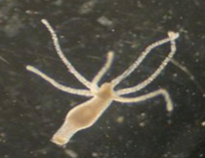
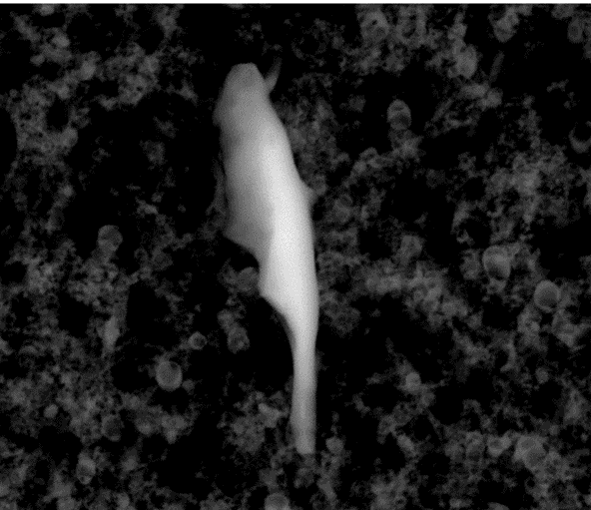
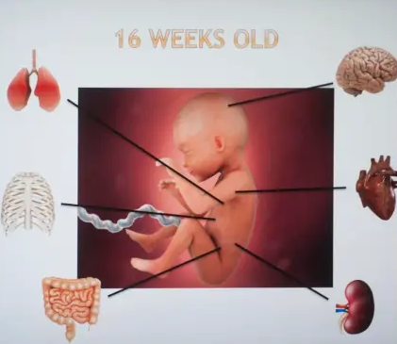
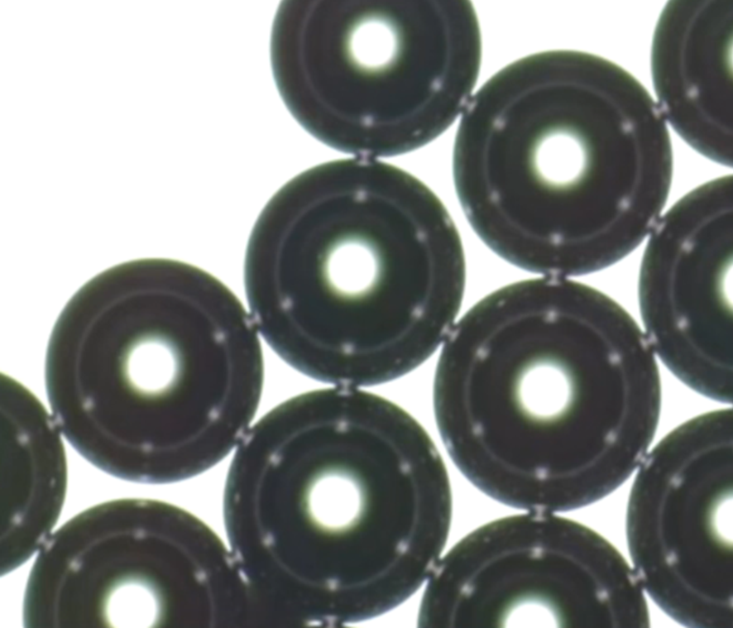
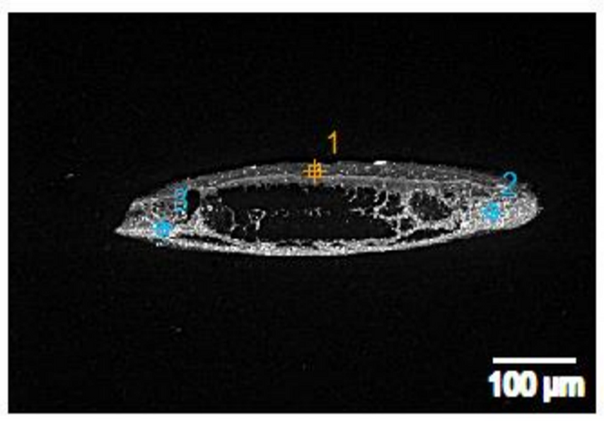
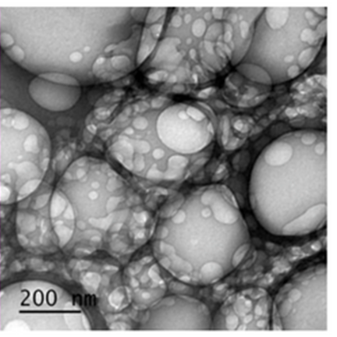
THIS IS WHAT WE KNOW IS IN THE COVID INJECTIONS (SO FAR):
HYDRA VULGARIS ORGANISMS (GMO)
PARASITES
ABORTED HUMAN FETAL TISSUE
MICROCHIPS
MICROBUBBLE TECHNOLOGY
STEEL AND ALUMINUM METALS
GRAPHENE OXIDE
AND THEY WANT TO REQUIRE YOU TO INJECT THIS INTO YOURSELF IF YOU WISH TO TRAVEL, EAT OUT, SHOP, WORK, OR GO TO SCHOOL.
WWW.FTWPROJECT.COM

Slide 25
Found in Covid Injections: (compared to scientific papers) Nano Routers that emit MAC addresses via Bluetooth Nano antennas and plasmonic antennas to amplify signal Nano rectennas as rectifier bridge of alternating and direct current Codecs- devices that perform transformations on a data stream or signal Logic gates- small digital electronic devices that compute binary functions like “and”, “or” ,“not” ,“true”, “false” ,“less than” ,“greater than” , etc. Used for the encryption of these network communications from vaccinated individuals to a remote network server.
PATENTS THAT DESCRIBE HOW THEY WILL HOOK UP HUMAN BEINGS TO THE “INTERNET OF THINGS” VIA 5G. (Now we know that they need the nanotech in the Covid shots in order to accomplish this) Routing policies for biological hosts (AT&T) US10163055B2 Devices and Methods for Transferring Data through a Human Body (AT&T) No. 20130142363 Cryptocurrency system Using Body Activity Data (Microsoft) W02020060606
Text
EXCELLENT REPORT! MUST READ! LINK IN BLOG POST TO REPORT IN ENGLISH “INTRABODY NANO NETWORK BRIEF SUMMARY” –MIK ANDERSON THROUGH LA QUINTA COLUMNA
WWW.FTWPROJECT.COM

Slide 26
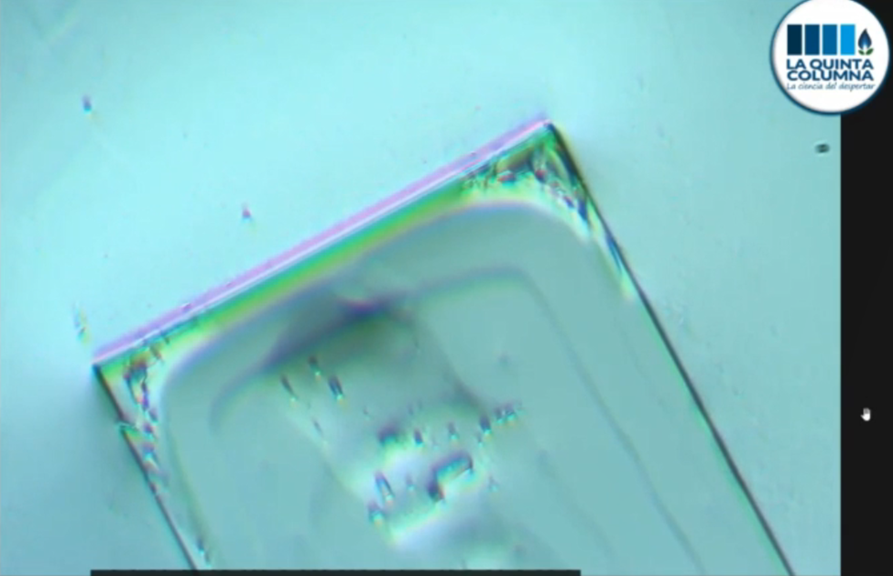
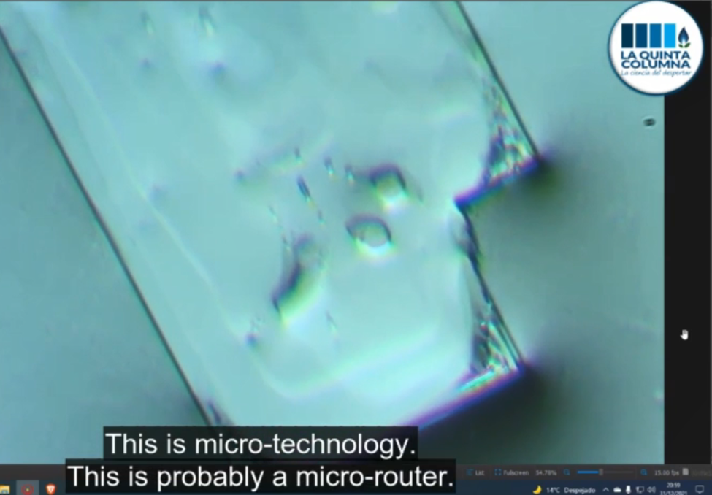
CIRCUITRY AND MICROTECHNOLOGY THAT SELF ASSEMBLES WITH EMF FOUND IN THE PFIZER VACCINES
Ricardo Delgado from La Quinta Columna discusses what they found in the Pfizer Vaccines, its CIRCUITRY AND MICROTECHNOLOGY. When the hydrogel in the vaccine dries it forms these images under the microscope. The edges form perfect squares, and it appears to have circuitry much like a circuit board. In several of the formations they have the same central square chip that looks like a CPU (central processing Unit). In these reports and videos the formations are shown to self assemble when stimulated with EMF.
WWW.FTWPROJECT.COM

Slide 27
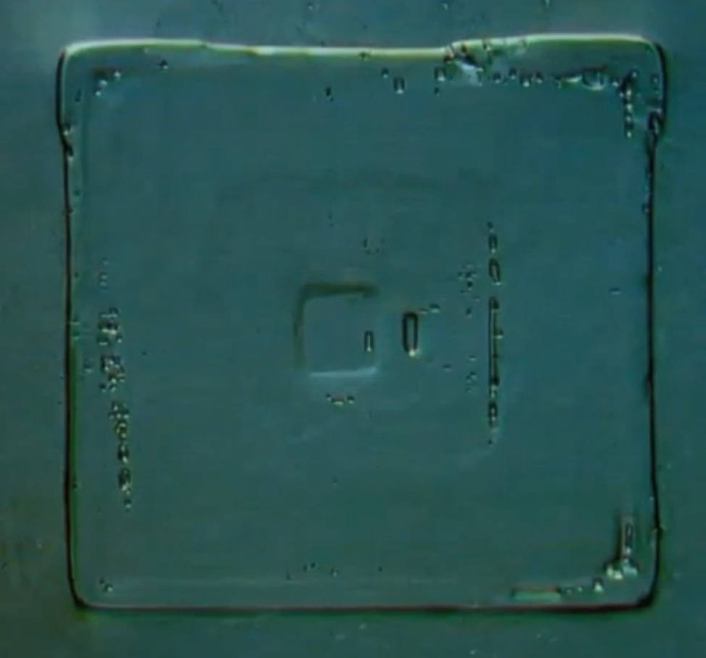
CIRCUITRY AND MICROTECHNOLOGY THAT SELF ASSEMBLES WITH EMF FOUND IN THE PFIZER VACCINES
CPU
WWW.FTWPROJECT.COM

Slide 28
CIRCUITRY AND MICROTECHNOLOGY THAT SELF ASSEMBLES WITH EMF FOUND IN THE PFIZER VACCINES
CIRCUITRY
You can download the NEW REPORT from La Quinta Columna "Identification of possible microtechnology and artificial patterns in Pfizer vaccine with optical microscopy“ WWW.LAQUINTACOLUMNA.NET
WWW.FTWPROJECT.COM

Slide 29
ENGINEERING PERSPECTIVE HOW WERE THESE MICROCHIPS MADE?
-Embedded CPU -vibrating needles -extremely expensive equipment -only a few labs in the world could make this
This narrows down how many companies and countries were involved in the creation of this, which also means they had to collaborate with each other in order to cover this up.
WWW.FTWPROJECT.COM

Slide 30
GERMAN PATHOLOGISTS FIND SAME MICROCHIP SUBSANCES IN COVID SHOTS
Since the initial discovery by La Quinta Columna, other teams of scientists from around the world have been replicating the work and finding the same things in the shots. This presentation shows a mechanically constructed object in the Pfizer vaccine. The machine is moving itself in the fluid.
The same types of object were also found in the J&J shots.
WWW.FTWPROJECT.COM

Slide 31
IMPORTANT DISCLOSURE STATEMENT
What the average person may not know is that the research required to find these substances in the Covid injections is not easy and involves great risk. Scientists have been threatened and censored in order to bring you these images.
The following are the most recent findings by a team of scientists in New Zealand showing nanotechnology in the Pfizer shots. It is to date the most alarming photos we have seen. Within 24 hours the website and videos have been censored off the internet. Luckily an archive was created before they took it down.
WWW.FTWPROJECT.COM

Slide 32
UNDECLARED NANO TECH FOUND IN PFIZER SHOTS BY NEW ZEALAND SCIENTISTS
Shapes and objects were found in the Pfizer shots, after exposure to heat and time and EMF, these shapes SELF ASSEMBLED into microchip circuit boards.
WWW.FTWPROJECT.COM

Slide 33
UNDECLARED NANO TECH FOUND IN PFIZER SHOTS BY NEW ZEALAND SCIENTISTS
These images show the vaccine mixed with human blood. When the vaccine meets up with human blood the white blood cells were annihilated and the red blood cells are heavily damaged.
WWW.FTWPROJECT.COM

Slide 34
VACCINATED HUMANS ARE NOW EMITTING BLUETOOTH CODES
BLUETOOTH CHALLENGE VIDEOS Normally Bluetooth devices have a name on them. But now when you go into a crowded room full of vaccinated people all of these anonymous Bluetooth addresses show up on your phone. Bluetooth challenge videos are popping up everywhere.
A French research team stopped random volunteers in a park. Separated them into groups of vaccinated and non vaccinated. They were then tested with their laptops Bluetooth and the vaccinated were registering an unnamed mac address as each were called near from the field.
HUMAN BEINGS SHOULD NOT EMIT A CODE!!!
WWW.FTWPROJECT.COM

Slide 35
GENE EDITING AND DNA COLLECTION
FROM ONE OF THE STUDIES SHOWING RESEARCH DONE USING HYDRA’S IN MRNA VACCINES
WWW.FTWPROJECT.COM

Slide 36
HYDRA = LOSING OUR HUMANITY
God’s order: “According to its kind” God made the beasts of the earth after their kind, and the cattle after their kind, and everything that creeps on the ground after its kind; and God saw that it was good.
(From Research of Dr. Ariyana Love from Finland)
Hydra Vulgaris= a fresh water organism that has been genetically modified that is being used in the vaccines to carry a variety of programmed synthetic gene sequences and messenger RNA and merge this with human DNA. This process is called transfection. It is essentially the rewiring and control of the ancestral circuitry of human beings.
These genetically modified Hydra’s have been produced in a lab at the University of Kiev. They have been modified in many different ways to produce almost 200 different “lines” of Hydra’s. Some of the Hydra genes have been merged with different toxic bacteria's and Luciferase. CRISPR/Cas9 technology is what they are using to re-code your DNA.
Why are genetically modified Hydra’s being injected into humans in the vaccines?
WWW.FTWPROJECT.COM

Slide 37
HYDRA PREDICTIVE PROGRAMMING
THIS IS A “PLAYING CARD” FROM A COLLEGE BIOLOGY LAB.
HYDRA from Marvel Comics: Evil Nazi group, that used injections to reprogram humans and that also had its main mad scientistS mind connected to an AI program computer.
WWW.FTWPROJECT.COM

Slide 38
SELF ASSEMBLING MICROBUBBLES OF GRAPHENE FOUND IN COVID VACCINES
“Microbeads”, “Microspheres”, “Microbubbles” listed as active ingredients in the Pfizer patent and the Moderna patent.
Made from Graphene Oxide. They are coated with gold nanoparticles and are used for “scaffolding” new DNA based tissues inside the human body.
They interlink by electrodes and can self replicate via electrical pulses. They are used to deliver drugs or a payload over a period of time, which can be over days, weeks, months or years as the Moderna patent specifies.
Found by Dr. Zandre Botha from South Africa while viewing one drop of covid vaccine through a microscope.
WWW.FTWPROJECT.COM

Slide 39
CRISPR Cas/9 GENE EDITING TECHNOLOGY LAUNCHED BY COVID COVER STORY
CRISPR/CAS9 is Gene editing technology. BIG BREAKTHROUGH occurred just months before Covid was “discovered in Wuhan”. For the first time they were able to get the technology to pass down genetic traits from mice to their offspring, and their offspring's offspring.
Now that their Frankenstein creation was ready, all they needed was a way to get this technology injected into every human on the planet. Enter the Covid Plandemic and the Covid Injections.
WWW.FTWPROJECT.COM

Slide 40
REVIEW: FROM OPERATION WARP SPEED EXPOSED
“VACCINE CZAR” Moncef Slaoui
During these interviews he disclosed two VERY DISTURBING bits of information. 1) Millions of Americans who receive the vaccine will be tracked via an “incredibly precise pharmacovigilance surveillance system” that will track the vitals and whereabouts of Americans who receive the Warp Speed Vaccine. 2) Google and Oracle have been awarded the Defense Contract to track and trace Americans who receive the vaccine.

Slide 41
BIG TECH GOT THE DEFENSE CONTRACT TO COLLECT DNA AND TRACK AND TRACE EVERY AMERICAN WHO GETS THE COVID VACCINE
5G ROLLED OUT AT “WARP SPEED” DURING ENTIRE COVID PANDEMIC WHILE EVERYONE WAS LOCKED IN THEIR HOMES AND FORBIDDEN TO PROTEST.

Slide 42
PURPOSE OF FRAUDULENT PCR TESTS IS TO COLLECT AND SELL YOUR DNA
WWW.FTWPROJECT.COM

Slide 43
WHY AM I SICK? SHEDDING TRANSMISSSION AND PROTECTION
Expect Flu Like Symptoms from EMF Pollution and “shedding” from vaccinated individuals.
Set of symptoms branded as “Covid”: fever, headache, loss of taste and smell, achy joints, extremely fatigued.
EMF Pollution / Radiation Sickness
“shedding” or “transmission” from the vaxxed
-studies and reports show that something is indeed being spread from vaxxed to unvaxxed.
-billions of people vaccinated with nanotech that emit a signal are adding to the radiation in the atmosphere. People are the new cell towers.
-more 5G radiating the public
-more satellites launched during the pandemic
WWW.FTWPROJECT.COM

Slide 44
VACCINATED PEOPLE MAKING THE UNVACCINATED SICK
We covered shedding and transmission from the vaccinated in depth in our presentation in May 2021. We believe that the sickness that is being transmitted from the vaccinated to the unvaccinated is being transmitted on an energetic level via the morphogenic field. We showed examples of how this works in our May presentation.
Documentation that shows knowledge and intent of the vaccine manufacturers to promote the shedding of vaccination symptoms to the unvaccinated.
John Hopkins- Self Spreading Vaccines
Pfizer documents admit that the experimental mRNA trial subjects are Super Spreaders who transmit disease to the unvaxxed. During Pfizer’s clinical trials it’s cleverly termed “occupational exposure”.
WWW.FTWPROJECT.COM

Slide 45
HOW TO PROTECT YOURSELF
#1 CLEAN UP TOXIC EMF ENVIRONMENTS AROUND YOU
Since the transmission of sickness is happening through the morphogenic field, there are things you can do to clean the morphogenic field, or change and clean up the energy. Our orgonite products are based on scientific data that shows the unique ways in which they work. We use shungite, iron oxide, steel, quartz, and brass powders, mixed in an epoxy resin. This process when cured creates a piezoelectric effect which passively pulses out the energy effects of the blended ingredients. Creating a field called orgone energy. Just shungite alone is used to clean up EMF and nuclear radiation, the blend of all of these ingredients is what creates the orgone energy field that gently pulses out from the formed object. The end result is a harmonizer that is able to transform the harmful wireless fields from; cell towers, smart meters, smartphones, internet router and your television, into more beneficial energy for you and your plants and pets.
How we make our products:
1. Mix
2. blend
3. pour
4. cure
WWW.FTWPROJECT.COM

Slide 46
HOW TO MEASURE THE EFFECTS
Blood samples are preserved for longer periods of time.
Preserving fruits and vegetable for longer periods of time
Providing pain relief
Better seed germination results
Seeing the energy field form in frozen water
Aiding in better sleep and relaxation
Bigger yields in plants
WWW.FTWPROJECT.COM

Slide 47
ABOUT OUR EMF PROTECTION PRODUCTS
SLEEPING PODS For a good nights sleep
HELP SUPPORT THE CRAZZ FILES BY SHOPPING FROM THIS LINK: https://www.ftwproject.com/ref/451
CHARGE PLATES for use around the home, to preserve food and more
PHONE SHIELDS to put on your cell phone, laptop and routers
PENDANTS for personal emf protection on your body
SCIENTIFIC STUDIES AND DOCUMENTATION DESCRIBING HOW OUR PRODUCTS WORK AVAILABLE ON OUR WEBSITE.
PYRAMIDS for gridding your home / property / garden for emf protection on a large scale
TILES for incorporating emf protection into construction projects
WWW.FTWPROJECT.COM

Slide 48
HOW TO PROTECT YOURSELF
#2 STRENGTHEN YOUR IMMUNE SYSTEM
Stunning effects of Immune system treatments shown to eradicate nanotechnology found in the shots.
Study Done on Nanotech found in covid test swabs:
“Analysis of test sticks from surface testing in the Slovak Republic – confirmation of genocide”
Fractal Graphene nanoantenna’s from La Quinta Columna Report Same thing found by the Slovak Republic team
Figure 17 3D. Darpa Hydrogel Crystals. To this was added human saliva with antibodies on the left and then on the right ivermectin. see Figures 18 and 19.
WWW.FTWPROJECT.COM

Slide 49
IMMUNE SYSTEM TREATMENTS ERADICATE NANOTECHNOLOGY FOUND IN COVID SHOTS
Human saliva with strong immune system antibodies (“recovered from Covid”) broke down the fractal antennae structures when applied to the left side of the slide:
Ivermectin applied to the RIGHT side of the slide completely eradicated the antennae structures and made them disappear all together:
Figure 18
Figure 19
WWW.FTWPROJECT.COM

Slide 50
HOW TO PROTECT YOURSELF
#2 STRENGTHEN YOUR IMMUNE SYSTEM
There are a number of different heath protocols and treatments that you can do to prevent illness, and protect yourself. Valerie Robitaille PhD is a Nutritionist and Herbalist who has been working with many people both vaxxed and unvaxxed to help them restore their health in the midst of this global attack on our immune systems.
She is also Hope’s mom, and a member of our handmade orgonite team helping us to get our products shipped out to people all over the world.
WWW.FTWPROJECT.COM

Slide 51
EXTENSIVE NOTES, REFERENCE LINKS AND PREVIOUS PRESENTATIONS ALL AVAILABLE ON OUR BLOG AT WWW.FTWPROJECT.COM
Topics covered more in depth in previous presentations:
Big Tech censoring links to 5G and Covid. Big Tech collecting DNA Conductive Hydrogels Darpa Hydrogel Covid Vaccine Operation Warp Speed Exposed Big Tech Defense contract for covid vaccine data Early Covid symptoms caused by 5G Social distancing, face masks Adverse reaction to covid vaccines 5G Auction Ookla 5G Map where are they turning on 5G? EMF protection, shungite and bee colony collapse Shedding and Transmission Reports Vaxxed to non vaxxed Spike proteins Fibers found in PCR test swabs Morphic field, morphogenic resonance, biophotons Orgone energy and shungite Gene therapies and the days of Noah
Graphene Oxide explained Graphene Oxide, steel, parasites in covid shots Graphene Oxide lethal dose study from 2016 How Graphene Oxide works with 5G Covid Symptoms is radiation sickness and GO poisoning Magnetism in vaccinated explained Connection between 5G rollout and Covid variants How to get graphene Oxide out of your body
WWW.FTWPROJECT.COM

