Slide 1
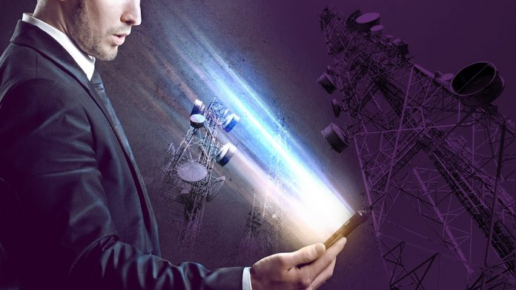
EMF PROTECTION, 5G, NANOTECH

Slide 2
EMF PROTECTION BASICS
SUMMARY Why we do what we do Dangers of EMF
5G Newest Updates Nanotech What you can do to protect yourself Science behind it: Orgone and Shungite How we make our EMF protection products How our EMF protection products work More science: Blood tests, plants, ice test, pyramid shape study Benefits and Testimonials All links and more info referenced can be found on our Blog Post

Slide 3
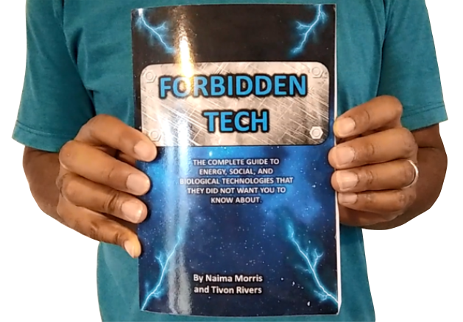
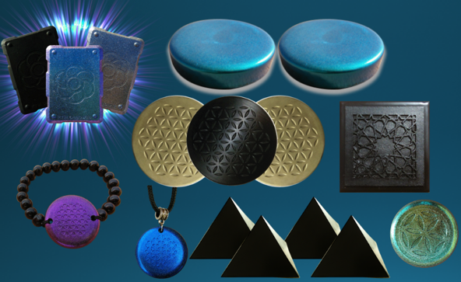
WHY WE DO WHAT WE DO
We are Christians, Engineers and Scientists. We feel it is our calling to help inform people about the technology that is being used against Gods creation.
FORBIDDEN TECH: The complete guide to energy, social, and biological technologies that they did not want you to know about. (2017) www.FORBIDDENTECH.WEBSITE
Handmade products orgone and shungite for EMF protection. Made by us in our workshop in Morocco. WWW.FTWPROJECT.COM
Online engineering academy for the co-development of researching and building DIY off grid energy devices. WWW.CLEANENERGYACADEMY.COM
Notes:
If time permits we’d like to play this 4 minute clip https://www.youtube.com/watch?v=aVj7_0A5-Ew

Slide 4
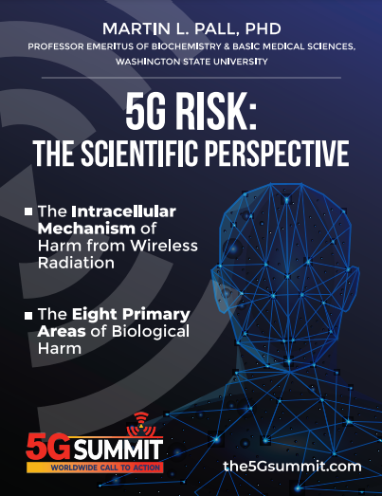
Dangers of EMF Radiation
Compelling Evidence for Eight Distinct Types of Great Harm Caused by Electromagnetic Field (EMF) Exposures and the Mechanism that Causes Them This 127-page eBook is a powerful summary of the science that telecoms don't want us to know, because it scientifically demonstrates, beyond any reasonable doubt, the biologically harmful effect of 5G deployments and wireless radiation in general. Includes citations to 139 scientific research papers.

Slide 5
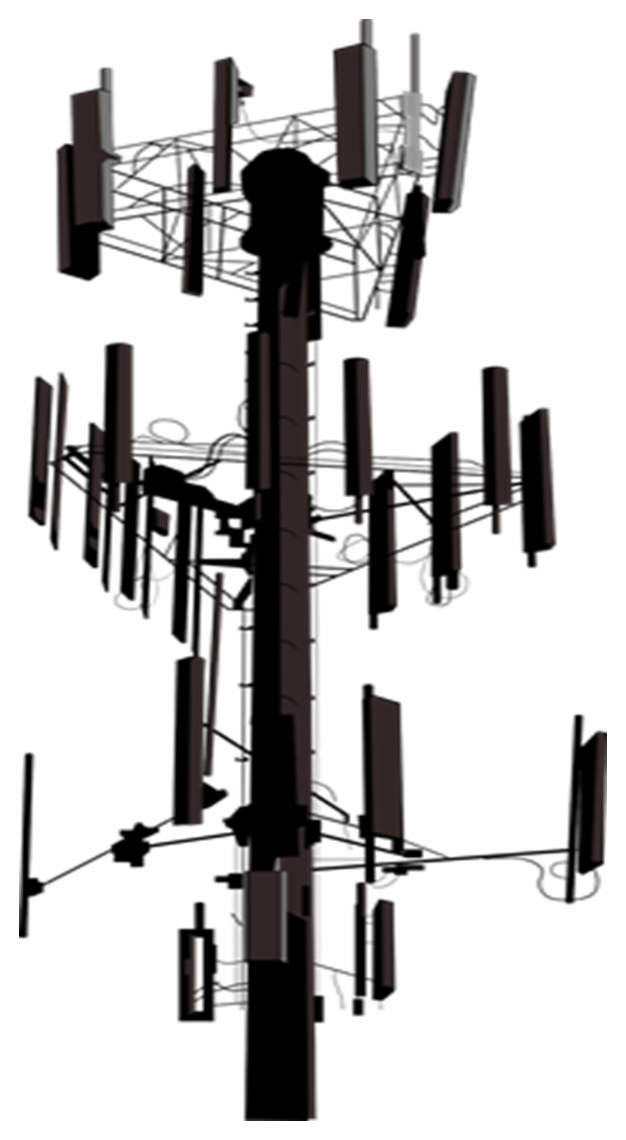
Dangers of EMF Radiation
Martin Pall, Professor Emeritus of Biochemistry and Basic Medical Sciences at Washingon State University
“EMFs act by activating channels in the membrane that surrounds each of our cells, called voltage-gated calcium channels (VGCCs). The EMFs put forces on the voltage sensor that controls the VGCCs of about 7.2 million times greater than the forces on other charged groups in our cells [4,6,7]. This is why weak EMFs have such large biological effects on the cells of our bodies! EMFs works this way not only on human and diverse animal cells [1-7] but also in plant cells [7] so that this is a universal or near universal mechanism of action. “
Listed in this 90 page paper on 5G EMF Hazards Paper

Slide 6
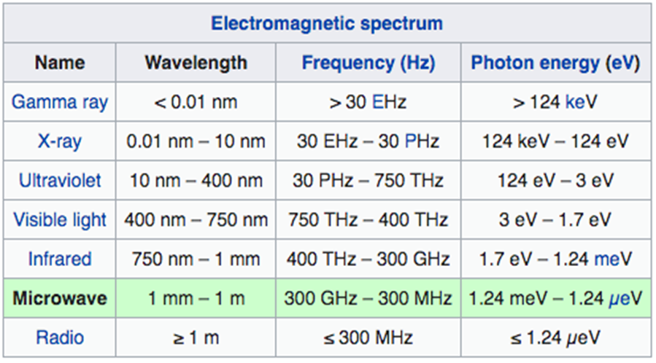
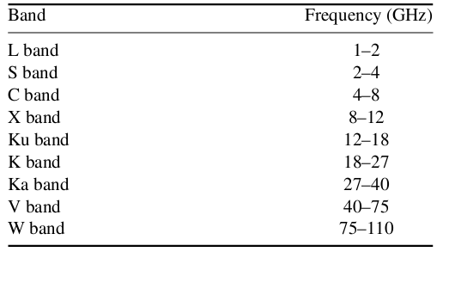
5G: What is C-Band?
Facts about C-Band:
C-band is a designated by IEEE (Institute of Electrical and Electronic Engineers) range of satellite frequencies that TV, government and radio channels use to transmit to ground-based larger satellite dishes, ranging from 4-8 GHz. In the United States, C-band is within 3.7-4.2 GHz (as determined by US FCC).
·Nuclear Fusion facilities and Particle Accelerators use high-power C-band RF sources to power their experiments (3.7, 4.6, 5.996 and 5.713 GHz)
·4.2-4.4 GHz is allocated to the Aeronautical Radio navigation Service (ARNS) worldwide to be use exclusively for radar altimeters installed on-board aircraft and ground-based transponders.
·In February 2020, The FCC adopted rules for C-Band at 3.7-4.2 GHz that allocated the lower 280 megahertz of the band, at 3.7-3.98 GHz, for terrestrial wireless use. Existing satellite operators will have to shift operations to the upper 200 megahertz of the band from 4-4.2 GHz
·In December 2021, Boeing and Airbus called on the US Government to delay the rollout of C-Band due to possible interference with aircraft instruments. January 18th, 2022, Verizon and AT&T announced that they would delay the 5G C-Band rollout near airports in response.
WWW.FTWPROJECT.COM

Slide 7
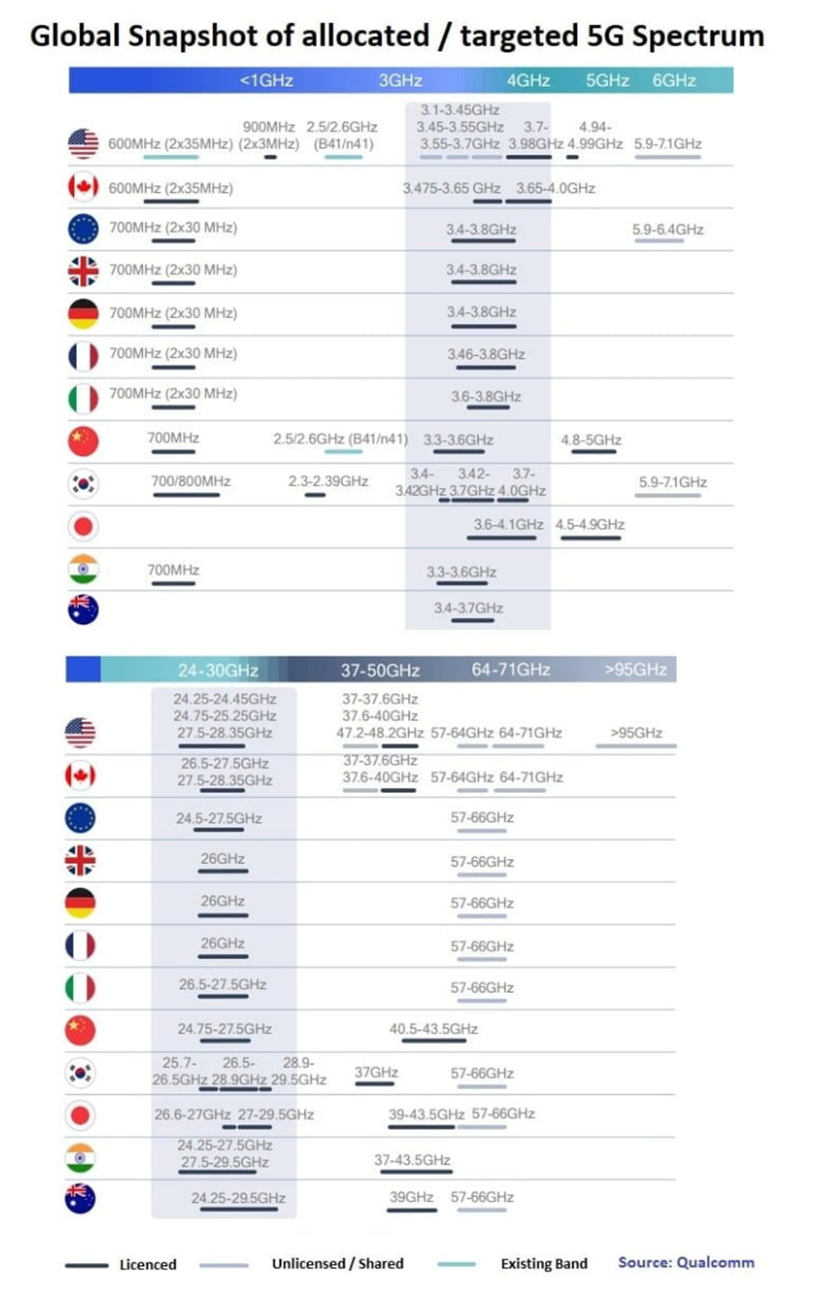
5G / C-Band Situation (source: Qualcomm)
WWW.FTWPROJECT.COM

Slide 8
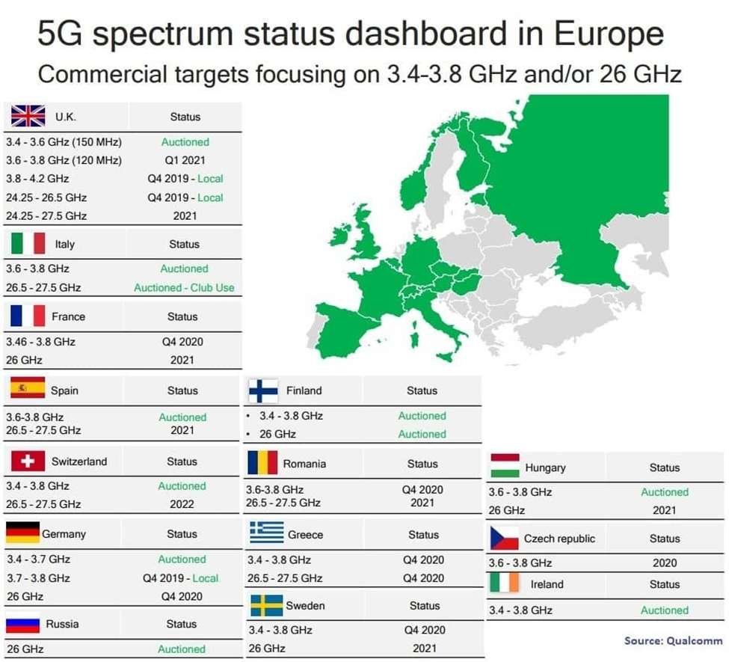
WWW.FTWPROJECT.COM

Slide 9
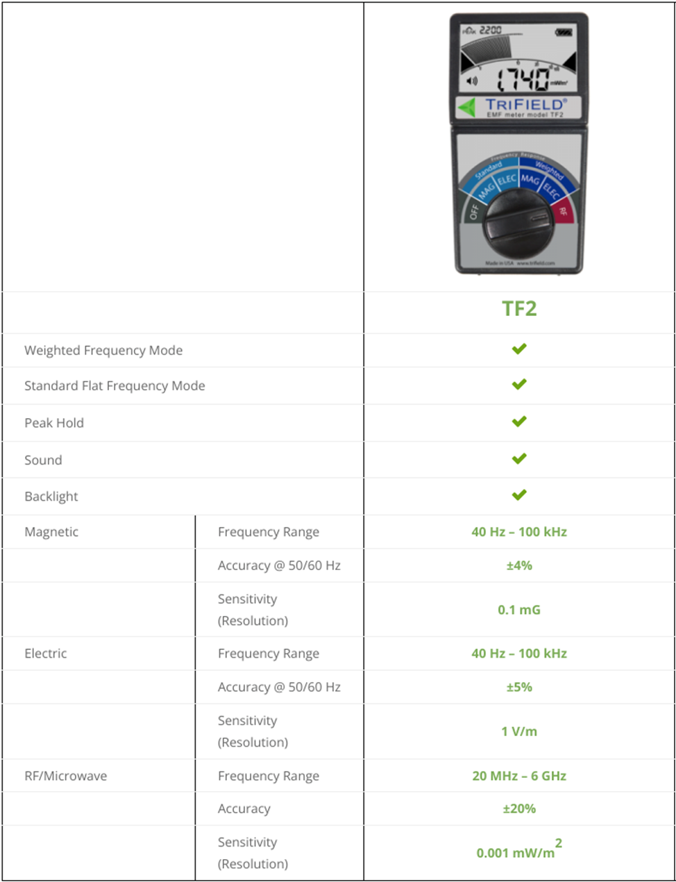
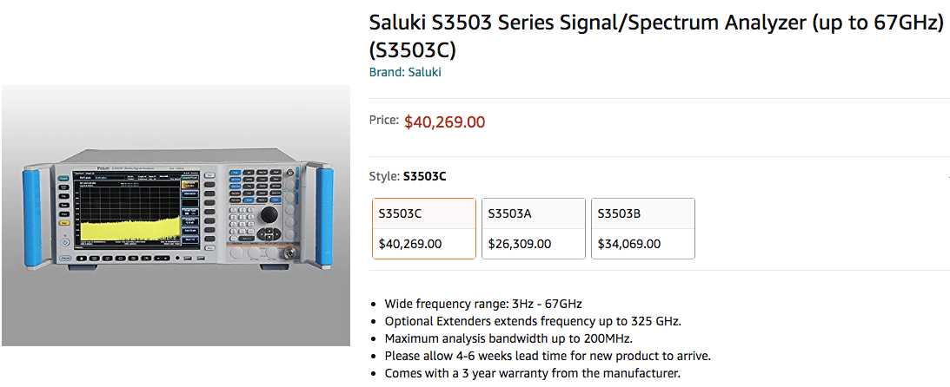
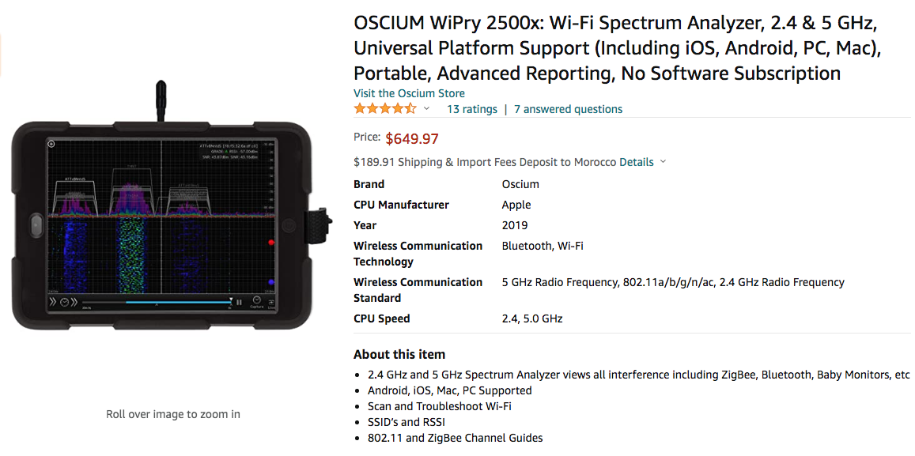
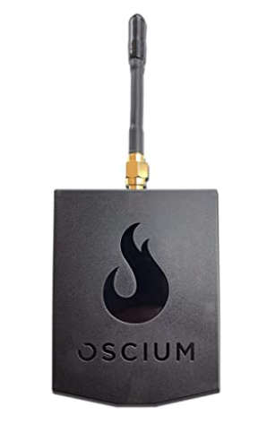
TRIFIELD METERS
WWW.FTWPROJECT.COM

Slide 10
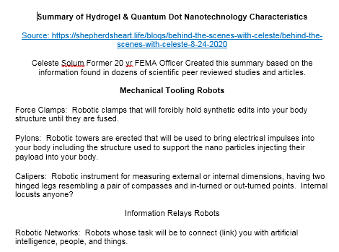
HYDROGEL NANOTECH CHARACTERISTICS STUDIES AND PATENTS
Nanotech used in hydrogels is designed to lock into our DNA to manipulate it, track and trace our bodies by collecting and transmitting our information to a data collection point, monitor our vitals, fuse into our system to allow a means of physical, biological control by an outside source. They are putting hydrogels in the Food Supply (Journal of Agriculture and Food Chemistry)

Slide 11
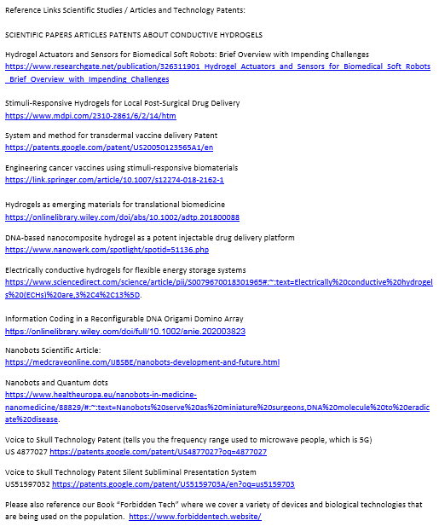
HYDROGEL NANOTECH CHARACTERISTICS STUDIES AND PATENTS

Slide 12
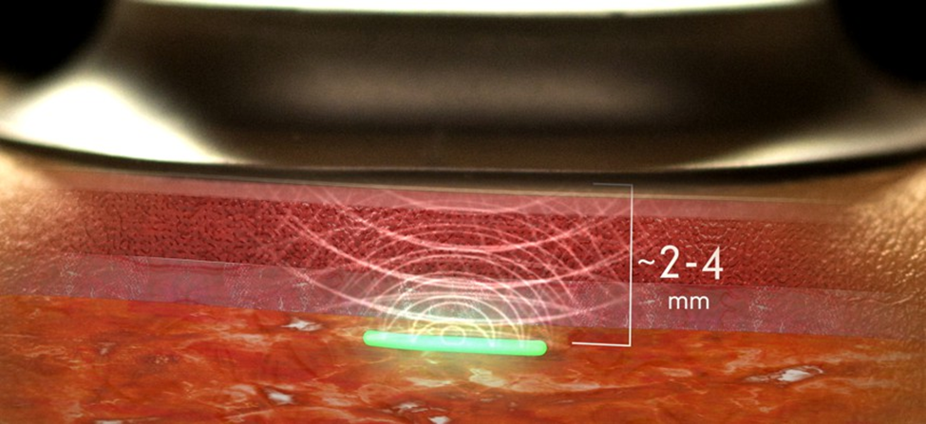
From: A Military-Funded Biosensor Could Be the Future of Pandemic Detection
WWW.FTWPROJECT.COM

Slide 13
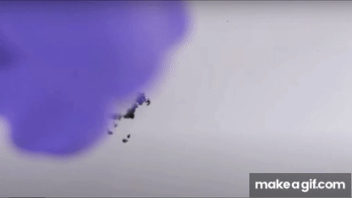
Properties of Graphene Oxide (or why they are REALLY using it in Bio-Medical Industry)
-Stimulated / controlled by EMF frequencies, specifically those found in 5G -multiplies when electronically stimulated -transparent -LUCIFEROUS-bioluminescence -magnetism - extremely strong -can be used to manipulate neural pathways in the brain.
THIS IS WHAT THEY ARE PUTTING IN YOUR BODY!! (VIEW IN SLIDESHOW MODE FOR ANIMATION)
WWW.FTWPROJECT.COM

Slide 14
EMF PROPERTIES OF HYDROGELS IN COVID INJECTIONS
Properties of Hydrogels: Hydrogels are “ON DEMAND” which means they can be triggered at any moment to deliver a payload. Hydrogels can be used as “BIOCENSORS” in the body, meaning they have the ability to accumulate data from your body such as your breathing, respiration, thoughts emotions, etc. Hydrogels have the ability to act through WIFI. They can both TRANSMIT AND RECEIVE Energy, messages, frequencies or impulses.
See it with your own eyes! Video of what hydrogels can do while beamed with electrical fields.

Slide 15
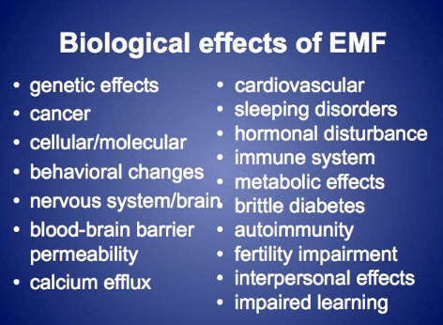
ELECTOMAGNETIC FREQUENCY (EMF) PROTECTION
Since graphene oxide is activated by EMF, you want to create a protective barrier in your immediate environment that mitigates the EMF so that it does not activate the graphene oxide.
-Don’t live near towers crowded cities -Turn off Wifi at night -Don’t use smart meters or smart appliances -Use orgone energy EMF protection devices to clean up the EMF in your environment
WWW.FTWPROJECT.COM

Slide 16
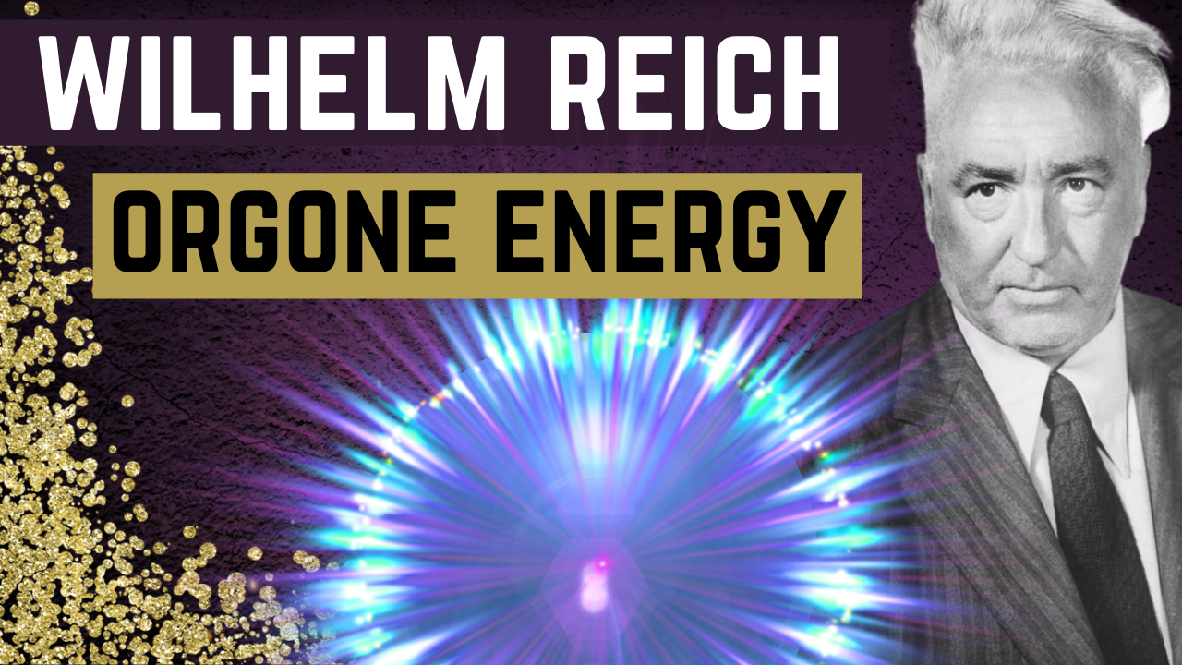
The Science Behind Our EMF Protection Products :Orgone
In the 1930’s, the late Dr. Wilhelm Reich discovered that living samples placed within containers made from alternating layers of steel and non-conductive organic material were able to harness healthy ‘cosmic energy’ from the environment. He called this energy ‘orgone’.
These orgone accumulators and had the ability to: – Preserve blood samples for longer periods of time – Sprout healthier plant seedlings – Provided pain relief for his patients who sat inside them.
Instead of a box, composites made from a blend of; iron oxide, steel, brass, shungite and crystal powders encased in epoxy resin produce the same effects and are able to transform the harmful wireless fields from; cell towers, smart meters, smartphones, internet router and your television, into more beneficial energy for you and your plants and pets.
Full length explanatory videos on our Website! FTWProject.com

Slide 17
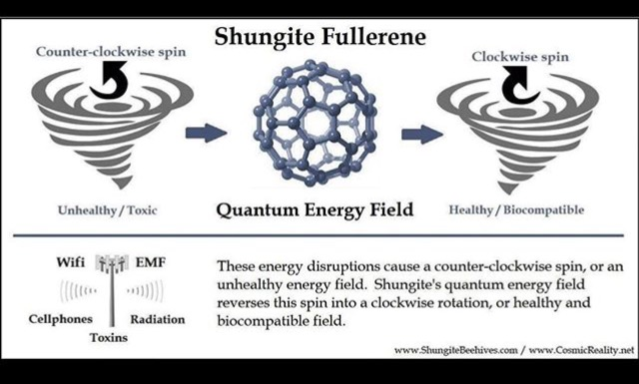
The Science Behind Our EMF Protection Products : Shungite
Shungite is a rare mineral, believed to come from an asteroid that can only be found in one place in the world: Karelia Russia. It is the only mineral of its kind that contains fullerenes, which have been proven effective in protection from EMF’s and also used for cleaning nuclear waste, such as Fukushima.
Full length explanatory videos on our Website! FTWProject.com

Slide 18
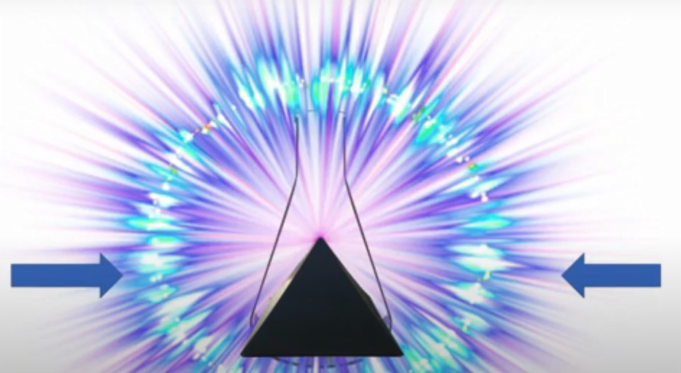
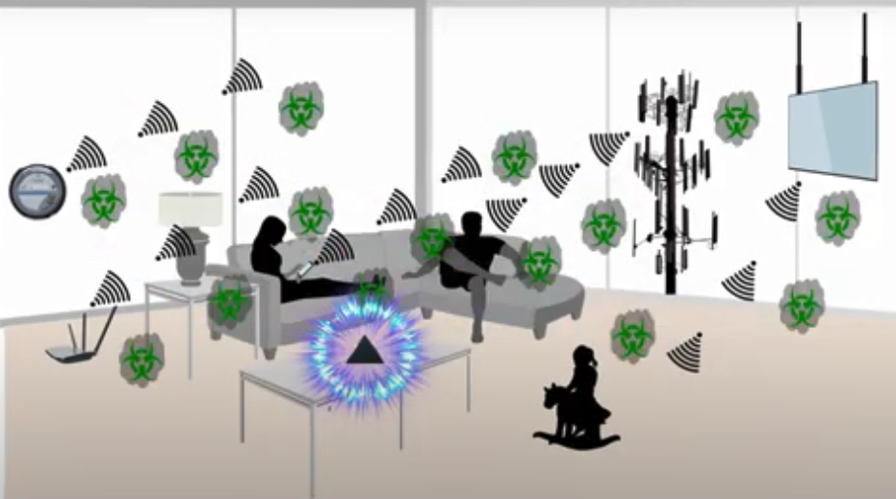
How our products work: Transforming EMF
We make our products by hand mixing, shungite, iron oxide, steel, brass, and quartz crystal (powder form) into an epoxy resin. When the epoxy cures into a solid plastic state it puts pressure on the surface area of the ingredients. This causes something known as the piezoelectric effect, which emits a harmonizing field generated by the specific properties of the ingredients. It is this field that transforms the harmful energy from EMF’s into healthy life preserving energy. Place our products all around yourself and your environment for the best effect.
Full length explanatory videos on our Website! FTWProject.com

Slide 19
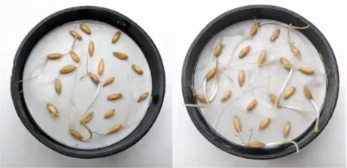
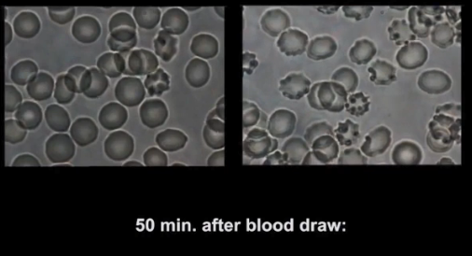
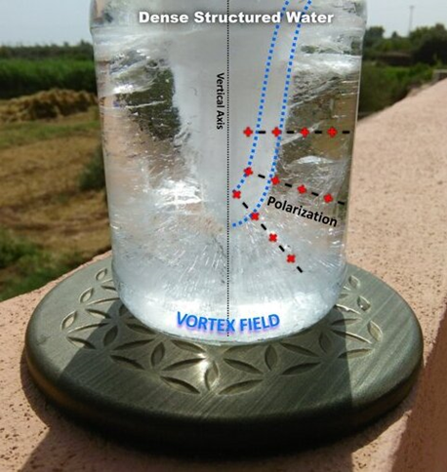
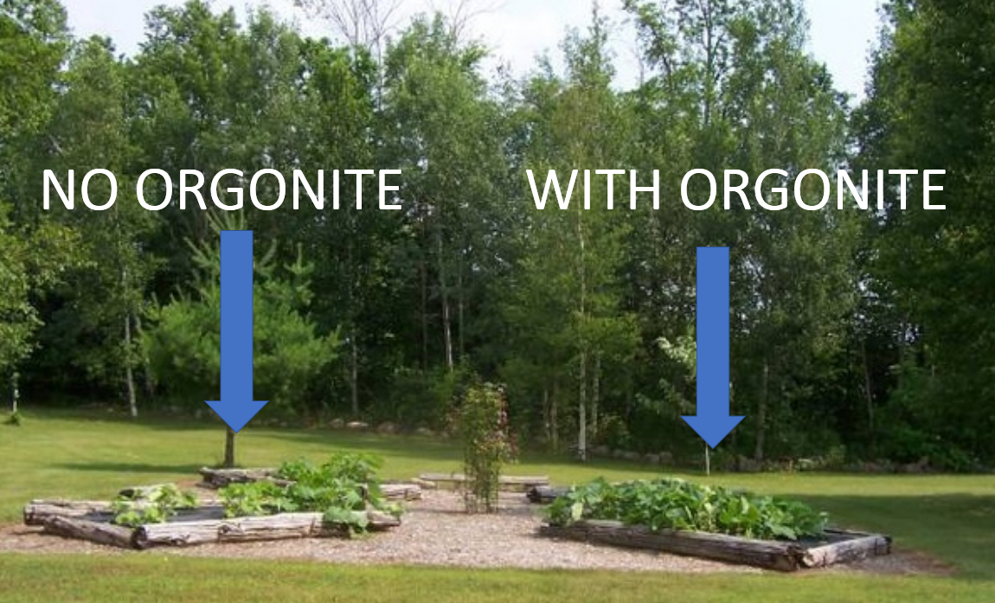
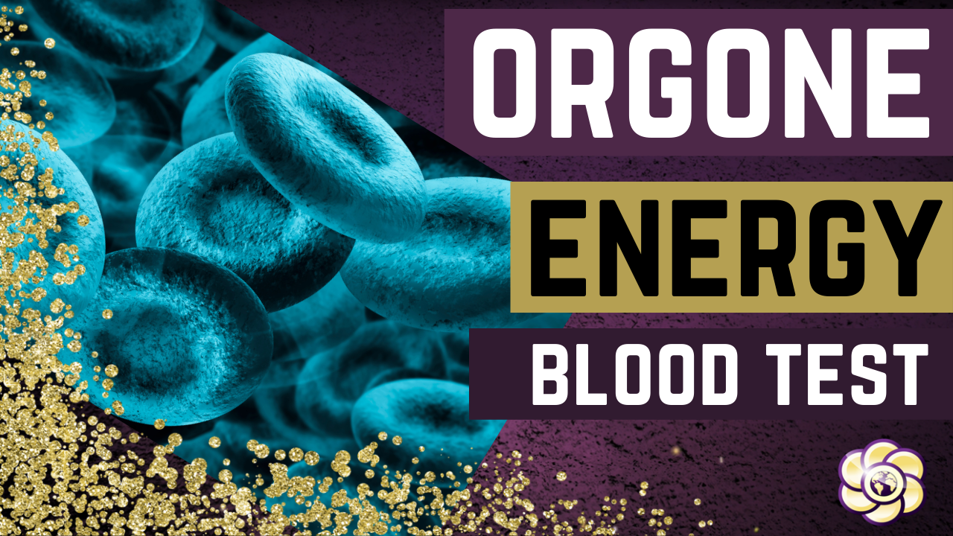
The Science Behind Our EMF Protection Products : Blood Test, Plants, Ice Test
The effects of this scientific phenomenon were replicated and well documented in studies done by the University of Pennsylvania and the Heraclitus Microscopic research laboratory. Also, the field can be seen in an “ice test”
Full length explanatory videos on our Website! www.FTWProject.com

Slide 20
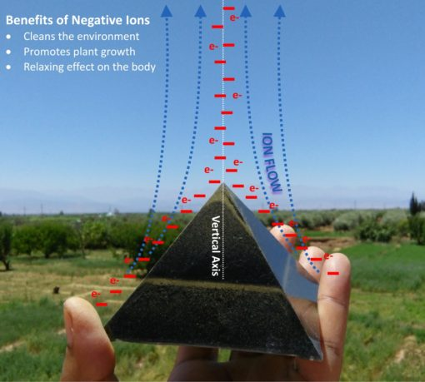
The Science Behind Our EMF Protection Products :Pyramid Shape
Alexander Golod, a Ukrainian former defense contractor and scientist performed pyramid research experiments that involved using expensive military helicopters and equipment that could measure ion columns in the atmosphere that were generated from pyramids. The shape of the pyramid has a function, it directs energy out through the tip to effect the environment around it. This is why we make Orgone Energy Shungite Pyramids. They can be used to place around your property to create a grid of protection against EMF’s, cell phone towers, and chemtrails.
Full length explanatory videos on our Website! FTWProject.com

Slide 21
BENEFITS OF OUR EMF PROTECTION PRODUCTS
-Better sleep -Stress relief -Pain relief -Healthy home environment -Better seed germination and plant growth -Preserves fresh food and extends shelf life -Maintain Healthy Blood

Slide 22
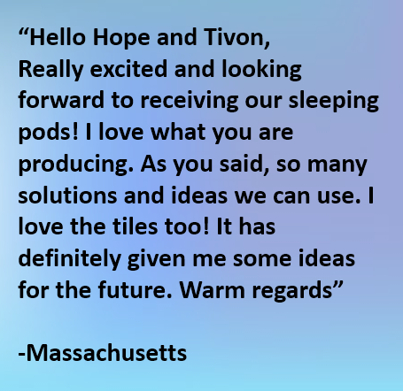
Testimonials From Customers
Read more testimonials on our website

Slide 23
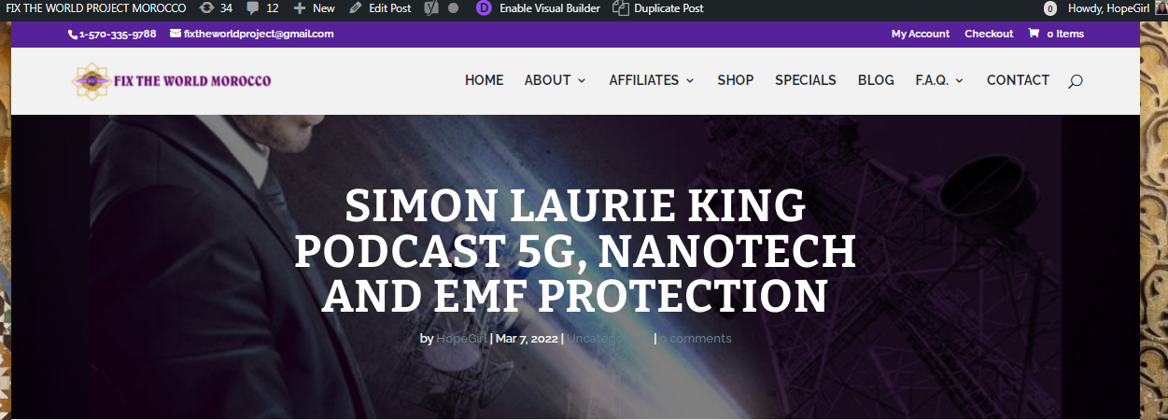
All Reference Links and Additional Videos can be found at the following Blog Post :
https://www.ftwproject.com/uncategorized/simon-laurie-king-podcast-5g-nanotech-and-emf-protection/ref/459

