Slide 1
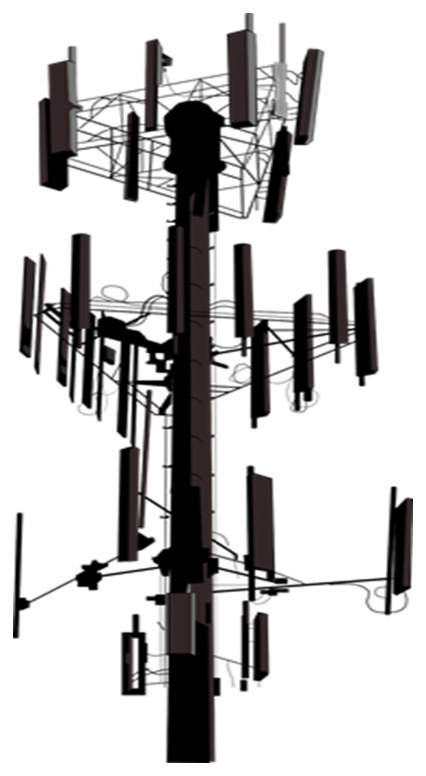
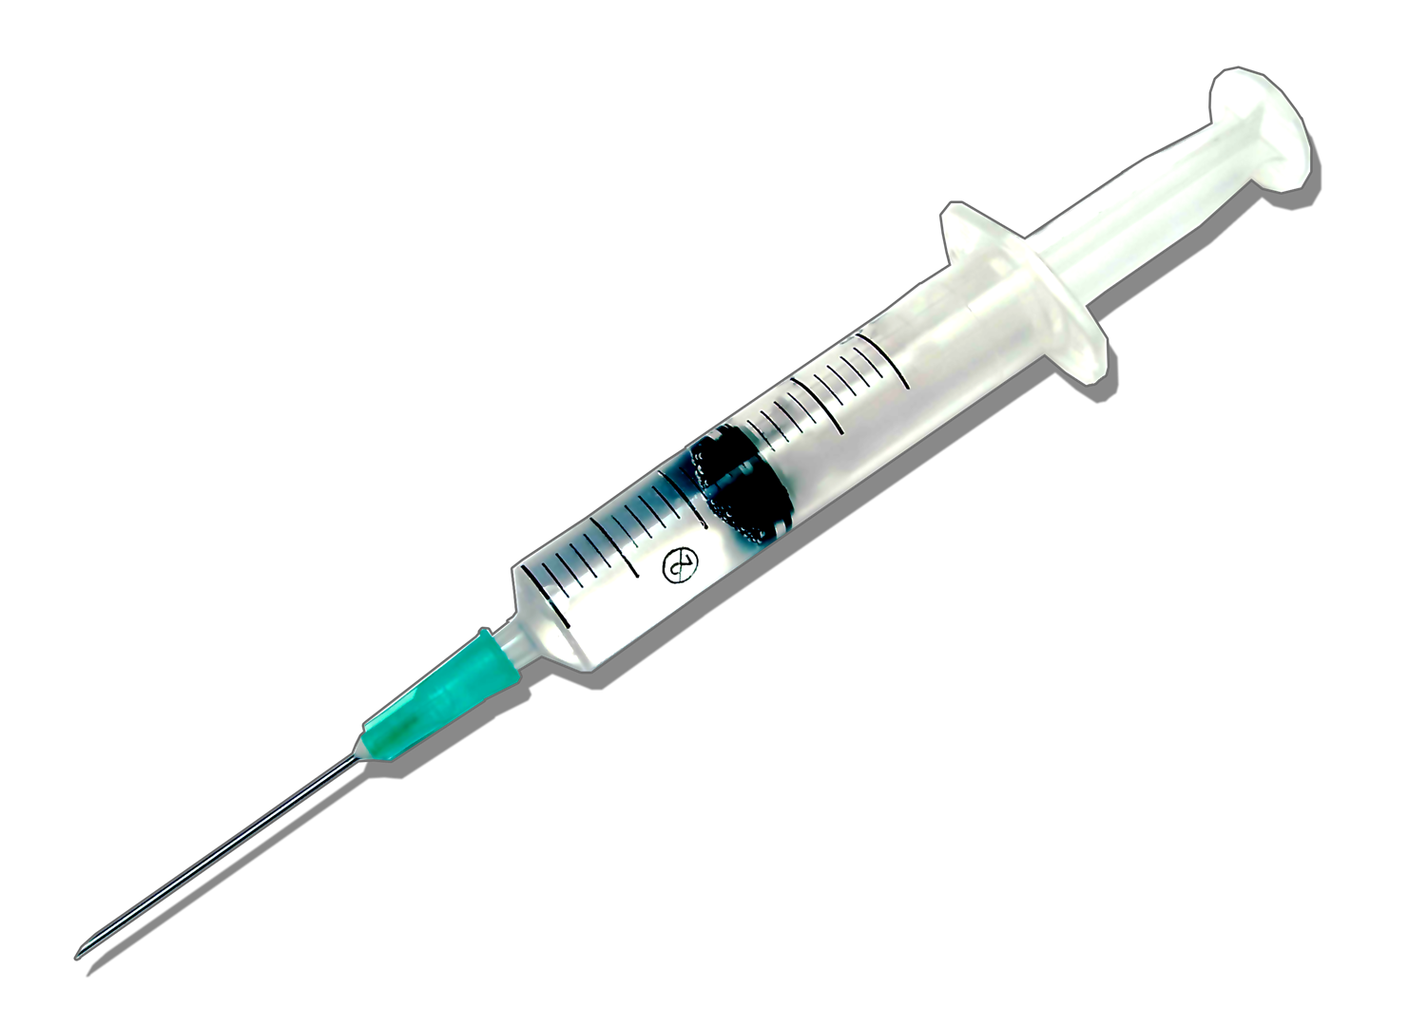
HERE COMES THE NEXT
WWW.FTWPROJECT.COM

Slide 2
Summary
Covid Tyranny is Not Over: Understanding what “state of Emergency” really means
Vaccine Shedding: New Documentation. Get ready for a Flu season like never before.
New Injections Rolling out NOW Worse Ones Ever! Big Pharma Free For all!
Amazing new study done on Covid Vax Self Assembling and EMF
5. New La Quinta Columna Research: Is “Shedding” an Electromagnetic effect?
6. Solutions for Shedding and Frequency Protection
All of our references in this presentation have been documented with links to scientific articles and backup documentation on our blog section of our website www.FTWproject.com

Slide 3
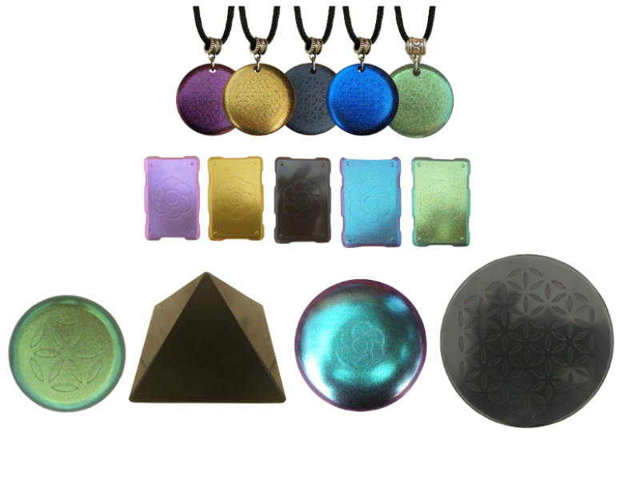
Special Offer Sample Pack Just for SGT Report!
MINI SAMPLE PACK
DELUXE SAMPLE PACK
10% off of our lowest special offer prices For a limited time only. Expires October 10 2022
Notes:
If time permits we’d like to play this 4 minute clip https://www.youtube.com/watch?v=aVj7_0A5-Ew

Slide 4
It may seem like restrictions are over and everything has gone back to a “new normal” but DO NOT BE DECEIVED! The global elite have every country locked in to a legal “state of emergency” which means they have full control and can put all restrictions back into place whenever they want without any warning or notice and there are plenty of recent signs that show that they plan to do just that!
“How did the coordinated and Homogenized approach to Covid happen in countries all over the world? It was the 1990 meeting RIO climate accords, Agenda 21, out of these came the control that we are seeing today. How does one take over the whole population at the same time? The powers utilized public health as the mechanism to do just that” –Todd Callender
Funding is given to states that declare public health emergencies. (while the independent economy crashes) This was found in an Arizona case study. Internationally Funding was given to countries that declared a state of Emergency by the IMF, while the independent economy was sabotaged
Most countries are insolvent so the only way they are still functioning is by extending the state of emergency so they can keep receiving funding.
WWW.FTWPROJECT.COM

Slide 5
HOW WE GOT HERE: LEGAL WALLS OF THE COVID 19 KILL BOX
1990 – The “Owners” decide there are too many people in the world and decided that depopulation was needed. The phrase “sustainable development” was created at this time. Code for depopulation
1992- Rio De Janeiro United Nations Climate Accords. “Agenda 21” was born. 179 Countries signed the UN Framework Convention on Climate Change and made a commitment to follow this on behalf of all the people in their country.
By 1994, enough nations had signed for the convention to enter into force. In September 1994, the United Nations hosted the International Conference on Population and Development in Cairo, Egypt.
In 2005, through the World Health Organization, the individuals who control the Bank of International Settlements created the revised International Health Regulations (IHR). This states that 196 countries agree to implement regulations (restrictions, masks, vaccines, border closures, lockdowns) as long as the WHO declares a “public health emergency of international concern” or PHEIC
Again, 179 nation-states signed on to a 20-year Programme of Action, which was extended in 2010 to cover 2014-2034.Every country that signed into these regulations then put into their local laws that they have to abide by these international health regulations.
2004-2020 Countries all around the world wrote the IHR regulations into their own local laws. In the US several Executive Orders and Acts were passed.
Jan. 30, 2020 WHO Director-General declaration of “public health emergency of international concern” All Nations involved followed in lockstep.
Reference: Todd Callender and Katherine Watt
WWW.FTWPROJECT.COM

Slide 6
POWER & CONTROL
=
While people are saying “Peace and Security” destruction will come upon them suddenly. -1 Thessalonians 5:3
“Restrictions” may be lifted but most places in the world are still under a declared state of emergency. This is done through endless “extensions” that no one seems to pay much attention to. As long as the state of emergency status is in place “they” control almost every government in the world.
Word Games and Lies from Joe -State of Emergency is still in place and extended. (expected to extend through the midterm elections) -Vaccine mandates still in place forcing people out of the military, unvaccinated not permitted to enter the country. (by air, migrants can come in by land) -New Vaccine Rollouts and state of emergency funding still issued
WWW.FTWPROJECT.COM

Slide 7
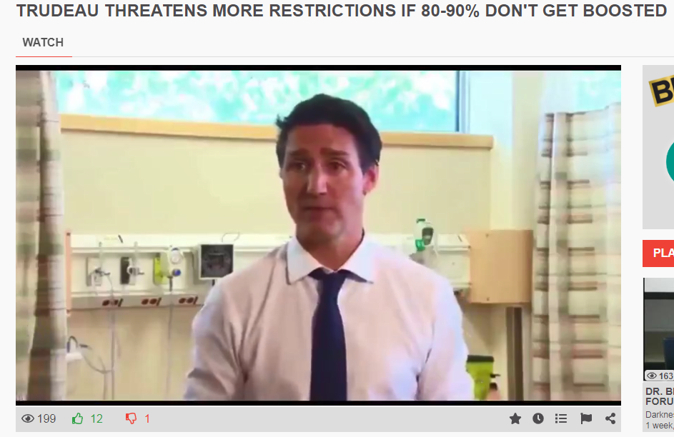
References in Notes
New Covid Measures Canada
New Covid Measures Germany
-Canada spends 28 million on building Covid Concentration Camps -China sleeping in streets in Shenzhen because of a missed PCR test QR codes showing red, denied entry to housing
WWW.FTWPROJECT.COM

Slide 8
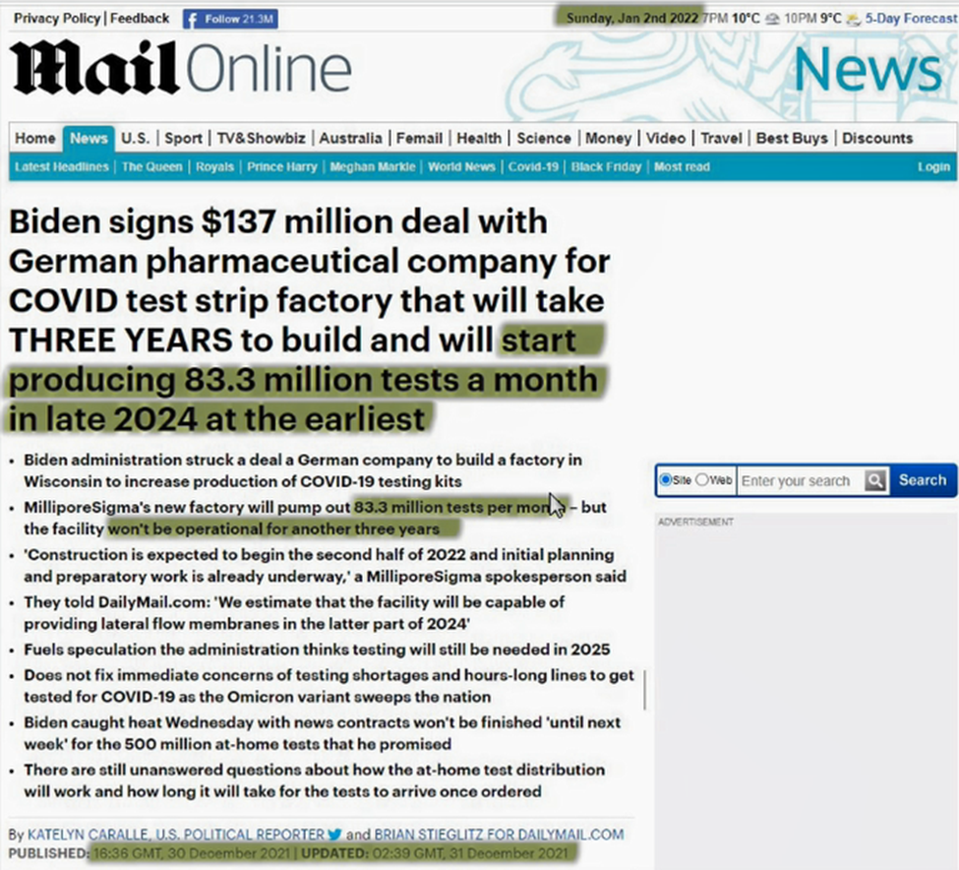
RECENT EXAMPLES OF ONGOING NARRATIVE
$137 million deal to make COVID PCR tests, the production of which WILL NOT START UNTIL 2024 Is this an investment that indicates to anyone that this Covid narrative is going away???
WWW.FTWPROJECT.COM

Slide 9
Vaccine Shedding: New Documentation
While many people are refusing the Covid injections, there are a whole range of new injections rolling out to the public right now, it is a new bioweapon wave of mRNA concoctions. (ALL SHOTS NOT JUST COVID SHOTS)
Even if YOU are not going to take these injections, many AROUND YOU WILL. These “vaccinated” people, with fresh injections will create a toxic environment during the cold and flu season. Here is what you need to know about shedding.
WWW.FTWPROJECT.COM

Slide 10
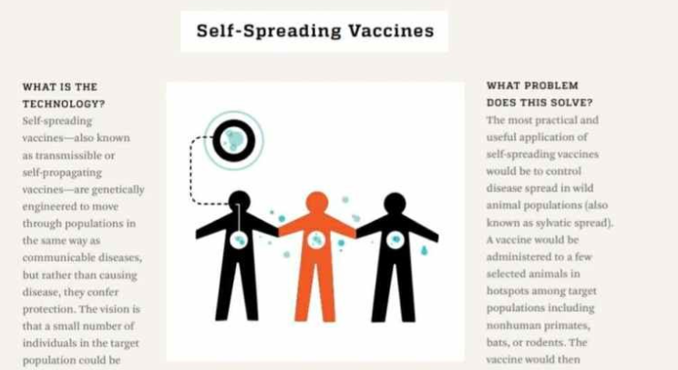
Vaccine Shedding: New Documentation
Is Graphene Oxide being shed from Vaxxed to Unvaxxed? Doctors have done some tests that seem to suggest this is the case.
Documentation that shows knowledge and intent of the vaccine manufacturers to promote the shedding of vaccination symptoms to the unvaccinated. John Hopkins- Self Spreading Vaccines
WWW.FTWPROJECT.COM

Slide 11
Vaccine Shedding: Testimonial
Massage Therapist Nicole Nogrady, who shares shocking details of how she knows the vaccine shedding is 100% real, and what has happened to her body as a result of massaging vaccinated clients.
Symptoms: she felt lightheaded, blood circulation was off and started having tingling and burning in hands and fingertips. Lymph node system felt like it was fighting off something, constantly had a sore throat, eyes were burning and noticed a strange smell coming from the vaccinated. (strange smell was also reported on by La Quinta Columna) Her nervous system went haywire, she had gastric issues, insomnia and extreme anxiety never experience before in her life. Her menstrual cycle was thrown way off and she developed circulatory symptoms related to POTS. She was hospitalized FIVE TIMES as a result.
WWW.FTWPROJECT.COM

Slide 12
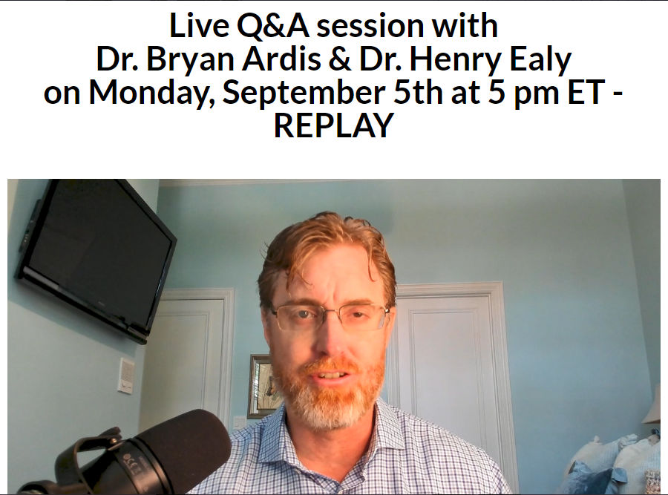
Many have been asking the question: “How long does a vaccinated person “shed” or “transmit” the toxic effects of the vaccine to other non vaccinated people after they receive the injection? Is there a specific time period one should avoid being around a freshly vaccinated person to prevent contamination from the bioweapon?
“Yes, people are shedding. What is interesting is that the shedding they actually see under the microscope looks identical to snake venom proteins. It's actually proposed by Dr. Peter McCullough and others that from research documentation, it's about 10 weeks of maximum shedding following the vaccines. I believe they came out with the 6 month booster protocol because they were actually measuring to see how long the vaccine maximum shedding period was. I believe it's actually six months, but per research documents it's 10 weeks.”
WWW.FTWPROJECT.COM

Slide 13
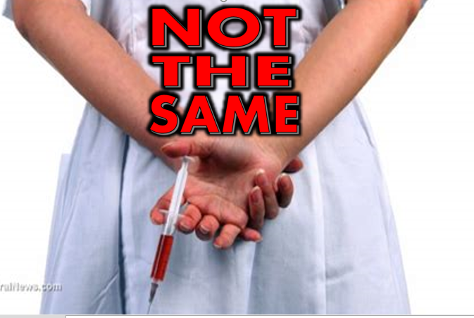
NO TESTING! NO SAFETY MEASURES! INTENTIONALLY MISLEADING THE PUBLIC!
In the past, what we knew of as “Vaccines” or “flu shots” ARE NOT THE SAME THING THAT THEY ARE ROLLING OUT RIGHT NOW WITH THE UPCOMING FLU SEASON. What they are doing now is a Big Pharma Free For All, with NO TESTING, and JABS OF ALL KINDS that are up to 10 times deadlier.
Here is what it different: ALL NEW INJECTIONS ARE NOW GENE EDITING mRNA SHOTS. (flu shots, covid shots, all vaccines) They have been trying to get Gene editing approved for many years. It has been blocked by the church until now. And executive order signed in 2019 legalized gene editing and now they are putting it in ALL SHOTS.
“Vaccines” used to need years of testing and clinical trials in order to be approved and given to the general population. They have done away with all testing. YOU ARE THE TEST.
How its made. “Vaccines” are now made by computer simulations.
WWW.FTWPROJECT.COM

Slide 14
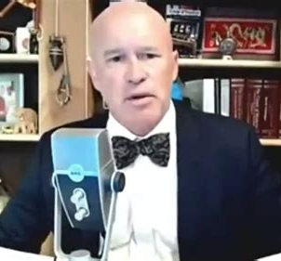
NO MORE TESTING DONE ON NEW SHOTS. YOU ARE THE TEST
EXECUTIVE ORDER 13887 Signed September 19 2019 (before the plandemic began in Wuhan)
Allowed for the first time for the creation of the platform that distributes new vaccine technologies such as DNA, mRNA, virus-like S-particles, vector-based and self-assembling nanoparticle vaccines.
“This Executive Order gave the platform to CRISPR Cas9 technology. This is gene editing. They have been trying to make mRNA gene editing legal for decades, but they were not able to because each time they tried the church always got in the way and stopped it. They needed to find a way to get the church and morality out of the picture so that they could edit the human genome and have no one comment on this from a moral standpoint or have a religious objection. So they created the platform to get mRNA distributed through this executive order, then they gave a Nobel peace prize to the women who created CRISPR Cas9 technology during the pandemic that was created to get CRISPR into the main stream without the objection of the church” –Dr. David Martin
WWW.FTWPROJECT.COM

Slide 15
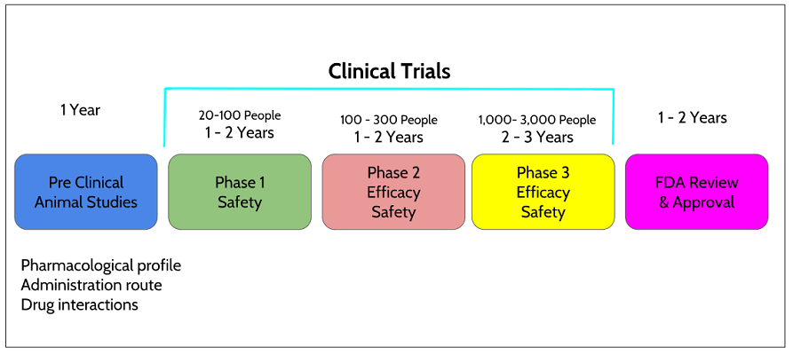
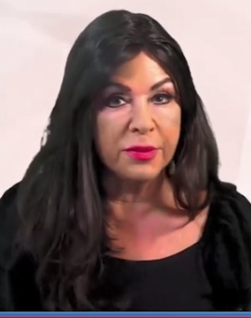
CLINICAL TRIALS? ANIMAL TESTING? WHATS THAT?!
On August 22, 2022 An FDA change to vaccine authorization allowed Pfizer and Moderna to apply for new booster shot approval without having to submit any clinical trial data of their new vaccines.
CDC skips C19 Injection Testing. Saying
“ Treat It Like The FLU. ‘ Opening Up MAX VAX Limits because Flu Vax Also Isn’t Tested..!”
“This is how it is supposed to go. There are phases of drug trials that have been used in the past to get many compounds from and idea to the pharmacy shelf. There were lots of precautionary stages that were supposed to establish safety. We have strayed so far from establishing any kind of safety measures, you might as well go into an industrial heavy metal factory and start injecting yourself with everything you can find in there. This is essentially what is happening.” –Dr. Jane Ruby
WWW.FTWPROJECT.COM

Slide 16
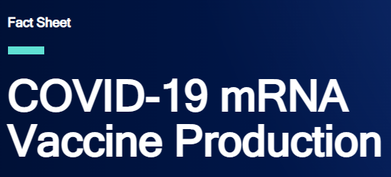
HOW THESE NEW VACCINES ARE MADE
A series of codes are typed into a computer program, which runs a simulation that spits out a special formula of ingredients, those ingredients are then mixed into a vial in a lab, billions of vials are produced and shipped out and immediately injected into the arms of individuals. And now it is approved to be injected into humans WITH ABSOLUTELY NO TESTING DONE PRIOR TO INJECTION.
From the National Human Genome Research Institute on COVID-19 mRNA Vaccine Production: “Early in the COVID-19 pandemic, researchers used state-of-the-art genomic sequencers to quickly sequence the SARS-CoV-2 virus. This sequence was quickly shared with other researchers. This allowed researchers from across the globe to analyze the virus and better understand how it causes disease. The speed of this crucial first step enabled the immediate research and development of viable vaccine candidates. Once a sequence is selected, a new plasmid can be produced within a couple of weeks…”
WWW.FTWPROJECT.COM

Slide 17
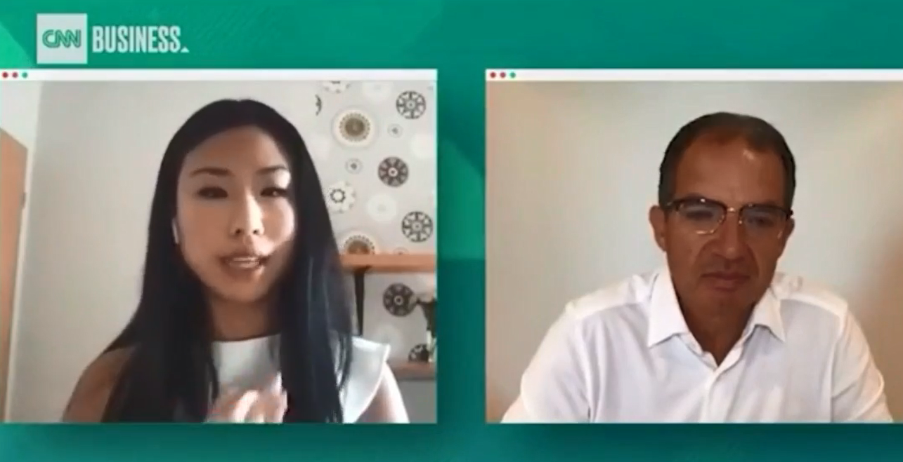
2022
-Pfizer new Bivalent Covid Updated Shots contains two strands of mRNA Gene Editing
-Moderna new Bivalent Covid Updated Shots two strands of mRNA Gene Editing
-MonkeyPox mRNA Vaccine
-Small Pox mRNA Vaccine
-Universal Flu Shot which contains TEN STRANDS OF mRNA Gene Editing.
Moderna CEO Stephane Bancel tells us about the new Universal Flu shot: “There are 10 viruses that circulate in the world, some of them mutate fast like Covid and the Flu. We think we can put in a single product a lot of mRNA’s that take care of all those viruses, and once a year in September you should get an annual booster, single dose, that has in the vial all those mRNA’s for all those viruses that have of course adapted to the strain of the season, like FLU or like Covid. The idea is a bit like the iPhone. A lot of people buy a new iPhone every September where you get new apps and refreshed apps. And that’s the same idea with this, you get Covid and Flu and RSV in a single dose. And you get the best science of the moment to protect you for the strain circulating now and in the fall/winter. We can combine all those things and provide to people all around the world the annual booster. So only one shot”
WWW.FTWPROJECT.COM

Slide 18
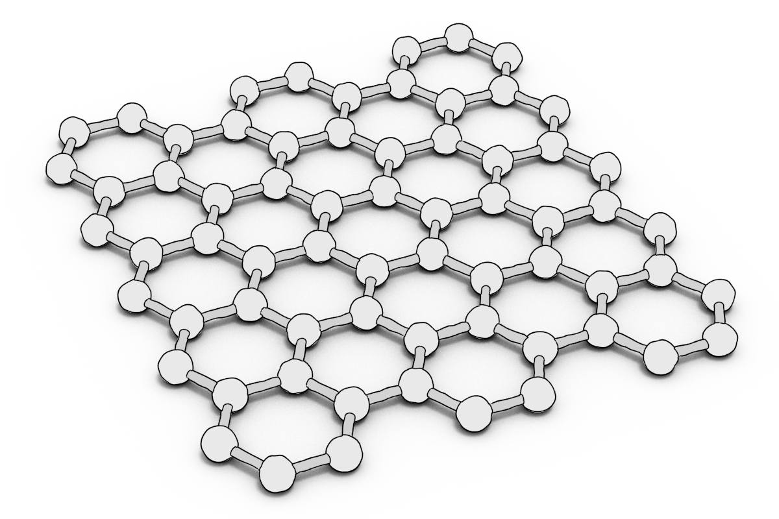
Graphene oxide is activated by electromagnetic frequencies (EMF), specifically the frequencies that are part of the 5G spectrum. All materials have what is known as an electronic absorption band. An absorption band is a range of wavelengths, frequencies or energies in the electromagnetic spectrum which are characteristic of a particular transition from initial to final state in a substance. This is a specific frequency above which a substance is excited and oxidizes very quickly. Frequencies beamed at human beings that have a build up of graphene oxide in their body can cause the graphene oxide to multiply very rapidly, breaking the balance of glutathione and causing a cytokine storm in a matter of hours.
Graphene Oxide is the main ingredient in DARPA patented hydrogels. It is these hydrogels that are in the Covid Jabs, the PCR test swabs and the masks. A conductive hydrogel is a polymer like material that has substantial qualities and applications. They are developing different kinds of conductive hydrogels that are being used in many things, in our food, our water, and injected into our bodies in vaccines. Conductive hydrogels contain nanotech that locks on to your DNA and can be controlled by 5G sensors. They allow for DNA collection and manipulation. Conductive hydrogels allow for tracking tracing and biological and mental control of human beings.
Notes:
If time permits we’d like to play this 4 minute clip https://www.youtube.com/watch?v=aVj7_0A5-Ew

Slide 19
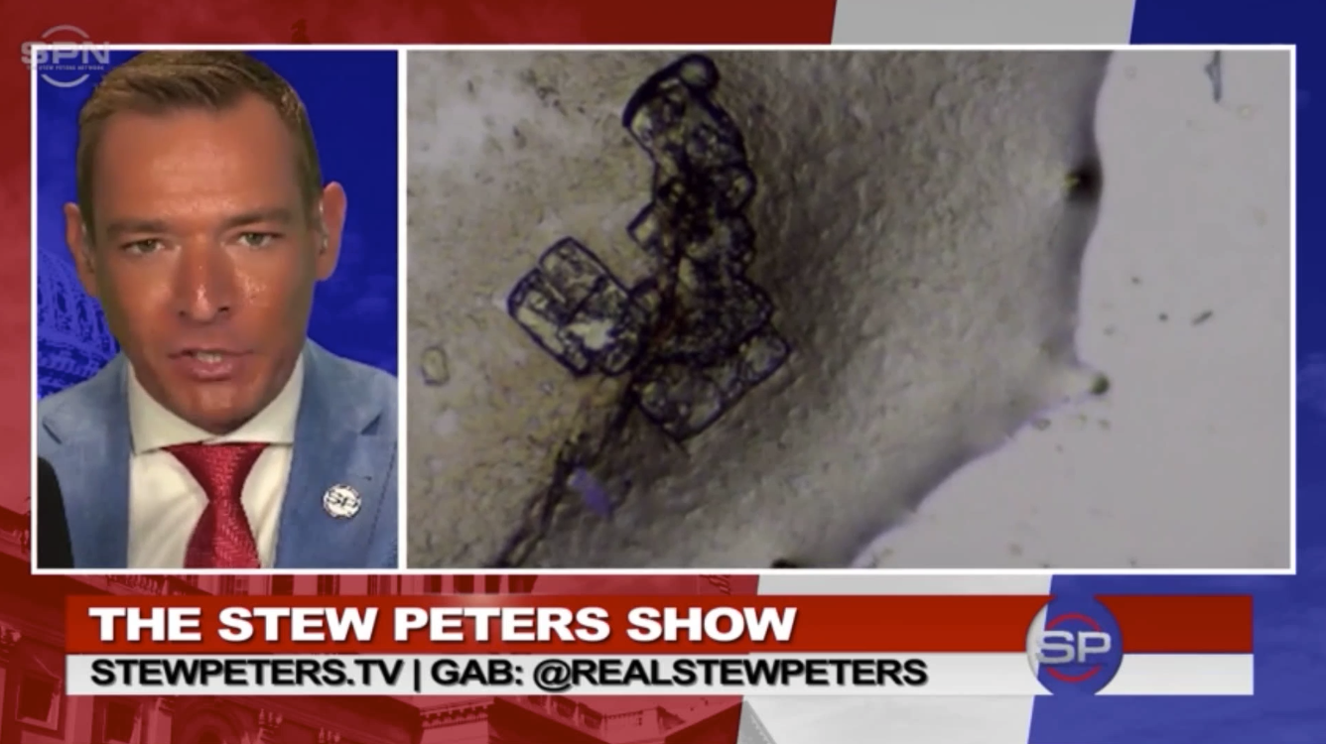
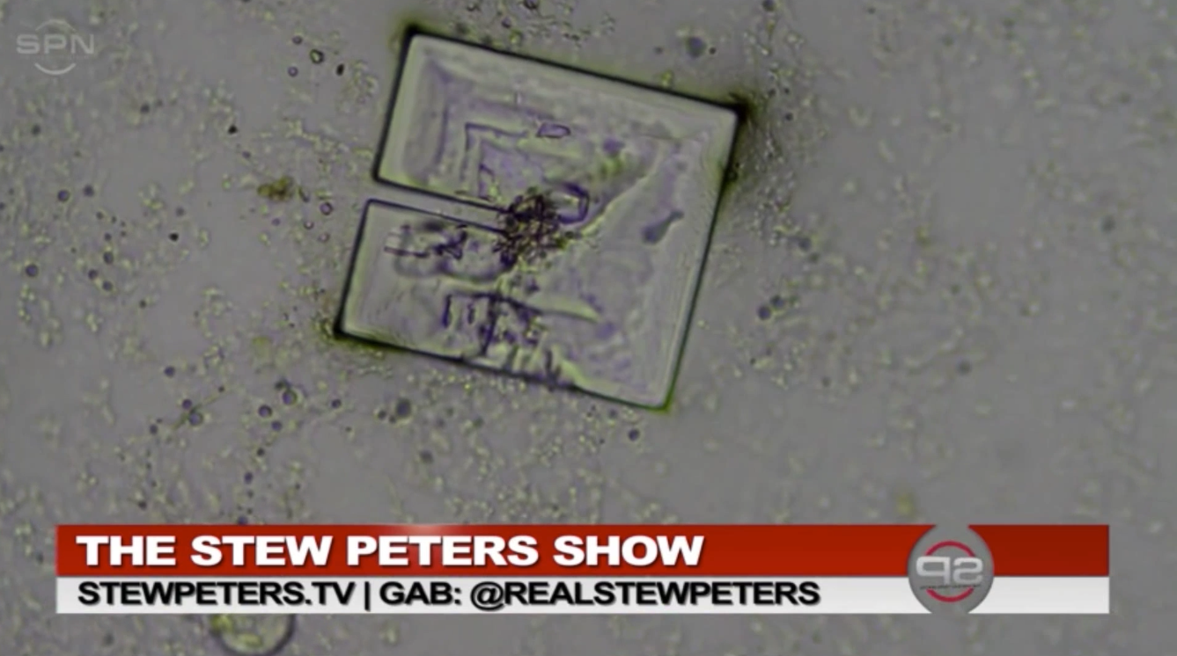
Amazing New Study on Covid Vax Self Assembling and EMF
Stew Peters interviewed Matt Taylor, an independent researcher and electrical engineer expat living in Ecuador. Matt conducted experiments with vaccine samples by exposing them to EMFs emitted from his wireless router. His discovery was the clear fluid in the sample began to show opaque self-organizing structures that grew in complexity during the time it was exposed to frequencies emitted from his wireless router.
EMF CAUSES STRUCTURES TO SELF ASSEMBLE IN THE VACCINES. WHEN THERE IS NO EMF THESE STRUCTURES DISASSEMBLE AND DISAPPEAR.
Notes:
If time permits we’d like to play this 4 minute clip https://www.youtube.com/watch?v=aVj7_0A5-Ew

Slide 20
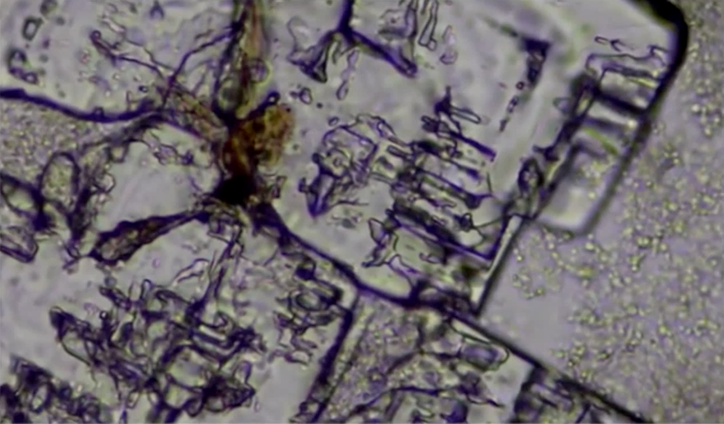
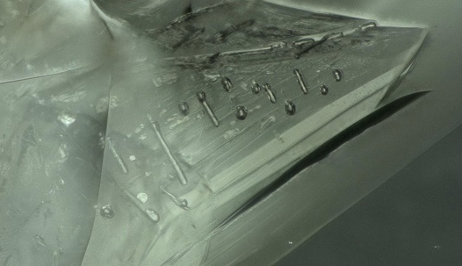
Amazing New Study on Covid Vax Self Assembling and EMF
Matt Taylor EMF Frequency in Vaccine “structures”
Mike Adams EMF Frequency in Xylitol Crystal
Some of the linear designs and patterns in the image above look very similar to the ones found
in the morphic resonance xylitol crystal experiments conducted by Dr. Mike Adams (The Health Ranger) is his lab.
Notes:
If time permits we’d like to play this 4 minute clip https://www.youtube.com/watch?v=aVj7_0A5-Ew

Slide 21
Special Offer Sample Pack Just for SGT Report!
The self-assembling structures look like circuit boards when fully formed from the translucent fluid, an dis-assemble/disappear when the router is turned off in a matter of minutes.
Matt concludes there is a direct relationship between frequency technology and health emergency injections/’clot shots’.
He is also calling on replication of his experiment.
These are examples of independent researchers of high caliber coming to the same conclusion: The contagion is the weaponized wireless infrastructure and the toxic sea of electromagnetic fields that we’re all immersed in.
Notes:
If time permits we’d like to play this 4 minute clip https://www.youtube.com/watch?v=aVj7_0A5-Ew

Slide 22
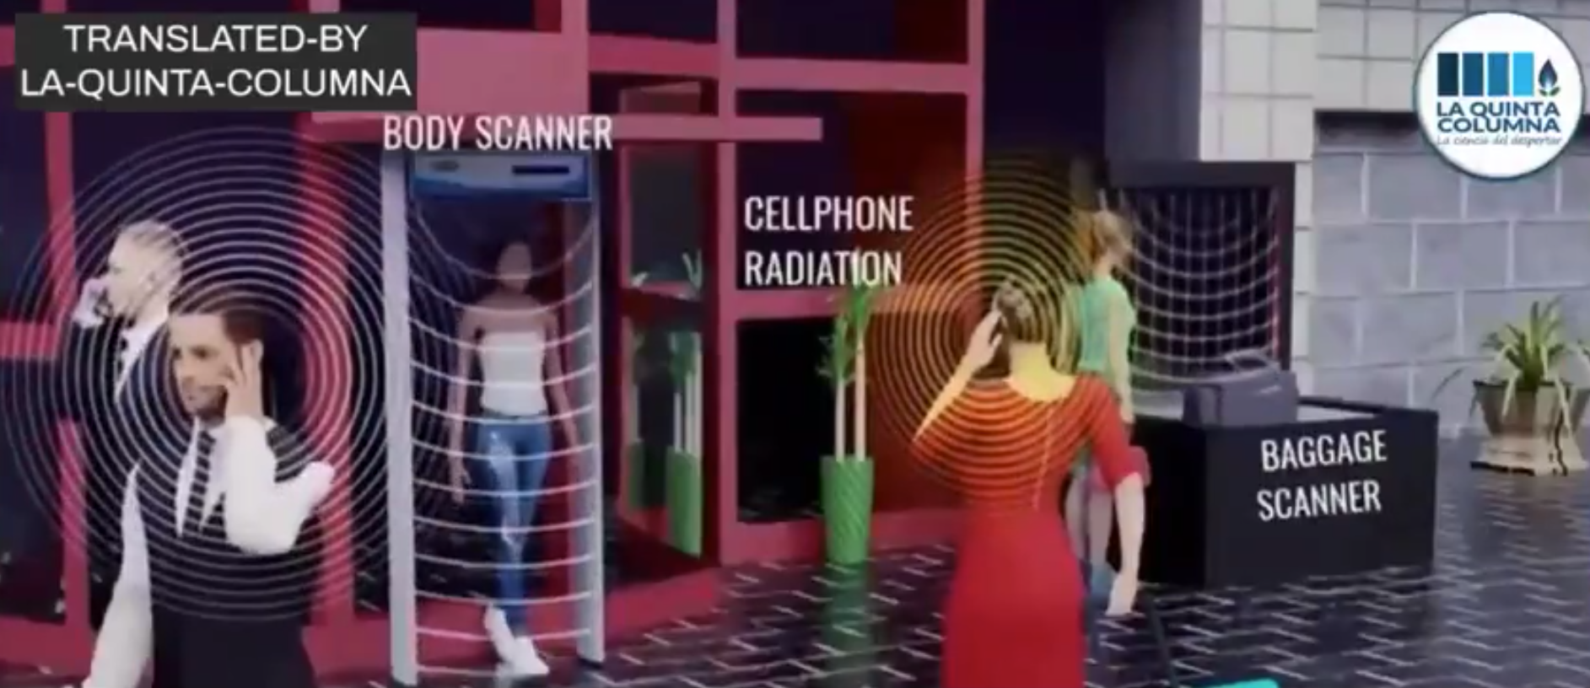
New La Quinta Columna Research: Is “Shedding” and Electromagnetic effect?
Question: Are the vaccinated contagious?
Ans: The shedding phenomenon is an electromagnetic effect that has symptoms similar to a contagion.
-there is no transmission of any pathogen (i.e. virus)
-there IS exposure to electromagnetic radiation (4G, 5G), made clear in the research of La Quinta Columna
-Contagious-like symptoms can be explained by electromagnetic resonance
Notes:
If time permits we’d like to play this 4 minute clip https://www.youtube.com/watch?v=aVj7_0A5-Ew

Slide 23
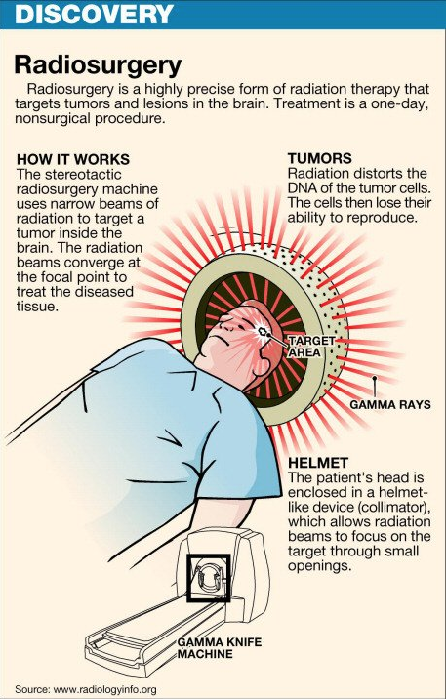
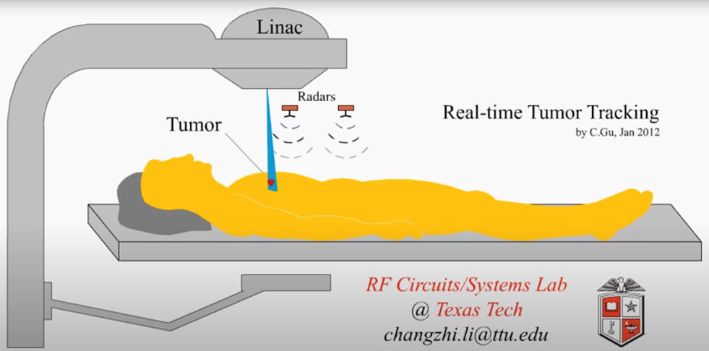
New La Quinta Columna Research: Is “Shedding” and Electromagnetic effect?
Ricardo Delgado shared a recent experience of being near people he knew that recently had radiotherapy.
What is radiotherapy? The use of high energy x-ray or proton radiation beams to kill cancer cells. The high energy beam destroys the cancer genetic code that controls cell growth and division. -Mayo Clinic
When a person comes from a radiotherapy session, they are also exposed to high EMFs (the multi-beam, RF power source, magnetron, RF monitoring sensors, etc.) Patients are told not to have human contact for at least 24 to 48 hours, and the clothes have to be put aside.
Ricardo mentioned his electromagnetic wave meter also detects residual RF emissions from patients that were just treated, like it does with inoculated people. The difference is the inoculated have a graphene marker that amplifies and catalyzes EMF radiation damage.
Notes:
If time permits we’d like to play this 4 minute clip https://www.youtube.com/watch?v=aVj7_0A5-Ew

Slide 24
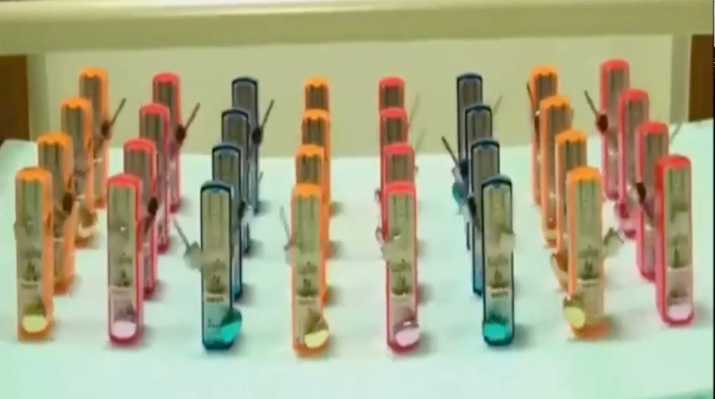
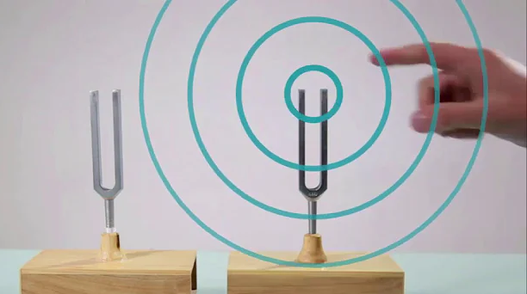
New La Quinta Columna Research: Is “Shedding” and Electromagnetic effect?
The full video of La Quinta Columna’s research translated into English is linked in the reference blog for this presentation. It summarizes the observations that EMFs exposure induces toxic effects including the contagious-like symptoms through sympathetic resonance (i.e. used in machines to scan the body; protons, x-rays and gamma rays using electrons, MRI scans, etc). RF frequencies excite protons (in your body) which in turn emit electromagnetic radiation.
PLAY VIDEO: Graphene Oxide, EMF Activation via special frequency example, “lock step” phenomenon of synchronized frequency control.
Notes:
If time permits we’d like to play this 4 minute clip https://www.youtube.com/watch?v=aVj7_0A5-Ew

Slide 25
STOP THE BEAST SYSTEM
SOLUTIONS: Protect yourself from shedding by limiting your exposure to freshly vaccinated crowds whenever possible and with a full immune system protocol, include supplements that block spike protein transmission and remove graphene oxide from the body.
Mitigate EMF in your environment to stop the transmission of frequencies that are being put out by the 4G and 5G weapon system that have been shown to control our physical and mental health. (as documented in our previous presentations)
How our products work to Mitigate EMF. Our handmade products are a composite of shungite, steel, iron oxide and brass powders all encased in an epoxy resin. When the resin cures it creates a piezoelectric effect that emits a field of healthy life preserving energy called orgone. This energy field was discovered and studied by late scientist Dr. Wilhelm Reich and there are fascinating studies around orgone energy that we’ve included in our research documentation section. When used in your environment, these devices transform the harmful energy given off by electromagnetic frequencies or EMF’s that come from 5G, your cell phones, Wi-Fi, and electronic devices, into healthy life preserving energy. Benefits are: better sleep, pain relief, better growth in plants, food preservation, better mental clarity and an overall calming effect.
Notes:
If time permits we’d like to play this 4 minute clip https://www.youtube.com/watch?v=aVj7_0A5-Ew

Slide 26
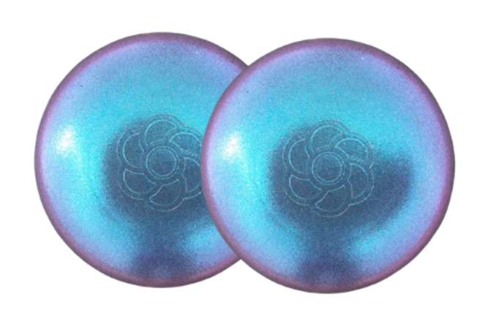
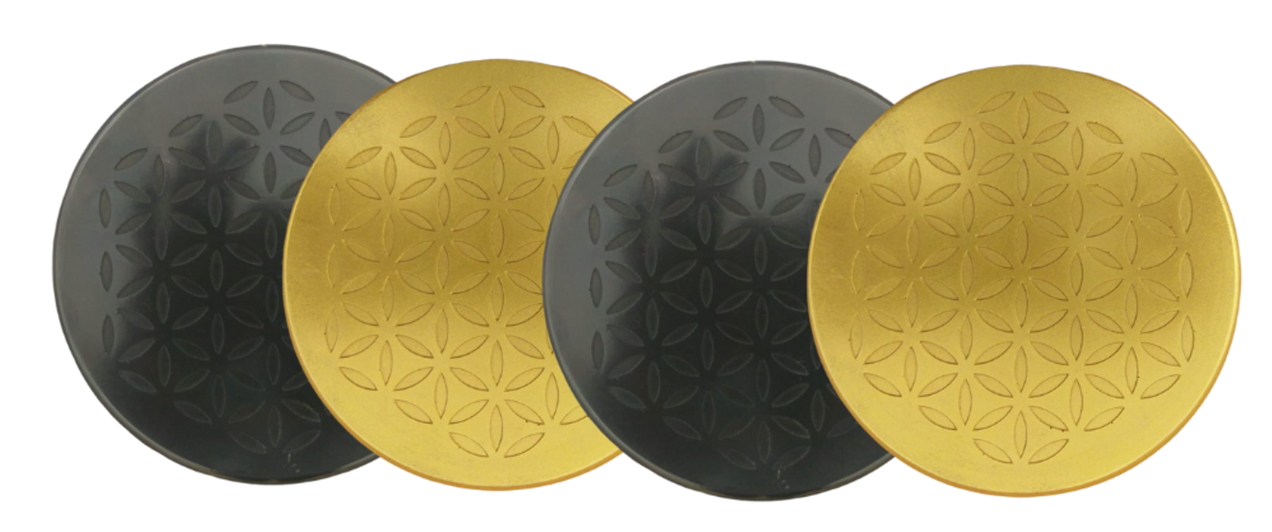
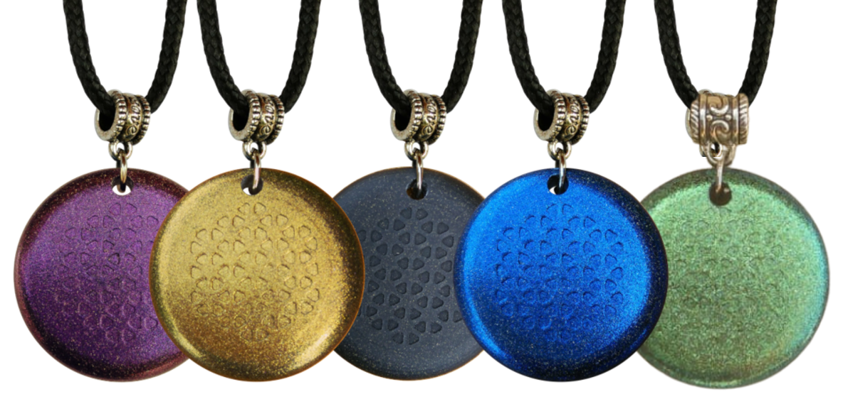
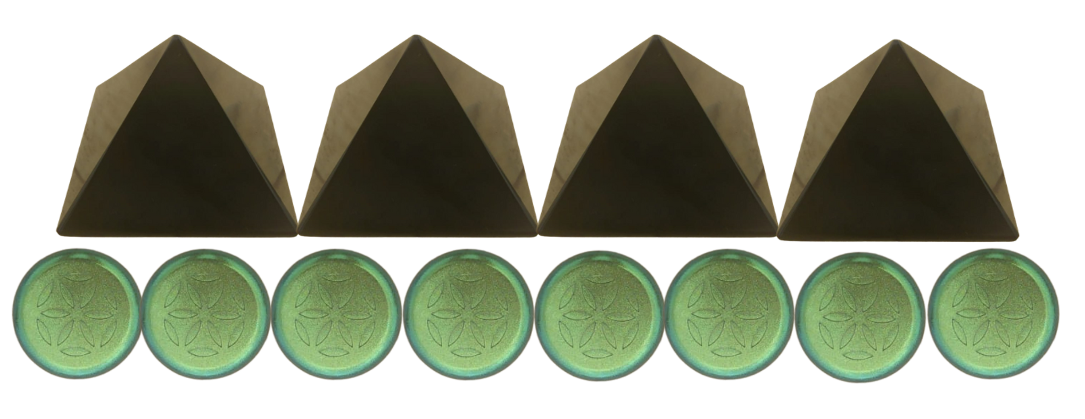
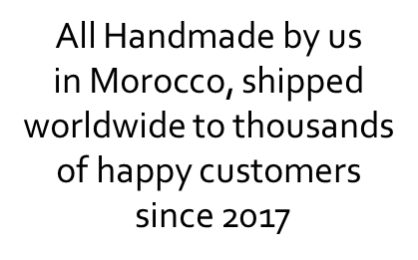
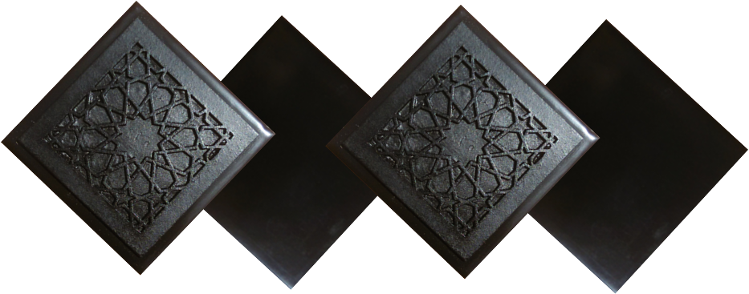
ABOUT OUR EMF PROTECTION PRODUCTS
HELP SUPPORT SGT REPORT BY SHOPPING FROM THIS LINK: https://www.ftwproject.com/ref/6/
SLEEPING PODS For a good nights sleep
CHARGE PLATES for use around the home, to preserve food and more
“We just can't believe our eyes! We have placed the garden pucks from our first order around our property, and the plants/trees with the pucks are BLOOMING within days! This is happening with every single place the pucks have been rested. Just incredible.” -Australia
PHONE SHIELDS to put on your cell phone, laptop and routers
PENDANTS for personal emf protection on your body
PYRAMIDS and garden sets for gridding your home / property / garden for emf protection on a large scale
SCIENTIFIC STUDIES AND DOCUMENTATION DESCRIBING HOW OUR PRODUCTS WORK AVAILABLE ON OUR WEBSITE.
TILES for incorporating emf protection into construction projects
WWW.FTWPROJECT.COM

Slide 27
GRAPHENE OXIDE REMOVAL
Graphene Oxide can be removed from the body through a protocol and combination of specific supplements. Here are the supplements to take. For more detailed description on how each one works to remove Graphene Oxide from the body, dosage amounts and instructions, as well as effectiveness testimonials and studies please see link below.
Astaxanthin Glutathione Melatonin
Milk Thistle Plus NAC
Quercetin
Vitamin C
Vitamin D3
Zinc
Amazing testimonial of one woman who has fully recovered from the adverse effects of the Covid shots. YES IT IS POSSIBLE IF YOU TAKE ACTION NOW!
Our Mom Valerie Robitaille PhD Nutritionist/Herbalist Helping people detox from the Covid Vaccines
WE WILL DONATE A COMMISSION TO SGT REPORT FOR ANY GRAPHENE OXIDE REMOVAL PROTOCOLS PURCHASED FROM THIS LINK
Notes:
If time permits we’d like to play this 4 minute clip https://www.youtube.com/watch?v=aVj7_0A5-Ew

Slide 28
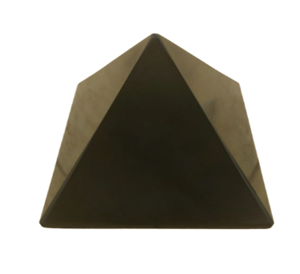
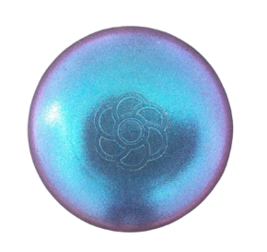
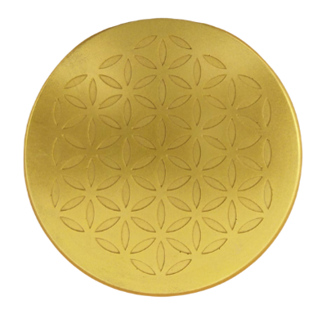
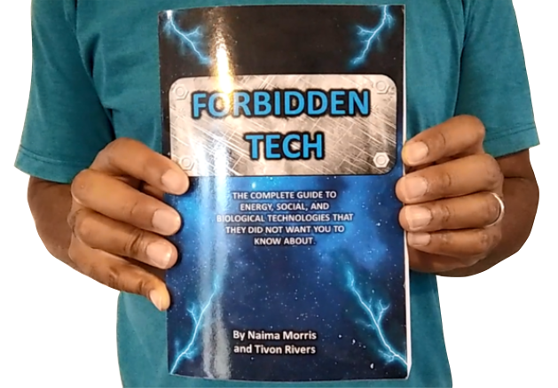
WHY WE DO WHAT WE DO
We are Christians, Engineers and Scientists. Helping to inform the public on the latest 5G, Covid Vaccine, and related technology issues. A little about our Family Business Websites:
Our Mom Valerie Robitaille PhD Nutritionist/Herbalist Helping people detox from the Covid Vaccines
WHY WE DO WHAT WE DO
.
OUR BOOK
FORBIDDEN TECH: The complete guide to energy, social, and biological technologies that they did not want you to know about. (2017)
Online engineering academy for the co-development of researching and building DIY off grid energy devices.
Notes:
If time permits we’d like to play this 4 minute clip https://www.youtube.com/watch?v=aVj7_0A5-Ew

