Slide 1
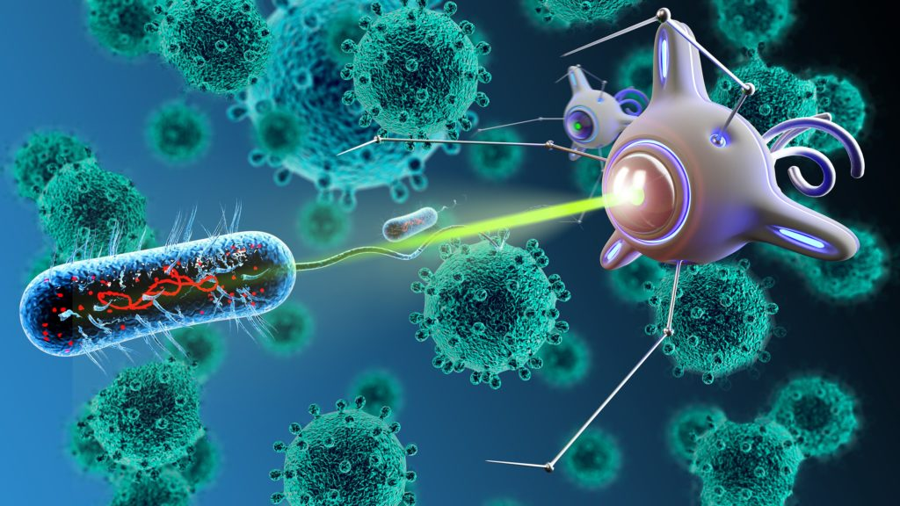
PLANDEMIC

Slide 2
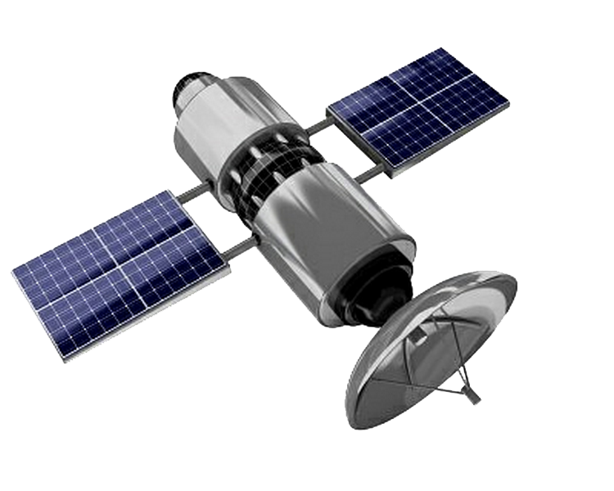
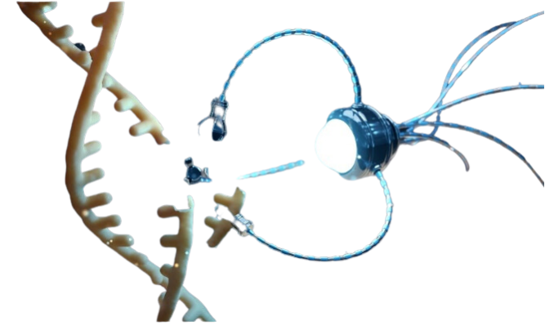
SUMMARY
-UN and WEF Using LEO Satellites to Link Digital ID to Bank Accounts
-No One Was Told They Were Being Injected With Electromagnetic Devices
-Quantum Dot Technology in the Injections is What Enables EMF Communication and Blue Tooth Codes From Human Bodies
-Nanotech is Programmed to Manipulate The Electrical Balance In Your Body
-Shocking new Tests Showing Hydrogel Programmable Plastic In Vaccinated Blood
-Finally Explained: White Fibrous Structures Pulled out of Vaccinated Deceased
-How They Hook Up Human Bodies to the Internet Using 6G,7G Terahertz and Graphene Nanotech in the Covid Injections
-Internet of Nano Things, Internet of Bio-Nano Things, Internet of Space Things
Blog Post with Links to everything referenced in the description.
WWW.FTWPROJECT.COM

Slide 3
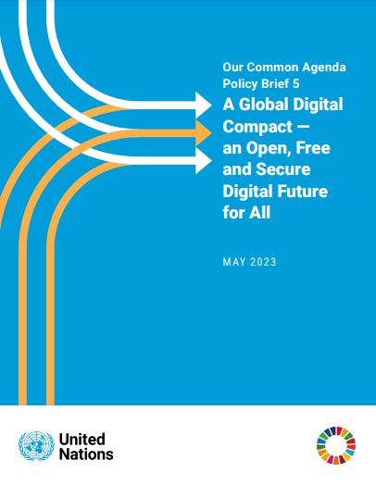
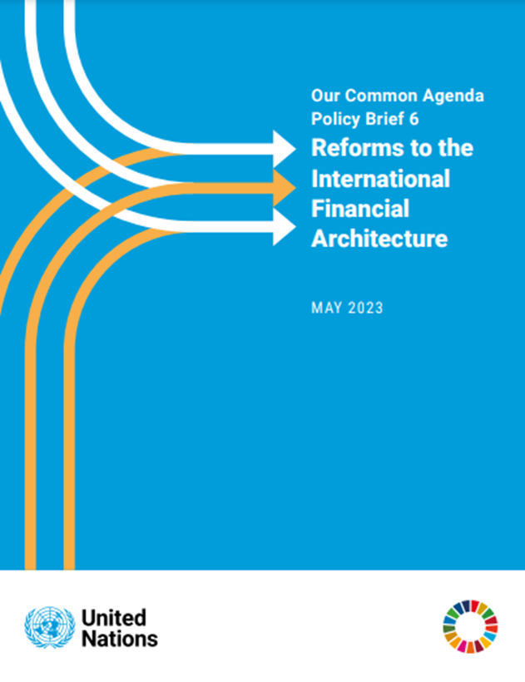
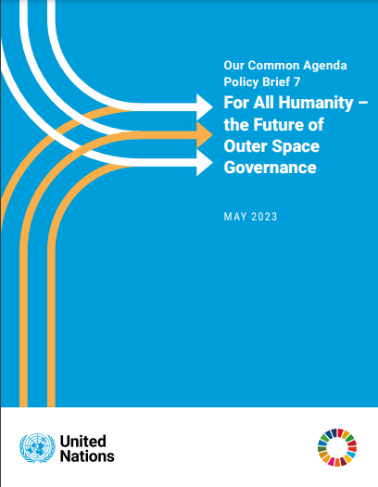
United Nations Planning Digital ID Linked to Bank Accounts
The plan, which is similar to the system developed by the World Economic Forum (WEF), is outlined in three new policy briefs from the UN titled, “A Global Digital Compact, Reforms to the International Financial Architecture, and The Future of Outer Space Governance.” Essentially, the objective is to have people, devices, and entities, all tied up in a connected network that could apparently be centrally administered, seemingly by unelected bureaucrats. These came out in May 2023
WWW.FTWPROJECT.COM

Slide 4
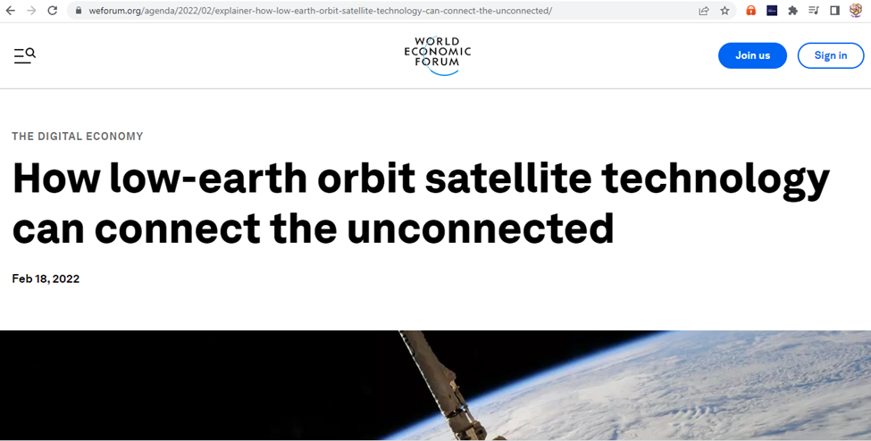
What does Outer Space Have to do with Digital ID and Bank Accounts?
This UN document is all about who gets to control the satellites, which is what they are using to track human beings through their bodies and control your data.
From the WEF website under “Digital Economy”
Nomenclature –changing of words to make it more appealing to the masses. Digital Inclusivity Reduce Digital Inequality Bridge the Digital Divide 2.9 Billion People Still Don’t Use Internet Barriers to Connectivity Closing Connectivity gaps Peaceful Uses of Outer Space access to space based assets universal Internet connectivity
WWW.FTWPROJECT.COM

Slide 5
WEF says that LOW EARTH ORBIT SATELLITES ARE THE ONLY OPTION THAT WOULD CONNECT THE 2.9 BILLION PEOPLE IN THE WORLD THAT ARE STILL NOT CONNECTED TO THE INTERNET.
The European Union recently announced plans for an LEO satellite system worth €6 billion. The EU is entering a space internet race where technology giants are spending billions of dollars on LEO satellite technology to close the global connectivity gaps. Space X’s Starlink, Elon Musk’s satellite internet venture, has deployed nearly 2,000 satellites in orbit and has applied for licences to fly more than 40,000 satellites. Bill Gates backs a $1 billion plan to cover Earth in 'Big Brother' satellites capable of streaming 'live and unfiltered' HD footage of the planet 500 Low earth orbit satellites that have cameras pointed onto the earth that will create real time imagery that people an view on their cell phones.
WWW.FTWPROJECT.COM

Slide 6
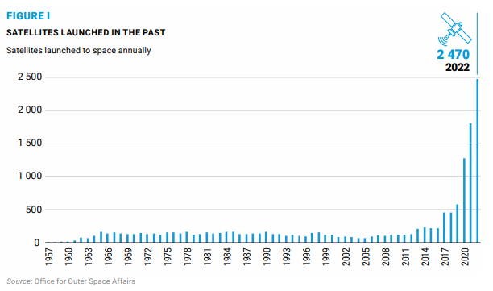
Look how many LEO satellites they launched into space DURING THE PANDEMIC
Its getting very congested up there in Low Earth Orbit. Check out this chart from the UN Paper on how many LEO satellites were launched into space. Look at the timing…during the pandemic is when they launched the most. Almost makes you think that the LEO satellites and the nanochips in the vaccines were connected somehow? Perhaps they had to get 5.55 billion people injected with nanotech sensors to complete their LEO control grid? Perhaps that’s the reason they did Covid, to convince a large part of the worlds population to inject themselves with nanotech sensors?
WWW.FTWPROJECT.COM

Slide 7
The Kingston Report An evidence-based, med-legal analysis of mRNA technologies and the dangers of the rapidly growing synthetic biology industry.
The governments and pharma companies lied to the public. They used nomenclature to change the names of things in the Covid 19 vaccines to make people believe they were being injected with something that was biological that was going to help their immune system and fight off the coronavirus.
The components that are in the vaccines are not biological, they are advanced nano technology that fuse with your body’s cells and create new biosynthetic lifeforms in your body.
A lot of this research comes from the ground breaking work of Karen Kingston. We are founding members of her sub stack and highly suggest others to follow her work.
We have done a Full Length hour long video presentation that walks through this disclosure step by step to show all the documentation proof and help define complex terms for the general public. It is called “No One Was Told They Were Being Injected with Electromagnetic Devices and can be found in the link to this presentation and on our website.
WWW.FTWPROJECT.COM

Slide 8
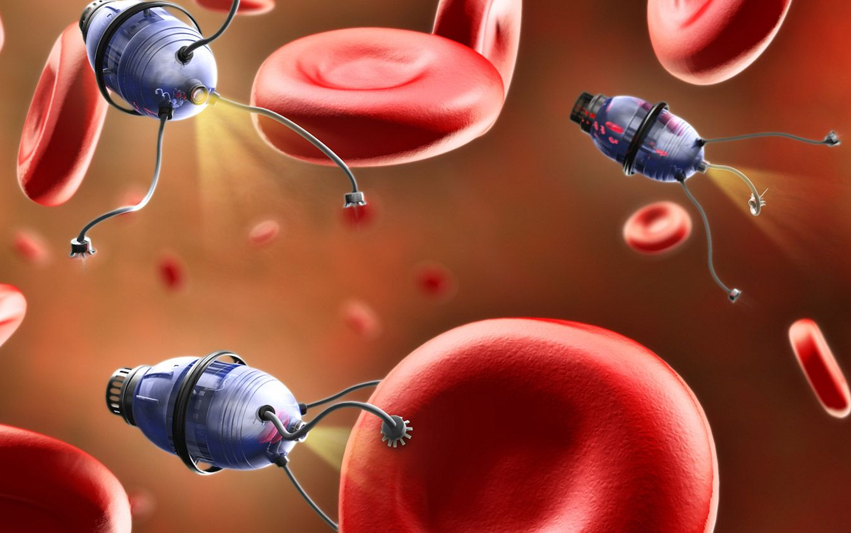
Here are the words they changed to deceive the public
MRNA IS SOFTWARE What mRNA really is, is a software program. The mRNA are the instructions or computer codes that program the lipid nanoparticles. The mRNA injections do not contain a biological virus or portion of a biological virus. There is truly nothing about Pfizer’s mRNA technology that meets the FDA’s definition of a vaccine.
SEQUENCES ARE COMPUTER GENERATED PROGRAMMING When Pfizer refers to mRNA, they are referring to the computer generated genetic sequences that can program a human cell to produce viruses, spike proteins, CANCERS, or nearly anything. Per Pfizer’s FDA approval application, they used the computer generated Wuhan code in the Covid Vaccines. All sequences are ordered from a company called Sino Biological which is headquartered in Beijing China. Sino Biological manufacturers and sells over 280+ SARS-CoV-2 mRNA variants.
“SPIKE PROTEINS” ARE LIPID NANOPARTICLE TECHNOLOGY BIOWEAPONS What they call “spike proteins” are actually the result of lipid nanoparticle technology destroying your cells. When you take a magnetic hydrogel and you infect a biological cell you can see that the cell is covered with all of these little spikes. This is what they are calling the spike protein. Your not infected with a virus, your infected with nanolipid particle technology that then reprograms that cell to give off these bio synthetic toxins in your body.
“LIPIDS” ARE NANOTECHNOLOGY What they are calling “Lipids” are actually self assembling nanoparticle technology that is fully programmable. These “lipids” have a cationic charge you don’t find that in nature.
THEY CHANGED THE WORDS TO FOOL THE PUBLIC
In the early publications (2008) the mRNA ‘vaccine’ technology was just called ‘nanoparticles’ or was appropriately labeled as cationic polymers. The blanket application of the term ‘lipid’ was applied before nanoparticle to make the technology more appealing to the masses
WWW.FTWPROJECT.COM

Slide 9
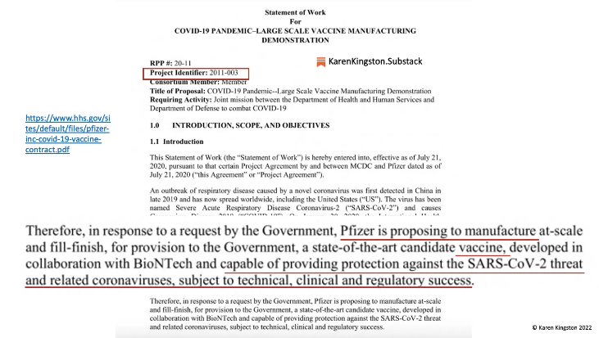
PROOF THE VACCINES ARE TECHNOLOGY AND NOT BIOLOGICAL CAN BE FOUND IN: -THE OPERATION WARP SPEED CONTRACT -THE VACCINE PATENTS
-THE PFIZER DOCUMENTS THEY WANTED TO HIDE FOR 75 YEARS
The Operation Warp Speed Department of Defence contract classifies the Covid Injections NOT AS BIOLOGICALS but at ELECTROMAGNETIC DEVICES.
WWW.FTWPROJECT.COM

Slide 10
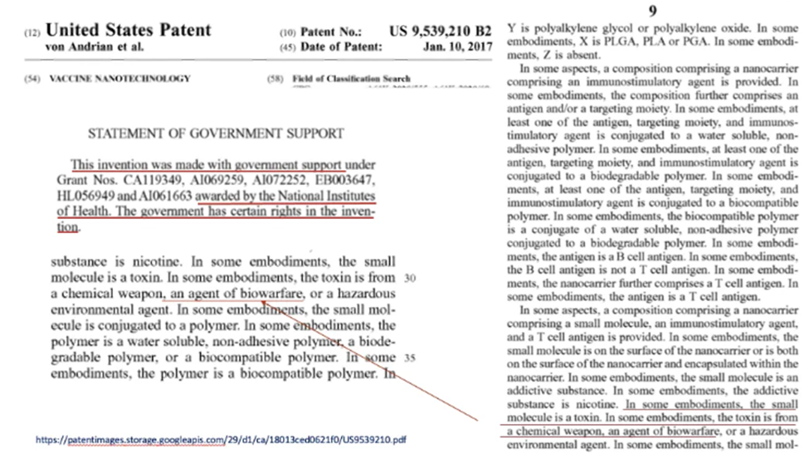
PROOF THE VACCINES ARE TECHNOLOGY AND NOT BIOLOGICAL CAN BE FOUND IN: -THE OPERATION WARP SPEED CONTRACT -THE VACCINE PATENTS
-THE PFIZER DOCUMENTS THEY WANTED TO HIDE FOR 75 YEARS
The Patent Titled “Vaccines Technology” which is a utility patent for the covid 19 vaccines, it literally lists the components of the vaccine as a toxin from a chemical weapon an agent of biowarfare.
WWW.FTWPROJECT.COM

Slide 11
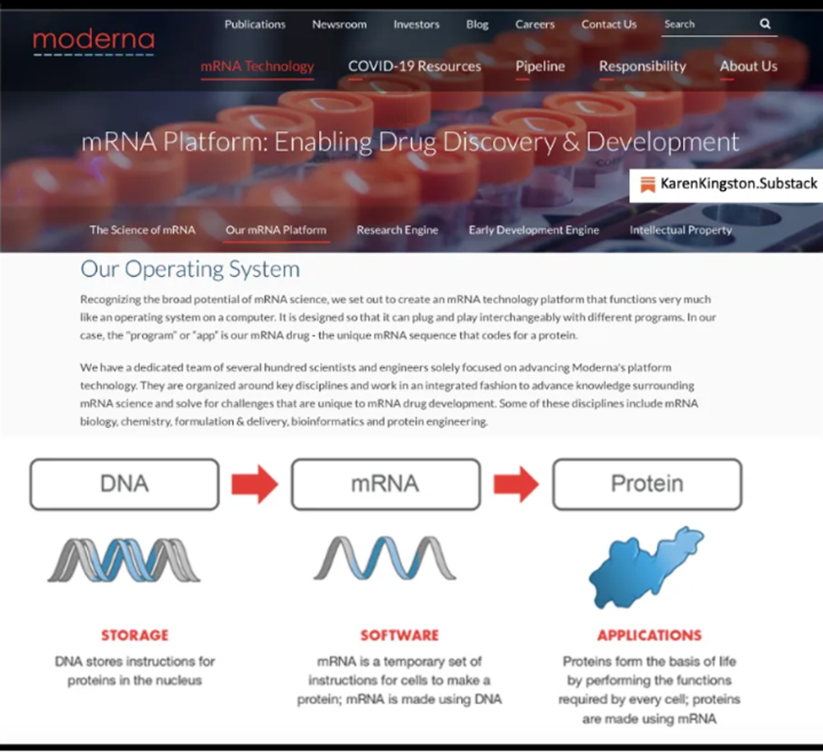
PROOF THE VACCINES ARE TECHNOLOGY AND NOT BIOLOGICAL CAN BE FOUND IN: -THE OPERATION WARP SPEED CONTRACT -THE VACCINE PATENTS
-THE PFIZER DOCUMENTS THEY WANTED TO HIDE FOR 75 YEARS
Moderna’s website defines mRNA as a software program and the call their vaccine an operating system.
Moderna has since redacted this info on their website after public exposure was brought to it. You can still find it using wayback machine.
WWW.FTWPROJECT.COM

Slide 12
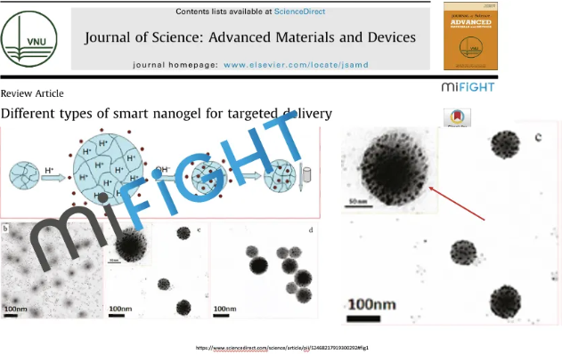
PROOF THE VACCINES ARE TECHNOLOGY AND NOT BIOLOGICAL CAN BE FOUND IN: -THE OPERATION WARP SPEED CONTRACT -THE VACCINE PATENTS
-THE PFIZER DOCUMENTS THEY WANTED TO HIDE FOR 75 YEARS
The Patents and Pfizer documentation explains that the components in the vaccines are nanotechnology, specifically hydrogels which are made from graphene oxide and fused with quantum dot technology. This technology then uses the cells of your own body and programs them to make new lifeform inside of you that are half natural and half unnatural. This technology is self-assembling, and fully programmable from an outside source.
WWW.FTWPROJECT.COM

Slide 13
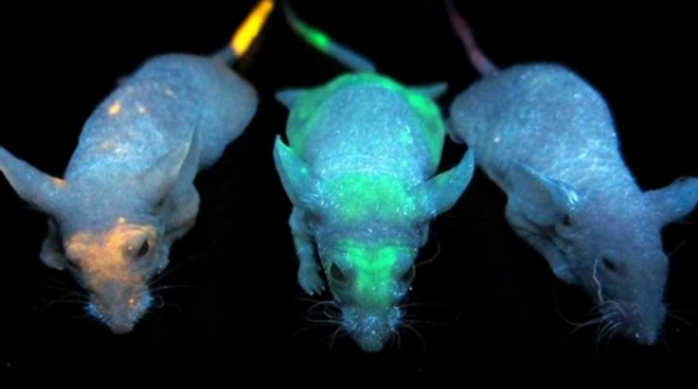
QUANTUM DOT TECHNOLOGY IN THE INJECTIONS IS WHAT ENABLES HIGHER FREQUENCY (EMF) COMMUNICATION FROM INJECTED HUMAN BODIES. BLUETOOTH AND QUANTUM FIELD FREQUENCIES
The patents describe that the hydrogel in the Covid Injections is fused with quantum dot technology. A quantum dot is a semiconductor that creates an electromagnetic field and has electronic and optical properties. They are used in quantum computing for their quantum communication properties. Luciferase and quantum dots are basically the same thing. We wrote about quantum dot technology in our book “Forbidden Tech” back in 2017.
Lab mice injected with quantum dots in University of Toronto Experiment. Noted: the quantum dots can be programmed to accumulate in specific areas of the body- such as your right hand or your forehead Mark of the beast.
WWW.FTWPROJECT.COM

Slide 14
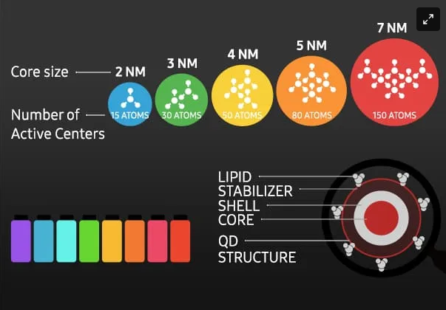
QUANTUM DOT TECHNOLOGY IN THE INJECTIONS IS WHAT ENABLES HIGHER FREQUENCY (EMF) COMMUNICATION FROM INJECTED HUMAN BODIES. BLUETOOTH AND QUANTUM FIELD FREQUENCIES
The electromagnetic fields and frequencies emitted by quantum dots can cause emotional, psychological, and physical disease and dysfunction in our bodies. Quantum dots can be used as neuroweapons and can cause severe disruptions to your emotions, energy, physical abilities and your ability to think straight (brain fog).
From the patents: quantum dot’s functionality is based on the quantum mechanics of the Bohr particle. Due to quantum mechanics, quantum dots that have been injected into humans by means of the COVID-19 bioweapons and can quite literally appear within the human body based on specific electromagnetic frequencies (EMF) or disappear based on specific frequencies.
Quantum dots respond to high- and short- frequencies that emit blue light. At these higher frequencies, the quantum dots reduce in size enabling them to connect with, receive, and emit frequencies from the quantum field.
Per the 2011 book publication, Quantum Confinement Effect, quantum dots are able to produce electromagnetic labels (i.e. Bluetooth addresses) inside the body and tag organs. Use of quantum dot technology in humans is regulated by the Centers of Devices & Radiological Health (CDHR) of the FDA because they are electronic devices that emit radiation.
WWW.FTWPROJECT.COM

Slide 15
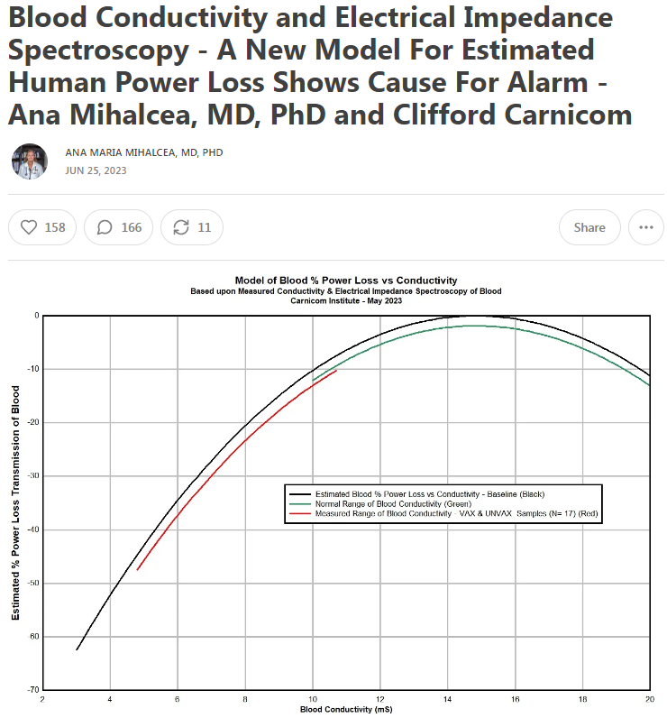
The Covid Injections contain “cationic lipids” which are synthetic components that do not exist in nature. These cationic lipids host a positive charge (bad for your health) that migrates towards negative electrons (good for your health). What this means is that this nanotech is literally sucking the life force out of you. And the creation of this electromagnetic field is probably effecting other people around you even if they are not injected. This explains the “shedding” or transmission of symptoms to the unvaccinated.
Furthermore, these cationic lipid nanoparticles are self assembling and fully programmable from an outside source.
Dr. Ana Mihalcea and Clifford Carnicom have done electrical impedance spectroscopy testing to show the loss of human power caused by the nanotech in these shots.
They found that the power loss is commonly estimated on the order of 25-40%, and is as low as 47%. Almost 50% of your life force energy is taken from you by this nanotech!
WWW.FTWPROJECT.COM

Slide 16
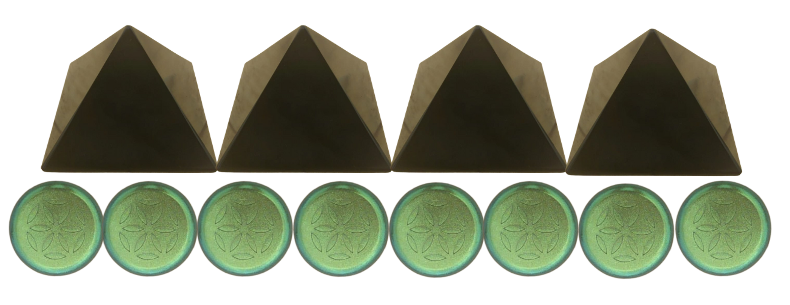
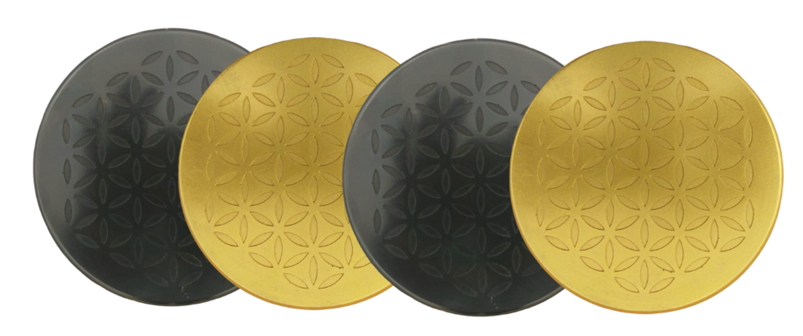
Treating the body with an understanding of Ions
Positive Ions (Bad For You) come from: electromagnetic fields, fluorescent lighting, carpet, metal, plastics, air pollution (chemtrails geoengineering) Covid 19 Nanotechnology
causes health issues like breathing difficulties, allergies, lethargy, infections, depression, anxiety, suicidal feelings, weakened immune system, brain function problems, nausea and vertigo.
ORGONITE DEVICE ARE NATURAL PASSIVE NEGATIVE ION EMITTERS one of the ways that our orgonite products work is they put negative ions back into the environment and back into your body and can help to mitigate the effects of this nanotechnology in this way.
Negative Ions Good For You come from: nature, forests, bodies of running water, sun light, orgone devices, plants, certain healthy foods and supplements.
can boost the immune system, alleviate stress, help balance mood swings, help with depression, provide more energy, help with respiratory issues, combat allergies and much more.
Certain supplements like glutathione, vitamin C, Quercetin, and drugs like ivermectin and hydroxychloroquine supply negative ions to the body, which is why these drugs worked to alleviate symptoms. They were helping to restore the electrical balance of the body.
WWW.FTWPROJECT.COM

Slide 17
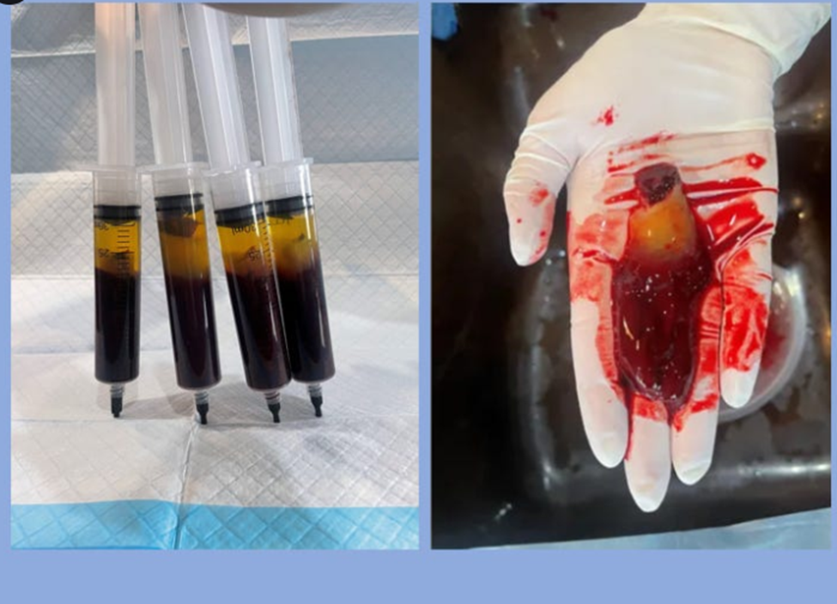
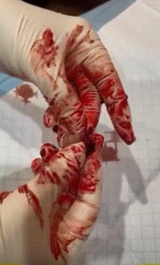
Hydrogel seen in the blood Tests run by Dr. Ana Mihalcea
Peoples blood looks like sludge or jello and cannot transport oxygen, it is filled with nanotech. Dr. Ana took blood from three vaccinated patients and let it sit in a tube for 4 hours. The blood separated on its own and a rubbery yellow hydrogel plastic formed on the top. Dr. Ana calls the hydrogel programmable plastics, because that’s what hydrogel essentially is. The hydrogel plastics in the blood cannot be dissolved by conventional blood thinners.
EDTA Chelation is the only thing so far that has been shown to break down the hydrogels to remove them from the body.
Video shows stretchy rubber band like texture of the hydrogel in blood.
WWW.FTWPROJECT.COM

Slide 18
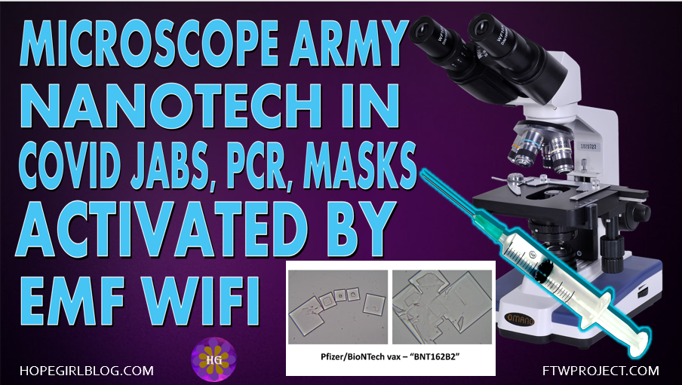
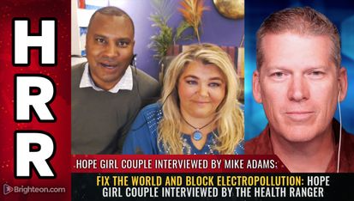
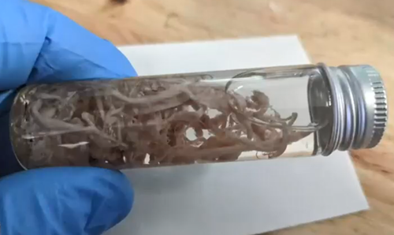
White Fibrous Structures Pulled out of Vaccinated Deceased Explained
We have had an ongoing investigation going for the past 18 months to discover the cause and purpose for the white fibrous structures pulled out of vaccinated deceased. We’ve interviewed several main people involved in the analysis of these structures including Dr. Jane Ruby, Mike Adams, and Matt Taylor. In the past several months we’ve found some answers.
THE COVID INJECTION PATENTS AND OTHER DOCUMENTATION EXPLAIN WHAT THESE STRUCTURES ARE, HOW THEY ARE FORMED, HOW THEY ARE CONTROLLED BY EMF, AND WHAT THEY ARE PROGRAMMED TO DO IN THE HUMAN BODY
Our ongoing investigation interviews regarding the white fibrous structures
We’ve created a full length video that walks the general public through this disclosure step by step can be found on our website under the Title “White Fibrous Structures Pulled out of Vaccinated Deceased Explained”
WWW.FTWPROJECT.COM

Slide 19
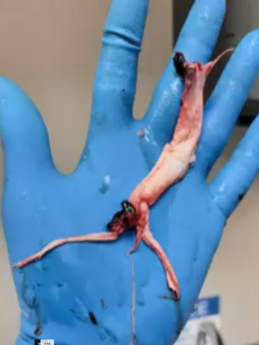
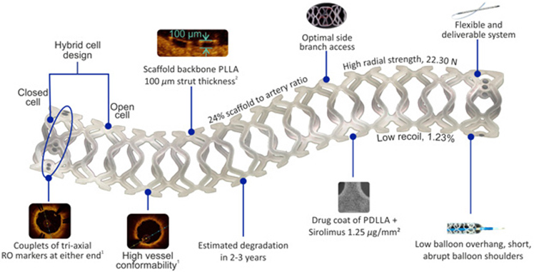
White Fibrous Structures Pulled out of Vaccinated Deceased Explained
These white fibrous structures are soft actuators that were grown by the programmable hydrogel inside of the covid injections.
The hydrogel goes into the body, adhere to the living cells, and then to pull elements out of cells and use those elements to build new structures inside the body that is half natural and half artificial. This process is called biosynthesis. The hydrogel is programmed to created structures that take the form or shape of human tissues such as arteries or veins.
These structures which are bioengineered and mimic tissues and organs in the body are called soft actuators. They can perform more diverse functions beyond those of human cells, tissues, or organs. They have been programmed to have “intelligence” that can direct their movement, self-heal and be multi responsive to the internal environment of the person that they are inside of. This same programming also enables them to respond to external stimuli including light, sound, temperature and electromagnetic signals or optics. actuators as a component of a machine that is responsible for moving and controlling a mechanism or system, for example opening a valve. Actuators require a control device that is controlled by a signal and a source of energy. When an actuator receives a signal (such as external EMF) it converts the systems energy (taken from the human body) into a mechanical motion. It is a form of automation or automatic control.
You cannot feel these growing inside of you. They have been found in living vaccinated people who do not have any symptoms. They have been found during the course of surgery on living vaccinated people. The Covid Injection experiment has grown these soft actuators inside of the bodies of billions of people across the planet. These peoples bodies, without their knowing are now connected to the internet of things and the internet of bodies through the EMF signals that not only communicate with the soft actuators growing in veins, but can control movements inside of a persons body and probably much more.
Structures pulled out the vaccinated deceased
Example of medical scaffolding made by hydrogels
WWW.FTWPROJECT.COM

Slide 20
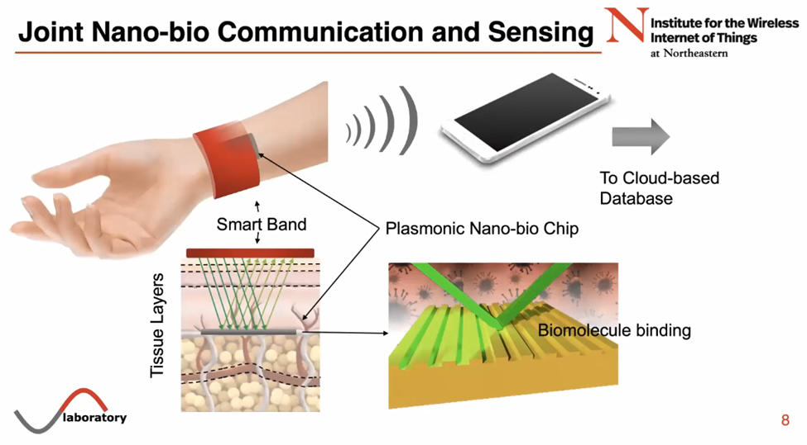
HOW THEY HOOK UP HUMAN BODIES TO THE INTERNET USING 6G 7G TERAHERTZ, AND GRAPHENE NANOTECH IN THE COVID INJECTIONS
The network that hooks up human bodies to the internet has just been established. This is what the most recent conferences and papers coming out of the UN and the WEF are focusing on right now. We have recently discovered a body of work that has been made public that discloses what the technology is, how it works, and what the plans are for rolling it out. While this technology is not really something new (its been worked on since at least the 1990’s) it was kept hidden and implemented covertly for years and then recently launched in full force right before Covid. Perhaps it is the reason why Covid happened. The network consists of a global grid that runs on 6G and 7G frequencies that connects all surfaces of the planet through satellites in space to the nano machine technology that has been injected into 5.55 billion people through the Covid-19 Injections.
WWW.FTWPROJECT.COM

Slide 21
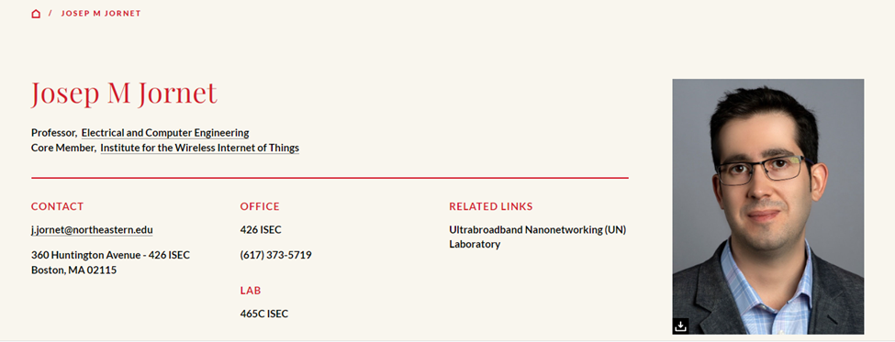
Who is presenting this technology to the governments of the world?
Professor Ian Alkyildiz (last name pronounced I-kill-deez) from the Georgia Institute of Technology has been developing terahertz communication systems for the internet of everything for at least the last 15 years. He’s worked with the US Army and DARPA and is currently running webinars for the United Nations. He’s set up technology research centers in Spain, South Africa, Finland, Saudi Arabia, Germany, Russi, India and Cyprus. This is just the beginning of his insanely impressive resume. His current areas of expertise and research includes:
6G, 7G wireless communication systems
Hologram communication
Terahertz communication
Internet of Bio-Nano Things
Intelligent surfaces
Molecular Communications
Josep Miquel Jornet is a Professor in the Department of Electrical and Computer Engineering, the director of the Ultrabroadband Nanonetworking (UN) Laboratory, and a member of the Institute for the Wireless Internet of Things and the SMART Center at Northeastern University (NU).
He is a leading expert in terahertz communications, in addition to wireless nano-bio-communication networks and the Internet of Nano-Things. He is serving as the lead PI (Principle Investigator) on multiple grants from U.S. federal agencies including the National Science Foundation, the Air Force Office of Scientific Research and the Air Force Research Laboratory as well as industry.
Josep Jornet was a student of Ian Alkyildiz and they worked together for many years writing IEEE papers and creating patents for terahertz communications wireless nano-bio-communication networks and the Internet of Nano-Things. Recently they gave a joint presentation for the UN in a webinar that explained the technology that is being used today to connect peoples bodies to the internet of things.
WWW.FTWPROJECT.COM

Slide 22
THE INTERNET OF THINGS AND BODIES IS RUN ON 6G, 7G TERAHERTZ FREQUENCIES
The lower frequencies between 700Mh and 2.6 GH is what they are calling 2G, 3G, and 4G. The equipment that operates on these frequencies are things like radio, cell phones, wifi, GPS satellites (3G).
The range above this is 5GHz to just under 100 GHz is what they are calling 5G. 5G is purely a weapon system using dangerous ranges of frequencies to bathe the public in microwave radiation. There is no equipment that only runs on 5G.
The range above this which is a HUGE range in frequencies is 95GHz-3THz.This is the range they are calling 6G (lower parts of it) and 7G for the higher parts. This specific range of frequencies is what they call the TeraHertz Band. Up until just prior to Covid, research for devices that operated in this range of frequencies was blocked by government agencies. It was considered “no mans land”, meaning anyone with the skills that proposed working with these frequencies was shot down by government officials.
Then, just about a year or two prior to Covid, the flood gates were opened to researchers. Patents working in Terahertz that had been on hold by the CIA were suddenly issued, and literally 100,000+ IEEE papers were written discussing the research of using TeraHertz Band frequencies
WWW.FTWPROJECT.COM

Slide 23
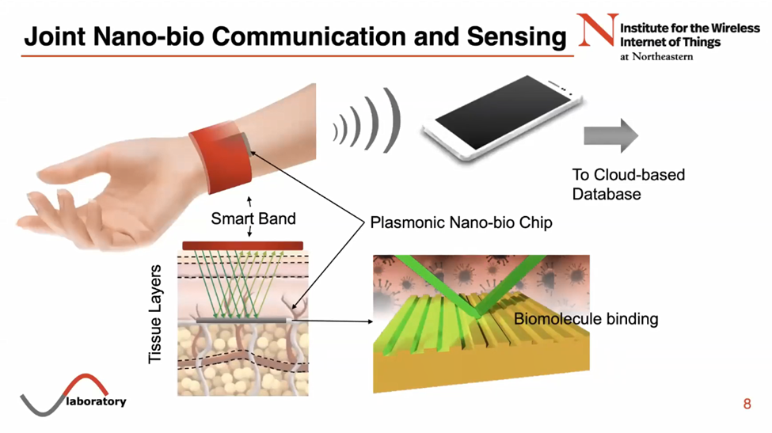
TECHNOLOGY THAT RUNS ON TERAHERTZ BAND FREQUENCIES
-Internet of space things (Low Earth Orbit Satellites like Starlink etc discussed in the 2023 UN briefing The Future of Outer Space Governance)
-Reconfigurable Intelligent surfaces -Pervasive Artificial Intelligence
-Network Automation
-All forms of Terahertz Communication for the internet of things
In the higher frequencies (what they call 7G) the equipment that operates on these frequencies is:
-Quantum communication, quantum computers (been around since 1990’s)
-Internet of Bio-Nano Things (injectables in the body, Covid 19 Injections)
-Internet of Nano-Things (technology like smart dust and the things they are spraying in the chemtrails)
Internet of Bio Nano Things
WWW.FTWPROJECT.COM

Slide 24
Internet of Nano -Things
The interconnection of nanoscale devices with existing communication networks and ultimately the Internet. Examples of these nano scale devices are smart dust and chemtrail components that blanket the air and the land, our water supply, nanotechnology based products like food, drugs, cosmetics (approved by the FDA by the way).
Internet of Bio-Nano Things
Used for health applications and injected into the body. Synthetic biology and nanotechnology that allows the engineering of biological embedded computing devices. This network allows for sensing data in the human body and creating within the body and interface internet.
Internet of Space things Taking the internet of things for networks on the ground and connecting it to satellite-based data networks in space.
WWW.FTWPROJECT.COM

Slide 25
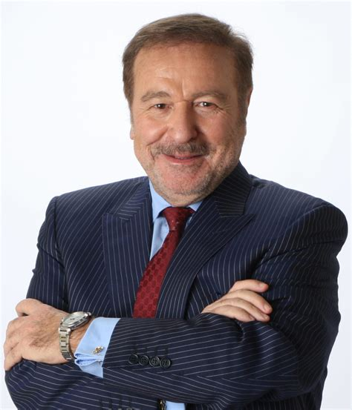
Ian Akyildiz slipped up and made the following statement at 13:40 in this presentation: https://www.youtube.com/watch?v=YAtQFkEg5-w
“I did a lot of research on the Internet of Bio-Nano Things in the last 15 years, this is bio nano machines that are injected into the body for monitoring of health problems. This is going really well. These Covid vaccines, these mRNAs are nothing more than small scale nano machines that are programmed and injected.”
Well he would know wouldn’t he?
Ian Alkyildiz Nanotech terahertz communications expert 6G,7G wireless communications Internet of Bio-Nano Things Internet of Space Nano Things Worked for US Army and DARPA and UN
WWW.FTWPROJECT.COM

Slide 26
Graphene Nano Antennas Used Inside the Body To Connect You to The Internet
Graphene Based Plasmonic Nano-Antennas Used Inside the Body From Jornets presentation to UN The plasmonic nano-bio chip is implanted inside of the body, underneath the tissue layers of skin. The chip is engineered to find specific biological markers in your blood so that you can beam radar at the chip in order to read what is going on in the blood. The data about what is
going on in your body read from these chips is then transmitted to your phone or the internet to a cloud based database.
Graphene Based Plasmonic Nano-Antennas invention of Akyildiz and Jornet
A nano sized antennae made out of graphene. They stimulate the graphene with Eletromagnetic waves which create plasma waves across the surface that allow for the communication needed. THIS PATENT WAS BLOCKED BY THE CIA FOR SEVERAL YEARS. They applied for it in 2010 and the CIA held it and would not issue the patent till 2017
WWW.FTWPROJECT.COM

Slide 27
Found in Covid Injections: (compared to scientific papers) Nano Routers that emit MAC addresses via Bluetooth Nano antennas and plasmonic antennas to amplify signal Nano rectennas as rectifier bridge of alternating and direct current Codecs- devices that perform transformations on a data stream or signal Logic gates- small digital electronic devices that compute binary functions like “and”, “or” ,“not” ,“true”, “false” ,“less than” ,“greater than” , etc. Used for the encryption of these network communications from vaccinated individuals to a remote network server.
PATENTS THAT DESCRIBE HOW THEY WILL HOOK UP HUMAN BEINGS TO THE “INTERNET OF THINGS” VIA 5G. (Now we know that they need the nanotech in the Covid shots in order to accomplish this) Routing policies for biological hosts (AT&T) US10163055B2 Devices and Methods for Transferring Data through a Human Body (AT&T) No. 20130142363 Cryptocurrency system Using Body Activity Data (Microsoft) W02020060606
Text
EXCELLENT REPORT! MUST READ! LINK IN BLOG POST TO REPORT IN ENGLISH “INTRABODY NANO NETWORK BRIEF SUMMARY” –MIK ANDERSON THROUGH LA QUINTA COLUMNA
WWW.FTWPROJECT.COM

Slide 28
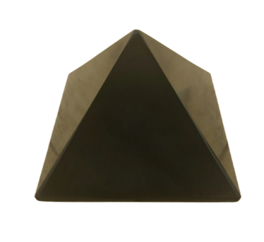
Why Surface Area Matters
The nanotechnology used needs to cover a large surface area in order to be the most effective. They call these surfaces “reflective intelligent surfaces” The more surfaces that are covered with this technology the more powerful the signal is. This is why they have taken then nano antennae's and transceivers and have covered a lot of surfaces with them, including buildings, people, trees, towers, particle in the air.
We use the same concept in our orgone products, but our intention is to use a lot of surface area to combat the bad health effects of this evil technology. We use powders to make our products because powders have a very high surface area. This is what amplifies the effectiveness of the orgone field that is generated from our products. The high surface area in our products creates a powerful enough field to transform the energy caused by this frequency technology. Most likely, our products are interrupting the signal grids they are trying to establish, which is why we suggest that people grid their property EMF protection orgone products to help fight back against this technology.
Orgone Pyramids for gridding your home
WWW.FTWPROJECT.COM

Slide 29
In the next slide Josep Jornet shows how this network operates in space and explains that miniature satellites in low earth orbit are already operating on terahertz frequencies and they are all up there just watching everything or “sensing”, they are just collecting data from the atmosphere.
In this slide Prof. Akyildiz is explaining how all the different technologies using all the different frequencies can link together and can switch over to different frequencies without getting out of sync.
WWW.FTWPROJECT.COM

Slide 30
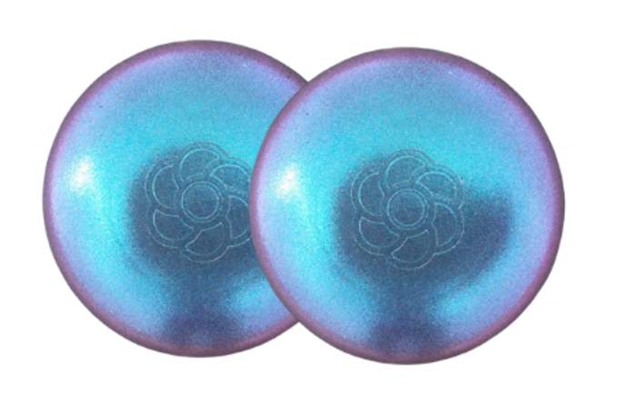
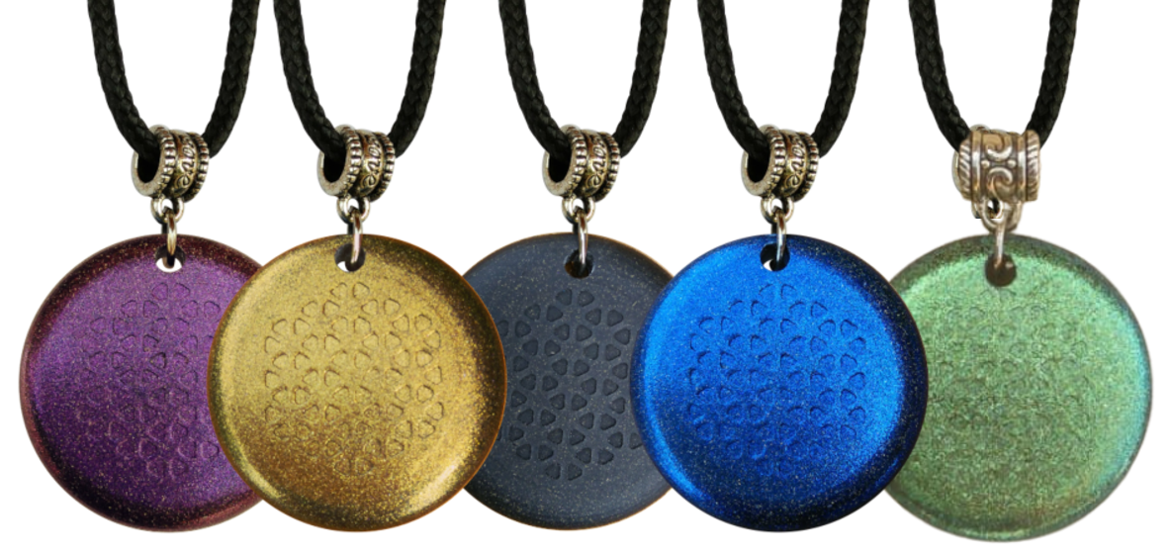
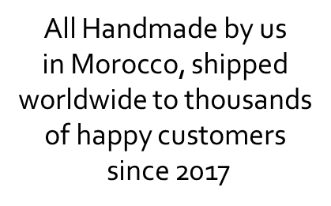
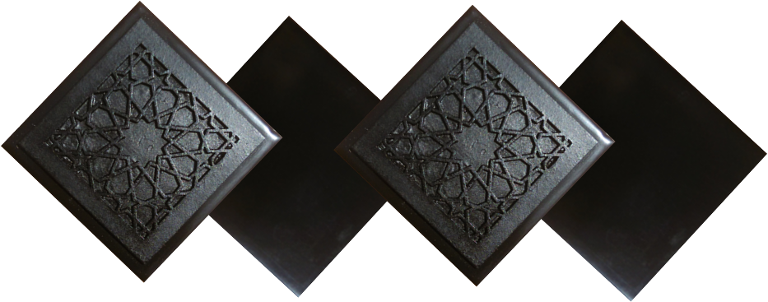
ABOUT OUR EMF PROTECTION PRODUCTS
HELP SUPPORT SGT REPORT BY SHOPPING FROM THIS LINK: https://www.ftwproject.com/ref/6/
SLEEPING PODS For a good nights sleep
CHARGE PLATES for use around the home, to preserve food and more
“We just can't believe our eyes! We have placed the garden pucks from our first order around our property, and the plants/trees with the pucks are BLOOMING within days! This is happening with every single place the pucks have been rested. Just incredible.” -Australia
PHONE SHIELDS to put on your cell phone, laptop and routers
PENDANTS for personal emf protection on your body
PYRAMIDS and garden sets for gridding your home / property / garden for emf protection on a large scale
SCIENTIFIC STUDIES AND DOCUMENTATION DESCRIBING HOW OUR PRODUCTS WORK AVAILABLE ON OUR WEBSITE.
TILES for incorporating emf protection into construction projects
WWW.FTWPROJECT.COM

