Slide 1
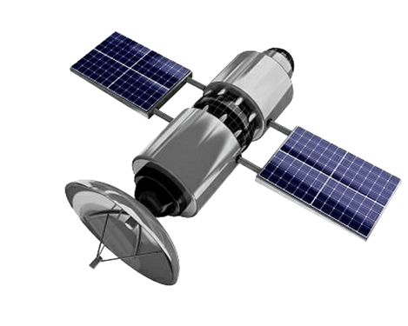
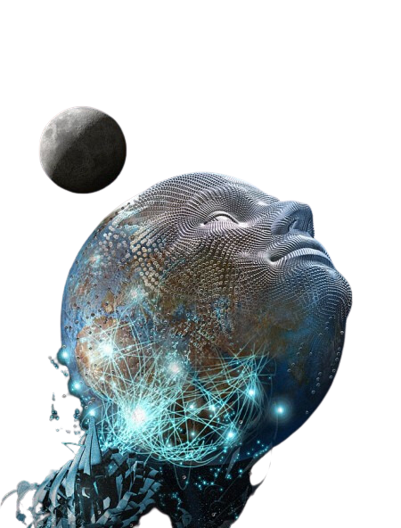
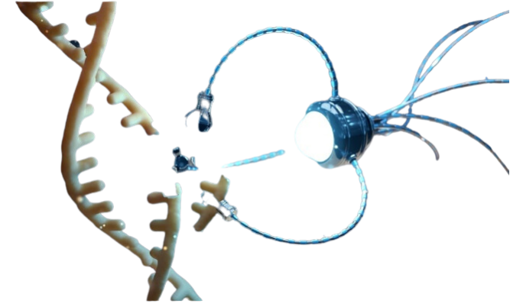
PRESENTED TO VAXXCHOICE BY HOPE AND TIVON OF FTWPROJECT.COM

Slide 2
SUMMARY
-No one was told they were being injected with electromagnetic devices. Proof from the patents, Pfizer Documents and FDA documents that the COVID injections are technology and NOT biological.
-How the nanotech in the injections connects you body to the internet, Bluetooth codes -What this nanotech is doing to human bodies- life force, hydrogel in the blood, soft actuators pulled from vaccinated deceased
-Treating the body with an understanding of ions
-From the Globalist Tech Industry “Covid mRNA Vaccines are small scale bio nano machines that are programmed and injected” -How they hook up human bodies to the internet using 6G, 7G Terahertz and Graphene Nanotech in the Covid Injections
-Show the full prison grid that connects human bodies to LEO satellites for full surveillance and control -Show that this technology is a weapon system and what it is capable of doing -Solutions on what you can do to protect yourself and your family
HOPEGIRLBLOG.COM
FTWPROJECT.COM

Slide 3
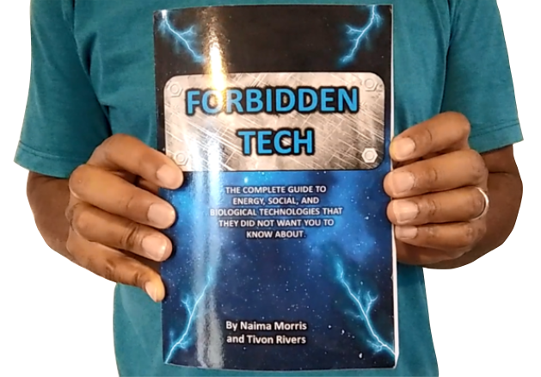
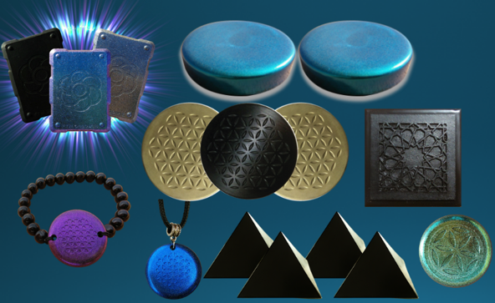
WHY WE DO WHAT WE DO
We are Christians, Engineers and Scientists. We feel it is our calling to help inform people about the technology that is being used against Gods creation.
FORBIDDEN TECH: The complete guide to energy, social, and biological technologies that they did not want you to know about. (2017) www.FORBIDDENTECH.WEBSITE
Handmade products orgone and shungite for EMF protection. Made by us in our workshop in Morocco. WWW.FTWPROJECT.COM
Online engineering academy for the co-development of researching and building DIY off grid energy devices. WWW.CLEANENERGYACADEMY.COM
Notes:
If time permits we’d like to play this 4 minute clip https://www.youtube.com/watch?v=aVj7_0A5-Ew

Slide 4
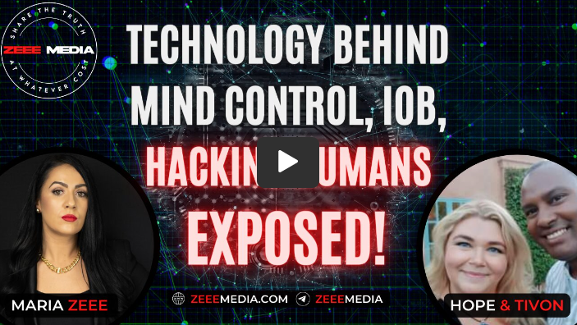
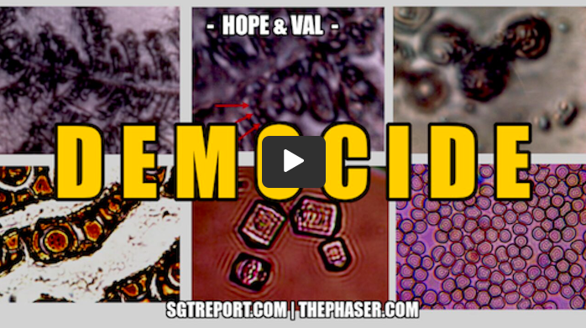
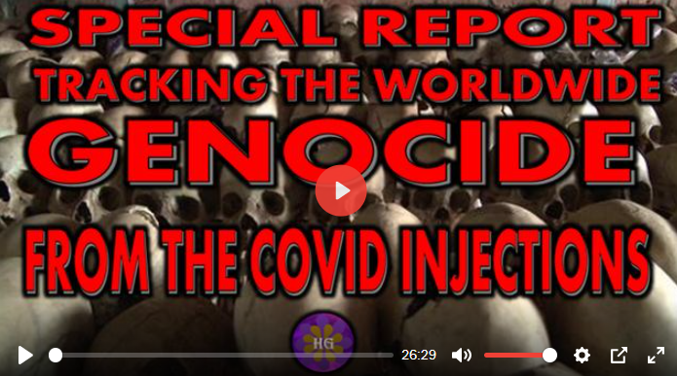
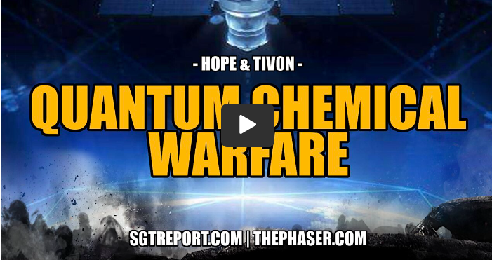
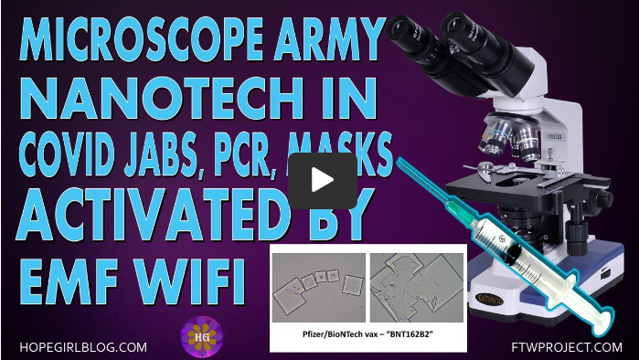
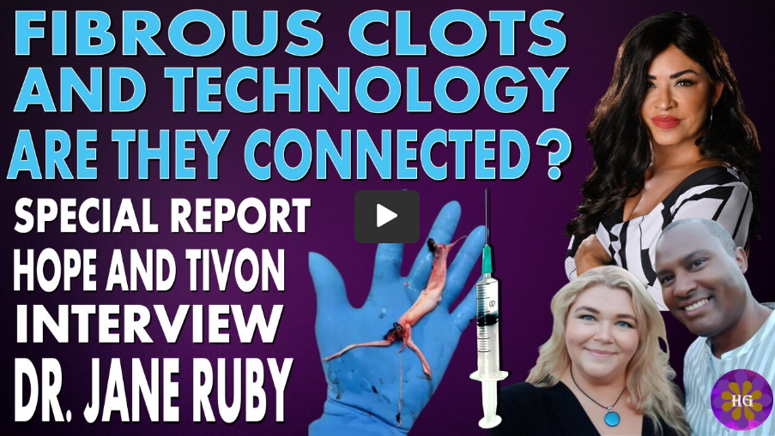
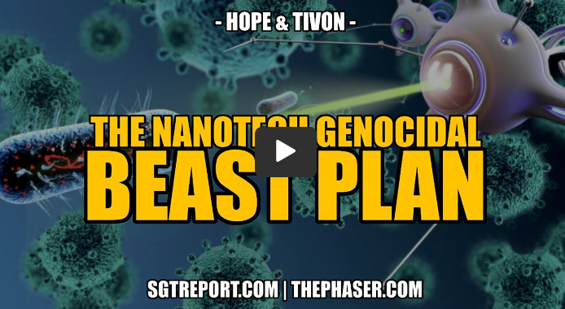
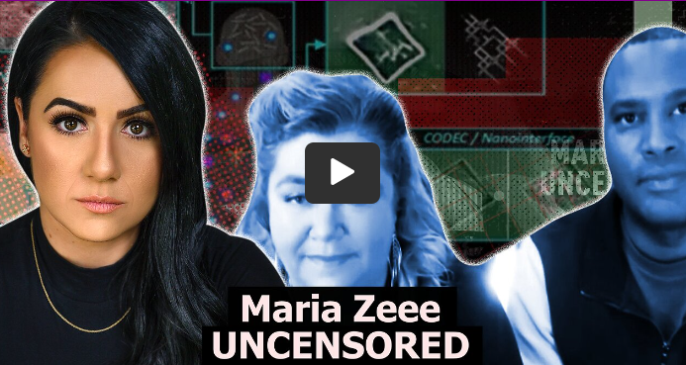
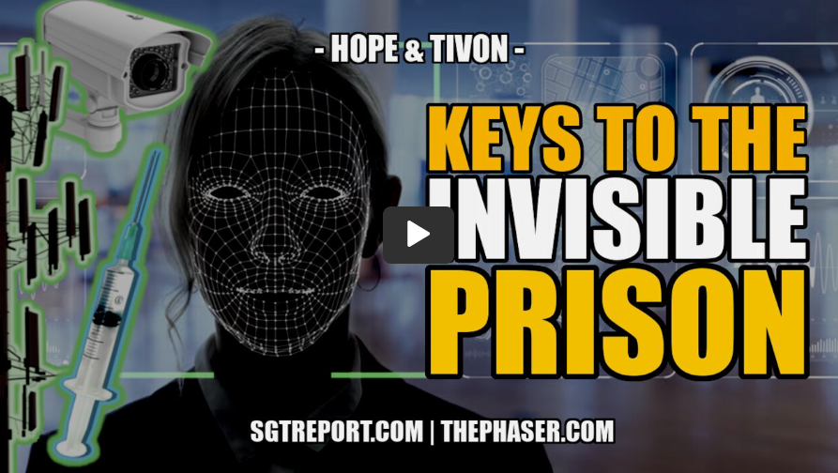
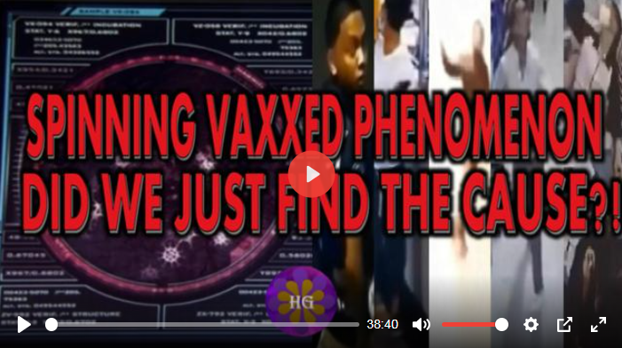
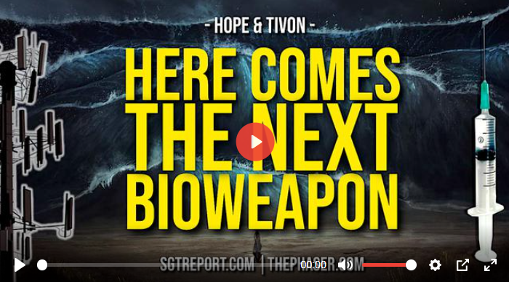
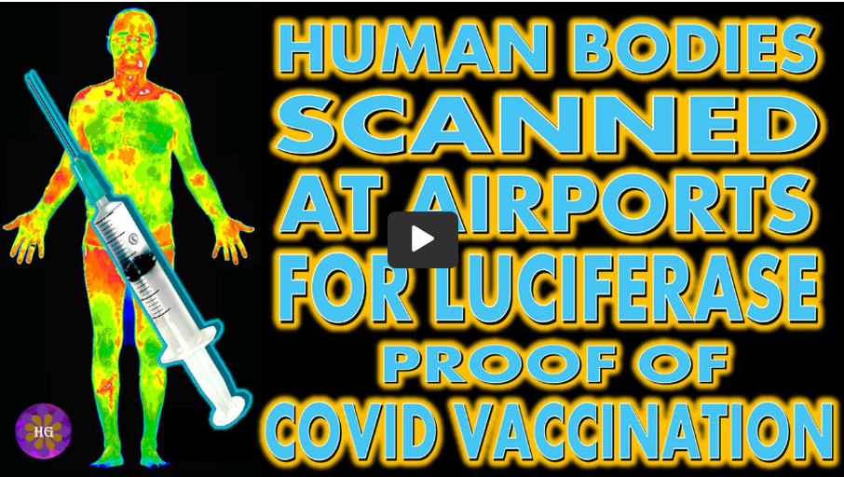
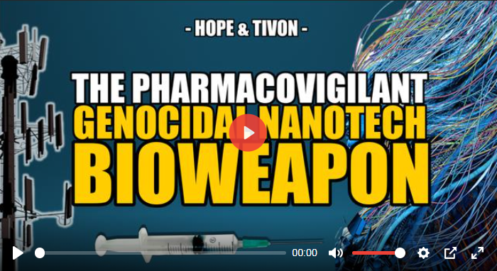
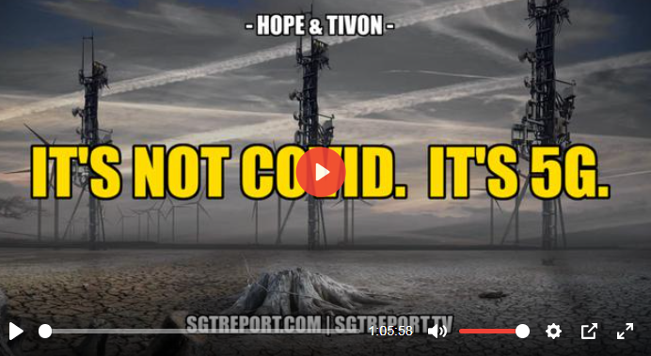
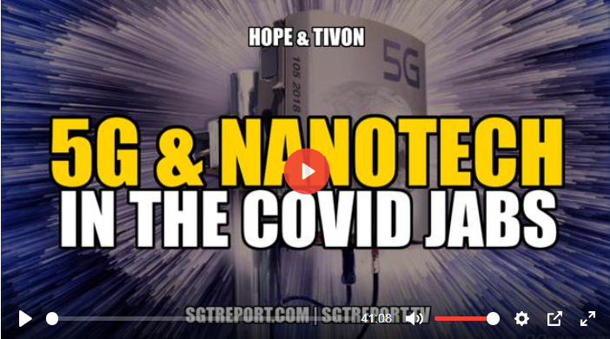
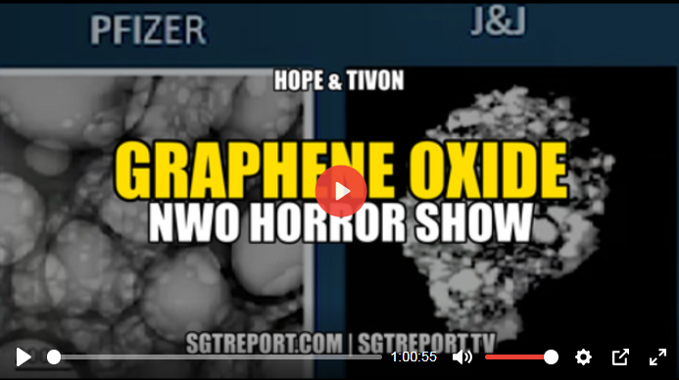
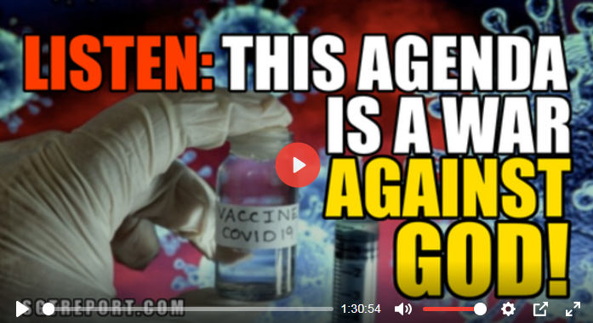
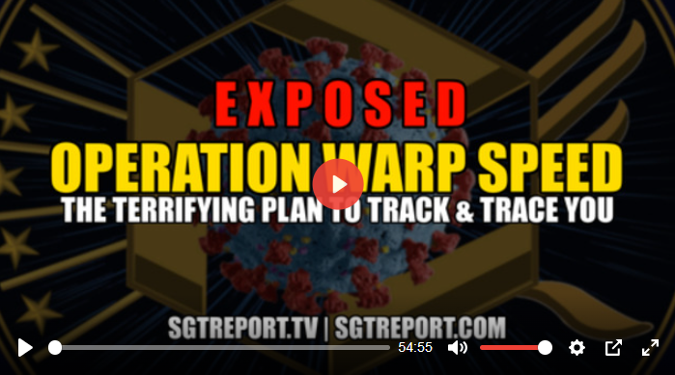
Links to our Extensive COVID Research for the last 3 years
https://www.hopegirlblog.com/hope-and-tivon-full-reference-list-of-covid-research-and-presentations/
Notes:
If time permits we’d like to play this 4 minute clip https://www.youtube.com/watch?v=aVj7_0A5-Ew

Slide 5
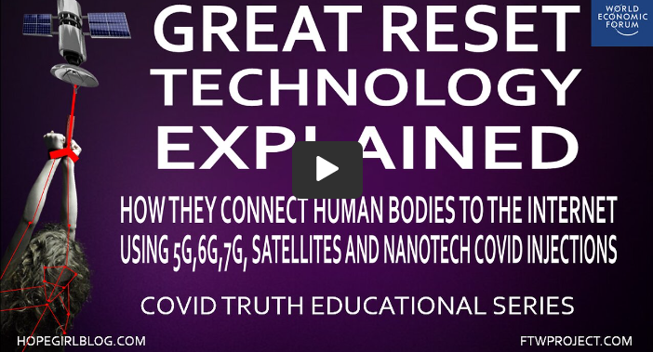
NEW!!!COVID TRUTH EDUCATIONAL SERIES
These videos are put together in a step by step educational format to help clear up the confusion of the lies that have been told to the public through the COVID agenda.
Notes:
If time permits we’d like to play this 4 minute clip https://www.youtube.com/watch?v=aVj7_0A5-Ew

Slide 6
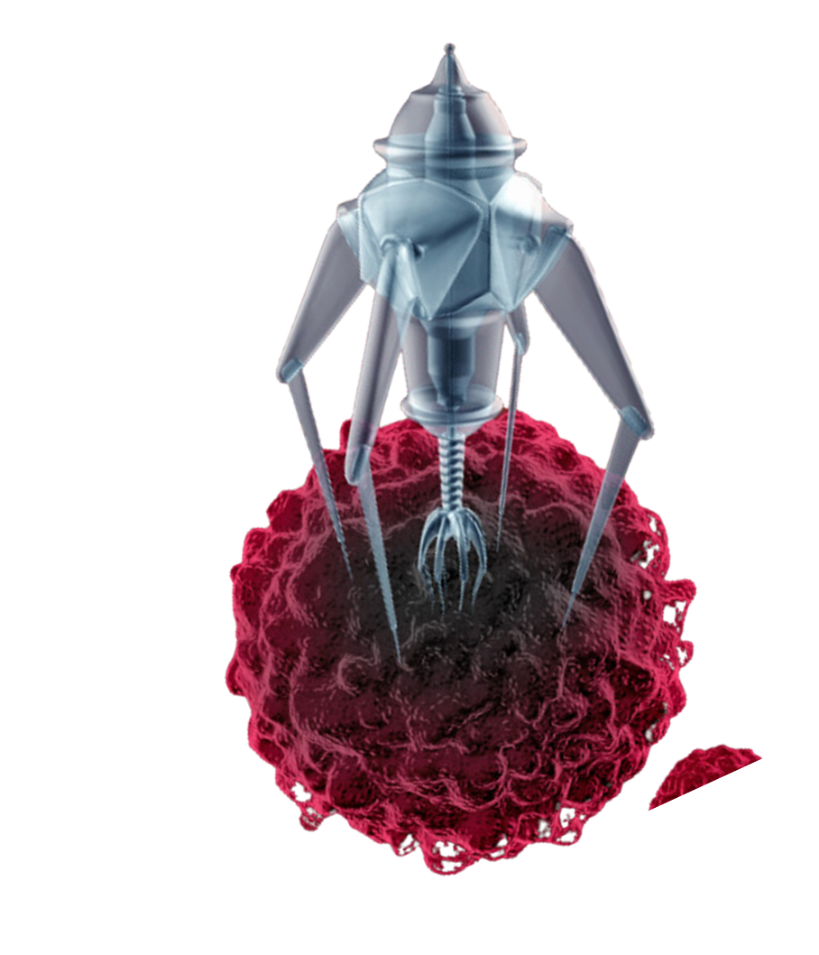
The governments and pharma companies lied to the public. They used nomenclature to change the names of things in the Covid 19 vaccines to make people believe they were being injected with something that was biological that was going to help their immune system and fight off the coronavirus.
The components that are in the vaccines are not biological, they are advanced nano technology that fuse with your body’s cells and create new biosynthetic lifeforms in your body.
We have done a Full Length hour long video presentation that walks through this disclosure step by step to show all the documentation proof and help define complex terms for the general public. It is called “No One Was Told They Were Being Injected with Electromagnetic Devices” and can be found in the link to this presentation and on our website.
WWW.FTWPROJECT.COM

Slide 7
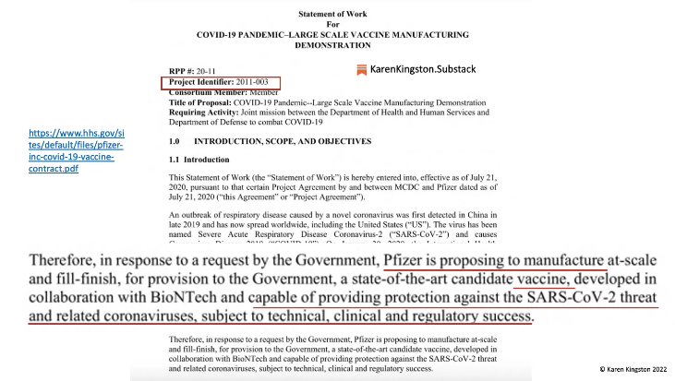
PROOF THE VACCINES ARE TECHNOLOGY AND NOT BIOLOGICAL CAN BE FOUND IN: -THE OPERATION WARP SPEED CONTRACT -THE VACCINE PATENTS
-THE PFIZER DOCUMENTS THEY WANTED TO HIDE FOR 75 YEARS
The Operation Warp Speed Department of Defense contract classifies the Covid Injections NOT AS BIOLOGICALS but at ELECTROMAGNETIC DEVICES.
WWW.FTWPROJECT.COM

Slide 8
THE OPERATION WARP SPEED CONTRACT CLASSIFIES COVID VACCINES AS ELECTROMAGNETIC DEVICES
Governments lie and deceive, this is the paper trail to show what they have been trying to hide.
In July of 2020 Pfizer entered into the Warpspeed contract with the DOD to create a vaccine that would provide protection against the coronavirus. Here is that contract: https://www.hhs.gov/sites/default/files/pfizer-inc-covid-19-vaccine-contract.pdf
Under section C.2. Chemistry Manufacturing Controls (CMC), the contract addresses the good manufacturing practices Pfizer must adhere to for the formulation and manufacturing of their lipid nanoparticles (LNPs). Specifically, under the Manufacturing Development Plan in the same contract it states “Pfizer will…ensure conformity with the Food, Drug, and Cosmetics Act (FD&C Act, Title 21 US Code) 21 USC 351 (a)(2)(b), regarding good manufacturing practices.”
When you look up this code: https://www.accessdata.fda.gov/scripts/cdrh/cfdocs/cfcfr/CFRSearch.cfm?fr=225.1
(FD&C Act, Title 21 US Code) 21 USC 351 (a)(2)(b)) It is a section of the FD&C Act that addresses good manufacturing processes for DEVICES. Per 21 USC 351, the term device may include, “an instrument, apparatus, machine, or contrivance…..intended to affect the structure or any function of the body of man or other animals, and which does not achieve its primary intended purpose through chemical action within the body…”
If a device is dependent on a chemical action within the body, it would be considered a drug or biologic. An example of this is a capsule that needs to be dissolved by stomach acid in order to release the medication it contains. The capsule is simply considered part of the drug, not as a separate device.
This means that the device (or contrivance) is self-operating and/or activated by an outside energy source and is not dependent on a chemical action from within the body. An example of a contrivance are the gold/graphene oxide nanoparticles in the Pfizer COVID-19 mRNA injections.
Per the FDA’s 2017 guidance on defining a drug versus a device, nanoparticles are defined as devices. Not only are nanoparticles categorized as devices, but the mechanism of action of the nanoparticles described in this FDA document shows their electromagnetic properties. Pfizer's mRNA nanoparticles are electromagnetic devices per their Operation Warp Speed DoD contract and the FDA. No one agreed to be injected with devices that would kill surrounding cells and tissue when activated by EMF
WWW.FTWPROJECT.COM

Slide 9
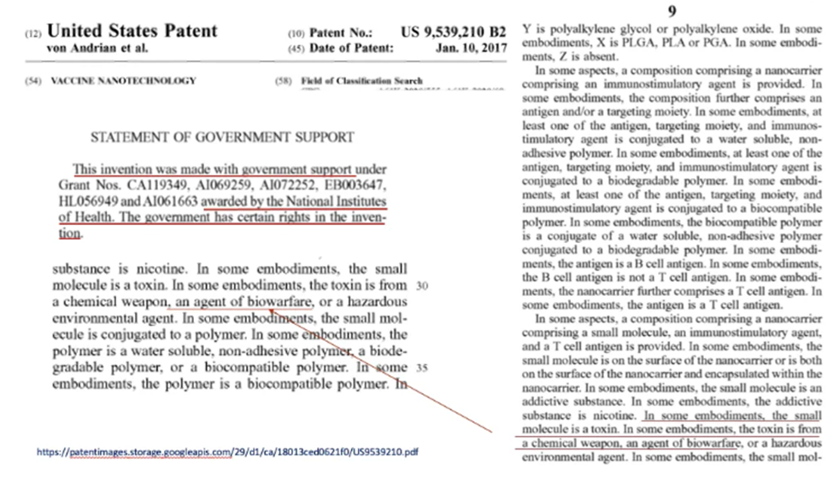
THE PATENTS ACTUALLY CALL THE COVID VACCINES AN AGENT OF BIOWARFARE
The Patent Titled “Vaccines Technology” which is a utility patent for the covid 19 vaccines, it literally lists the components of the vaccine as a toxin from a chemical weapon an agent of biowarfare.
WWW.FTWPROJECT.COM

Slide 10
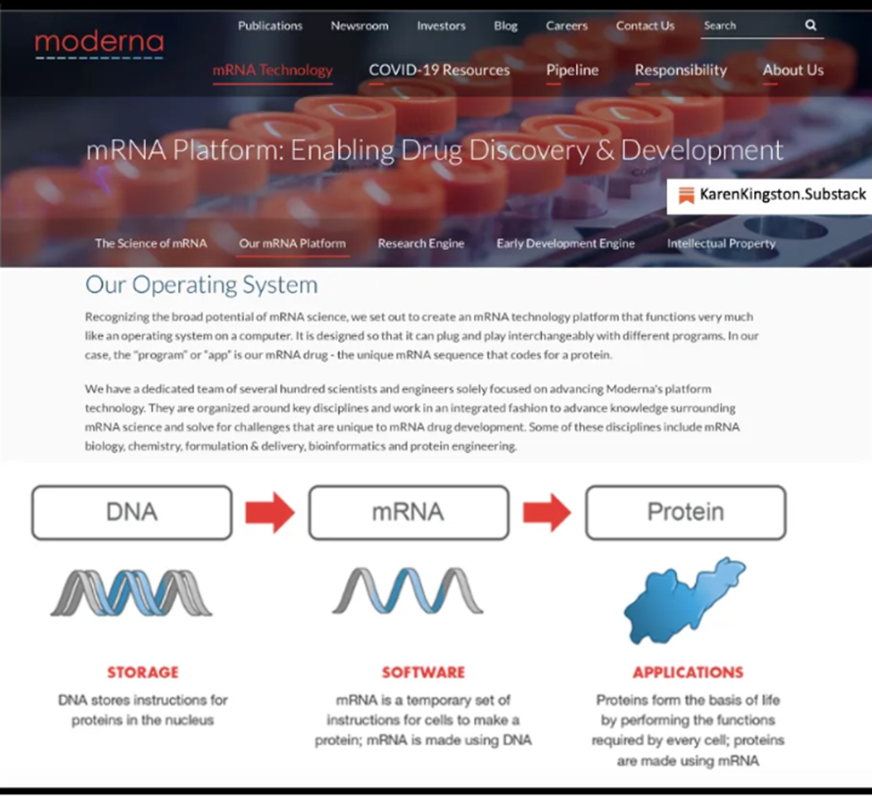
MODERNA CALLS THE MRNA SOFTWARE AND THE VACCINES AN OPERATING SYSTEM
Moderna’s website defines mRNA as a software program and the call their vaccine an operating system.
Moderna has since redacted this info on their website after public exposure was brought to it. You can still find it using wayback machine.
WWW.FTWPROJECT.COM

Slide 11
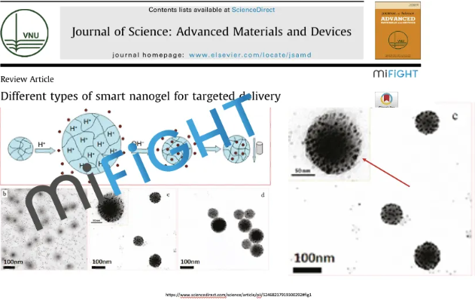
THE VACCINES ARE GRAPHENE FUSED WITH QUANTUM DOT NANOTECHNOLOGY
The Patents and Pfizer documentation explains that the components in the vaccines are nanotechnology, specifically hydrogels which are made from graphene oxide and fused with quantum dot technology. This technology then uses the cells of your own body and programs them to make new lifeform inside of you that are half natural and half unnatural. This technology is self-assembling, and fully programmable from an outside source.
WWW.FTWPROJECT.COM

Slide 12
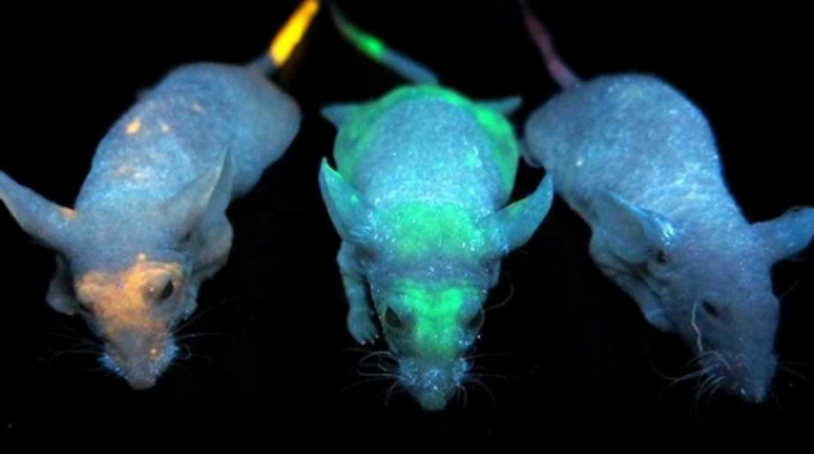
QUANTUM DOT TECHNOLOGY IN THE INJECTIONS IS WHAT ENABLES HIGHER FREQUENCY (EMF) COMMUNICATION FROM INJECTED HUMAN BODIES. BLUETOOTH AND QUANTUM FIELD FREQUENCIES
The patents describe that the hydrogel in the Covid Injections is fused with quantum dot technology. A quantum dot is a semiconductor that creates an electromagnetic field and has electronic and optical properties. They are used in quantum computing for their quantum communication properties. Luciferase and quantum dots are basically the same thing. We wrote about quantum dot technology in our book “Forbidden Tech” back in 2017.
Lab mice injected with quantum dots in University of Toronto Experiment. Noted: the quantum dots can be programmed to accumulate in specific areas of the body- such as your right hand or your forehead Mark of the beast.
WWW.FTWPROJECT.COM

Slide 13
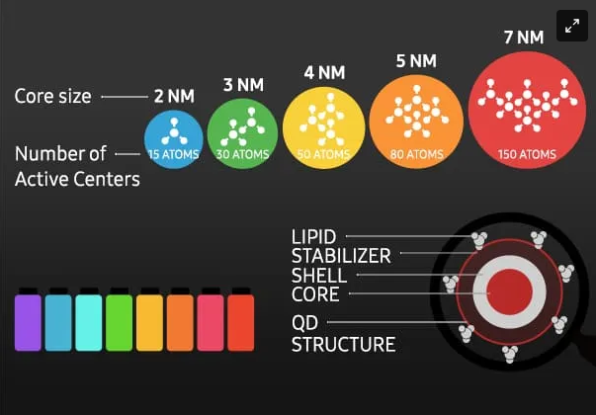
QUANTUM DOT TECHNOLOGY IN THE INJECTIONS IS WHAT ENABLES HIGHER FREQUENCY (EMF) COMMUNICATION FROM INJECTED HUMAN BODIES. BLUETOOTH AND QUANTUM FIELD FREQUENCIES
The electromagnetic fields and frequencies emitted by quantum dots can cause emotional, psychological, and physical disease and dysfunction in our bodies. Quantum dots can be used as neuroweapons and can cause severe disruptions to your emotions, energy, physical abilities and your ability to think straight (brain fog).
From the patents: quantum dot’s functionality is based on the quantum mechanics of the Bohr particle. Due to quantum mechanics, quantum dots that have been injected into humans by means of the COVID-19 bioweapons and can quite literally appear within the human body based on specific electromagnetic frequencies (EMF) or disappear based on specific frequencies.
Quantum dots respond to high- and short- frequencies that emit blue light. At these higher frequencies, the quantum dots reduce in size enabling them to connect with, receive, and emit frequencies from the quantum field.
Per the 2011 book publication, Quantum Confinement Effect, quantum dots are able to produce electromagnetic labels (i.e. Bluetooth addresses) inside the body and tag organs. Use of quantum dot technology in humans is regulated by the Centers of Devices & Radiological Health (CDHR) of the FDA because they are electronic devices that emit radiation.
WWW.FTWPROJECT.COM

Slide 14
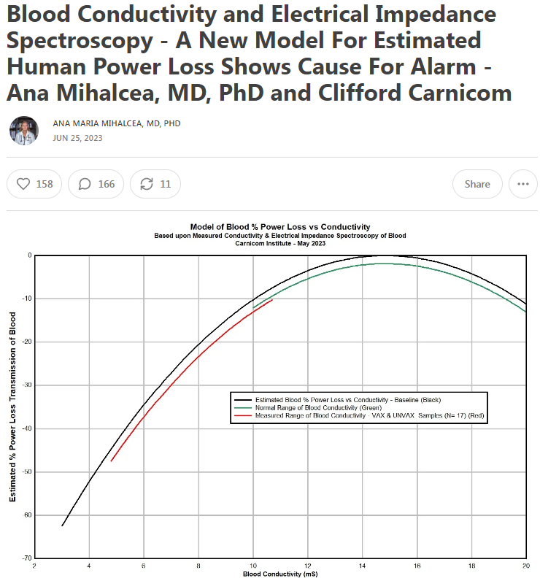
The Covid Injections contain “cationic lipids” which are synthetic components that do not exist in nature. These cationic lipids host a positive charge (bad for your health) that migrates towards negative electrons (good for your health). What this means is that this nanotech is literally sucking the life force out of you. And the creation of this electromagnetic field is probably effecting other people around you even if they are not injected. This explains the “shedding” or transmission of symptoms to the unvaccinated.
Furthermore, these cationic lipid nanoparticles are self assembling and fully programmable from an outside source.
Dr. Ana Mihalcea and Clifford Carnicom have done electrical impedance spectroscopy testing to show the loss of human power caused by the nanotech in these shots.
They found that the power loss is commonly estimated on the order of 25-40%, and is as low as 47%. Almost 50% of your life force energy is taken from you by this nanotech!
WWW.FTWPROJECT.COM

Slide 15
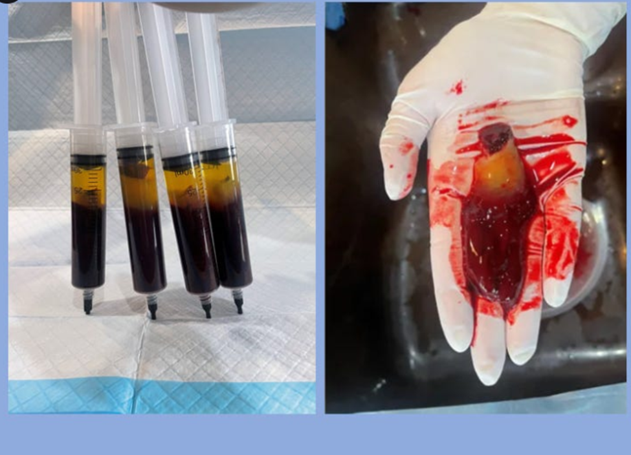
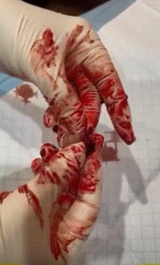
Hydrogel seen in the blood Tests run by Dr. Ana Mihalcea
Peoples blood looks like sludge or jello and cannot transport oxygen, it is filled with nanotech. Dr. Ana took blood from three vaccinated patients and let it sit in a tube for 4 hours. The blood separated on its own and a rubbery yellow hydrogel plastic formed on the top. Dr. Ana calls the hydrogel programmable plastics, because that’s what hydrogel essentially is. The hydrogel plastics in the blood cannot be dissolved by conventional blood thinners.
EDTA Chelation is the only thing so far that has been shown to break down the hydrogels to remove them from the body.
Video shows stretchy rubber band like texture of the hydrogel in blood.
WWW.FTWPROJECT.COM

Slide 16
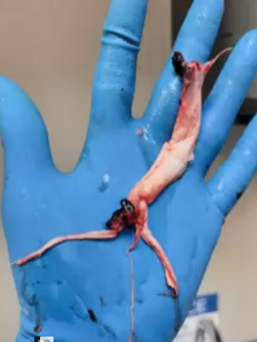
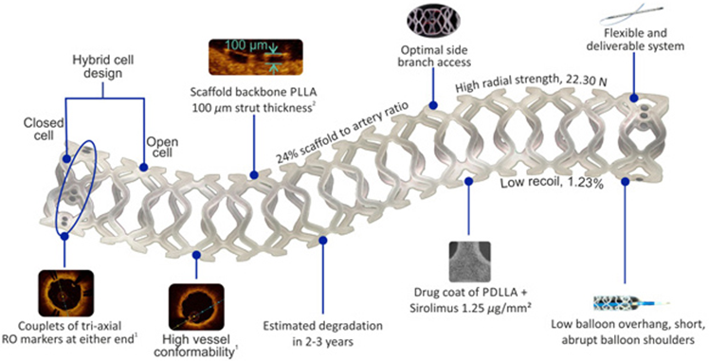
White Fibrous Structures Pulled out of Vaccinated Deceased Explained
These white fibrous structures are soft actuators that were grown by the programmable hydrogel inside of the covid injections.
The hydrogel goes into the body, adhere to the living cells, and then to pull elements out of cells and use those elements to build new structures inside the body that is half natural and half artificial. This process is called biosynthesis. The hydrogel is programmed to created structures that take the form or shape of human tissues such as arteries or veins.
These structures which are bioengineered and mimic tissues and organs in the body are called soft actuators. They can perform more diverse functions beyond those of human cells, tissues, or organs. They have been programmed to have “intelligence” that can direct their movement, self-heal and be multi responsive to the internal environment of the person that they are inside of. This same programming also enables them to respond to external stimuli including light, sound, temperature and electromagnetic signals or optics. actuators as a component of a machine that is responsible for moving and controlling a mechanism or system, for example opening a valve. Actuators require a control device that is controlled by a signal and a source of energy. When an actuator receives a signal (such as external EMF) it converts the systems energy (taken from the human body) into a mechanical motion. It is a form of automation or automatic control.
You cannot feel these growing inside of you. They have been found in living vaccinated people who do not have any symptoms. They have been found during the course of surgery on living vaccinated people. The Covid Injection experiment has grown these soft actuators inside of the bodies of billions of people across the planet. These peoples bodies, without their knowing are now connected to the internet of things and the internet of bodies through the EMF signals that not only communicate with the soft actuators growing in veins, but can control movements inside of a persons body and probably much more.
Structures pulled out the vaccinated deceased
Example of medical scaffolding made by hydrogels
WWW.FTWPROJECT.COM

Slide 17
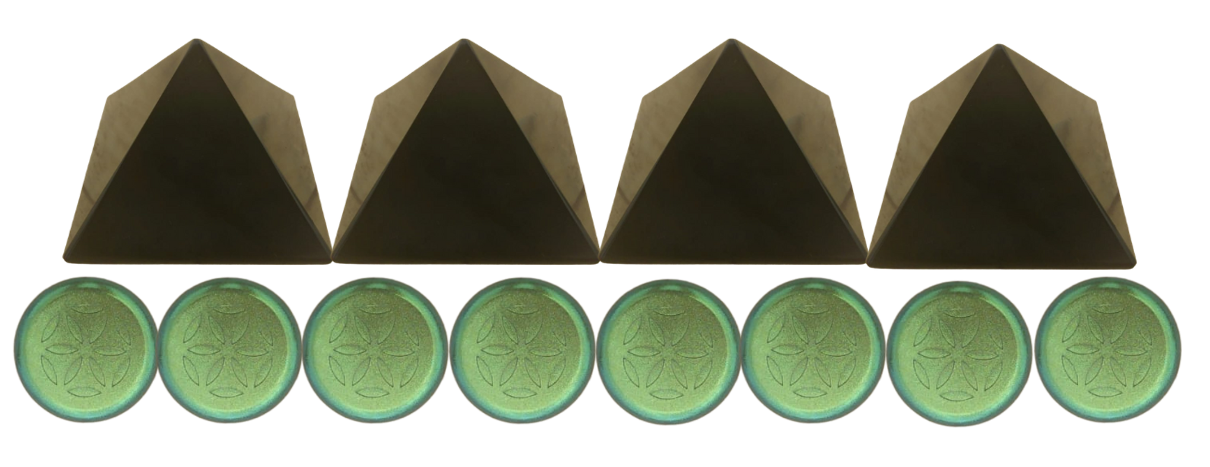
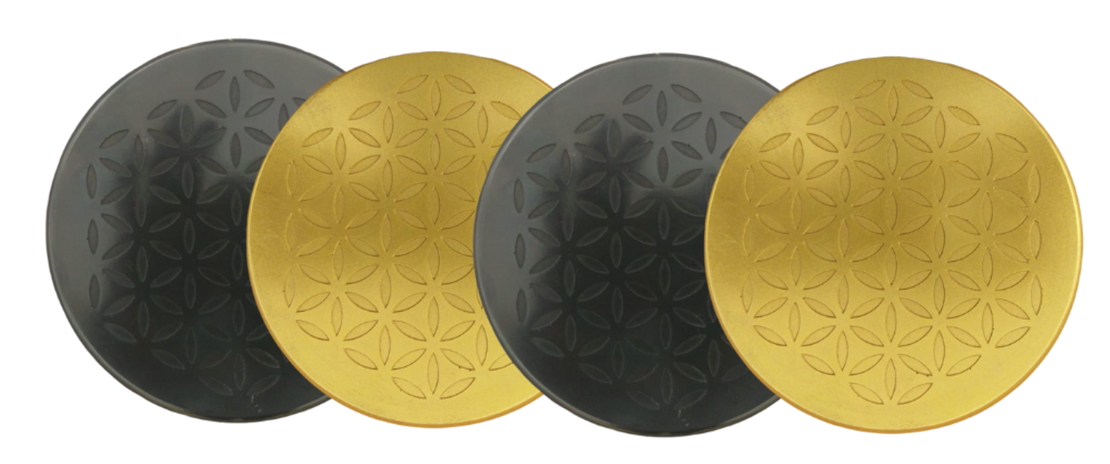
Treating the body with an understanding of Ions
Positive Ions (Bad For You) come from: electromagnetic fields, fluorescent lighting, carpet, metal, plastics, air pollution (chemtrails geoengineering) Covid 19 Nanotechnology
causes health issues like breathing difficulties, allergies, lethargy, infections, depression, anxiety, suicidal feelings, weakened immune system, brain function problems, nausea and vertigo.
ORGONITE DEVICE ARE NATURAL PASSIVE NEGATIVE ION EMITTERS one of the ways that our orgonite products work is they put negative ions back into the environment and back into your body and can help to mitigate the effects of this nanotechnology in this way.
Negative Ions Good For You come from: nature, forests, bodies of running water, sun light, orgone devices, plants, certain healthy foods and supplements.
can boost the immune system, alleviate stress, help balance mood swings, help with depression, provide more energy, help with respiratory issues, combat allergies and much more.
Certain supplements like glutathione, vitamin C, Quercetin, and drugs like ivermectin and hydroxychloroquine supply negative ions to the body, which is why these drugs worked to alleviate symptoms. They were helping to restore the electrical balance of the body.
WWW.FTWPROJECT.COM

Slide 18
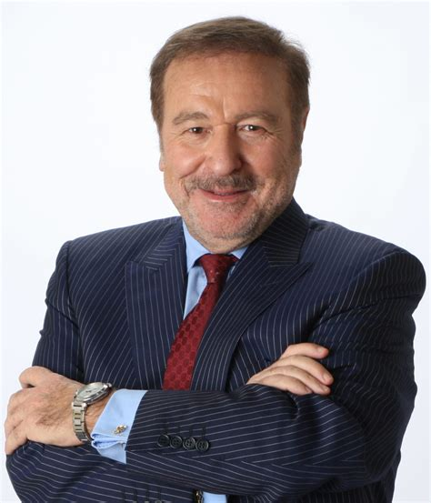
Ian Akyildiz slipped up and made the following statement at 13:40 in this presentation: https://www.youtube.com/watch?v=YAtQFkEg5-w
“I did a lot of research on the Internet of Bio-Nano Things in the last 15 years, this is bio nano machines that are injected into the body for monitoring of health problems. This is going really well. These Covid vaccines, these mRNAs are nothing more than small scale nano machines that are programmed and injected.”
Well he would know wouldn’t he?
Ian Alkyildiz Nanotech terahertz communications expert 6G,7G wireless communications Internet of Bio-Nano Things Internet of Space Nano Things Worked for US Army and DARPA and UN
WWW.FTWPROJECT.COM

Slide 19
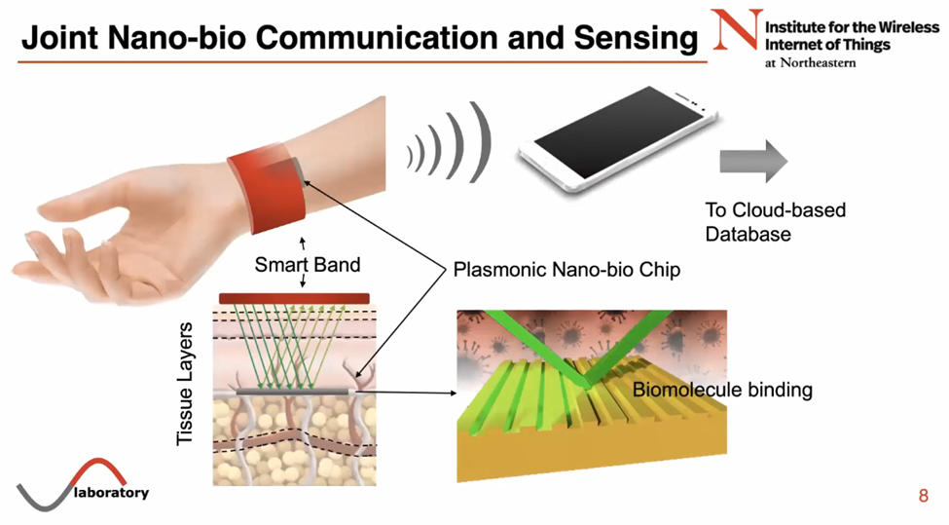
HOW THEY HOOK UP HUMAN BODIES TO THE INTERNET USING 6G 7G TERAHERTZ, AND GRAPHENE NANOTECH IN THE COVID INJECTIONS
The network that hooks up human bodies to the internet has just been established. This is what the most recent conferences and papers coming out of the UN and the WEF are focusing on right now. We have recently discovered a body of work that has been made public that discloses what the technology is, how it works, and what the plans are for rolling it out. While this technology is not really something new (its been worked on since at least the 1990’s) it was kept hidden and implemented covertly for years and then recently launched in full force right before Covid. Perhaps it is the reason why Covid happened. The network consists of a global grid that runs on 6G and 7G frequencies that connects all surfaces of the planet through satellites in space to the nano machine technology that has been injected into 5.55 billion people through the Covid-19 Injections.
WWW.FTWPROJECT.COM

Slide 20
Who is presenting this technology to the governments of the world?
Professor Ian Alkyildiz (last name pronounced I-kill-deez) from the Georgia Institute of Technology has been developing terahertz communication systems for the internet of everything for at least the last 15 years. He’s worked with the US Army and DARPA and is currently running webinars for the United Nations. He’s set up technology research centers in Spain, South Africa, Finland, Saudi Arabia, Germany, Russi, India and Cyprus. This is just the beginning of his insanely impressive resume. His current areas of expertise and research includes:
6G, 7G wireless communication systems
Hologram communication
Terahertz communication
Internet of Bio-Nano Things
Intelligent surfaces
Molecular Communications
Josep Miquel Jornet is a Professor in the Department of Electrical and Computer Engineering, the director of the Ultrabroadband Nanonetworking (UN) Laboratory, and a member of the Institute for the Wireless Internet of Things and the SMART Center at Northeastern University (NU).
He is a leading expert in terahertz communications, in addition to wireless nano-bio-communication networks and the Internet of Nano-Things. He is serving as the lead PI (Principle Investigator) on multiple grants from U.S. federal agencies including the National Science Foundation, the Air Force Office of Scientific Research and the Air Force Research Laboratory as well as industry.
Josep Jornet was a student of Ian Alkyildiz and they worked together for many years writing IEEE papers and creating patents for terahertz communications wireless nano-bio-communication networks and the Internet of Nano-Things. Recently they gave a joint presentation for the UN in a webinar that explained the technology that is being used today to connect peoples bodies to the internet of things.
WWW.FTWPROJECT.COM

Slide 21
THE INTERNET OF THINGS AND BODIES IS RUN ON 6G, 7G TERAHERTZ FREQUENCIES
The lower frequencies between 700Mh and 2.6 GH is what they are calling 2G, 3G, and 4G. The equipment that operates on these frequencies are things like radio, cell phones, wifi, GPS satellites (3G).
The range above this is 5GHz to just under 100 GHz is what they are calling 5G. 5G is purely a weapon system using dangerous ranges of frequencies to bathe the public in microwave radiation. There is no equipment that only runs on 5G.
The range above this which is a HUGE range in frequencies is 95GHz-3THz.This is the range they are calling 6G (lower parts of it) and 7G for the higher parts. This specific range of frequencies is what they call the TeraHertz Band. Up until just prior to Covid, research for devices that operated in this range of frequencies was blocked by government agencies. It was considered “no mans land”, meaning anyone with the skills that proposed working with these frequencies was shot down by government officials.
Then, just about a year or two prior to Covid, the flood gates were opened to researchers. Patents working in Terahertz that had been on hold by the CIA were suddenly issued, and literally 100,000+ IEEE papers were written discussing the research of using TeraHertz Band frequencies
WWW.FTWPROJECT.COM

Slide 22
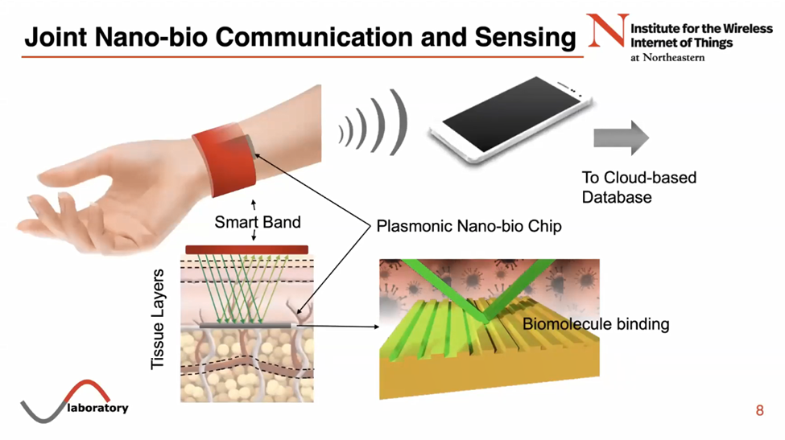
TECHNOLOGY THAT RUNS ON TERAHERTZ BAND FREQUENCIES
-Internet of space things (Low Earth Orbit Satellites like Starlink etc discussed in the 2023 UN briefing The Future of Outer Space Governance)
-Reconfigurable Intelligent surfaces -Pervasive Artificial Intelligence
-Network Automation
-All forms of Terahertz Communication for the internet of things
In the higher frequencies (what they call 7G) the equipment that operates on these frequencies is:
-Quantum communication, quantum computers (been around since 1990’s)
-Internet of Bio-Nano Things (injectables in the body, Covid 19 Injections)
-Internet of Nano-Things (technology like smart dust and the things they are spraying in the chemtrails)
Internet of Bio Nano Things
WWW.FTWPROJECT.COM

Slide 23
Internet of Nano -Things
The interconnection of nanoscale devices with existing communication networks and ultimately the Internet. Examples of these nano scale devices are smart dust and chemtrail components that blanket the air and the land, our water supply, nanotechnology based products like food, drugs, cosmetics (approved by the FDA by the way).
Internet of Bio-Nano Things
Used for health applications and injected into the body. Synthetic biology and nanotechnology that allows the engineering of biological embedded computing devices. This network allows for sensing data in the human body and creating within the body and interface internet.
Internet of Space things Taking the internet of things for networks on the ground and connecting it to satellite-based data networks in space.
WWW.FTWPROJECT.COM

Slide 24
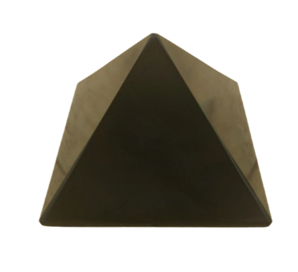
Why Surface Area Matters
The nanotechnology used needs to cover a large surface area in order to be the most effective. They call these surfaces “reflective intelligent surfaces” The more surfaces that are covered with this technology the more powerful the signal is. This is why they have taken then nano antennae's and transceivers and have covered a lot of surfaces with them, including buildings, people, trees, towers, particle in the air.
We use the same concept in our orgone products, but our intention is to use a lot of surface area to combat the bad health effects of this evil technology. We use powders to make our products because powders have a very high surface area. This is what amplifies the effectiveness of the orgone field that is generated from our products. The high surface area in our products creates a powerful enough field to transform the energy caused by this frequency technology. Most likely, our products are interrupting the signal grids they are trying to establish, which is why we suggest that people grid their property EMF protection orgone products to help fight back against this technology.
Orgone Pyramids for gridding your home
From Ian Akyildiz Presentation
WWW.FTWPROJECT.COM

Slide 25
In the next slide Josep Jornet shows how this network operates in space and explains that miniature satellites in low earth orbit are already operating on terahertz frequencies and they are all up there just watching everything or “sensing”, they are just collecting data from the atmosphere.
In this slide Prof. Akyildiz is explaining how all the different technologies using all the different frequencies can link together and can switch over to different frequencies without getting out of sync.
WWW.FTWPROJECT.COM

Slide 26
HOPEGIRLBLOG.COM
FTWPROJECT.COM

Slide 27
Graphene Based Plasmonic Nano-Antennas Used Inside the Body From Jornets presentation to UN The plasmonic nano-bio chip is implanted inside of the body, underneath the tissue layers of skin. The chip is engineered to find specific biological markers in your blood so that you can beam radar at the chip in order to read what is going on in the blood. The data about what is
going on in your body read from these chips is then transmitted to your phone or the internet to a cloud based database.
Graphene Based Plasmonic Nano-Antennas invention of Akyildiz and Jornet
A nano sized antennae made out of graphene. They stimulate the graphene with Eletromagnetic waves which create plasma waves across the surface that allow for the communication needed. THIS PATENT WAS BLOCKED BY THE CIA FOR SEVERAL YEARS. They applied for it in 2010 and the CIA held it and would not issue the patent till 2017
WWW.FTWPROJECT.COM

Slide 28
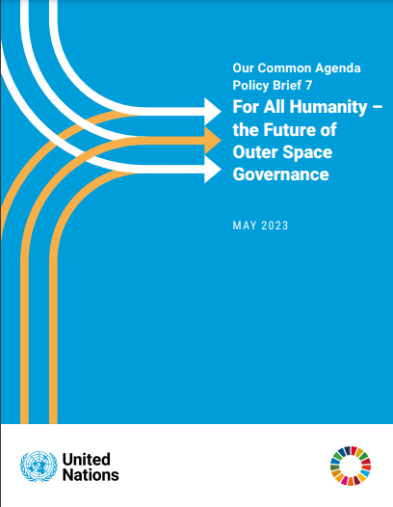
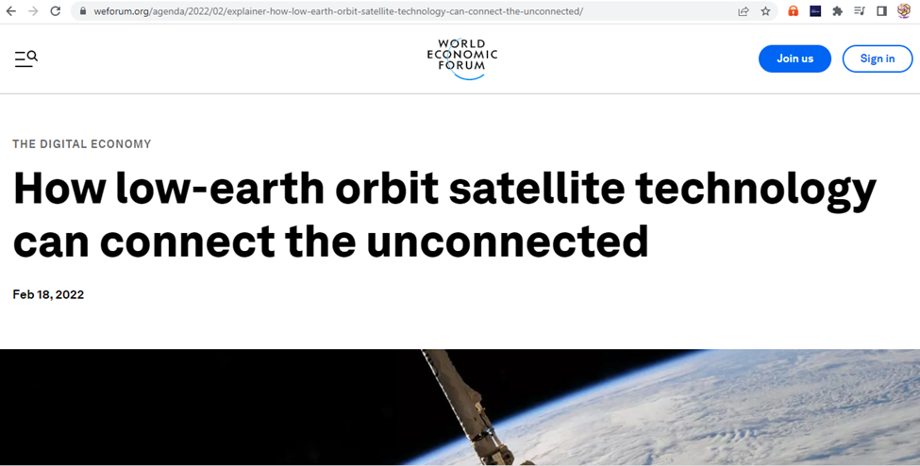
United Nations Planning Digital ID Linked to Bank Accounts
The plan, which is similar to the system developed by the World Economic Forum (WEF), is outlined in three new policy briefs from the UN titled, “A Global Digital Compact, Reforms to the International Financial Architecture, and The Future of Outer Space Governance.” Essentially, the objective is to have people, devices, and entities, all tied up in a connected network that could apparently be centrally administered, seemingly by unelected bureaucrats. These came out in May 2023
This UN document is all about who gets to control the satellites, which is what they are using to track human beings through their bodies and control your data.
What does Outer Space Have to do with Digital ID and Bank Accounts? From WEF website under “Digital Economy”
WWW.FTWPROJECT.COM

Slide 29
WEF says that LOW EARTH ORBIT SATELLITES ARE THE ONLY OPTION THAT WOULD CONNECT THE 2.9 BILLION PEOPLE IN THE WORLD THAT ARE STILL NOT CONNECTED TO THE INTERNET.
The European Union recently announced plans for an LEO satellite system worth €6 billion. The EU is entering a space internet race where technology giants are spending billions of dollars on LEO satellite technology to close the global connectivity gaps. Space X’s Starlink, Elon Musk’s satellite internet venture, has deployed nearly 2,000 satellites in orbit and has applied for licences to fly more than 40,000 satellites. Bill Gates backs a $1 billion plan to cover Earth in 'Big Brother' satellites capable of streaming 'live and unfiltered' HD footage of the planet 500 Low earth orbit satellites that have cameras pointed onto the earth that will create real time imagery that people an view on their cell phones.
WWW.FTWPROJECT.COM

Slide 30
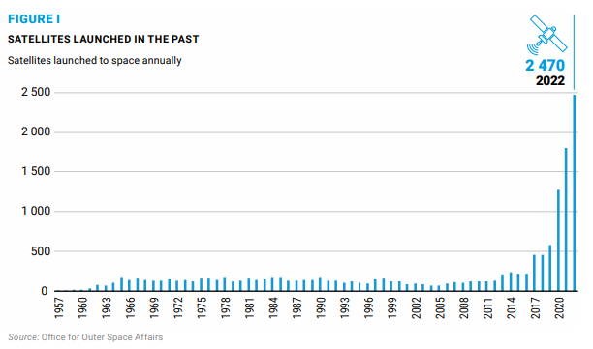
Look how many LEO satellites they launched into space DURING THE PANDEMIC
Its getting very congested up there in Low Earth Orbit. Check out this chart from the UN Paper on how many LEO satellites were launched into space. Look at the timing…during the pandemic is when they launched the most. Almost makes you think that the LEO satellites and the nanochips in the vaccines were connected somehow? Perhaps they had to get 5.55 billion people injected with nanotech sensors to complete their LEO control grid? Perhaps that’s the reason they did Covid, to convince a large part of the worlds population to inject themselves with nanotech sensors?
WWW.FTWPROJECT.COM

Slide 31
Why we got censored on Rumble and Attacks from Flat Earthers
Several months ago we did a presentation called Quantum Chemical Warfare where we went in depth discussing quantum mechanics and atomic clocks used by satellites for GPS which all needed to be synced up in order for the infrastructure to work so they could track and trace human beings through the nanotech that was injected into them through the COVID injections. This presentation was censored on Rumble, a supposed “free speech platform”. After we gave the presentation, we found this slide in Ian Alkyildiz presentation that shows the 4 DARPA projects right now that are bigger than the internet. #1 on the list is ATOMIC GPS Chip Scale Atomic Navigation and Quantum Assisted Sensing… precisely what we were discussing in our presentation and why we believe we got censored.
This information we are putting out about the electronic prison grid is being heavily attacked by an internet Army of “Flat Earthers”. They “astroturf” the comments sections of these particular videos to try to discredit the information. We are not sure if most of these comments are written by real people or if they are AI robots. They claim that satellites in space are not real, that space is not real, because the earth is flat, because NASA lies. Therefore the prison grid they are setting up is not real, and the weapons technology they are using on everyone is not real. As someone who has had the great misfortune of being on the receiving end of the targeting weapons satellites technology, we can assure you that satellites are very real. And while the opposing forces don’t want you to look up or believe that the technology exists, we feel that it is imperative that we disclose this technology grid to anyone who is willing to listen… because when they start turning on all this equipment, people will need to know what is happening to them.
HOPEGIRLBLOG.COM
FTWPROJECT.COM

Slide 32
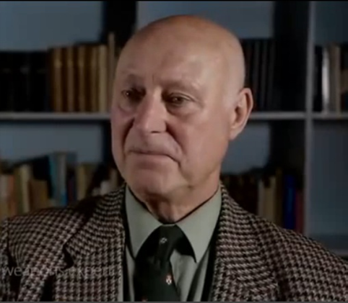
There are Weapons on the other side of the track and trace technology
“Microwave weapons were introduced in the 50’s, they are so effective as a stealth weapon and have been used many times and it has been reported. You can beam people you don’t like as a government to give them cancer, breast cancers, neurological illnesses, you can choose what you want them to get by choosing which pulse frequency to affect the brain with. You can choose the level of microwave radiation and the speed at which you want them to get ill” “We have 8,300 papers and I have knowledge of 2,300 myself. What the governments found was that you could induce illness by changing the pulse frequency… For instance 6.6 pules a second can induce severe sexual aggression in men. You can target other parts of people’s bodies. You can target the heart and cause heart seizures. You can target the lungs and cause bleeding. You can target, if you’re clever enough, some of the essential glands in the body that control all of the whole organ systems.”
“I don’t care if they track and trace me, I’ve got nothing to hide!” REALLY????
HOPEGIRLBLOG.COM
FTWPROJECT.COM

Slide 33
We learned from Josep Jornets presentation to the UN that terahertz frequencies have the unique ability to interact with molecules in the body. This is how they can target an individual. Josep shows a chart that says they have figured out at exactly what terahertz frequency specific molecules or materials can get excited, or where the frequency is absorbed.
To a person who has been on the receiving end of energy weapon frequency technology that governments have been covertly using on citizens, this chart reads a whole different way. The chart shows at exactly what terahertz frequencies you need to beam at a person to target different parts of their body. The first peak could be the frequency to target the heart for a heart attack, the second peak could be the skin, maybe the third peak is the frequency to penetrate the brain and cause strokes and so on.
HOPEGIRLBLOG.COM
FTWPROJECT.COM

Slide 34
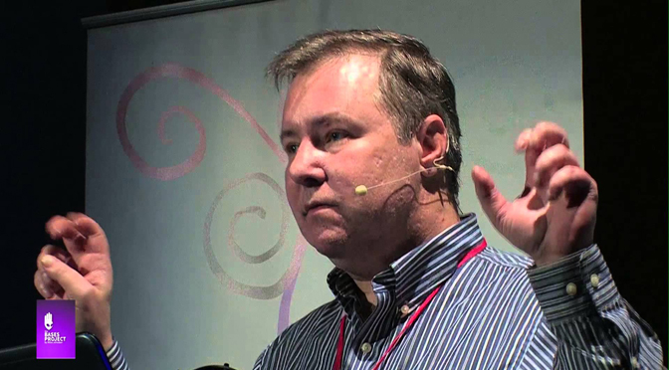
In this presentation, Titled “We are on the Verge of Cataclysmic Discovery!” given in 2017 Dr. Duncan describes the many ways of mind control that have been achieved through the technology that he was developing.
Dr. Duncan speaks of speaks of magnetically activated nanoparticles used for brain sensing and control. All aspects of cognition can be controlled and interrogated. Human thoughts can be mapped out. The nanoparticles are activated under certain magnetic frequencies and will alter the brain patterns and pathways. Below is a magnified picture of a needle that’s injected that is putting the scaffolding of the magnetically activated nanoparticles over the brain.
Dr. Robert Duncan is a Harvard University trained scientist and engineer who worked on black projects for DARPA, CIA, Justice Department and the Department of Defense.
Dr. Robert Duncan Developed Voice of God Weapon Technology (V2K)
HOPEGIRLBLOG.COM
FTWPROJECT.COM

Slide 35
SOLUTIONS : WHAT YOU CAN DO TO PROTECT YOURSELF AND YOUR FAMILY
There are many fellow warriors who are working on developing treatments for those who have been injured by the Covid Injections. We specialize in EMF protection which should be part of a full regime that people can do right now to protect themselves. Our three foundational principles: DON’T BE AN ANTENNAE! -Detox heavy metals out of your body choose a protocol (lots to choose from on the vaxxchoice.com website) ARMOR YOUR IMMUNE SYSTEM! -Supplements and diet changes to strengthen your immune system. Plus treating your body with negative ions in your environment to balance out your bodies electricity.
BLOCK THE SIGNAL AND NEUTRALIZE THE ENERGY WEAPON -Use a variety of EMF protection methods to block the signal, including don’t live in a 15 minute city or close to towers, put metal screens on all of your windows (this blocks and scatters the signals), use EMF protection paint on your homes, special outlets to clean up dirty electricity…there are many options. One we want to talk about is adding orgone devices to your environment, which does more than just block these bad frequencies, it neutralizes them and changes them into healthy life giving energy. Lets learn how this works…
HOPEGIRLBLOG.COM
FTWPROJECT.COM

Slide 36
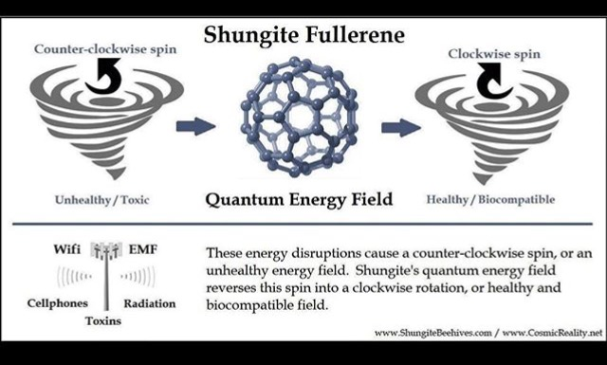
The Science Behind Our EMF Protection Products :Orgone Energy and Shungite
In the 1930’s, the late Dr. Wilhelm Reich discovered that living samples placed within containers made from alternating layers of steel and non-conductive organic material were able to harness healthy ‘cosmic energy’ from the environment. He called this energy ‘orgone’.
These orgone accumulators and had the ability to: – Preserve blood samples for longer periods of time – Sprout healthier plant seedlings – Provided pain relief for his patients who sat inside them.
Instead of a box, composites made from a blend of; iron oxide, steel, brass, shungite and crystal powders encased in epoxy resin produce the same effects and are able to transform the harmful wireless fields from; cell towers, smart meters, smartphones, internet router and your television, into more beneficial energy for you and your plants and pets.
Shungite is a rare mineral, believed to come from an asteroid that can only be found in one place in the world: Karelia Russia. It is the only mineral of its kind that contains fullerenes, which have been proven effective in protection from EMF’s and also used for cleaning nuclear waste, such as Fukushima.
Full length explanatory videos on our Website! FTWProject.com

Slide 37
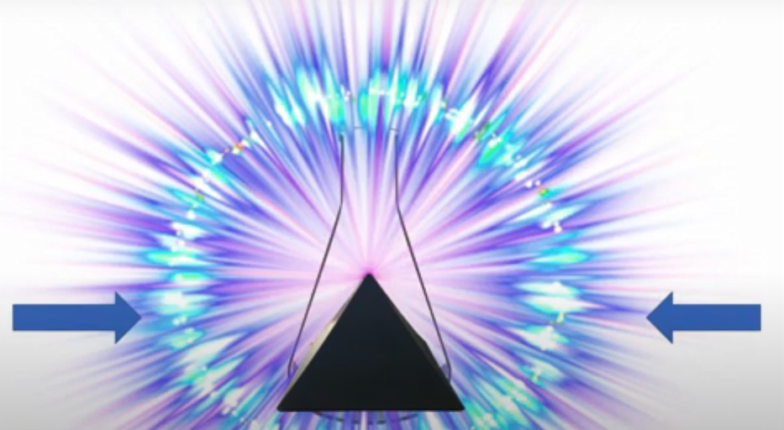
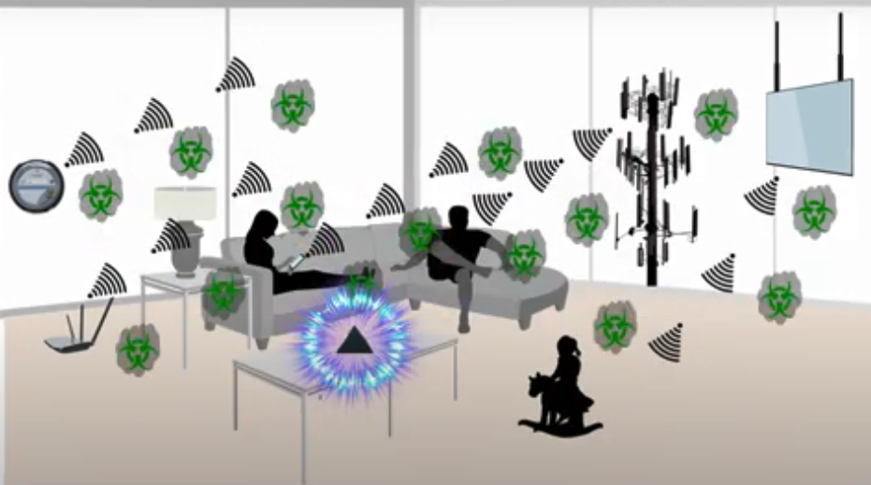
How our products work: Transforming EMF
We make our products by hand mixing, shungite, iron oxide, steel, brass, and quartz crystal (powder form) into an epoxy resin. When the epoxy cures into a solid plastic state it puts pressure on the surface area of the ingredients. This causes something known as the piezoelectric effect, which emits a harmonizing field generated by the specific properties of the ingredients. It is this field that transforms the harmful energy from EMF’s into healthy life preserving energy. Place our products all around yourself and your environment for the best effect.
Full length explanatory videos on our Website! FTWProject.com

Slide 38
The Science Behind Our EMF Protection Products : Blood Test, Plants, Ice Test
The effects of this scientific phenomenon were replicated and well documented in studies done by the University of Pennsylvania and the Heraclitus Microscopic research laboratory. Also, the field can be seen in an “ice test”
Full length explanatory videos on our Website! www.FTWProject.com

Slide 39
The Science Behind Our EMF Protection Products :Pyramid Shape
Alexander Golod, a Ukrainian former defense contractor and scientist performed pyramid research experiments that involved using expensive military helicopters and equipment that could measure ion columns in the atmosphere that were generated from pyramids. The shape of the pyramid has a function, it directs energy out through the tip to effect the environment around it. This is why we make Orgone Energy Shungite Pyramids. They can be used to place around your property to create a grid of protection against EMF’s, cell phone towers, and chemtrails.
Full length explanatory videos on our Website! FTWProject.com

Slide 40
ABOUT OUR EMF PROTECTION PRODUCTS
SLEEPING PODS For a good nights sleep
Support Vaxxchoice By Shopping at this link: https://ftwproject.com/ref/493/
CHARGE PLATES for use around the home, to preserve food and more
“I carry my sleeping pod with me at all times in my front pocket, this and the pyramids are the only thing that have helped the targeting and stopped my heart palpitations.” -Connecticut
PHONE SHIELDS to put on your cell phone, laptop and routers
PENDANTS for personal emf protection on your body
PYRAMIDS and garden sets for gridding your home / property / garden for emf protection on a large scale
SCIENTIFIC STUDIES AND DOCUMENTATION DESCRIBING HOW OUR PRODUCTS WORK AVAILABLE ON OUR WEBSITE.
TILES for incorporating emf protection into construction projects
WWW.FTWPROJECT.COM

