Slide 1
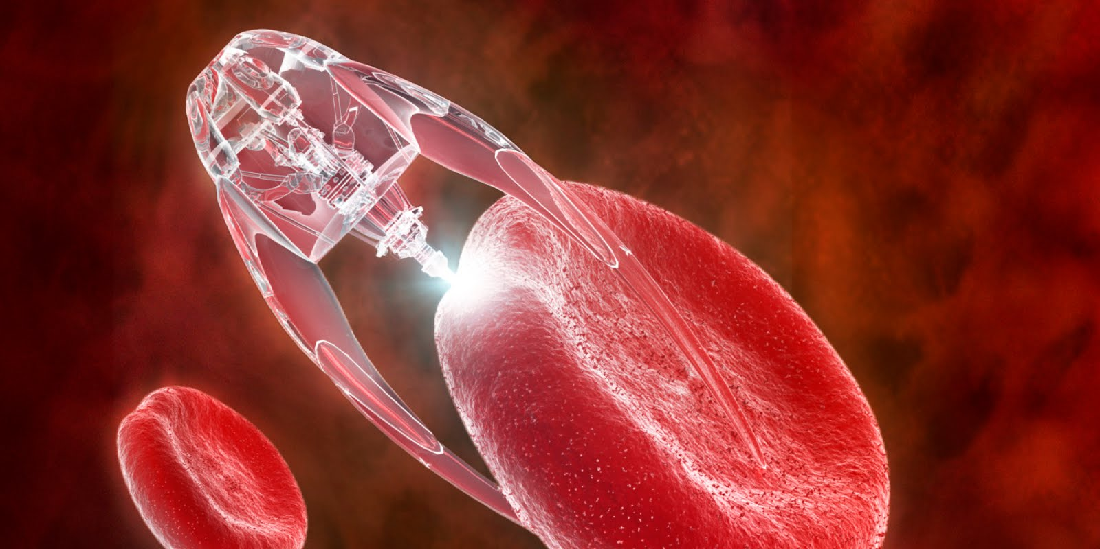




PART TWO

Slide 2
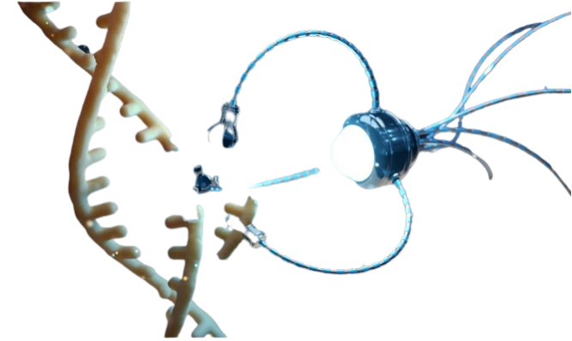
SUMMARY
-Nanotech in the Vaxxed vs. Unvaxxed
-Hidden Pfizer Mengele Experiment on 44,000 US Military Men Women and Children: WHAT EVERY AMERICAN NEEDS TO KNOW
- DARPA INSIDER: Nanotech and Mind Control
- Targeted Individual Program: Testing ground for what they plan to do the world population through the great reset
- The 20+ Year History of the development of mRNA Bioweapons by DARPA
- The Nanotech Manhattan Project Timeline: Comparing Covid events with tech development and political moves by world governments over the last 30+ Years
ATTENTION: They are removing a lot of these reference documents from the internet. Many people have contacted us asking for these reference documents so that they can use them as evidence in courts around the world. It is because of this that we purposefully re-upload the documentation to our own servers so that it is searchable and accessible to the public. Please be sure to visit the blog post for this and all of our other presentations for our important back up reference documentation.
WWW.FTWPROJECT.COM

Slide 3

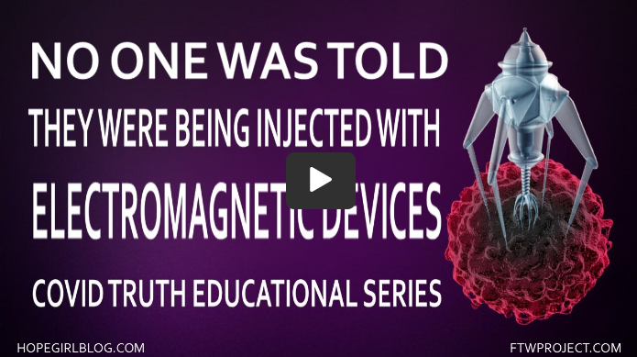


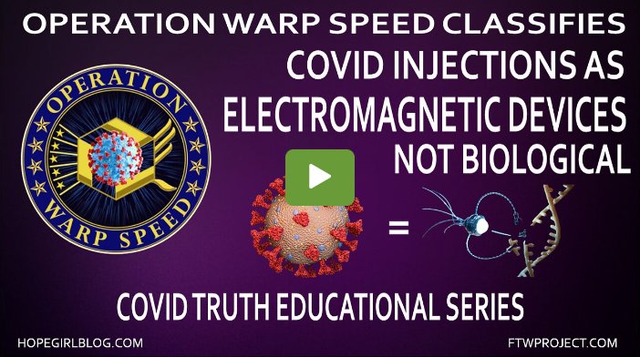

NEW!!!COVID TRUTH EDUCATIONAL SERIES
These videos are put together in a step by step educational format to help clear up the confusion of the lies that have been told to the public through the COVID agenda.
Notes:
If time permits we’d like to play this 4 minute clip https://www.youtube.com/watch?v=aVj7_0A5-Ew

Slide 4
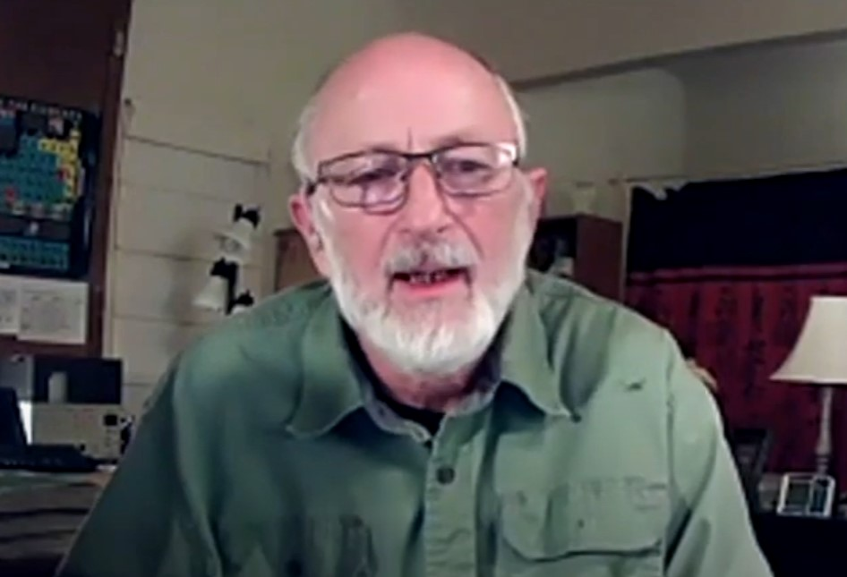
NANOTECH IN VAXXED VS. UNVAXXED
25 YEARS OF TRANSHUMANISM
- First to analyze and study Cross Domain Bacteria, 0.5 microns in size (aka Morgellons) from samples found in the both the environment and suffering victims.
- Modified ‘organism’ has 4 different forms (including fibrous) and can reside in blood and tissues in the body
- Has both parasitic and symbiotic qualities (can be observed by the morphology of the blood)
- Interviewed whistleblower implies link with EMF targeting and mind control.
These revelation in combination with C19 plandemic ties together the Chemtrail, Morgellons, and Targeted Individual programs (Geoengineering and Bioengineering) under the Transhumanist agenda.
Clifford Carnicom – Environmental Research Scientist and Founder of The Carnicom Institute and the Carnicom Foundation Disclosure Project
Carnicom Institute: https://carnicominstitute.org/
Carnicom Institute Disclosure Project Part 1 Overview with Clifford Carnicom (SkyWatchMap YT Channel)
https://www.youtube.com/watch?v=RbQ9feYX3Zc
Earlier presentations with Dr. Gwen Scott
https://www.youtube.com/watch?v=gI0H_nEypyQ&t=1843s
https://www.youtube.com/watch?v=bqt0dzAtBsU&t=188s

Slide 5
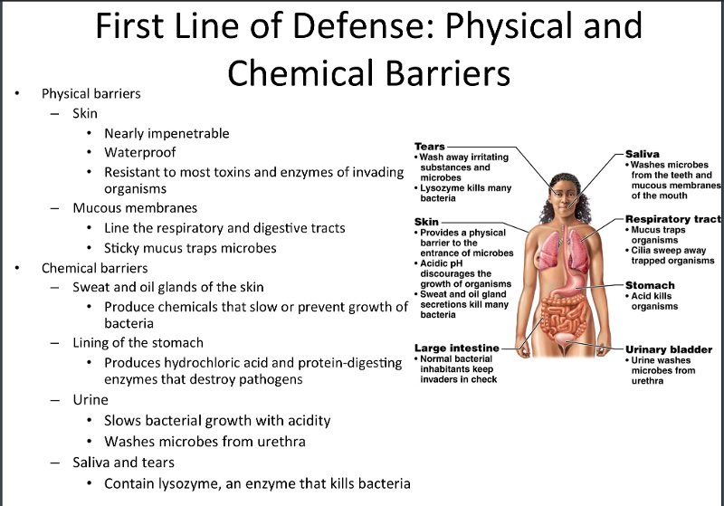
NANOTECH IN VAXXED VS. UNVAXXED
God created our bodies with groups of organs called organ systems that work together to keep the body in balance. When God created these systems he also created defenses for them, physical barriers to microbes such as skin and mucus membranes, as well as mechanical defenses that remove microbes and debris from areas of the body where they might cause harm or infection.
Nanotech in the air, food, water has to make its way through all of these God given defenses in order to do the most damage.
INJECTING NANOTECH DIRECTLY INTO THE BLOOD BY PASSES ALL OF THESE DEFENSE SYSTEMS.
YES THERE IS A DIFFERENCE BETWEEN BEING INJECTED OR NOT BEING INJECTED.

Slide 6
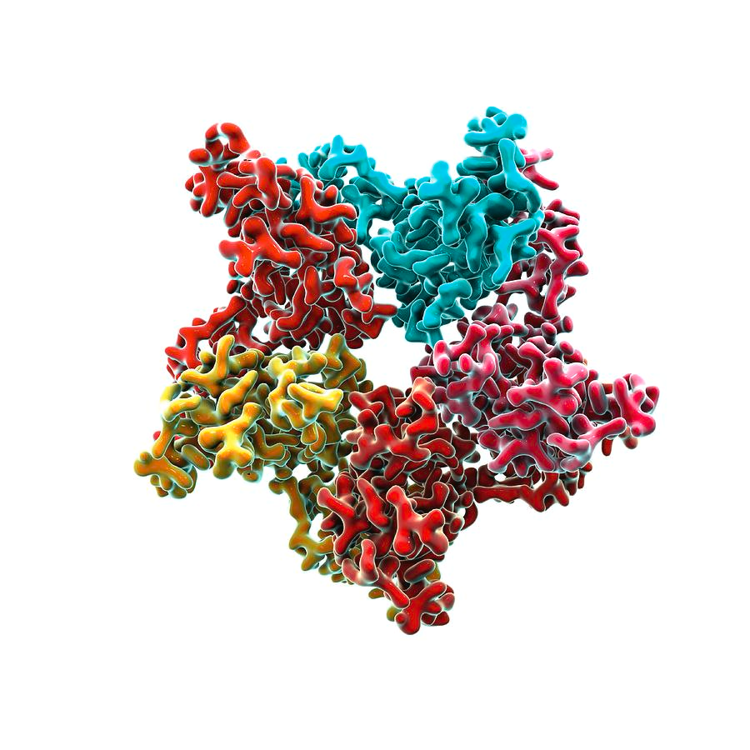
HIV PROTEINS PUT INTO COVID INJECTIONS TO DISARM IMMUNE SYSTEM
Our immune system naturally attacks the nanotech causing it to not be as effective in operating the way it was programmed to. So in order to ensure that the nanotech will do the most damage and operate at its full capacity you need to disarm the immune system.
They put at least three HIV proteins in the injections to do just that.
HIV Proteins: ADF, GP12, PP14 were found in the injections in an analysis available on the Vaxxchoice.com website
We have been bombarded with nanotech in our environment for decades and our amazing resilient bodies have been adapting.
THERE IS REASON WHY DECADES OF POLUTING OUR ENVIRONMENT WASN’T GOOD ENOUGH AND WHY THEY HAD TO INVEST A TREMENDOUS AMOUNT OF TIME MONEY AND ENERGY TO GET MOST OF THE POPULATION TO INJECT THIS DIRECTLY INTO THEIR BODIES.
WWW.FTWPROJECT.COM

Slide 7

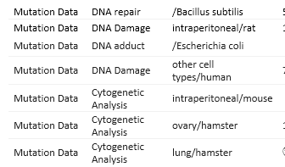

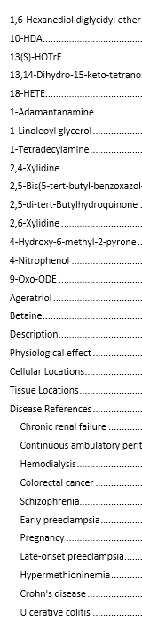
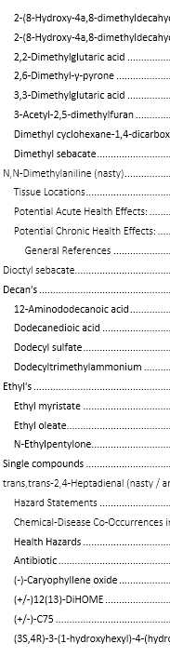
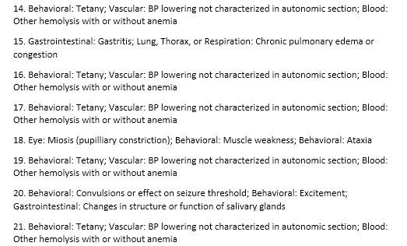
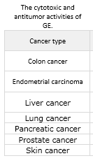
99 PAGES OF TOXIC INGREDIENTS FOUND IN COVID SHOTS
A vial of the Covid Vaccine was obtained from a confidential patient. The contents were thoroughly examined with the proper equipment and expertise and a full toxicology report was created showing 99 pages of toxic ingredients in the shots.
Full Toxicology report available in blog post

Slide 8
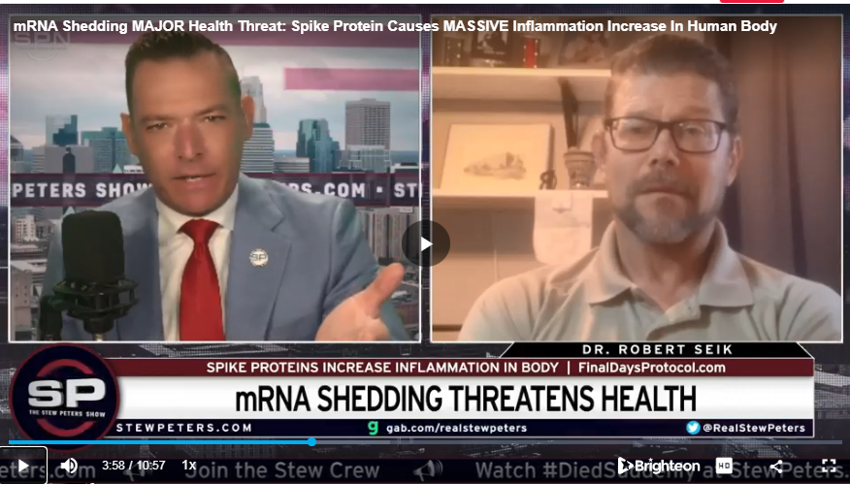
THE TOXIC LOAD IN VAXXED VS. VAXXED
“What we don’t know: Is there a difference between the “spike protein” load the body may have from getting the vaccine verses just being exposed to it (shedding). I don’t know that this has been elucidated in a science yet…. My assumption is that those of us that have not received the jab do not have as much spike protein load as those us who did. That’s not yet confirmed but we still have to deal with it.”
Spike protein antibody tests can test to see if your body has created antibodies for the spike protein toxin and can also show quantity. It may not give a direct response to the toxic load of a vaxxed vs unvaxxed person, but it is the best tool available at this time.
Dr. Robert Seik on Stew Peters talks about the difference in Toxic load
THINGS THAT DID NOT HAPPEN IN THE VOLUME THEY ARE HAPPENING NOW BEFORE THE INJECTIONS:
Sudden Death
Excess Deaths
Heart Attacks in Children
Myocarditis
Pericarditis
Turbo Cancers
Guillain Barre
Bells Palsy
Micro clotting
White Structures pulled out of deceased
Blue tooth codes coming from people
Blue tooth codes coming from graves
People collapsing on live TV
Athletes Collapsing on the field
and surely there will be more to come once more time goes by like: STERILIZATION

Slide 9
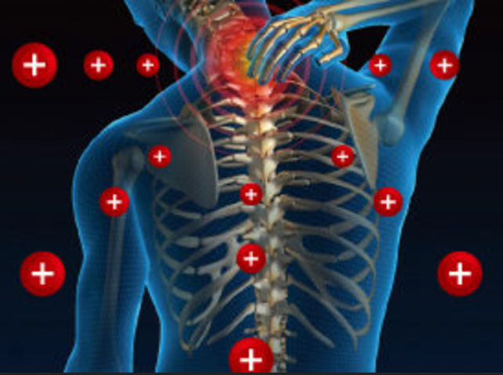
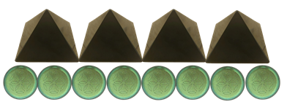
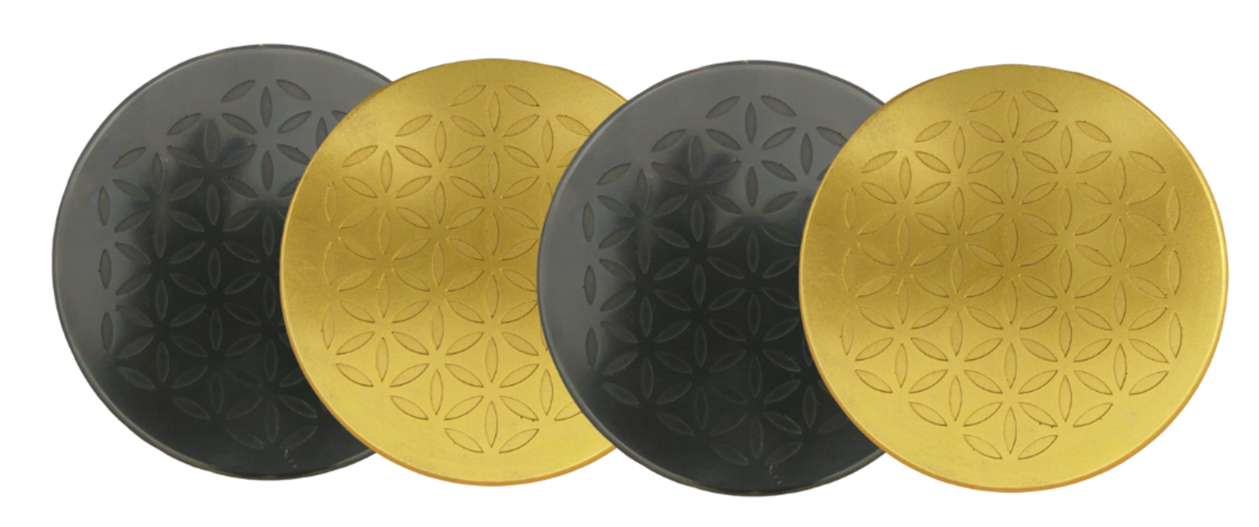
How Our Orgonite Products Effect Nanotech and Your Body
NEGATIVE IONS TO FIGHT THE TECH
The nanotechnology in your body is supplying positive ions, which drain the lifeforce out of you and weaken your immune system. You need negative ions to help treat the body electrically and restore balance and strengthen your immune system. Our products are passive negative ion generators that continuously put negative ions into your environment and your body to help you fight off the toxic nanotechnology.
INTERRUPTS THE SIGNAL
The nanotech inside of your body needs a clear signal from the nano communications grid they are establishing using 5G,6G,7G Terahertz frequencies from cell towers, satellites, smart surfaces etc. This is the communications grid used to track and trace you and also to initiate commands to the nanotech to do various things inside of your body. The orgone field that is generated from our products interrupts their signal and makes it more difficult for their technology to work on you.
For the best defense against these attacks, we always recommend a full armored holistic approach that involves heavy metal detox, digital detox, lifestyle changes, diet changes, and several forms of EMF protection in your environment.
Our products do more than just block EMF, they transform the energy fields around you into healthy life preserving energy.

Slide 10


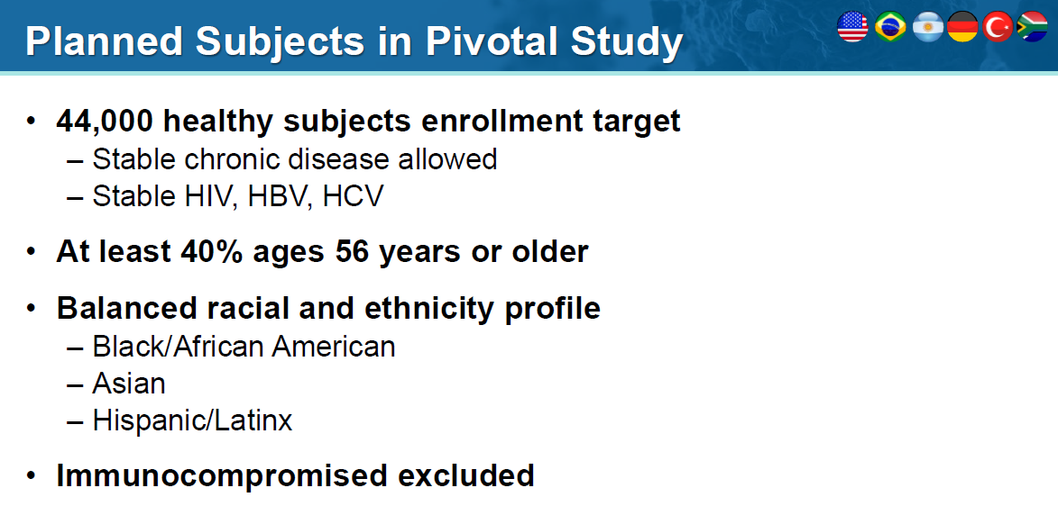
THE HIDDEN PFIZER EXPERIMENT ON 44,000 US MILITARY SERVICE MEMBERS
AND THEIR FAMILIES. WHAT EVERY AMERICAN NEEDS TO KNOW
Full Report with Todd Callender in blog post.
Pfizer experimented on or did a biological weapons test for their slave or kill shots on 44,000 American military service members and their families, this included women and children.
These 44,000 Americans were injected with the experimental “Covid-19 Vaccine” as part of the 3-phase clinical trial that Pfizer then used to get Emergency Use Authorization to give these bioweapon injections to the rest of the American population.
This ‘4X-worse-than’ Dr. Mengele experiment on American men, women and children was documented in study C4591001 and a post market exam that Pfizer tried to hide and a federal judge ruled it must be released.
The Pfizer Phase 3 Clinical Trial:
Full Report Made available to the public in blog post.
WWW.FTWPROJECT.COM

Slide 11
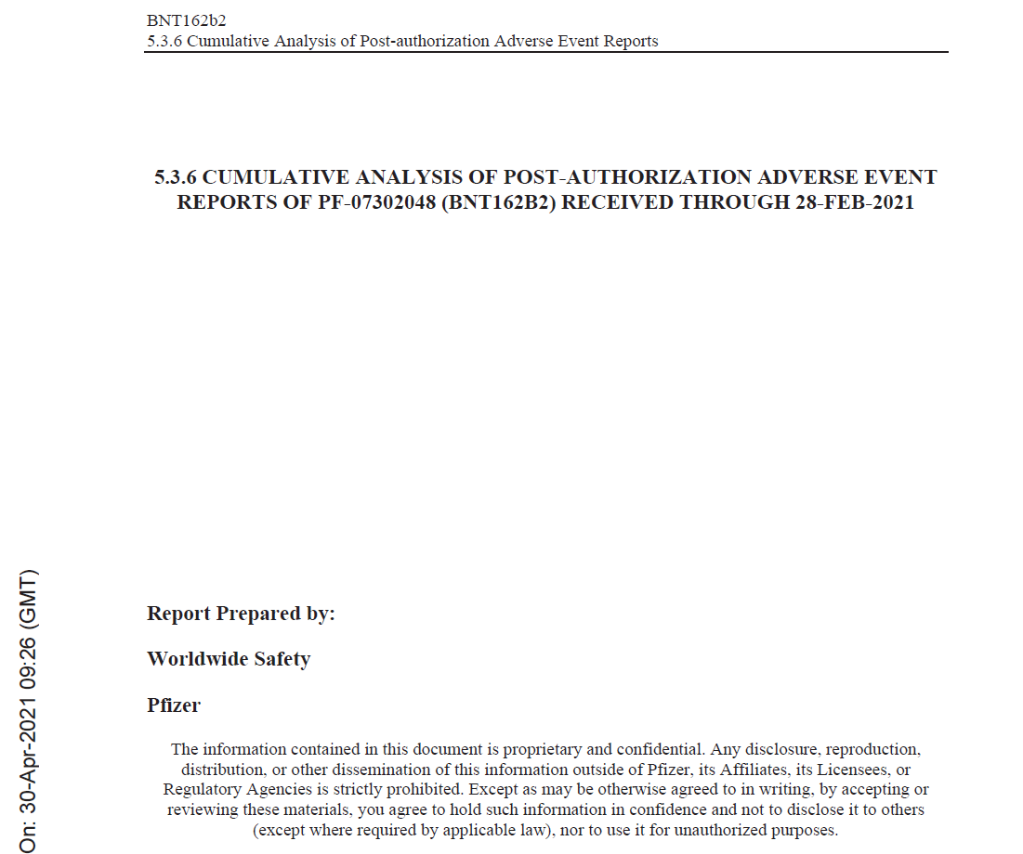
THE HIDDEN PFIZER EXPERIMENT ON 44,000 US MILITARY SERVICE MEMBERS
AND THEIR FAMILIES.WHAT EVERY AMERICAN NEEDS TO KNOW
The post market exam hidden by Pfizer shows an appendix of 1291 diseases that are caused by the shots.
According to military doctors, some of whom are qualified as Chemical, Biological and Radiological warfare experts, it would have taken years to prepare the tests in order to test for these 1291 diseases – many of which have never been seen before in the US and most of which have never been seen before by these doctors – in their entire careers. This is what they injected into everyone. It took years to prepare the tests for those diseases…
THEY KNEW BECAUSE THEY PLANNED IT AND THEY WERE TESTING THEIR WEAPON.
CONFIDENTIAL
The Confidential Post Market Exam Pfizer tried to hide and was forced to release by a Federal Judge.
Full Report Made available to the public in blog post.
WWW.FTWPROJECT.COM

Slide 12
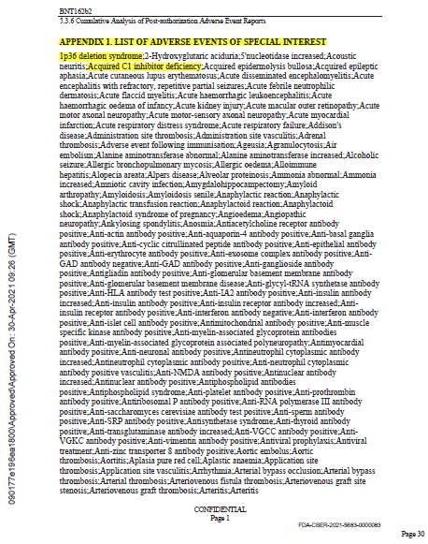
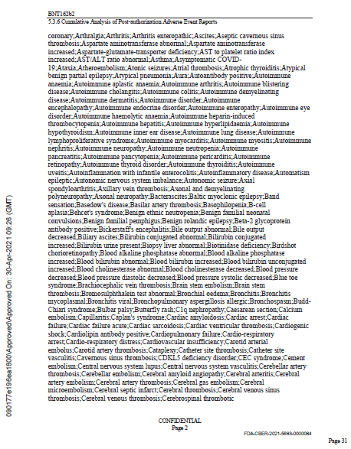
1291 DISEASES CAUSED BY THE COVID INJECTIONS LISTED IN THE CONFIDENTIAL PFIZER DOCUMENTS, PLANNED FOR TWO DECADES #PFIZERKNEW
TEN PAGES LIKE THIS!!!
Full Report Made available to the public in blog post.
WWW.FTWPROJECT.COM

Slide 13


THE HIDDEN PFIZER EXPERIMENT ON 44,000 US MILITARY SERVICE MEMBERS
AND THEIR FAMILIES. WHAT EVERY AMERICAN NEEDS TO KNOW
After injection of the bioweapon into the 44,000 test victims, they used something called an “Intouch e-diary” which is an ePCR device that hooked up to an app on their cell phones. It measured the cellular changes in their bodies in real time and sent all of their bodies’ data to a data management company in Israel.
This company then laundered the data, erased all of the adverse reactions that the test victims were experiencing and sent a fake report back to the DOD and FDA to make it look like the clinical trial was safe and effective. This laundered fake report is what they used to get the emergency use authorization needed to inject the rest of the US population with this bioweapon.
Example of ePCR= Electronic Patient Care Reports
Any internet-connected device (smartphones, tablets, laptops and desktop computers) can be used interchangeably by the patient throughout the course of a study, providing further convenience and flexibility
Downloadable app for both iOS and Android devices
WWW.FTWPROJECT.COM

Slide 14
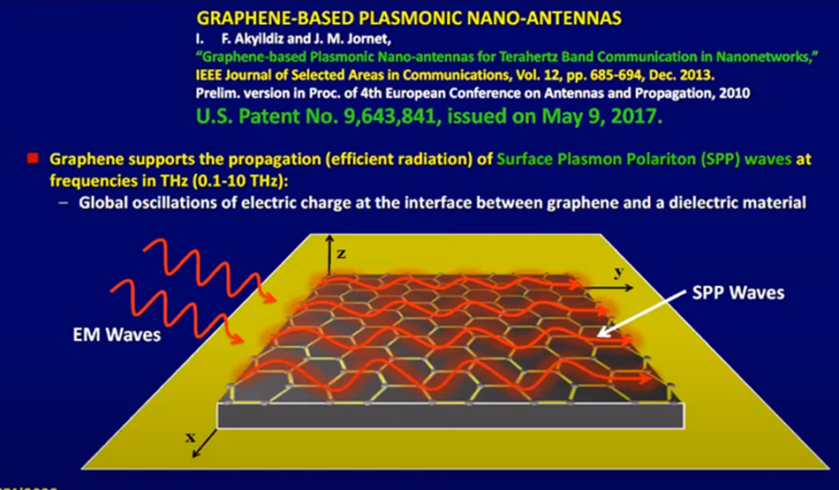
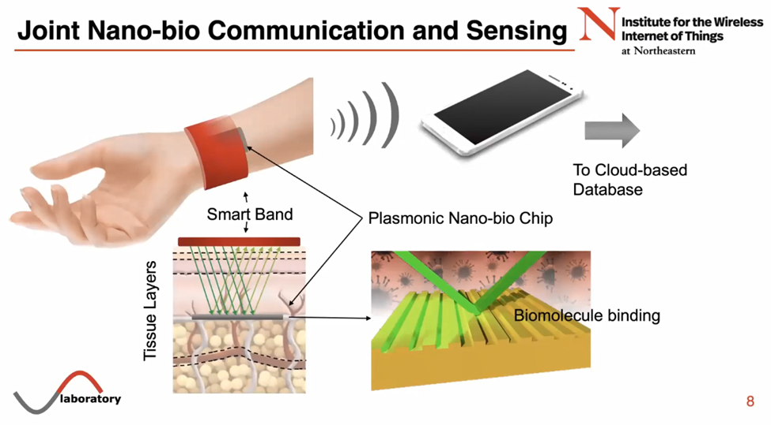
THE HIDDEN PFIZER EXPERIMENT ON 44,000 US MILITARY SERVICE MEMBERS
AND THEIR FAMILIES. WHAT EVERY AMERICAN NEEDS TO KNOW
Graphene Based Plasmonic Nano-Antennas
invention of Akyildiz and Jornet
A nano sized antennae made out of graphene. They stimulate the graphene with Electromagnetic waves which create plasma waves across the surface that allow for the communication needed.
The ePCR devices used to read cellular structure changes in a persons body in real time were run on terahertz frequency nano-communication networks. This technology was communicating with the nanotechnology and graphene plasmonic antennas that are patented and put into the bioweapon shots to monitor what is happening inside of your body and also to initiate commands given to your body from an outside source.
Graphene Based Plasmonic Nano-Antennas Used Inside the Body
From Josepe Jornets presentation to UN
The plasmonic nano-bio chip is implanted inside of the body, underneath the tissue layers of skin. The chip is engineered to find specific biological markers in your blood so that you can beam radar at the chip in order to read what is going on in the blood. The data about what is going on in your body read from these chips is then transmitted to your phone or the internet to a cloud based database.
WWW.FTWPROJECT.COM

Slide 15

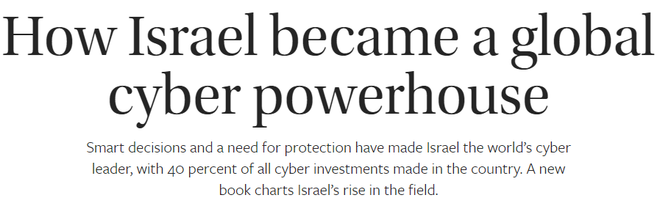

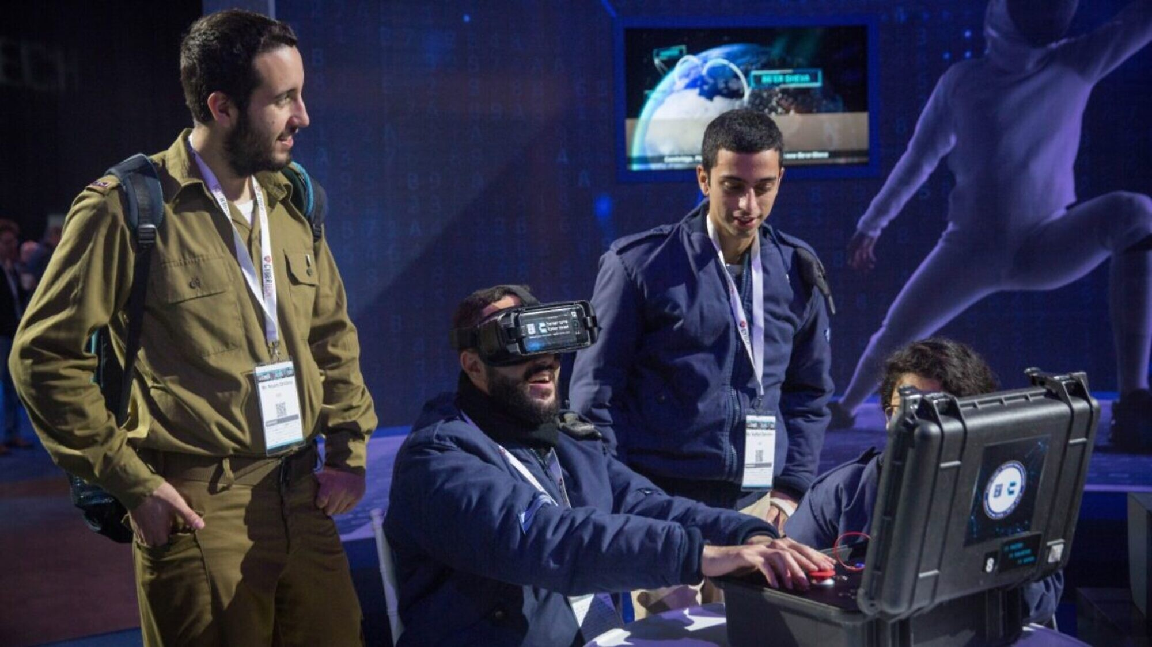

THE HIDDEN PFIZER EXPERIMENT ON 44,000 US MILITARY SERVICE MEMBERS
AND THEIR FAMILIES. WHAT EVERY AMERICAN NEEDS TO KNOW
All of this data was sent to the State of Israel, through a bio data collection company called ERT.
Israel is the cyber powerhouse of the world, its the REAL silicon valley. It is the control center for all of this data for many western countries. It is also the power seat of the beast system and the synagogue of Satan.
Israeli Prime Minister Benjamin Netanyahu admits they are the testing lab for Pfizer and are creating a genetic database from peoples medical records.
WWW.FTWPROJECT.COM

Slide 16
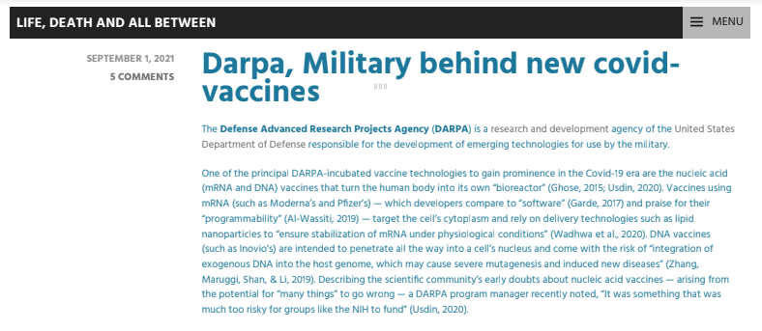
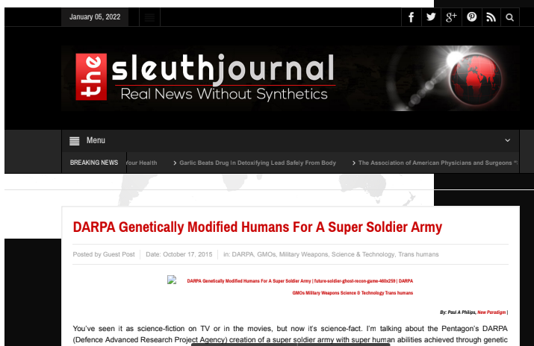
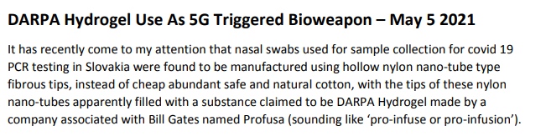
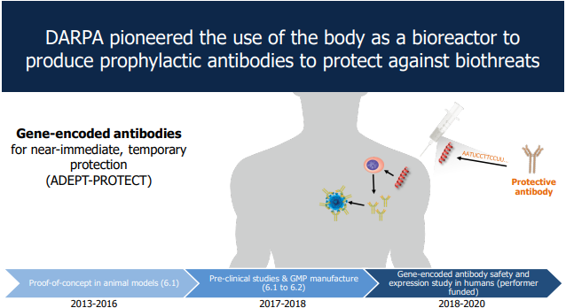
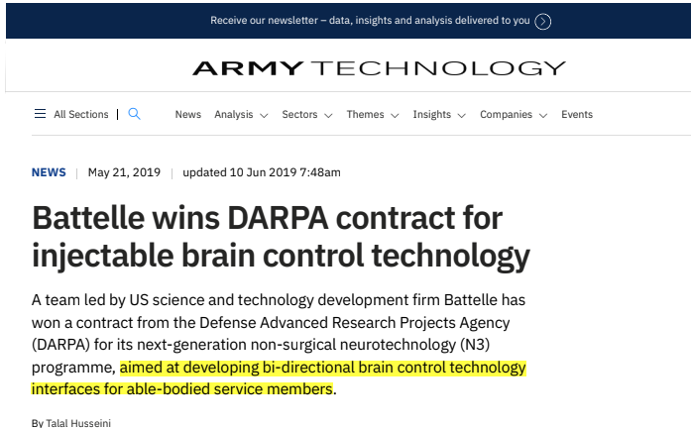
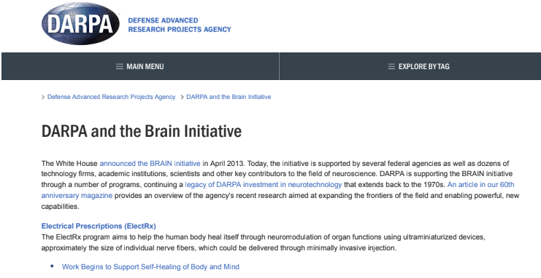
WHISTLEBLOWER DISCLOSURES FROM ACTIVE US MILITARY MEMBERS
These disclosures come from active US service members from all over the military whose names are withheld for their protection. This information was shared with us from Todd Callender, who sued the DOD and crafted the template for 210,000 servicemember plaintiffs in a class action suit regarding the mandatory COVID injections in the military. While working on this case, Todd disclosed his findings of the case MOLECULAR PATHOLOGY V. MYRIAD GENETICS (2013 SUPREME COURT CASE) which points to the gene modification plan the DOD has crafted to make super soldiers. Him mentioning this case caused many whistleblowers to share their knowledge of the super soldier programs. Below are several of their disclosures links to all PDF’s on this blogpost.
DARPA HYDROGEL USE AS A 5G TRIGGERED WEAPON
DARPA MILITARY BEHIND NEW COVID VACCINES,
LIFE DEATH AND ALL IN BETWEEN
DARPA GENETICALLY MODIFIED HUMANS FOR A SUPER SOLDIER ARMY
DARPA VACCINE BIZ ADEPT VIGNETTE
DARPA INJECTABLE BRAIN CONTROL TECHNOLOGY
DARPA AND THE BRAIN INITIATIVE
WWW.FTWPROJECT.COM

Slide 17
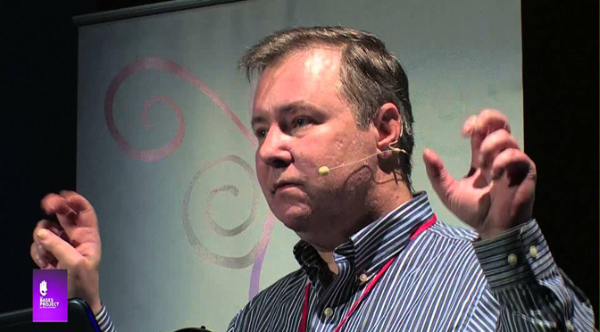
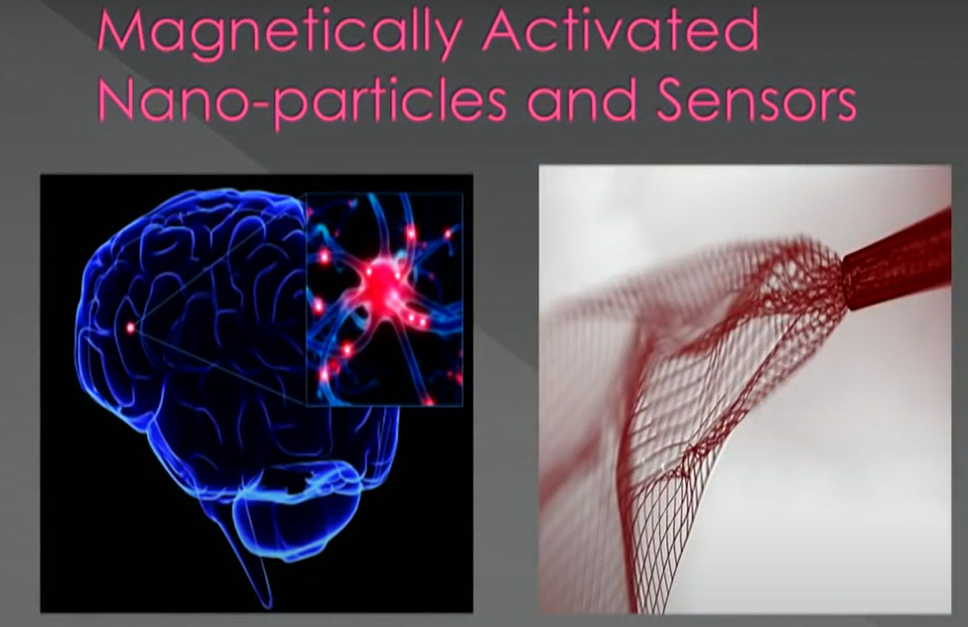
DARPA INSIDER: NANOTECH AND MIND CONTROL
In this presentation, Titled “We are on the Verge of Cataclysmic Discover!” given in 2017 Dr. Duncan describes the many ways of mind control that have been achieved through the technology that he was developing.
Dr. Duncan speaks of speaks of magnetically activated nanoparticles used for brain sensing and control. All aspects of cognition can be controlled and interrogated. Human thoughts can be mapped out. The nanoparticles are activated under certain magnetic frequencies and will alter the brain patterns and pathways.
Below is a magnified picture of a needle that’s injected that is putting the scaffolding of the magnetically activated nanoparticles over the brain.
Dr. Robert Duncan is a Harvard University trained scientist and engineer who worked on black projects for DARPA, CIA, Justice Department and the Department of Defense. He was involved in artificial intelligence and cybernetics. As an MIT student he studied under professor Noam Chomsky on linguistics, studying computer AI language. During his career he became aware of the military’s experimentation on targeting US civilian populations and soon realized he was part of creating a dangerous weapon if used for dark projects.
Dr. Robert Duncan
Developed
Voice of God
Weapon
Technology (V2K)
HOPEGIRLBLOG.COM
FTWPROJECT.COM

Slide 18
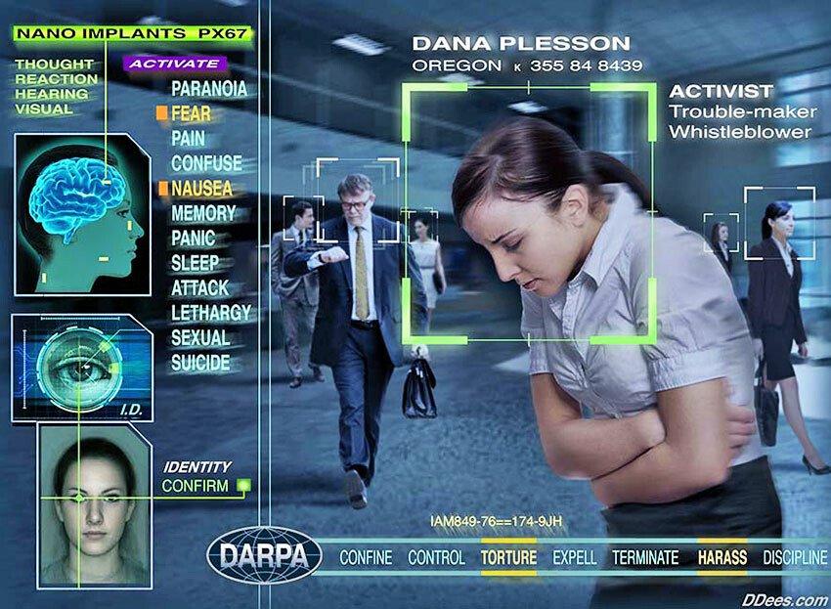
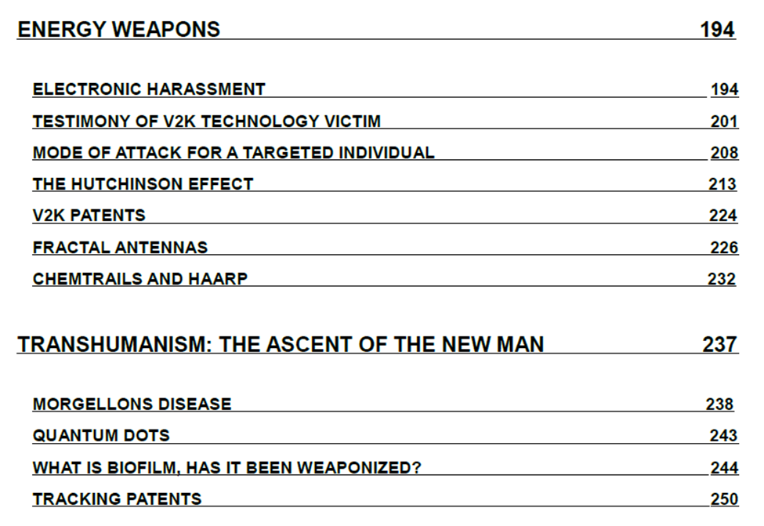

Targeted Individual Program Testing Ground For What They Plan to Do to The World Population Through the Great Reset
The Targeted Individual program is a domestic torture program aimed at unsuspecting citizens, predominantly in the 5 eyes countries. This program is covert and has been operating and targeting humans for decades. The weapons used on targeted individuals are what they call “quiet weapons for silent wars”. Between 3-10 million people have reported to have been on the receiving end of this technology.
Electronic Harassment is the use of electromagnetic devices to harass or kill another human being. These devices are known as “soft kill” weapons.
From Our Book Forbidden Tech 2017
The Complete Guide to Energy, Social, and Biological Technologies That They Did Not Want You to Know About
FTWPROJECT.COM

Slide 19




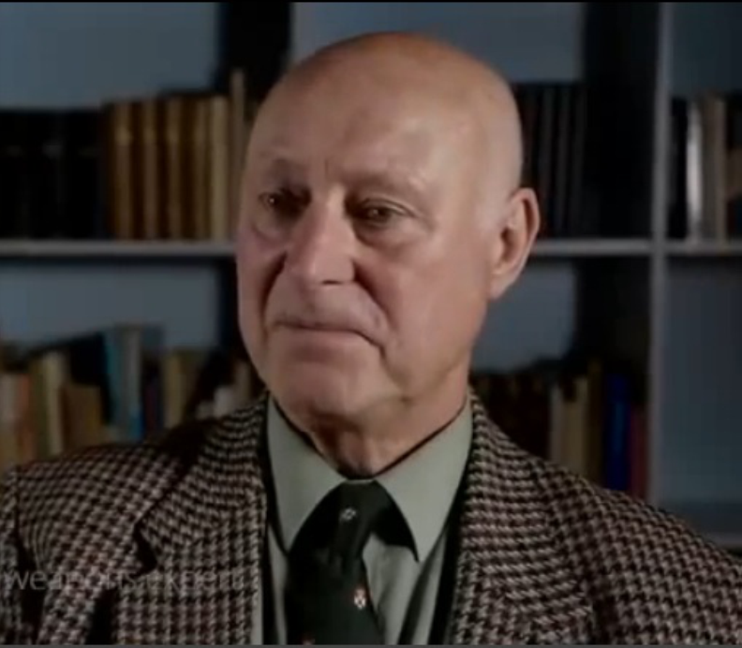
WHAT FREQUENCIES ARE USED TO TARGET HUMANS?
“Microwave weapons were introduced in the 50’s, they are so effective as a stealth weapon and have been used many times and it has been reported. You can beam people you don’t like as a government to give them cancer, breast cancers, neurological illnesses, you can choose what you want them to get by choosing which pulse frequency to affect the brain with. You can choose the level of microwave radiation and the speed at which you want them to get ill”
“We have 8,300 papers and I have knowledge of 2,300 myself. What the governments found was that you could induce illness by changing the pulse frequency… For instance 6.6 pules a second can induce severe sexual aggression in men. You can target other parts of people’s bodies. You can target the heart and cause heart seizures. You can target the lungs and cause bleeding. You can target, if you’re clever enough, some of the essential glands in the body that control all of the whole organ systems.
One specific paper from the government that lists all of the illnesses you can get from microwave sickness includes severe neurological disorders. We have government documents that actually say this needs to be kept secret from the western governments because it will affect the efficiency of the military, the weapons industry, and it will also affect industrial profits.”
Barrie Trower, an ex MI5 agent who also served in the Royal Navy as a specialist in microwave technology during the cold war era gives an account of the covert technology
HOPEGIRLBLOG.COM
FTWPROJECT.COM

Slide 20
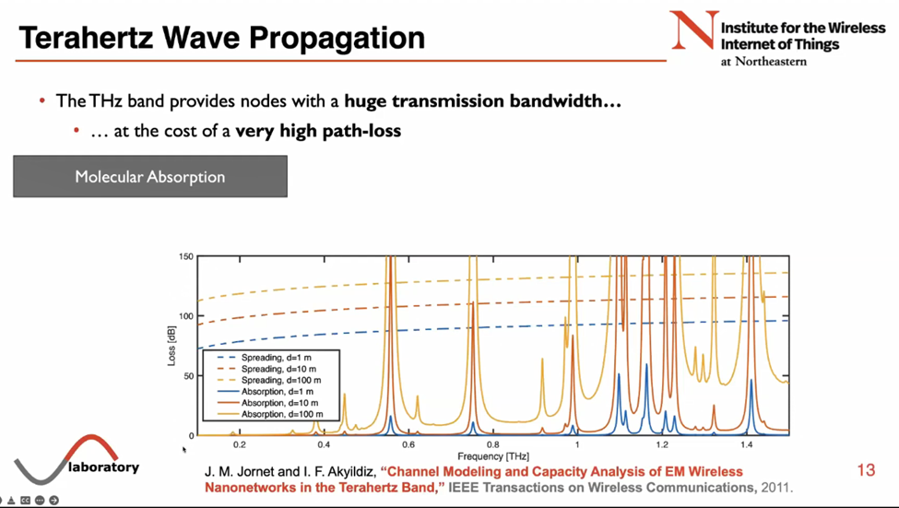

We learned from Josep Jornets presentation to the UN that terahertz frequencies have the unique ability to interact with molecules in the body. This is how they can target an individual. Josep shows a chart that says they have figured out at exactly what terahertz frequency specific molecules or materials can get excited, or where the frequency is absorbed.
To a person who has been on the receiving end of energy weapon frequency technology that governments have been covertly using on citizens, this chart reads a whole different way. The chart shows at exactly what terahertz frequencies you need to beam at a person to target different parts of their body. The first peak could be the frequency to target the heart for a heart attack, the second peak could be the skin, maybe the third peak is the frequency to penetrate the brain and cause strokes and so on.
HOPEGIRLBLOG.COM
FTWPROJECT.COM

Slide 21
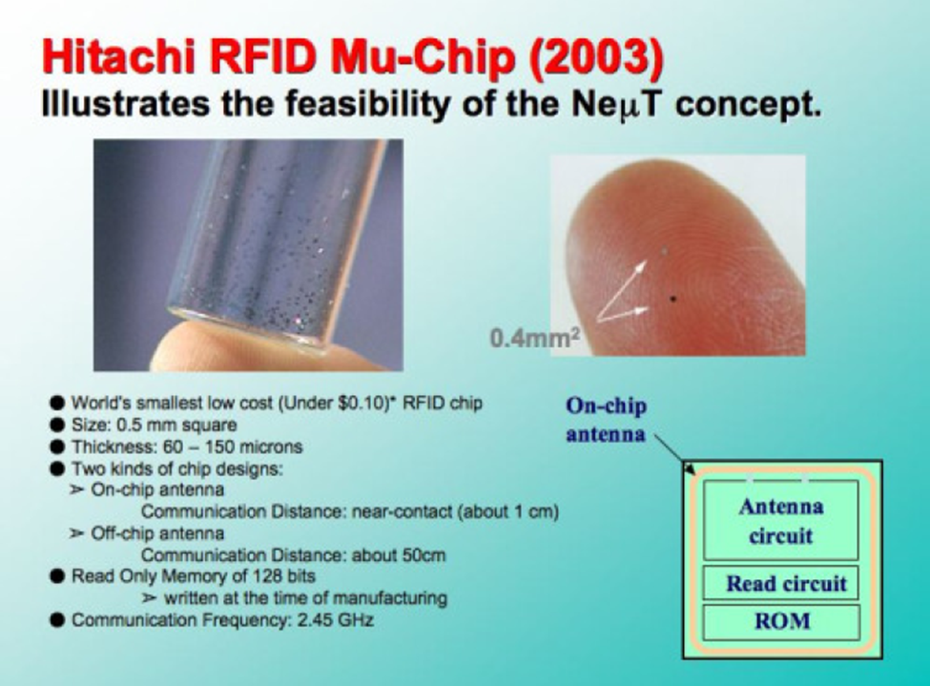
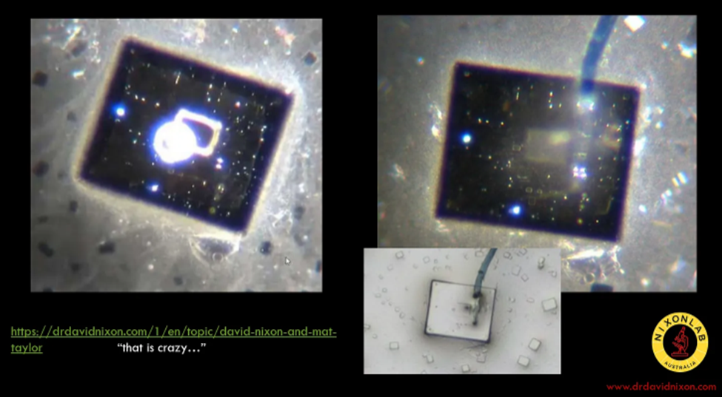
SMART DUST
Smart Dust are Microchip dust chips that relay certain radio frequency identification information. These smart dust chips are used as sensors to collect data from the environment. If you spray them in the ocean or in the clouds you can get a 3D representation of the environment.
From our Book Forbidden Tech, Smart Dust Mu-Chip
Image: Dr. David Nixon C19 Pfizer Vial Microchips with optical communication connections
HOPEGIRLBLOG.COM
FTWPROJECT.COM

Slide 22
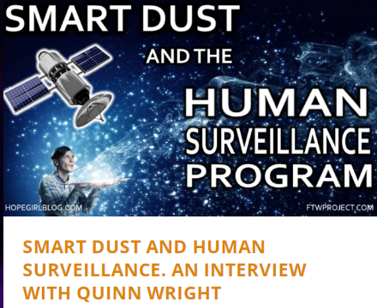

SMART DUST AND THE HUMAN SURVEILLANCE GRID
In this interview conducted by our mother Valerie Robitaille, Quinn Wright gives his testimony of being a victim of the targeted individual program. He documents with video: energy weapons, smart dust, blue street lights and gangstalking targeted at him.
“One of the things that they would do to me is target my heart. I knew this because I have a frequency detector I would have turned on while I slept. I would wake up in pain around my heart in the middle of the night and the frequency detector would be beeping like crazy, so I knew there was some type of foreign frequency that was coming in and attacking my heart. So I ordered orgonite from your family after seeing Tivon’s Testimony on Youtube. One of the first things I used was the sleeping pod. I put it in my shirt pocket to protect my heart. Ever since using it all of my heart palpitations and pain I was having went away and its been a month and half since I started using it. I actually call this a heart pod instead of a sleeping pod because I use it to protect my heart.
As a targeted individual, you don’t have anything to loose so its worth trying new things.
I also ordered their pyramids and even though they were more pricey than the smaller cheaper made pyramid I bought on ebay, I have to tell you that the quality means everything, you pay for what you get. These pyramids made a HUGE difference. I used to get what I call flash attacks during the day that were keeping me feeling sluggish, and I was feeling hopeless because the smaller orgonite pyramid that I bought from ebay wasn’t really helping. But since I got these pyramids from your family the flash attacks totally stopped and this saved me at my lowest point. So I can testify that this really made a difference and the quality really matters”
There are many people in this truth movement, BIG names, people you would know, these are the ones that are bringing the truth about the COVID agenda and other censored information. They are being targeted right now by these energy weapons. Some have made it public, others have not. We are doing all that we can to try to try to help them. We will be doing a show with Todd Callender and Vaxxchoice soon that fully discusses solutions to help those who are paying the price of bringing the truth the general public.
WWW.FTWPROJECT.COM

Slide 23
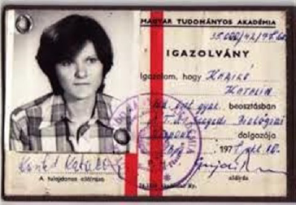
Sponsored by DARPA –
the development of mRNA bioweapons -labeled as "vaccines"
Many people around the world may have wondered how it is possible that billions of "vaccine doses" can be made available at the push of a button, and all governments worldwide have agreed to torture their populations until everyone is dosed with a vaccine at least three times or even more - from babies to hospice residents.
To understand the organizations and structures behind mRNA technology that has been built over the past two decades, one must look at the history of mRNA technology:
Katalin Karikó was working for the counterintelligence in Hungary before she emigrated to the US. As she explained, she has been forced to sign a contract in her twenties with the state security in 1985. She emigrated and started working at the University in Pennsylvania researching the mRNA technology.
FULL PAPER IS PUBLISHED IN THE BLOG NOTES
WWW.FTWPROJECT.COM

Slide 24
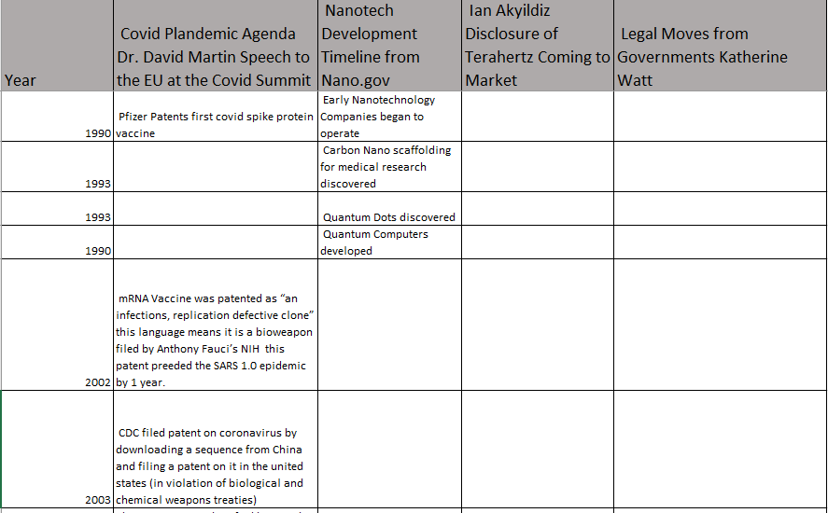
Nanotech The Next Manhattan Project For the Great Reset
The next few slides show a timeline comparison of several key factors. We believe this shows how they were waiting for the technology to get to a certain point and then they started lining up the legal structure to usurp constitutions of countries so that they could pull off Covid and get 5.55 Billion people injected with the technology that hooks them into the satellite grid of control.
HOPEGIRLBLOG.COM
FTWPROJECT.COM

Slide 25
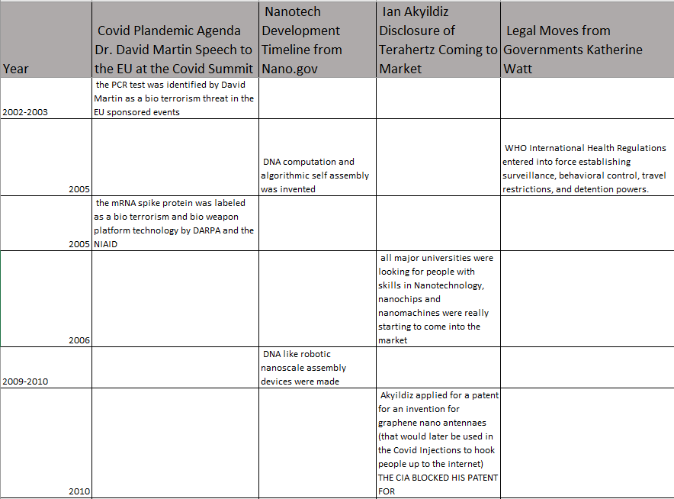
Text
Nanotech The Next Manhattan Project For the Great Reset
HOPEGIRLBLOG.COM
FTWPROJECT.COM

Slide 26
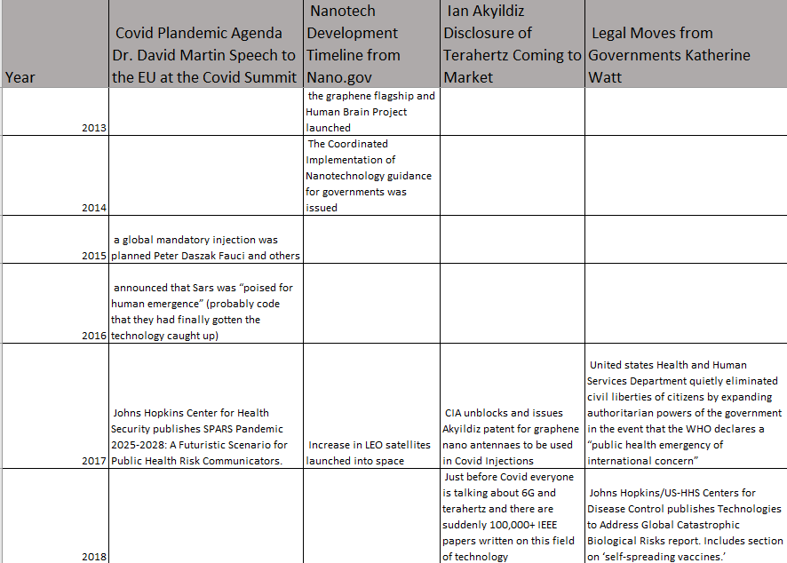
Text
Nanotech The Next Manhattan Project For the Great Reset
HOPEGIRLBLOG.COM
FTWPROJECT.COM

Slide 27
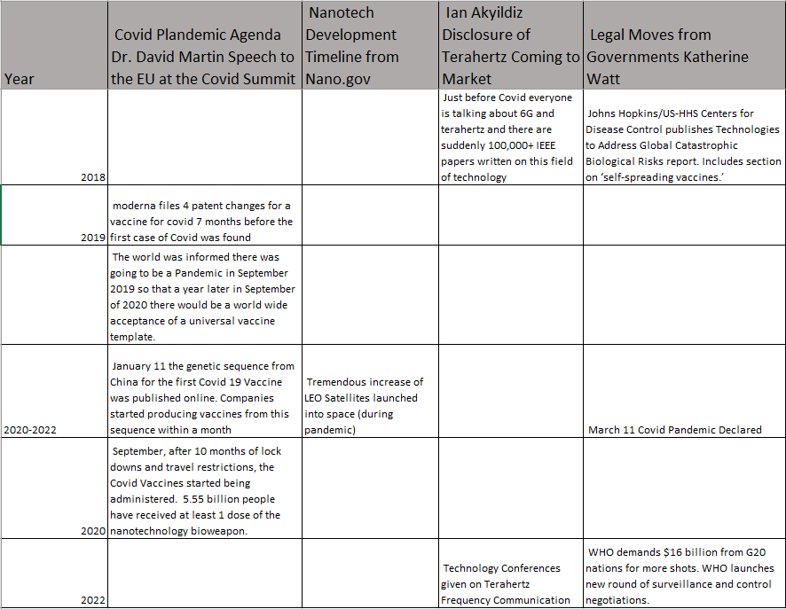
Text
Nanotech The Next Manhattan Project For the Great Reset
HOPEGIRLBLOG.COM
FTWPROJECT.COM

Slide 28


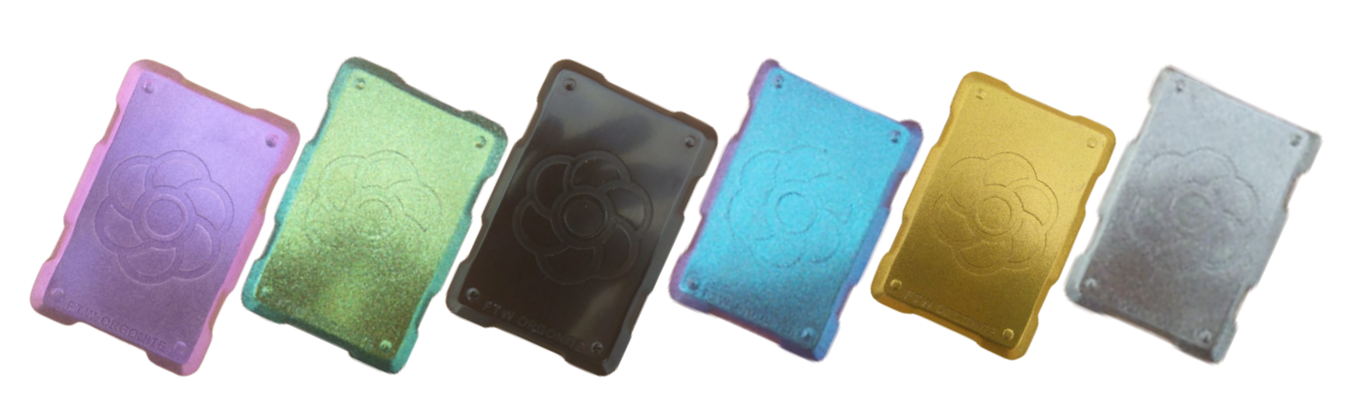

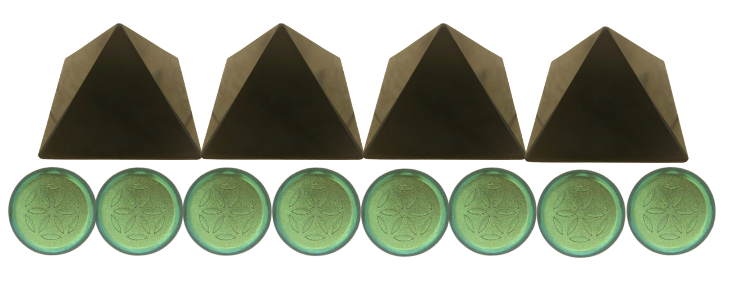

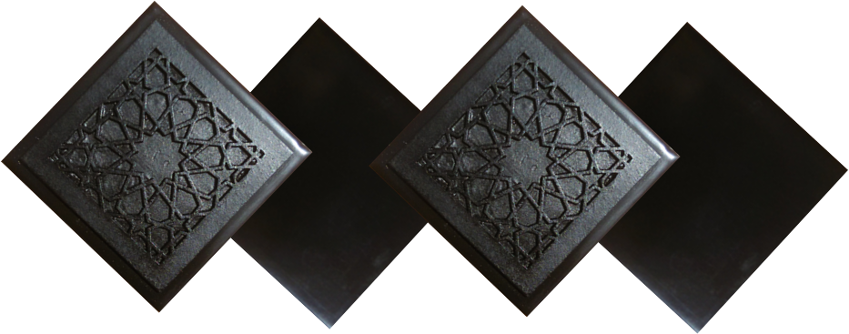
ABOUT OUR EMF PROTECTION PRODUCTS
HELP SUPPORT SGT REPORT BY SHOPPING FROM THIS LINK: https://www.ftwproject.com/ref/6/
SLEEPING PODS For a good nights sleep
CHARGE PLATES for use around the home, to preserve food and more
“We just can't believe our eyes! We have placed the garden pucks from our first order around our property, and the plants/trees with the pucks are BLOOMING within days! This is happening with every single place the pucks have been rested. Just incredible.” -Australia
PHONE SHIELDS to put on your cell phone, laptop and routers
PENDANTS for personal emf protection on your body
PYRAMIDS and garden sets for gridding your home / property / garden for emf protection on a large scale
SCIENTIFIC STUDIES AND DOCUMENTATION DESCRIBING HOW OUR PRODUCTS WORK AVAILABLE ON OUR WEBSITE.
TILES for incorporating emf protection into construction projects
WWW.FTWPROJECT.COM

