Slide 1
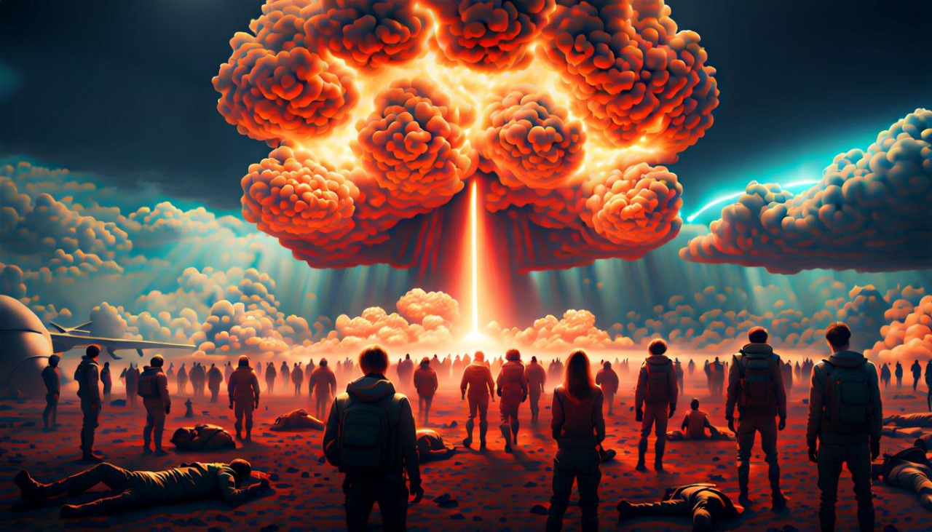
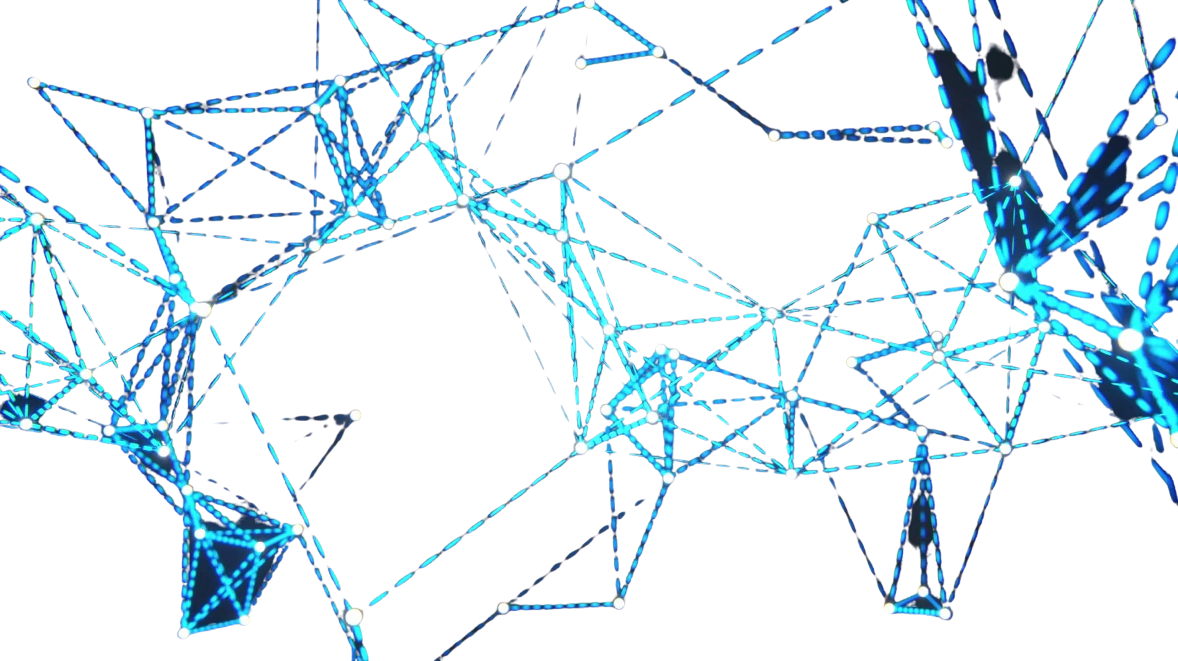

Slide 2
TIMELINE
THE FIRST LIE IN RECORDED HISTORY (they have been lying to you this whole time)
“YE SHALL BE AS GODS”
1956
BIOSENSORS
1995
WIRELESS BODY AREA NETORK (WBAN)
2017
SYSTEM UPGRADE
CYBER-PHYSICAL BACKBONE
METAMATERIALS -TERAHERTZ SOFTWARE DEFINED
THIS IS TRANSHUMANISM THE 4TH INDUSTRIAL REVOLUTION AS IN THE DAYS OF NOAH
2019-22
COVID DEPLOYMENT GRAPHENATED POPULATION
FUTURE
15 MINUTE SMART CITIES POPULATION CONTROL
WWW.FTWPROJECT.COM

Slide 3
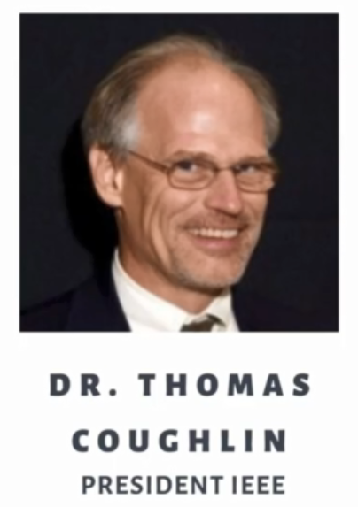
INSTITUTE OF ELECTRICAL AND ELECTRONICS ENGINEERS (IEEE)
The IEEE is the WORLDS LARGEST technical professional organization dedicated to advancing technology for the benefit of humanity.
DO NOT IGNORE IEEE WHITE PAPER REFERENCES!
Comprised of: Physicists, Chemists, Engineers, Electricians, Radio Engineers, Computer Networking and MUCH MORE THAN ELECTRICAL ENGINEERS.
They are the WORLDS LARGEST international society of BIOMEDICAL ENGINEERS.
They make all the standards for the internet and wireless world wide. They are involved in forming public policy for all governments.
They are in 190 countries, 64 percent of their organizations membership is located OUTSIDE of the United States.
They have more than 5 million white papers with 200,000 more added annually and sponsor 2,000 conferences and events in 106 countries.
They have 3,700 branches at colleges and universities in over 100 countries
They have 3625 Student branch Chapters of IEEE technical societies
“that’s not real, it doesn’t exist”
IEEE research is accessible through membership and a pay wall. We joined, here is what we found.
WWW.FTWPROJECT.COM

Slide 4
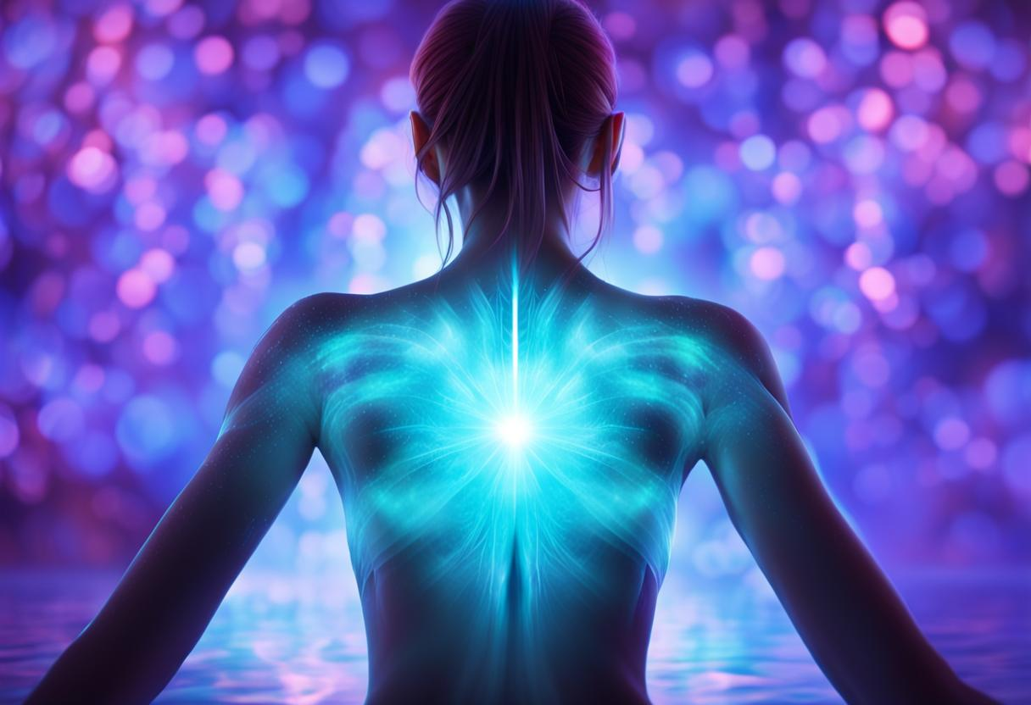
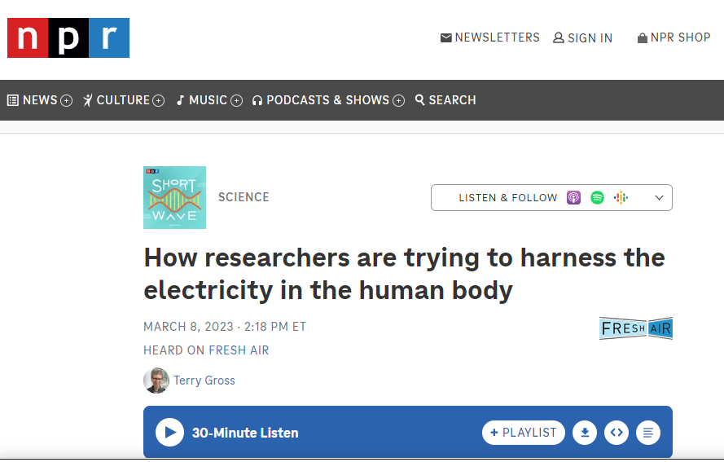
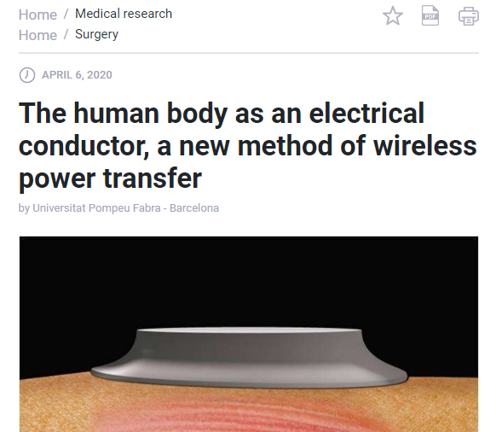
BIOFIELD
The human body is electrical and has an electromagnetic field. All the chemical reactions in our body are mediated by an electrical signal that goes through our systems.
The biofield or biological field, a complex organizing energy field engaged in the generation, maintenance, and regulation of biological homeodynamics (systems). FROM NIH WEBSITE
There are tons of medical journal articles and white papers that discuss using the electricity produced by the human body as a conductor for a wireless power transfer.
The biofield Is the “scientifically accepted” term in Western medicine. In other cultures through history it has also been referred to as “CHI” “Prana” etc. It is the life force that is emitted through all living things.
Your body naturally has electromagnetic frequency waves from your biofield. This is what they are measuring on an EEG in a hospital for example for signs of life.

Slide 5
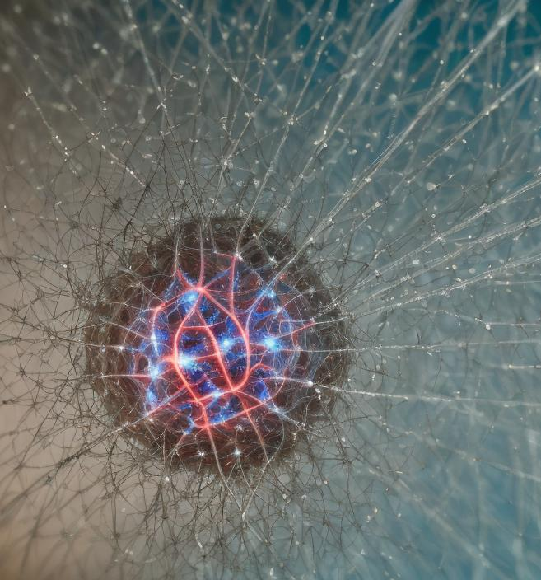
BIOSENSORS
A biosensor is an integrated receptor-transducer device, which can convert a biological response into an electrical signal. The design and development of biosensors have taken a center stage for researchers or scientists in the recent decade owing to the wide range of biosensor applications, such as health care and disease diagnosis, environmental monitoring, water and food quality monitoring, and drug delivery.
-Biosensors have been around since 1956 (the first being elecro-chemical), they were made commercially available in 2010 and many different kinds of biosensors have been developed and are used for all sorts of different things.
-There are several kinds of biosensors: optical, piezoelectric, electrochemical, hybridized synthetic biology. -There are a million ways that biosensors have been put into human bodies without a persons knowledge or consent. (air, water, food, vaccines, etc.) -Biosensors also have the ability to modify the DNA of the subject.
-They are Micro and NANO in scale and located in the interstitial fluid in between your cells. -Biosensors use your bodies natural electric energy to power themselves and emit a data signal that is connected to the internet of things. They communicate with electricity just like your cell phone. Cell phones can be “bootstrapping” devices for biosensors.
-Biosensors that are made out of hybridizing your DNA emit a signal using electrochemical elements such as light and can be controlled using optogenetics (controlling biological systems through light)
Whistleblower in the field comes forward. Mentions the Abuse of Wireless Sensor Network and Covid Paper Discussed Between Todd Callender and Maria Zeee
WWW.FTWPROJECT.COM

Slide 6
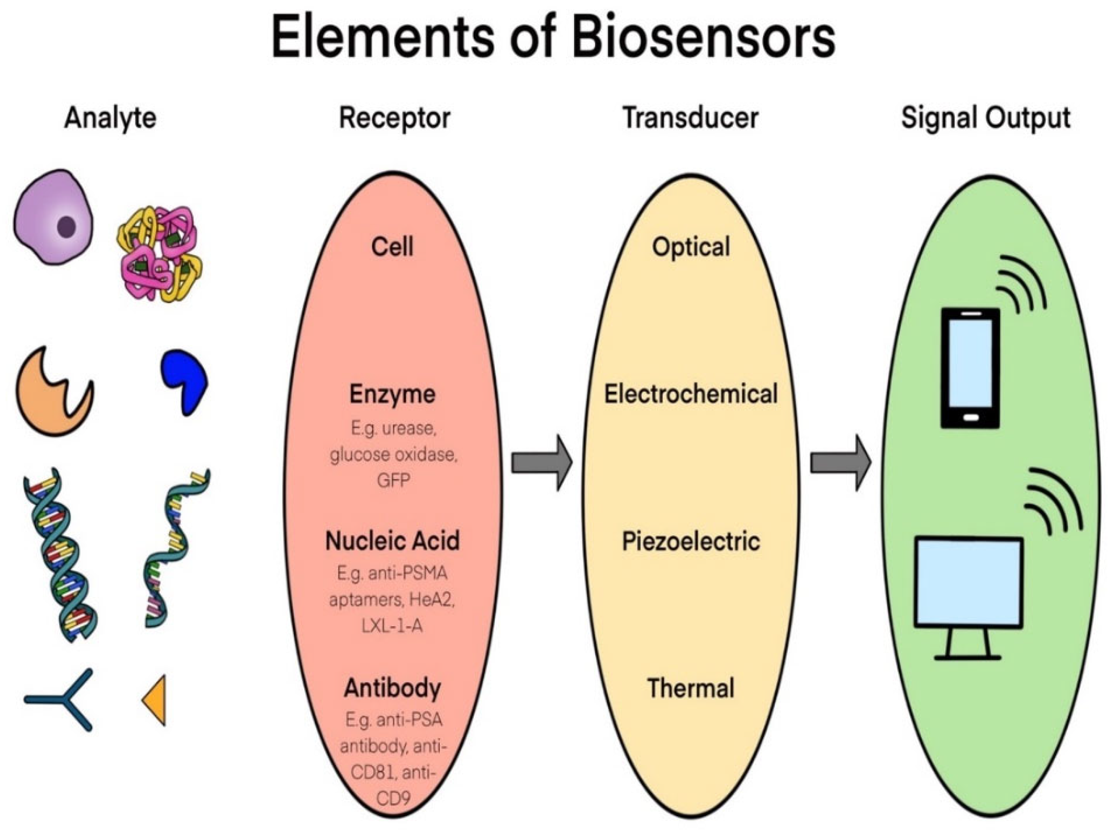
BIOSENSORS
There are 4 Main Components of a Biosensor 1) Analyte = a chemical or biological material that gives the electron reaction as it is connected
2) Receptor = also known as the recognition layer that binds to the target component
3) Transducer = acts as an interface measuring the production that occurs with the bioreceptor, transforms energy into a measurement
4) Signal = Component that Displays the information
What Biosensors are used for: -Analysis of Living subjects remotely can use anything in your body (blood, glucose, etc.) -Obtain Sample, analyze and transmit data -Uses your body natural electric energy to power itself and to send and receive data. HUMAN BODIES ARE NODES ON THE NETWORK
WWW.FTWPROJECT.COM

Slide 7
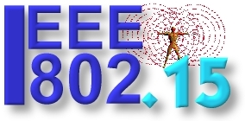
IEEE 802.15.4
Dealing with standards for communication with portable devices BODIES INCLUDED
WWW.FTWPROJECT.COM

Slide 8
IEEE 802.15.6
Dealing with standards for inter body communication INSIDE THE BODY THEN GOING OUT FROM THE BODY
WWW.FTWPROJECT.COM

Slide 9
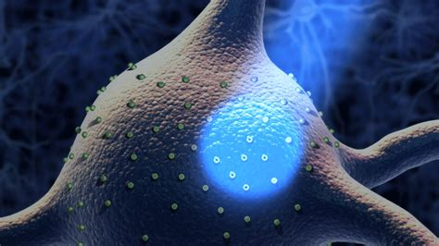
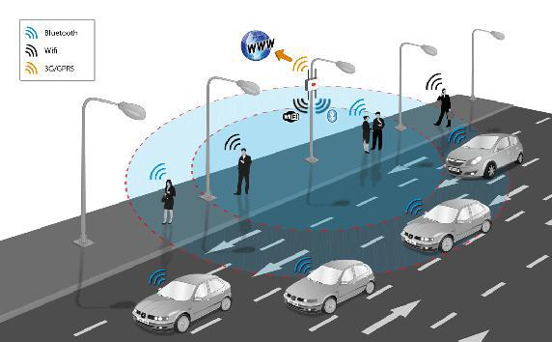
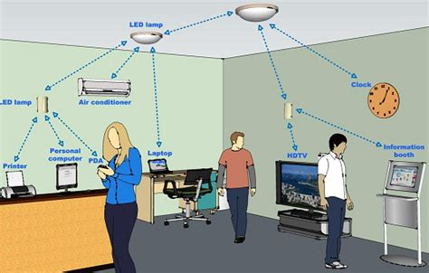
BIO PHOTONICS / OPTIGENETICS / VLC
BIOPHOTONICS is a field of biology and photonics that combines the interaction of light and biological materials. OPTIGENETICS is a biological technique to control the activity of neurons or other cell types with light. This is achieved by expression of light-sensitive ion channels, pumps or enzymes specifically in the target cells.
Biosensors could be used to make a change to peoples receptors within their body. For people who’s receptors have been changed, they can be more sensitive to certain kinds of light signaling from the environment or a wireless network.
Visible Light Communication (VLC) In telecommunications, visible light communication is the use of visible light as a transmission medium. VLC is a subset of optical wireless communications technologies. The technology uses fluorescent lamps to transmit signals at 10 kbit/s, or LEDs for up to 500 Mbit/s over short distances.
Examples: New VLC Lighting that will be used to control people.
WWW.FTWPROJECT.COM

Slide 10
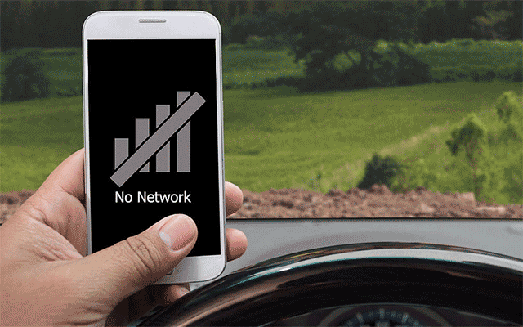
WEAKNESSES IN THEIR SYSTEM
The leaders in this industry give presentations where they clearly list the obstacles or weaknesses in their technology that they struggled to overcome. Below is a list of examples. This is why they needed to UPGRADE the system in order to get the tech to work well enough to achieve their goals.
They couldn’t get the electromagnetic waves across the old network.
Problems with the old system: Free space Signal absorption Interference Line of sight propagation Fading Doppler Effects Distance (especially 60GHz and Thz bands) Energy consumption Coverage
WWW.FTWPROJECT.COM

Slide 11
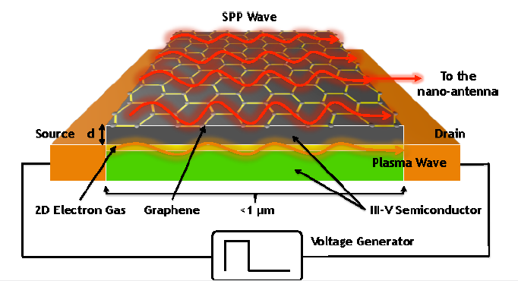
METAMATERIALS TERAHERTZ SOFTWARE DEFINED
From our last presentation, Metamaterials Terahertz software defined is the suite of nanoscale technologies with the terahertz frequency range.
These technologies were basically “on hold” to the commercial world by governments (even though they were developed). They were released in 2017 as part of an infrastructure upgrade to the Global Information Network, which would be further initiated 3 years later with the graphenation of the population through the COVID Injections.
“COVID Vaccines are bio-nano machines”
Ian Akyildiz and Josepe Jornet are Industry leaders in all things “Internet of Things”. (IOT IOB IONT etc.)
These materials are GRAPHENE BASED which is a necessary part of these new technologies and what was needed to get them to work. Hence the upgrade.
WWW.FTWPROJECT.COM

Slide 12
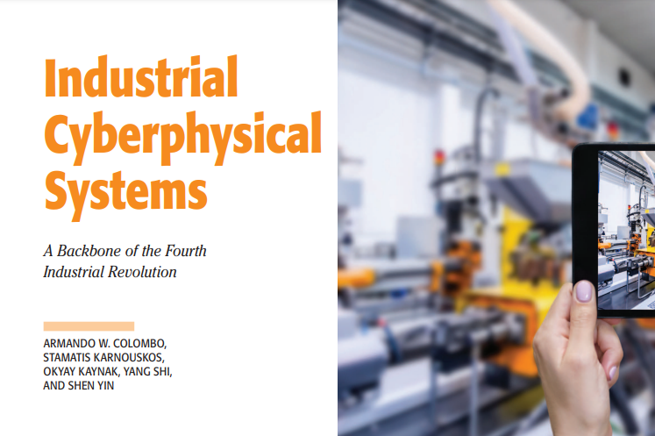
CYBER-PHYSICAL BACKBONE
NEW SYSTEM INFRASTRUCTURE INCLUDES EVERYTHING: 5G TOWERS, SATELLITES, METAMATERIALS, FIBEROPTICS ETC.
A cyber-physical system ( CPS) or intelligent system is a computer system in which a mechanism is controlled or monitored by computer-based algorithms.
A backbone or core network is a part of a computer network which interconnects networks, providing a path for the exchange of information between different LANs or subnetworks. A backbone can tie together diverse networks in the same building, in different buildings in a campus environment, or over wide areas.
cyber-physical systems (CPS) and the Internet of Things (IoT) are converging over time to include a common emphasis on hybrid systems of interacting digital, analog, physical, and human components (from NIST)
“Load Balancing” term that means to test the ability to transmit signals over the new networks they just installed.
IEEE Paper: Industrial Cyberphysical Systems: A Backbone of the Fourth Industrial Revolution
This Infrastructure was deployed in 2017. Same Year the Terahertz Metamaterials were deployed.
WWW.FTWPROJECT.COM

Slide 13
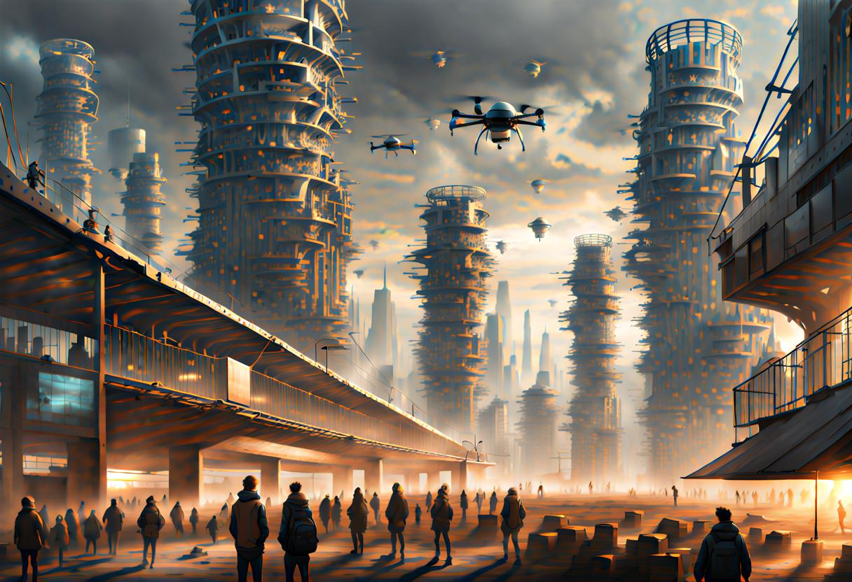
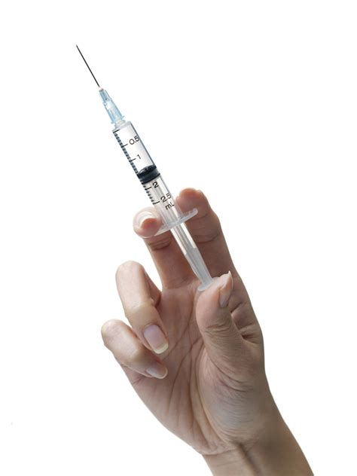
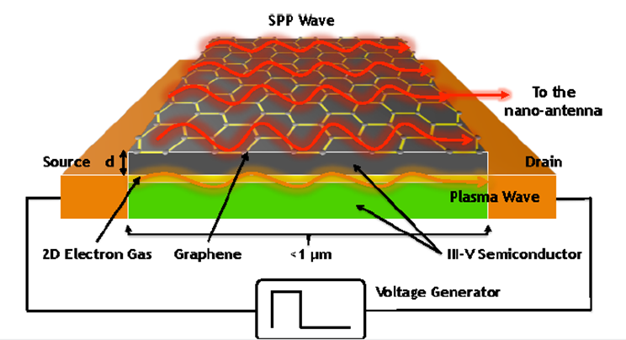
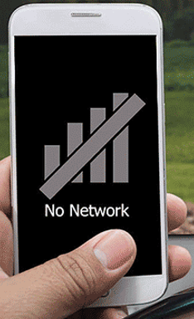
THE SYSTEM UPGRADE
4
The new system with the graphenated population is now ready for the deployment of 15 minute smart cities as a means to control the worlds population.
3
Once the infrastructure was deployed they then graphenated the population through creating a fake pandemic, making people shelter in place (for better tracking and tracing abilities) and injected most of the worlds population with graphene. They needed the graphene injected (big difference from bioaccumulation) in peoples bodies for the amplification of the signals.
2
This upgrade was initiated in 2017 when they installed the infrastructure for the new system known as the cyber-physical backbone. No one in the non tech world even noticed. The IEEE world however knew all about it.
1
Even with all the technology they had developed up to this point, it still wasn’t doing what they wanted it to (meaning control humans) at the levels of speed and efficiency that they needed. So they did a full system upgrade.
WWW.FTWPROJECT.COM

Slide 14
TIMELINE
THE FIRST LIE IN RECORDED HISTORY (they have been lying to you this whole time)
“YE SHALL BE AS GODS”
1956
BIOSENSORS
1995
WIRELESS BODY AREA NETORK (WBAN)
2017
SYSTEM UPGRADE
CYBER-PHYSICAL BACKBONE
METAMATERIALS -TERAHERTZ SOFTWARE DEFINED
THIS IS TRANSHUMANISM THE 4TH INDUSTRIAL REVOLUTION AS IN THE DAYS OF NOAH
2019-22
COVID DEPLOYMENT GRAPHENATED POPULATION
FUTURE
15 MINUTE SMART CITIES POPULATION CONTROL
WWW.FTWPROJECT.COM

Slide 15
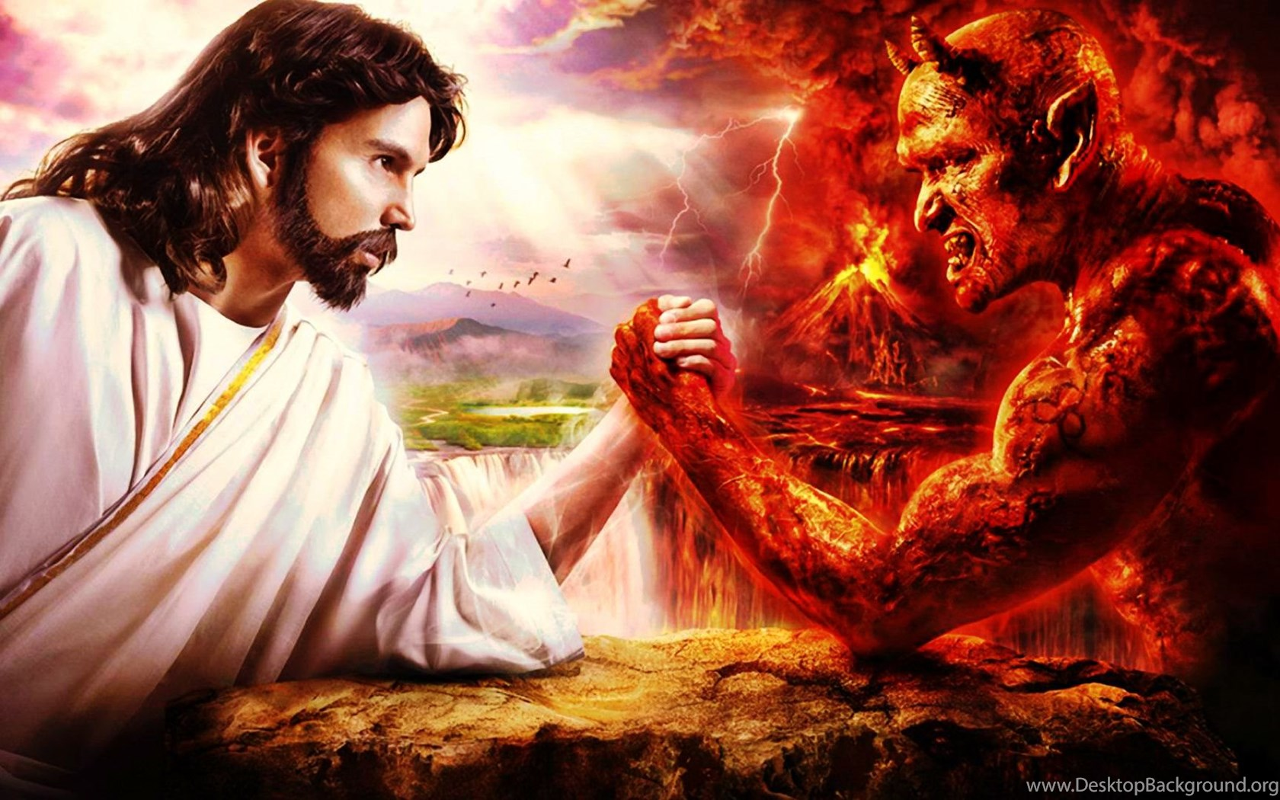
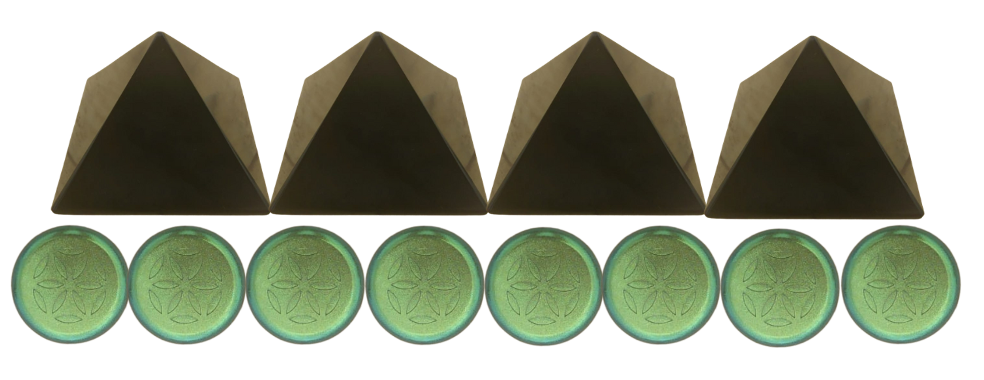
FIGHTING EVIL TECH WITH GOOD TECH ON THE SAME TECH LEVEL
We make products by hand here for EMF protection. These products are based on orgone energy, which is a healthy life preserving energy field generated by a composite of metal powders mixed in an epoxy resin. The end result is something called orgonite. Orgonite uses piezoelectricity, surface area, morphogenetic fields, and backscatter to preserve energy. It can also help fight back against the bad tech.
Piezoelectric
Back Scatter
THEIR TECH
OUR TECH
Morphogenetic Field
Surface Area
WWW.FTWPROJECT.COM

Slide 16
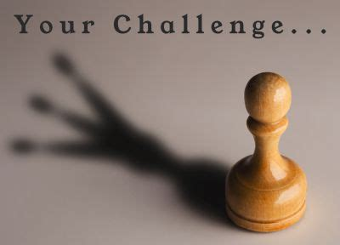
“HOPE AND TIVON BIOSENSOR CHALLENGE”
Attention to all the GOOD hackers out there. Lets find the weaknesses in their system, and exploit them to stop the signal.
Here are some of their system weaknesses, how do we exploit them? Free space Signal absorption Interference Line of sight propagation Fading Doppler Effects Distance (especially 60GHz and Thz bands) Energy consumption Coverage
IDEAS FOR COUNTERMEASURES
What technologies are IN Biosensors? Can living bugs modified to be biosensors be killed or detoxed from the body? Can graphene be safely removed from the body? Can tracking signals emitted from within the body be scrambled or cloaked- wearables.
WE NEED ALL HANDS ON DECK! HELP US FIND SOLUTIONS.
WWW.FTWPROJECT.COM

Slide 17
METHODS
Over the past few decades the following government projects played a role in moving the world toward their ultimate goal. Each one is an area to research, here are a few highlights.
MOSAIC WARFARE is a concept that involves sending a large number of weapon and sensor platforms at the enemy to overwhelm them. From DARPA using, The Internet of Military Things (IoMT) a class of Internet of things for combat operations and warfare.
GLOBAL INFORMATION GRID a network of information transmission and processing maintained by the United States Department of Defense.
LETHAL AUTONOMOUS WEAPON SYSTEM (LAWS) a type of autonomous military system that can independently search for and engage targets based on programmed constraints and descriptions. LAWs are also known as lethal autonomous weapon systems, autonomous weapon systems, robotic weapons or killer robots.
PROJECT MAVEN Defense Department initiative to integrate artificial intelligence and machine learning across operations to extract objects of interest from imagery. Started by Google and taken over by the Pentagon. Many Google employees left when they realized that the program would be used on civilians in Mosaic Warfare.
NETWORK CENTRIC WARFARE, also called network-centric operations or net-centric warfare, is a military doctrine or theory of war that aims to translate an information advantage, enabled partly by information technology, into a competitive advantage through the computer networking of dispersed forces. It was pioneered by the United States Department of Defense in the 1990s.
WWW.FTWPROJECT.COM

Slide 18
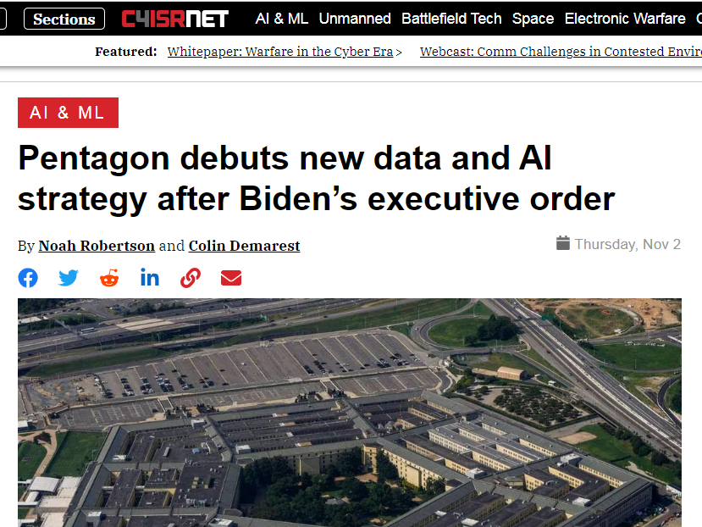
THE PENTAGON AND ARTIFICIAL INTELLIGENCE
The DOD held an Artificial Intelligence Symposium in 2020 A DOD directive was issued to deploy AI Then Biden Executive order On October 30 And the Pentagon Responded They are Moving FULL STEAM AHEAD
WWW.FTWPROJECT.COM

Slide 19
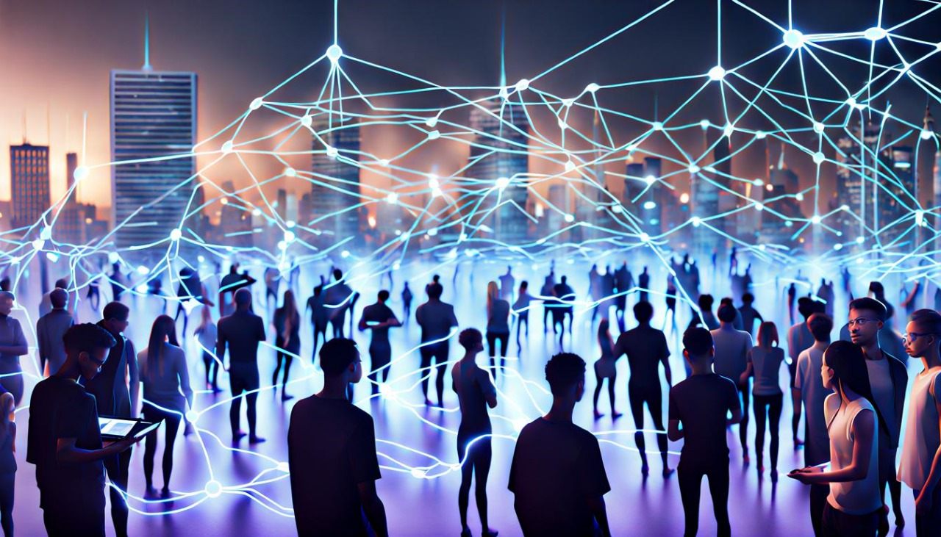
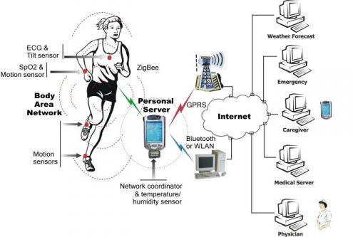
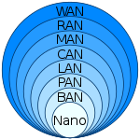
WIRELESS BODY AREA NETWORK
Our bodies are being used as a communications propagation system since 1995.
A Wireless Body Area Network (WBAN) or a body sensor network connects independent nodes (e.g. sensors and actuators) that are situated in the clothes, on the body or under the skin of a person. The network typically expands over the whole human body and the nodes are connected through a wireless communication channel. https://www.waves.intec.ugent.be/research/wireless-body-area-networks
Computer Area Networks
Nano- a network of biosensors which is inside of your body (BAN) BAN – Your Body area network which is inside of your personal Area network (PAN) which is your computer electronic devices within your personal workspace, which is inside of a local area network (LAN) which is a network in limited area like a university campus, residence which sits inside of a CAN…etc.
WWW.FTWPROJECT.COM

Slide 20
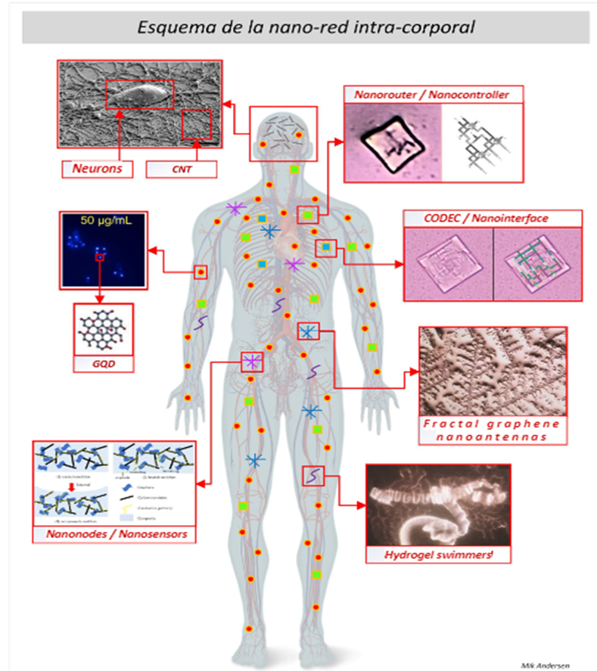
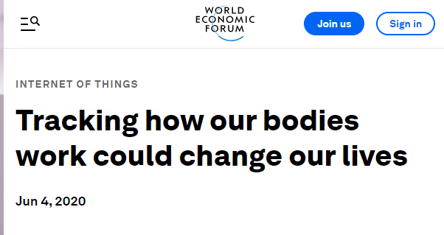
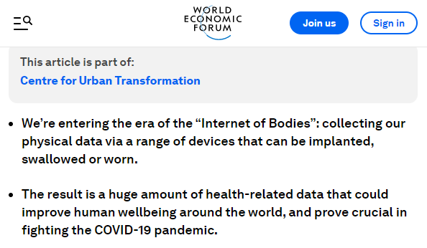
INTERNET OF BODIES (IOB)
IoB is “a growing industry of devices that monitor the human body, collect health and other personal information, and transmit that data over the Internet.”
Researchers who have been finding nanotechnology when they are looking at the blood under the microscope need to understand that there is an industry of people who work daily jobs that are regulating these nano networks. These are the biosensors and components that make up the Wireless Body Area Network and the Internet of Bodies.
WWW.FTWPROJECT.COM

Slide 21
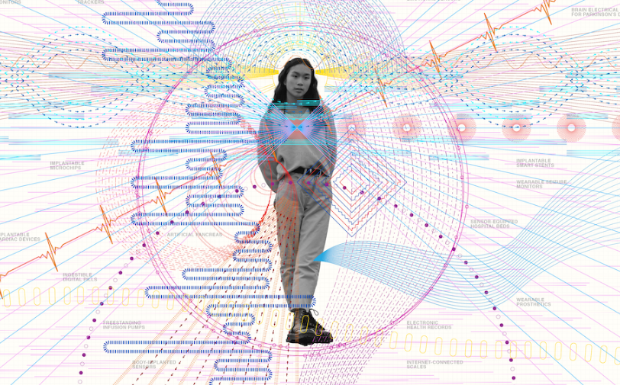
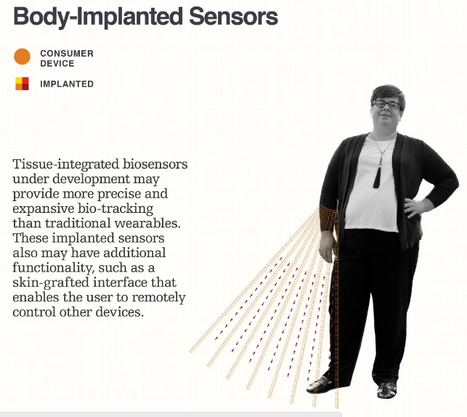
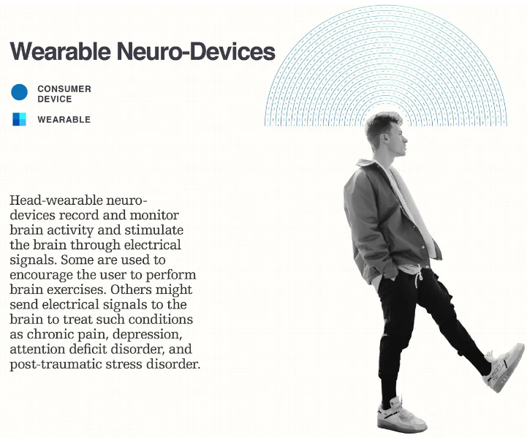
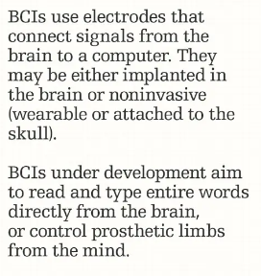
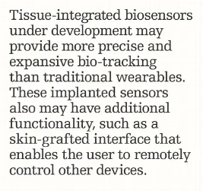
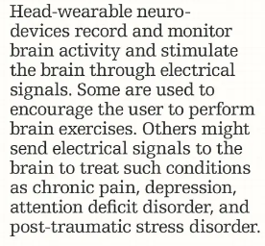
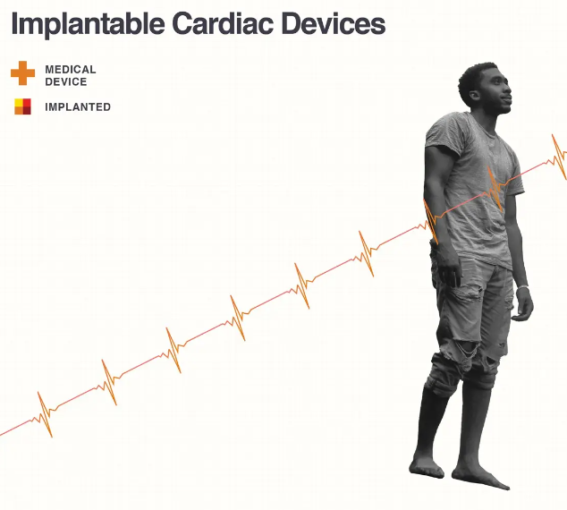
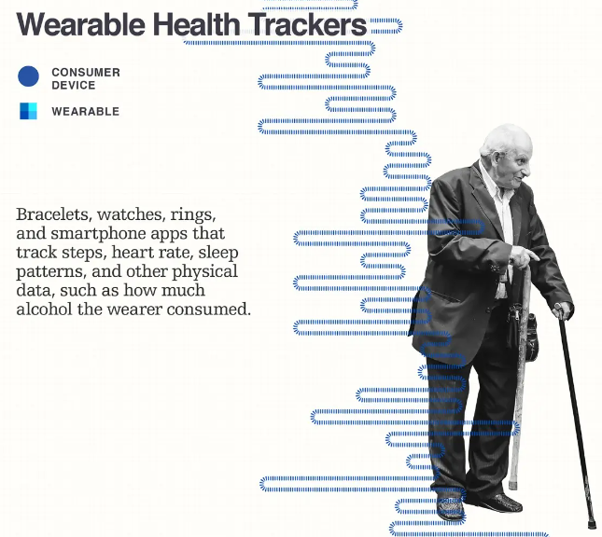
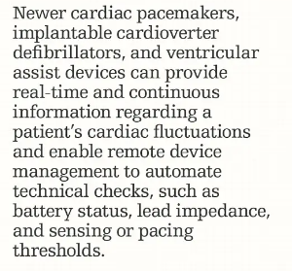
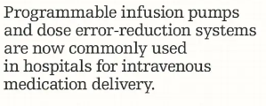
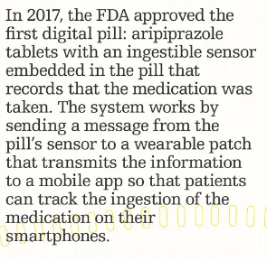
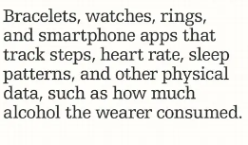
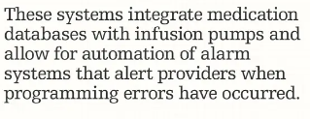
INTERNET OF BODIES EXAMPLES (FROM RAND.ORG)
WWW.FTWPROJECT.COM

Slide 22
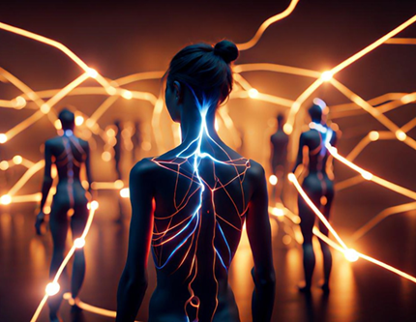
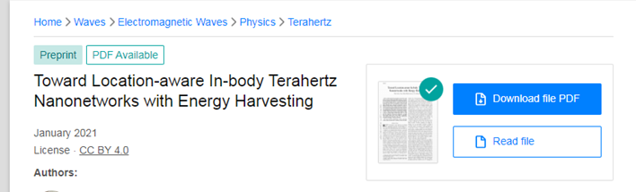
“GREEN ENERGY” IS SOYLENT GREEN ENERGY
“Nanoscale wireless networks are expected to revolutionize a variety of domains, with significant advances conceivable in in-body healthcare. In healthcare, these nanonetworks will consist of energy-harvesting nanodevices passively flowing through the bloodstream, taking actions at certain locations, and communicating results to more powerful Body Area Network (BAN) nodes. From Paper Below.
WWW.FTWPROJECT.COM

Slide 23
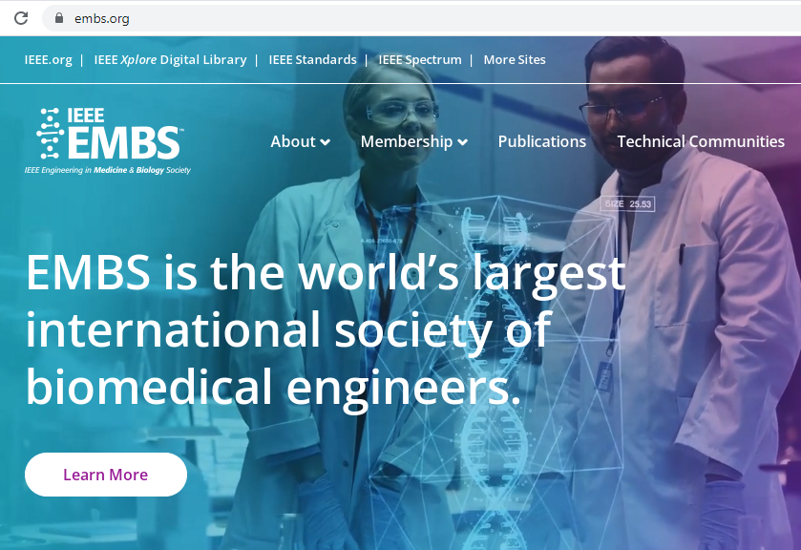
WIRELESS HEALTHCARE HOW THEY CONTROL YOUR HEALTH
IEEE EMBS are the WORLDS LARGEST international society of BIOMEDICAL ENGINEERS.
WIRELESS HEALTH CARE IS WHAT THEY ARE CALLING:
Precision Health Care Designer Drugging Electroceuticals Nanothermonostics Biomedical Tissue Engineering Regenerative Medicine
This is the industry that is changing your DNA, bringing in transhumanism and hooking your body up to the cloud.
WWW.FTWPROJECT.COM

Slide 24
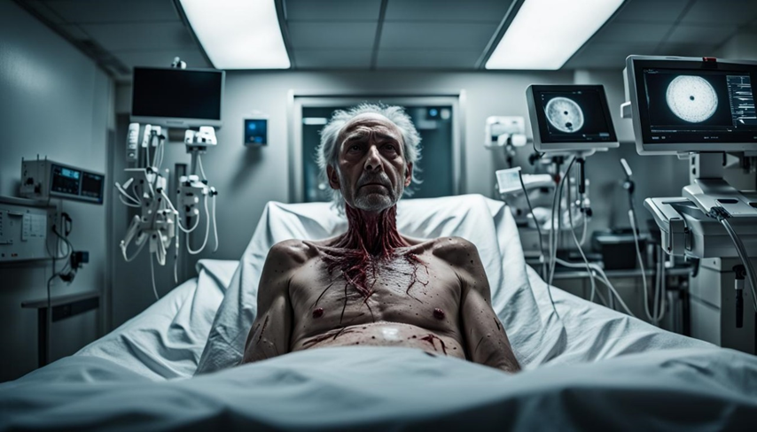
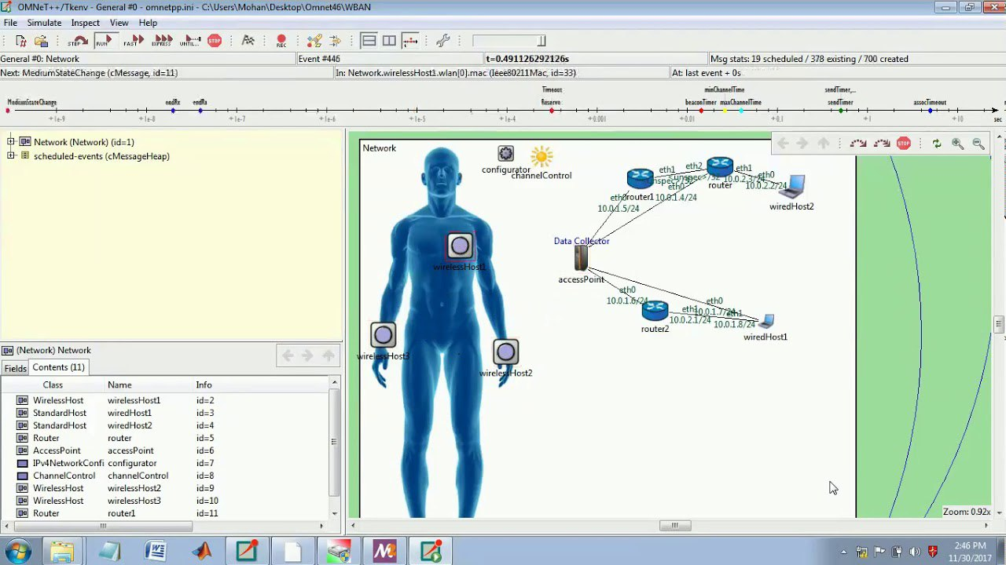
MEDICAL BODY AREA NETWORK
MEDICA BODY AREA NETWORS FIRST REPORT AND ORDER FROM THE FCC 2012 INTRODUCTION 1. By this Report and Order and Further Notice of Proposed Rulemaking (Further Notice), we expand our Part 95 MedRadio rules to permit the development of new Medical Body Area Network (MBAN) devices in the 2360-2400 MHz band, and propose procedures for selecting a party to register and coordinate MBAN use of the 2360-2390 MHz portion of the band. The MBAN technology will provide a flexible platform for the wireless networking of multiple body transmitters used for the purpose of measuring and recording physiological parameters and other patient information or for performing diagnostic or therapeutic functions, primarily in health care facilities. This platform will enhance patient safety, care and comfort by reducing the need to physically connect sensors to essential monitoring equipment by cables and wires. Our decision herein is the latest in a series of actions to expand the spectrum available for wireless medical use.
Hospitals use Medical Body Area Networks and a software called OMNET to report data from human bodies up to the cloud. This was done in hospitals during COVID. Data ran through PROJECT SALUS - A Pentagon effort that provided predictive logistics tools for COVID-19 response to the command. We did a report with Todd Callender about this data being reported to a database in ISRAEL.
WWW.FTWPROJECT.COM

Slide 25
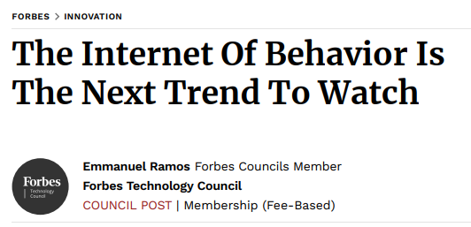
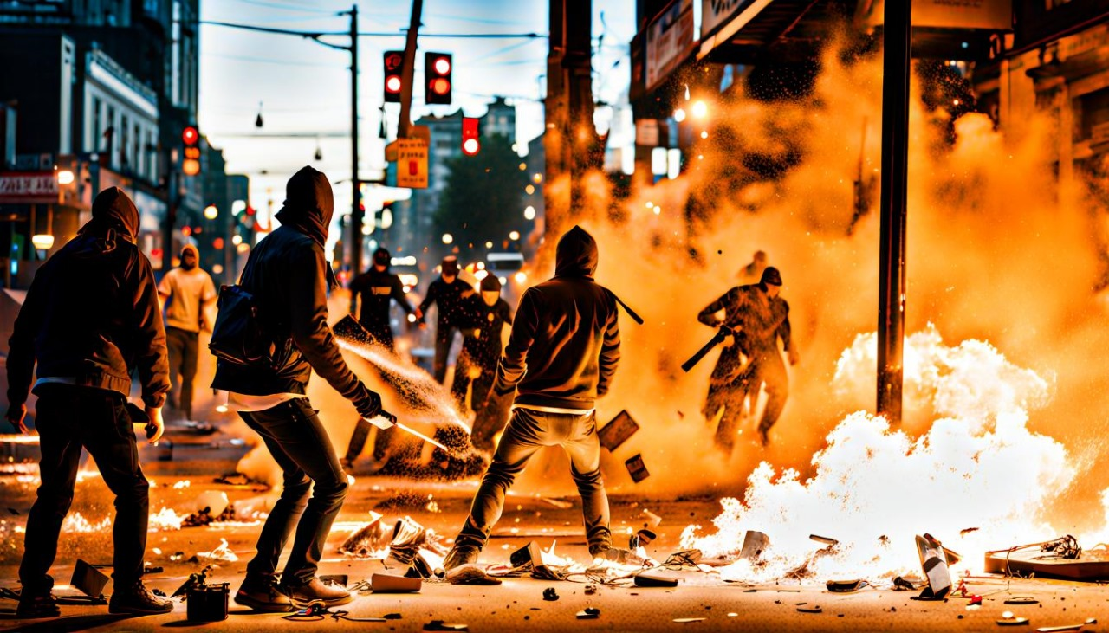
Mass formation psychosis Division Right / Left Psychologic OPS Planned Protests and Movements
General Behavior Changes in our Family Friends and Loved ones, especially after the vaccines.
Internet of Behavior (IoB). IoB offers a revolutionary way to
monitor, control and model human behavior IoB is a system that uses sensors and other technologies to monitor, analyze and predict human behavior. It combines artificial intelligence (AI), machine learning (ML), big data analytics, cloud computing, Internet of Things (IoT) devices, mobile applications, wearable devices, augmented reality (AR), virtual reality (VR), robotics automation systems and more into one comprehensive platform for collecting behavioral data from individuals or groups. The collected data can then be used for various purposes such as predictive analytics or automated decision-making processes.
WWW.FTWPROJECT.COM

Slide 26
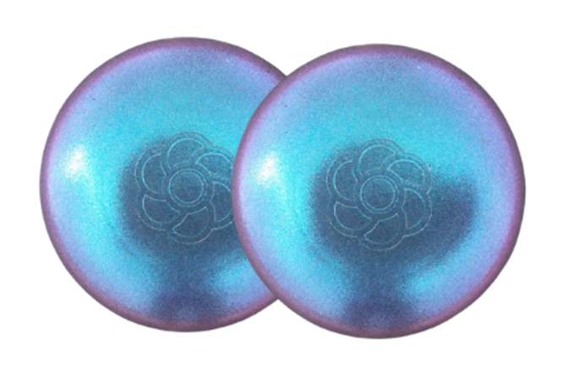
ABOUT OUR EMF PROTECTION PRODUCTS
HELP SUPPORT SGT REPORT BY SHOPPING FROM THIS LINK: https://www.ftwproject.com/ref/6/
SLEEPING PODS For a good nights sleep
CHARGE PLATES for use around the home, to preserve food and more
“We just can't believe our eyes! We have placed the garden pucks from our first order around our property, and the plants/trees with the pucks are BLOOMING within days! This is happening with every single place the pucks have been rested. Just incredible.” -Australia
PHONE SHIELDS to put on your cell phone, laptop and routers
PENDANTS for personal emf protection on your body
PYRAMIDS and garden sets for gridding your home / property / garden for emf protection on a large scale
SCIENTIFIC STUDIES AND DOCUMENTATION DESCRIBING HOW OUR PRODUCTS WORK AVAILABLE ON OUR WEBSITE.
TILES for incorporating emf protection into construction projects
WWW.FTWPROJECT.COM

