Slide 1
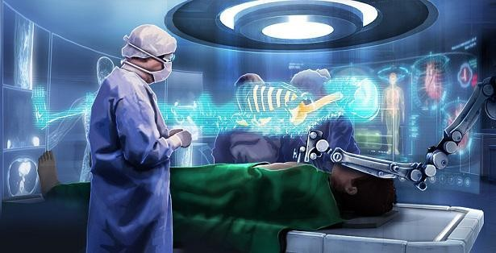

Slide 2
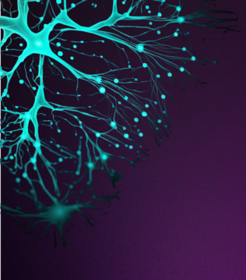
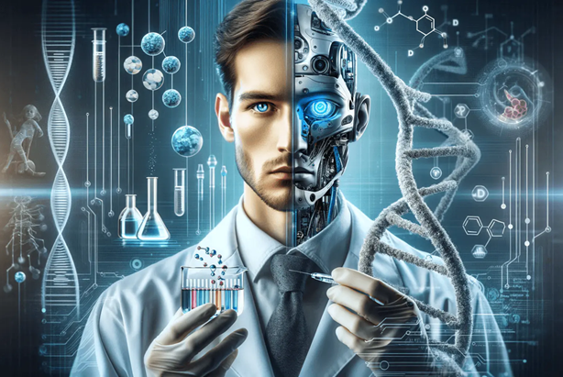
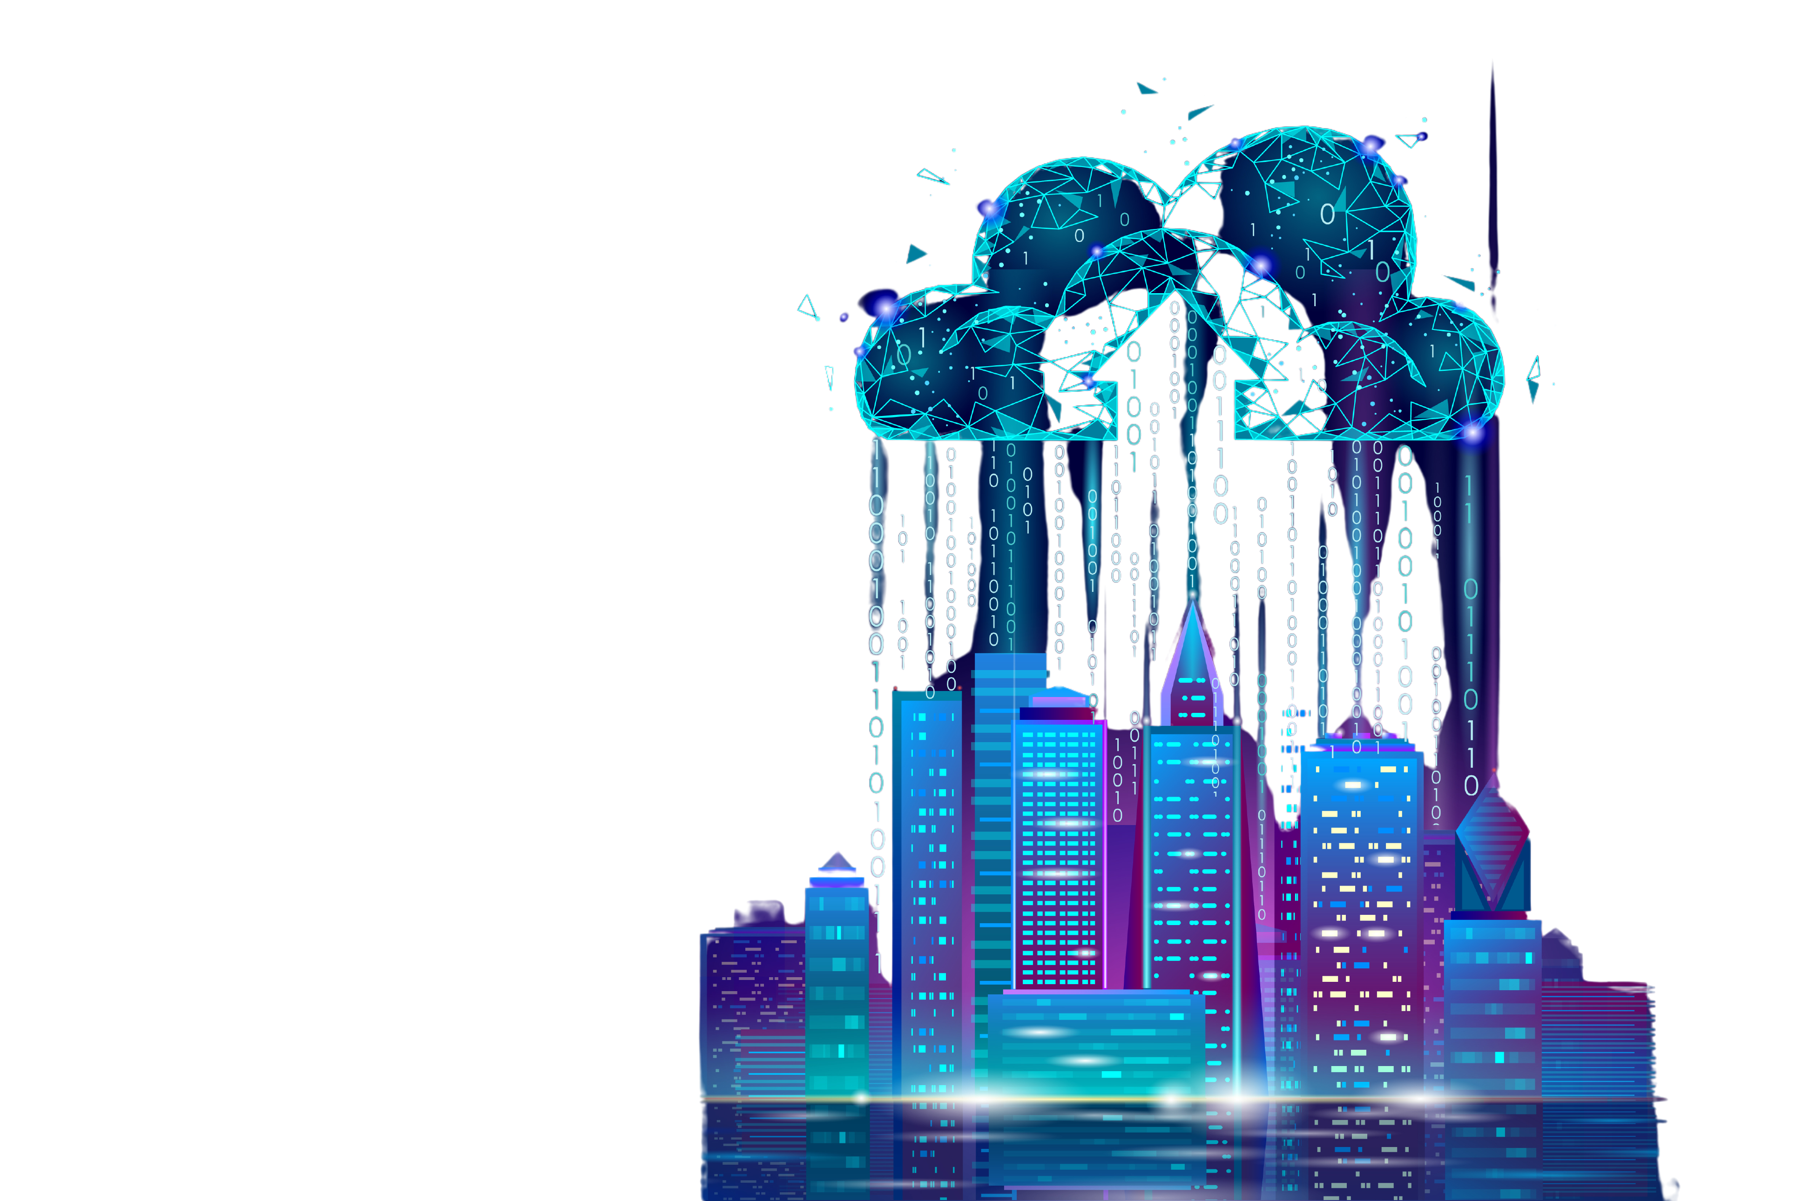
SUMMARY
Medical Body Area Network Biosensors and Wake up Radio Metamaterials for Electromagnetic Control Wireless Drugging and the Digital Nervous System Telehealth Technology and Remote Health Monitoring How they Use Biosensor Networks to Track your Every Move in your house Using the Internet of things to monitor your every move after COVID Emerging Technology AI Precision Healthcare Nvidia Smart City MBAN Hospital Setup NVIDIA and AMD to run the Tech Digital Twins in Healthcare "You are now the Guinea Pig" Modernization Act Bioluminescent Interface Why Peoples Faces are Glowing Migrants from Emerging Tech Industry Coming to an American City Near You
All explanations are taken from white papers / government websites / scientific articles too many to list here on this slide. Please see extensive notes on blog post for links to articles.
WWW.FTWPROJECT.COM

Slide 3
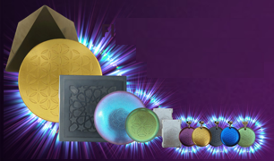
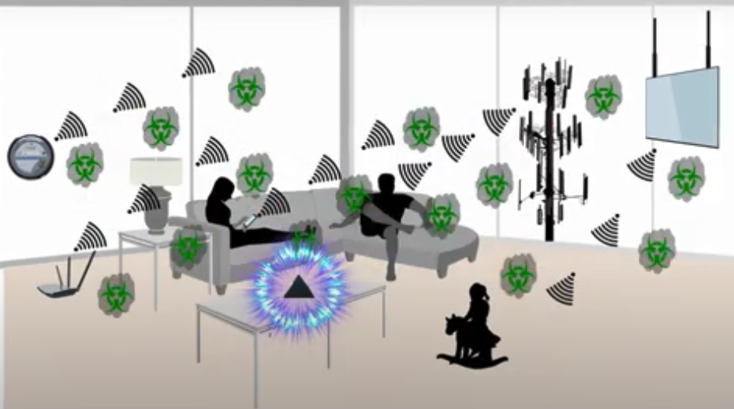
PROTECT YOURSELF FROM EMERGING TECHNOLOGIES BY PROTECTING YOURSELF FROM EMF
We make our products by hand mixing, shungite, iron oxide, steel, brass, and quartz crystal (powder form) into an epoxy resin. When the epoxy cures into a solid plastic state it puts pressure on the surface area of the ingredients. This causes something known as the piezoelectric effect, which emits a harmonizing field generated by the specific properties of the ingredients. It is this field that transforms the harmful energy from EMF’s into healthy life preserving energy. Place our products all around yourself and your environment for the best effect.
BENEFITS OF OUR EMF PROTECTION PRODUCTS
-Better sleep -Stress relief -Pain relief -Healthy home environment -Better seed germination and plant growth -Preserves fresh food and extends shelf life -Maintain Healthy Blood
Full length explanatory videos on our Website! FTWProject.com

Slide 4
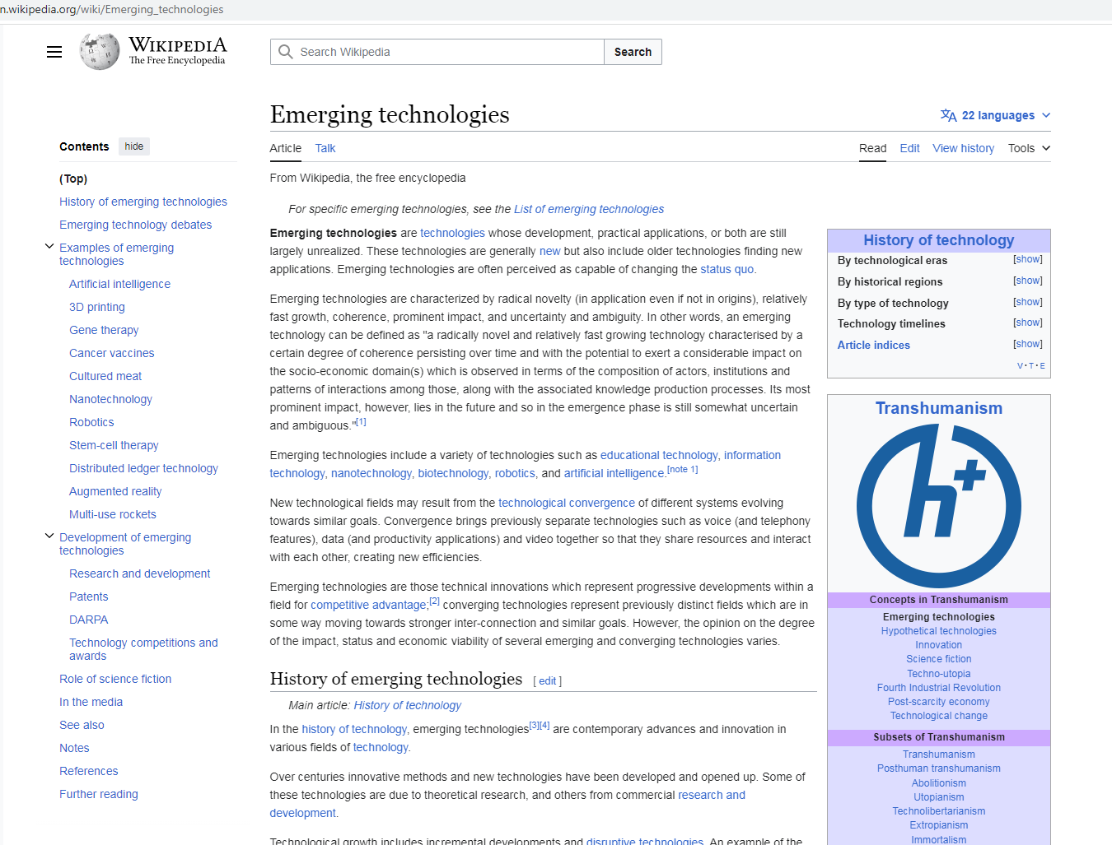
EMERGING TECHNOLOGIES IS TRANSHUMANISM
LOOK HOW THE CLASSIFY EXAMPLES OF TRANSHUMANISM
THEY BOAST ABOUT THIS…THEY ARE SO PROUD!!!
THIS IS CRYPTOCURRENTY
WWW.FTWPROJECT.COM

Slide 5
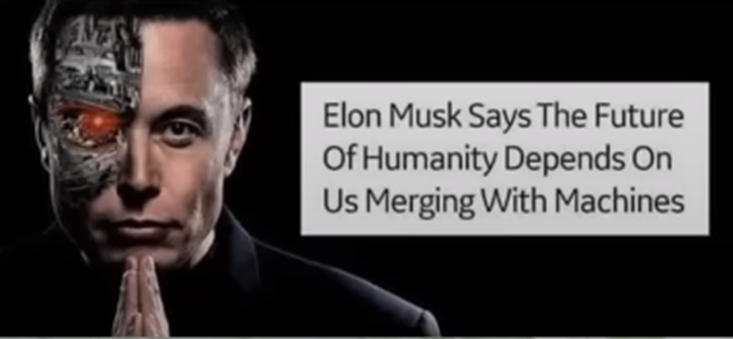
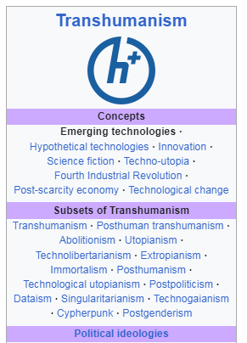
MERGING MAN WITH MACHINE THROUGH OUR DNA
Our DNA is made up of 4 Nucleic acids, adenine, guanine, thymine, & cytosine. In this patent for the mRNA injections it discusses changing our DNA by adding two extra Cytosines. Bringing our DNA from “ATCG” to “ATCCCG”. What are the Extra Cytosines for? In the History of Cytosine (Wikipedia)
In 1998, cytosine was used in an early demonstration of quantum information processing when Oxford University researchers implemented the Deutsch–Jozsa algorithm on a two qubit nuclear magnetic resonance quantum computer (NMRQC).[6]
Cytosine is used in quantum computing / Artificial intelligence.
Emerging Technologies: From Wikipedia discusses a suite of new technologies that are all under the category of transhumanism. -Artificial Intelligence -Gene therapy -Nanotechnology -Blockchain technology -Augmented Reality -Cancer Vaccines -DARPA
WWW.FTWPROJECT.COM

Slide 6
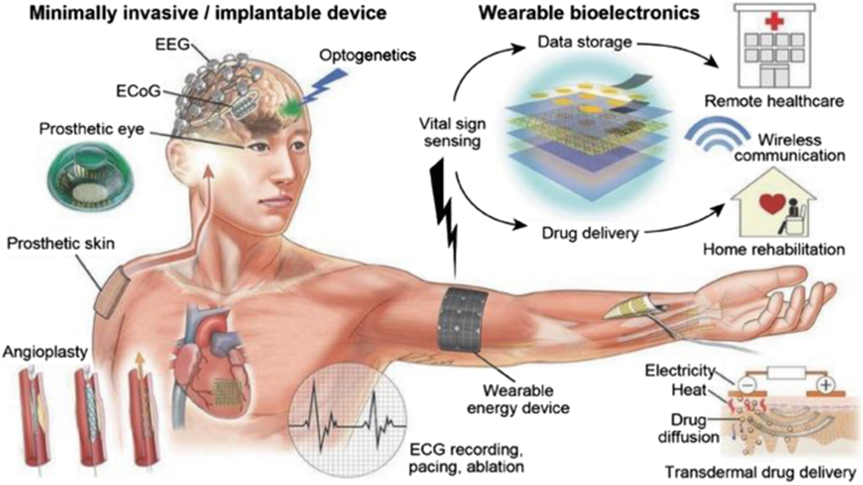
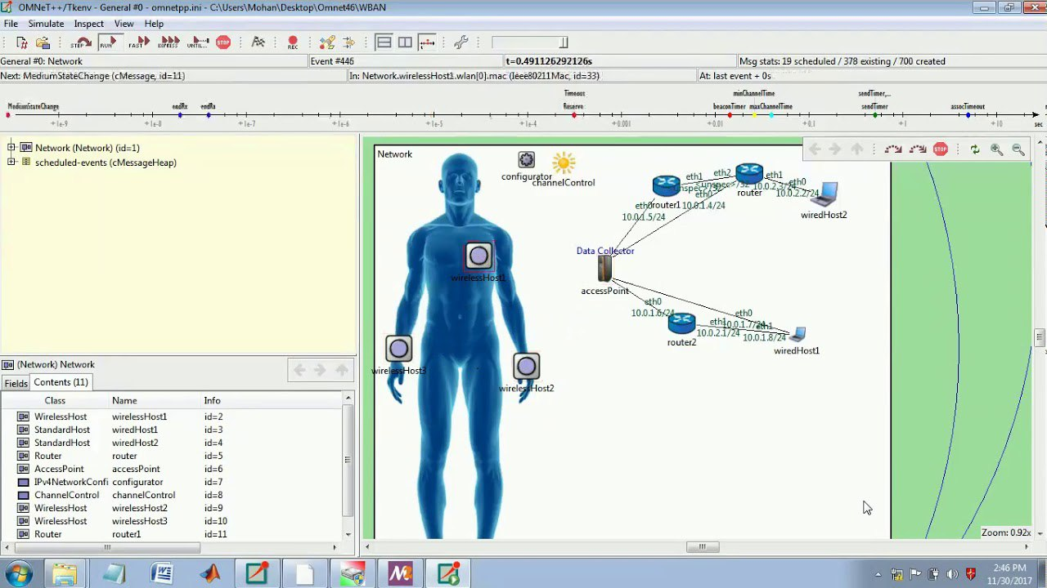
MEDICAL BODY AREA NETWORKS DEFINED
MBANs are networks of wireless sensors, often no bigger than a Band-Aid, which can transmit data on a patient's vital health indicators to their doctor or hospital. The FCC mandated the MBAN in 2014. MBAN is a Subset of the WBAN.
The first use of MBANs will likely be in hospitals, but a longer term application could be remote monitoring devices that allow doctors to check on patients at home.\
The networks can potentially alert doctors to problems before the patient’s condition becomes critical, thus avoiding the need for acute intervention.
The technology has more laws allowing it to do whatever it wants to your body than you do. All the regulatory agencies have been very busy creating the legal structure for wBAN, MBAN, Wireless drugging, and patient compliance for many years now.
This is the reason why humans now have mac addresses. Its for this network. We are all patients to this satanic medical system now. It also clearly states that this network follows you to your house. Which is your kill box.
WIRELES BODY AREA NETWORK SOFTWARE OMNET HOW THEY LOG IN AND OUT OF YOUR BODY: Hospitals use Medical Body Area Networks and a software called OMNET to report data from human bodies up to the cloud. This was done in hospitals during COVID.
The MBAN technology will provide a flexible platform for the wireless networking of multiple body transmitters used for the purpose of measuring and recording physiological parameters and other patient information or for performing diagnostic or therapeutic functions, primarily in health care facilities. This platform will enhance patient safety, care and comfort by reducing the need to physically connect sensors to essential monitoring equipment by cables and wires. Our decision herein is the latest in a series of actions to expand the spectrum available for wireless medical use. FCC Regulations
WWW.FTWPROJECT.COM

Slide 7
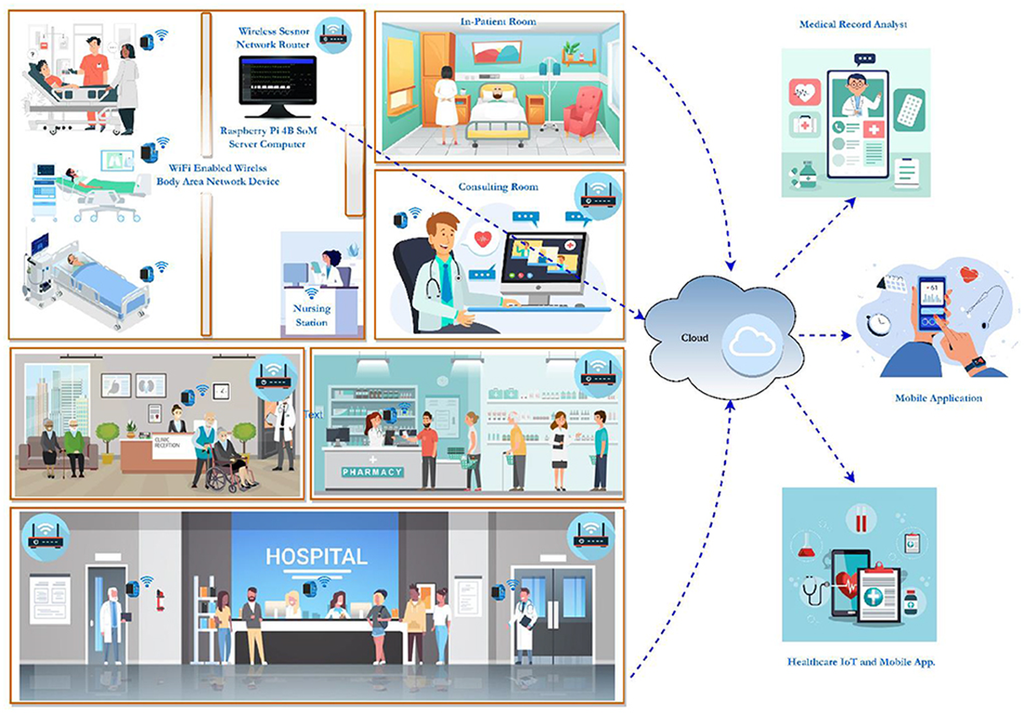
MBANS: HOW THEY WORK
FROM: Frontiers in Sustainable Cities 2022 This is a model of a biosensor network using WBANs and WSNs to identify early symptoms and monitor air quality. The patient's wearable device, built using the IoT module, is equipped with various biosensors. The biosensor nodes are equipped with minimal storage and processing power, and they use the IEEE 802.15.6 protocol to transfer information with the base station (BS). The BS has a powerful Raspberry Pi 4 B computer with Graphical Processing Unit (GPU) capabilities and IoT connectivity.
The whole WBAN database, including all patient information, is stored on an NVIDIA 128 Core Jetson Nano server computer. Using a smartphone app and IoT connectivity, physicians, medical analysts, and other authorized users can access patients' medical histories stored on a server. The first use of MBANs will likely be in hospitals, but a longer term application could be remote monitoring devices that allow doctors to check on patients at home.
WWW.FTWPROJECT.COM

Slide 8
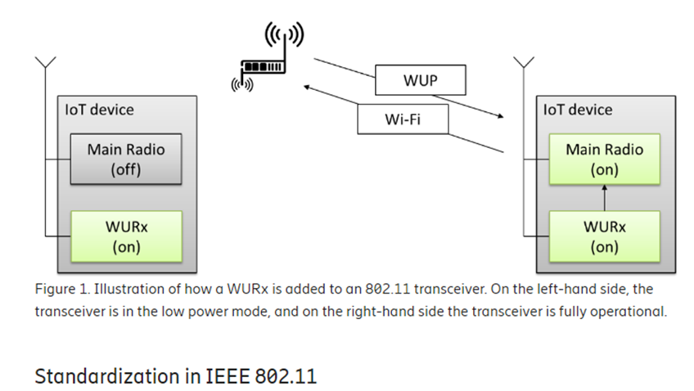
BIOSENSORS USE WAKE UP RADIO TECHNOLOGY
Wake Up Radio Imagine a receiver in a very low power mode that would, in a magical way, wake up just in time for the data to be received. This is what they have designed the biosensors that are inside of our bodies to do. From: Wake-Up Radio – A key component of IoT? https://www.ericsson.com/en/blog/2017/12/wake-up-radio--a-key-component-of-iot
WWW.FTWPROJECT.COM

Slide 9
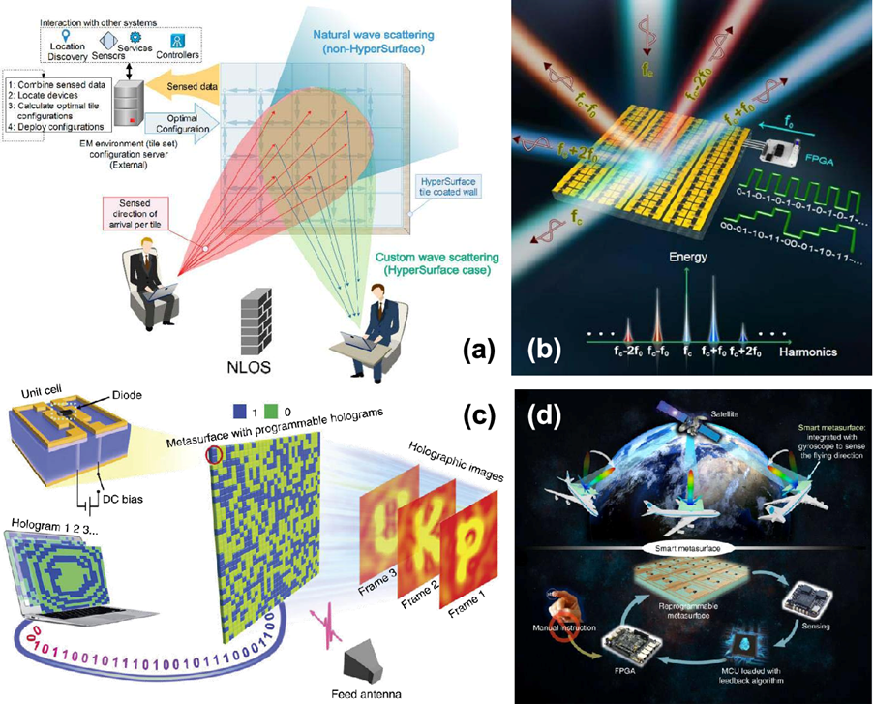
Software Defined Metamaterials are the suite of nanoscale technologies that operate in the terahertz frequency range.
METAMATERIALS enable electromagnetic control over electromagnetic waves in fields such as imaging, radar, or wireless communications. Metamaterials and their two-dimensional analogues, metasurfaces have powerful control over electromagnetic waves from microwave to visible range and can become programmable. Programmable metamaterials may not only host multiple EM functionalities that can be chosen or combined through simple software directives, but also be provided with means to adapt to the environment or communicate with other metamaterials, thereby enabling a myriad of applications in sensing, imaging, or communications.
WE ARE SATURATED IN METAMATERIALS SINCE THE UPGRADE THAT STARTED IN 2017 WITH THE 4TH INDUSTRIAL REVOLUTION CYBER PHYSICAL BACKBONE
WWW.FTWPROJECT.COM

Slide 10
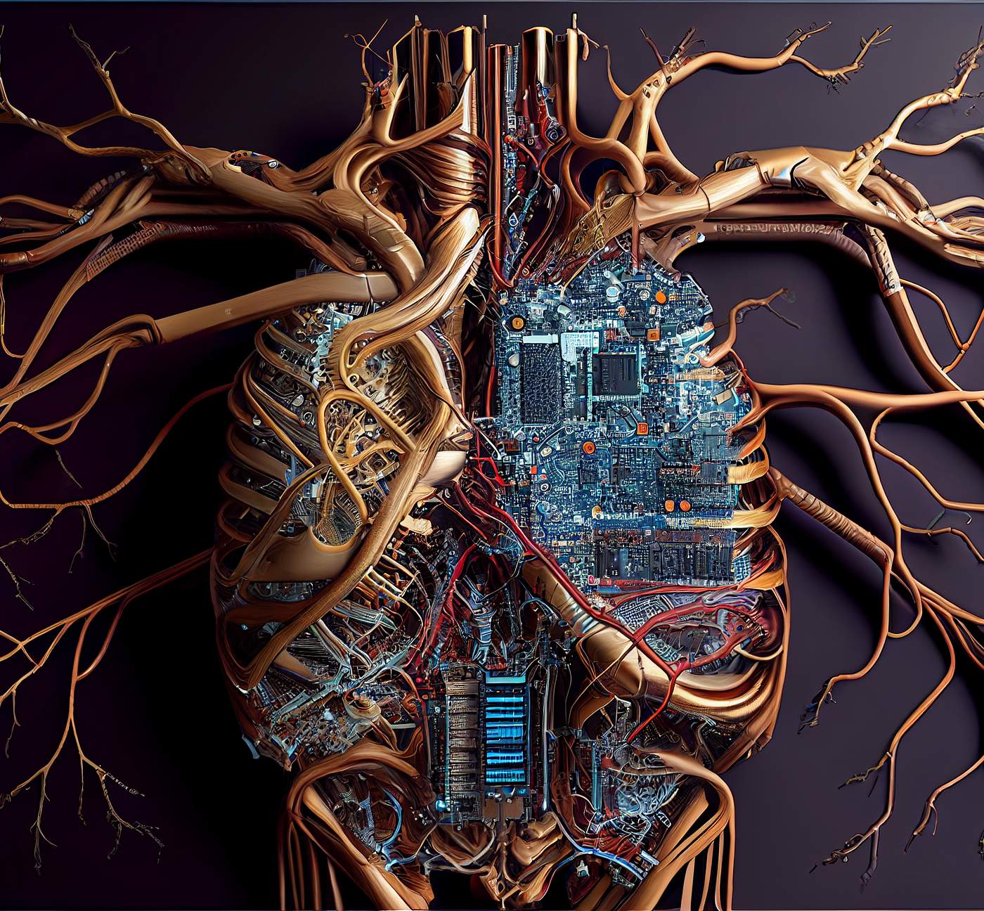
WIRELESS DRUGGING AND THE DIGITAL NERVOUS SYSTEM
DIGITAL DRUG DELIVERY USING AI DECISION MAKING
The digital nervous system (DNS), a smart healthcare body-area network (BAN). Separate nodes on the human body work in unison to sense and communicate health parameters and actuate medical treatments. Sensor nodes (e.g., breathing/sweat, pulse, motion) convert physiological information into digital signals which are wirelessly relayed to a central decision-making base unit, and actuator nodes, exemplified by an implantable drug delivery device, convert digital signals into biochemical fluxes. Data transferred from the BAN to cloud data handling services can be utilized for direct contact with care providers or emergency services, as well as decision making, analysis, and improved treatment schemes (which can be relayed back to the BAN).
Body area networks (BANs), cloud computing, and machine learning are platforms that can potentially enable advanced healthcare outside the hospital. By applying distributed sensors and drug delivery devices on/in our body and connecting to such communication and decision-making technology, a system for remote diagnostics and therapy is achieved
From: A digital nervous system aiming toward personalized IoT healthcare
WWW.FTWPROJECT.COM

Slide 11
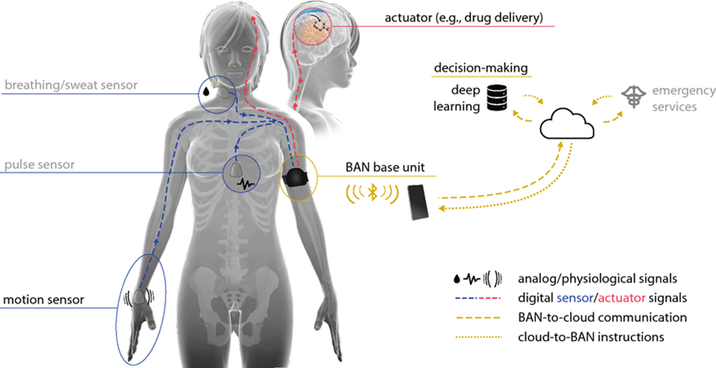
WIRELESS DRUGGING AND THE DIGITAL NERVOUS SYSTEM
Here we see the actuator in the brain for the bio electronic drug delivery. The Body Area Network Base unit that can be activated through a wearable, your breathing and sweat censor to watch your interstitial fluids with a pulse sensor, which will be on the inside of your body to verify the drug delivery. On the right is a data base for decision making with an artificial intelligence making the decision on when to drug you all connected to your medical industrial complex “emergency services” personnel.
WWW.FTWPROJECT.COM

Slide 12
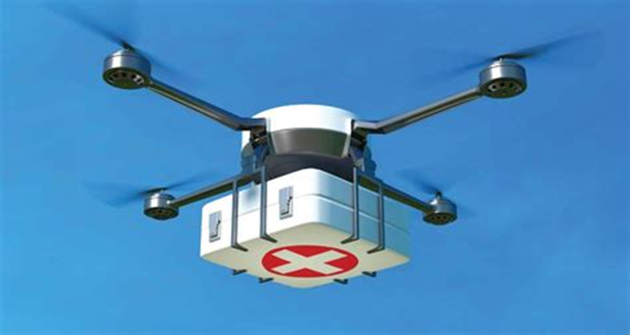
TELEHEALTH TECHNOLOGY AND REMOTE HEALTH MONITORING
Telehealth is the use of digital information and communication technologies to access health care services remotely and manage your health care. Technologies can include computers and mobile devices, such as tablets and smartphones. This may be technology you use from home. Or a nurse or other health care professional may provide telehealth from a medical office or mobile van, such as in rural areas. Telehealth can also be technology that your health care provider uses to improve or support health care services. The Issue with Telehealth is in Remote Monitoring Technology that allows your provider or health care team to check your health remotely: Web-based or mobile apps for uploading data to your provider or health care team. -Devices that measure and wirelessly send data, such as blood pressure, blood sugar and oxygen levels.-Wearable devices that automatically record and send data (heart rate, blood sugar, how you walk, your posture, tremors, physical activity or your sleep).-Home monitoring devices for older people or people with dementia that can find changes in daily activities such as falls.-Devices that send notifications to remind you to do exercises or take drugs
Software for Remote Patient Monitoring Systems
WWW.FTWPROJECT.COM

Slide 13
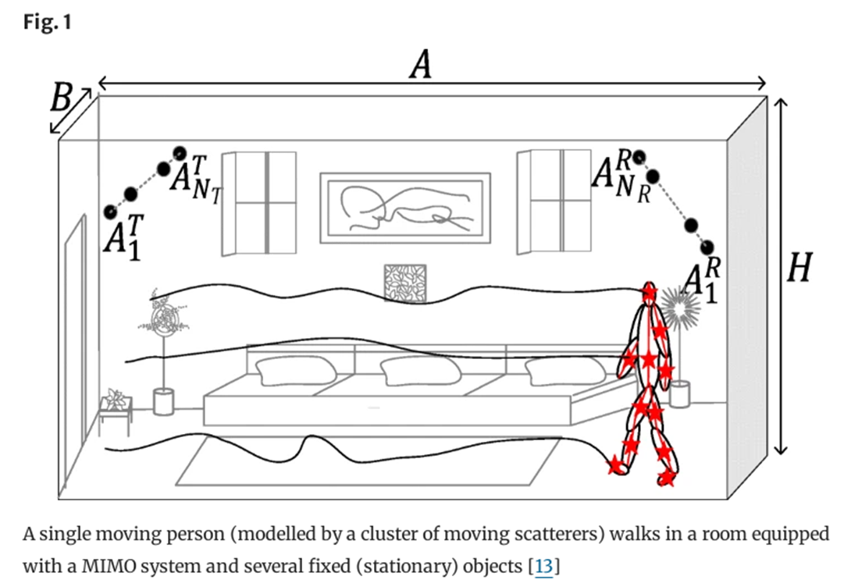
HUMAN ACTIVITY RECOGNITION SYSTEMS: HOW THEY TRACK YOUR EVERY MOVE WHILE IN YOUR HOME USING “MARKERS” SURVEILLANCE AND RADIO FREQUENCY SIGNAL PROCESSING. Abstract
Extensive research showed that the physiological response of human tissue to exposure to low-frequency electromagnetic fields is the induction of an electric current in the body segments. As a result, each segment of the human body behaves as a relay, which retransmits the radio-frequency (RF) signal. To investigate the impact of this phenomenon on the Doppler characteristics of the received RF signal, we introduce a new three-dimensional (3D) non-stationary channel model to describe the propagation phenomenon taking place in an indoor environment. Here, the indoor space is equipped with a multiple-input multiple-output (MIMO) system. A single person is moving in the indoor space and is modelled by a cluster of synchronized moving point scatterers, which behave as relays…
From “A non-stationary relay based 3D MIMO channel model with time-vairant path gains for human activity recognition in indoor environments”
WWW.FTWPROJECT.COM

Slide 14
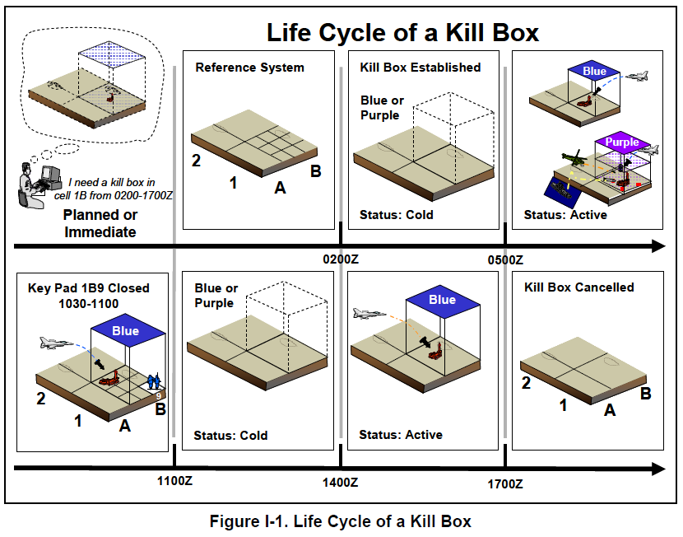
C40 KILL BOX CITIES AND REMOTE MONITORING
A Kill Box is a military strategy or procedure used in warfare where a three dimensional area is set up to enable timely coordination control and facilitate rapid attacks. Effectively, they are using the MBAN and WBAN to turn your home into a Kill box. The network is connected to an autonomous weapon system where electronic warfare of various kinds can be carried out on civilians. For the ultimate control and extinction of the population.
The C40 network is a set of major cities around the world that have committed to fighting “climate change.” -15 minute cities -You’ll own nothing and you’ll be happy.
WWW.FTWPROJECT.COM

Slide 15
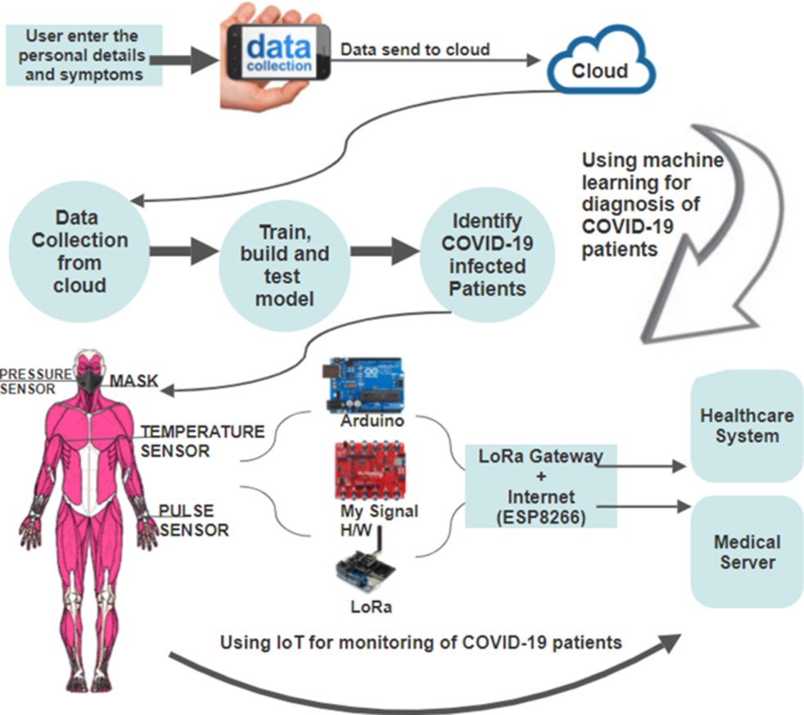
USING THE INTERNET OF THINGS TO MONITOR YOU AFTER COVID
“To prevent coronavirus disease 2019 (COVID-19) from spreading, the regular identification and monitoring of infected patients are needed. In this regard, wireless body area networks (WBANs) can be used in conjunction with machine learning and the Internet of Things (IoT) to identify and monitor the human body for health-related information, which in turn can aid in the early diagnosis of diseases. This paper proposes a novel coronavirus-body area network (CoV-BAN) model based on IoT technology as a real-time health monitoring system… In addition, power consumption is reduced when LoRa technology is used as a relay node.” Just look at what is going on in this image. Identifying Covid patients, masks, sensors, Arduinos, connecting to the internet, reporting to the hospital’s medical servers. LoRa is Low power networking protocols designed to wirelessly connect your body to the internet.
From: An Intelligent and Energy-Efficient Wireless Body Area Network to Control Coronavirus Outbreak
WWW.FTWPROJECT.COM

Slide 16
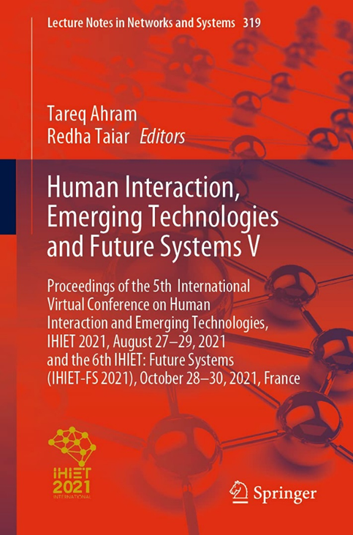
EMERGING TECHNOLOGIES AND AI PRECISION HEALTH CARE
Healthcare system sustainability by application of advanced technologies in telemedicine and e-health. medical data collection processing Architecture to assist in the collection of data belonging to patients and will be stored and processed by machine learning algo rhythms. It has 5 layers and we will explain them below. Device layer, patient data is collected and medical devices that can be found in a hospital capture that data, these devices have an interface for data capture and must have another interface to send data over the network. Doctors or health professionals use the devices to capture the data. Modern health is unthinkable without the use of advance technical means. These include communication technologies, specialized computer systems, artificial intelligence and others.
How is AI used in Precision Medicine?
Precision medicine methods identify phenotypes of patients with less‐common responses to treatment or unique healthcare needs. AI leverages sophisticated computation and inference to generate insights, enables the system to reason and learn, and empowers clinician decision making through augmented intelligence.
WWW.FTWPROJECT.COM

Slide 17
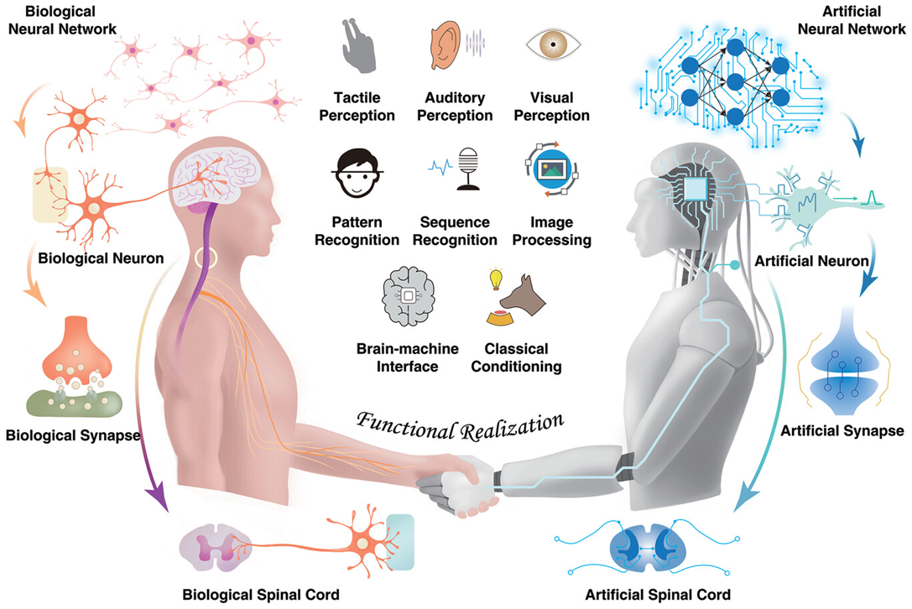
DIGITAL TWINS IN HEALTH CARE
A digital twin is a virtual model of a physical entity, with dynamic, bi-directional links between the physical entity and its corresponding twin in the digital domain. Digital twins are increasingly used today in different industry sectors. Applied to medicine and public health, digital twin technology can drive a much-needed radical transformation of traditional electronic health/medical records (focusing on individuals) and their aggregates (covering populations) to make them ready for a new era of precision (and accuracy) medicine and public health. Digital twins enable learning and discovering new knowledge, new hypothesis generation and testing, and in silico experiments and comparisons. They are poised to play a key role in formulating highly personalized treatments and interventions in the future.
From: Digital Twins: From Personalised Medicine to Precision Public Health and Memristor-Based Intelligent Human-Like Neural Computing
Note the Aleister Crowly Hexagram which is a symbol equivalent to the pentagram or pentacle. The two symbols together represent the interweaving of the planetary and elemental forces. Merging man and machine-Transhumanism
WWW.FTWPROJECT.COM

Slide 18
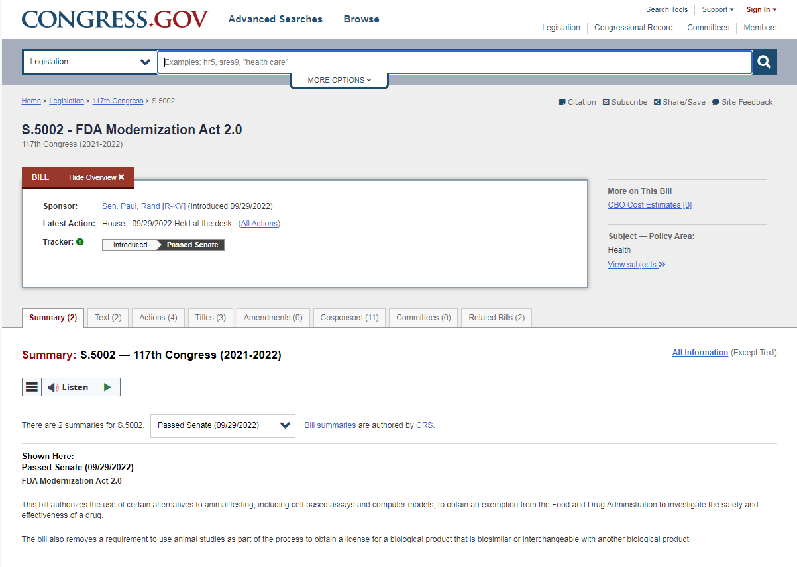
"You are now the Guinea Pig" MODERNIZATION ACT
The FDA has already changed over the system. There is no more animal testing and there is no more testing of any kind that is required to be done before they employ the commercial availability of any new drug. The congressional bill has language in it that also allows for “cell-based assays and computer models” to be used as testing instead of animal testing of new drugs. This is speaking about using your digi twin to test new drugs.
An understanding of this can lead one to conclude that: They release a new product out onto the market, get a whole bunch of people to take it not knowing that it hasn’t been tested (the people are the test) and then they use the WBAN to pull data from peoples biosensors to see what kind of results they are getting with people.
WWW.FTWPROJECT.COM

Slide 19
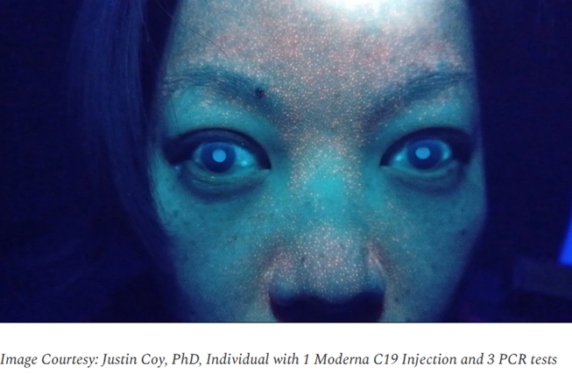
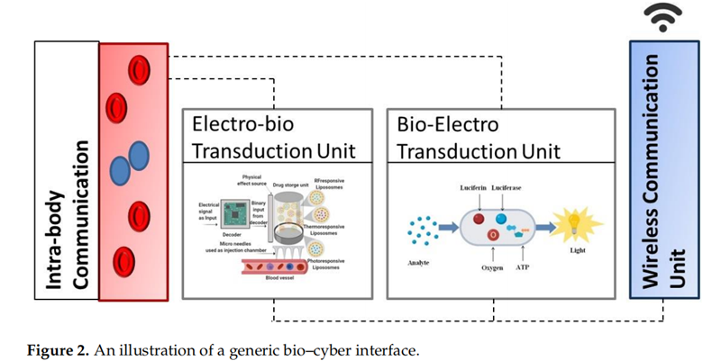
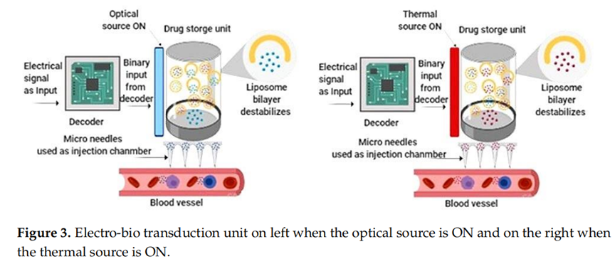
Bioluminescence reaction - a chemical reaction produces an electronically excited substance that emits light.
- Is used for tagging, identification of objects or biomarkers in living systems.
- Used to monitor the change of metabolic states of living systems under study
- In the Internet of Bio-nanoThings, is currently being research as a method to signal the presence concentration of information molecules in the ‘nano-network’
WWW.FTWPROJECT.COM

Slide 20
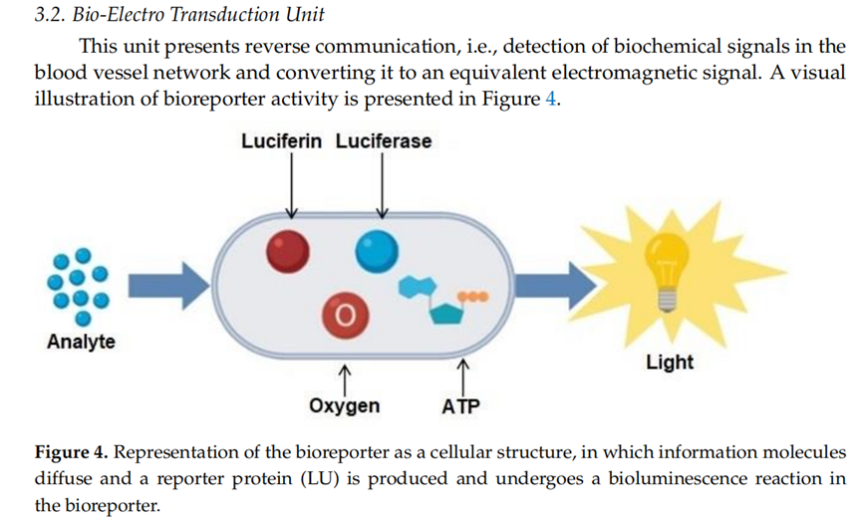
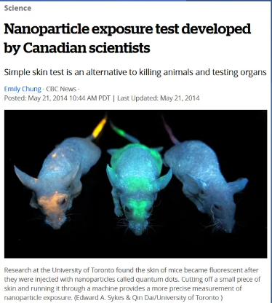
Bioreporters use bioluminescence as a signal. Alternatively, heat signature can be used. Novel AI algorithm models with the ability to process massive datasets are needed for 24/7 real-time monitoring and simulation.
WWW.FTWPROJECT.COM

Slide 21
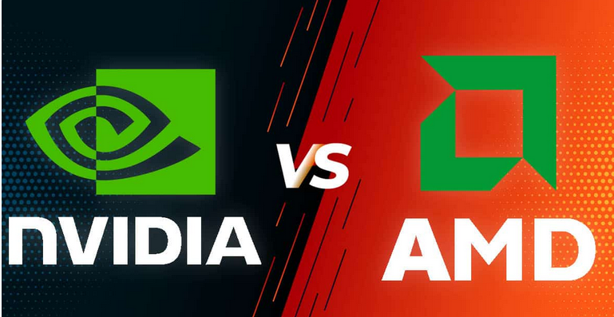
NVIDIA AND AMD TO RUN THE TECH
A graphics processing unit (GPU) is a specialized circuit used to accelerate the computer graphics power on the personal computers, mobile phones, gaming consoles and industrial server farms
- Within the last few years GPUs are found to be useful for non-graphic calculations due to their ability to do work in a parallel fashion. This inherent property lends the hardware to include training of neural networks and cryptocurrency mining.
- The GPU market is a multi-trillion dollar industry due to the promise of greatly accelerating innovation using accelerated AI, neural driven hardware. (Presently dominated by Nvidia and AMD)
- New companies are forming however to challenge current GPU paradigms with new cost (and energy) efficient chip-sets and are set to disrupt the industry in the coming years.
- The battle is for new kinds of memory and processor designs and more if it. in small energy efficient packages.
- Main industry direction is real-world simulation of processes used by industry, bio-n Tech, and governments that can afford the server data-centers necessary to process real-world matrix-based datasets.
WWW.FTWPROJECT.COM

Slide 22
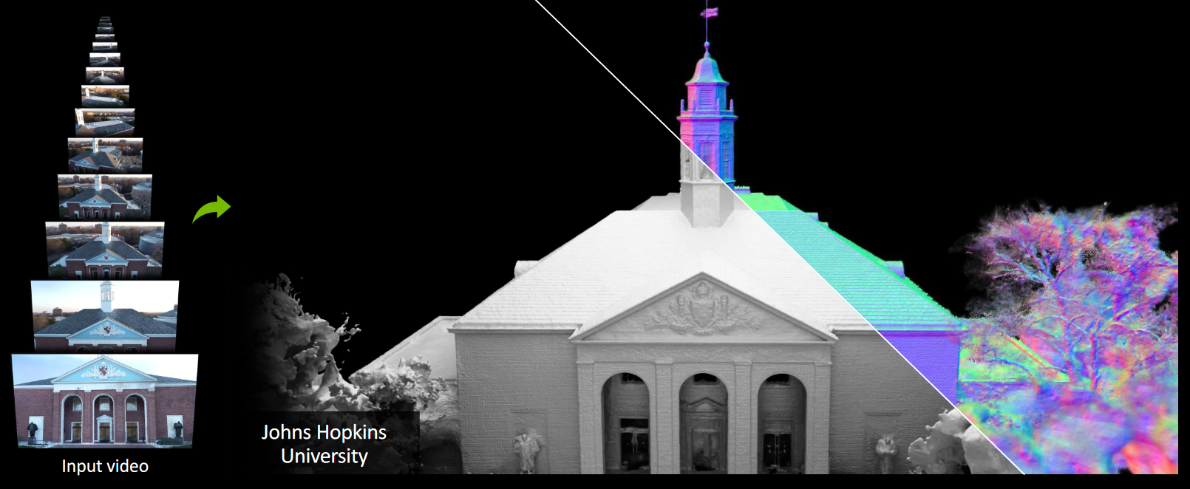
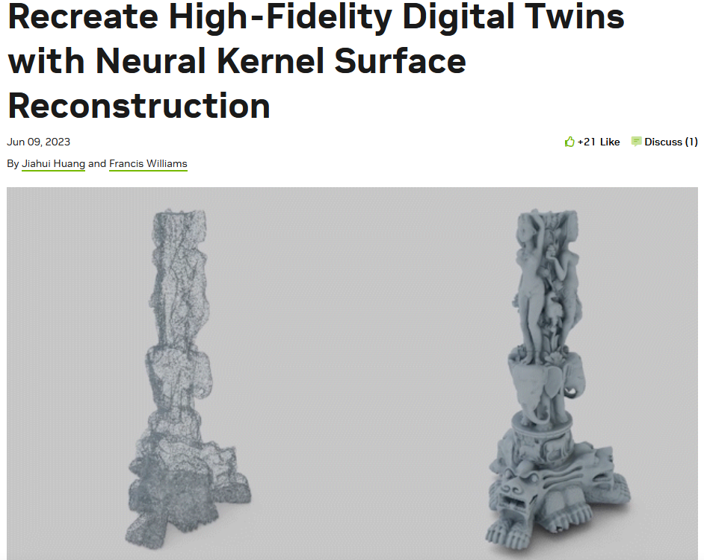
NVIDIA AND AMD TO RUN THE TECH
- Neuralangelo is a framework for high-fidelity 3D surface reconstruction from RGB images using neural volume rendering. 3D meshes and rendering is extracted from 2D images samples! Joint project included NVIDIA Research and John Hopkins University.
WWW.FTWPROJECT.COM

Slide 23
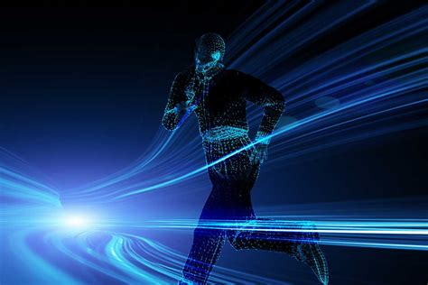
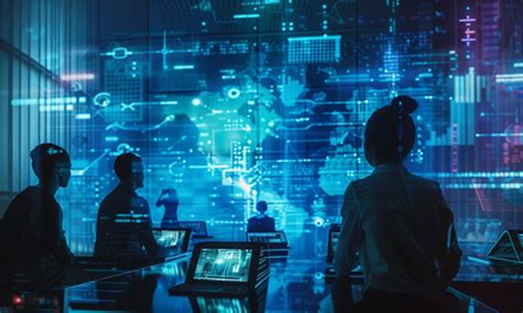
Since NAFTA there has been various agreements between the countries of North America to allow the free flow of resources including laborers between each others countries.
-Emergent Technology Industry New Jobs, New graduates from abroad
-Coming to America to implement Emerging Tech Jobs for lower salaries
There is a monetary incentive for doing this. Corporations are doing this for the globalist Agenda.
WWW.FTWPROJECT.COM

Slide 24
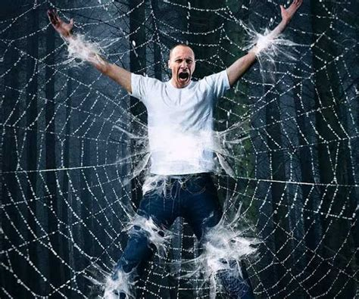
WBAN- The Evil Web to Ensnare Humanity
In the Book of Job Bildad describes the dangerous path of the wicked: “His vigorous stride is shortened, And his own scheme brings him down. “For he is thrown into the net by his own feet, And he steps on the webbing.
“A snare seizes him by the heel, And a trap snaps shut on him.
A noose for him is hidden in the ground, And a trap for him on the path.
All around terrors frighten him, And harry him at every step.
“His strength is famished, And calamity is ready at his side.
Such is the destiny of all who forget God; so the hope of the godless will perish. His confidence is fragile; his security is in a spider’s web. He leans on his web, but it gives way; he holds fast, but it does not endure.… Job 8:14
When I asked God to show me in the Bible a scripture that would spiritually symbolize what the WBAN is, he showed me webs in the book of Job. They have saturated everything with their web of technology.
WWW.FTWPROJECT.COM

Slide 25
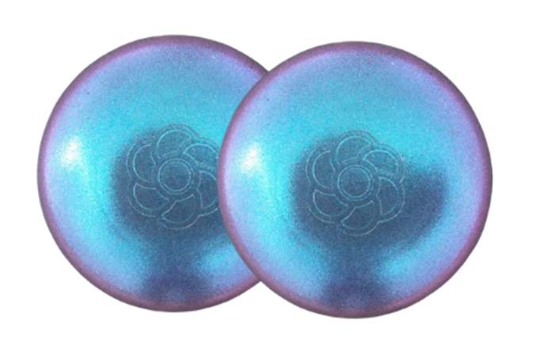
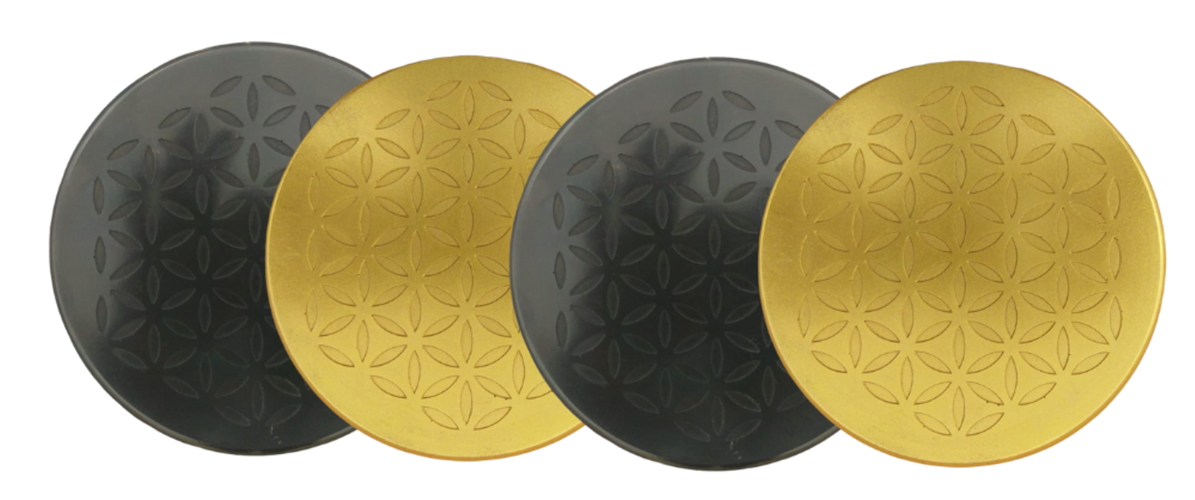
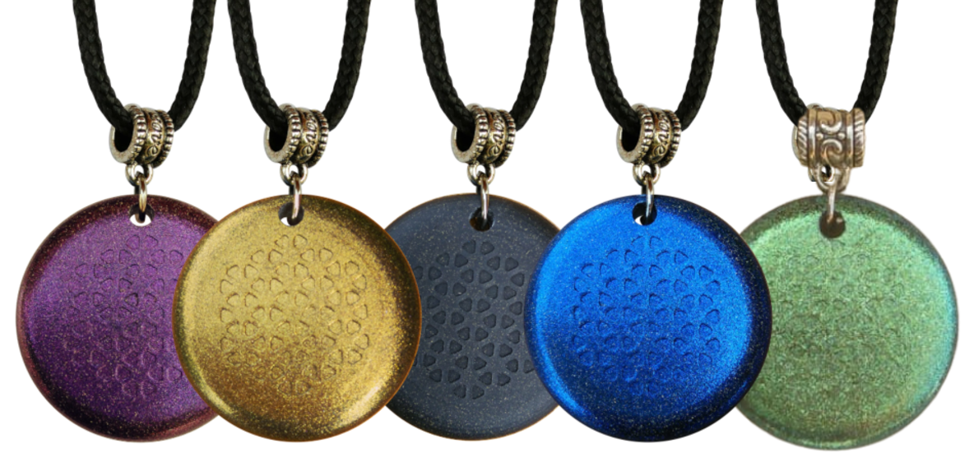
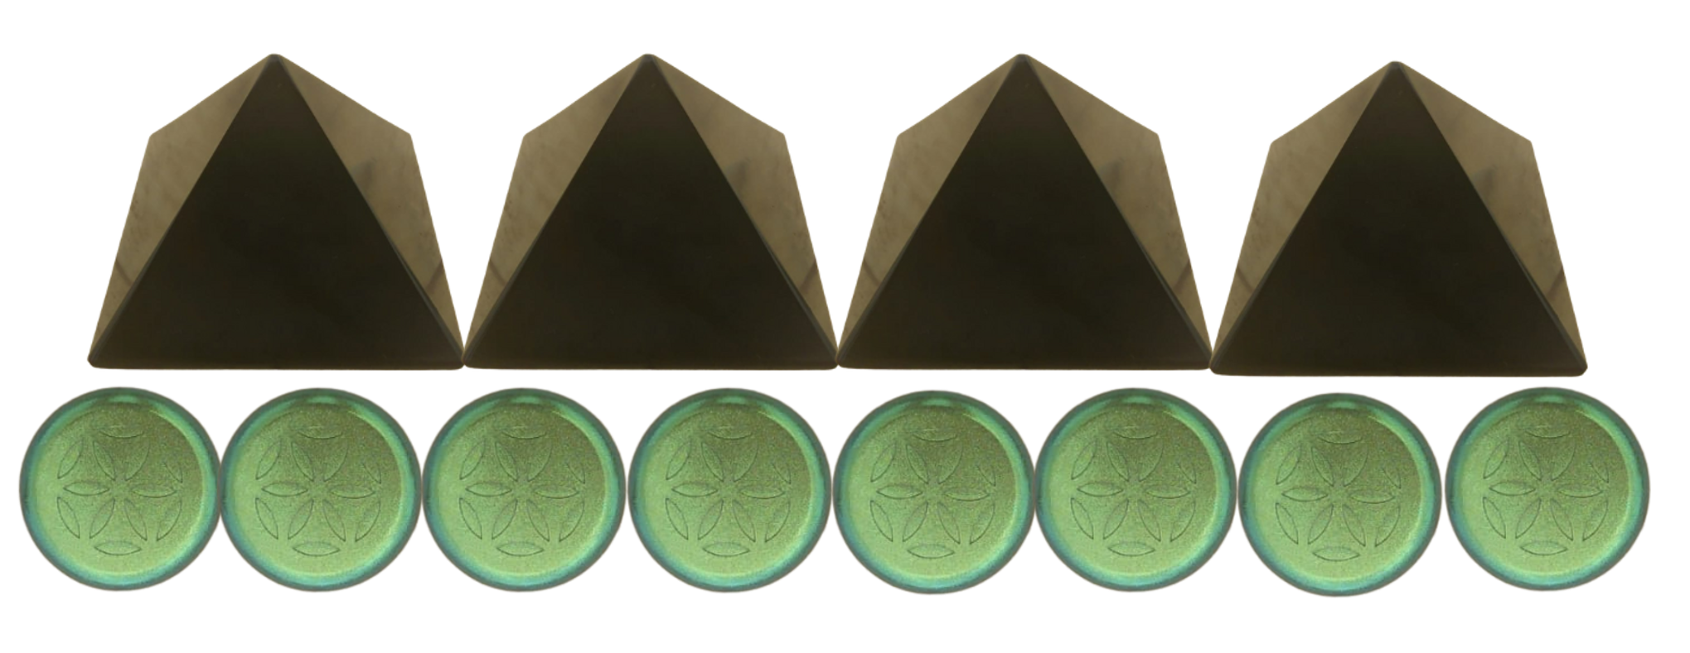
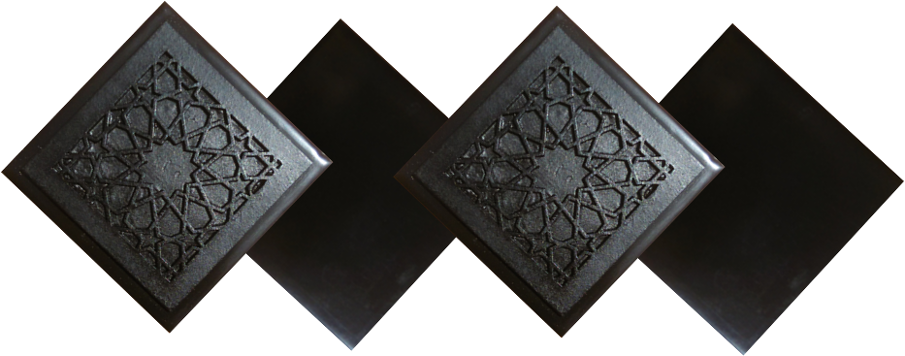
ABOUT OUR EMF PROTECTION PRODUCTS
HELP SUPPORT SGT REPORT BY SHOPPING FROM THIS LINK: https://www.ftwproject.com/ref/6/
SLEEPING PODS For a good nights sleep
CHARGE PLATES for use around the home, to preserve food and more
“We just can't believe our eyes! We have placed the garden pucks from our first order around our property, and the plants/trees with the pucks are BLOOMING within days! This is happening with every single place the pucks have been rested. Just incredible.” -Australia
PHONE SHIELDS to put on your cell phone, laptop and routers
PENDANTS for personal emf protection on your body
PYRAMIDS and garden sets for gridding your home / property / garden for emf protection on a large scale
SCIENTIFIC STUDIES AND DOCUMENTATION DESCRIBING HOW OUR PRODUCTS WORK AVAILABLE ON OUR WEBSITE.
TILES for incorporating emf protection into construction projects
WWW.FTWPROJECT.COM

Slide 26
