Slide 1
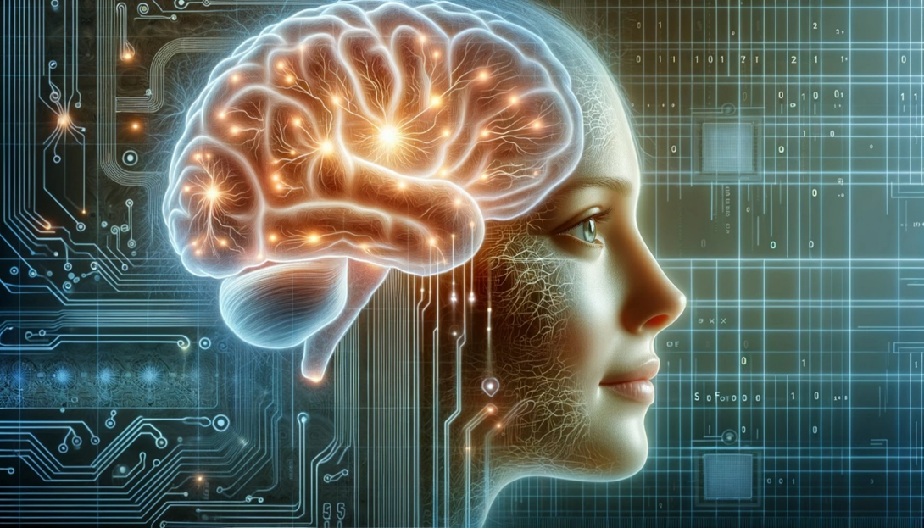
MK ULTRA FOR THE MASSES

Slide 2
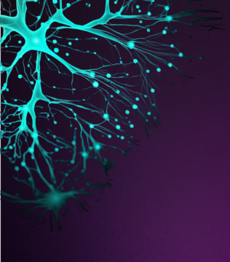
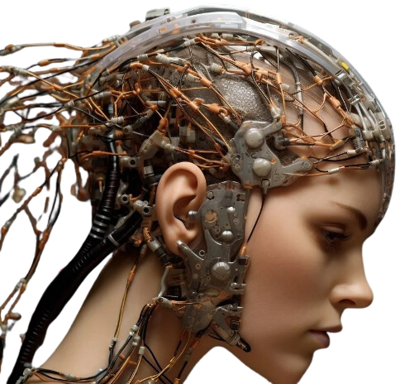
SUMMARY
Emerging Technologies is Transhumanism Bioluminescent Interface Why are People Faces Glowing? Neuroscience is MK Ultra for the Masses Brain Initiative and Graphene Flagship Brain Interface Technology Mind Reading Technology Via Neural Interfaces Internet of Behaviors Digital Twins and Memristors Digital Twins in HealthCare Wireless Drugging and the Digital Nervous System c40 KillBox Cities and Remote Monitoring 5th Generation Warfare Cognitive Warfare NATO and Brain Interfaces Neural Lobotomy: DARPA N3’s NVIDIA and AMD to run the Tech Merging Man With Machine Through our DNA WBAN The Evil Web to Ensnare Humanity Protect Yourself from Emerging Technology
All explanations are taken from white papers / government websites / scientific articles too many to list here on this slide. Please see extensive notes on blog post for links to articles.
WWW.FTWPROJECT.COM

Slide 3
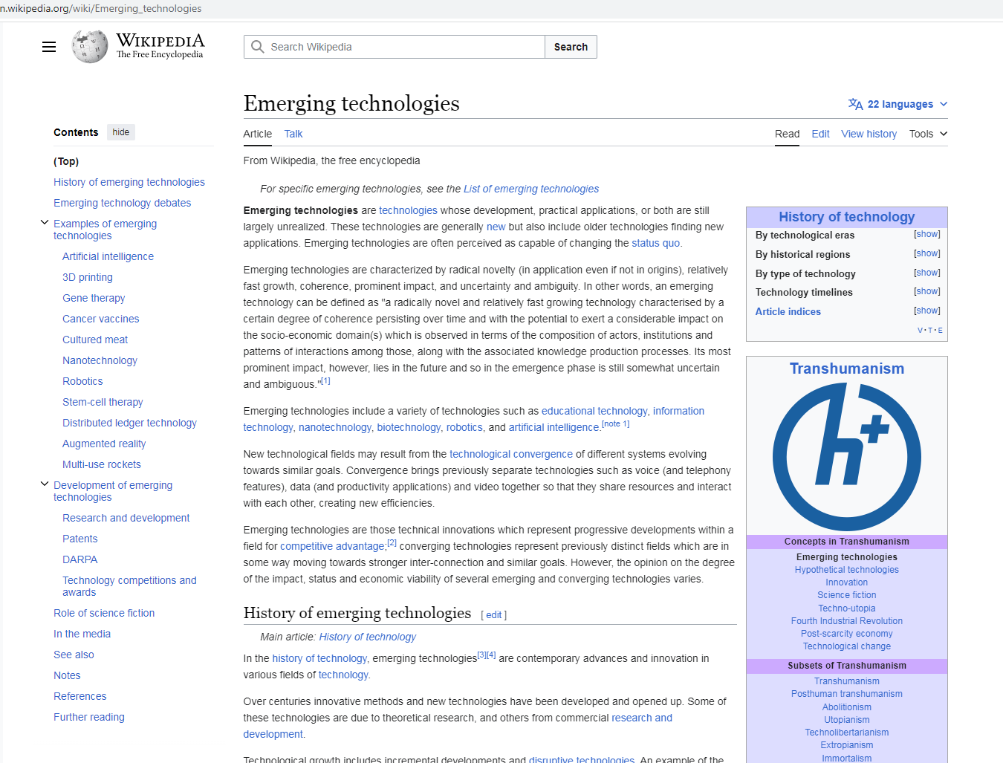
EMERGING TECHNOLOGIES IS TRANSHUMANISM
LOOK HOW THE CLASSIFY EXAMPLES OF TRANSHUMANISM
Artificial Intelligence Quantum Computing Machine Learning Gene Therapy Cancer Vaccines Nanotechnology Cultured Meat Robotics Stem Cell Therapy Blockchain Augmented Reality DARPA Neuroscience Brain Computer Interface Memristors Metamaterials Carbon Nanotubes Quantum Dot Electronic Medical Records
THEY BOAST ABOUT THIS…THEY ARE SO PROUD!!!
WWW.FTWPROJECT.COM

Slide 4
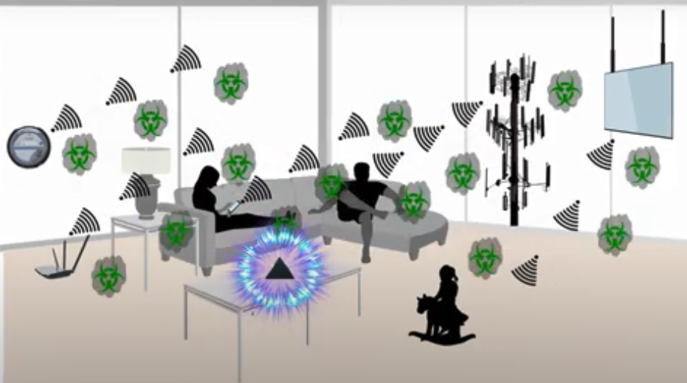
PROTECT YOURSELF FROM EMERGING TECHNOLOGIES BY PROTECTING YOURSELF FROM EMF
We make our products by hand mixing, shungite, iron oxide, steel, brass, and quartz crystal (powder form) into an epoxy resin. When the epoxy cures into a solid plastic state it puts pressure on the surface area of the ingredients. This causes something known as the piezoelectric effect, which emits a harmonizing field generated by the specific properties of the ingredients. It is this field that transforms the harmful energy from EMF’s into healthy life preserving energy. Place our products all around yourself and your environment for the best effect.
BENEFITS OF OUR EMF PROTECTION PRODUCTS
-Better sleep -Stress relief -Pain relief -Healthy home environment -Better seed germination and plant growth -Preserves fresh food and extends shelf life -Maintain Healthy Blood
Full length explanatory videos on our Website! FTWProject.com

Slide 5
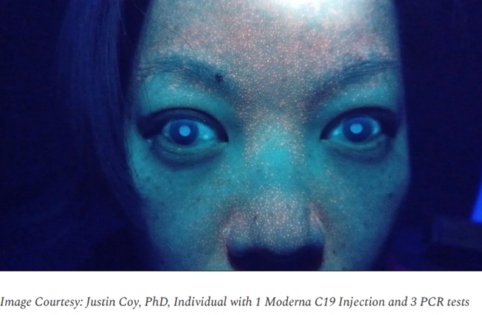
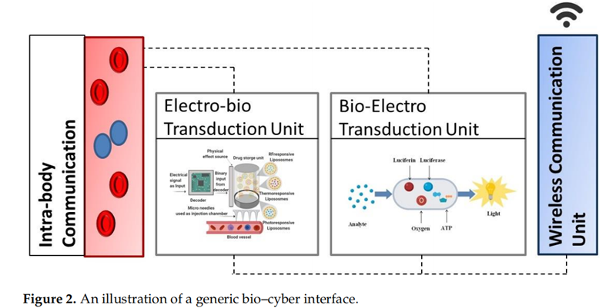
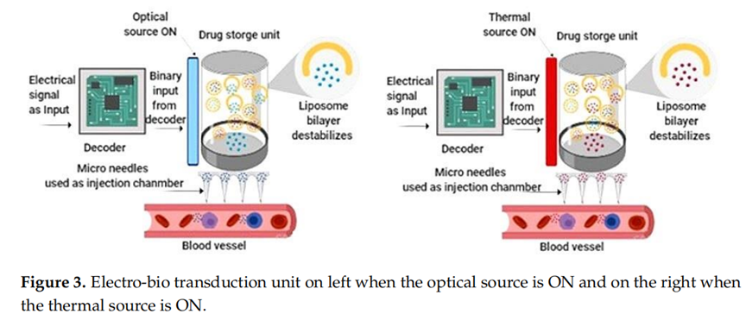
Bioluminescence reaction - a chemical reaction produces an electronically excited substance that emits light.
- Is used for tagging, identification of objects or biomarkers in living systems.
- Used to monitor the change of metabolic states of living systems under study
- In the Internet of Bio-nanoThings, is currently being research as a method to signal the presence concentration of information molecules in the ‘nano-network’
WWW.FTWPROJECT.COM

Slide 6
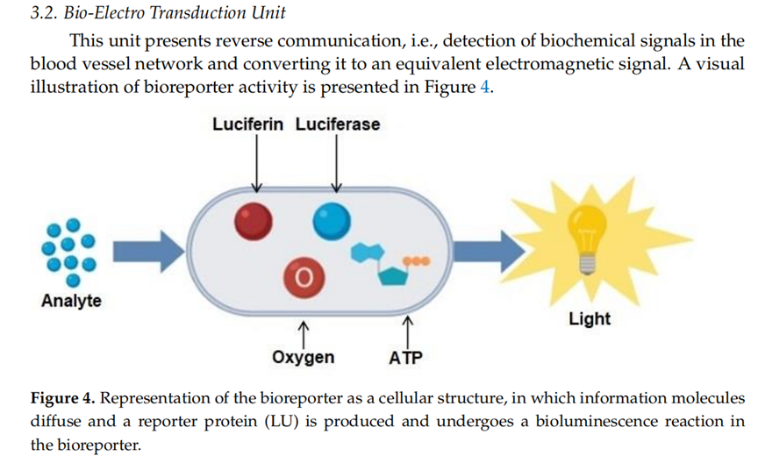
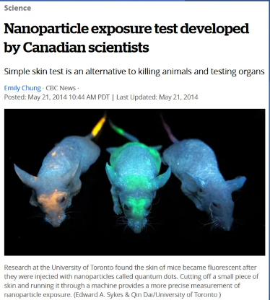
Bioreporters use bioluminescence as a signal. Alternatively, heat signature can be used. Novel AI algorithm models with the ability to process massive datasets are needed for 24/7 real-time monitoring and simulation.
WWW.FTWPROJECT.COM

Slide 7
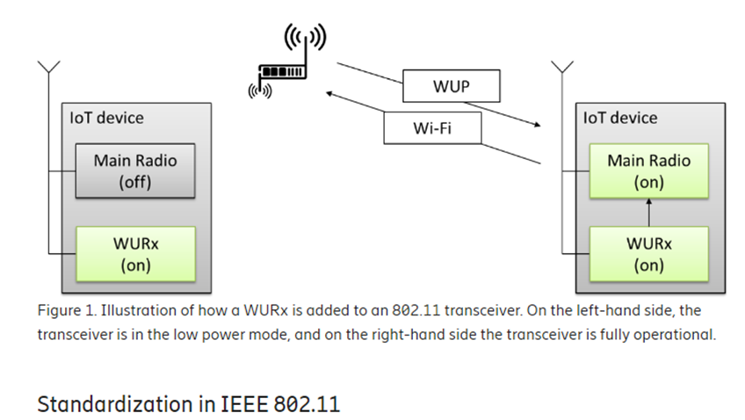
BIOSENSORS USE WAKE UP RADIO TECHNOLOGY
Wake Up Radio Imagine a receiver in a very low power mode that would, in a magical way, wake up just in time for the data to be received. This is what they have designed the biosensors that are inside of our bodies to do. From: Wake-Up Radio – A key component of IoT? https://www.ericsson.com/en/blog/2017/12/wake-up-radio--a-key-component-of-iot
WWW.FTWPROJECT.COM

Slide 8
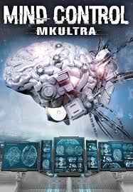
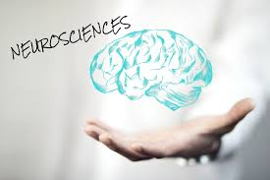
NEUROSCIENCE IS MKULTRA FOR THE MASSES
We don’t call it MK Ultra, we call it Neuroscience, we call it what DARPA calls it, we call it what Harvard calls it, we call it what MIT calls it. MK Ultra is not some historical event that happened once in the 60s and then went away. It has evolved into the emerging technologies industry and is fully deployed on the population under the auspices of “Neurosciences”.
Project MKUltra was an illegal human experiments program designed and undertaken by the U.S. Central Intelligence Agency (CIA) to develop procedures and identify drugs that could be used during interrogations to weaken people and force confessions through brainwashing and psychological torture. It began in 1953 and was halted in 1973. MKUltra used numerous methods to manipulate its subjects' mental states and brain functions, such as the covert administration of high doses of psychoactive drugs (especially LSD) and other chemicals without the subjects' consent, electroshocks, hypnosis, sensory deprivation, isolation, verbal and sexual abuse, and other forms of torture.
Neuroscience is the scientific study of the nervous system (the brain, spinal cord, and peripheral nervous system), its functions and disorders. It is a multidisciplinary science that combines physiology, anatomy, molecular biology, developmental biology, cytology, psychology, physics, computer science, chemistry, medicine, statistics, and mathematical modeling to understand the fundamental and emergent properties of neurons, glia and neural circuits. The techniques used by neuroscientists have expanded enormously, from molecular and cellular studies of individual neurons to imaging of sensory, motor and cognitive tasks in the brain.
WWW.FTWPROJECT.COM

Slide 9
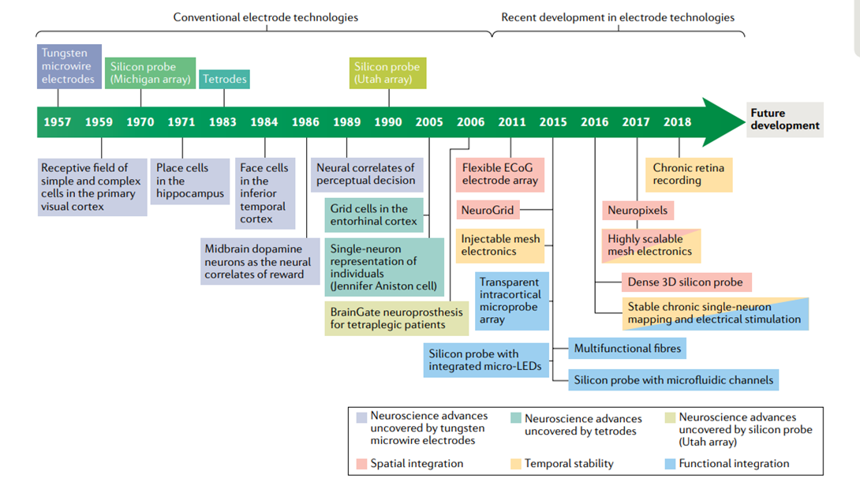
NEUROSCIENCE TECHNOLOGY DEVELOPMENT TIMELINE
From: Novel electrode technologies for neural recordings 2019
WWW.FTWPROJECT.COM

Slide 10
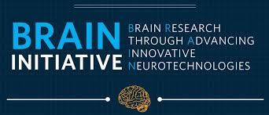
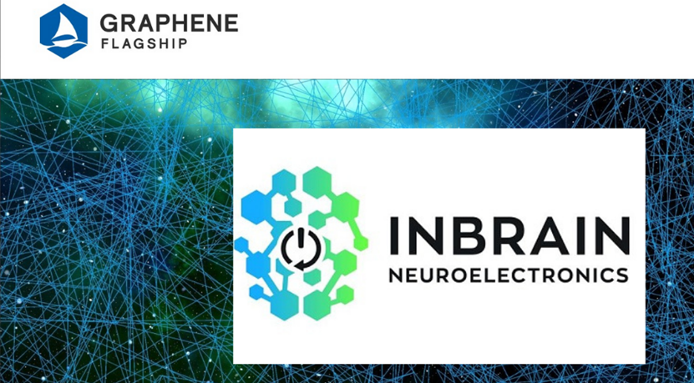
BRAIN INITIATIVE AND GRAPHENE FLAGSHIP BOTH LAUNCHED IN 2013
The Brain Initiative: (Launched in 2013 Barack Obama) The Brain Research Through Advancing Innovative Neurotechnologies® Initiative, or The BRAIN Initiative®, is a partnership between Federal and non-Federal partners with a common goal of accelerating the development of innovative neurotechnologies. Through the application and dissemination of these scientific advancements, researchers will be able to produce a revolutionary new dynamic picture of the brain that, for the first time, shows how individual cells and complex neural circuits interact in both time and space. The endeavor brings together neuroscientists with nanotechnology specialists and materials engineers to solve issues such as applying electrical stimulus to very small groups of neurons, which may make it possible to treat brain conditions with vastly improved precision. https://braininitiative.nih.gov/about/overview
Graphene Flagship Launched in 2013 by the EU It is one of Europe's biggest ever research initiatives, gathering more than 170 academic and industrial partners from 22 countries, all exploring different aspects of graphene and related materials. Graphene Flagship spin-off INBRAIN Neuroelectronics develops intelligent graphene-based neural implants for personalised therapies in brain disorders.
INBRAIN Neuroelectronics is a spin-off company of Graphene Flagship partners the Catalan Institute of Nanoscience and Nanotechnology (ICN2) and ICREA, Spain. It was established in 2019, at the intersection between MedTech, DeepTech and Digital Health, with a mission to decode brain signals to devise medical solutions for patients with epilepsy, Parkinson’s disease and other neurological disorders. The company designs small implantable brain intelligent systems, with the ability to interpret brain signals with unprecedented high fidelity, producing a therapeutic response adapted to the clinical condition of each specific patient.
WWW.FTWPROJECT.COM

Slide 11
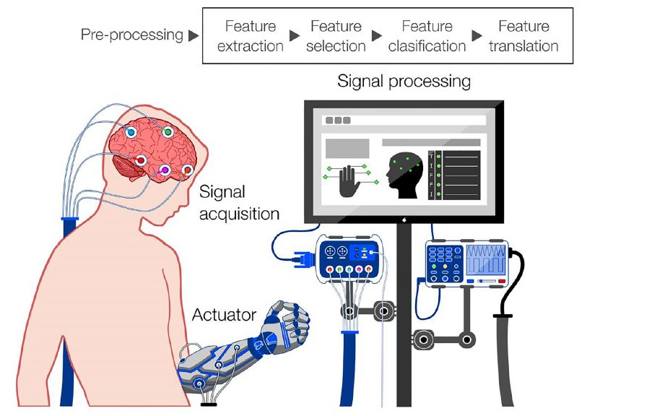
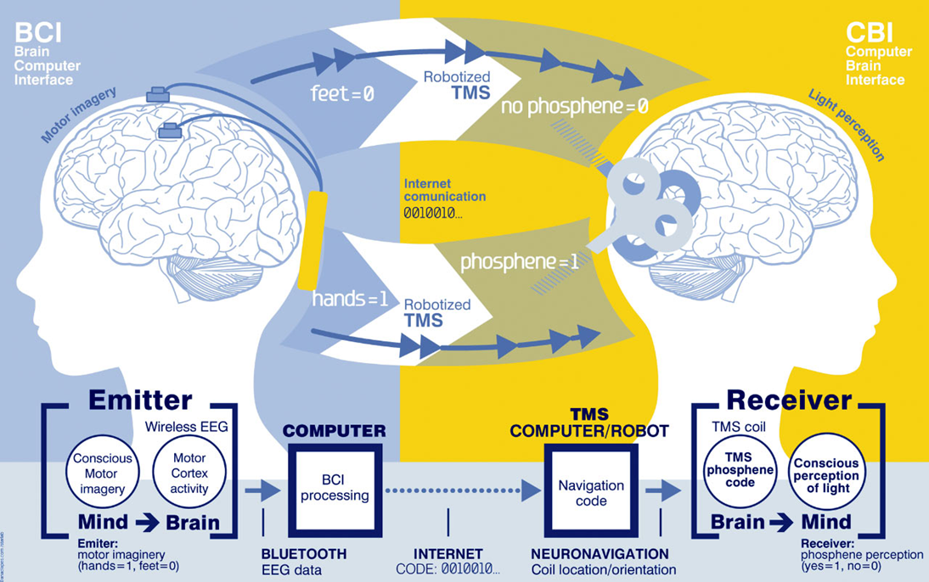
BRAIN INTERFACE TECHNOLOGY
BRAIN COMPUTER INTERFACE (BCI)
BRAIN TO BRAIN INTERFACE (B2B)
A brain–computer interface (BCI), sometimes called a brain–machine interface (BMI) or smartbrain, is a direct communication pathway between the brain's electrical activity and an external device, most commonly a computer or robotic limb. BCIs are often directed at researching, mapping, assisting, augmenting, or repairing human cognitive or sensory-motor functions. They are often conceptualized as a human–machine interface that skips the intermediary component of the physical movement of body parts, although they also raise the possibility of the erasure of the discreteness of brain and machine. Implementations of BCIs range from non-invasive (EEG, MEG, MRI) and partially invasive (ECoG and endovascular) to invasive (microelectrode array), based on how close electrodes get to brain tissue.
BrainNet: A Multi-Person Brain-to-Brain Interface for Direct Collaboration Between Brains 2019 “We present BrainNet which, to our knowledge, is the first multi-person non-invasive direct brain-to-brain interface for collaborative problem solving. The interface combines electroencephalography (EEG) to record brain signals and transcranial magnetic stimulation (TMS) to deliver information noninvasively to the brain. The interface allows three human subjects to collaborate and solve a task using direct brain-to-brain communication. Two of the three subjects are designated as “Senders” whose brain signals are decoded using real-time EEG data analysis. The decoding process extracts each Sender’s decision about whether to rotate a block in a Tetris-like game before it is dropped to fill a line. The Senders’ decisions are transmitted via the Internet to the brain of a third subject, the “Receiver,” who cannot see the game screen. The Senders’ decisions are delivered to the Receiver’s brain via magnetic stimulation of the occipital cortex.
WWW.FTWPROJECT.COM

Slide 12
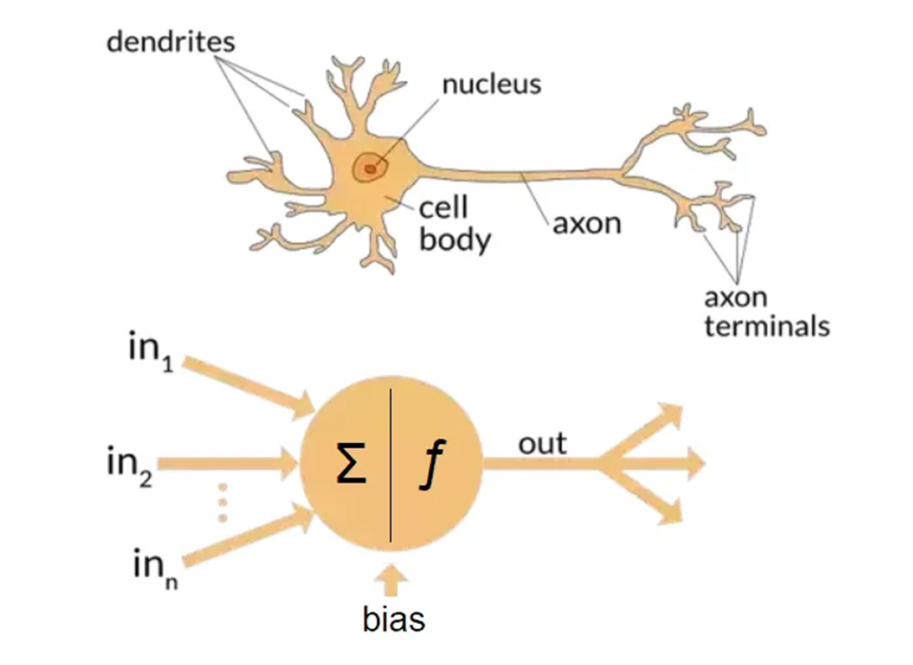
MIND READING TECHNOLOGY VIA NEURAL INTERFACES
From: The differences between Artificial and Biological Neural Networks The idea behind perceptrons (the predecessors to artificial neurons) is that it is possible to mimic certain parts of neurons, such as dendrites, cell bodies and axons using simplified mathematical models of what limited knowledge we have on their inner workings: signals can be received from dendrites, and sent down the axon once enough signals were received. This outgoing signal can then be used as another input for other neurons, repeating the process. Some signals are more important than others and can trigger some neurons to fire easier. Connections can become stronger or weaker, new connections can appear while others can cease to exist. We can mimic most of this process by coming up with a function that receives a list of weighted input signals and outputs some kind of signal if the sum of these weighted inputs reach a certain bias. Note that this simplified model does not mimic neither the creation nor the destruction of connections (dendrites or axons) between neurons, and ignores signal timing. However, this restricted model alone is powerful enough to work with simple classification tasks.
Biological Neuron and Artificial Neuron
Mind Reading Technology Via Neural Interfaces From: Neural Interfaces, The Game Changer Of Wireless Interaction
Arrival Of Neural Interfaces
Neural interfaces had already arrived and it offers the potential to support a wide range of activities in a wide range of settings. Mudra, for example, has created an Apple Watch band that allows users to interact with the device simply by moving their fingers — or thinking about moving their fingers. That means someone using the device can listen to music or make phone calls without having to stop what they’re doing…
Think of this technology as using your fingers, voice, or eyes to control a computer or play a game. It sounds like science fiction, but it’s becoming more real by the day thanks to a few companies developing technology that detects neural activity and converts those measurements into signals computers can understand.
NextMind’s Journey In Neural Interfaces
One of those companies, NextMind, has been shipping its version of the mind-reading technology to developers for over a year. First unveiled at CES in Las Vegas, the company’s neural interface is a black circle that can read brain waves when strapped to the back of a user’s head.
WWW.FTWPROJECT.COM

Slide 13
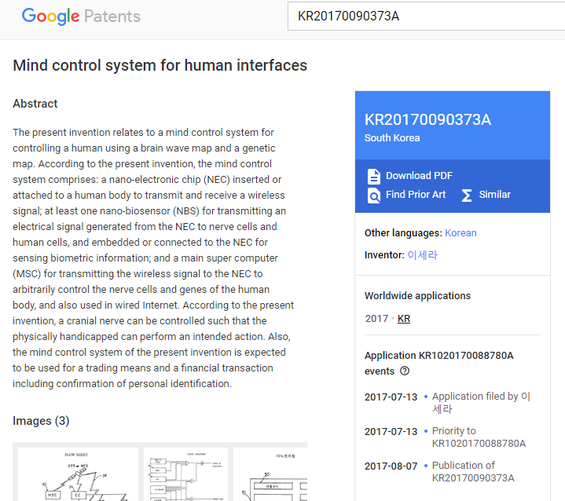
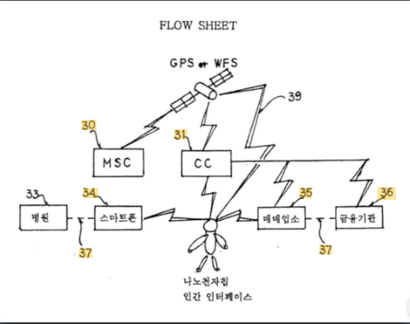
PATENT FOR MIND CONTROL DEVICE
Mind control system for human interfaces Abstract
The present invention relates to a mind control system for controlling a human using a brain wave map and a genetic map. According to the present invention, the mind control system comprises: a nano-electronic chip (NEC) inserted or attached to a human body to transmit and receive a wireless signal; at least one nano-biosensor (NBS) for transmitting an electrical signal generated from the NEC to nerve cells and human cells, and embedded or connected to the NEC for sensing biometric information; and a main super computer (MSC) for transmitting the wireless signal to the NEC to arbitrarily control the nerve cells and genes of the human body, and also used in wired Internet. According to the present invention, a cranial nerve can be controlled such that the physically handicapped can perform an intended action. Also, the mind control system of the present invention is expected to be used for a trading means and a financial transaction including confirmation of personal identification.
WWW.FTWPROJECT.COM

Slide 14
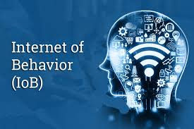
INTERNET OF BEHAVIORS
The Internet Of Behavior Is The Next Trend To Watch- Forbes IoB is a system that uses sensors and other technologies to monitor, analyze and predict human behavior. It combines artificial intelligence (AI), machine learning (ML), big data analytics, cloud computing, Internet of Things (IoT) devices, mobile applications, wearable devices, augmented reality (AR), virtual reality (VR), robotics automation systems and more into one comprehensive platform for collecting behavioral data from individuals or groups. The collected data can then be used for various purposes such as predictive analytics or automated decision-making processes. IoB is a revolutionary technology that enables the monitoring, control and modeling of human behavior. It combines the power of the technologies mentioned above to provide an unprecedented level of insight into how people interact with their environment. IoB has been used in various industries such as healthcare, retail, finance, education, transportation and more.
IoB works by connecting devices to each other through networks or protocols like Bluetooth Low Energy (BLE). This connection allows for real-time data exchange between different systems, which can then be analyzed using AI algorithms. In order for IoB systems to work effectively, they must utilize several technologies, including sensors that detect changes in environmental conditions, communication protocols such as Wi-Fi or BLE, edge computing capabilities that allow for local processing, ML algorithms that analyze collected data, databases for storing information and APIs that facilitate integration with other applications or services. All these components come together to create an intelligent system capable of understanding user behavior patterns over time so it can make predictions about future actions based on past behaviors.
By 2023, 40% of the population will be tracked digitally to influence behavior's. According to Gartner’s annual technology trend report, more than 3.5 billion people will be directly impacted by the Internet of Behavior's (IoB). IoB will be a prevalent reality pushing digital boundaries and challenging what it means to be a human in a digital world. -Gartner Top Strategic Predictions For 2020 And Beyond
WWW.FTWPROJECT.COM

Slide 15
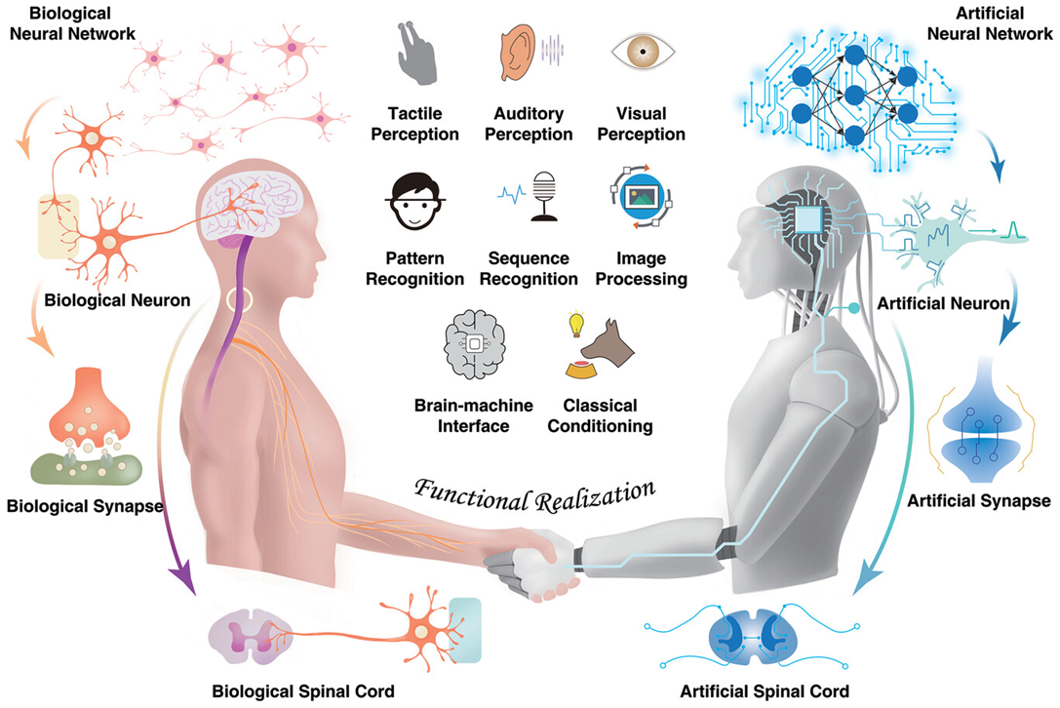
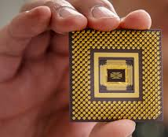
DIGITAL TWINS AND MEMRISTORS
A memristor is a non-linear two-terminal electrical component relating electric charge and magnetic flux linkage.
Memristor-Based Intelligent Human-Like Neural Computing https://onlinelibrary.wiley.com/doi/10.1002/aelm.202200877 Humanoid robots, intelligent machines resembling the human body in shape and functions, cannot only replace humans to complete services and dangerous tasks but also deepen the own understanding of the human body in the mimicking process… Memristors, featured with high similarity to the biological elements, play an important role in mimicking the biological nervous system. The memristor-based nervous system allows humanoid robots to obtain high energy efficiency and bionic sensing properties, which are similar properties to the biological nervous system.
Note the Aleister Crowly Hexagram which is a symbol equivalent to the pentagram or pentacle. The two symbols together represent the interweaving of the planetary and elemental forces. Merging man and machine-Transhumanism
WWW.FTWPROJECT.COM

Slide 16
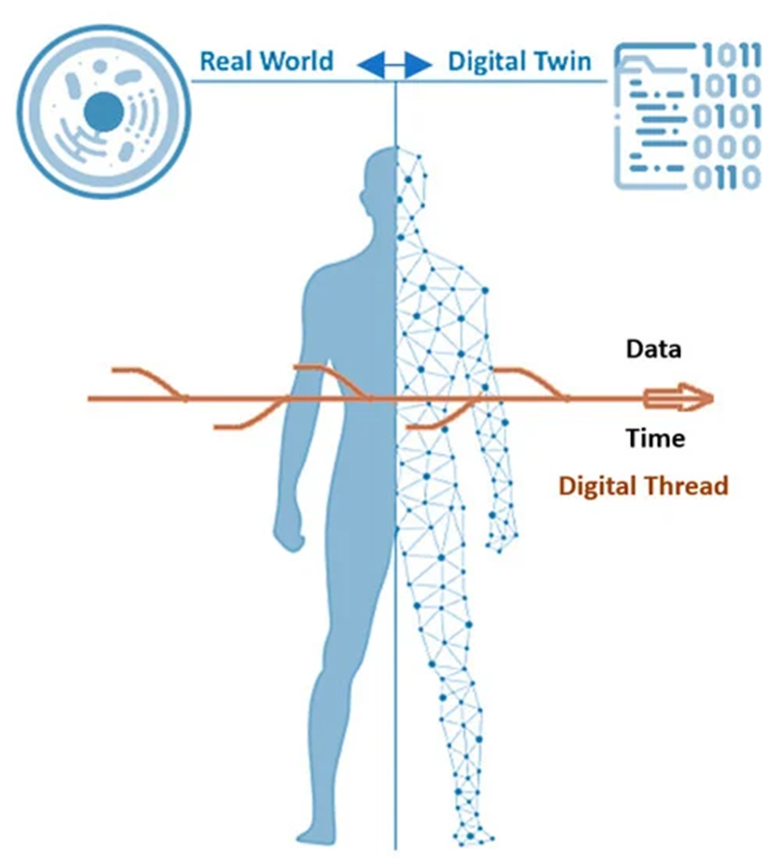
DIGITAL TWINS IN HEALTH CARE
Digital Twins: From Personalized Medicine to Precision Public Health
A digital twin is a virtual model of a physical entity, with dynamic, bi-directional links between the physical entity and its corresponding twin in the digital domain. Digital twins are increasingly used today in different industry sectors.
The FDA Modernization Act passed in 2022 has language in it that also allows for “cell-based assays and computer models” to be used as testing instead of animal testing of new drugs. This is speaking about using your digi twin to test new drugs. This bill allows an applicant for market approval for a new drug to use methods other than animal testing to establish the drug's safety and effectiveness. Under this bill, these alternative methods may include cell-based assays, organ chips and microphysiological systems, sophisticated computer modeling, and other human biology-based test methods.
Applied to medicine and public health, digital twin technology can drive a much-needed radical transformation of traditional electronic health/medical records (focusing on individuals) and their aggregates (covering populations) to make them ready for a new era of precision (and accuracy) medicine and public health. Digital twins enable learning and discovering new knowledge, new hypothesis generation and testing, and in silico experiments and comparisons. They are poised to play a key role in formulating highly personalized treatments and interventions in the future.
WWW.FTWPROJECT.COM

Slide 17
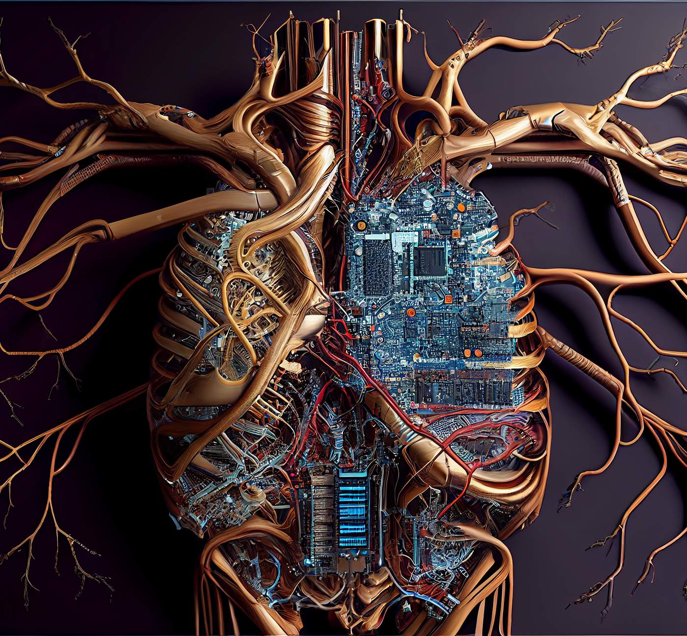
WIRELESS DRUGGING AND THE DIGITAL NERVOUS SYSTEM
DIGITAL DRUG DELIVERY USING AI DECISION MAKING
The digital nervous system (DNS), a smart healthcare body-area network (BAN). Separate nodes on the human body work in unison to sense and communicate health parameters and actuate medical treatments. Sensor nodes (e.g., breathing/sweat, pulse, motion) convert physiological information into digital signals which are wirelessly relayed to a central decision-making base unit, and actuator nodes, exemplified by an implantable drug delivery device, convert digital signals into biochemical fluxes. Data transferred from the BAN to cloud data handling services can be utilized for direct contact with care providers or emergency services, as well as decision making, analysis, and improved treatment schemes (which can be relayed back to the BAN).
Body area networks (BANs), cloud computing, and machine learning are platforms that can potentially enable advanced healthcare outside the hospital. By applying distributed sensors and drug delivery devices on/in our body and connecting to such communication and decision-making technology, a system for remote diagnostics and therapy is achieved
From: A digital nervous system aiming toward personalized IoT healthcare
WWW.FTWPROJECT.COM

Slide 18
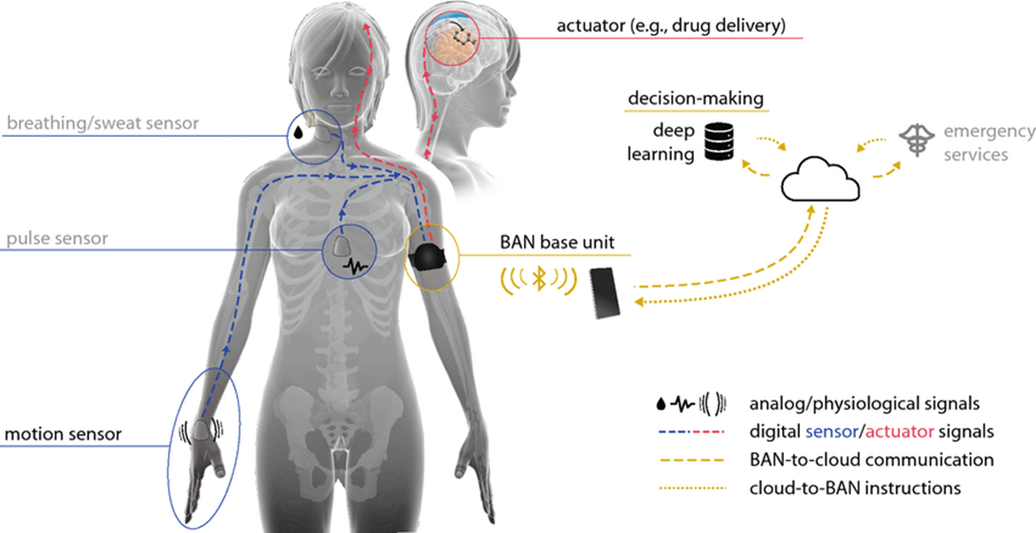
WIRELESS DRUGGING AND THE DIGITAL NERVOUS SYSTEM
Here we see the actuator in the brain for the bio electronic drug delivery. The Body Area Network Base unit that can be activated through a wearable, your breathing and sweat censor to watch your interstitial fluids with a pulse sensor, which will be on the inside of your body to verify the drug delivery. On the right is a data base for decision making with an artificial intelligence making the decision on when to drug you all connected to your medical industrial complex “emergency services” personnel.
WWW.FTWPROJECT.COM

Slide 19
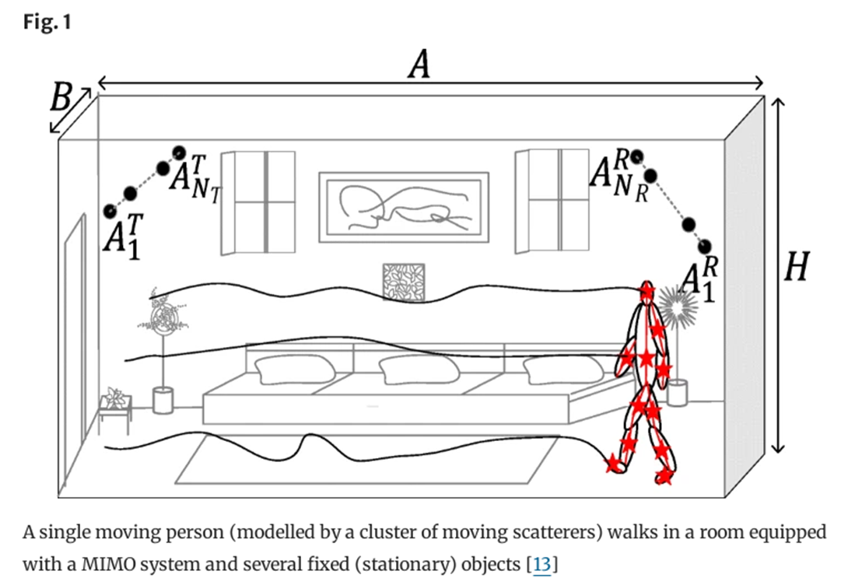
C40 KILL BOX CITIES AND REMOTE MONITORING
HUMAN ACTIVITY RECOGNITION SYSTEMS: HOW THEY TRACK YOUR EVERY MOVE WHILE IN YOUR HOME USING “MARKERS” SURVEILLANCE AND RADIO FREQUENCY SIGNAL PROCESSING. From A non-stationary relay based 3D MIMO channel model with time-vairant path gains for human activity recognition in indoor environments. https://link.springer.com/article/10.1007/s12243-021-00844-0
Abstract
Extensive research showed that the physiological response of human tissue to exposure to low-frequency electromagnetic fields is the induction of an electric current in the body segments. As a result, each segment of the human body behaves as a relay, which retransmits the radio-frequency (RF) signal. To investigate the impact of this phenomenon on the Doppler characteristics of the received RF signal, we introduce a new three-dimensional (3D) non-stationary channel model to describe the propagation phenomenon taking place in an indoor environment. Here, the indoor space is equipped with a multiple-input multiple-output (MIMO) system. A single person is moving in the indoor space and is modelled by a cluster of synchronized moving point scatterers, which behave as relays…
WWW.FTWPROJECT.COM

Slide 20
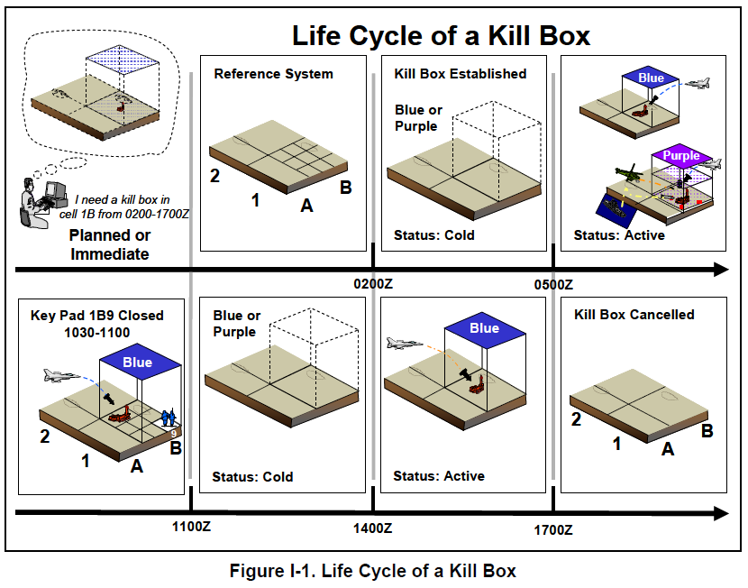
C40 KILL BOX CITIES AND REMOTE MONITORING
A Kill Box is a military strategy or proceedure used in warfare where a three dimensional area is set up to enable timely coordination control and facilitate rapid attacks. Effectively, they are using the MBAN and WBAN to turn your home into a Kill box. The network is connected to an autonomous weapon system where electronic warfare of various kinds can be carried out on civilians. For the ultimate control and extinction of the population.
The C40 network is a set of major cities around the world that have committed to fighting “climate change.” -15 minute cities -You’ll own nothing and you’ll be happy.
WWW.FTWPROJECT.COM

Slide 21
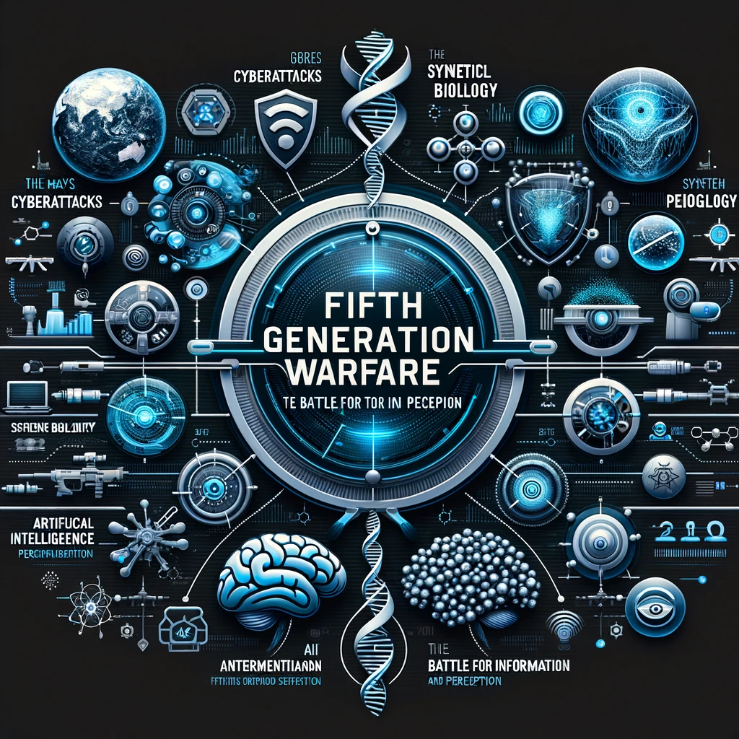
Fifth-generation warfare is warfare that is conducted primarily through non-kinetic military action, such as social engineering, misinformation, cyberattacks, along with emerging technologies such as artificial intelligence and fully autonomous systems. Fifth generation warfare has been described by Daniel Abbot as a war of "information and perception".
2 VECTORS OF 5TH GENERATION WARFARE
CYBER
PHYSICAL
Information Warfare Psychological Operations Cognitive Warfare Global Information Grid Online Covert Operations Yellow Journalism Media Censorship / Propaganda
Energy / Frequency Weapons Autonomous Weapons Neurological Weapons Bioweapons Nanotechnology Emerging Technologies
WWW.FTWPROJECT.COM

Slide 22
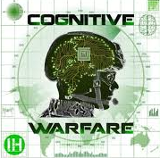
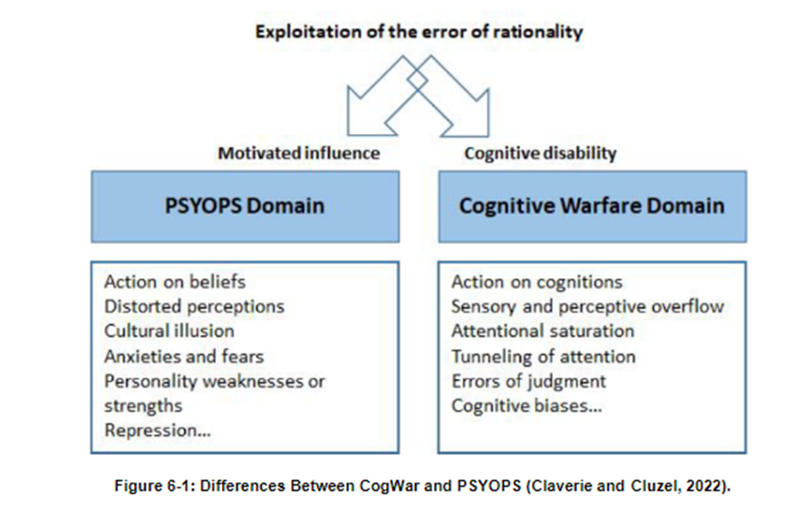
SUMMARY
COGNITIVE WARFARE AND NATO
Cognitive Warfare includes activities conducted in synchronization with other Instruments of Power, to affect attitudes and behaviors, by influencing, protecting, or disrupting individual, group, or population level cognition, to gain an advantage over an adversary. Designed to modify perceptions of reality, whole-of-society manipulation has become a new norm, with human cognition shaping to be a critical realm of warfare. Cognitive Warfare focuses on attacking and degrading rationality, which can lead to exploitation of vulnerabilities and systemic weakening. Cognitive Warfare as the use of public opinion, psychological operations, and legal influence to achieve victory.
From: Mitigating and Responding to Cognitive Warfare NATO Report https://www.researchgate.net/publication/369305190_Mitigating_and_Responding_to_Cognitive_Warfare
In this NATO report from last year they cover psychological operations and online information warfare. Then they proceed on to talk about Developing Neuroscience Technologies for Defense Against Cognitive Warfare. And here they delineate very clearly for us the two vectors of 5G warfare: Psyops domain and Cognitive Warfare Domain. Or Cyber Information / and Physical technology weapons.
WWW.FTWPROJECT.COM

Slide 23
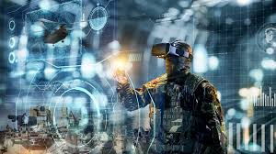
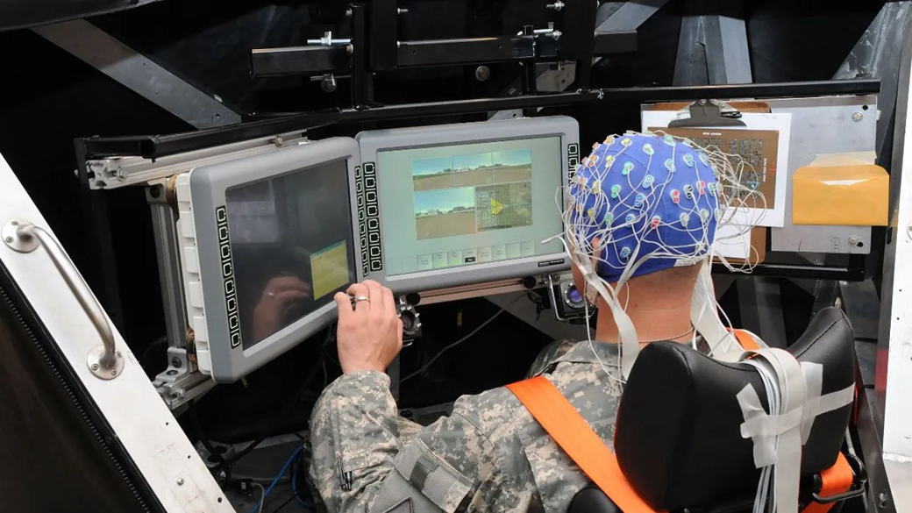
SUMMARY
COGNITIVE WARFARE AND BRAIN COMPUTER INTERFACE SCIENCES
From: Mitigating and Responding to Cognitive Warfare NATO Report
CHAPTER 6.1 INTRODUCTION – COGNITIVE NEUROSCIENCE: DEFENCE AGAINST COGNITIVE WARFARE “Future battles will involve far less permissive environments, agile logistics, and adaptive command-and- control. With the increased role of automation, artificial intelligence-enabled virtual teammates, and remote control/supervision of technology, there is a new focus on Cognitive Warfare (CogWar). CogWar targets the human brain/mind by using disinformation, propaganda, and information overload to confuse the enemy and exploit cognitive vulnerabilities. There is a pressing need for the DoD to invest in the emerging area of CogWar, a capability that does not yet exist for allied nation’s military, but near-peer adversaries are aggressively developing such capabilities. Adversarial advances in offensive CogWar must be proactively matched and exceeded by leveraging expertise in cognitive and brain sciences, brain-machine interfaces, applied psychology and AI/ML to enhance the warfighter’s ability to counter such attacks and prevail in the modern battlefield.
WWW.FTWPROJECT.COM

Slide 24
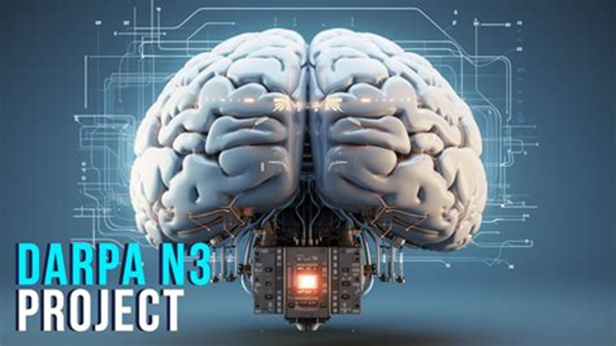
THE NEURAL LOBOTOMY:DARPA N3 AUGMENTED HUMANS
“They can put technology into the brain without surgery that changes your neurons and will allow people to hook up to a brain machine interface to do things like fly drones with their mind and control cyber defense systems and multitask during military operations. Anything that is used in DARPA’s N3 is brain to brain interfaces, neuron to neuron interfaces and you are exchanging neurons, resurfacing brain tissue an exchanging neural nets. And if they want to erase your memory or change out your DNA sequencing to ensure you take a different action there is a flow chart for how they do that.” – Sabrina Wallace
What is DARPA N3? Next-Generation Nonsurgical Neurotechnology (N3)
The N3 program aims to develop a safe, portable neural interface system capable of reading from and writing to multiple points in the brain at once. Whereas the most effective, state-of-the-art neural interfaces require surgery to implant electrodes into the brain, N3 technology would not require surgery and would be man-portable, thus making the technology accessible to a far wider population of potential users. Noninvasive neurotechnologies such as the electroencephalogram and transcranial direct current stimulation already exist, but do not offer the precision, signal resolution, and portability required for advanced applications by people working in real-world settings.
WWW.FTWPROJECT.COM

Slide 25
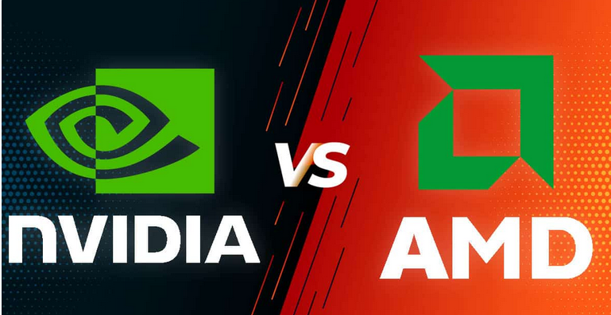
NVIDIA AND AMD TO RUN THE TECH
A graphics processing unit (GPU) is a specialized circuit used to accelerate the computer graphics power on the personal computers, mobile phones, gaming consoles and industrial server farms
- Within the last few years GPUs are found to be useful for non-graphic calculations due to their ability to do work in a parallel fashion. This inherent property lends the hardware to include training of neural networks and cryptocurrency mining.
- The GPU market is a multi-trillion dollar industry due to the promise of greatly accelerating innovation using accelerated AI, neural driven hardware. (Presently dominated by Nvidia and AMD)
- New companies are forming however to challenge current GPU paradigms with new cost (and energy) efficient chip-sets and are set to disrupt the industry in the coming years.
- The battle is for new kinds of memory and processor designs and more if it. in small energy efficient packages.
- Main industry direction is real-world simulation of processes used by industry, bio-n Tech, and governments that can afford the server data-centers necessary to process real-world matrix-based datasets.
WWW.FTWPROJECT.COM

Slide 26
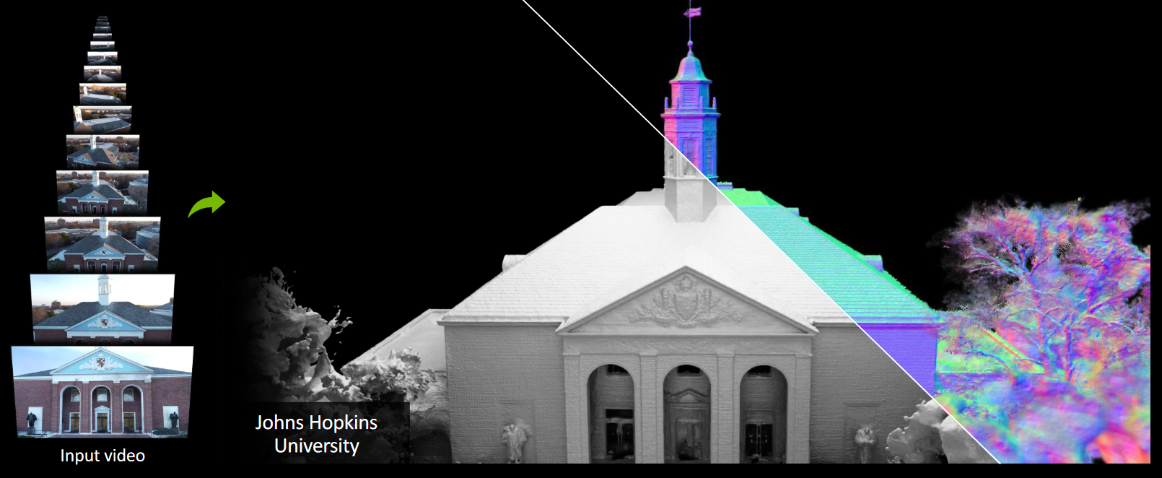
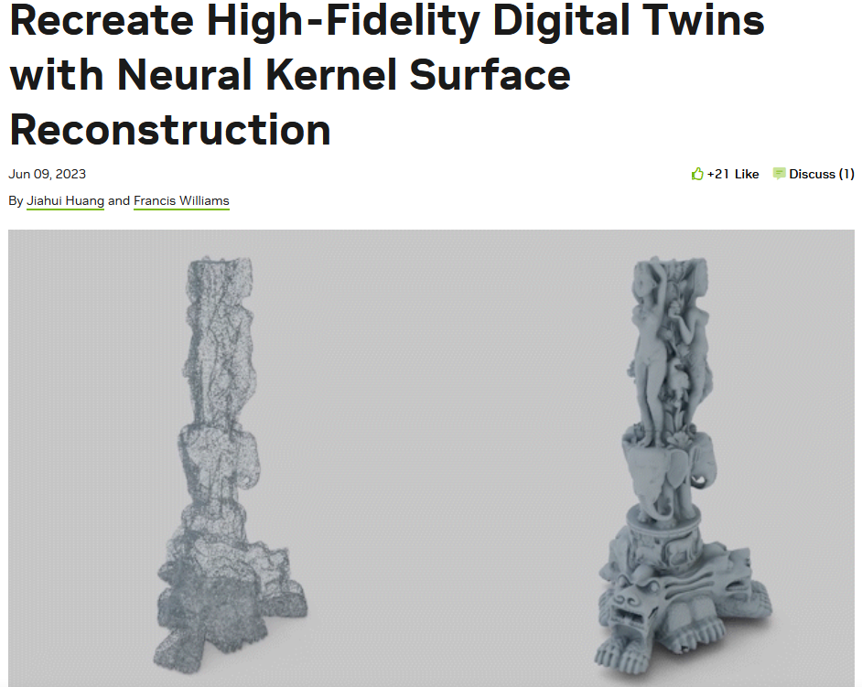
NVIDIA AND AMD TO RUN THE TECH
- Neuralangelo is a framework for high-fidelity 3D surface reconstruction from RGB images using neural volume rendering. 3D meshes and rendering is extracted from 2D images samples! Joint project included NVIDIA Research and John Hopkins University.
WWW.FTWPROJECT.COM

Slide 27
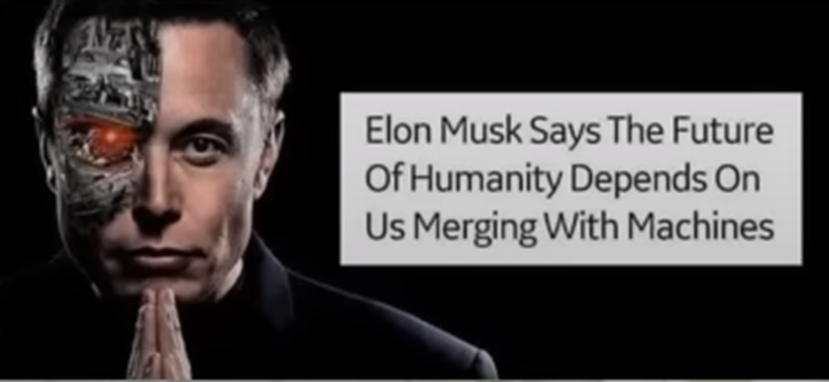
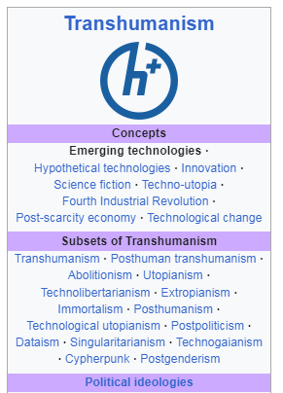
MERGING MAN WITH MACHINE THROUGH OUR DNA
Our DNA is made up of 4 Nucleic acids, adenine, guanine, thymine, & cytosine. In this patent for the mRNA injections it discusses changing our DNA by adding two extra Cytosines. Bringing our DNA from “ATCG” to “ATCCCG”. What are the Extra Cytosines for? In the History of Cytosine (Wikipedia)
In 1998, cytosine was used in an early demonstration of quantum information processing when Oxford University researchers implemented the Deutsch–Jozsa algorithm on a two qubit nuclear magnetic resonance quantum computer (NMRQC).[6]
Cytosine is used in quantum computing / Artificial intelligence. They are replacing our 6th sense with AI
Emerging Technologies: From Wikipedia discusses a suite of new technologies that are all under the category of transhumanism. -Artificial Intelligence -Gene therapy -Nanotechnology -Blockchain technology -Augmented Reality -Cancer Vaccines -DARPA
WWW.FTWPROJECT.COM

Slide 28
WBAN- The Evil Web to Ensnare Humanity
In the Book of Job Bildad describes the dangerous path of the wicked: “His vigorous stride is shortened, And his own scheme brings him down. “For he is thrown into the net by his own feet, And he steps on the webbing.
“A snare seizes him by the heel, And a trap snaps shut on him.
A noose for him is hidden in the ground, And a trap for him on the path.
All around terrors frighten him, And harry him at every step.
“His strength is famished, And calamity is ready at his side.
Such is the destiny of all who forget God; so the hope of the godless will perish. His confidence is fragile; his security is in a spider’s web. He leans on his web, but it gives way; he holds fast, but it does not endure.… Job 8:14
When I asked God to show me in the Bible a scripture that would spiritually symbolize what the WBAN is, he showed me webs in the book of Job. They have saturated everything with their web of technology.
WWW.FTWPROJECT.COM

Slide 29
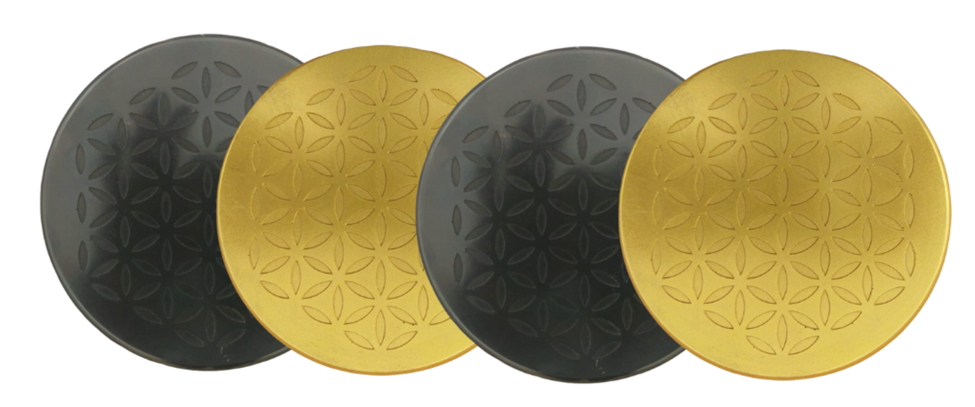
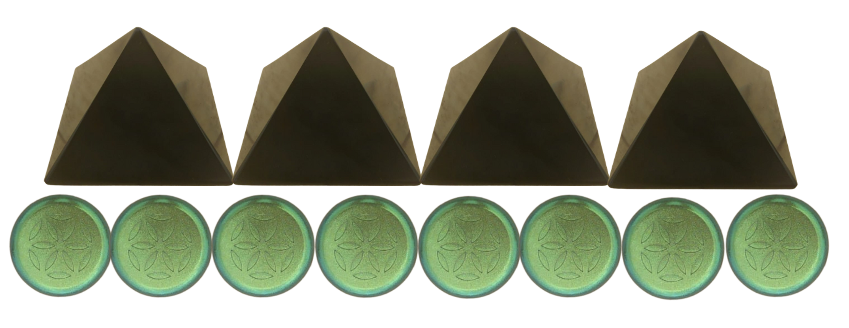
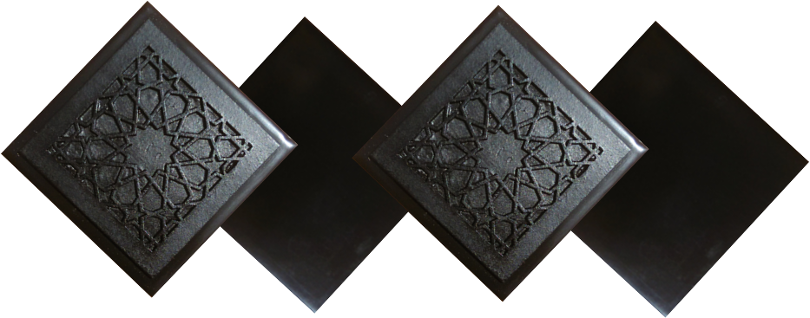
ABOUT OUR EMF PROTECTION PRODUCTS
Help Support Zeee Media By purchasing from this link: https://www.ftwproject.com/ref/468
SLEEPING PODS For a good nights sleep
CHARGE PLATES for use around the home, to preserve food and more
“I carry my sleeping pod with me at all times in my front pocket, this and the pyramids are the only thing that have helped the targeting and stopped my heart palpitations.” -Connecticut
PHONE SHIELDS to put on your cell phone, laptop and routers
PENDANTS for personal emf protection on your body
PYRAMIDS and garden sets for gridding your home / property / garden for emf protection on a large scale
SCIENTIFIC STUDIES AND DOCUMENTATION DESCRIBING HOW OUR PRODUCTS WORK AVAILABLE ON OUR WEBSITE.
TILES for incorporating emf protection into construction projects
WWW.FTWPROJECT.COM

